Slide 1

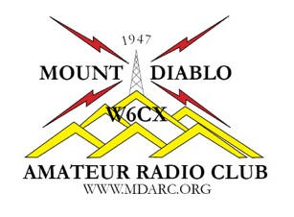
Chapter 2
Radio and Signals Fundamentals
Name, Callsign
Discussion Leader
American Radio Relay League
Notes:
333

Slide 2
Brief Review of Chapter 3 Exam Questions
What is the electrical term for the electromotive force (EMF) that causes electron flow?
Voltage
Ampere-hours
Capacitance
Inductance
2019 MDARC Technician License Course
2

Slide 3
Brief Review of Chapter 3 Exam Questions
What is the electrical term for the electromotive force (EMF) that causes electron flow?
Voltage
T5A05 Page 3-2
2019 MDARC Technician License Course
3

Slide 4
Brief Review of Chapter 3 Exam Questions
What formula is used to calculate current in a circuit?
Current (I) equals voltage (E) multiplied by resistance (R)
Current (I) equals voltage (E) divided by resistance (R)
Current (I) equals voltage (E) added to resistance (R)
Current (I) equals voltage (E) minus resistance (R)
2019 MDARC Technician License Course
4

Slide 5
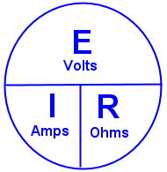
Brief Review of Chapter 3 Exam Questions
What formula is used to calculate current in a circuit?
Current (I) equals voltage (E) divided by resistance (R)
I=E/R
T5D01 Page 3-5
Look familiar?
2019 MDARC Technician License Course
5

Slide 6
Brief Review of Chapter 3 Exam Questions
What component is commonly used to change 120V AC house current to a lower AC voltage for other uses?
Variable capacitor
Transformer
Transistor
Diode
2019 MDARC Technician License Course
6

Slide 7
Brief Review of Chapter 3 Exam Questions
What component is commonly used to change 120V AC house current to a lower AC voltage for other uses?
Transformer
T6D06 Page 3-9
2019 MDARC Technician License Course
7

Slide 8
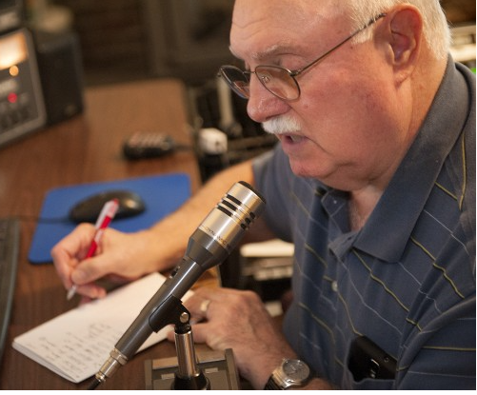
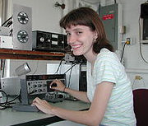
Chapter 2 Radio and Signals Fundamentals
In this session we will see electricity at work to generate radio signals.
2019 MDARC Technician License Course
8

Slide 9
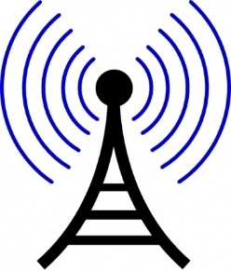
Chapter 2 2.1 Radio Signals and Waves
Radio Signals are composed of radio waves that travel at the speed of light.
When Hams talk about signals, they are referring to the electrical energy they use to exchange information inside or out of a radio.
2019 MDARC Technician License Course
9

Slide 10
Chapter 2 2.1 Radio Signals and Waves
Radio waves start in an antenna as an electrical signal that constantly reverses direction.
The rate at which the signal changes direction--backward and forward-- is the signal’s frequency.
The radio waves radiate from the antenna and vibrate or oscillate at the same frequency as the electrical signal.
As the radio wave passes other antennas, it creates replicas of the original electrical signal.
2019 MDARC Technician License Course
10

Slide 11
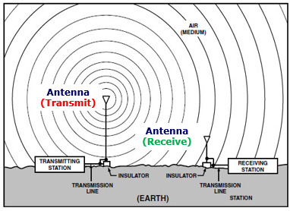
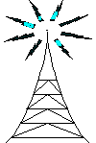
Chapter 2 2.1 Radio Signals and Waves
Radio waves from transmitter to receiver
Information (voice, data, video, commands, etc.) is converted to electronic form.
The information in electronic form is added to a radio wave.
The radio wave carrying the information is sent from the station antenna into space.
2019 MDARC Technician License Course
11

Slide 12
Chapter 2 2.1 Radio Signals and Waves
Radio wave from transmitter to receiver
The radio waves carry the information.
The receiver extracts the information from the received wave.
The information is then presented to the user in a format that can be understood (sound, picture, words on a computer screen, response to a command, etc.)
2019 MDARC Technician License Course
12

Slide 13
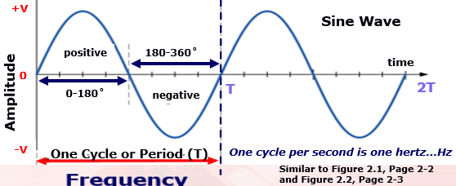
Chapter 2 2.1 Radio Signals and Waves
Frequency, Amplitude and Phase
Frequency is the number of complete cycles of an alternating current or alternating voltage that occur per second.
Frequency Similar to Figures 2.1 and 2.2
2019 MDARC Technician License Course
13

Slide 14
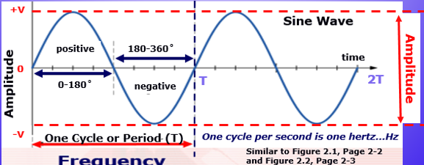
Chapter 2 2.1 Radio Signals and Waves
Frequency, Amplitude and Phase
Amplitude is the strength or magnitude of a signal.
Frequency Similar to Figures 2.1 and 2.2
2019 MDARC Technician License Course
14

Slide 15
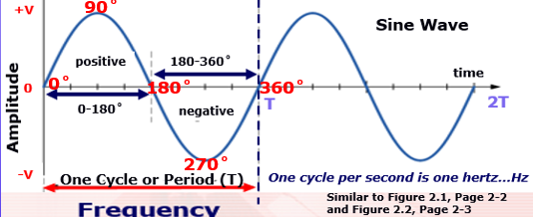
Chapter 2 2.1 Radio Signals and Waves
Frequency, Amplitude and Phase
Phase is a measure of the position in time within a repeating waveform, such as a sine wave.
2019 MDARC Technician License Course
15

Slide 16
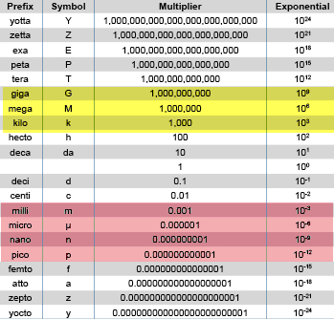
Chapter 2 2.1 Radio Signals and Waves
Metric prefixes are commonly used in amateur radio.
The highlighted prefixes are the most frequently used in amateur radio.
Expansion of Table 2.1
2019 MDARC Technician License Course
16

Slide 17
Chapter 2 2.1 Radio Signals and Waves
The Radio Spectrum
Radio Spectrum is the term used to refer to the vast array of available radio frequencies.
Audio Frequencies (AF) are signals below 20 kHz that humans can hear.
Radio Frequencies (RF) are signals above 20kHz.
2019 MDARC Technician License Course
17

Slide 18
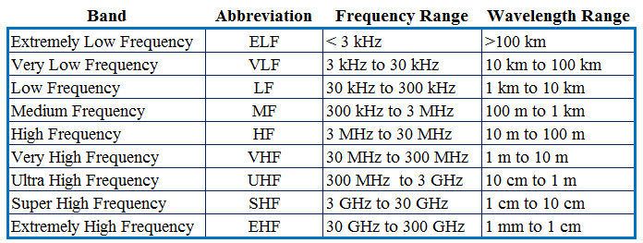
Chapter 2 2.1 Radio Signals and Waves
The Radio Spectrum
Remember that 1 MHz = 1000 kHz; 1 GHz = 1000 MHz
Similar to Table 2-2
2019 MDARC Technician License Course
18

Slide 19
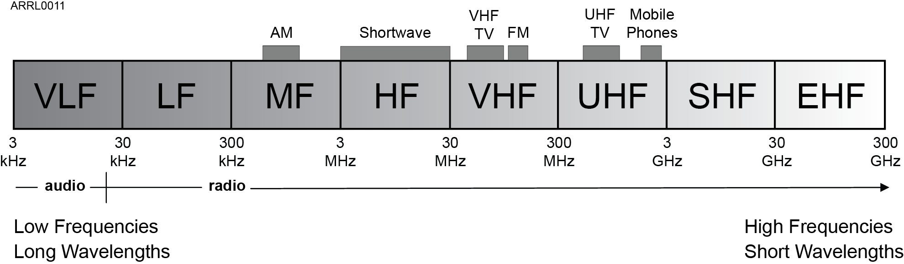
Chapter 2 2.1 Radio Signals and Waves
The part of the electromagnetic spectrum composed of radio waves is called the radio frequency or Radio Frequency Spectrum.
Figure 2.3
2019 MDARC Technician License Course
19

Slide 20
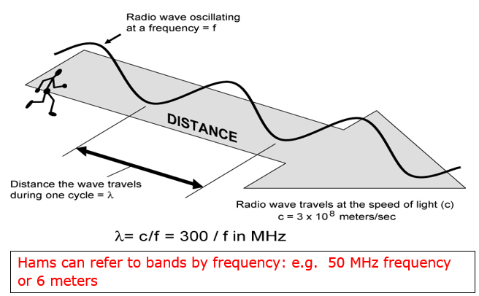
Chapter 2 2.1 Radio Signals and Waves
Wavelength is the distance a radio wave travels during one cycle of the wave’s electric and magnetic fields.
Figure 2.5
2019 MDARC Technician License Course
20

Slide 21
Chapter 2 2.1 Radio Signals and Waves
Since the Wavelength is the distance a radio wave travels during one cycle of the wave’s electric and magnetic fields and the speed of light is constant, here is the formula that relates wavelength and frequency.
300,000,000 meters per second /
Wavelength (λ) in meters = Frequency (f) in hertz or cycles per second
where the Speed of light is 300,000,000 meters per second.
Illustration: What is the wavelength of a 1 MHz radio wave (typical of an AM Broadcast)?
λ = 300 = 300 meters
1
Formula simplification
Wavelength (λ) in meters = 300 /frequency in MHz
2019 MDARC Technician License Course
21

Slide 22
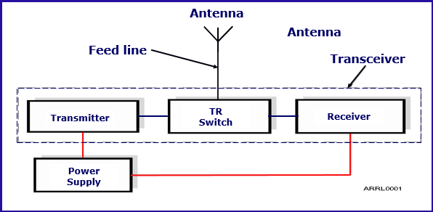
Chapter 2 2.2 Radio Equipment Basics
Refer to Figure 2.6
A basic radio station is made up of a transmitter and receiver connected to an antenna with a feed line. The transmit-receive (TR) switch allows the transmitter and receiver to share the antenna.
A Transceiver includes the transmitter, receiver and TR switch in a single enclosure
2019 MDARC Technician License Course
22

Slide 23
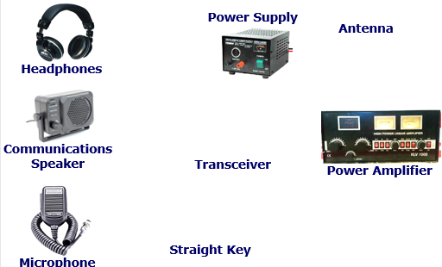
Chapter 2 2.2 Radio Equipment Basics
Accessory Radio Equipment
23

Slide 24
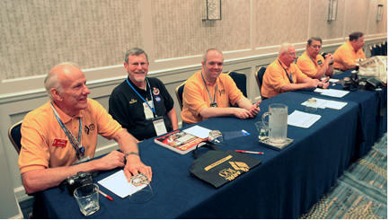
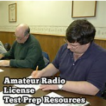
Class Session 6 Assignment
In preparation for the next class session, do the following…….
● Study Chapter 4 “Propagation, Antennas and Feed Lines.”
● Study The Chapter 4 Question Pool questions found in the chapter ”blue boxes.”
See you next week!
2019 MDARC Technician License Course
24

Slide 25
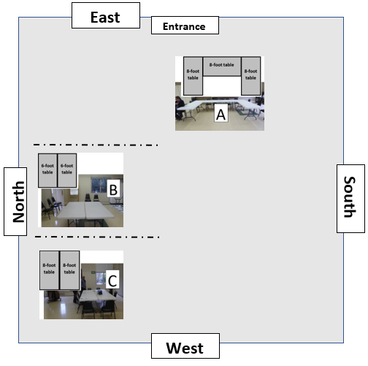
Please follow the Elmers’ directions

