Slide 1
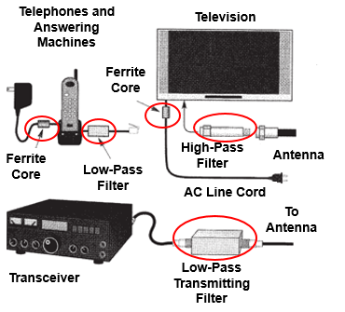
Chapter 5 5.4 RF Interference (RFI)
Remedies
Filters
Play a major part in eliminating or reducing Radio Frequency Interference.
Used both to prevent unwanted signals from being radiated and to keep unwanted signals from being received.
Figure 5.15, Page 5.19
2019 MDARC Technician License Course
1

Slide 2
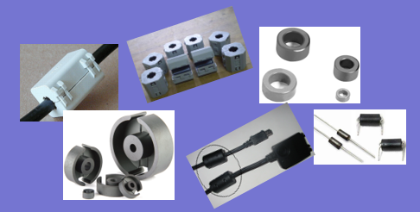
Chapter 5 5.4 RF Interference (RFI)
Remedies
Ferrite Core RFI Filters….aka Choke Filters
Made from a ceramic magnetic material designed to absorb RF energy over a broad frequency range, such as HF and VHF.
They come in many sizes and shapes with many different uses.
Rings (toroid)
Rods
Beads
2019 MDARC Technician License Course
2

Slide 3
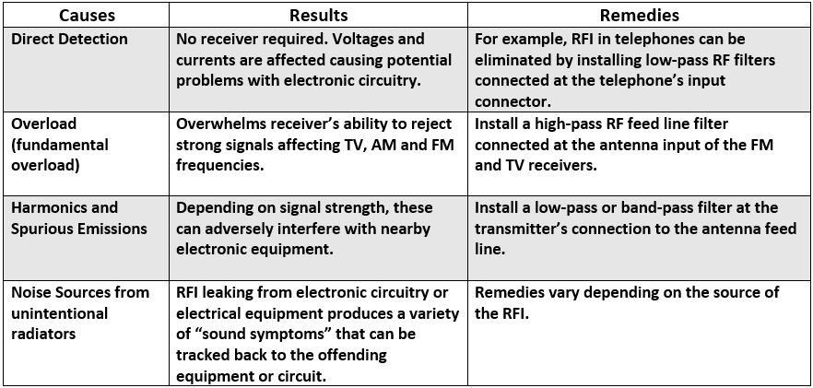
Chapter 5 5.4 RF Interference (RFI)
Radio Frequency Interference can be of several types
2019 MDARC Technician License Course
3

Slide 4
Chapter 5 5.4 RF Interference (RFI)
Guidelines to follow
Be certain your station is in good working order.
Use shielded wire and shielded cables to prevent coupling with unwanted signals and undesired RF radiation.
Eliminate interference to your own appliances.
Eliminate sources of interference coming from electrical equipment in your own house.
2019 MDARC Technician License Course
4

Slide 5
Chapter 5 5.4 RF Interference (RFI)
Guidelines to follow with the neighbors
DIPLOMACY is a key starter!
Verify if the interference is actually coming from your equipment.
Provide assistance to the neighbor to determine the nature of the interference.
Overload
Harmonics
Detection
Offer to help eliminate RFI sources coming from their house.
2019 MDARC Technician License Course
5

Slide 6
Chapter 5 5.4 RF Interference (RFI)
The law is on your side
An unlicensed device permitted under Part 15 or an unintentional radiator may not cause interference to a licensed communications station, such as to an Amateur Radio station. Its owner must prevent it from causing such interference or stop operating it.
An unlicensed device permitted under Part 15 must accept interference caused by a properly operating licensed communication station, such as from an Amateur Radio station.
From Page 5-23, under PART 15 Rules
2019 MDARC Technician License Course
6

Slide 7
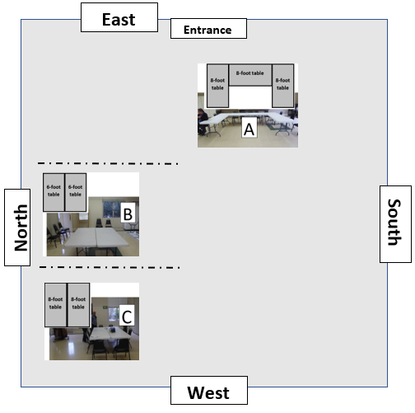
Please follow the Elmers’ directions

