Slide 1
Hackathon
Identify New Bikes

Slide 2
Problem Statement: Identify New Bikes
Detailed Description:
1. Display "Upcoming" bikes details like bike name, price and expected launch date in India, for manufacturer 'Honda' & Bike price should be less than 4 Lacs.
2. For Used cars in Chennai, extract all the popular models in a List; Display the same
3. Try to 'Login' with Google, give invalid account details & capture the error message
(Suggested site: zigwheels.com)
Key Automation Scope:
Handling windows & frames
Filling simple form, Capture warning message
Extract menu items from frames & store in collections
Navigating back to home page

Slide 3
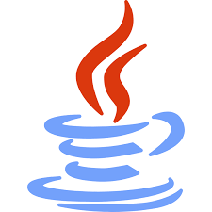

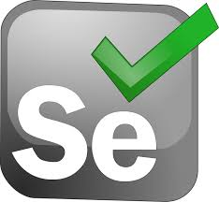







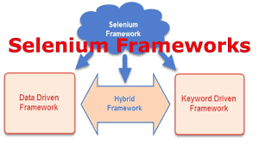

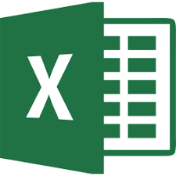



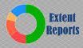
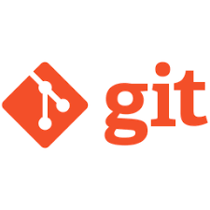







Concepts we have used in our project:
Java
Selenium
Choice of Web Browser/OS
Hybrid (Data+Keyword driven)
POI
TestNG
Extent Report Logger
Web Page Synchronization
Functional Testing Report
Error/ Exception Handling
Locator Selection Priority
Jenkins
Maven
E2E Execution
Conditional Flow
Source Code Management with Git
Code Comments, Naming Conventions, Clean Syntax, Folder Structure
And many more...

Slide 4
Selenium
Selenium is a beneficial automation tool because it is not only open source but also a portable software testing framework for web applications .
Selenium support multiple languages like Java, C#, Ruby, Python etc.

Slide 5
TestNG
TestNG is an open source test automation framework for java.
The design goal of TestNG is to cover a wider range of test categories: functional, end-to-end, etc., with more powerful and easy-to-use functionalities.
It also provide some advanced and useful features which makes it a more robust framework as compared to its peers.

Slide 6
Hybrid
Hybrid Test framework is a concept where we are using the advantage of both keyword and data-driven framework. Here for keywords, we use Excel files to maintain test cases, and for test data, we can use dataprovider of TestNG framework.

Slide 7
Data- Driven Framework
Data Driven framework is used to drive test cases and suites from an external data feed. The data feed can be data sheets like xls, xlsx, xml, csv files, etc. A Data Driven Framework in Selenium is a technique of separating the “data set” from the actual “test case” (code).

Slide 8
Keyword- Driven Framework
Keyword-driven testing is a type of functional automation testing framework which is also known as table-driven testing or action-word based testing.
It is a method used for speeding up automated testing by separating keywords for common set of functions and instructions. All the operations and instructions to be performed are written in a table format, usually a spreadsheet.

Slide 9
Reports
Functional Testing is a type of software testing that validates the software system against the functional requirements/specifications.
ExtentReports is an open-source reporting library used for test automation. It is easily integratable with major testing frameworks like TestNG, JUnit, NUnit, etc. These reports are HTML documents that depict results as pie charts. They also allow the generation of custom logs, snapshots, and other customized details.
We have included Functional Testing Report, TestNG reports as well as Extent Reports in our project.

Slide 10
Jenkins
Jenkins is an open-source Continuous Integration (CI) server, which automates the build and deploy process of your web applications.
By running your Selenium test suite in Jenkins, you can also automate testing as part of the build process.

Slide 11
Maven
Maven is a tool which is used for building and managing dependency for java based projects.
Maven can be used when building project with POM (Page Object Model) when working on big projects

Slide 12
Source Code Management with Git
Git is a free and open source distributed version control system designed to handle everything from small to very large projects with speed and efficiency.
Jenkins is a continuous integration server and this means it needs to check out source code from a source code repository and build code. Jenkins works with Git through the Git plugin.

Slide 13
Thankyou!

