Slide 1
Foodys
Meal delivery app similar to GrubHub and UberEats
CSP-584 Enterprise Web Applications
Project Phase - 2
Prajwal Tarikere Prakash - A20446903
Pradeep Kumar Lokesh - A20449741

Slide 2
Requirement Specifications
Customer
Register
Login/Logout
View Restaurant
View Menu
Order Food
Payment
Order History
Restaurant
Update Menu
View and Manage Orders
Update Order Status
Driver
Register
Login/Logout
View Orders
Earnings

Slide 3
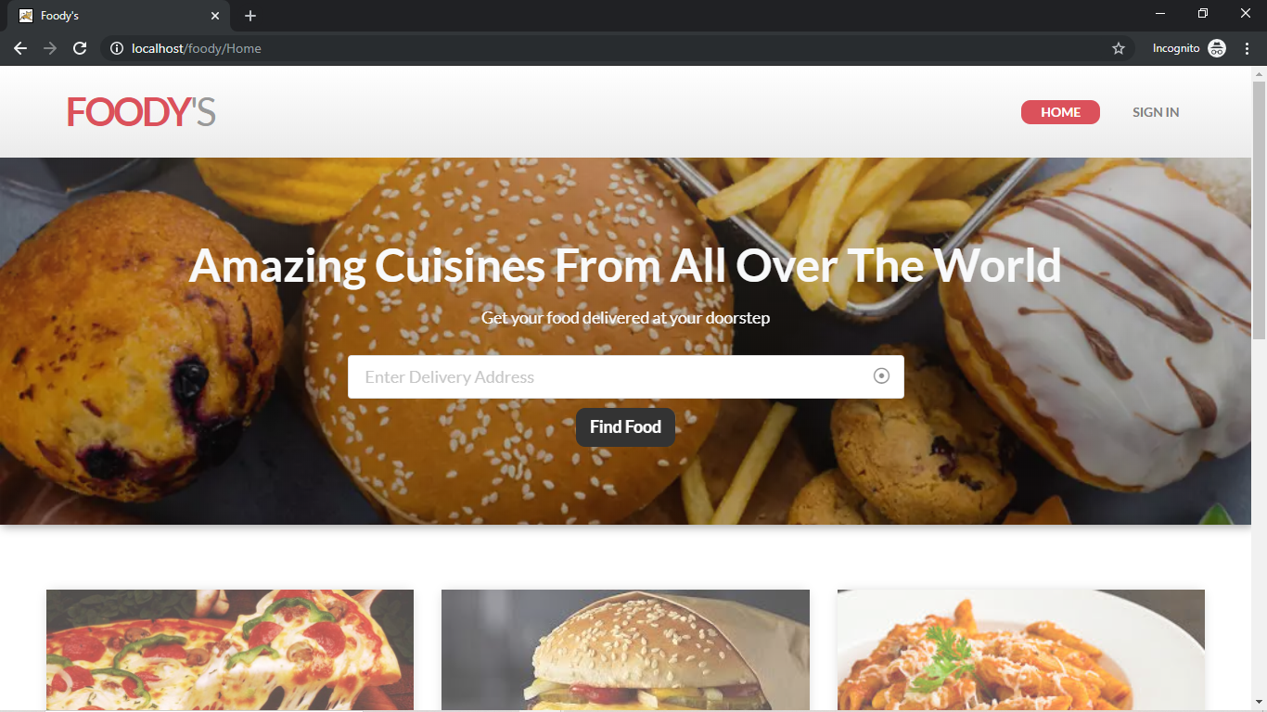
Main Web Page

Slide 4
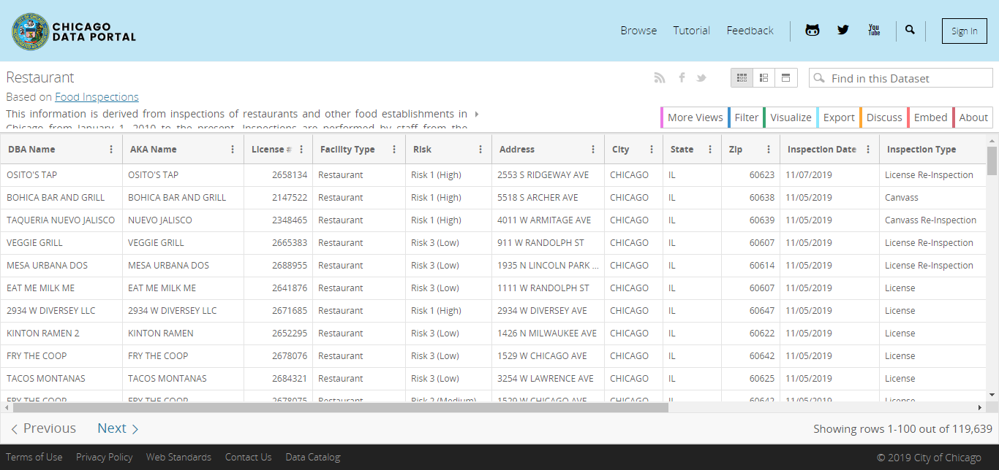
Data Set

Slide 5
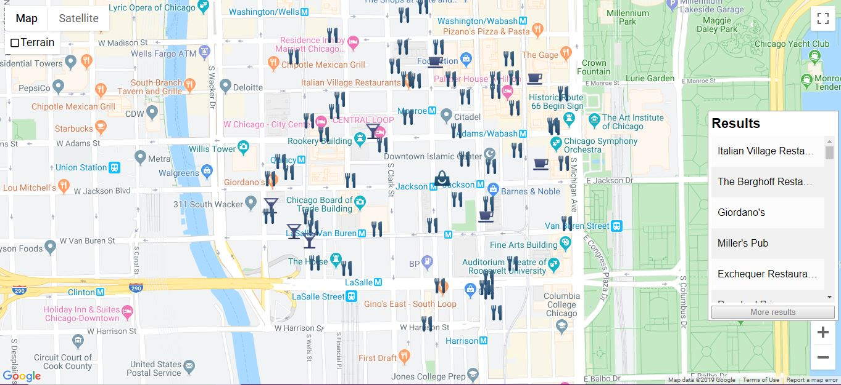
Restaurants On Map

Slide 6
Technologies Used
Front End
CSS
HTML
Javascript
Back End
Java
MySQL
APIs
Google Maps API
Google Places API
Geocoding API

Slide 7
References
https://developers.google.com/
https://data.cityofchicago.org/Health-Human-Services/Restaurant/5udb-dr6f

