Slide 1
Foodys
Meal delivery app similar to GrubHub and UberEats
CSP-584 Enterprise Web Applications
Project Phase-1
Prajwal Tarikere Prakash - A20446903
Pradeep Kumar Lokesh - A20449741

Slide 2
Requirement Specifications
Customer
Register
Login/Logout
View Restaurant
View Menu
Order Food
Payment
Order History
Restaurant
Update Menu
View and Manage Orders
Update Order Status
Driver
Register
Login/Logout
View Orders
Earnings

Slide 3
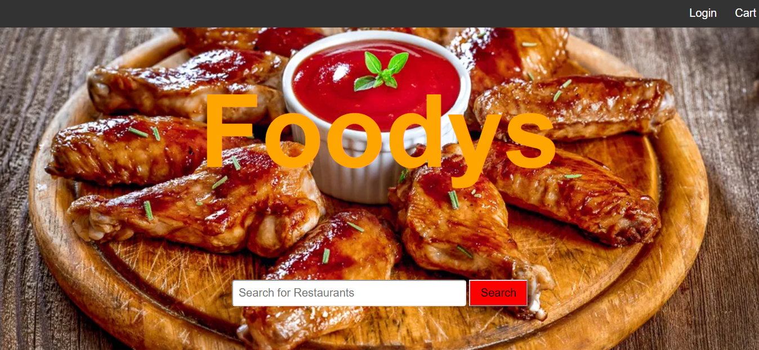
Main Web Page

Slide 4
Registration
Update Menu
Login
Receive Orders
View Restaurant
Manage Orders
View Menu
Restaurant
Add Item
Review Order
Checkout
Customer
Payment
List Of Orders
Track Order
Earnings
Order History
Logout
Driver
Use Case Diagram

Slide 5
Technologies Used
Front End
CSS
HTML
Javascript
Back End
Java
Python
APIs
Google Maps API
Google Places API
UBER API

Slide 6
References
https://developers.google.com/
https://developer.uber.com/

