Slide 1
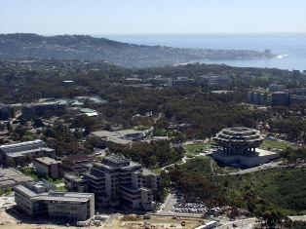
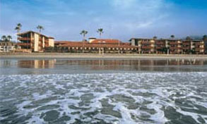
Next Meeting
Next meeting.
Any objections to Week of March 5, 2012 in San Diego?
  Core dates of March 6 & 7 (Tues/Wed)

Slide 2
Next steps
Also Known As “Homework”
Things heard
  Jin Zhi + Fortes + Wright + Parashar–
    December .. Peter to follow up on visa. Visitation being planned
  Yutong Lu + Bill Gropp – Visitation
  NSF can help with visa processing of funded by NSF-c
Mechanisms
  Bulletin board approach to match-making (Social/Google+) Virtual continuation
    Felix w/input with China Colleague.
  Face-to-face meetings long(er) student exchanges
  Virtual Meetings w/longer presentations – more focused
  Ad-hoc (but organized) meetings collocated at conferences (e.g SC)
    Let's do something at SC... Who?
    Monday Morning. ← use bulletin board to request who can/wants to come to a meeting.
      Depei Qian, Manish Parashar

Slide 3
More homework
Email list of all participants
  Phil, Peter, Yifeng
Regular electronic updates
  What works? What won't be lost in the noise.
  Inside of social media.

Slide 4
What Agencies Said
Could extend SI2 solicitation for explicit international collaboration
Supplements, Workshops, Summer Schools
OISE Programs
Adapt Dimensions of Biodiversity China-US collaboration language
There are graduate student summer research programs (Soon, Nov 9th)
International Research expro.

