Slide 1
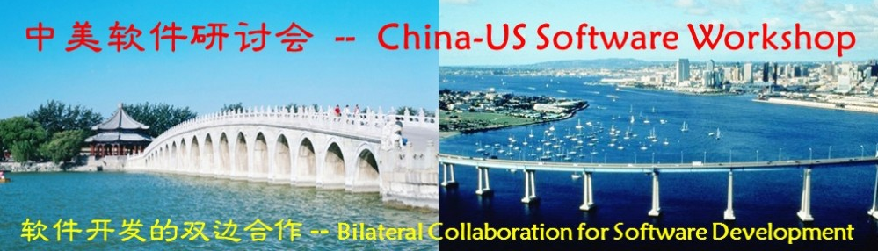


Trustworthy Software: U.S. Presentation
Rebecca Wright
Rutgers University
September 27, 2011
Beijing, China

Slide 2
Credits
These slides contain material from Carl Landwehr (Trustworthy Computing, National Science Foundation)
and from the U.S. Trustworthy Software participants and their coauthors:
Lorenzo Alvisi (University of Texas – Austin)
Patrick Traynor (Georgia Institute of Technology)
Felix Wu (University of California – Davis)
Rebecca Wright (Rutgers University)

Slide 3
What is Trustworthy Software?
Trustworthy Software: software systems that can be justifiably relied upon to carry out their intended duties.
Many complexities in this simple statement!

Slide 4
“Software” vs. “Computing”
I’m using the term “trustworthy software” as synonymous with NSF’s “trustworthy computing”.
This takes a broad perspective and encompasses the development of software and its interactions with hardware, other software, and users.
Difficult to separate software and computing even if we wanted to.

Slide 5
Complexities of Trustworthy Software
Even just defining “intended function” is difficult.
Trusted to do what, by whom, in what environments?
Many aspects of trust have a very human dimension.
Writing software to carry out specified functions is difficult even when the functions are well-specified, even for small systems, even in isolation, and even without failing or malicious components.
Far more complicated when there may be:
interacting systems
failures of components
attackers
multiple administrative domains interacting
large heterogeneous networks
systems being used in ways beyond their originally intended ways
etc.

Slide 6

Trustworthy Computing Research
Research has been conducted in trustworthy computing for decades by many talented people
Nevertheless, the problems are far from solved; indeed they seem to be growing
Research needs and funding will likely continue to grow in response
New research in this field should draw on this history: What has been tried? How and why did it succeed or fail?
There are many novel and interesting problems yet to be addressed, both within and across research domains.
Innovative solutions are needed!

Slide 7
Computing Landscape: 1960s to mid-’70s
Moving from single stream batch processing to multiprocessing to timesharing
Business Computing
Automation of business processes in many industries
Business analysis
Some outsourcing to batch providers
Academic Computing Centers
Campus-wide research and educational computing
Development of timesharing systems: CTSS, DTSS, Multics, MTS, ...
Commercial timesharing
CompuServe, Tymshare, National CSS, Comshare etc.
Commodity computing
Defense (Military/Intelligence)
Early real-time command – control systems (WWMCCS)
Extensive computing for other purposes; cost-driven resource-sharing

Slide 8
Trustworthy Software: 1960s to mid-’70s (1/3)
Business Computing:
Need to provide reliable systems and protect assets.
Threats:
reliability of systems
theft of assets, information
Threat agents:
faulty software and hardware,
thieves and fraudsters
insiders and outsiders
Mitigation approach:
best practices for data backups
assure accountability via audit and control mechanisms
risk assessment to focus resources (RACF, ACF2)

Slide 9
Trustworthy Software: 1960s to mid-’70s (2/3)
Academic and commercial online computing services:
Need to provide service and open communication.
Threats:
service theft
programs/data theft
interference among users
vandalism
Threat agents:
customers
faculty/students
insiders
Mitigation approach:
assure isolation among users’ computations
assure availability of resources: backup arrangements
accounting for use of resources

Slide 10
Trustworthy Software: 1960s to mid-’70s (3/3)
Defense computing:
Need to provide robust systems and satisfy regulations for protection of classified information (primarily confidentiality)
Threats:
espionage,
sabotage;
nation-state actors
Threat agents:
nation-state actors
Mitigation approach:
“color change”, physical separation, “system high” operation
“Multi-level secure” computing as a goal: information at different security levels, users with different clearances, sharing a common computer system
Research approaches: Reference monitors, security kernels, secure operating systems, virtualization, encryption

Slide 11
The Web and the Internet Boom 1990’s
Internet commerce
Users as content providers
Every day activities, some with financial value, migrating onto networked computers
Large-scale running of untrusted code
Emergence of online fraud as a business.

Slide 12
Today’s Software Systems Landscape
Internet, WWW, social computing, cloud computing, mobile phones as computing devices, ubiquitous computing, etc.
Embedded systems in cars, medical devices, household appliances, and other consumer products.
Critical infrastructure heavily reliant on software for control and management, with increasing human interaction (e.g., Smart grid).
Computing, especially data-intensive computing, drives advances in almost all fields.
Many kinds of devices, many kinds of communication networks, all interacting and interoperating.
Each model has its own attributes: strengths, threats, costs.
As always, users demand functionality over security (but then complain if security is not provided).

Slide 13
Engineering Principles for Security
Saltzer and Schroeder, Protection of Information in Computer Systems, Proceedings of the IEEE, Sept., 1975 (V. 63 #9)
Design principles:
Economy of mechanism (simplicity over complexity)
Fail-safe defaults (default exclusion, explicit permission)
Complete mediation (check each access)
Open design
Separation of privilege
Least privilege
Least common mechanism (minimize the shared mechanisms)
Psychological acceptability (usability)
Work factor (compare cost of breaking mechanism with attacker resources)
Compromise recording
These principles need to be re-interpreted as technology advances and sometimes different principles are needed.

Slide 14
OS Security R&D and Criteria Development 1968 – 2000
TCSEC Product
Development
“Penetrate and Patch”
Period
TDI
Published
Military Message Experiment
TNI
Published
Anderson Rept:
Reference
Monitor Concept
Orange Book
Published:
TCB Concept
Federal Crit.
First Draft
RISOS,
PAP Projects
NCSC
Founded
Common Crit.
First Draft
V. 1.0
Ware Rept
1970
1980
1990
2000
ADEPT-50
MULTICS
SCOMP
KSOS
AFDSC
MULTICS (AIM)
First
Evaluations
Completed
DEC
VMM
Sec Kernel
(SKVAX)
SSL
Timesharing
Demonstrated
Common Criteria
Int. Std.
Security Kernel
Experimentation
Common Criteria

Slide 15
Toward MLS Computing Service 1966 – 1996
Dominant Architectures
Large Centralized
Timesharing
Medium Centralized
Timesharing plus
Networks
Workstation - based
Client - Server,
LAN / WAN
Research/Commercial Examples
OS/Hardware
BSD Unix
MACH
MULTICS/GE645
TSS/IBM 360/67
TENEX/ PDP-10+
Unix/PDP-7++
Tandem
Sun
MS/DOS/
IBM PC
Macintosh
Networks
Arpanet
Ethernet
Internet
1970
1980
DEC
SKVAX
1990
MLS Community Examples
PSOS
SAT
LOCK
Synergy
OS
ADEPT-50
AFDSC
MULTICS
(AIM)
UCLA
DSU
TMACH
DTMACH
KSOS
DSS
Trusted
Xenix
CMW
Proto./Products
SCOMP
Networks
Multinet Gateway
Boeing LAN
Verdix LAN
Database
Woods
Hole Study
SDDS
SINTRA
SeaViews
LDV

Slide 16
Security modeling and formal approaches to software development, 1968 - 1995
Programming
Methodology
Parnas
Info. Hiding
72
Hoare
CSP 78 - 85
Sufrin Z
84
Raise
85
Balzac
91
Dijkstra
Disc. of
Prog -76
Gries
Sci. of Prog
81
Knuth
Literate Prog.
86
Dijkstra
T.H.E. 68
Struct. Pgming -
DD&H - 72
Program Verification
SRI: SPECIAL- HDM 76/ EHDM 83 / PVS 90?
IPV-
PARC
73
UT / CLINC:
GVE 74 / ROSE 88
IP Sharp ORA-Canada:
mEVES-mVerdi 83
EVES -Verdi 87
Floyd
67
Hoare
69
SDC/Burroughs/Unisys:
Ina-Jo / FDM
ORA-US:
Romulus (Ulyssess)84?
Penelope86/CLIO
Automated Theorem Proving
ISI, GE, RPI:
XIVUS / AFFIRM 76
Larch 80
Bledsoe
Boyer-
Moore 71
London
SDVS 77
HOL 85
LCF 77
1970
1980
Clark
Wilson
1990
Walter
et al
Goguen.-
Meseguer
Non-
Interference
McCullough
Restrictiveness
HWM-
ADEPT-50
Ware
Rept
Feiertag
B-L / KSOS
Bell-
LaPadula
McCullough
Hook-up
Security
Modeling &
Theory
Gray
Probabilistic
N-I
Anderson
Rept -
Ref Monitor
Denning
Lattice
Sutherland
McLean
System Z

Slide 17




Trustworthy Software US Participants
Lorenzo Alvisi (University of Texas – Austin)
Patrick Traynor (Georgia Institute of Technology)
Felix Wu (University of California – Davis)
Rebecca Wright (Rutgers University)
Z. Morley Mao was also planning to come, but had to change her plans.

Slide 18
Lorenzo Alvisi
Byzantine fault tolerance
Systems spanning multiple administrative domains
Lightweight fault tolerance for reliable distributed applications
Cache consistency in wide-area networks

Slide 19
Byzantine Fault Tolerance
Byzantine fault-tolerance encompasses arbitrarily faulty behavior
Includes behavior caused by buggy software and by security breaches
Strengthening the theory and practice of Byzantine fault tolerance can help create systems that are both fault tolerant and secure.

Slide 20
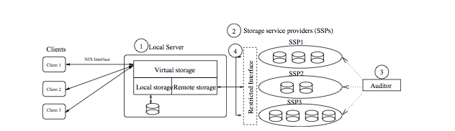
Byzantine Fault Tolerance
Safestore [KAD07]:
A Byzantine-failure-resilient distributed storage system to maintain long-term data durability
Architecture is based on fault isolation along administrative, physical, and temporal dimensions
Spreads data across autonomous storage service providers (SSPs) using a new storage system architecture:

Slide 21
Byzantine Fault Tolerance
Zyzzyva [KADCW07]:
Uses speculation to reduce the cost and simplify the design of Byzantine fault tolerant state machine replication
Replicas respond to a client’s request without first running an expensive three-phase commit
Instead, replicas optimistically adopt the order proposed by the primary and respond immediately to the client.
Clients can detect any resulting inconsistencies, and help correct replicas converge on a single total ordering of requests.
Reduces replication overheads to near their theoretical minima.

Slide 22
Systems Spanning Multiple Administrative Domains
Much work in trustworthy computing relies on the assumption that nodes can be cleanly categorized as correct or faulty
This simple picture is challenged by “MAD” systems that span multiple administrative domains like peer-to-peer services, cloud/outsourced storage, Internet routing, and wireless mesh routing. In MAD systems:
Evidence suggests that a large number of peers in MAD services will free-ride or deviate from the assigned protocol if it is in their interest to do so. Giving these peers sufficient incentives to cooperate can improve the operation of the system, as compared to having to tolerate a larger number of Byzantine failures. (BAR model has a mix of Byzantine, Acquiescent, and Rational parties.)
The decentralized nature of MAD services makes it much easier for Byzantine nodes to magnify their influence on the system.
It is often preferable to design systems where trust can be removed from services, in the sense that users do not have to make strong trust assumptions to expect to get useful work out of services.

Slide 23
MAD Results (1/2)
BAR state machine replication [AACDMP05], instantiated in the context of a peer-to-peer cooperative backup system.
Flightpath: a BAR peer-to-peer application that provides a highly reliable data stream to a dynamic set of peers. Obtains advantages if rational peers only switch if > ε gain can be obtained. [LCMKRAD08]

Slide 24
MAD Results (2/2)
A new foundation for social-based Sybil defenses. Exploring approaches that rely on the social graph's community structure.
Depot [MSLCADW10]: a cloud storage system that minimizes trust assumptions. It tolerates buggy or malicious behavior by any number of clients or servers yet gives guarantees to correct clients.

Slide 25
Trustworthy Software US Participants
Lorenzo Alvisi (University of Texas – Austin)
Patrick Traynor (Georgia Institute of Technology)
Felix Wu (University of California – Davis)
Rebecca Wright (Rutgers University)

Slide 26
Patrick Traynor
security in cellular networks, particularly when converged with the larger Internet.
systems challenges of applied cryptography and security for the Internet, mobile devices and wireless systems.

Slide 27
Cellular Network Security
The security of cellular systems has relied on their closed nature and trust in the honest behavior of users.
Their recent integration with the Internet and introduction of highly capable mobile phones means these assumptions no longer hold.
These systems provide connectivity to more than five billion subscribers around the globe and represent the only reliable critical infrastructure available to the majority of those people.
It is important to understand the threats and weaknesses in order to mitigate them.

Slide 28
Cellular Network Security
Telephony provenance and authentication [BPAHT10, DT10, DBAT10]
Security implications of third-party text messaging for emergency response [T11]
Automated remote repair for mobile malware [NGT11]
(sp)iPhone: decoding vibrations from nearby keyboards using mobile phone accelerometers [MVCT11]
Leveraging cellular infrastructure to improve fraud prevention [PGT09]
Cellular botnets: measuring the impact of malicious devices on a cellular network core [TLORJLM09]
Exploiting, and mitigating attacks on, open functionality in SMS-capable cellular networks [TEMP09a, TEMP09b]
Attack causality in Internet-connected cellular networks [TMP07]
Securing mobile browsers

Slide 29
Determining Call Provenance [BPAHT10]
Caller ID informs a receiver of the asserted source of an incoming phone call.
Such data is not authenticated, making it easy for an attacker to trick potential victims into believing their false identity.
PinDr0p measures the path taken between the sender and the receiver in order to determine the call source.
uses audio artifacts such as spectral clarity and packet loss at the receiver

Slide 30
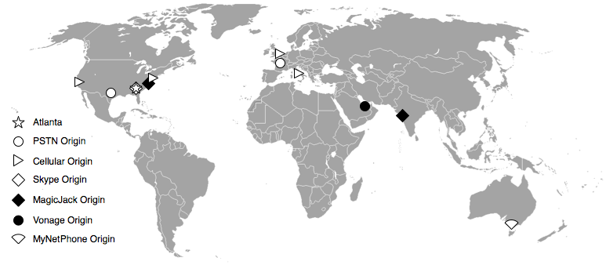
PinDr0p
A world-wide study validated the approach:
with three training messages from each phone, identified call source with > 97% accuracy.
New company PinDr0p Security has been formed.

Slide 31
SMS and Emergency Management [T11]
In many recent emergencies, SMS text messages were a reliable means of communication even when other means of communication were not available.
As a result, there are now a number of third-party services that offer emergency SMS alert systems to schools, municipalities, and other institutions.
But the SMS systems were not designed with these kinds of highly localized, high-volume loads in mind and are not currently able to withstand them!

Slide 32
SMS and Emergency Management [T11]
[T11] provides a thorough analysis of how such fragility can impact physical security. Conclusions:
such systems cannot meet the requirements set forth by federal regulations in the U.S. Warning, Alert and Response Network (WARN) Act of 2006
the network overload caused by such systems may make attempts to call for help more difficult during an emergency.
Now working with providers to develop and deploy efficient broadcast SMS for use in these scenarios.

Slide 33
Trustworthy Software US Participants
Lorenzo Alvisi (University of Texas – Austin)
Patrick Traynor (Georgia Institute of Technology)
Felix Wu (University of California – Davis)
Rebecca Wright (Rutgers University)

Slide 34
Felix Wu
Social computing / social informatics
Security issues related to both networking and networked systems.
Unknown vulnerability analysis
IPSec/VPN policy management
Routing protocol security
Internet architecture
Mobility
Secure computer architecture
Email antispam
Information visualization for security
Anomaly analysis and explanation

Slide 35
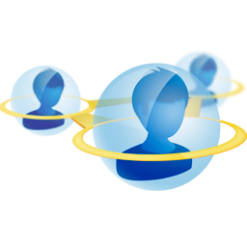
Social Computing / Social Informatics
A huge paradigm shift in the way computing and communication is carried out.
Facebook, blogs, Wikipedia, Twitter, …
Adds new concerns about trustworthiness.
Also adds the potential for new user-centric and community-centric mechanisms and models for providing and assessing trustworthiness.

Slide 36
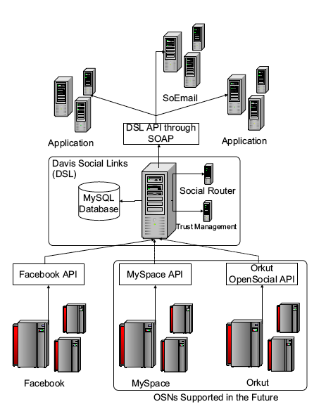
Davis Social Links test bed [BBW09]
built on top of existing online social networks
API allows third party applications to leverage the power of social networks
includes social-aware OS kernel [TCYBGLW09], social router [BBSW09], and trust management system

Slide 37

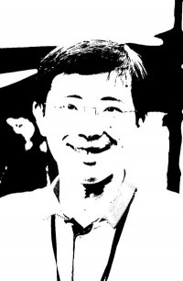
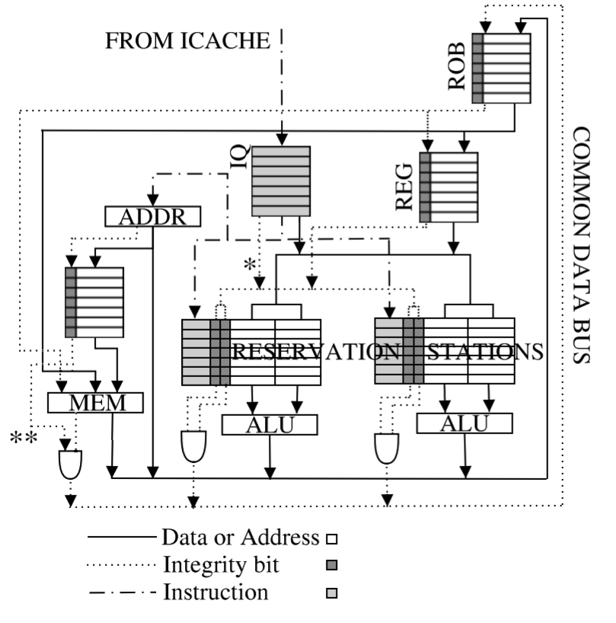

FAITH [LNHLRWY11]
Application
Existing
Applications
Social-Enabled
Applications
and Games
Wrapper
Eric
Felix
Social Context
tagging
DSL/FAITH
Name-ID
resolution
Community
Oriented
Keywords
Social network
transformation
Policy/Reputation-based
Route discovery
OSN
FAITH over OSN
FAITH: an experimental system to intercept and manipulate online social informatics,
emphasizing trustworthiness.

Slide 38
Social Computing Applications
Prototyped social computing applications provide insight and ability to experiment:
SoEmail [TRW10]
social-aware software patching
social-aware search (popularity vs. diversity)
social-aware Wiki

Slide 39
Social Computing Tools
Tools are needed for analyzing and understanding social networks and for enhancing their use:
privacy in social networks [BW09, BW10]
analysis of user keyword similarity in online social networks [BGW11]
crawling online social graphs [YLW10]

Slide 40
Goal: Architecting a Trustworthy Social Informatics System
A trustworthy social informatics system, in turn supporting a trustworthy social computing paradigm.
Research questions: What is the appropriate boundary for social informatics? What should be the right process for the social community to form converging decisions?

Slide 41
Trustworthy Software US Participants
Lorenzo Alvisi (University of Texas – Austin)
Patrick Traynor (Georgia Institute of Technology)
Felix Wu (University of California – Davis)
Rebecca Wright (Rutgers University)

Slide 42
Rebecca Wright
Computer and communications security
Theory of networked interactions, including privacy, accountability, convergence, reliability, robustness.
Applied cryptographic protocols.
Voter registration databases.

Slide 43
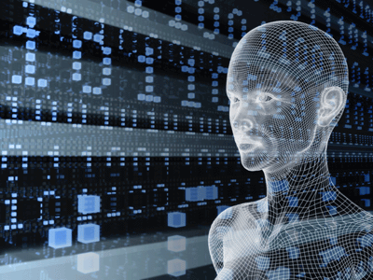
Analysis of Systems and Their Properties
Mathematical definitions can be elusive, especially when the desired properties involve the meeting of systems and humans.
But, they can be useful for capturing some aspects and driving solutions.
Formal definitions enable rigorous analysis and understanding of tradeoffs, possibilities, and impossibilities.

Slide 44
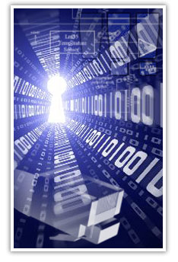
Privacy
Means different things to different people, to different cultures, and in different contexts.
Appropriate uses of data:
What is appropriate?
Who gets to decide?
What if different stakeholders disagree?
Simple approaches to “anonymization” don’t work in today’s world where many data sources are readily available.
There are some good definitions for some specific notions of privacy.

Slide 45
Secure Multiparty Computation
Data Analysis
Multiple Data Sources
Combined data
Knowledge
Secure
distributed
protocol
results
results
Useful when privacy concern is about combining data in a centralized location.

Slide 46
Our SMC Work
[WY04,YW05]: privacy-preserving construction of Bayesian networks from vertically partitioned data.
[YZW05]: privacy-preserving frequency mining in the fully distributed model (enables naïve Bayes classification, decision trees, and association rule mining).
[JW05, JPW06, JPUW10]: privacy-preserving clustering: k-means clustering for arbitrarily partitioned data and a divide-and-merge clustering algorithm for horizontally partitioned data.
[SKW08]: privacy-preserving reinforcement learning, partitioned by observation or by time.
[IMSW07, IMSW09]: private multiparty sampling and approximation of vector combinations.
[RKWF05, RKW08]: an experimental platform for privacy-preserving data analysis, improved performance of Lindell-Pinkas privacy-preserving natural logarithms (an important primitive in many computations).
[JW06, JW08b]: Private policy enforcement for inference control policies on aggregate database queries.
[JW08]: Privacy-preserving imputation of missing data.
[YZW07, SW09]: Privacy-preserving model and attribute selection.

Slide 47
Differential Privacy
Provides strong mathematical guarantees that interaction with a database provides essentially the same results if only one individual’s data is changed.
Allows natural separation of individual privacy and utility in many cases (aggregate results, synthetic data, and more).
Our work: differentially private random decision trees [JPW09], pan-private streaming algorithms [MMNW11].

Slide 48

Distributed Computing, Networks, and Game Theory (1/2)
We consider asynchronous dynamics in distributed systems in which computational nodes repeatedly make decisions in response to others’ behavior.
We study when simple and unsophisticated rules of behavior (e.g. “best reply” and “regret minimization”) guarantee convergence in asynchronous computational environments.
In an asynchronous setting, if each node’s reaction function has bounded recall and is self-independent, then the existence of multiple stable states implies that the system cannot guarantee convergence to a stable state [JSW11].

Slide 49
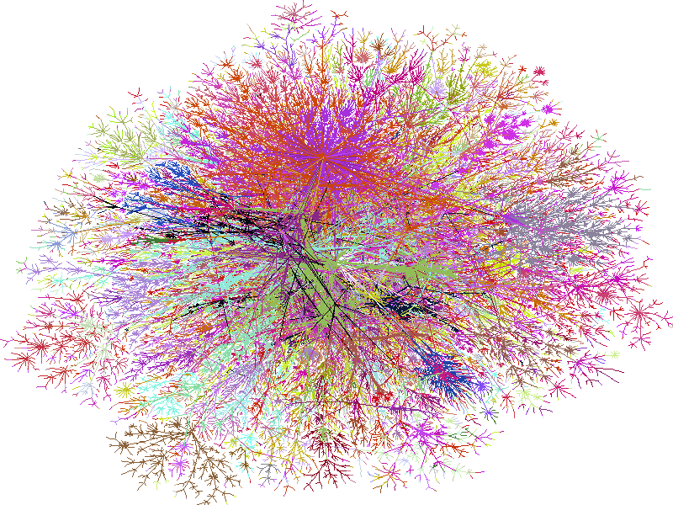
Distributed Computing, Networks, and Game Theory (2/2)
Applies to a broad range of settings including:
BGP Internet routing
TCP congestion control
stabilization of asynchronous Boolean circuits
technology diffusion in social networks
convergence of game dynamics to pure Nash equilibria
Other analysis of Internet routing protocols:
In BGP routing, under realistic utility functions, participants have an incentive to cheat [GHJRW08].
The effect of communication modeling on BGP convergence [JRW09].

Slide 50

The Center for Discrete Mathematics and Theoretical Computer Science (DIMACS) facilitates research, education, and outreach in discrete math, CS theory, algorithms and their applications.
Multi-year special focus programs address topics where these subjects can contribute, that are in areas of great need, and that are poised for advances.
Homed at Rutgers University, with university and industry partners in New Jersey, elsewhere in the US, and internationally.

Slide 51
Trustworthy Software US Participants
Lorenzo Alvisi (University of Texas – Austin)
Patrick Traynor (Georgia Institute of Technology)
Felix Wu (University of California – Davis)
Rebecca Wright (Rutgers University)

Slide 52
Trustworthy Software: Research Challenges
How do you determine what system properties must be trustworthy?
How do you express the system properties that you want to trust?
System specification, from the technical side but also the human side
What do “trust”, “privacy”, etc. mean, abstractly and in real systems?
How do you build a system with the desired properties?
How do you assure yourself that the system as built has those properties?
Verification and testing, but also empirical study of how users interact with systems
How do you establish the provenance / trustworthiness of software and of data?
How do you take malicious behavior into account:
in system design
in system development and test
in system operation: situational awareness, defense, recovery, forensics
How do you provide incentives/reduce disincentives for people to adopt trustworthy systems? For people to behave responsibly?
How do you measure results?

