Slide 1
The NSFC Key Research Program on Trustworthy Software

Slide 2
Basic Information
Name: Fundamental Research on Trustworthy Software
Launched by NSFC in 2007
  Information Sci & Tech.; Math; management sci.
Will continue till 2014 ~ 2015
Budget: 150 million RMB +
Funded projects: 70+ normal projects; 12 key projects (Zhi Jin, Wei Dong, Ming Gu, …)

Slide 3
Research Topics Covered
Software evolution
Software process
Requirement analysis
Software testing and static analysis
Symbolic computation and termination proof
Software metrics
Theorem proving / proof checking
……

Slide 4
Typical Applications
Embedded systems:
  Lunar Probe Satellite (嫦娥探月卫星)
  Railway and Subway systems
  Remote Control System for the Opening Ceremony of the Olympic Games (奥运会开幕式空中机械控制系统)
  ……
Network systems
  E-commerce
  car networks, tax-form submission systems (?)

Slide 5
Today’s Talks
Wei Dong (National University of Defense Technology): Verification, Testing and Monitoring of Safety Critical Software
Fei He (Tsinghua University): Modeling and Verification of Trustworthy Embedded Software Systems
Zhi Jin (Peking University): Control Theory based Requirements Engineering for Trustworthy Systems
Xin Peng (Fudan University): Requirements-Driven Runtime Adaptation for Trustworthiness Assurance
Jian Zhang (Chinese Academy of Science): Program Analysis and Test Data Generation Through Constraint Solving
Jianjun Zhao (Shanghai Jiao Tong University): Program Analysis and Software Testing for System Dependability

Slide 6
Verification, Testing and Monitoring of Safety Critical Software
——Overview of Our Work
Wei Dong
Department of Computer Science
National University of Defense Technology

Slide 7
Overview of Our Research on Trustworthy Software
Different Applications
Embedded Control Software
Embedded Operating Systems
Model Checking
Testing
Reliability Engineering
Different Techniques
Static Analysis
Runtime Verification
Theorem Proving
Different Levels
Program
Model
System as Black Box
Notes:
我们关于可信软件的研究，分别针对程序、模型、系统等不同抽象层次，研究了模型检验、测试、静态分析、可靠性工程、运行时验证、定理证明的相关理论和关键技术，并针对嵌入式控制软件、操作系统等不同类型软件系统进行了实验应用。

Slide 8
Model Checking
Model Checking of UML Models
  Model checking UML Statecharts and collaboration diagram via transforming them into extended hierarchical automata (EHA)
  Slicing extended hierarchical automata to reduce state space.
Symbolic Model Checking for Extended Temporal Logic
  Using automata as temporal connectors to strengthen the expressiveness beyond LTL, which can describe all ω-regular properties.
  Developed a tool ENuSMV.
Model Checking of C Program via Slicing Execution
  Proposed a light weight version of symbolic execution called slicing execution via variable abstraction.
  Proposed a property oriented searching reusing framework.
  Using stateful dynamic partial-order reduction.
Notes:
一、UML状态图和协作图的模型检验。使用扩展层次自动机EHA作为中间模型，把UML状态图转换为EHA，定义了EHA的操作语义，生成状态模型，然后进行模型检验。采用对EHA进行切片的方式缩减状态空间。
二、ETL的符号化模型检验。基于tableau 方法，给出了采用交错自动机作为连接子的ETL的基于BDD 的符号化模型检验算法。在模型检验工具NuSMV 的基础上，实现了支持扩展时序逻辑的符号化模型检验工具ENuSMV。它允许用户通过描述自动机的方式自定义时序连接子，能够检验全部的ω-正规性质。
三、基于切片执行的C程序模型检验
1、提出了切片执行的基本概念和方法。基于对程序验证基本规律的分析，我们提出了变量抽象方法，只考虑程序中与待验证性质相关的变量和语句。基于变量抽象，我们定义了部分最强后置条件，进而定义了程序的保守近似语义。基于这两个概念，我们提出了切片执行的概念，它是一种轻量级的符号执行过程。
2、提出了面向时序安全性质验证的搜索复用框架并将其应用于切片执行。搜索复用框架也是一种反例路径制导的抽象精化（CEGAR）框架，基于伪反例路径进行模型精化。相比传统的CEGAR框架，搜索复用框架的最大特点是能够在不同精度的抽象模型之间进行充分的信息复用，从而避免了大量不必要的重复搜索，有效降低了验证开销。
3、提出了面向有状态模型检验的有状态动态偏序缩减方法，并将其集成到切片执行过程中。我们将切片执行方法扩展到了对并发C程序的验证。为了进一步进行状态空间缩减，我们提出了有状态动态偏序缩减方法，并将其自然地集成到切片执行框架中，用于指导切片执行，使其避免搜索多条具有相同偏序关系的并发进/线程交迭执行路径。

Slide 9
Software Testing
Model-based Testing
  Generating test cases from UML Statecharts.
Property Oriented Testing
  Focus testing efforts on system behaviors of utmost interests.
  Proposed a set of depth-oriented coverage criteria for testing.
  Save testing budget and time.
Path-wise Test Data Generation for C Program
  Improve the Iterative Relaxation Method by omitting the constructions of predicate slice and input dependency set.
  Fit for both white-box and black-box testing.
Notes:
一、基于模型的测试。从UML状态图生成测试用例集，能够达到状态覆盖、迁移覆盖、路径覆盖等要求。
二、面向性质的实时系统测试。由于传统的控制流覆盖和数据流覆盖等准则是用来度量“全面”测试的充分性的，而不是度量用户感兴趣行为的测试充分性的，因此我们提出一组用于度量面向性质测试的测试深入程度的覆盖准则。然后提出了一种用于反应式系统的选择性测试方法，令系统模型为M，待测时序属性为P，假设M满足P。该方法只为模型M中使性质P的前件为真的那些行为生成测试用例。一般来说，使性质P前件为真的模型行为(待测行为)远远少于模型M的全部行为，因此为了让功能测试达到同样“深度”（即测试序列中回路的允许出现次数），面向性质测试比非面向性质测试需要更少的开销；而在同等开销下，面向性质测试比非面向性质测试进行得更加深入。
三、面向路径的C程序测试数据生成方法。过研究静态、动态数据依赖关系的性质，将Gupta等提出的谓词片推广为路径静态切片，证明路径静态切片构造算法的正确性。进一步提出了Gupta方法的改进，它省略构造谓词片和输入依赖集的过程，任选一组输入运行W上的语句，计算W上各谓词函数关于输入变量的线性关系，然后为输入变量建立线性方程系统，求解后直接获得一组新的输入。改进后的方法构造线性约束的效率更高。

Slide 10
Static Analysis
Memory Errors Analysis for C Program
  Propose a demand-driven approach to memory leak detection based on flow- and context-sensitive pointer analysis.
  Propose an algorithm to detect null pointer dereference errors utilizing both of the must and may alias information.
Abstract Interpretation
  Collaboration work with Professor Patrick Cousot in École Normale Supérieure (ENS), Paris.
  Propose:
    floating-point polyhedra abstract domain to discover linear invariants
    interval linear abstract domains to discover non-convex invariants
    linear absolute value abstract domains to discover piece-wise linear invariants
Notes:
一、C程序内存错误静态分析。
1、基于C 程序的一种流敏感、上下文敏感的指针分析方法，提出了一个需求驱动（demand-driven）的内存泄漏检测算法。该算法首先假设程序中的某一语句引发了内存泄漏，由此假设出发，可以得到一些初始信息，然后进行后向分析，来判断这个假设是否成立。通过指针分析，可以得到指向图（points-to graph），基于这样的指向图，计算出数据流事实（data flow fact），从而判断是否有内存泄漏发生。
2、提出了一种检测空指针解引用错误的算法，它利用了必然别名（must alias）和可能别名（may alias）信息来提高检测算法的精度。从一个不精确的流不敏感、上下文不敏感指针分析算法出发，计算出赋值语句所产生的必然别名信息。使用必然别名信息，可以提高可能别名的精度，还能够在赋值语句处更新更多的表达式，降低空指针解引用检测算法的误报率。
二、抽象解释
1、提出了浮点多面体抽象域，作为经典凸多面体域的一种可靠浮点构造方法，凸多面体域是目前表达能力最强、应用最广泛的数值抽象域之一，但是其基于多精度有理数的实现在可扩展性和易处理性方面受到限制。我们仅基于凸多面体的约束表示（无需生成子表示）并采用浮点系数，给出了凸多面体抽象域的一种可靠浮点实现方法，以通过浮点实现来提高凸多面体域的计算效率和处理能力。
2、把区间线性代数引入到程序分析中，提出了一系列支持区间系数的区间线性抽象域。提出了区间多面体抽象域，用以推导程序中变量间的区间线性不等式关系，该域可以看作是经典凸多面体域的区间系数扩展版本。作为一种受限情形，还提出了行阶梯形区间线性等式抽象域，用以推导区间线性等式关系。采用浮点数并基于向外舍入的区间算术可靠地实现了这些抽象域。
3、提出了线性绝对值不等式抽象域（用来推导线性绝对值不等式/区间线性不等式/广义线性互补不等式关系）和线性绝对值等式抽象域（用来推导线性绝对值等式/水平线性互补等式关系）。线性绝对值不等式域是经典多面体域的一般化，虽然表达能力与区间多面体域相同，但是其域操作都是具体域上对应操作的最佳抽象。而线性绝对值等式域是经典仿射等式域的一般化。基于广义线性互补系统的双重描述法并采用多精度有理数实现了这两个抽象域。

Slide 11
Runtime Verification and Active Monitoring
Impartial Anticipation in Runtime Verification
  Collaboration work with Professor Martin Leucker (now in University Lübeck) at Technische Universität München (TUM) , Germany.
  Propose an uniform approach to synthesizing monitors for a variety of different logics
  Propose a method to construct anticipatory monitors for parameterized LTL.
Software Active Monitoring
  Improve the runtime verification to predict non-conformance (prediction), and prevent the system from reaching the violation (prevention).
  Based on anticipatory semantics.
Notes:
一、具有公平性和预测性的运行时验证。为时序逻辑的运行时验证提出了三值语义：i)True，ii)False和iii)inconclusive，该语义使得运行时验证中的监控器满足公平性（Impartiality）和预测性（Anticipation）这两个原则。进一步为各种线性逻辑的运行时验证提出了一个统一的框架和监控器构造过程，并证明只要该逻辑对应的自动机理论满足遗忘性（Forgettable）和忠实性（Faithful）准则，在该框架下自动构造的监控器就一定满足公平性和预测性，并对LTL、正规线性时序逻辑RLTL、线性μ演算νTL、一元二阶逻辑（Monadic Second Order Logic）S1S等线性逻辑进行了实例验证。
二、软件主动监控。以面向线性时序逻辑的运行时验证技术为基础，提出了基于软件系统模型的软件主动监控技术和方法。在系统模型中，不但关心系统状态之间的迁移关系，而且关心驱使状态迁移发生的方法和事件。本文以该模型为基础，提出了如何前瞻系统行为，如何针对运行时监控器监控结论自动产生在特定状态处的调控动作，以及如何采用适当的执行机制使得调控动作能够被及时使能和钝化，从而避免软件失效的方法和技术，形成包含失效预测及预防的闭环回路，使得被监控系统的行为能够向着期望的方向被不断监控和调控。

Slide 12
Trustworthy Property Guided Software Development
Trustworthiness of Embedded Control Software
Domain Property Mining
(e.g. Temporal FTA, FMEA)
General Properties
(e.g. memory errors)
Requirement Analysis
Software Design
Software Implementation
Software Testing
Software Deployment
Safety Analysis
Model Checking
Theorem Proving
Static Analysis
Runtime Monitoring

Slide 13
Some Ongoing and Future Work
I: Analysis and Verification of Cyber Physical Software
    Cyber-Physical System (CPS) features the tight combination and coordination between computa-tional and physical elements. Analysis and verification of CPS software will face some grand challenges which are also very interesting.
II: Verification-Driven Embedded OS Development
    Integrating formal methods and tools, which include model checking, static analysis and theorem proving, to develop trustworthy microkernel based embedded operating system which will be use in critical areas.
Notes:
一、高可信信息－物理融合系统（Cyber Physical System）的软件分析与验证
二、验证驱动的可信嵌入式操作系统开发，通过模型检验、静态分析、定理证明等手段，对调度、内存管理、进程间通信、实时性、中断等性质进行保证。

Slide 14
Modelling and Verification of Trustworthy Embedded Software Systems
Fei He
On behalf of Trustworthy Software Research Group in
Tsinghua University

Slide 15
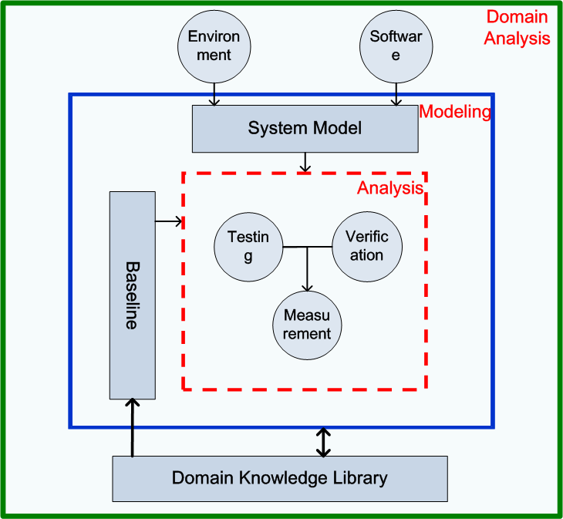
Framework of Our Research
The key techniques
  Modeling
  Verification
  Evaluation
Notes:
We suggest a three-steps process for evaluation of trustworthiness.

Slide 16
Trustworthy Modeling
Faithful modeling
  As close as possible to the real system.
Effective modeling
  Domain knowledge based description and analysis
  Different level of abstraction and refinement
Modeling Language EDOLA
  Domain specific, formal, and component-based

Slide 17
Model Checking
Abstraction and refinement
  Integrate evolutionary computation with abstraction refinement
  Predicate abstraction for model checking
Assume-guarantee reasoning
  Automatic system decomposition by date-mining technique
  Symbolic assumption generation by BDD-learning
Applications in PLC systems
  Translation-based model checking for PLC programs

Slide 18
Decision Procedures
maxSAT: A SAT solver based on maxterm covering
  Determines the satisfiability by maxterm covering theorem
  Up to 7 optimization strategies to accelerate the search process
An array theory of bounded elements
  Allows to specify complex array properties
  Decidable fragment of array logic
aCiNO: An extensible SMT solver
  An open framework
  Able to generate certificates

Slide 19
Theorem Proving
Type and rewriting theory
  Coq modulo theory
  Higher-order computability path ordering for polymorphic terms
Applications in PLC systems
  A modeling and verification framework based on theorem proving
Notes:
CoqMT is the base for the next-generation of Coq, which make the integration of Coq and decision procedures possible.

Slide 20
Evaluation of Trustworthiness
Select a level L
Based on the model requests，modeling the software system by Edola
modification
Properties hold with the requested analysis method?
N
feedback
timeout
Y
Level L: yes
Level L : unknown
Level L: No
Notes:
The trustworthiness level decide what kind of model should be built, and what kind of properties should be verified.
An evaluation flow based on modeling and verification.

Slide 21
Future Projects
Trustworthy code generation for embedded software
  The code generation process need be automatic
  The generated code must be correct
A model checker for component-based system
  Permit intricate interaction among components, like message passing interaction etc.
  Domain-knowledge based optimization.

Slide 22
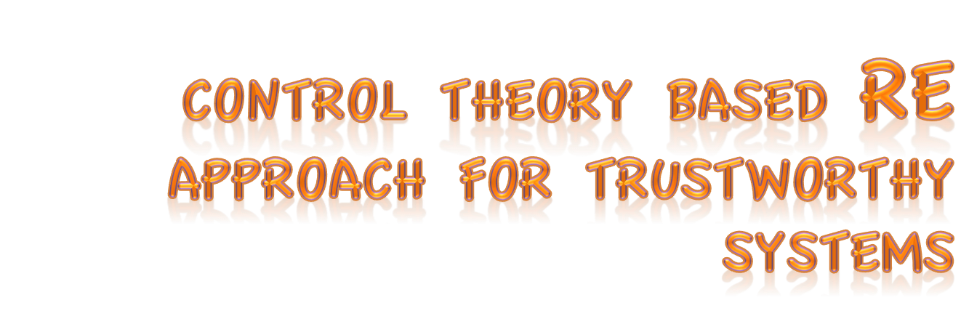
Zhi Jin
Key Laboratory of High Confidence of Software Technologies
Peking University
zhijin@sei.pku.edu.cn

Slide 23




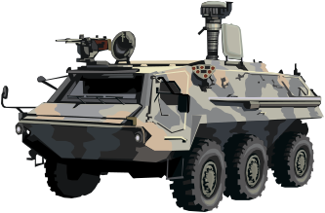
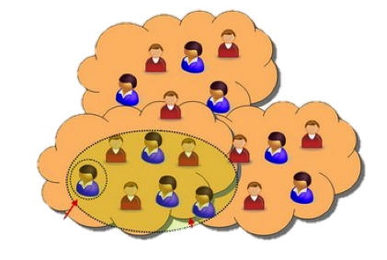


Software need to be trustworthy
Software to be
tightly integrated with
the physical systems and
the social systems
with
networked sensing,
computation, and
actuation, etc.
Such software need to
  be trustworthy
Software
Social World
Physical World
Networked Interaction
Notes:
增加人组成的社会，以及与社会系统的交互。

Slide 24
From W&W Trustworthy Requirements?
Software
Physical
and
Social
World
Availability
Reqs.
System Fault
Self-adaptation
Reqs.
Changeable Factors
Context-aware
Reqs.
Non-Deterministic
Factors
Security Reqs.
Malicious Factors
Safety Reqs.
Safety-Critical
Factors
Robustness
Reqs.
Errors
Functional Reqs.

Slide 25
Trustworthy Challenges RE
Current RE approaches mainly focus on the functional aspect (for implementing the business logics)
No Systematical approach for dealing with the trustworthy aspects (for guaranteeing the system behaviors predictable when facing at the malicious, changeable, undeterministic, error-prone, etc. environment)

Slide 26
Domain
Assumptions
Specification
Requirements
What causes the un-predictability?
Two Souses
In the functioning of a software system
The interactive environment may be undependable:
The D may temporarily or permanently be unsatisfied
by uncontrolled factors in the interactive environment.
The software system may be faulty and/or required to be adaptive:
The software’s behavior may not conform to the S,
because of internal faults or the change of the interactive
environment.

Slide 27
New Methodology is Appealing
Model the running software system as a control system
For handling the uncontrolled factors in the interactive environment, and the unexpected software behaviors, use feed-forward and feed-back controllers respectively to ensure the satisfiability of R
Provide a knowledge-based approach to identifying and adjusting controlling policies in the controllers
These controlling policies serve as the requirements for guaranteeing the trustworthiness

Slide 28
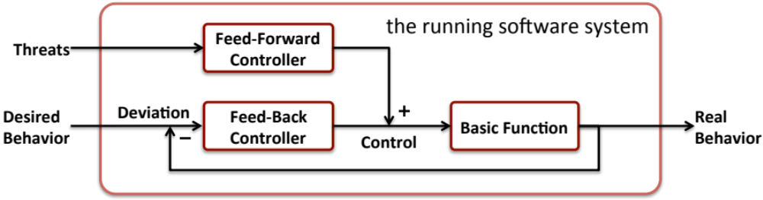
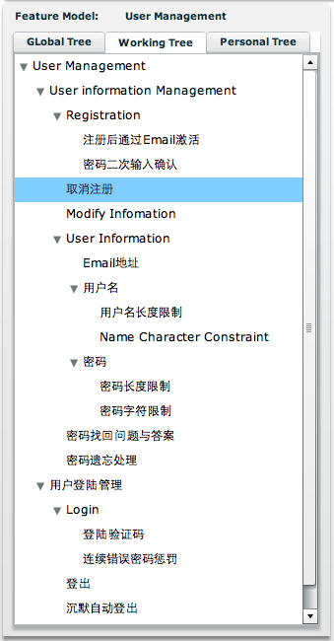
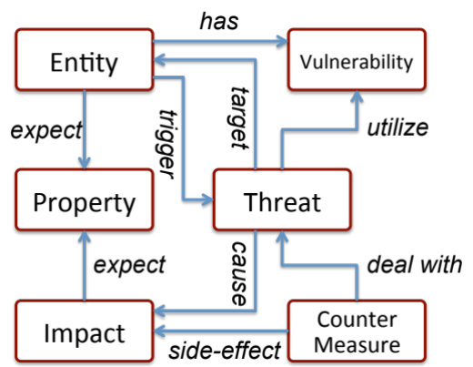

FB Control-Cases
FF Control-Cases
Use-Cases
organized as
a feature model
A Knowledge Base
about Threats and Faults
The concept model
of the knowledge base
Collaborative
Knowledge Collecting

Slide 29
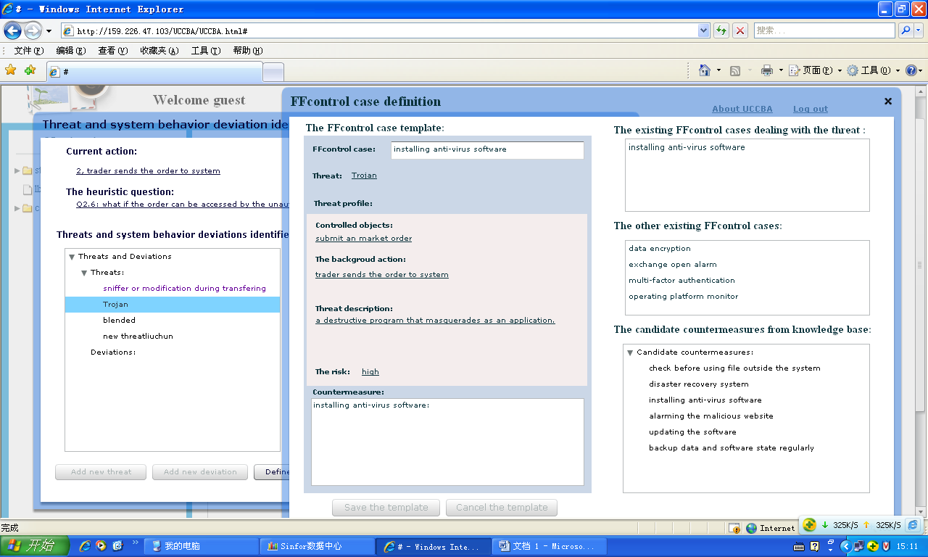
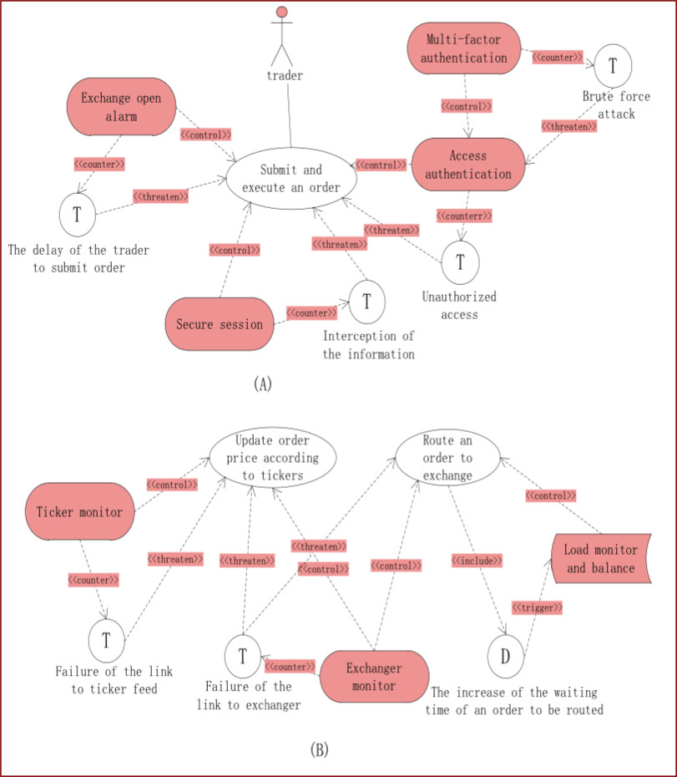
A web-based supporting tool
http://159.226.47.103/CCDRM1/bin-debug/CCDRM1.html
Case Study
The On-line Stock trading system from the industrial partner
identify 7 control cases based on 20 use cases
The result is conformance with that produced by experts

Slide 30
Summary
Control Theory and Knowledge based RE help to
  Separate the trustworthy concerns
  Reuse trustworthy related requirements patterns
  Help to conduct the RE process systematically
RE for Trustworthy Systems, there are more things:
  See deeper in the real world: Model how to sense it, how to be aware of it, how to be conformance with it, and how to prioritize the trustworthy requirements in terms of the real world risk, ……
  Develop more suitable and reasonable, easier-to-follow methodologies
  Last but most important: Develop the knowledge body for requirements of trustworthy systems
We need collaborations!!!

Slide 31
Requirements-Driven Runtime Adaptation for Trustworthiness Assurance
Xin Peng
School of Computer Science, Fudan University, China
pengxin@fudan.edu.cn
www.se.fudan.edu.cn/pengxin

Slide 32
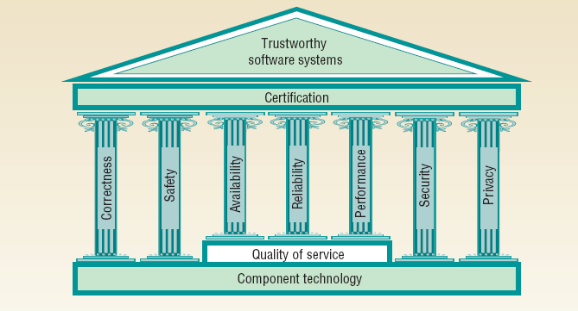
Software trustworthiness: beyond security
Wilhelm Hasselbring, Ralf Reussner. Toward Trustworthy Software Systems. Computer, April 2006.

Slide 33
Trustworthiness Assurance
By construction
  rigorous design, testing, formal methods, code analysis, software process, …
By runtime assurance
  requirements/design model defined as knowledge base
  runtime assurance by self-adaptation (self-management)
    monitoring: monitor runtime system events, parameters…
    analysis: analyze potential threats to trustworthiness
    plan: generate adaptation plans by decision making
    execute: enforce adaptation plans on the structure and/or behavior of the running system

Slide 34
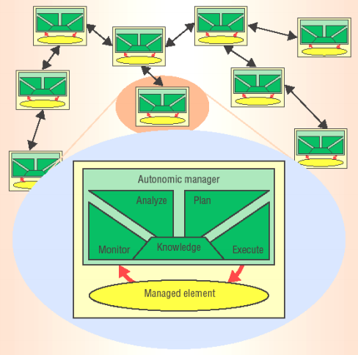
Self-Management:
The vision of autonomic computing
Self-*: systems shall managing themselves.
  Self-tuning........performance
  Self-configuring...flexibility
  Self-healing.......dependability
  Self-protecting..security/privacy
Self-Adaptation Control Loop
Monitoring
Analyzing
Planning
Execution
+
Sensing
Actuating
+
Knowledge
Jeffrey O. Kephart, David M. Chess. The vision of autonomic computing. Computer, January 2003.

Slide 35
Ongoing work-1
Self-tuning for overall quality satisfaction
Assumptions
  proper solutions for individual quality attributes
  trustworthiness problems lie in conflicts among different quality attributes
Objective
  achieve optimized overall quality satisfaction by dynamic quality tradeoff at runtime
Solution
  runtime earned value measurement as feedback
  dynamically tuned priority ranks for different quality attributes
  functional requirements reconfigured by requirements reasoning in response to priority tuning of quality attributes
  requirements reconfiguration mapped to runtime architecture

Slide 36
Quality Tradeoff Control Loop
Feedback: Earned Value
PID Controller
Preference Ranks of Softgoals
control
Preference-driven Goal Reasoner
Value Indicator
goal configurations
Architecture Configurator
Architecture Reconfiguration
Running System
runtime data
[Peng et al. @ RE 2010]
Process under Control

Slide 37
Ongoing work-2
Self-tuning for survivability
Survivability [Knight et al. @ 2004]
  capability of ensuring crucial services under severe or adverse conditions, with acceptable quality degradation or even sacrifice of some desirable services
  survivability rather than absolute reliability: absolute reliability is often expensive, or even impossible
Idea
  runtime earned value measurement as feedback
  services (functional requirements) dynamically bound and unbound based on feedback control
  requirements reconfiguration mapped to runtime architecture

Slide 38
Ongoing work-3
Self-healing for repairing potential failures
Detect potential failure by runtime verification
  pre/post- conditions
  temporal specifications
  contextual assumption failure detection
Self-repair: resolve potential failures by
  intervention
  compensation
  switching to alternative designs
  switching to other agents providing similar services
  …

Slide 39
Future Work
Requirements-driven adaptation in more social-technical and distributed applications like mobile, ubiquitous applications, and service oriented systems
Framework and tools for integration with cloud-based platforms
Capture and incorporate design decisions as knowledge base for runtime adaptation decisions
Explore more sophisticated decision mechanisms for runtime adaptations, e.g. control theory, machine learning, AI, …
Failure diagnosing for more accurate repairing

Slide 40
Program Analysis and Test Data Generation Through Constraint Solving
Jian Zhang
Chinese Academy of Sciences
Email: zj@ios.ac.cn

Slide 41
Black-box testing –
combinatorial testing; EFSM-based testing
Given a C program, find
a set of test cases to meet some criterion
  Branch/statement coverage
  basis path
general bugs (e.g., memory leak and infinite looping) or application-specific bugs (violation of user-specified assertions)
hot paths in the program
Notes:
Dr Zhang and his students are interested in software testing (esp. test data generation) and static analysis.

Slide 42
Combinatorial Testing
(Combination Testing)
Black-box testing technique, used in AT&T, Motorola, Microsoft, IBM, TNO
The system-under-test (SUT) has a set of parameters/components, each of which can take some values.
Example:
  Browser: IE, Netscape, Firefox, ...
  Operating system: Linux, Windows NT, ...
  Manufacturer: HP, Dell, Lenovo, ...
Notes:
Combinatorial testing is an important black-box testing technique, which is used by some large companies.

Slide 43
Finding Smallest Test Suite
Backtracking search + heuristics
Tool: EXACT for finding Covering Arrays
Tool: BOAS for finding Orthogonal Arrays
Jun Yan and Jian Zhang, J. Systems and Software 2008; Feifei Ma and Jian Zhang, PRICAI 2008.
Charles Colbourn: “The CA(24;4,12,2) yields a *lot* of improvements!”
Notes:
Zhang and his students have proposed methods for finding the smallest test suite for combinatorial testing. Some tools have been developed.

Slide 44
Symbolic Execution + Constraint Solving
[Zhang VSTTE 2005 (LNCS 4171)]
Verification / bug finding
Unit testing; model-based testing
Remedy for classical static analysis
Notes:
For the past 10 years, Zhang has been pushing the use of symbolic execution and constraint solving techniques. He has argued that such a combination has many benefits.

Slide 45
Some specific research results
Path feasibility analysis: PAT / ePAT (2001)
A sufficient condition for the detection of infinite looping. [Zhang 2001]
A method for finding executable/feasible basis paths [Yan-Zhang 2008]
Volume computation for Path Execution Frequency Computing [Ma-Liu-Zhang 2009]
Notes:
He and his students have been working on various problems in software testing and static analysis. Here is a partial list of their results.

Slide 46
Data generation for unit testing
Examples: GNU coreutils
remove_suffix() in basename.c
cat() in cat.c
cut_bytes() in cut.c
parse_line() in dircolors.c
set_prefix() in fmt.c
attach() in ls.c
[Xu-Zhang 2006]
Notes:
Here are some experimental results about unit test generation.

Slide 47
Memory Leak Detection
Tool: Meldor (on top of LLVM/clang)
* inter-procedural, path sensitive
[Xu-Zhang 2008][Xu-Zhang-Xu 2011]
Found memory leak problems in
  which
  wget
  …
Notes:
Zhang and his students have also worked on the automatic detection of memory leak problems in C programs.

Slide 48
Program Analysis and Software Testing for System Dependability
Jianjun Zhao
Software Theory and Practice Group
Shanghai Jiao Tong University
http://stap.sjtu.edu.cn

Slide 49
Research Profile
General objective
  Improve how we code, debug and test large infrastructural software systems
Focus
  Software dependability
    Debugging, testing and analysis of multi-core systems
    Computer aided verification and programming
  Program understanding
    Program analysis
  Software Testing
    Regression testing
    Automatic generation of test cases

Slide 50
Outline
AutoLog: Facing Log Redundancy and Insufficiency
BPGen: An Automated Breakpoint Generator for Debugging
A Lightweight and Portable Approach to Making Concurrent Failures Reproducible

Slide 51
AutoLog: Facing Log Redundancy and Insufficiency
Joint work with my students Cheng Zhang, Longwen Lu, Yu Fan, and Zhenyu Guo, Ming Wu, and Zheng Zhang from Microsoft Research Asia

Slide 52
Motivation
Logging is the predominant practice when debugging:
  Easy to add
  (Usually) no side effects
  A “program” over the program
This freedom comes with a cost:
  Log redundancy: too many irrelevant logs
  Log insufficiency: critical logs may still be missing
Notes:
We show the main points in the introduction. (1 min)

Slide 53


Overview of AutoLog
AutoLog: target in-house interactive debugging
Two ideas:
  Log slicing to highlight relevant logs
  Log refinement to produce sufficient logs
Aha, find the bug.
Show me more logs !
log refinement
program
program slicing
highlighted logs
instrumented program
execution
log slicing
slice-DB
logs
Notes:
Here is AutoLog’s architecture shown as the animation of the workflow. (2 min)

Slide 54
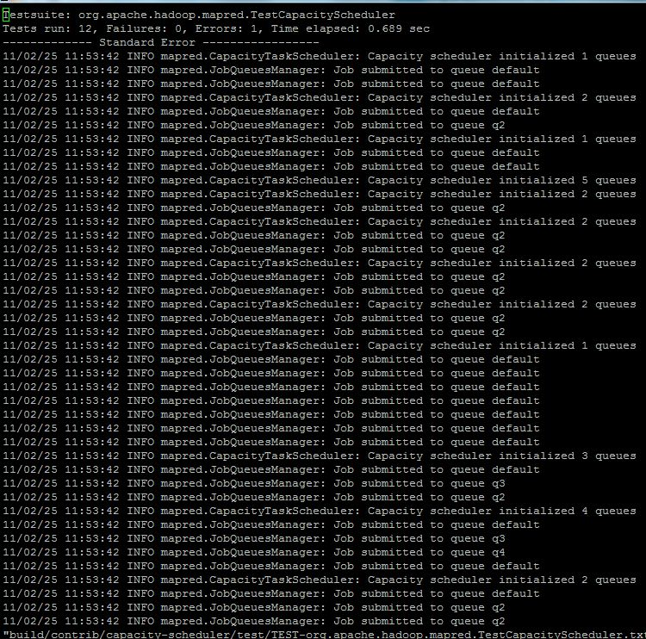
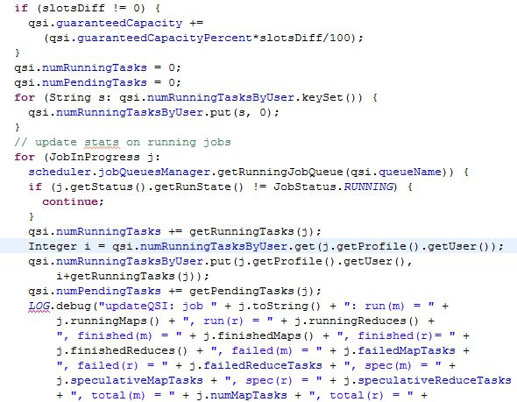
Log Slicing – Basic Idea
Identify relevant logs by analyzing program dependencies
Notes:
(0.5 min)

Slide 55
Log Refinement – basic idea
all program points
When existing logs are insufficient to cover the root cause
  Log slicing can provide little help
Automatically insert new logging statements
all program statements
static slice
hybrid slice
hybrid slice
failure site
dynamic
slice
logs
logs
logs
New logs will eventually cover the root cause
root cause
Notes:
Here we illustrate the relations between different slices and introduce log refinement. (1.5 min)

Slide 56
A Lightweight and Portable Approach to Making Concurrent Failures Reproducible
Joint work with my students Qingzhou Luo, Sai Zhang, and Min Hu

Slide 57
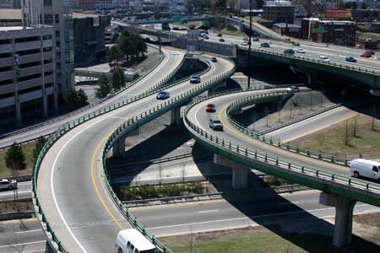
Concurrency is efficient…
Notes:
1. In general, concurrency bugs can be categorized into two groups, shared-memory access-related bugs and lock-related bugs.
All of these bugs are sensitive to thread interleavings.
2. (click) The testing and bug detection of multithreaded programs are usually extremely difficult due to the existing of non-deterministic behaviors, which causes the state-space explosion of thread interleaving.
That is to say, all feasible paths within a thread should be covered, all feasible pairs of concurrent paths should be covered, and all feasible thread interleaving of a given pair of concurrent paths should be covered as well.
3. (click) During the last decade, many efforts have been made to develop effective and efficient approaches to detection of concurrency bugs.
Especially, "effective" means bugs can be distinguished from huge number of thread interleavings, "efficient" means the detection approach is scalable or will not cause heavy overhead.
4. (click) Our contributions are ….

Slide 58
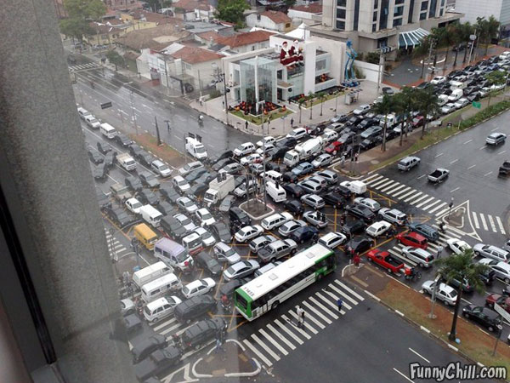
Concurrency is also bug-prone
Notes:
1. In general, concurrency bugs can be categorized into two groups, shared-memory access-related bugs and lock-related bugs.
All of these bugs are sensitive to thread interleavings.
2. (click) The testing and bug detection of multithreaded programs are usually extremely difficult due to the existing of non-deterministic behaviors, which causes the state-space explosion of thread interleaving.
That is to say, all feasible paths within a thread should be covered, all feasible pairs of concurrent paths should be covered, and all feasible thread interleaving of a given pair of concurrent paths should be covered as well.
3. (click) During the last decade, many efforts have been made to develop effective and efficient approaches to detection of concurrency bugs.
Especially, "effective" means bugs can be distinguished from huge number of thread interleavings, "efficient" means the detection approach is scalable or will not cause heavy overhead.
4. (click) Our contributions are ….

Slide 59
Motivation
Debugging and bug reproduction plays an important role in software development cycle
  A lot of time spent on reproducing the bug rather than correcting it
Bug fixing in concurrent programs is even harder due to non-deterministic execution
  Thread scheduling is non-predictable
We need a way to deterministically reproduce concurrent bugs
  Existing techniques and tools focus on sequential programs

Slide 60
Approach
Multithreaded Java Program
Static Datarace Detection
Instrumentation Points
Class Instrumentation
Preprocessing
Program Crashes
Execute Program
Thread Execution Order and Object State
Thread Schedule Recording
Instrumented Version
Capture & Replay
JUnit Tests Generation
JUnit Tests
Developer: execute JUnit tests to reproduce failures
Offline Analysis

Slide 61
BPGen: An Automated Breakpoint Generator for Debugging
Joint work with my students Cheng Zhang, Dacong Yan

Slide 62
Debugging and breakpoints
Software debugging is time-consuming
Automated debugging is promising
Over 70% debugging developers use breakpoints
Notes:
1. No matter

Slide 63
Basic idea of breakpoint generation
Combine proper automated debugging techniques and present the final result as breakpoints
  Flexible
  Familiar to developers
  Effort-saving

Slide 64
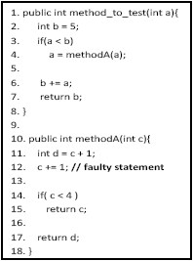
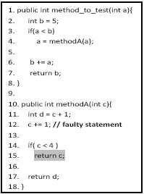
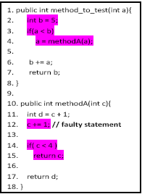
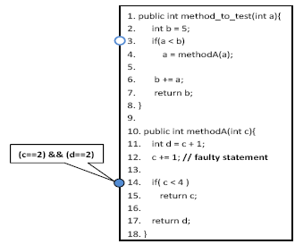
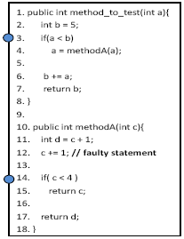
Overview of the BPGen process
-- the flow graph
Nearest neighbor query
Dynamic program slicing
Memory graph comparison and breakpoint condition generation
Breakpoint generation

Slide 65
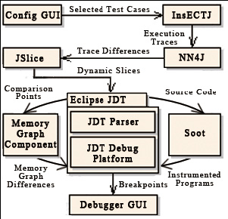
Implementation of BPGen

Slide 66
Thanks

