Slide 1
NSF OCI Software Program
Gabrielle Allen
Program Director
National Science Foundation
Office of Cyberinfrastructure
gdallen@nsf.gov

Slide 2
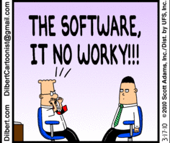
Software as Infrastructure
Software is an integral enabler across all science and engineering disciplines of computation, experiment and theory and central component of new cyberinfrastructure
Environments and Applications becoming more complex:
Multiscale/multimodel simulation codes
New data analytics and statistics
Distributed, heterogeneous and massively parallel environments
Academic research environment: financial, social and organizational challenges
SCIENCE
CDSE and SOFTWARE
INFRA -STRUCTURE

Slide 3

Software Challenges
Responsive to scientists needs
Software engineering: robustness, usability, reliability, ….
Disruptive technologies: ultrascale computing, distributing computing, data-intensive, …
Research environment: motivation, credit, funding mechanisms, licensing, …
Global issues: across agencies, across disciplines, international, industry
Scientific Discovery
Technological Innovation
Software
Need pathways for innovation: Science drives technology innovation and vice versa

Slide 4
Software Infrastructure for Sustained Innovation (SI²⁾ Program
Scientific Software Elements (SSE): Small Groups
Scientific Software Integration (SSI): Focused Groups
Scientific Software Innovation Institutes (S2I2): Large Multidisciplinary Groups
Cross-cutting NSF framework to create a software ecosystem that scales from individual researchers to large hubs
Transform innovations into sustainable software as integral part of CIF21
Notes:
Transform innovations into sustainable software as integral part of CIF21

Slide 5
Competitive SI2 Proposals
Provide transformative innovations in software resources that will become an integral part of cyberinfrastructure for science and/or engineering in one or more fields
Proposals need to describe the science and engineering communities that their proposed software will advance.
Provide a robust, reliable, useable, and sustainable software infrastructure with an effective management for development and implementation which is deeply embedded in targeted domains
Lead to significant advances in science and/or engineering in one or more fields
Contribute to a national cyberinfrastructure
Promote the integration of research, education, and broadening participation of under-represented groups

Slide 6
FY 10 SSE Awards
Project Title | PI
Reducing the Complexity of Comparative Genomics with Online Analytical Processing | R. Kosara, University of North Carolina at Charlotte
A Tracing Virtual Machine for Statistical Computing | J. Vitek, Purdue University
Software Infrastructure For Partitioning Sparse Graphs on Existing and Emerging Computer Architectures | G. Karypis, University of Minnesota-Twin Cities
SciDB - A Scientific Data Management System | M. Stonebraker, Massachusetts Institute of Technology
Parallel and Adaptive Simulation Infrastructure for Biological Fluid-Structure Interaction | B. Griffith, New York University Medical Center
Lagrangian Coherent Structures for Accurate Flow Structure Analysis | S. Shadden, Illinois Institute of Technology
Software for integral equation solvers on manycore and heterogeneous architectures | G. Biros, GA Institute of Technology
Adaptive Software for Quantum Chemistry | S. Hirata, University of Florida
Cloud-Computing-Clusters for Scientific Research | J. Rehr, University of Washington
Comprehensive Sustained Innovation in Acceleration of Molecular Dynamics Simulation and Analysis on Graphics Processing Units. | R. Walker, University of California-San Diego
Extensible Languages for Sustainable Development of High Performance Software in Materials Science | E. Van Wyk, University of Minnesota-Twin Cities
Statistical software for astronomical surveys | G. Babu, Pennsylvania State University

Slide 7
FY 10 SSI Awards
Project Title | PI
Real-Time Large-Scale Parallel Intelligent CO2 Data Assimilation System | A. Michalak, University of Michigan Ann Arbor
Accelerating the Pace of Research through Implicitly Parallel Programming | D. August, Princeton University
CyberGIS Software Integration for Sustained Geospatial Innovation | S. Wang, University of Illinois at Urbana-Champaign
A Productive and Accessible Development Workbench for HPC Applications Using the Eclipse Parallel Tools Platform | J. Alameda, University of Illinois at Urbana-Champaign
Developments in High Performance Electronic Structure Theory | M. Gordon, Iowa State University
Scalable Hierarchical Algorithms for Extreme Computing (SHARE) | R. Brower, Boston University

Slide 8
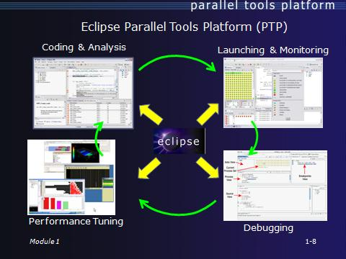
Workbench for HPC Applications
Provide uniform access to capabilities needed to develop, debug, optimize, deploy, execute, and maintain science and engineering applications on a diverse range of parallel computers, with a particular focus on NSF’s investments in HPC through TeraGrid/Extreme Digital platforms as well as Blue Waters.

Slide 9
Workbench for HPC Applications Development
Specific Targeted Applications/User Community:
Multidisciplinary, HPC applications
HPC application development community
Specific Need addressed/Impact:
Transform process of developing, debugging, optimizing, deploying, executing and maintaining scientific codes on parallel computers by using best practices from the software engineering industry.
Specific software elements/infrastructure developed?
Enhance Eclipse Parallel Tools platform for completeness, scalability, debugging, integration, usability, and specific platform issues
Key aspects of the engineering process:
Leverage Eclipse Foundation processes and infrastructure (including wiki, bugtracker, mailling lists, source repository) and integrated release process
Leverage Eclipse Build and test infrastructure, investigate opportunities to improve processes with NMI Build and Test
Tangible metrics:
Adoption of Eclipse PTP by research groups
Breadth of coverage of NSF HPC and other relevant HPC platforms
Number and type of issues identified in requirements gathering phase of development cycle
Survey tutorial attendees, assess numbers of PTP users reached through classrooms as well as training sessions
Broader Impacts:
Through educational materials developed/disseminated, impact CSE curricula and equip new generation with tools to tackle extreme-scale computing
Broad distribution of Parallel Tools through Eclipse.org distributions
User Driven development will help ensure relevance to users and NSF investments in HPC
Project Team:
Jay Alameda, NCSA, U Illinois, PI
Gregory R. Watson, IBM, Co-PI
Steven R. Brandt, LSU, Co-PI
Marc Snir, U Illinois, Co-PI
Allen Maloney, U Oregon, Co-PI
Industry partners
IBM Corp
International partners
Poznan Supercomputing and Networking Center

Slide 10
International Collaborative Opportunities
Expect new NSF-wide SI2 solicitation (group “SSE” and community “SSI”) this spring
Encourage international collaborations
Exploring explicit international partnerships
Usual NSF mechanisms to support international collaborations and software activities, particularly building on SI2 investments
E.g. Supplements, EAGER awards
Talk to NSF program officers (e.g. me) about ideas and needs

