Slide 1

United States National Science Foundation: International Opportunities
Nancy Sung
Program Director
East Asia-Pacific

Slide 2
National Science Foundation Organization of Research Program Areas
Biological Sciences (BIO)
Computer and Information
Science and Engineering (CISE)
Education and Human Resources (EHR)
Engineering (ENG)
Geosciences (GEO)
Social, Behavioral and Economic Sciences (SBE)
Office of Integrative Activities (OIA)
Office of International Science and Engineering (OISE)
Office of Cyberinfrastructure (OCI)
Office of Polar Programs (OPP)
NSF Directorates
NSF Office of the Director
Mathematical and Physical Sciences (MPS)

Slide 3

International Collaboration at NSF
Support for International Activities is integrated with research and education activities across NSF
Scientist-initiated, scientist-led, and science-driven international collaborative research
Large facilities and platforms
Workshops and people exchanges, involving students and young scientists
Participation in global science agenda focused on a specific discipline

Slide 4
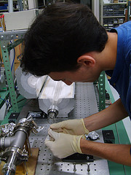
National Science Foundation Office of International Science and Engineering
NSF-wide criteria:
Intellectual Merits, Broad Impacts
Integration of research and education, broaden participation
Criteria for OISE funding:
True intellectual collaboration
New research opportunities
Benefit to US science community
Active engagement of students & junior researchers

Slide 5
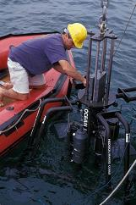
From Commitments to Funding Mechanisms for International Collaborations
Integral component of proposals submitted
to NSF disciplinary programs
Supplements to existing awards
Proposals to International Office
U.S. participants ONLY
Faculty
Postdoctoral Researchers
Students (undergraduate and graduate)
GVF
Notes:
Support for research that has an international dimension is provided across the Foundation – NOT just by OISE; Vast majority is funded outside OISE

Slide 6
Supporting International Activities at NSF
Research/Education Community
NSF/Disciplinary
Programs
NSF/OISE
Programs
Co-funding &
Supplements
$$$$$
$$

Slide 7
Obtaining NSF Funding is a very competitive process.
Notes:
The overall average proposal funding rate for all NSF proposals decreased from 31 percent in FY 2001 to 23 percent in FY 2005, while the number of proposals grew 32 percent in this same time period. From 2005 to 2008, the number of competitive proposals received averaged around 43,000 per year and the funding rate hovered around 25 percent as the graph indicates.
In FY 2009, NSF received slightly more proposals than previous years for a total of 45,228 proposals. At the same time, the additional Recovery Act funds enabled NSF to increase its funding rate to 32 percent in FY 2009, the highest since FY 2000. In FY 2010, proposals increased over FY 2009 by 22% to 55,528. 13,015 awards were made in 2010, resulting in a drop in funding rate to 23%.

Slide 8
OISE-Managed Funding Opportunities
by Career Stage
International Research Experiences for Students - IRES
East Asia Pacific Summer Institutes - EAPSI
International Research Fellowship Program - IRFP
Pan-American Advanced Studies Institutes - PASI
Catalyzing New International Collaborations - CNIC
Partnerships for International Research and Education – PIRE
Science Across Virtual Institutes - SAVI

Slide 9
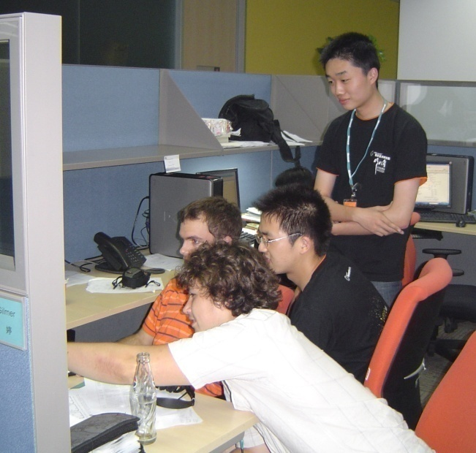
International Research Experiences for Students (IRES)
OISE-Managed Funding Opportunity
U.S. undergraduate & graduate students organized by U.S.-based faculty for an international research experience
Foreign mentorship required, consortia encouraged
Focused research experiences overseas (> 4 weeks, > 4 students)
$150,000 maximum ($50,000 per year for up to 3 years)
Deadline: summer 2012 (??)
Also NSF Research Experiences for Undergraduates (REU)
 | Proposals | Awards
FY 2008 | 151 | 38
FY 2009* | 132 | 59
FY 2010 | 158 | 32
Notes:
Currently 95 active IRES awards, totalling nearly $14 M

Slide 10
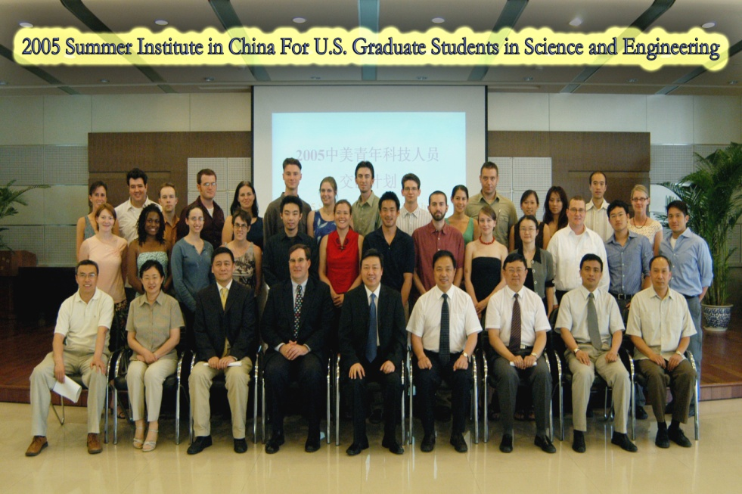
East Asia & Pacific Summer Institutes
U.S. graduate students initiate scientific relationships which enable future collaboration with foreign counterparts
Research experiences for 8-10 weeks at host laboratories in Australia, China (40), Japan, Korea, New Zealand, Singapore, or Taiwan
Students apply directly, deadline in fall
Support
$ 5,000 stipend
Support for attending a pre-departure orientation in Washington, D.C.
International round-trip airfare to host location
Living expenses abroad (by foreign partner organizations)
 | Proposals | Awards
FY 2008 | 526 | 191
FY 2009 | 319 | 190
FY 2010 | 544 | 221
Notes:
Currently nearly 300 active EAPSI awards

Slide 11
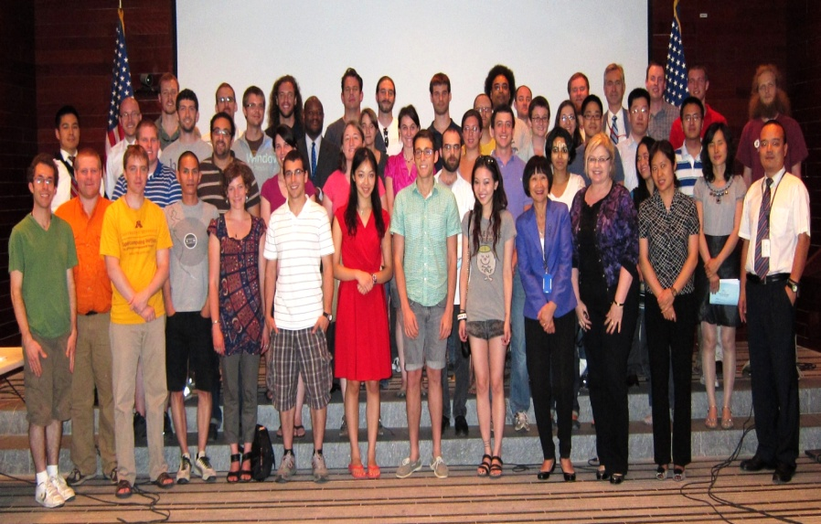
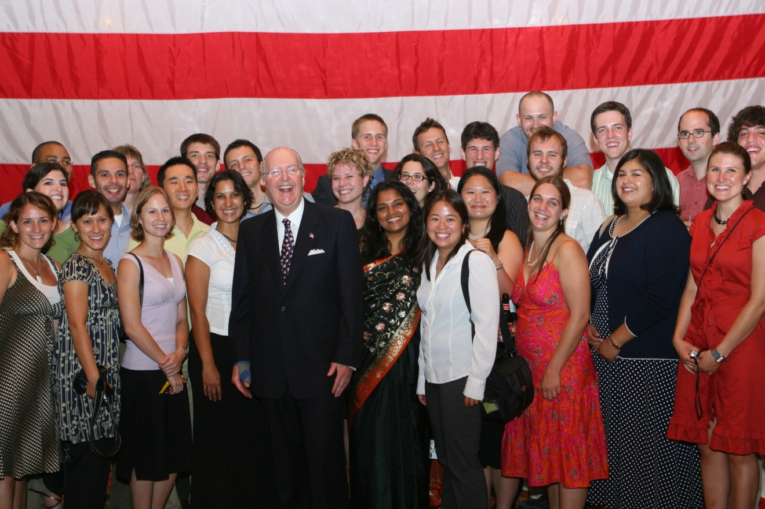
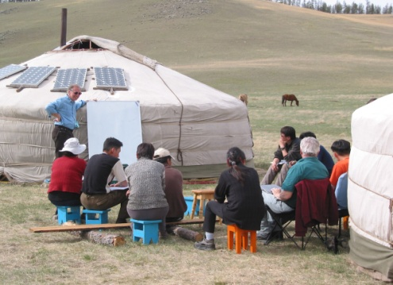
East Asia and Pacific Summer Institute for U. S. Graduate Students
Joint program with Ministry of Science and Technology
Each year, up to 40 graduate students will conduct research for two months in China

Slide 12
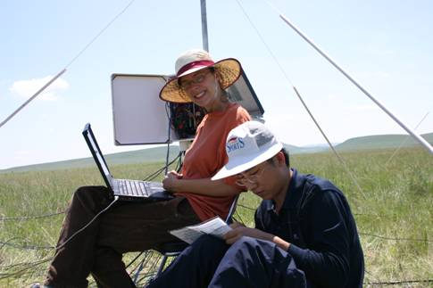
International Research Fellowship Program
Early post-docs (within two years of PhD.)
Post-doc is applicant and PI
Introduce scientists and engineers in the early stages of their careers to international collaborative research opportunities
Residence abroad for nine to 24 months
Up to $200,000
Dependent support for transportation, insurance and cost of living
 | Proposals | Awards
FY 2008 | 151 | 38
FY 2009* | 132 | 59
FY 2010 | 158 | 32
* Includes ARRA
Notes:
30 Awards in 2010

Slide 13
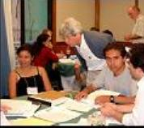
Advanced Studies Institutes
Advanced graduate, post-doctoral, and junior faculty level
PI organizes short courses on leading-edge research themes
Ten days to one month, involving lectures, demonstrations, research seminars, and discussions
25 to 40 students/participants from the U.S. and other countries
Jointly supported initiative between NSF and DOE
 | Proposals | Awards
FY 2008 | 11 | 6
FY 2009 | 23 | 17
FY 2010 | 24 | 10
Notes:
23 active PASIs
Incorporated Research Institutions of Seismology Consortium (IRIS)

Slide 14
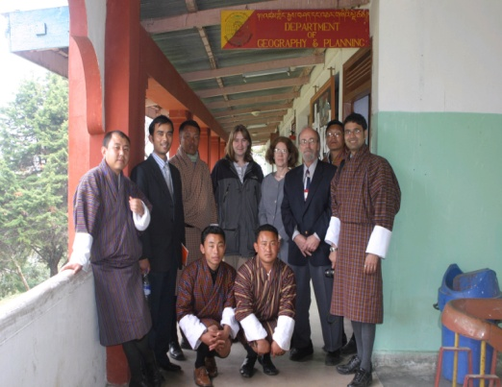
Planning Visits: Catalyzing New International Collaborations (CNIC)
Assess foreign expertise, facilities, equipment, data, experimental protocols, sites, etc.
Visits, Planning, preliminary data-gathering, Coordination Networking
Intended outcome: Research proposal to NSF Directorate
 | Visits |  | Wkps
FY | Props | Awds | Props | Awds
2008 | 84 | 46 | 101 | 41
2009 | 80 | 47 | 100 | 55
2010 | 61 | 32 | 104 | 45

Slide 15







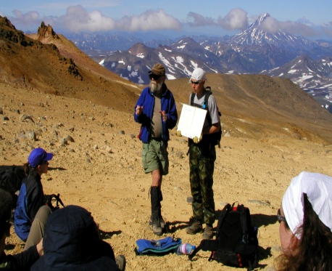
Partnerships for International
Research and Education
Bold, forward-looking research
Facilitate student preparation for and participation in international research collaborations
Contribute to the development of a diverse, globally-engaged U.S. science and engineering workforce
Strengthen the capacity of institutions, multi-institutional consortia, and networks to engage in and benefit from international research and education collaborations
47 PIRE awards have engaged collaborators in more than 70 countries
Awards typically have a five-year duration with an average total budget of $2.8M
 | Proposals | Awards
PIRE-1 (2005) | 181* | 12
PIRE-2 (2007) | 69 | 20
PIRE -3 (2010) | 84 | 15
* No PIRE pre-proposals in 2005
Notes:
PIRE: FY 2009-2010, institutional eligibility was broadened to allow a more diverse set of institutions to apply. As a result, 521 preliminary proposals were reviewed, 83 full proposals were subsequently invited, and OISE funded 15 awards (18% success rate). All awards were co-funded by NSF directorates or offices for a total of approximately $55M. Each NSF grant-making directorate and offices co-funded at least one award.

Slide 16
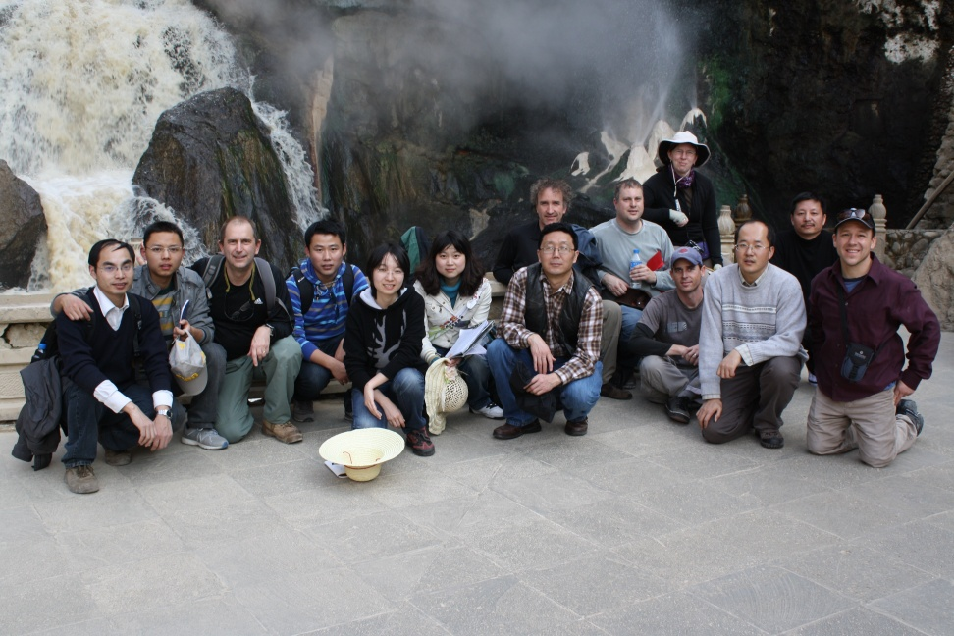
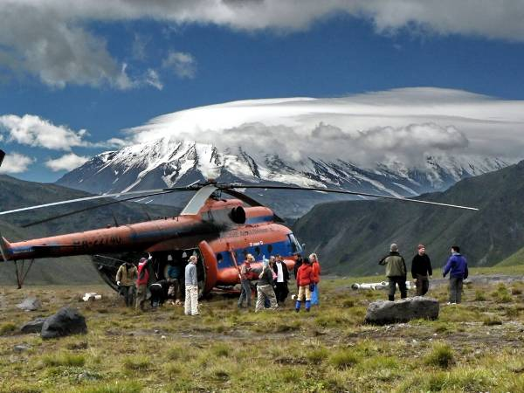
Partnerships for International Research and Education (PIRE)
Of the 46 awards, 10 involved China
UCSB: electron chemistry and catalysis ($2.5M+$4M)
Michigan: training in social context, population, and environmental change ($2.5M)
Nevada: hot spring ecosystems ($3.8M)
Missouri: earthquake ($2.2M)
Northwestern: intelligent structural health management ($2.5M)
Georgia: invasive species ($2.5M)
FIU: cyber infrastructure ($2.3M)
Columbia: superconductivity ($2M)
Illinois at Chicago: data cloud ($3.5M)
Penn State: bilingualism, mind, and brain ($2.8M)
Notes:
PIRE: FY 2009-2010, institutional eligibility was broadened to allow a more diverse set of institutions to apply. As a result, 521 preliminary proposals were reviewed, 83 full proposals were subsequently invited, and OISE funded 15 awards (18% success rate). All awards were co-funded by NSF directorates or offices for a total of approximately $55M. Each NSF grant-making directorate and offices co-funded at least one award.

Slide 17
Science Across Virtual Institutes: SAVI
“Glue” bringing together US researchers and their foreign counterparts
Enabling maximum leveraging of human and infrastructure resources
Fundable activities include
Collaborative research
Joint workshops
Student exchanges
Long-term research visits by postdocs and junior faculty
HOW?
Proposals submitted to disciplinary program officers
Co-funded and endorsed by Division, Directorate, and OISE
(OISE will fund 1/3; up to $150K)
More information at http://www.nsf.gov/savi

Slide 18

Keys to Success: A good partnership requires courtship, patience, and trust
Address how the collaboration will enhance the research
Value added
Mutual benefits
Include bio and letter of commitment from collaborators
Involve U.S. students, junior researchers
Prepare, mentor, and assess them
Pay them: travel, living costs, stipends
Meaningful attention to diversity
Know and observe special rules
Visa regulations
Imports and exports
Work with others in your institution
Consult NSF and OISE early
Program Manager
Country Contact

Slide 19
Contact Information
James Wang, Ph.D
jzwang@nsf.gov
Nancy Sung, Ph.D.
nsung@nsf.gov
Office of International Science and Engineering
U. S. National Science Foundation

Slide 20


Thank You!
谢谢！

