Slide 1
China-US Software Workshop
March 6, 2012
Scott Klasky
Data Science Group Leader
Computer Science and Mathematics Research Division
ORNL

Slide 2
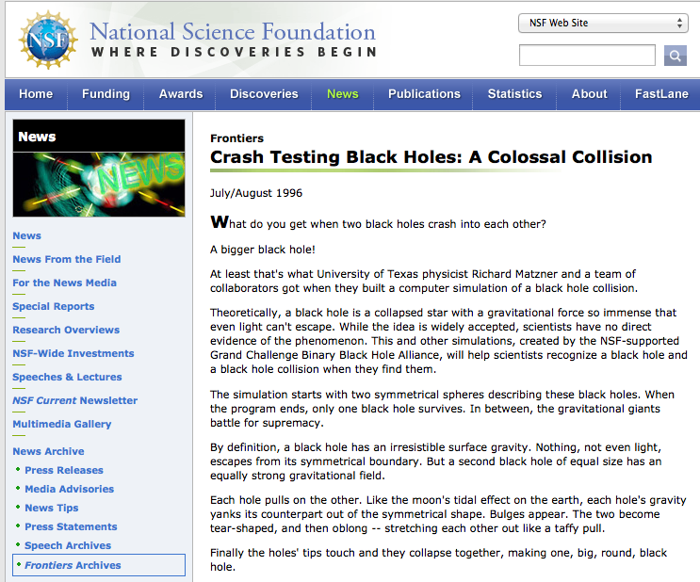
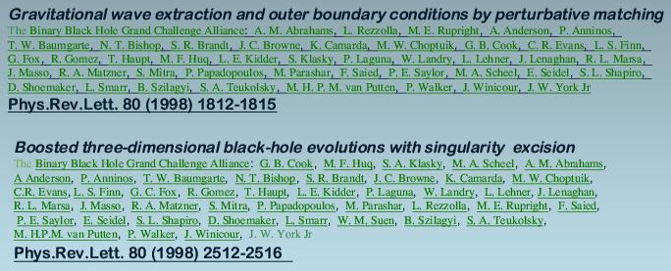
Remembering my past
Sorry, but I was a relativist a long long time ago.
NSF funded the Binary Black Hole Grand Challenge 1993 – 1998
8 Universities: Texas, UIUC, UNC, Penn State, Cornell, NWU, Syracuse, U. Pittsburgh

Slide 3
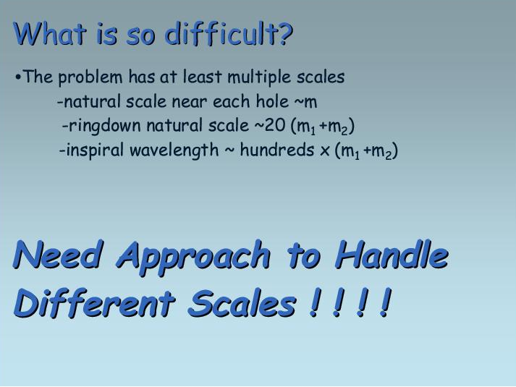
The past, but with the same issues
R. Matzner, http://www2.pv.infn.it/~spacetimeinaction/speakers/view_transp.php?speaker=Matzner

Slide 4
Some of my active projects
DOE ASCR: Runtime Staging: ORNL, Georgia Tech, NCSU, LBNL
DOE ASCR: Combustion Co-Design: Exact: LBNL, LLNL, LANL, NREL, ORNL, SNL, Georgia Tech, Rutgers, Stanford, U. Texas, U. Utah
DOE ASCR: SDAV: LBNL, ANL, LANL, ORNL, UC Davis, U. Utah, Northwestern, Kitware, SNL, Rutgers, Georgia Tech, OSU
DOE/ASCR/FES: Partnership for Edge Physics Simulation (EPSI): PPPL, ORNL, Brown, U. Col, MIT, UCSD, Rutgers, U. Texas, Lehigh, Caltech, LBNL, RPI, NCSU
DOE/FES: SciDAC Center for Nonlinear Simulation of Energetic Particles in Burning Plasmas: PPPL, U. Texas, U. Col., ORNL
DOE/FES: SciDAC GSEP: U. Irvine, ORNL, General Atomics, LLNL
DOE/OLCF: ORNL
NSF: Remote Data and Visualization: UTK, LBNL, U.W, NCSA
NSF Eager: An Application Driven I/O Optimization Approach for PetaScale Systems and Scientific Discoveries: UTK
NSF G8: G8 Exascale Software Applications: Fusion Energy , PPPL, U. Edinburgh, CEA (France), Juelich, Garching, Tsukuba, Keldish (Russia)
NASA/ROSES: An Elastic Parallel I/O Framework for Computational Climate Modeling : Auburn, NASA, ORNL

Slide 5
Scientific Data Group at ORNL
Name | Expertise
Line Pouchard | Web Semantics
Norbert Podhorszki | Workflow automation
Hasan Abbasi | Runtime Staging
Qing Liu | I/O frameworks
Jeremy Logan | I/O optimization
George Ostrouchov | Statistician
Dave Pugmire | Scientific Visualization
Matthew Wolf | Data Intensive computing
Nagiza Samatova | Data Analytics
Raju Vatsavai | Spatial Temporal Data Mining
Jong Choi | Data Intensive computing
Wei-chen Chen | Data Analytics
Xiaosong Ma | I/O
Tahsin Kurc | Middleware for I/O & imaging
Yuan Tian | I/O read optimizations
Roselyne Tchoua | Portals
TBD | Software Engineer

Slide 6
Top reasons of why I love collaboration
I love spending my time working with a diverse set of scientist
I like working on complex problems
I like exchanging ideas to grow
I want to work on large/complex problems that require many researchers to work together to solve these
Building sustainable software is tough, I want to

Slide 7
ADIOS
Goal was to create a framework for I/O processing that would
Enable us to deal with system/application complexity
Rapidly changing requirements
Evolving target platforms, and diverse teams

Slide 8
ADIOS involves collaboration
Idea was to allow different groups to create different I/O methods that could ‘plug’ into our framework
Groups which created ADIOS methods include: ORNL, Georgia Tech, Sandia, Rutgers, NCSU, Auburn
Islands of performance for different machines dictate that there is never one ‘best’ solution for all codes
New applications (such as Grapes and GEOS-5) allow new methods to evolve
Sometimes just for their code for one platform, and other times ideas can be shared

Slide 9
ADIOS collaboration

Slide 10
What do I want to make collaboration easy
I don’t care about clouds, grids, HPC, exascale, but I do care about getting science done efficiently
Need to make it easy to
Share data
Share codes
Give credit without knowing who did what to advance my science
Use other codes and tools and technologies to develop more advanced codes
Must be easier than RTFM
System needs to decide what to be moved, how to move it, where is the information
I want to build our research/development from others

Slide 11
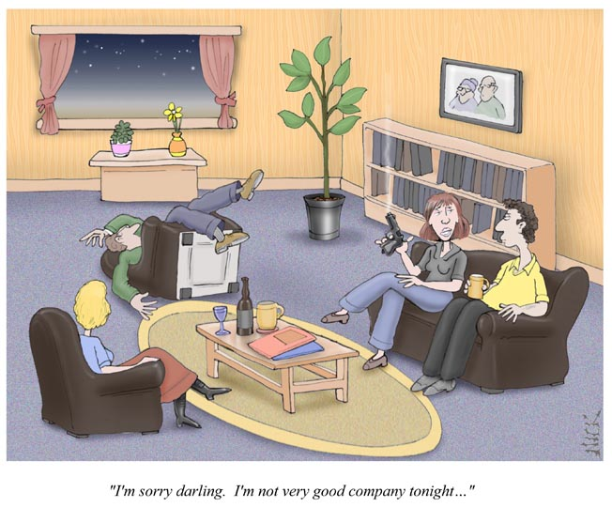
Need to deal with collaborations gone bad
bobheske.wordpress.com
I have had several incidents where “collaborators” become competitors
Worry about IP being taken and not referenced
Worry about data being used in the wrong context
Without record of where the idea/data came from it makes people afraid to collaborate

Slide 12
Why now?
Science has gotten very complex
Science teams are getting more complex
Experiments have gotten complex
More diagnostics, larger teams, more complexities
Computing hardware has gotten complex
People often want to collaborate but find the technologies too limited, and fear the unknown

Slide 13
What is GRAPES
GRAPES: Global/Regional Assimilation and PrEdiction System developed by CMA
Global 6h forecast field
Background field
Global 6h
forecast field
Grads
Output
Initialization
GRAPES Global model
Analysis field
GRAPES input
Filter
Modelvar
postvar
GTS data
3D-VAR DATA ASSIMILATION
QC
ATOVS资料
QC
Static
Data
Database
预处理
Regional model
6h cycle, only 2h for 10day global prediction

Slide 14
Development plan of GRAPES in CMA
After 2011, Only use GRAPES model
GFS
Pre-operation
GRAPES GFS 25km
GRAPES GFS 50km
Pre-operation
Operation
T639L60-3DVAR+Model
System upgrade
T639L60-3DVAR+Model
Operation
higher resolution is a key point of future GRAPES
AIRS selected channel
Operation
FY3-ATOVS, FY2-Track wind
QuikSCAT
Operation
Grapes-global-3DVAR 50km,
GPS/COSMIC
Operation
GDAS
EUmetCAST-ATOVS
Operation
Operation
Global-3DVAR NESDIS-ATOVS, More channel
2006
2007
2008
2009
2010
2011

Slide 15
Why IO?
Grapes_input and colm_init are Input func.
Med_last_solve_io/med_before_solve_io are output func.
IO dominates the time of GRAPES when > 2048p
25km H-resolution Case Over Tianhe-1A

Slide 16
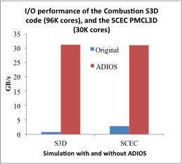
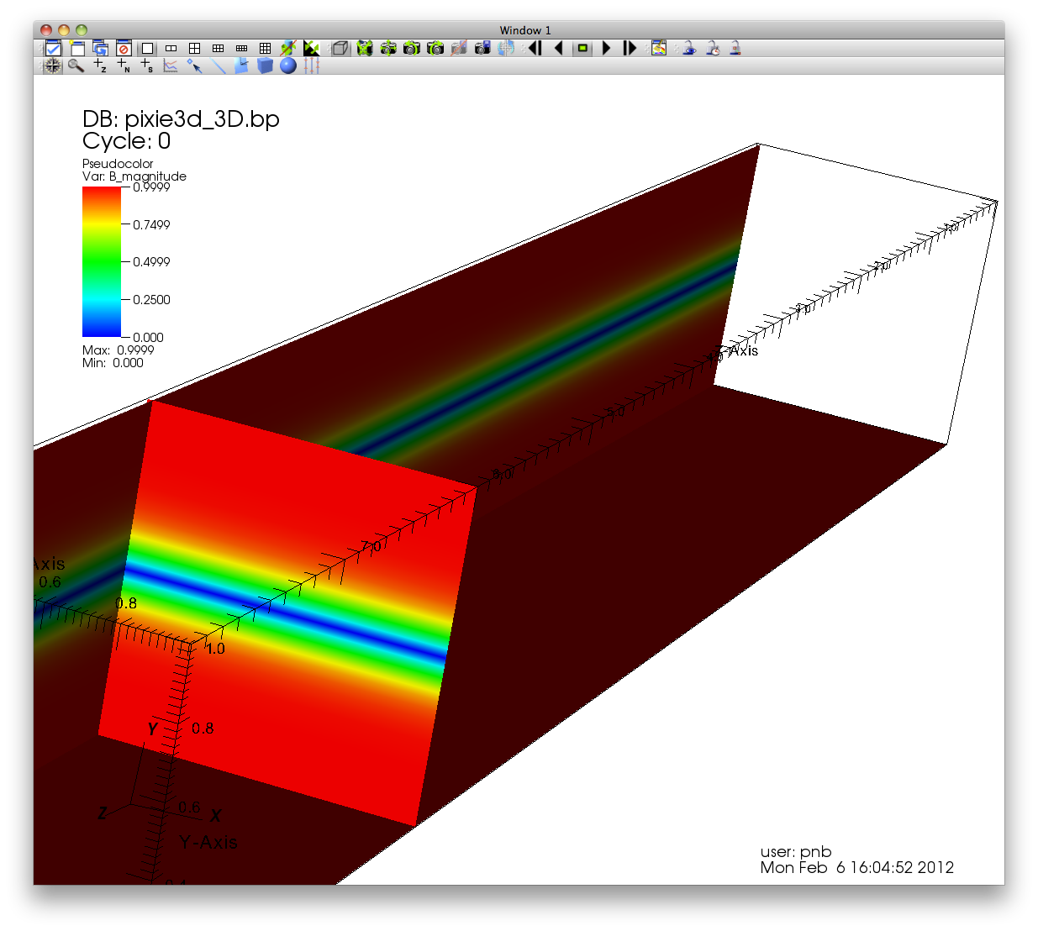
Typical I/O performance when using ADIOS
High Writing Performance (Most codes achieve > 10X speedup over other I/O libraries)
S3D→ 32 GB/s with 96K cores, 0.6% I/O overhead
XGC1 code → 40 GB/s, SCEC code → 30 GB/s
GTC code → 40 GB/s, GTS code → 35 GB/s
Chimera → 12X performance increase
Ramgen → 50X performance increase

Slide 17
Details: I/O performance engineering of the Global Regional Assimilation and Prediction System (GRAPES) code on supercomputers using the ADIOS framework
GRAPES is increasing the resolution, and I/O performance must be reduced
GRAPES will begin to need to abstract I/O away from a file format, and more into I/O services.
One I/O service will be writing GRIB2 files
Another I/O service will be compression methods
Another I/O service will be inclusion of analytics and visualization

Slide 18
Benefits to the ADIOS community
More users = more sustainability
More users = more developers
Easy for us to create I/O skeletons for next generation system designers

Slide 19
Skel
grapes.xml
skel params
Skel is a versatile tool for creating and managing I/O skeletal applications
Skel generates source code, makefile, and submission scripts
The process is the same for all “ADIOSed” applications
Measurements are consistent and output is presented in a standard way
One tool allows us to benchmark I/O for many applications
skel xml
grapes_params.xml
grapes_skel.xml
skel src
skel makefile
skel submit
Source files
Makefile
Submit scripts
make
make deploy
skel_grapes
Executables

Slide 20
What are the key requirements for your collaboration - e.g., travel, student/research/developer exchange, workshop/tutorials, etc.
Student exchange
Tsinghua University sends student to UTK/ORNL (3 months/year)
Rutgers University sends student to Tsinghua University (3 months/year)
Senior research exchange
UTK/ORNL + Rutgers + NCSU send senior researchers to Tsinghua University (1+ week * 2 times/year)
Our group prepares tutorials for Chinese community
Full day tutorials for each visit
Each visit needs to allow our researchers access to the HPC systems so we can optimize
Computer time for teams for all machines
Need to optimize routines together, and it is much easier when we have access to machines
2 phone calls/month

Slide 21
Leveraging other funding sources
NSF: EAGER proposal, RDAV proposal
Work with Climate codes, sub surfacing modeling, relativity, …
NASA: ROSES proposal
Work with GEOS-5 climate code
DOE/ASCR
Research new techniques for I/O staging, co-design hybrid-staging, I/O support for SciDAC/INCITE codes
DOE/FES
Support I/O pipelines, and multi-scale, multi-physics code coupling for fusion codes
DOE/OLCF
Support I/O and analytics on the OLCF for simulations which run at scale

Slide 22
What specific mechanisms need to be set up?
Need

Slide 23
What the metrics of success?
Grapes I/O overhead is dramatically reduced
Win for both teams
ADIOS has new mechanism to output GRIB2 format
Allows ADIOS to start talking to more teams doing weather modeling
Research is performed which allow us to understand new RDMA networks
New understanding of how to optimize data movement on exotic architecture
New methods in ADIOS that minimize I/O in Grapes, and can help new codes
New studies from Skel give hardware designers parameters to allow them to design file systems for next generation machines, based on Grapes, and many other codes
Mechanisms to share open source software that can lead to new ways to share code amongst a even larger diverse set of researchers

Slide 24
I/O performance engineering of the Global Regional Assimilation and Prediction System (GRAPES) code on supercomputers using the ADIOS framework
Objectives and significance of the research
Need for and impact of China-US collaboration
Improve I/O to meet the time-critical requirement for operation of GRAPES
Improve ADIOS on new types of parallel simulation and platforms (such as Tianhe-1A)
Extend ADIOS to support the GRIB2 format
Feed back the results to ADIOS and help researchers in many communities
Connect I/O software from the US with parallel application and platforms in China
Service extensions, performance optimization techniques, and evaluation results will be shared
Faculty and student members of the project will gain international collaboration experience
Approach and mechanisms; support required
Team & Roles
Dr. Zhiyan Jin, CMA, Design GRAPES I/O infrastructure
Dr. Scott Klasky, ORNL, Directing ADIOS, with Drs. Podhorszki, Abbasi, Qiu, Logan
Dr. Xiaosong Ma, NCSU/ORNL, I/O and staging methods, to exploit in-transit processing to GRAPES
Dr. Manish Parashar, RU, Optimize the ADIOS Dataspace method for GRAPES
Dr. Wei Xue, TSU, Developing the new I/O stack of GRAPES using ADIOS, and tuning the implementation for Chinese supercomputers
Monthly teleconference
Student exchange
Meetings at Tsinghua University with two of the ADIOS developers
Meeting during mutual attended conferences (SC, IPDPS)
Joint publications

