Slide 1



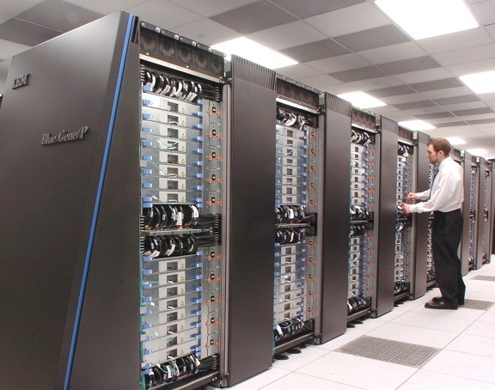

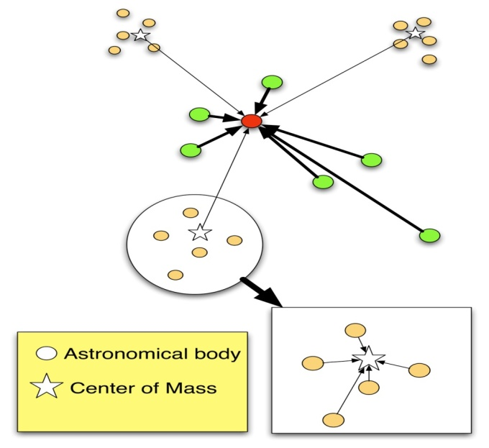

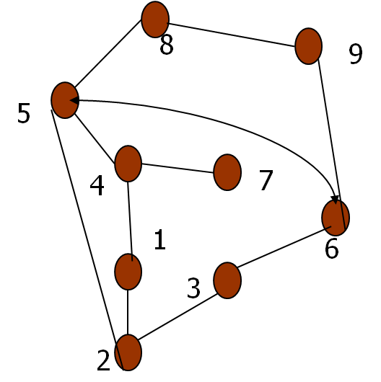
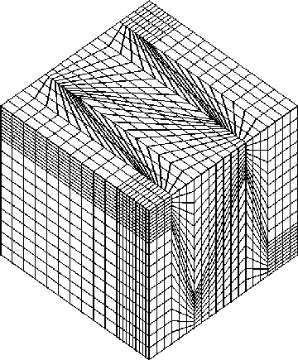
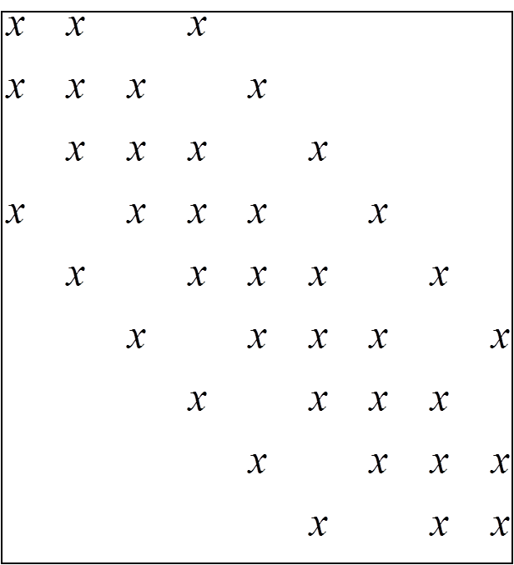
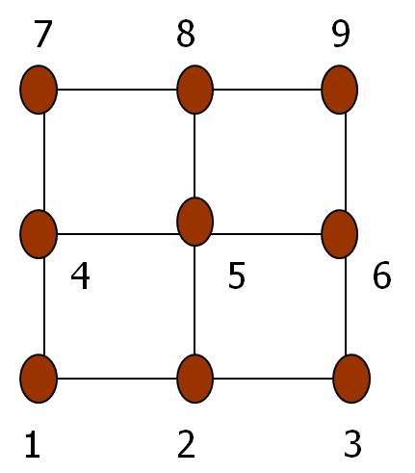
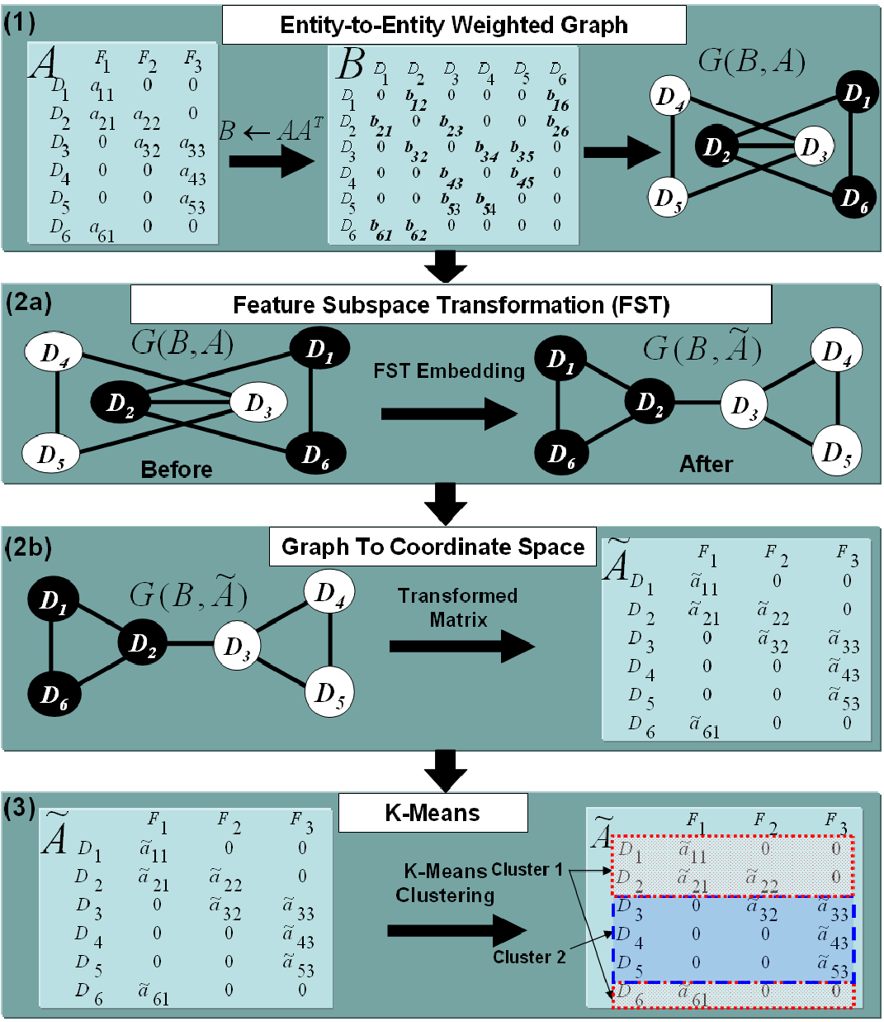
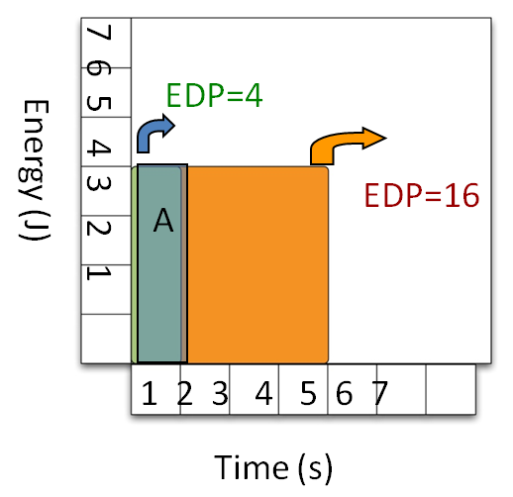
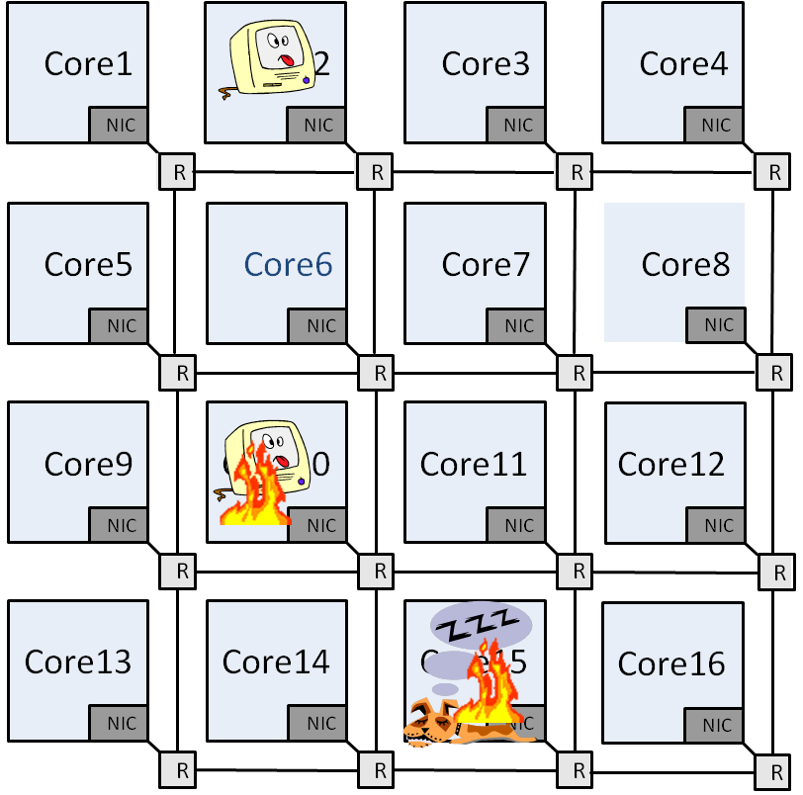
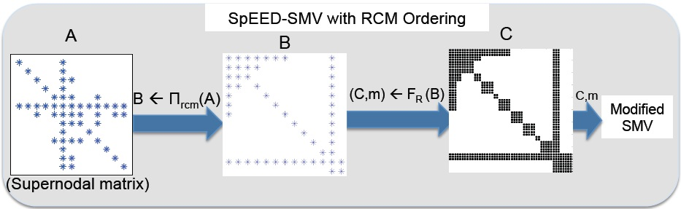
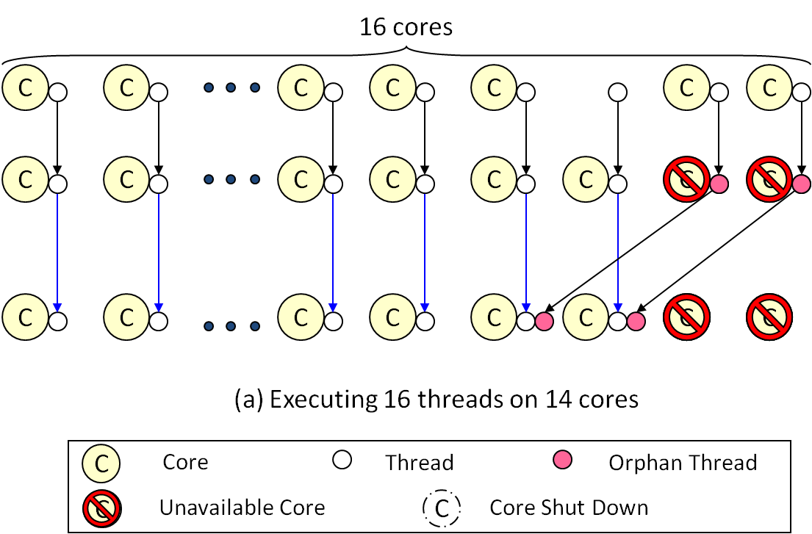
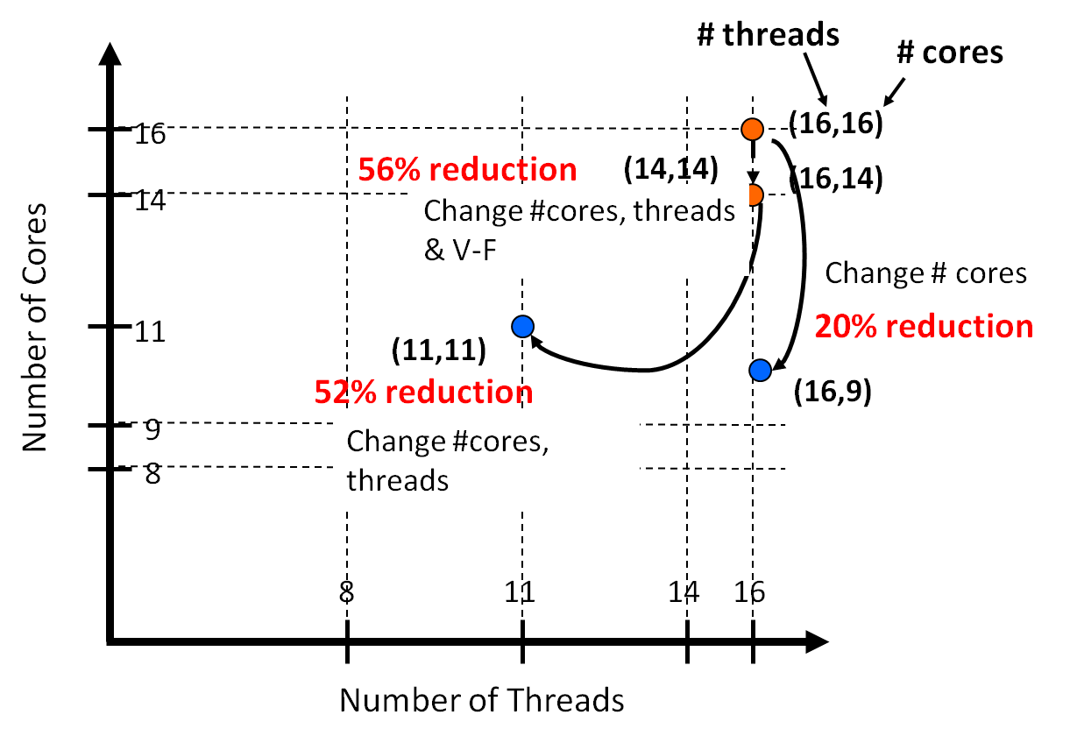
Sparse Computations: Better, Faster, Cheaper!
Padma Raghavan
Department of Computer Science and Engineering, The Pennsylvania State University
padma@psu.edu
User
Challenges in Processing
High Dimensional Sparse Data
Developer
Will my application speed-up, compute high quality solutions?
Can I make sparse codes better, faster, cheaper?
WHERE DOES SPARSITY COME FROM?
One sparse dataset: 3 forms
Matrix ⬄ Graph ⬄ Mesh
Algebraic Combinatorial Geometry
WHAT IS SPARSITY?
Consider N interacting variables
NxN pair-wise interactions
Dense: elements, NxN matrix/array
Sparse: c N elements, c is a small number
Discretization
SPARSITY PROPERTIES
Compact representation
Memory and computational cost scaling
O(N) per sweep through data
Data mining
Approximations
Graph
Matrix
Mesh
Issue: Can we transform data for BETTER classification?
Focus: Quality of classification
Method: Feature subspace transformation (FST) by force-directed graph embedding. Apply K-Means on transformed data (FST K-Means)
Issue: Can we make sparse matrix vector multiplication (SMV) FASTER on multicores?
Focus: Performance
Method: Identify and use smaller dense sub-matrices ‘hidden’ in the sparse matrix -- Sparsity-exploiting effectively dense (SpEED-SMV )
Issue: Can we schedule for energy efficiency (CHEAPER)?
Focus: Reduce energy delay product (EDP)
Method: Dynamic scheduling with helper threads that learn application profile to select number of cores, threads and voltage/frequency levels
Obtaining a supernodal ordered matrix
EnergyDelayProduct [EDP] (Energy X Time) is lower
for faster system A
B
Ordering supernodal matrix using RCM ordering scheme
Run away leakage on idle cores
Thermal emergencies
Transient errors
Decreasing memory loads by reducing index overheads
Helper thread’s recipe
Collect performance/energy statistics as the execution progresses
Calculate EDP values
Use data fitting with available data and interpolate to predict configuration
Classification Accuracy (P)
Number of correctly classified documents
Total number of documents
FST-K-Means improves the classification accuracy of 5 out of 8 datasets.
Cluster Cohesiveness (J)
Performance comparison: SpEED-SMV vs. RxC-SMV
jth document of cluster M_{i}
Centroid of cluster M_{k}
Best EDP adaptivity?
Monitor- Model- Adapt
FST-K-Means improves the cluster cohesiveness for K-Means and is competitive with GraClus on the benchmark datasets.
SpEED-SMV improves the performance of SMV by as much as 59.35% and 50.32%, and on average, 37.35% and 6.07%, compared to traditional compressed sparse row and blocked compressed sparse row schemes
Achieve up to 66:3% and 83:3% savings in EDP when adjusting all the parameters properly in applications FFT and MG, respectively
Anirban Chatterjee, Sanjukta Bhowmick, Padma Raghavan: Feature subspace transformations for enhancing k-means clustering. CIKM 2010: 1801-1804
Manu Shantharam, Anirban Chatterjee, Padma Raghavan: Exploiting dense substructures for fast sparse matrix vector multiplication. IJHPCA 25(3): 328-341 (2011)
Yang Ding, Mahmut T. Kandemir, Padma Raghavan, Mary Jane Irwin: A helper thread based EDP reduction scheme for adapting application execution in CMPs. IPDPS 2008: 1-14
Software for sparse computations can deliver high quality solutions that are scalable and energy efficient by exploiting latent structure in the data and adapting to match hardware attributes
This research was funded in part by the NSF Grants CSR-SMA 0720769, CCF 0830679 and OCI 0821527

