Slide 1

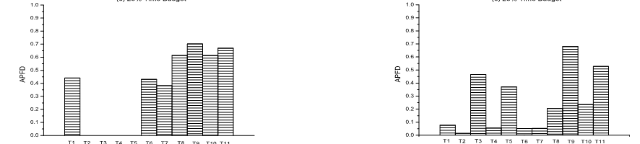
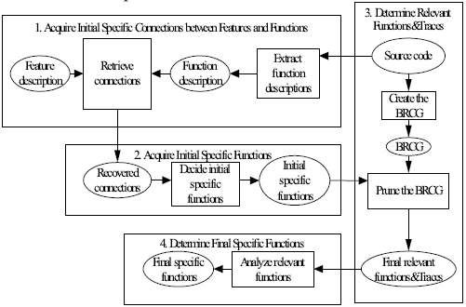
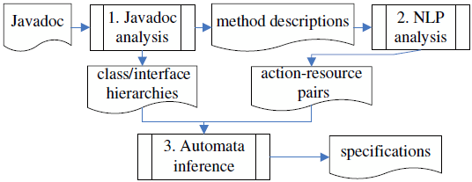


Research on techniques for evolutionary software development
Lu Zhang (zhanglu@sei.pku.edu.cn)
Professor in School of Computer Science and Electronics Engineering, Peking University, China.
Problem 1：Incremental Code Modification
Problem 2：Test Reuse and Optimization
Able to adjust regression test execution in respect to time constraints
Using integer linear programming
Empirically much more effective than previous approaches to time-aware test-case prioritization
Developers
Source
Code
Testers
Problem 4：Facilitating the Use of Bug Repositories
Problem3： Facilitating the Use of Software Libraries
Bug
Repositories
Software
Libraries
Inferring implicit resource specifications from documentation
Based on NER and class-hierarchy analysis
Able to detect real faults in various open-source systems
ACM SIGSOFT Distinguished Paper Award
First automatic approach to static feature location
First application of information retrieval to feature location
Competitive to dynamic approach to feature location
ACM SIGSOFT Distinguished Paper Award
Natural Language
Similarity
Combining natural language info and execution info
20-30% more accurate than previous approaches
New
Report
Conclusion
We have investigated a series of facilitating techniques for evolutionary software development. According to our empirical results, our techniques may provide substantial help for software developers. We have published our research in top venues in software engineering, such as TOSEM, ICSE, FSE, ISSTA, ECOOP, and ASE.
Existing
Reports
Execution
Similarity
The research is carried out in the Key Laboratory of High Confidence Software Technologies (Peking University), Ministry of Education
Notes:
3 feet by 3.5 feet

