Slide 1
Virtualization Framework for Data Service on GLEON and CREON
Fang-Pang Lin
NCHC
PRAGMA 20 @ HK, March 2011

Slide 2
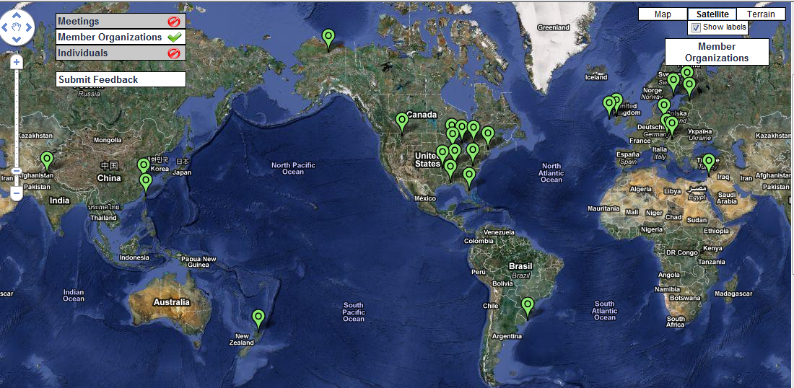
GLEON: revolutionizing understanding of aquatic ecosystems through an international grassroots network of people, data, and lake observatories
28 Site Members (sites shown)
208 Individual Members (5Sep10)

Slide 3

Requirements revisit
Connecting Sciences based on ecosystems of lakes & coral reefs:
  Providing sociological and economic impacts in conservation, planning, decision making, risk management, climate change …etc.
Reference Models
  GLEON:
    based on mass conservation in dynamics of DOC (Dissolved Organic Carbon) of lake system.
  CREON: yet to be listed.
    NCHC currently uses Knowledge4Fish as a driver.

Slide 4
Wish list from GLEON
Scale up Current GLEON data in a geographical distribution.
Add Meteorological data
Add coordinates or Geometry data
  2D and/or 3D depending on availability for sites of interest
Land use:
  land coverage, grass land, forests, soil types (mostly of remote sensing data) to be expected to connect to social economical variables.
Hydrological information:
  watersheds (boundary definitions), rivers, underground waters … etc.

Slide 5
Services provided in GLEON Central
  Compute Service:
    CONDOR service: (virtualized in PRAGMA by phil et al.)
      A front-end GUI allowing users to enter and to upload input data, and a clear separation of the backend CONDOR production system. Also provide a Web-based Viz system for 2D graphics for results.
  Data Service:
    GLEON data set: web-UI based on a set of tools from Luke and CFL colleagues.
    Lake-base: http://lakes.gleon.org/ (Paul Hanson et al.)
      It provides internet scale synthesized data, harvested from internet and also outstandingly from national agency open data such as USGS.
    2D Satellite Image service from AIST Geogrid (Sekiguchi, Tanaka, Ryosuke, Sarawut et al)
      - Introduced but not used (training ?!)

Slide 6
IT Challenges for GLEON
Availability:
  Real-time streaming and automation issues are not crucial momentarily, hence weaken the needs for scaling up the physical data network for GLEON sites. Yet we conjecture this will be the driver for new science.
Performance:
  Current DB is not big. If the wish list realized, we may expect big data.
  Use file-based service in a Cloud fashion. It can handle simulation and observational data all together with performance. Needs both internal data policy and standards.
GIS extension:
  OGC standards are well supported in governmental agencies and used extensively in data exchange between major proprietary and public GIS systems. But OGC needs expert to work on!

Slide 7
Virtualization Framework:
4 Layers of Abstraction
Observational System
Data Center
System Automation
Knowledge Sharing

Slide 8
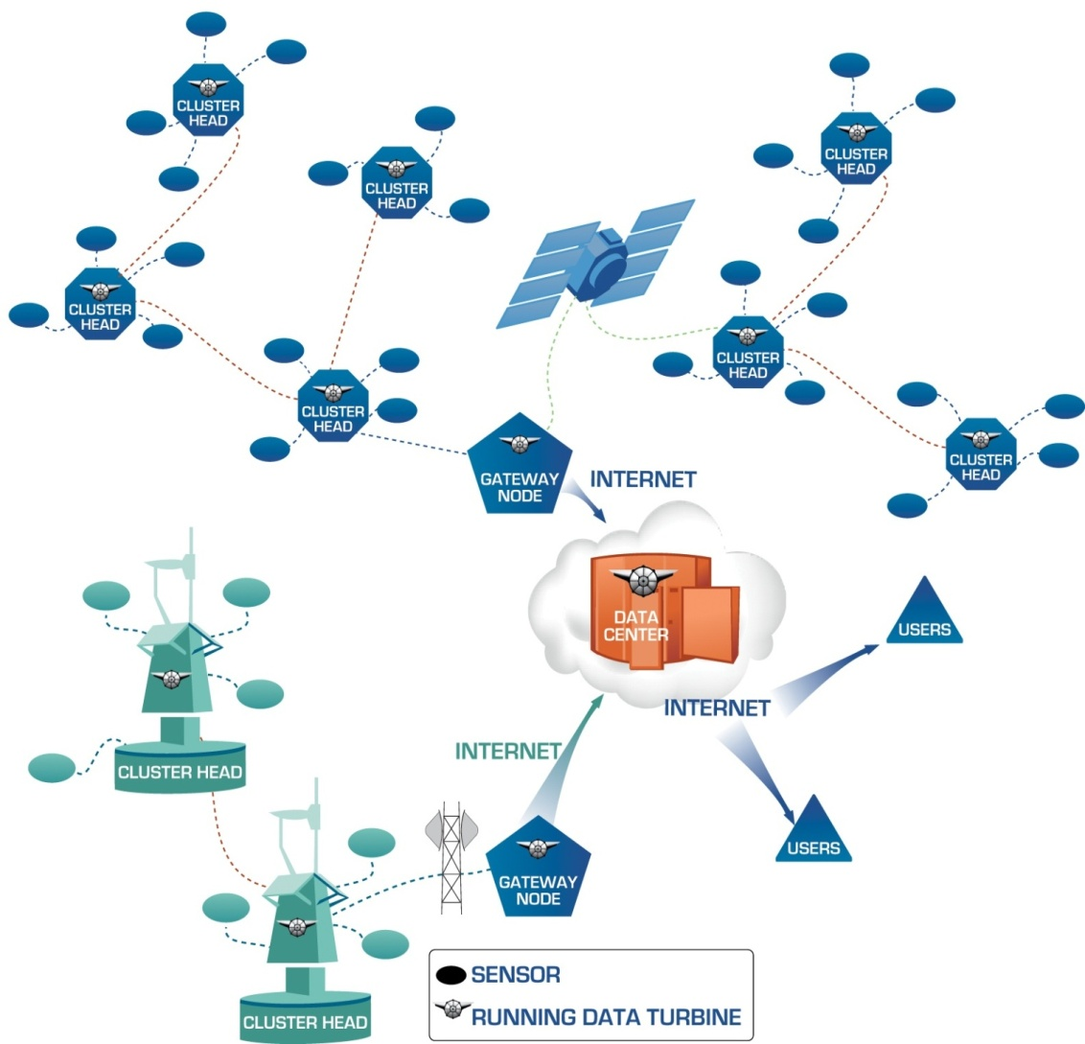
Layer 1: Generic Observing System Architecture
Move intelligence closer to the local
Focus: Move computation into the field with Embedded Cyberinfrastructure
Sensors
Cluster Head: aggregation point for sensors. Last IP-addressable point in network
Gateway Node: entry point to the Internet
A generic architecture facilitates scalability, robustness, reproducibility, and efficiency.
Source: Sameer Tilak

Slide 9
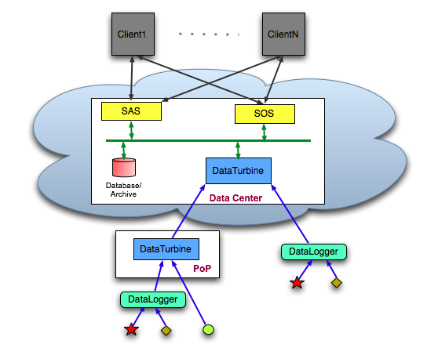
Layer 2: Data Center Architecture based on OGC standards
Hide the complexity of resources provisioning
Source: Sameer Tilak

Slide 10
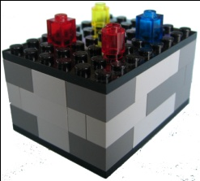


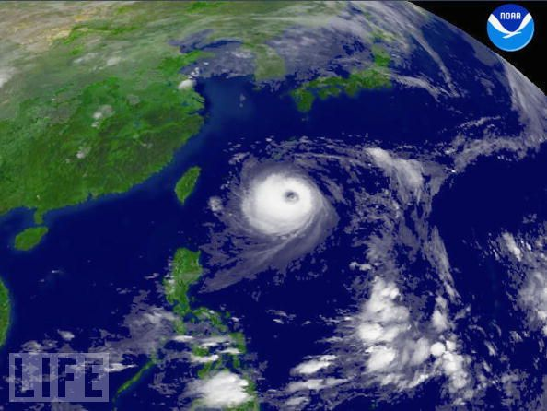
Layer 3: Simple but Broad Automation
Enable understanding between components
Meta-data
Argument/analysis
Data
Ontologies
Models
Source: Dave Robertson
Acquisition
protocols
Analysis
protocols
Sensors
Human reporters

Slide 11

Layer 4: Sharing Experiment Protocols
(www.openk.org)
OpenKnowledge
kernel supplier
Share knowledge for connecting sciences
request protocol
request plugin
Source: Dave Robertson

Slide 12
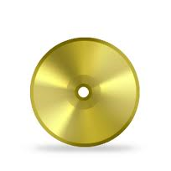
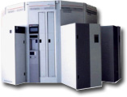

GLEON Service Model Revisit
GLEON Domain
GLEON data policy
GLEON Control vocabulary
GLEON Central
Data Center
(e.g. PRAGMA-CONDOR)
Site C
vega
Site B
vega
vega
Site A
Direct collaboration

Slide 13
3 Types of Service Models
Typical Web Service
Big Data Service
Streaming Data Service

Slide 14
Typical Web Service
Data center
db
Application
server
Query
Application
server
HTTP
server
External
client
Application
server
Application
server
db
Result
Characteristics:
Small queries and results
Little client computation
Moderate server computation
Moderate data accessed per query
Examples:
Web sites serving dynamic content
Source: David O’Hallaron

Slide 15
Big Data Service
Data-intensive computing system (e.g. Hadoop)
External
client
External
data
sources
Parallel
compute server
Query
Parallel
data server
Parallel
query server
Result
d₁
d₂
d₃
Parallel
file system
(e.g., GFS,
HDFS)
Source
dataset
Derived
datasets
Characteristics:
Small queries and results
Massive data and computation performed on server
Examples:
Search
Photo scene completion
Log processing
Science analytics
Source: David O’Hallaron

Slide 16
Streaming Data Service
Continuous
query stream
External
client and
sensors
External
data
sources
Parallel
compute server
Parallel
data server
Parallel
query server
Continuous
query results
d₁
d₂
d₃
Source
dataset
Derived
datasets
Characteristics:
Application lives on client
Client uses cloud as an accelerator
Data transferred with query
Variable, latency sensitive HPC on server
Often combines with Big Data service
Examples:
Perceptual computing on high data-rate sensors: real time brain activity detection, object recognition, gesture recognition
Source: David O’Hallaron

Slide 17
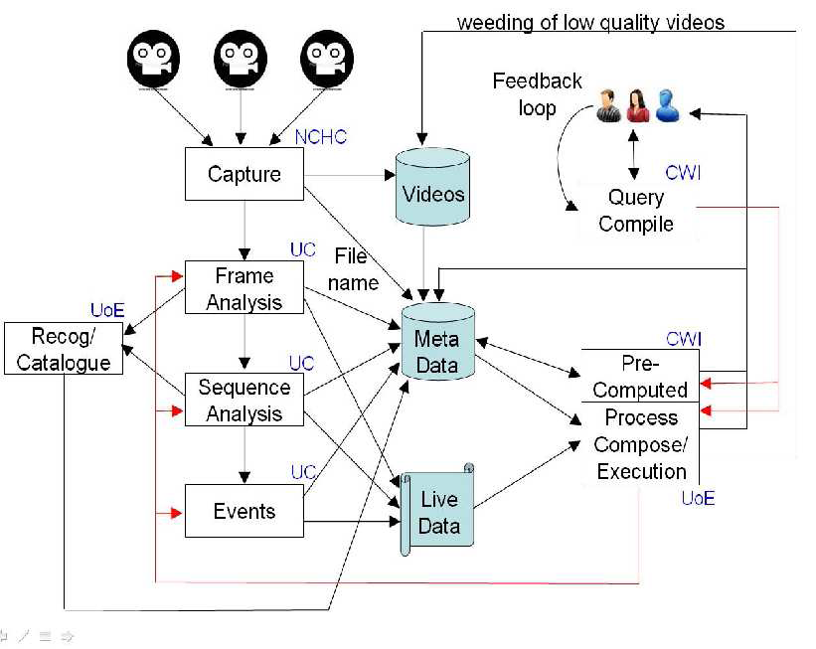
Exmaple for CREON:
Fish4Knowledge Architecture
4.2 GB & 5000 image files per minute
Source: Bob Fisher

Slide 18
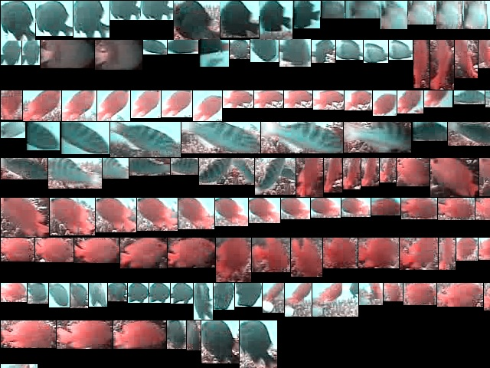
Source: Fish4Knowledge – EU FP-7 project

Slide 19
Live streaming:
MonitorGrid Architecture
Stream Receiver
Image Processor
Image Managing
& Browsing
Retrieve and divide
the stream into each
frame sliders in it’s
owned round-robin
queue.
Perform the motion
detection / stream
encoding in real-time.
InI – Internet
Navigation Interface.
/ Management interface.
Capture
Devices
Display
Devices
NFS
NFS
(DV, HDV, CCTV, Web CAM, IP CAM, Capture card, and etc.)
(LCD, HDTV, Mobile
screen, TDW, and etc.)

Slide 20
Stream Receiver
Stream Receiver
Image Processor
Image Managing
& Browsing
Round-robin Queue
Capture
Devices
Display
Devices
NFS
NFS
(DV, HDV, CCTV, Web CAM, IP CAM, Capture card, and etc.)
(LCD, HDTV, Mobile
screen, TDW, and etc.)

Slide 21
Image Processor
Stream Receiver
Image Processor
Image Managing
& Browsing
Codec
MJPEG
MPEG1/2/4
SWF/FLV
WMV
Capture
Devices
Display
Devices
Motion Detection
Image Segmentation
Object Tracking
Image Retrieval
NFS
NFS
(DV, HDV, CCTV, Web CAM, IP CAM, Capture card, and etc.)
(LCD, HDTV, Mobile
screen, TDW, and etc.)

Slide 22
Image Management and Browsing
Stream Receiver
Image Processor
Image Managing
& Browsing
History info.
database
Query
Capture
Devices
InI for Web
browsing
Display
Devices
Direct streaming
NFS
NFS
(DV, HDV, CCTV, Web CAM, IP CAM, Capture card, and etc.)
(LCD, HDTV, Mobile
screen, TDW, and etc.)

Slide 23
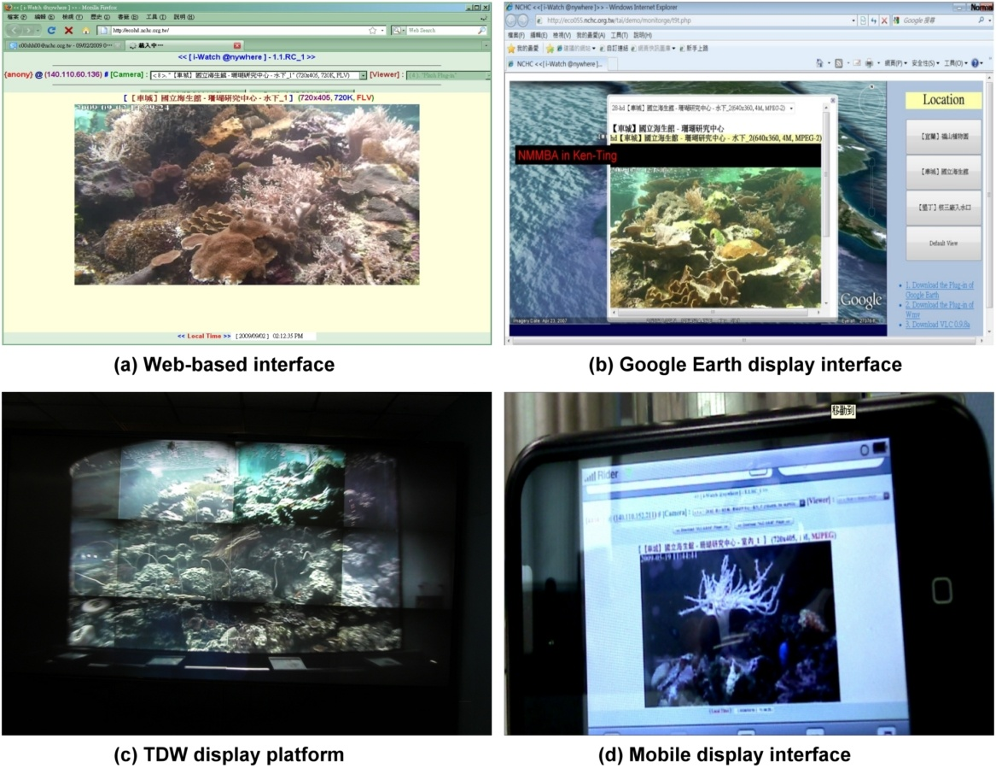
Display Interface

