Slide 1

Numerical Simulation of Integrated Terrestrial Processes over the East River (Dongjiang) in South China
PRAGMA 20, HKU
March 2, 2011
Ji Chen
Department of Civil Engineering
The University of Hong Kong

Slide 2
Acknowledgement:
HK CPU/RGC HKU7022_PPR_2: Assuring Hong Kong's water supply: learning the lessons of the 1963 drought
Groups:
Hong Kong Observatory, Water Supplies Department
Pearl River Water Resources Commission in Guangzhou
Xinfengjiang Reservoir Authority in Heyuan
Research Cooperators:
WU Yingping, CHAN Shu Ning, ZHANG Runrun

Slide 3
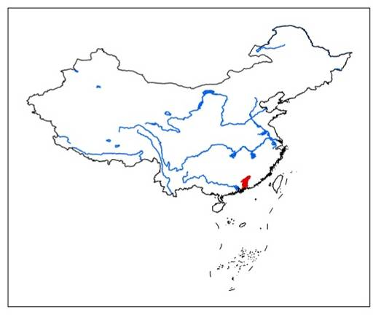
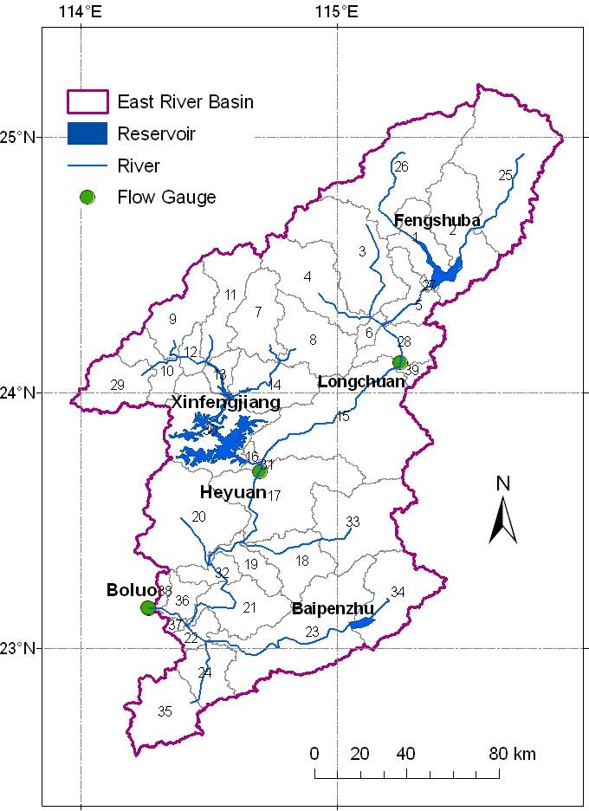
Study area
The East River (Dongjiang) Basin
Drainage area: 25,325 km²
Mainstem length: 562 km
Total reservoir storage capacity: 18.2×10⁹ m³
XFJR is the biggest reservoir in the basin
Water supply for:
  Hong Kong, Shenzhen, Heyuan, Huizhou, Dongguan, Guangzhou
80% of fresh water supply in Hong Kong is from the East River
Hong Kong

Slide 4
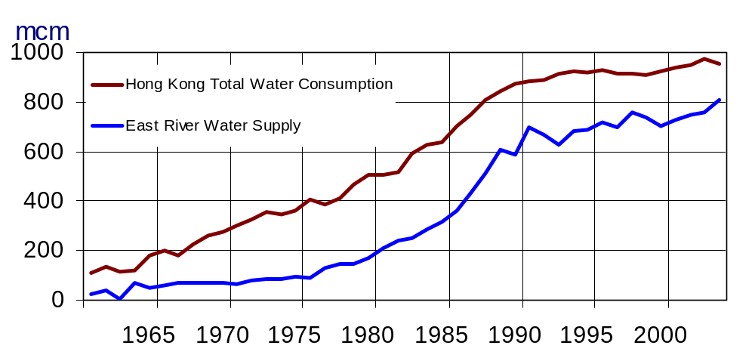
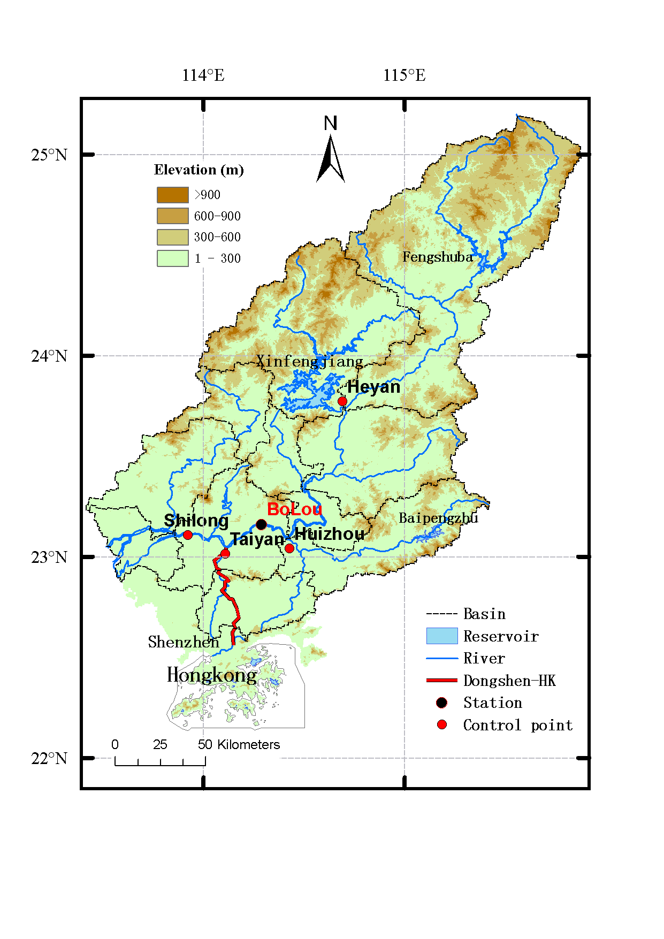
The East River water
and the water supply
in Hong Kong

Slide 5
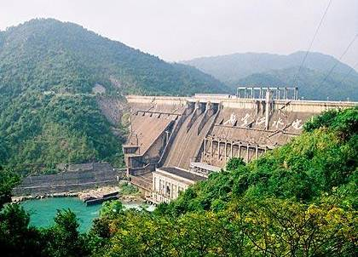
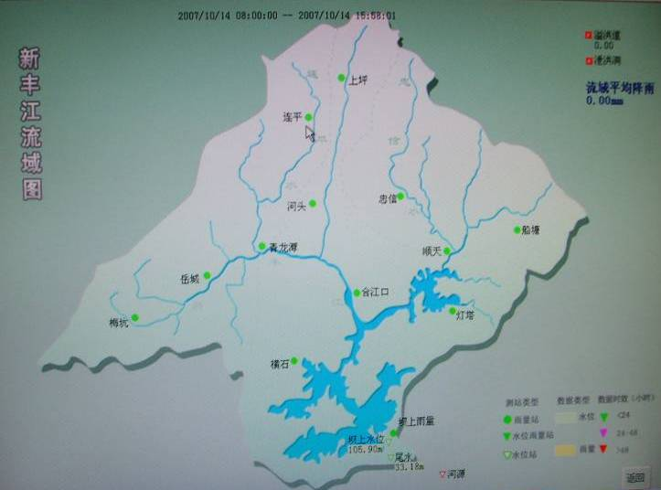
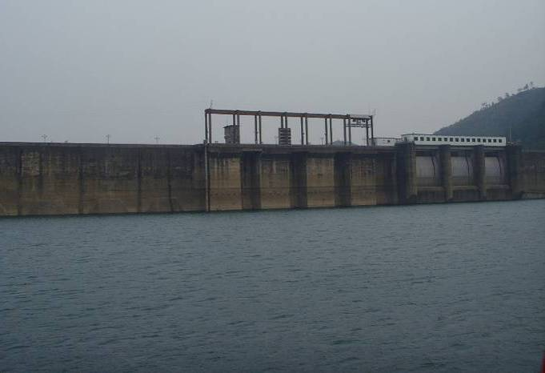
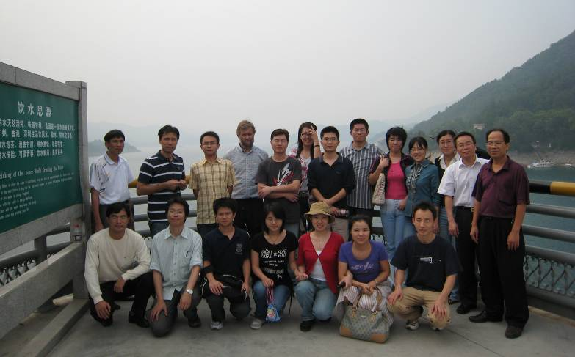
Xinfengjiang Reservoir (XFJR)
Started: Oct 1959
Area: 5,734 km²
Storage capacity: 14 billion m³
Effective storage: 6.4 billion m³
Field Trip: Oct 14, 2007

Slide 6
Water Resources in the East River

Slide 7
WRAP
Developed by Prof. Ralph A. Wurbs and his students in Texas A&M University, USA, in the late 1980s
Priority-based simulation system
  Available streamflow is allocated to each water right in turn in ranked priority order
  The most senior water right (with the highest priority) can get water required first
Modeling and analysis of river/reservoir system operations under the effects of
  Water supply diversions
  Basic streamflow requirements (for environmental and navigation purpose)

Slide 8
WRAP Main Structure
Ranking water rights in priority order
Reading natural streamflow and evaporation rate
Carrying out simulation for each water right as follows:
Determining diversion/streamflow target
Determining amount of water available
to the right
Move to next water right
Making diversion and reservoir releases
Adjusting streamflow at all CPs
Recording simulation results of the right

Slide 9
Control Points of the East River Basin
FSB
XFJ
HY
BPZ
BL
HZ
SL
TY

Slide 10
Xinfengjiang Reservoir
Only Xinfengjiang Reservoir is included
The reservoir contains 76% of total reservoir storage capacity in the East River basin
Total capacity: 13.89 billion m³
  Conservative capacity: 6.49 billion m³
  Inactive capacity: 4.31 billion m³
  Flood control capacity: 3.09 billion m³

Slide 11
Water Right Priority Order
Water availability for each water user is affected by the water right priority
Two different priority orders:
City Direction Priority Order
D-I-A Priority Order

Slide 12
City Direction Priority Order
the priority is assigned to the cities and regions according to their location (upstream to downstream) and their importance, i.e.
  HK > SZ > HY > HZ > DG > GZ
for each city, its priority is assigned according to the types of water usage, i.e.
  Domestic > Industrial > Agricultural > Streamflow Requirement
the salinity suppression requirement at SL, BL and the minimal instream flow requirement in HY should be satisfied first before any water diversion

Slide 13
D-I-A Priority Order
for each city, priority is assigned according to the types of water usage, i.e.
  Domestic > Industrial > Agricultural >
  Streamflow Requirement
the priority is assigned to the cities according to their location (upstream to downstream) and the GDP i.e.
  HK > SZ > HY > HZ > DG > GZ
the salinity suppression requirement at SL, BL and the minimal instream flow requirement in HY should be satisfied first before any right water diversion

Slide 14
Main Settings in Simulations
Main Parameters | Settings
Length of simulation period in month | 12 months (the 1963 water year)
Starting month of each cycle | Starting at October for each simulation
Reservoir initial storage | Different storages for each simulation

Slide 15
Mean Rv(%) of each water right with different initial reservoir storage
at the beginning of Oct (CC (conservative capacity))
D E S C E N D I N G P R I O R I T Y O R D E R | City | 10%CC | 50%CC | 70%CC | 90%CC
 | HK(D) | 100.00 | 100.00 | 100.00 | 100.00
 | HK(O) | 93.78 | 100.00 | 100.00 | 100.00
 | SZ(D) | 80.07 | 100.00 | 100.00 | 100.00
 | SZ(I) | 66.67 | 100.00 | 100.00 | 100.00
 | SZ(A) | 77.90 | 100.00 | 100.00 | 100.00
 | HY(D) | 66.67 | 100.00 | 100.00 | 100.00
 | HY(I) | 66.67 | 100.00 | 100.00 | 100.00
 | HY(A) | 41.70 | 66.58 | 85.44 | 100.00
 | HZ(D) | 66.67 | 91.67 | 100.00 | 100.00
 | HZ(I) | 60.39 | 85.39 | 100.00 | 100.00
 | HZ(A) | 36.08 | 61.08 | 94.78 | 100.00
 | DG(D) | 57.11 | 82.11 | 96.41 | 100.00
 | DG(I) | 50.00 | 75.00 | 87.43 | 100.00
 | DG(A) | 52.20 | 63.80 | 74.30 | 100.00
 | GZ(D) | 50.00 | 75.00 | 83.33 | 100.00
 | GZ(I) | 50.00 | 75.00 | 83.33 | 100.00
 | GZ(A) | 52.20 | 63.80 | 74.30 | 100.00

Slide 16
Mean R_{v}(%) of each water right with different initial reservoir storage
at the beginning of Oct (CC (conservative capacity))
D-I-A | 10%CC | 50%CC | 70%CC | 90%CC
HK(D) | 100.0 | 100.00 | 100.00 | 100.00
HK(O) | 93.78 | 100.00 | 100.00 | 100.00
SZ(D) | 80.07 | 100.00 | 100.00 | 100.00
HY(D) | 66.67 | 100.00 | 100.00 | 100.00
HZ(D) | 66.67 | 100.00 | 100.00 | 100.00
DG(D) | 66.67 | 100.00 | 100.00 | 100.00
GZ(D) | 66.67 | 91.67 | 100.00 | 100.00
SZ(I) | 62.26 | 91.67 | 100.00 | 100.00
HY(I) | 58.33 | 84.35 | 100.00 | 100.00
HZ(I) | 58.33 | 83.33 | 100.00 | 100.00
DG(I) | 58.33 | 83.33 | 100.00 | 100.00
GZ(I) | 58.33 | 83.33 | 100.00 | 100.00
SZ(A) | 70.90 | 82.50 | 100.00 | 100.00
HY(A) | 35.51 | 55.71 | 79.55 | 100.00
HZ(A) | 28.70 | 53.70 | 80.00 | 100.00
DG(A) | 52.20 | 63.80 | 74.30 | 100.00
GZ(A) | 52.20 | 63.80 | 74.30 | 100.00

Slide 17
Hydrologic Processes

Slide 18
Introduction of SWAT (Soil & Water Assessment Tool)
Development
Developed in the USDA-ARS in the 1990s
Objective
  Predict the impact of climate change and land management practices on water, sediment and agricultural chemical yields.
Application
Contributed by several federal agencies (USA EPA, NRCS, etc.)
Components
Weather
Hydrology
Soil erosion
Pollutant transportation
Runoff
Sediment
Nutrients
Pesticides
Base Flow
Crop Growth
Evaporation
Land Management

Slide 19
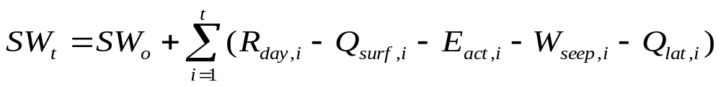
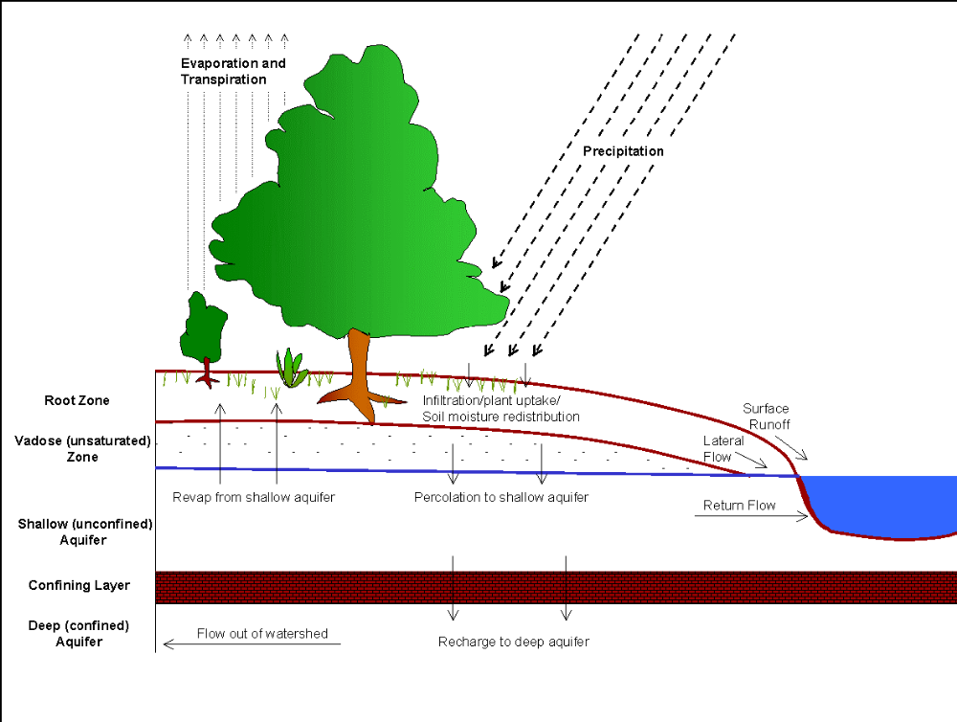
Hydrologic cycle in SWAT (Soil and Water Assessment Tool)
(mm/d)
Soil profile
Groundwater
(Neitsch et al. 2005)

Slide 20
Terrestrial Hydrologic Cycle in SWAT
Precipitation
Rainfall
Snowfall
Irrigation
Snowmelt
Infiltration
Surface Runoff
Soil Water
Tran.
Pot-
Pond
Wet-
Loss
hole
land
Soil
Plant
Lateral
Perc.
Evap.
Transp.
Flow
Revap.
Channel Flow
Baseflow
Shallow Aquifer
Perc.
Water Use (Irrigation)
Deep Aquifer

Slide 21
Main Inputs to SWAT
DEM data
(Topographic features)
Soil Texture
(Percentage of silt, clay, and sand)
Soil data
Characteristics
(Soil depth, Bulk density, K_{sat}, etc.)
Land Use data
Wind Speed
Precipitation
Weather data
+
Solar Radiation
Air Temperature
Relative Humidity
Planting/Harvesting date
Crop Growth
PHU (Potential Heat Unit) for the maturity of crop
Tillage
Irrigation
Fertilization
Land Management
Pesticide
Harvest / Kill Operation

Slide 22
Major Outputs
Surface runoff
Runoff
Lateral flow
Hydrologic Output
Sediment
Base flow
Evaporation
Soil water
Organic N
Nitrogen
NOx-N
Organic P
Water Quality Output
Phosphorus
Mineral P
BOD
DO

Slide 23
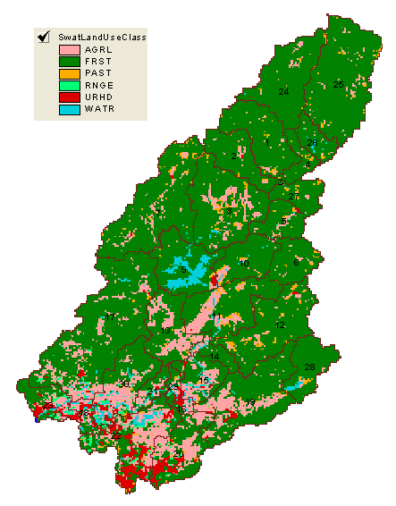
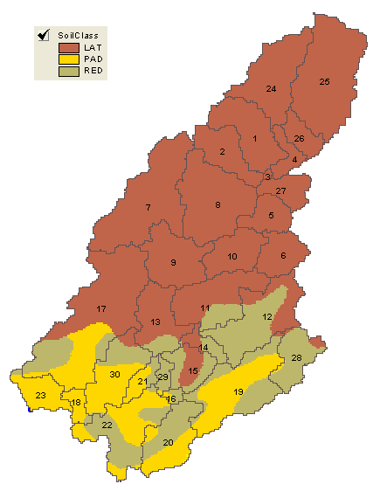
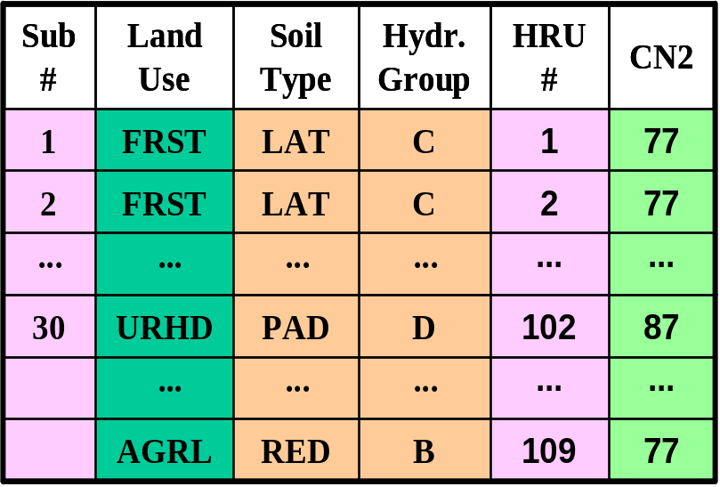
HRUs Distribution
Subbasin can be divided into hydrologic response units (HRUs) , Each HRU possesses unique landuse / soil attributes / management.
Based on Land Use & Soil Type
How to distribute HRUs for a subbasin
A | B | C
B | C | C
B | A | A
1 | 2 | 1
2 | 2 | 1
1 | 3 | 3
A1 | B2 | C1
B2 | C2 | C1
B1 | A3 | A3
+
Land Use
Soil Type
Land Use / Soil Type
+
HRU list

Slide 24
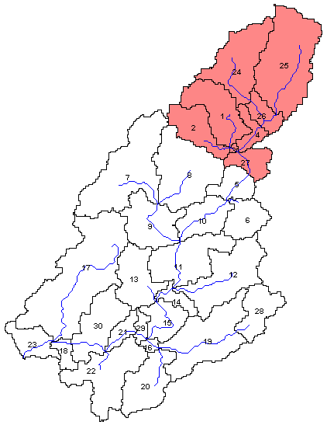
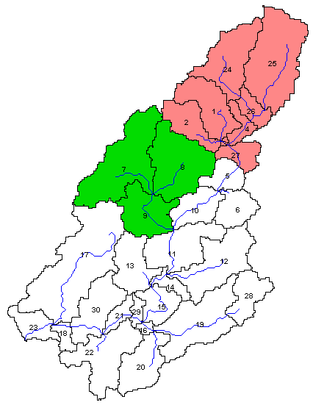
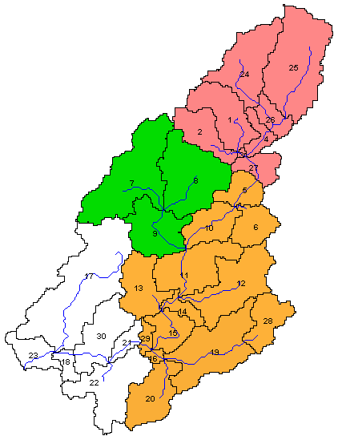
Longchuan
Longchuan
Longchuan
Calibration
XFJ
XFJ
Drainage area controlled by | Observation Daily | Calibration | Validation
Longchuan | 1952 – 1984 33yr | 1952 – 1972 21yr | 1973 – 1984 12yr
XFJ | 1965 – 1984 20yr | 1965 – 1984 20yr
Boluo | 1954 – 1984 31yr | 1954 – 1972 19yr | 1973 – 1984 12yr
Boluo
Parameter | Description | Range | Calibrated Value
 |  |  | Longchuan
αgw | Base flow recession constant | 0 – 1 | 0.003
esco | Soil evaporation compensation factor | 0.001 – 1 | 0.999
epco | Plant uptake compensation factor | 0.001 – 1 | 0.001
gw_revap | Groundwater “revap” coefficient | 0.02 – 0.2 | 0.05
rchrg_dp | Deep aquifer percolation fraction | 0 – 1 | 0.1
Calibrated Value
Longchuan | XFJ
0.003 | 0.0066
0.999 | 0.999
0.001 | 0.001
0.05 | 0.02
0.1 | 0.016
Calibrated Value
Longchuan | XFJ | Boluo
0.003 | 0.0054 | 0.0054
0.999 | 0.999 | 0.999
0.001 | 0.001 | 0.001
0.05 | 0.02 | 0.2
0.1 | 0.016 | 0.5

Slide 25
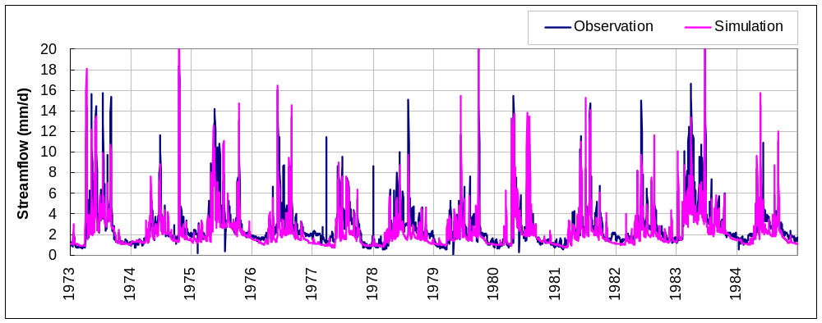
Validation
Daily streamflow at Boluo (Validation period)
Evaluation
 | Relative Bias | Correlation Coefficient
Daily flow | – 0.16 | 0.87

Slide 26
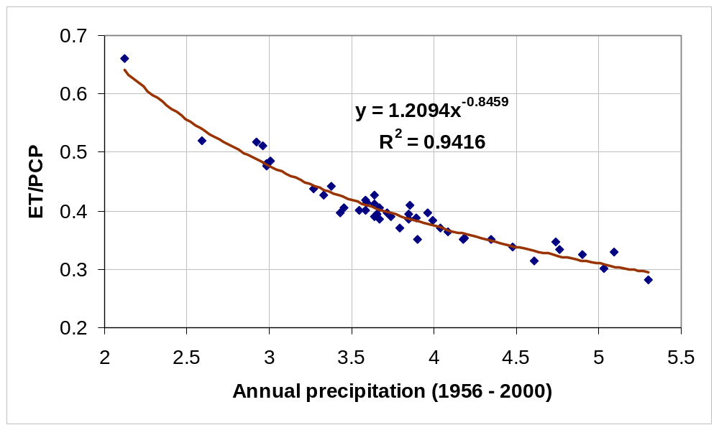
Water balance
- over watershed
Annual Mean Item | Value (mm/d)
PCP | 3.798
ET | 1.484
Flow | 2.155
ET/PCP | 40.1%
SF/PCP | 56.7%
Boluo

Slide 27
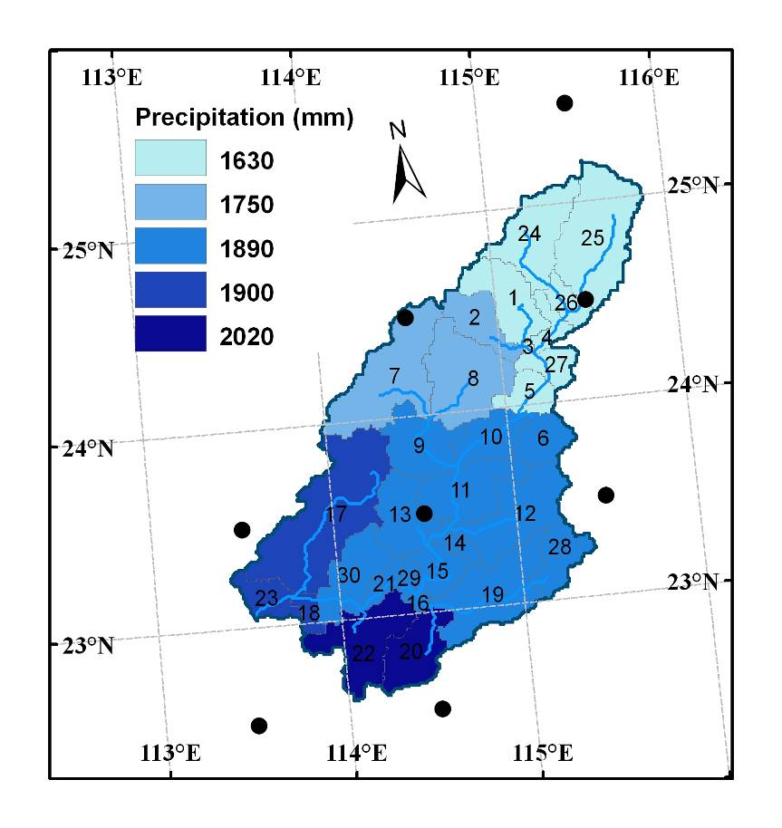
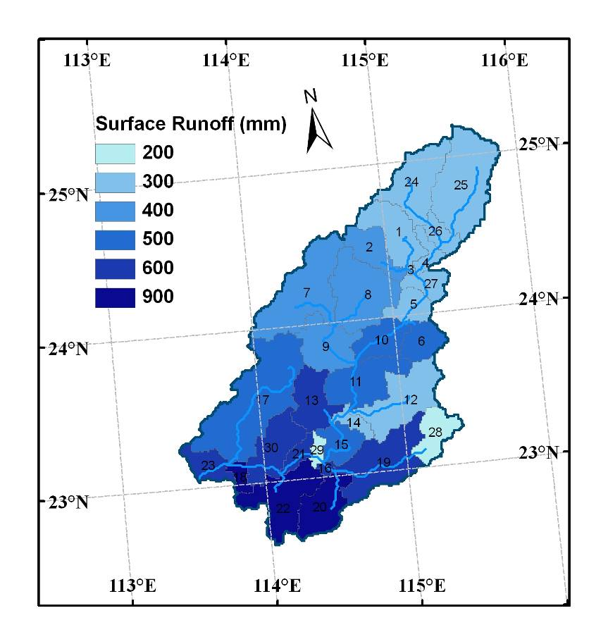
Spatial distribution of hydrologic components
Annual average (1951 – 2000)
Precipitation (mm/yr)
Surface Runoff (mm/yr)

Slide 28
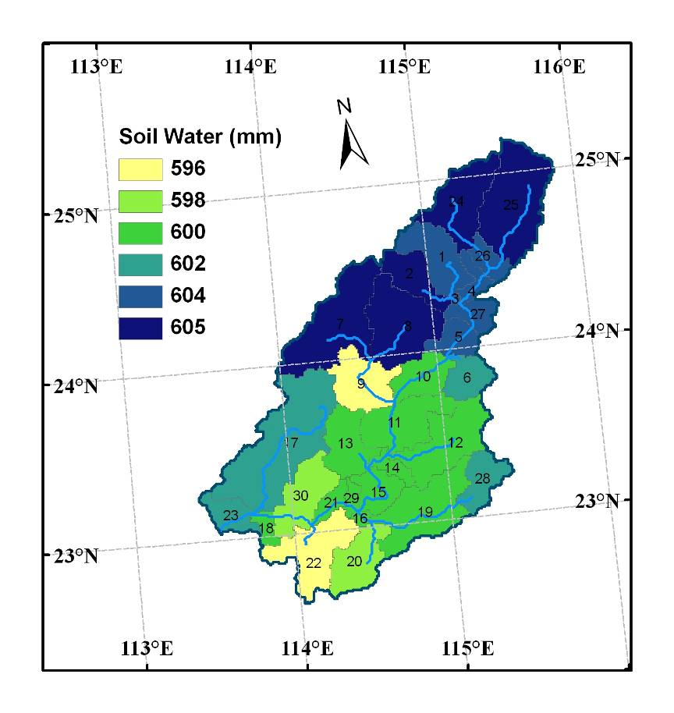
Spatial distribution of hydrologic components
Annual average (2000)
Soil Water (mm)

Slide 29
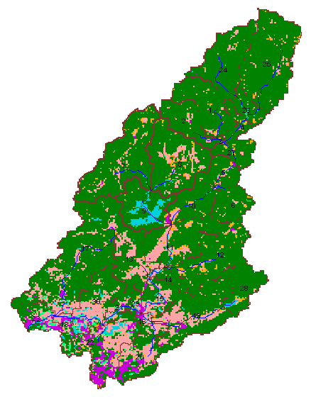
Reservoir operation
- Reservoirs in ERB
Xinfengjiang
Built 07/1958
Operated 05/1960
Cap.: 14 × 10⁹m³
Boluo

Slide 30
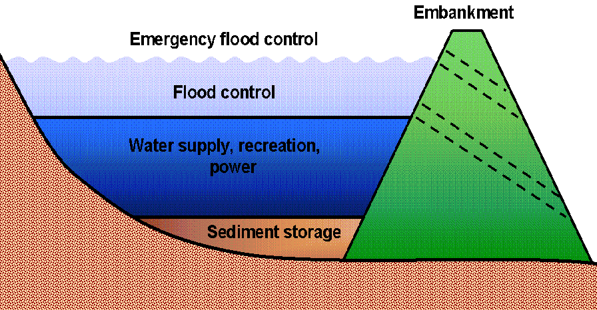
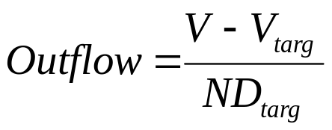
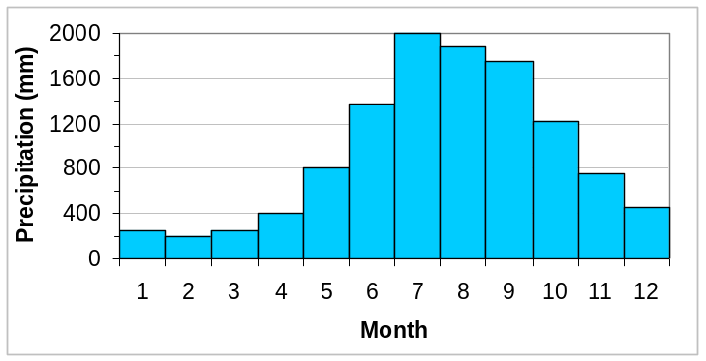

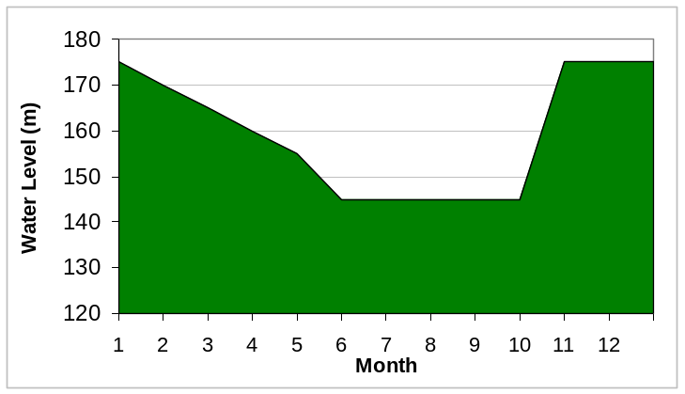


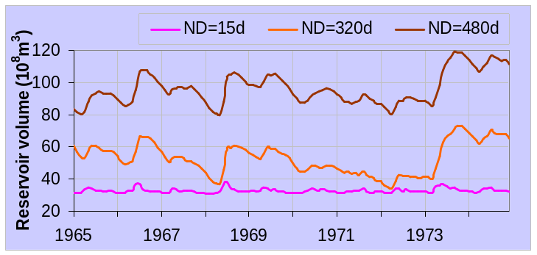
Reservoir operation
- simulated by SWAT
Controlled outflow with target release
Non-flooding
Flooding
Non-flooding
Target reservoir volume for a given day
Normal Level
The same value for all the days in each month
Level for preventing
Low level in
flooding
non-flooding season
Number of days required for the reservoir to reach target storage

Slide 31
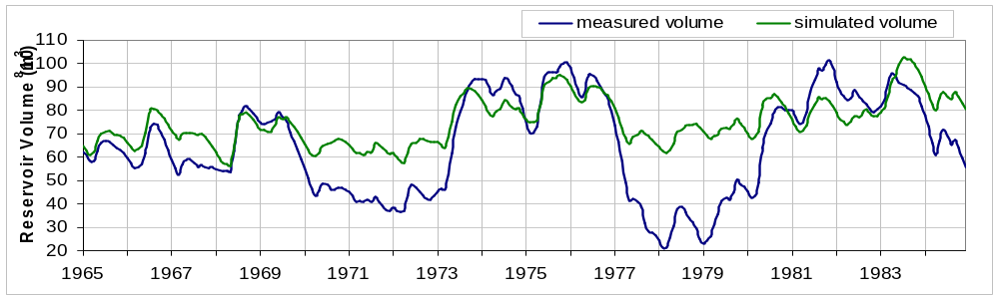
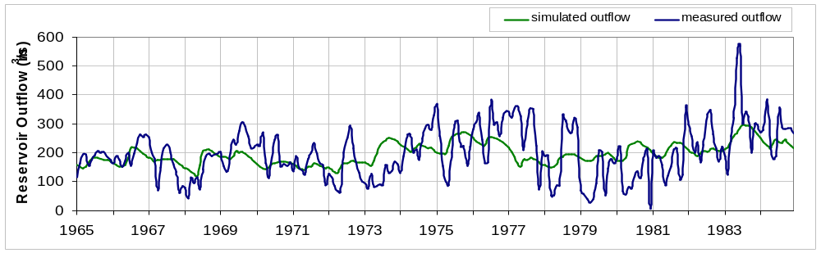
Reservoir operation
- simulated by SWAT
Volume
Outflow

Slide 32
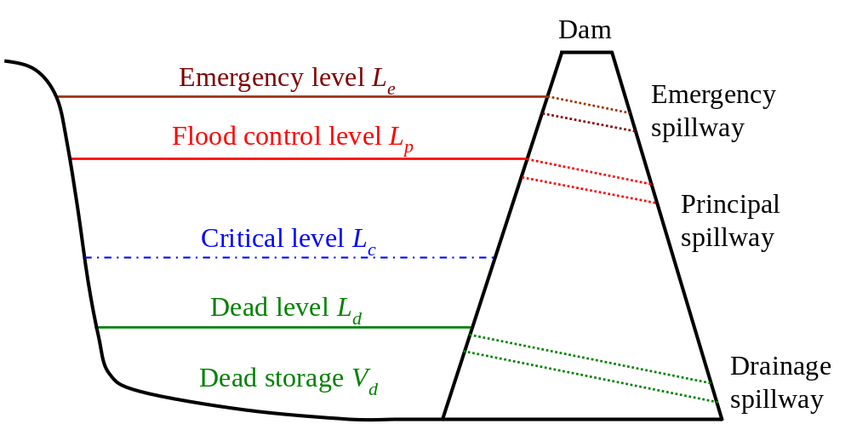

A New Reservoir Simulation Scheme
Storage V(i) | Operation Purpose and Equation for Computating Outflow, O(i) (m³/d), on a given day i
V(i) > V_{p} | flood control,
V_{p} ≥ V(i) > V_{d} | hydropower generation, downstream water supply, and water resources,
V(i) ≤ V_{d} | 0
Power Supply Storage

Slide 33
Comparison and Evaluation
Variable | Scheme | Monthly Statistical Terms
 |  | RMSE | NSE
Storage | I (Target release) | 1.87 | 0.28
 | II (Mechanism based scheme) | 1.57 | 0.50
Outflow | I | 6.9 | 0.19
 | II | 6.0 | 0.38

Slide 34
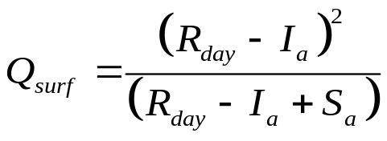
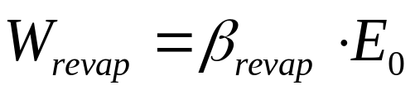
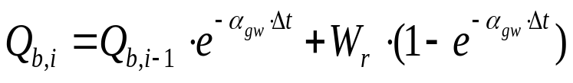
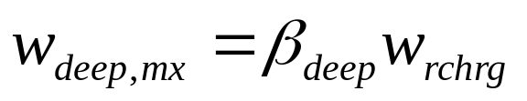
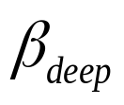
Four hydrologic processes in SWAT
Hydrologic Processes | Calculation and Parameters involved |  | Limitations
Overland flow |  | S_{a} | without considering direct overland flow from saturated area
Revap |  | βrevap | to be calibrated time invariant spatially unchanged
Baseflow |  | αgw | to be calibrated f (W_{r})
Percolation to deep aquifer |  |  | to be calibrated this amount of water is returned to hydrologic cycle only by pumping

Slide 35
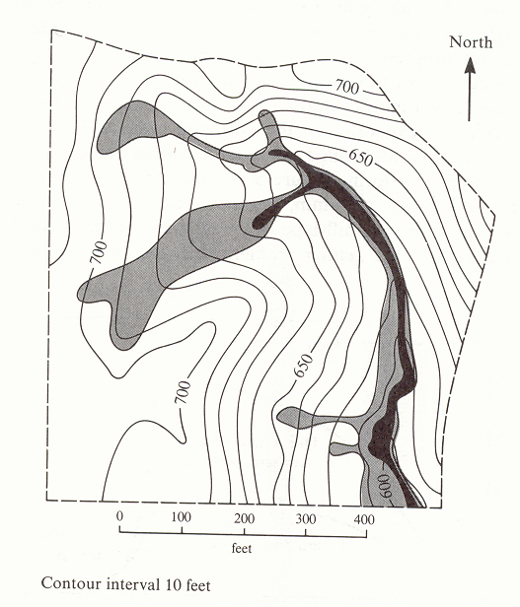
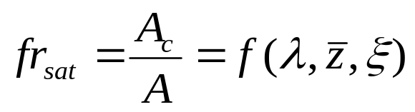
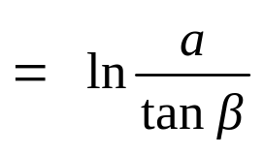
Saturated Area and Water Table Depth
Saturated area and its expansion
(Dunne and Leopold, 1978)
Saturated fraction
fr_{sat}
z_{wt}
fr_{sat}
a
Topographic Index
ß
α is the upstream contributing area
tanβ is the local slope
(Beven and Kirkby 1979)

Slide 36
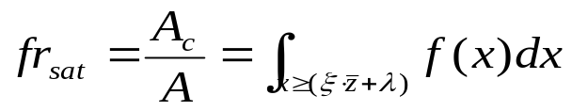

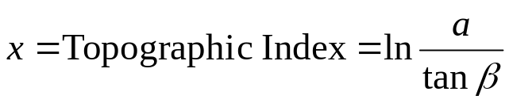









Integrated of SWAT-TOPMODEL
Hydrologic Processes | Calculation and Parameters involved |  | Strengths
Revap |  |  | Temporal and spatial varying
Baseflow
Overland flow | - | Rainfall falling on the saturated area enters channel directly | Quick surface runoff
Saturated fraction
Probability distribution of TI
Mean value of TI
Basin average water table depth
Decay factor of soil
Basin lateral transmissivity
Saturated lateral hydraulic
conductivity at the surface

Slide 37
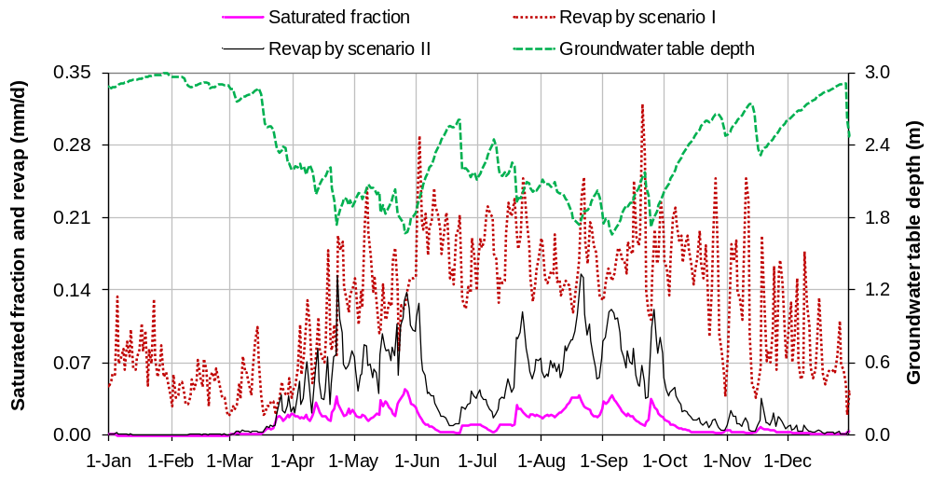
Revap simulation
Scenario | Model | Revap | Comparison period
I | SWAT | f (PET) | Jan and Mar Mid Sep
II | SWAT-TOPMODEL | f (PET, frsat)

Slide 38
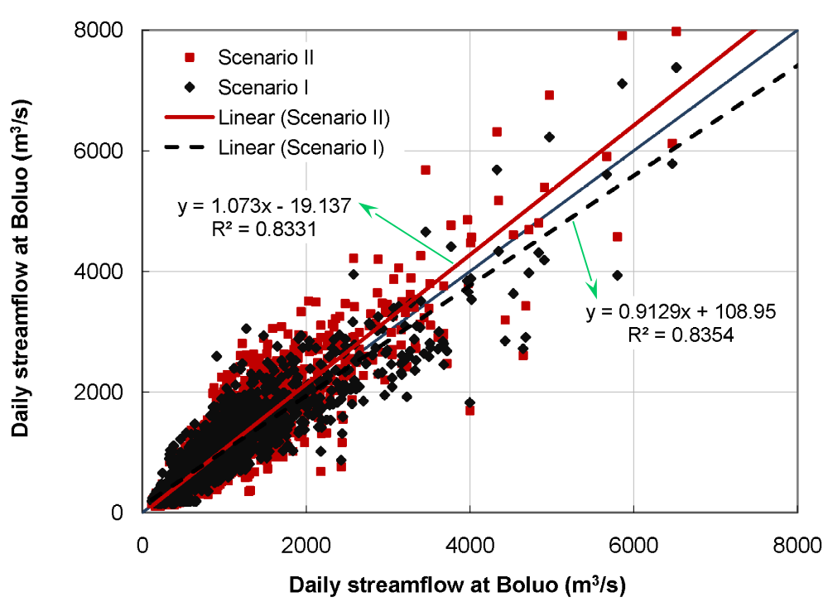
Evaluation
Scenario I: SWAT
Scenario II: SWAT-TOPMODEL
Model | Period | Mean |  | PB (%) | NSE | R²
 |  | Observed | Simulated |  | D / M | D / M
SWAT | Calibration | 818.64 | 831.17 | 1.53 | 0.84 / 0.93 | 0.84 / 0.93
 | Validation | 808.88 | 847.34 | 4.75 | 0.82 / 0.90 | 0.84 / 0.91
SWAT- TOPMODEL | Calibration | 818.64 | 833.82 | 1.85 | 0.80 / 0.88 | 0.83 / 0.93
 | Validation | 808.88 | 854.05 | 5.59 | 0.77 / 0.82 | 0.84 / 0.91

Slide 39
Soil Erosion

Slide 40
Land Phase
Sediment in surface runoff
(MUSLE)
sed mass of soil erosion (ton)
q_{peak} peak runoff (m³/s)
area_{hru} area of HRU(ha)
K_{USLE} soil erodibility factor
C_{USLE} factor of land cover and management
P_{USLE} conservation practice factor
LS_{USLE} account for the factor of topography
CFRG coarse fragment factor

Slide 41
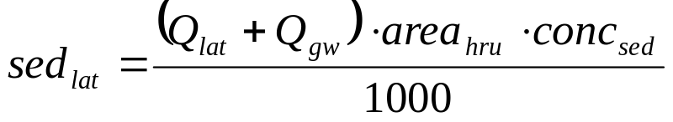
Sediment Erosion
Land Phase
(2) Sediment in lateral & groundwater flow
sed_{lat} sediment loading in lateral and groundwater flow (ton)
Q_{lat} lateral flow for a given day (mm H₂O)
Q_{gw} groundwater flow for a given day (mm H₂O)
area_{hru} area of the HRU (km²)
conc_{sed} concentration of sediment in lateral and groundwater flow (mg/L)

Slide 42
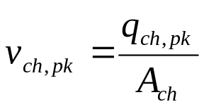
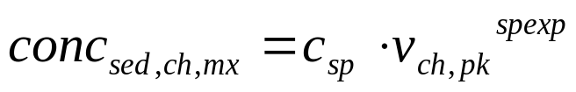

Sediment Erosion
Water Phase
conc_{sed,ch,mx} maximum conc. of sed. transported (ton/m³ or kg/L)
C_{sp} coefficient defined by the user
v_{ch,pk} peak channel velocity (m/s)
Spexp exponent defined by the user
normally varies between 1.0 and 2.0 and was set at 1.5 in the original Bagnold stream power equation (Arnold et al., 1995).
prf peak rate adjustment factor
q_{ch} average rate of flow (m³/s)
A_{ch} cross-sectional area of flow

Slide 43




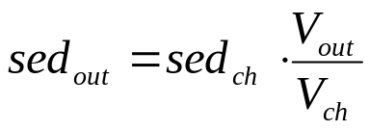
Sediment Erosion
Water Phase
deposition is the dominant process and the net amount of sediment deposited
degradation is the dominant process and the net amount of sediment reentrained
K_{CH} is the channel erodibility factor (cm/hr/Pa)
C_{CH} is the channel cover factor
Final amount of SS
(ton)
Sed. transported out of the reach
(ton)

Slide 44
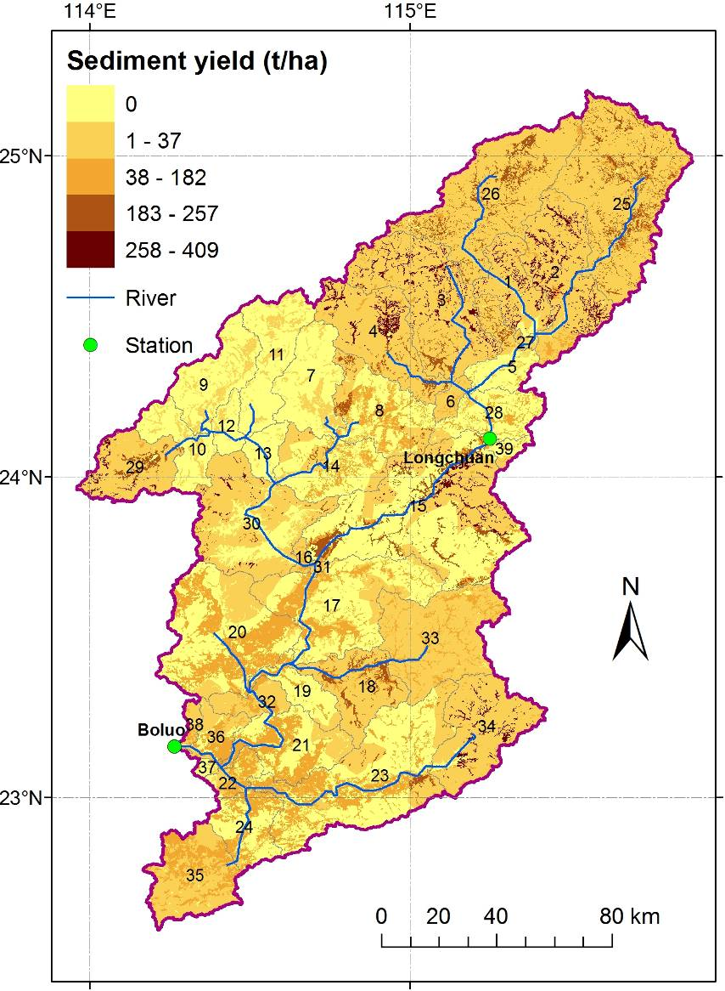
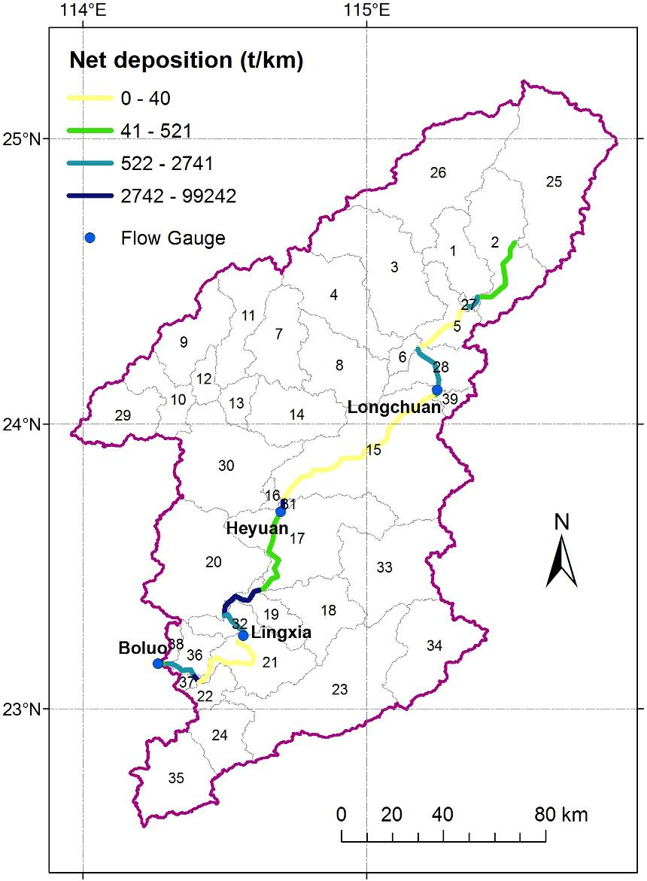
Soil Erosion and Sediment Transport

Slide 45
Water Quality

Slide 46
NPS and PS Pollution
Land Phase
(NPS)
The transport of nutrients from land areas into streams and water bodies is a normal result of soil weathering and erosion processes
Governing movement of mineral and organic forms of nitrogen and phosphorus from land areas to the stream network
N & P cycle
Land Phase
N & P loadings

Slide 47
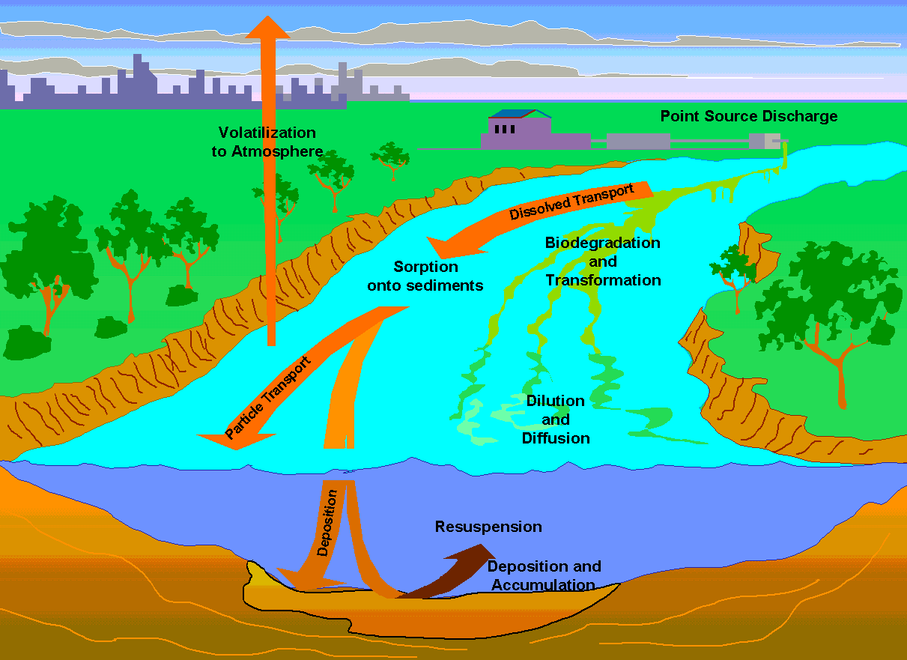
NPS and PS Pollution
Water Phase
Determine the loadings of water, sediment, nutrients and pesticides to the main channel in land phase hydrologic cycle
Keep track mass flow and models the transformation of chemicals in the stream
NPS
NPS: Loadings from land areas
NPS
PS: Loadings from sources not associated with a land areas

Slide 48
NPS and PS Pollution
Water Phase
(NPS & PS)
Parameters which affect water quality and can be considered pollution indicators include nutrients, total solids, biological oxygen demand and microorganisms (Loehr, 1970; Paine, 1973).
The SWAT in-stream water quality algorithms incorporate constituent interactions and relationships used in the QUAL2E model (Brown and Barnwell, 1987).

Slide 49
NPS and PS Pollution
Water Phase
(NPS & PS)
(0) Alge
Simulate algal growth in the stream
Why?
During the day, algae increase the stream’s DO via photosynthesis.
At night, algae reduce the stream’s DO via respiration.
As algae grow and die, they form part of the in-stream nutrient cycle.
How?
Growth and decay of algae/chlorophyll a is calculated as a function of the growth rate, the respiration rate, the settling rate and the amount of algae present in the stream.

Slide 50
NPS and PS Pollution
Water Phase - N
(1) orgN
orgN → NH₄⁺
algal biomass N → orgN
orgN settling (sed.)
ΔorgN_{str} change in organic nitrogen concentration (mg N/L)
α₁ fraction of algal biomass that is nitrogen (mg N/mg algal biomass)
ρ_{a} local respiration or death rate of algae (day⁻¹ or hr⁻¹)
algae algal biomass concentration at the beginning of the day (mg alg/L)
β_{N,3} rate constant for hydrolysis of orgN to ammonia N (day⁻¹ or hr⁻¹)
orgN_{str} organic nitrogen concentration at the beginning of the day (mg N/L)
σ₄ rate coefficient for organic nitrogen settling (day⁻¹ or hr⁻¹)
TT flow travel time in the reach segment (day or hr)

Slide 51
NPS and PS Pollution
Water Phase - P
(1) orgP
orgP → soluble inorganic P
algal biomass P → orgP
orgP settling (sed.)
ΔorgP_{str} change in organic P concentration (mg P/L)
α₂ fraction of algal biomass that is P (mg P/mg alg biomass) <user defined>
ρ_{a} local respiration or death rate of algae (day⁻¹ or hr⁻¹)
algae algal biomass concentration at the beginning of the day (mg alg/L)
β_{P,4} rate constant for mineralization of organic phosphorus (day⁻¹ or hr⁻¹)
orgP_{str} organic P concentration at the beginning of the day (mg P/L)
σ₅ rate coefficient for organic phosphorus settling (day⁻¹ or hr⁻¹)
TT flow travel time in the reach segment (day or hr)

Slide 52
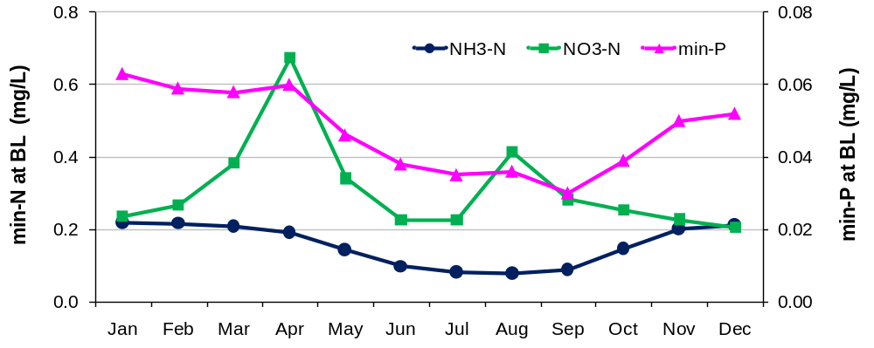
Seasonal variation of stream water quality
NH3-N: constant PS load
Low conc. in wet season
Critical period for nutrient:
Ending of dry season →
Beginning of wet season
NO3-N: PS and NPS loads
Planting & Fertilization (Apr & Aug)
Eluviation (Mar)

Slide 53


NPS pollution load

Slide 54
Conclusions
This study focused on the improvement of our understanding of the integrated terrestrial processes over the East River
(Water, Sediment, Nutrients, Reservoir operation and Land management)
Water resources: to overcome the projected water shortage induced by the drought condition as in 1963, 70% conservative capacity of Xinfengjiang reservoir would be filled
Reservoir simulation: A mechanism-based numerical scheme for a multiyear and multipurpose reservoir is developed
Model integration: Hydrologic representation in SWAT are enhanced physically by integrating TOPMODEL features
Sediment & Water quality: Soil erosion and NPS pollution features are analyzed, with identification of critical area and critical period

Slide 55
Thank you !

