Slide 1




CONFERENCE SERVICE PLATFORM: ARCHITECTURE AND IMPLEMENTATION
Guangyuan Liu, CNIC
March 2011, Hong Kong

Slide 2
Conference Service Platform
What is CSP?
What Can CSP Do?
How Does CSP Do?

Slide 3
What is CSP?
Web Application
Based on Duckling platform
Create and publish conference website online

Slide 4
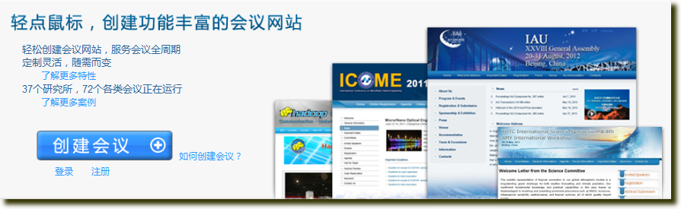
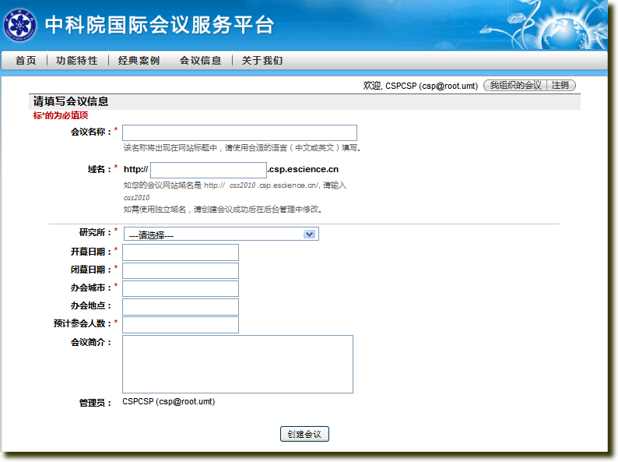
One-Click Creating
Feature 1/8
Online
Easy
Convenient
  Servers, network condition, software environment and database

Slide 5
Easy and Quick Setup
Feature 2/8
For sponsors and organizers
Customize registration, paper submission, reservation and payment
Edit themes, layouts and page contents
Internationalization

Slide 6
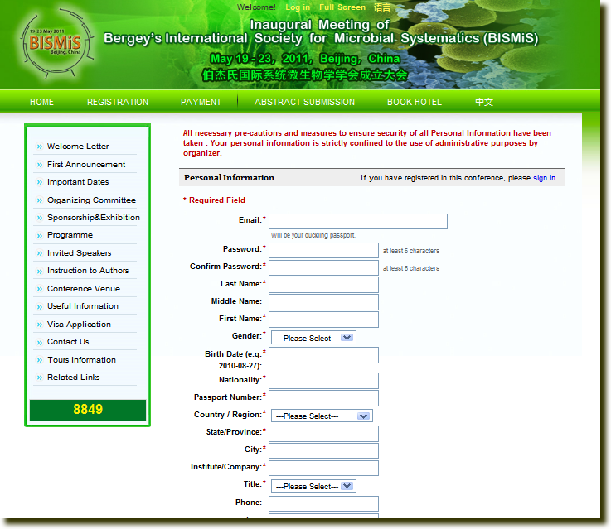
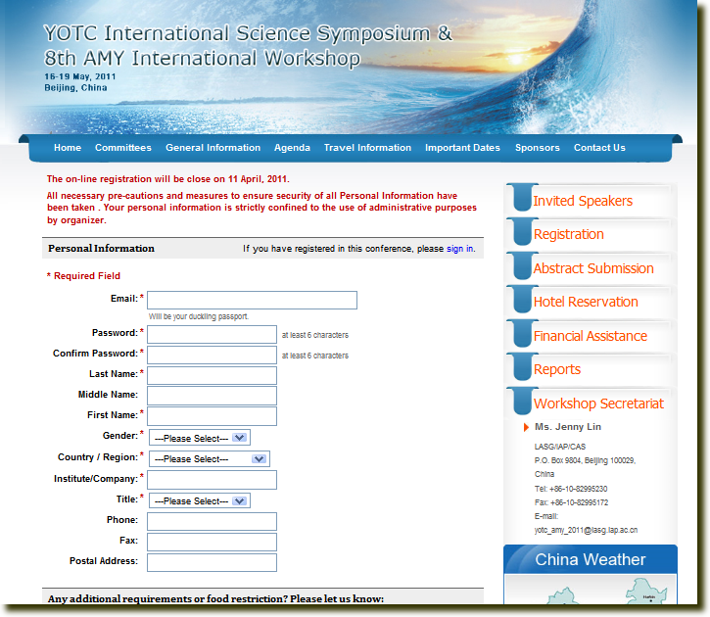
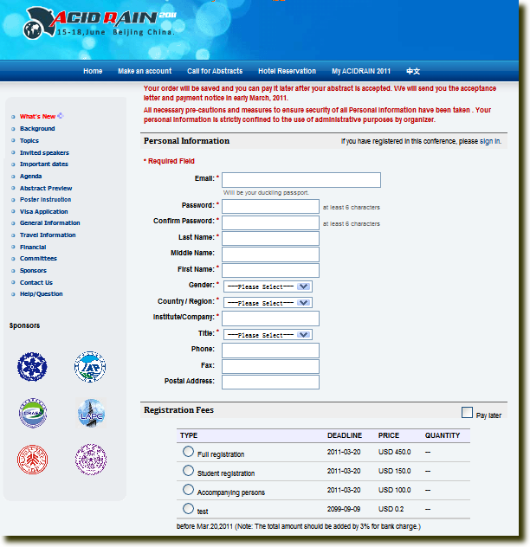
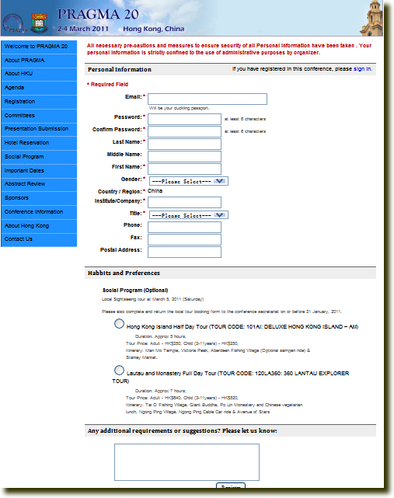
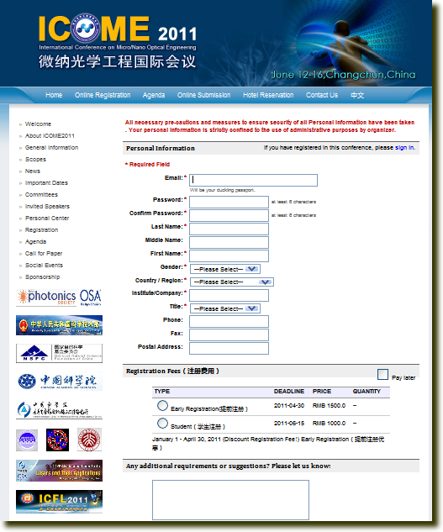
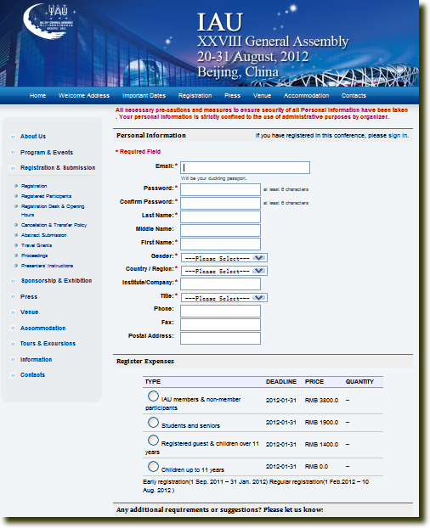
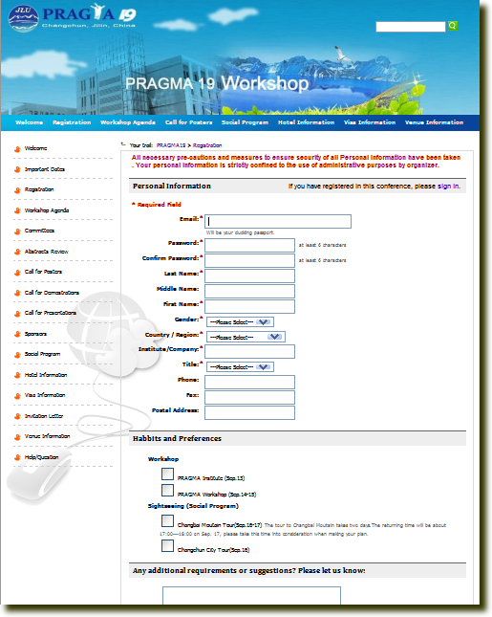
more

Slide 7



Life Cycle Conference Service
Feature 3/8
For attendees
Registration, paper submission, paper review, hotel reservation, social activity and online payment
Title in here
Register
Title in here
Title in here
Submit a
paper
Review a
paper
Title in here
Title in here
Attend a
social activity
Reserve a
hotel room
Title in here
Pay for
registration

Slide 8
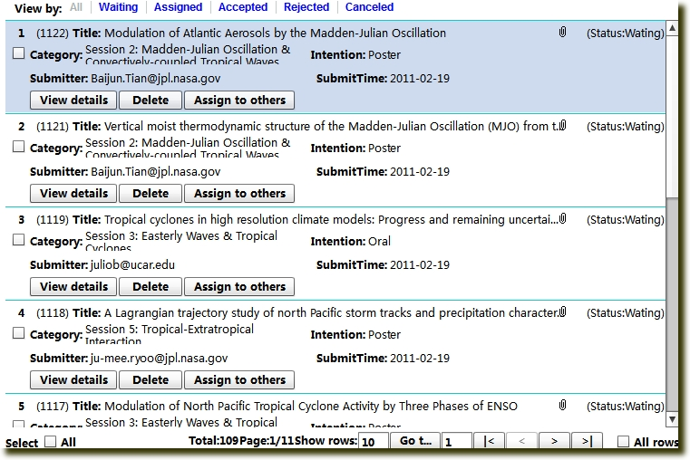
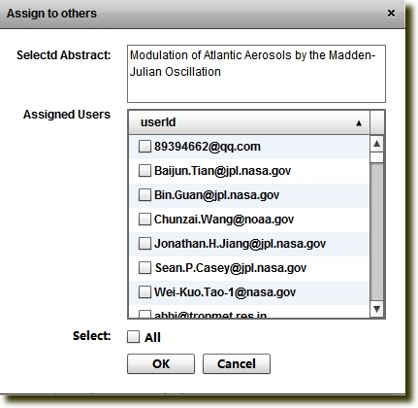
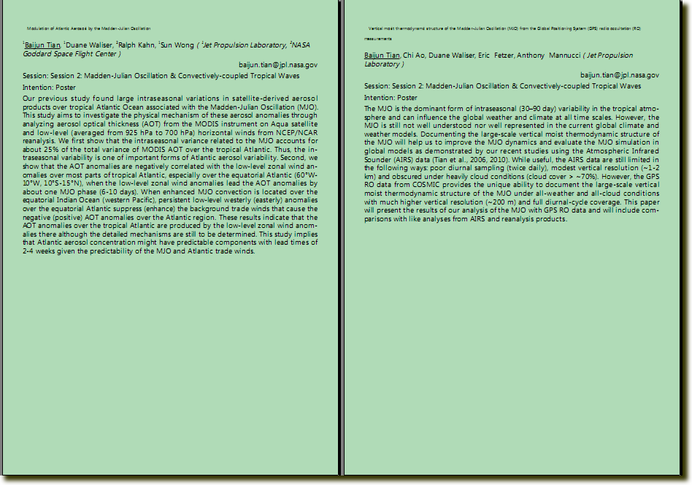
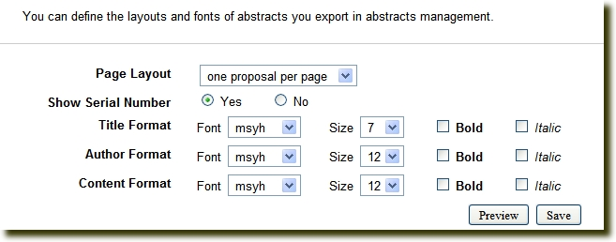
Paper Submission and Review
Feature 4/8
Workflow service
  Submit, assign, review, feedback
Proceedings export
  Automatic typesetting

Slide 9
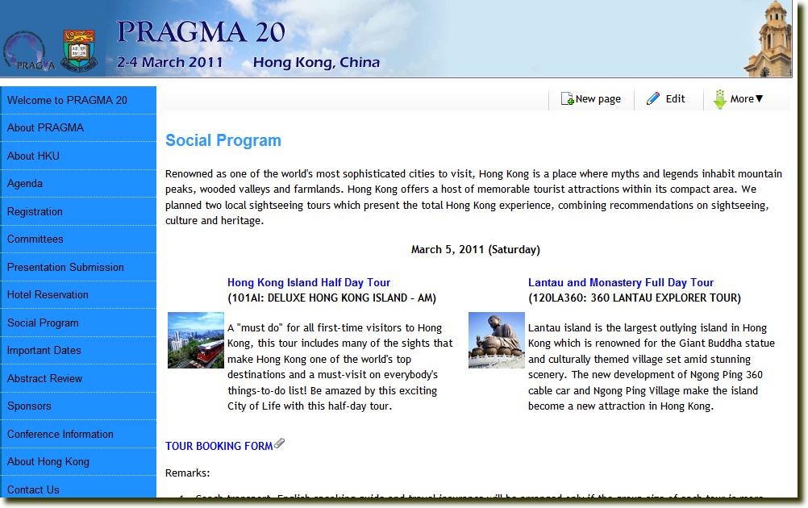
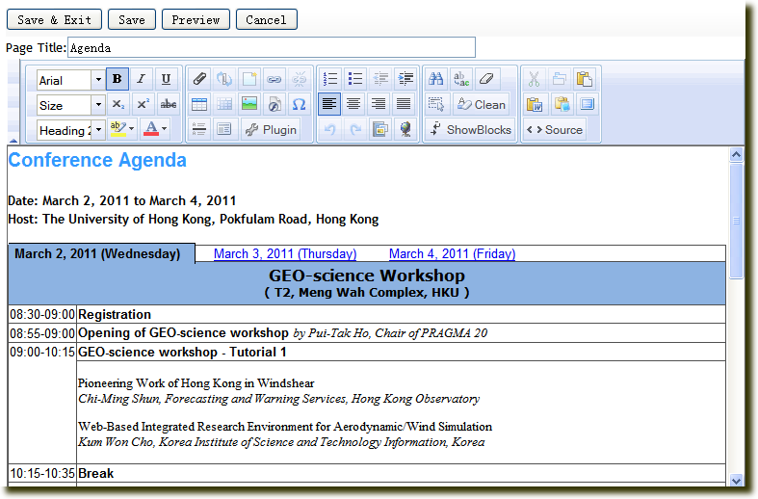
Real-Time Publishing
Feature 5/8
News, agenda and instructions
  What you see is what you get
Collaborative editing
  Edit in different geographical locations

Slide 10
Payment
Feature 6/8
Online and offline
  Registration, social activity and reservation
Multiple types
  Credit card
  Bank card
  Remittance

Slide 11
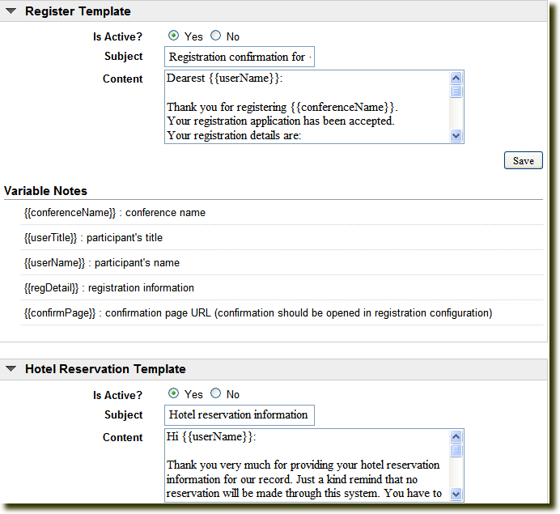
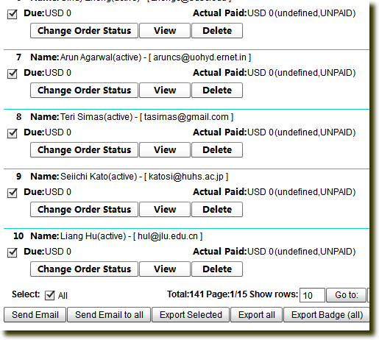
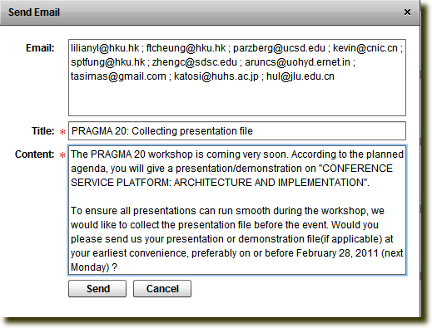
Notification and Feedback
Feature 7/8
Communicate smoothly
  Online feedback
  Mail notification
Configurable mail templates

Slide 12
Data Hosting
Feature 8/8
Export all data at anytime
  Multiple categories (registration, payment, reservation, papers…)
  Multiple formats (zip, excel, pdf…)
Permanent hosting service
  Your website is still alive

Slide 13
How Does CSP Work 1
One application for one conference
  High cost in development and maintenance
  Waste of money and power (against LC lifestyle)
One web server for multiple websites
  High load and low performance
One application for all conferences
  Website is virtualized
  Data is stored together physically and separated logically according to a unique siteID for each website
  All websites with different data set share the same logic
Multiple servers for multiple websites
  Distributed web servers
  Load balance

Slide 14
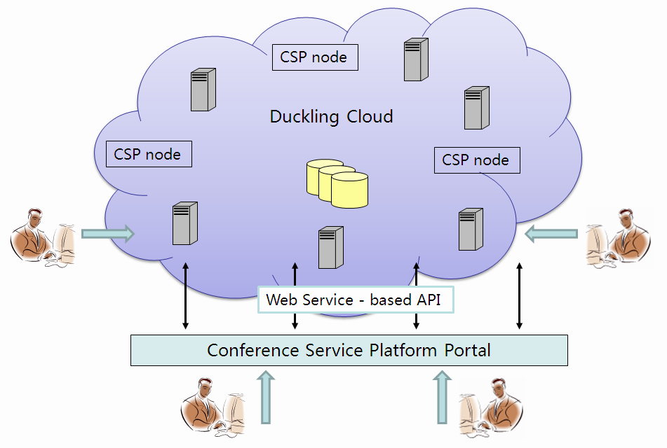
How Does CSP Work 2
DB

Slide 15
Current Progress
Started from June 2010
72 conferences
2,700+ attendees
37 institutes

Slide 16
Thanks!

