Slide 1

The Performance Analysis of Molecular dynamics RAD GTPase with AMBER application on
Cluster computing environtment.
Heru Suhartanto,
Arry Yanuar,
Toni Dermawan
Universitas Indonesia

Slide 2
Acknowledgments:
Fang Pang Lin – for invitation to SEAP 2010, Taichung, Taiwan and for introduction to Peter Azberger
Peter Arzberger – for invitation to PRAGMA20 and introduction to the audiences

Slide 3
InGRID: INHERENT/INDONESIA GRID
Idea
  RI-GRID: National Grid Computing infrastructure development proposal, Mei 2006, by FAculty of Computer Science, UI
Part of UI competitive grants (PHK INHERENT K1 UI)
  ”Menuju Kampus Dijital: Implementasi Virtual Library, Grid Computing, Remote-Laboratory, Computer Mediated Learning, dan Sistem Manajemen Akademik dalam INHERENT,” Sep ’06 – Mei ‘07
Objective:
  Developing Grid Computing Infrastructure with computation capacity intially 32 processors (~intel pentium IV) and 1 TB storage.
  Hopes: the capacity will improve as some other organization will joint the InGRid.
  Developing e-Science community in Indonesia

Slide 4
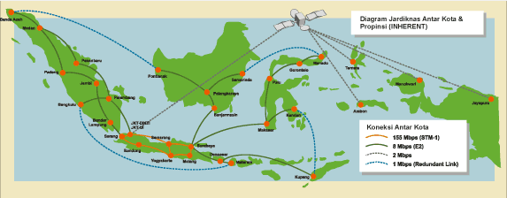
Grid computing Challenges : still developing, minimum HR, depend on grants,
Researches challenges : reliable resources integration, management of rich natural resources, wide areas but composing with thousands of island, natural disasters: earthquake, tsunami, landslide, floods, forest fires, etc.

Slide 5
The InGRID Architecture
User
inGRID
PORTAL
U*
INHERENT
Windows/x86
Cluster
User
Globus
Head Node
Linux/x86
Cluster
UI
I*
Globus
Head Node
Linux/Sparc
Cluster
Globus
Head Node
Solaris/x86
Cluster
Custom
PORTAL

Slide 6
Hastinapura Cluster
Nama Node | Head Node | Worker Nodes | Storage Node
Arsitektur | Sun Fire X2100 | Sun Fire X2100 | -
Prosesor | AMD Opteron 2.2 GHz (Dual Core) | AMD Opteron 2.2 GHz (Dual Core) | Dual Intel Xeon 2.8 GHz (HT)
RAM | 2 GB RAM | 1 GB RAM | 2 GB RAM
Harddisk | 80 GB | 80 GB | 3 x 320 GB
Fakultas Ilmu Komputer Universitas Indonesia

Slide 7
Softwares Hastinapura Cluster
 | Functions | Applications (versi)
1 | compilers | gcc (3.3.5); g++ (3.3.5, GCC); g77 (3.3.5, GNU Fortran); g95 (0.91, GCC 4.0.3)
2 | Aplikasi MPI 1 | MPICH (1.2.7p1, Release date: 2005/11/04 11:54:51)
3 | Operating system | Debian/Linux OS (3.1 “Sarge”)
4 | Resource management | Globus Toolkit [2] (4.0.3)
5 | Job scheduler | Sun Grid Engine (SGE) (6.1u2)
Fakultas Ilmu Komputer Universitas Indonesia

Slide 8
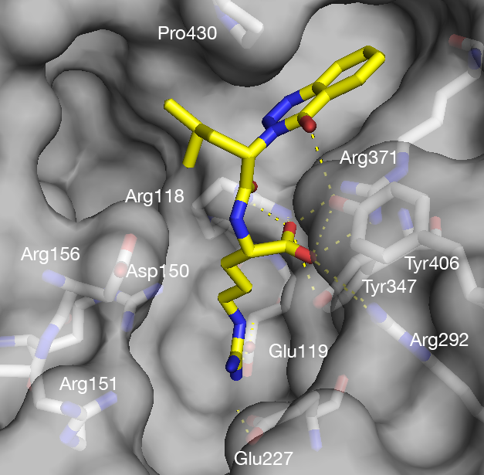
Molecular Dynamics Simulation
Computer Simulation Techniques
Molecular Dynamic Simulation
MD simulation on virus H5N1 [3]
Fakultas Ilmu Komputer Universitas Indonesia
Notes:
Salah satu teknik simulasi komputer yang lazim digunakan para peneliti adalah simulasi dinamika molekular atau saya singkat menjadi simulasi DM. Salah satu contoh simulasi DM bisa dilihat pada Gambar 3, simulasi DM yang dilakukan pada virus H5N1 untuk membuat inhibitor/penghambat dengan menggunakan ligand.

Slide 9
“MD simulation : computational tools used to describe the position, speed an and orientation of molecules at a certain time” Ashlie Martini [4]
Fakultas Ilmu Komputer Universitas Indonesia

Slide 10
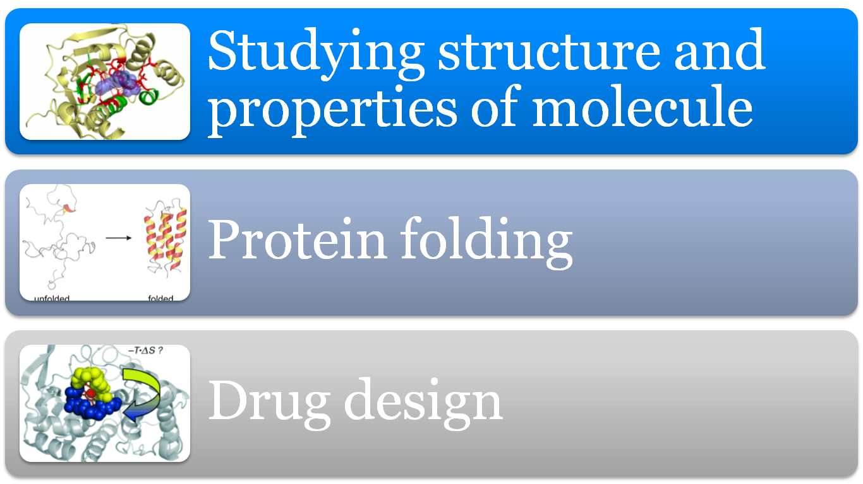
MD simulation purposes/benefits:
Sumber gambar: [5], [6], [7]
Fakultas Ilmu Komputer Universitas Indonesia

Slide 11
Challenges in MD simulation
O(N²) time complexity
Timesteps (simulation time)
Fakultas Ilmu Komputer Universitas Indonesia
Notes:
Persoalan pada simulasi DM dari sudut pandang komputasi

Slide 12
Focus of the experiment
Study the effect of MD simulation timestep on the executing / processing time;
Study the effect of in vacum and implicit solvent technique with generalied Born (GB) model on the executing / processing time;
Study (scalability) how the number of processors improve executing / processing time;
Study how the output file grows as the timesteps increase.
Fakultas Ilmu Komputer Universitas Indonesia

Slide 13
Scope of the experiments
Preparation and simulation with AMBER packages
Performance is based on the execution time of the MD simulation
No parameter optimization for the MD simulation
Fakultas Ilmu Komputer Universitas Indonesia

Slide 14
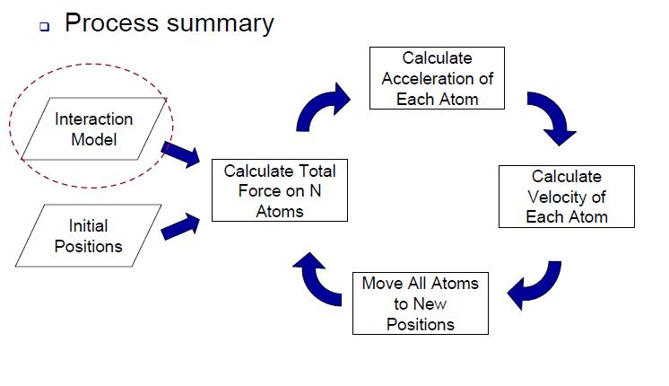
Molecular Dynamics basic process [4]
Fakultas Ilmu Komputer Universitas Indonesia

Slide 15
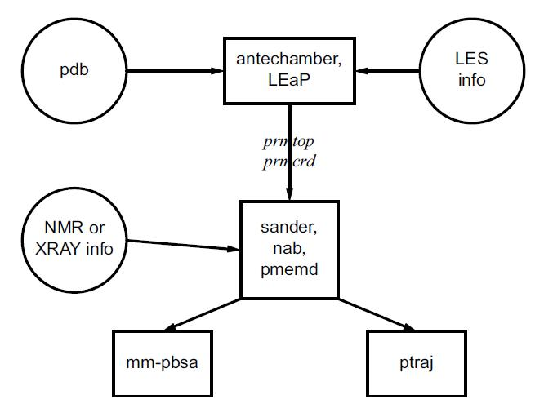
Flow of data in AMBER [8]

Slide 16
Flows in AMBER [8]
Preparatory program
LEaP is the primary program to create a new system in Amber, or to modify old systems. It combines the functionality of prep, link, edit, and parm from earlier versions.
ANTECHAMBER is the main program from the Antechamber suite. If your system contains more than just standard nucleic acids or proteins, this may help you prepare the input for LEaP.

Slide 17
Flows in AMBER [8]
Simulation
  SANDER is the basic energy minimizer and molecular dynamics program. This program relaxes the structure by iteratively moving the atoms down the energy gradient until a sufficiently low average gradient is obtained.
  PMEMD is a version of sander that is optimized for speed and for parallel scaling. The name stands for "Particle Mesh Ewald Molecular Dynamics," but this code can now also carry out generalized Born simulations.

Slide 18
Flows in AMBER [8]
Analysis
  PTRAJ is a general purpose utility for analyzing and processing trajectory or coordinate files created from MD simulations
  MM-PBSA is a script that automates energy analysis of snapshots from a molecular dynamics simulation using ideas generated from continuum solvent models.

Slide 19
The RAD GTPase Protein
RAD (Ras Associated with Diabetes) is a family of RGK small GTPase located inside human body with diabetes type 2. The crystal form of Rad GTPase has resolution of 1,8 angstrom.
The crystal form of RAD GTPase is stored in d Protein Data Bank (PDB) file.
Ref: A. Yanuar, S. Sakurai, K. Kitano, Hakoshima, dan Toshio, “Crystal structure of human rad gtpase of the rgk-family,” Genes to Cells, vol. 11, no. 8, pp. 961-968, Agustus 2006

Slide 20
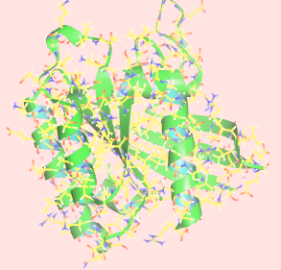


RAD GTPase Protein
Reading from PDB with NOC:
The leap.log reading:
number of atom 2529
Fakultas Ilmu Komputer Universitas Indonesia

Slide 21
Parallel approach in MD simulation
Algorithms for fungsi force:
  data replication
  Data distribution
Data decomposition
  Particle decomposition
  Force decomposition
  Domain decomposition
  Interaction decomposition
Fakultas Ilmu Komputer Universitas Indonesia

Slide 22
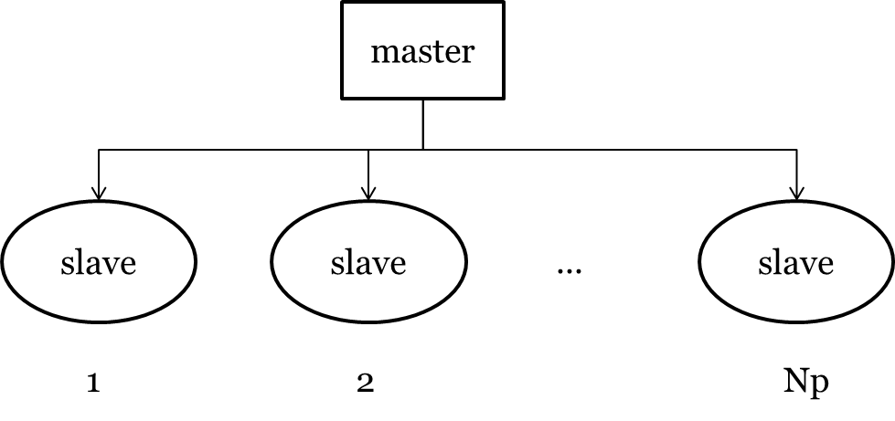
Parallel implementation in AMBER
Atoms are distributed among available processors (Np)
Each Execution nodes / processors compute force function
Updating position, computing parsial force, ect.
Write to output files
Fakultas Ilmu Komputer Universitas Indonesia

Slide 23
Experiment results
Fakultas Ilmu Komputer Universitas Indonesia

Slide 24
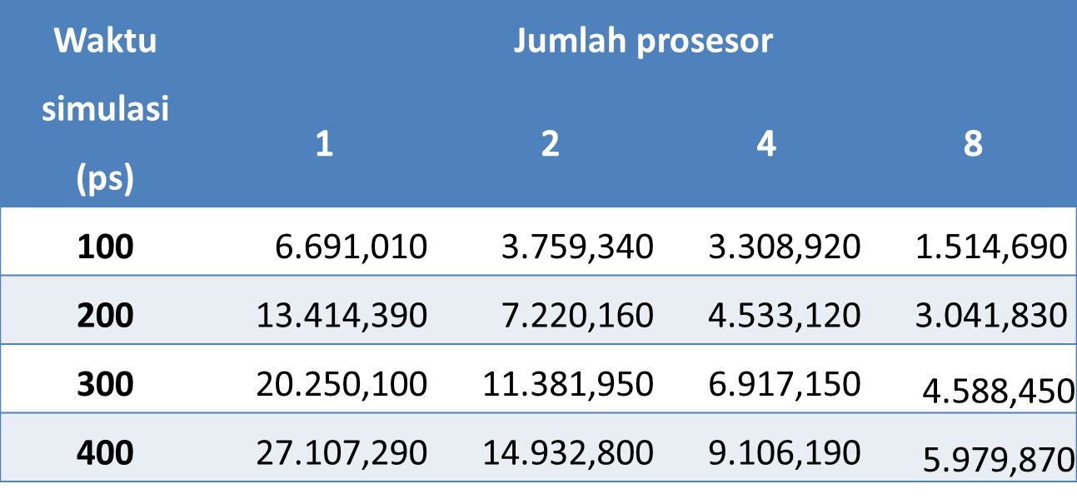
Execution time with In Vacuum
Fakultas Ilmu Komputer Universitas Indonesia

Slide 25
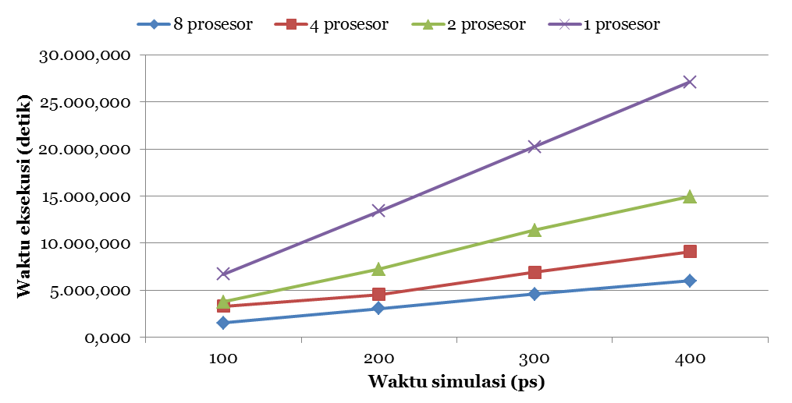
Execution time for In Vacuum
Fakultas Ilmu Komputer Universitas Indonesia

Slide 26
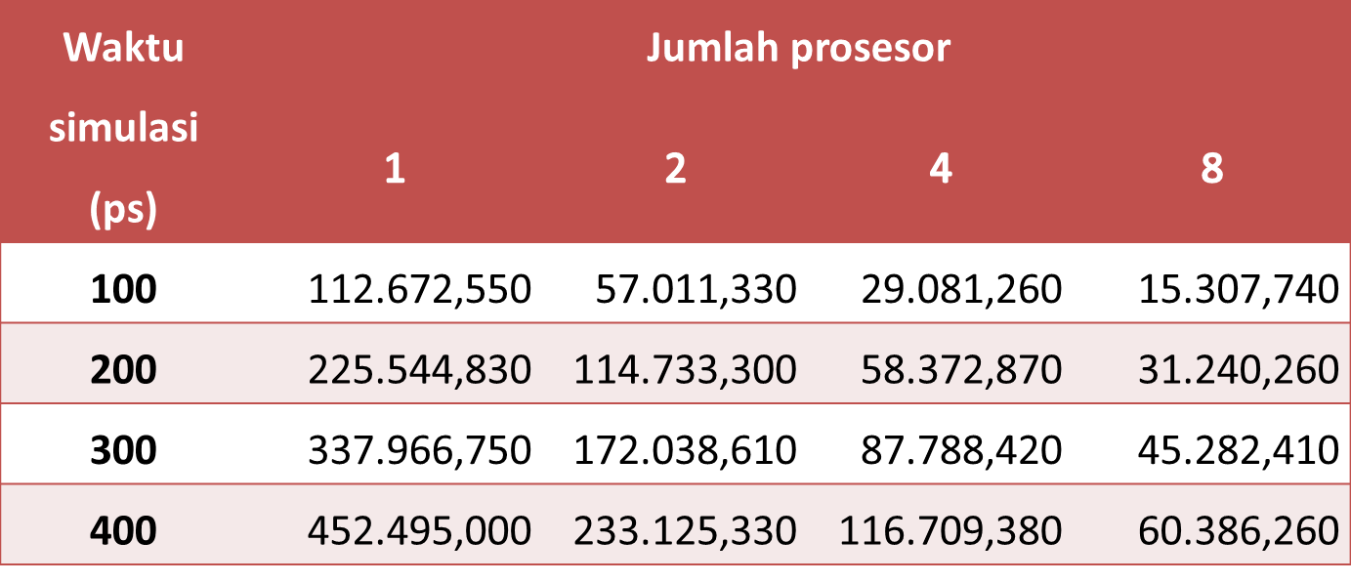
Execution time for Implicit Solvent with GB Model
Fakultas Ilmu Komputer Universitas Indonesia

Slide 27
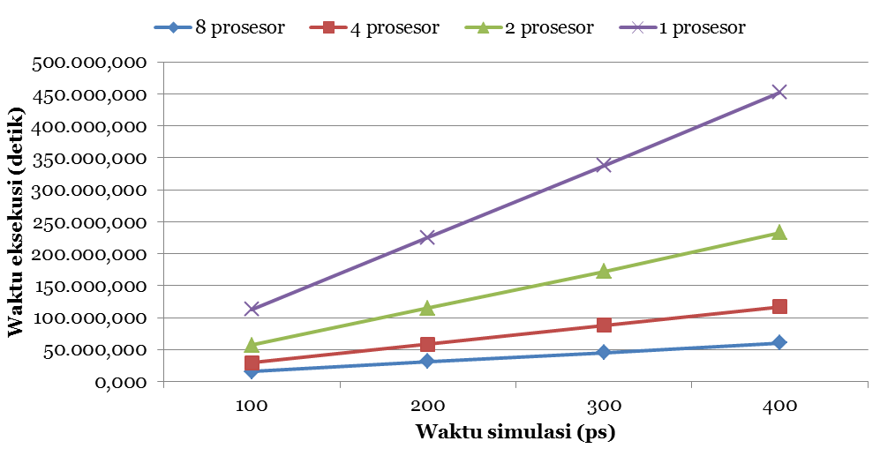
Execution time for Implicit Solven with GB Model
Fakultas Ilmu Komputer Universitas Indonesia

Slide 28
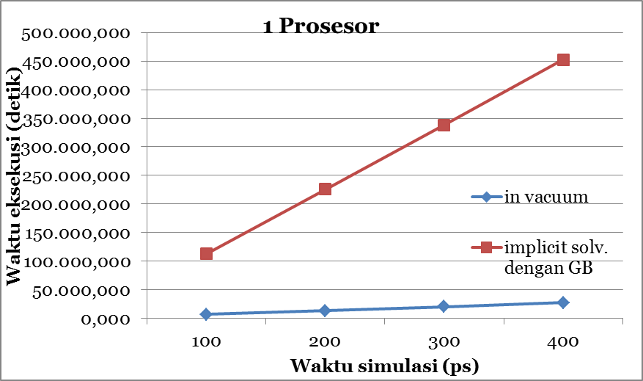
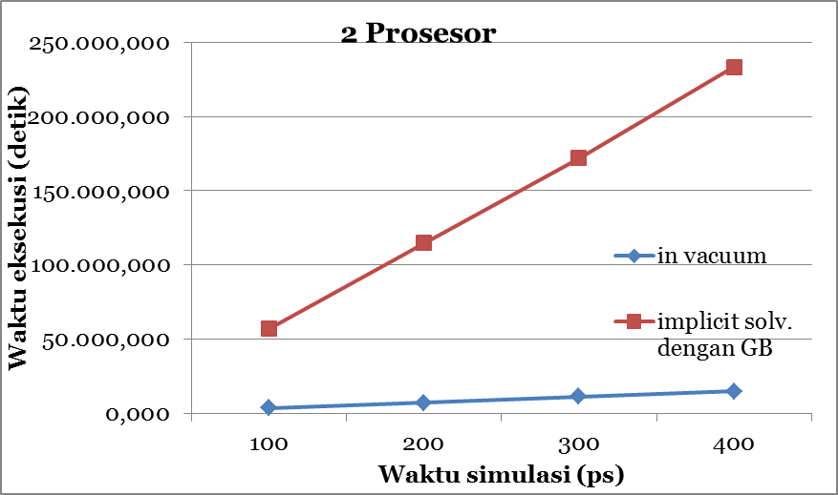
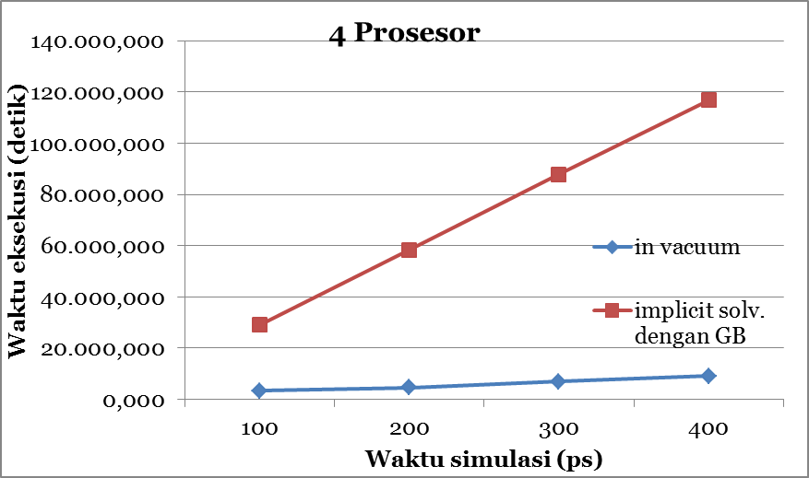
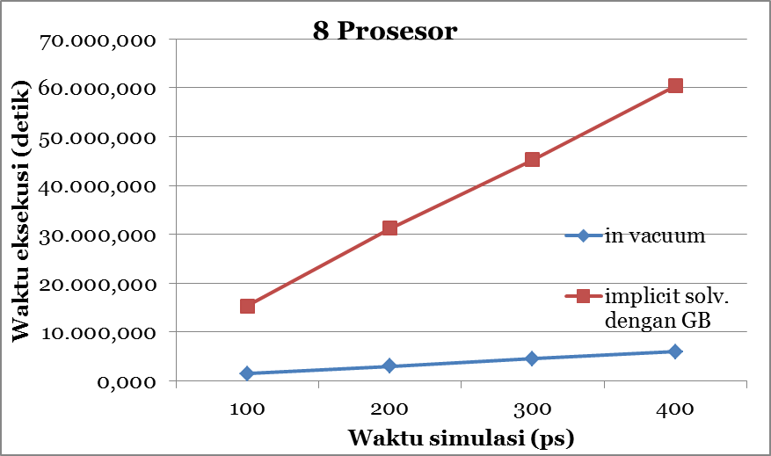
Execution time comparison between In Vacuum and Implicit Solvent with GB model
Fakultas Ilmu Komputer Universitas Indonesia

Slide 29
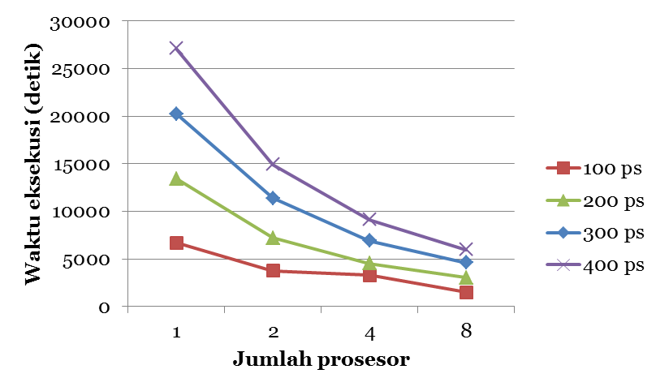
The effect of Prosesor number on MD simulation with In Vacuum
Fakultas Ilmu Komputer Universitas Indonesia

Slide 30
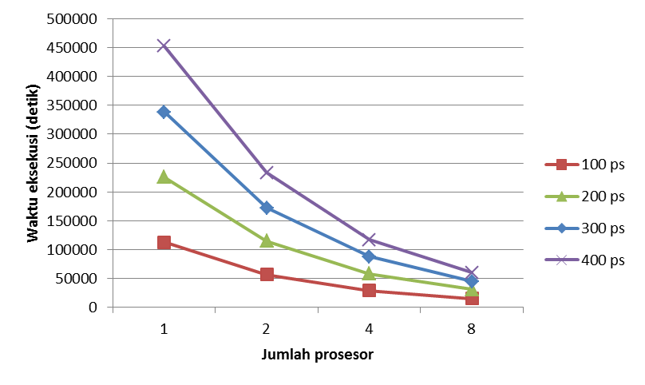
The effect of processors number at MD simulation with Implicit Solvent with GB Model
Fakultas Ilmu Komputer Universitas Indonesia

Slide 31
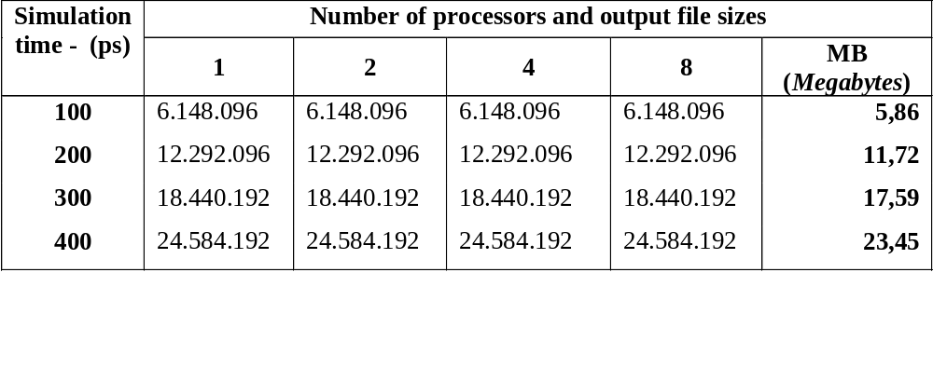
Output file sizes as the simulation time grows – in vacum

Slide 32
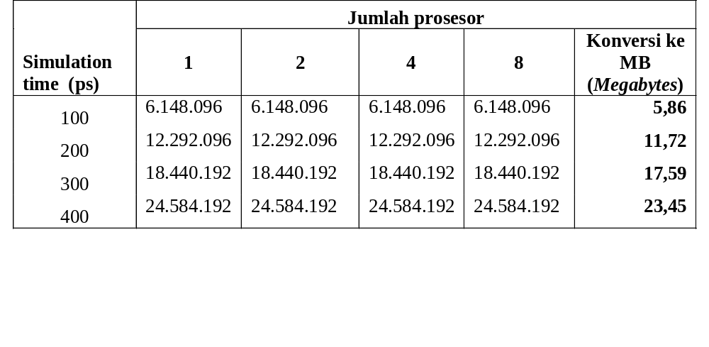
Output file sizes as the simulation time grows –
Implicit solvent with GB model

Slide 33
Gromacs on the Pharmacy Cluster
This cluster is built to back up the Hastinapura Cluster which has storge problems.

Slide 34
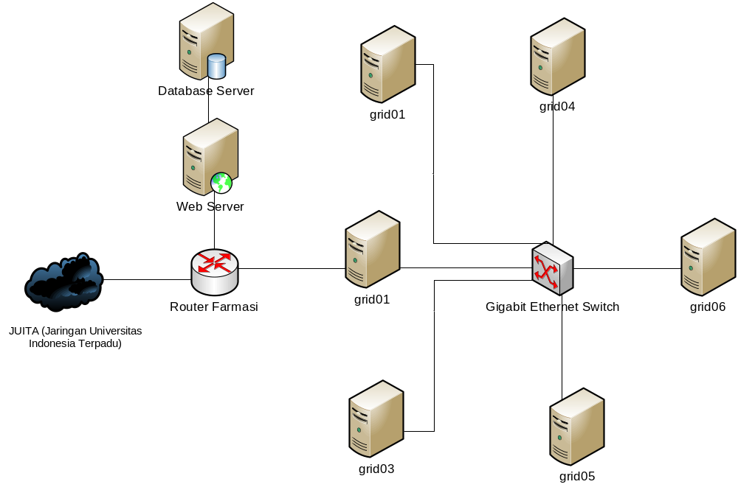
Network Structure of Pharmacy Cluster

Slide 35
Software
MPICH 2 1.2.1
Installed Gromacs 4.0.5

Slide 36
Installation Steps
Installing All node with Ubuntu CD
Configuring NFS (Network File System)
Installing MPI
Installing Gromacs Application

Slide 37
Problems
Everything work fine in the first a few months, but after the nodes have been used for 5 months, the nodes often crashed when its running simulation
Crashed means, for example if we run gromacs simulation in 32 nodes (now the clustes consisting of 6 four cores PC), the execution node one by one collapse after a few times
Unreliable electrical supplies

Slide 38
Sources of problems?
Network Configuration or
NFS Configuration or
HW Problem, NIC, Switch or
Processor Overheat

Slide 39
Problems – Error Log
Fatal error in MPI_Alltoallv: Other MPI error, error stack:
MPI_Alltoallv(459)................: MPI_Alltoallv(sbuf=0xc81680, scnts=0xc60be0, sdispls=0xc60ba0, MPI_FLOAT, rbuf=0x7f7821774de0, rcnts=0xc60c60, rdispls=0xc60c20, MPI_FLOAT, comm=0xc4000006) failed
MPI_Waitall(261)..................: MPI_Waitall(count=8, req_array=0xc7ad40, status_array=0xc6a020) failed
MPIDI_CH3I_Progress(150)..........:
MPID_nem_mpich2_blocking_recv(948):
MPID_nem_tcp_connpoll(1709).......: Communication error
Fatal error in MPI_Alltoallv: Other MPI error, error stack:
MPI_Alltoallv(459)................: MPI_Alltoallv(sbuf=0x14110e0, scnts=0x13f0920, sdispls=0x13f08e0, MPI_FLOAT, rbuf=0x7f403eb4c460, rcnts=0x13f09a0, rdispls=0x13f0960, MPI_FLOAT, comm=0xc4000000) failed
MPI_Waitall(261)..................: MPI_Waitall(count=8, req_array=0x140c7b0, status_array=0x1408c90) failed
MPIDI_CH3I_Progress(150)..........:
MPID_nem_mpich2_blocking_recv(948):

Slide 40
Next targets
Currently we are running experiments on GPU as well, the results will be available soon,
Solving the cluster problems (considering Rocks),
Clustering PCs at 2 students lab (60 and 140 nodes), and run experiments in the “nights/holidays” periods,
Rebuilding the grid,
Sharing some resources to PRAGMA.
Your advices are very important and useful, Thank you!

Slide 41
References
[1]http://www.cfdnorway.no/images/PRO4_2.jpg
[2]http://sanders.eng.uci.edu/brezo.html
[3]http://www.atg21.com/FigH5N1jcim.png
[4] A. Martini, “Lecture 2: Potential Energy Functions”, 2010, [Online]. Tersedia di: http://nanohub.org/resources/8117. [Diakses pada 18 Juni 2010].
[5]http://www.dsimb.inserm.fr/images/Binding-sites_small.png
[6]http://thunder.biosci.umbc.edu/classes/biol414/spring2007/files/protein_folding(1).jpg
[7]http://www3.interscience.wiley.com/tmp/graphtoc/72514732/118902856/118639600/ncontent
[8] D. A. Case et al., “AMBER 10”, University of California, San Francisco, 2008, [Online]. Tersedia di: http://www.lulu.com/content/paperback-book/amber-10-users-manual/2369585. [Diakses pada 11 Juni 2010].
Fakultas Ilmu Komputer Universitas Indonesia

