Slide 1


Calling the Cloud:
Connecting Mobile Devices to the Grid.
Joel Tucci
University of Tsukuba

Slide 2
Motivations
Pervasive Computing is rapidly becoming just that, quite pervasive.
People carrying around a large number of internet enabled devices.
With a lot of sensors built in, and the capability to add even more sensors via external devices.
  Cell phones will be huge enablers of “citizen science”
But how do we manage all the data?

Slide 3
Why Gfarm?
Open source
Extremely scalable
Secure
Designed for e-science
  Useful to have your data uploaded to the same file system used to process it.

Slide 4
Why not Dropbox?
The Dropbox server system is NOT open source!
Impossible to deploy your own server
  Data essentially is always “remote”, must be copied to cluster before processing.
  Legal issues
    Medical privacy, security etc.

Slide 5
Why the iPhone?
One of the most popular smart phones.
Very mature set of development tools.
Can connect external devices/sensors to the phone.

Slide 6
Design Goals
Be as lightweight as possible.
  Space, and especially memory, are quite scarce.
    No unnecessary frameworks
Be easily incorporated into other code
  Export everything as a library.

Slide 7
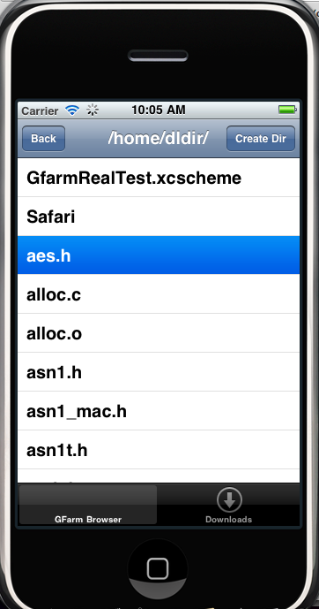
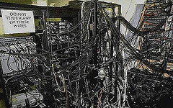
Architecture
Client
Applications
Gfarm Client Library
Gfarm-iPhone Bridge
Metadata management
Security
Caching
Gfarm servers

Slide 8
Reducing Bandwidth
Compression
  Zlib compression offers better battery life, especially for highly compressible files such as text.
Rabin fingerprinting
  Breaks files into chunks.
  Useful for updates with small changes.

Slide 9
Demonstration

