Slide 1
Bio Applications Virtualization using Rocks
Nadya Williams
nadya@sdsc.edu
UCSD

Slide 2
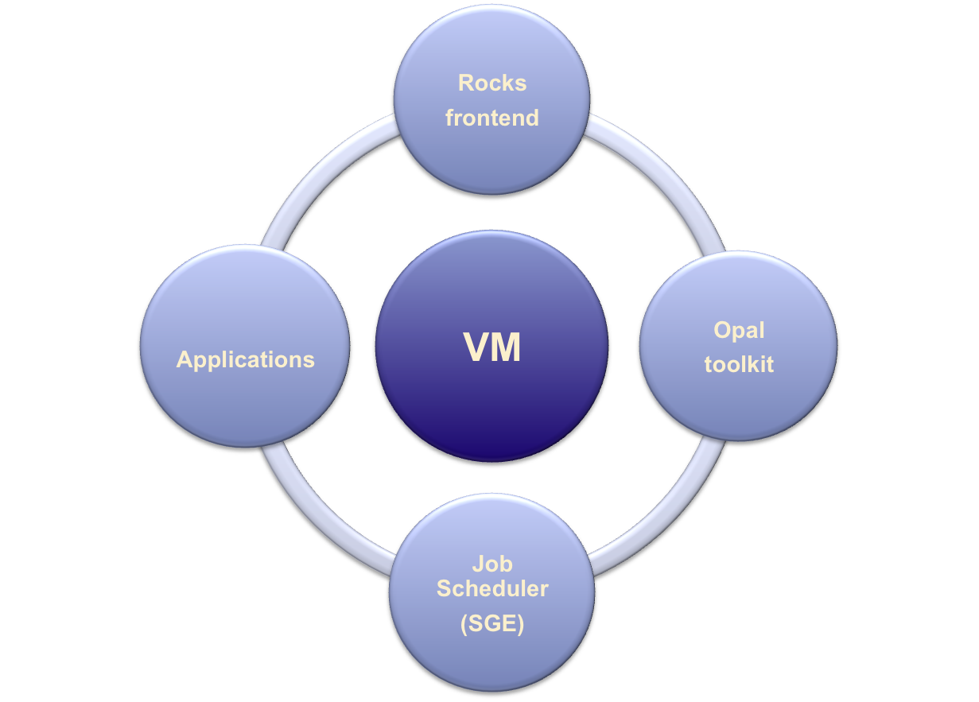
VM configuration key parts
all networking
all services
configuration
configuration
app deployment
master
working nodes

Slide 3
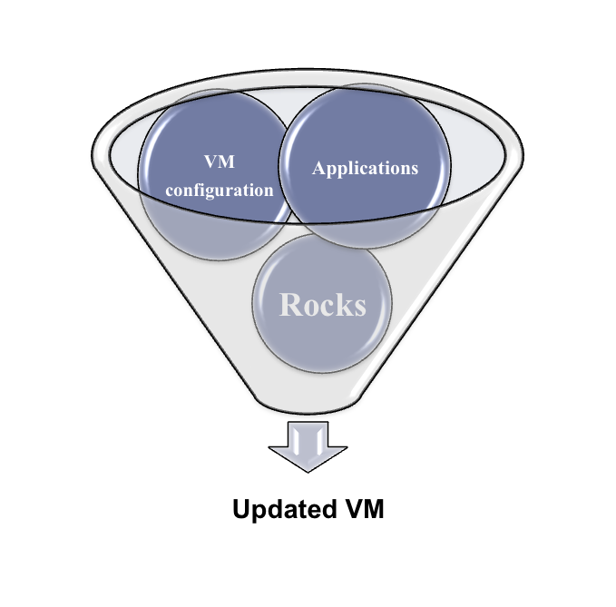
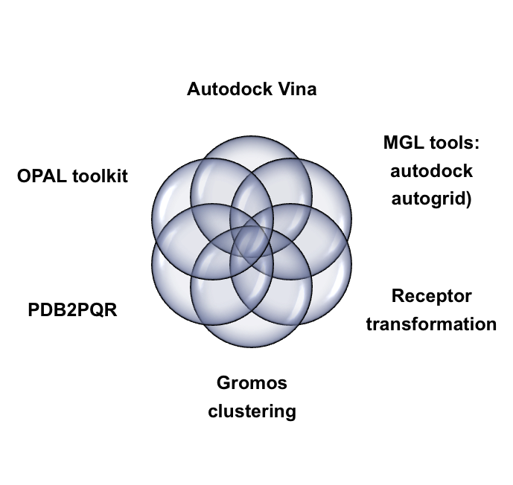

VM reconfiguration
Applications

Slide 4
One host as an example: rocsk-214.sdsc.edu

Slide 5
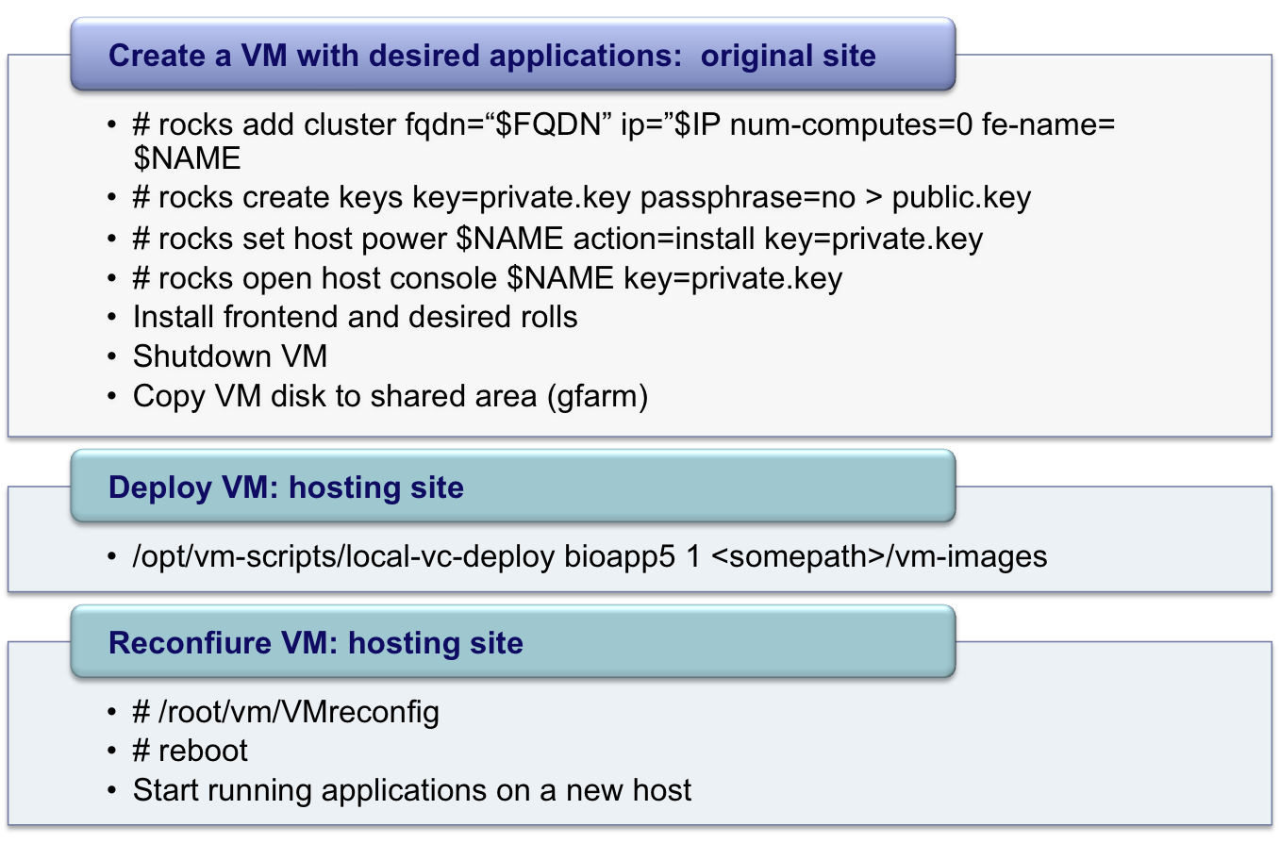
VM creation and deployment process
Run
one time
Run
many
times

Slide 6
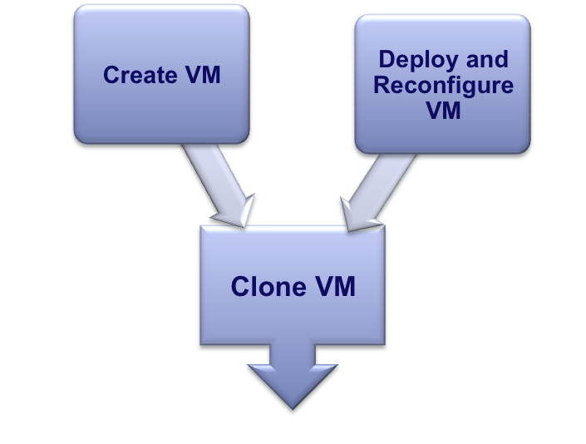
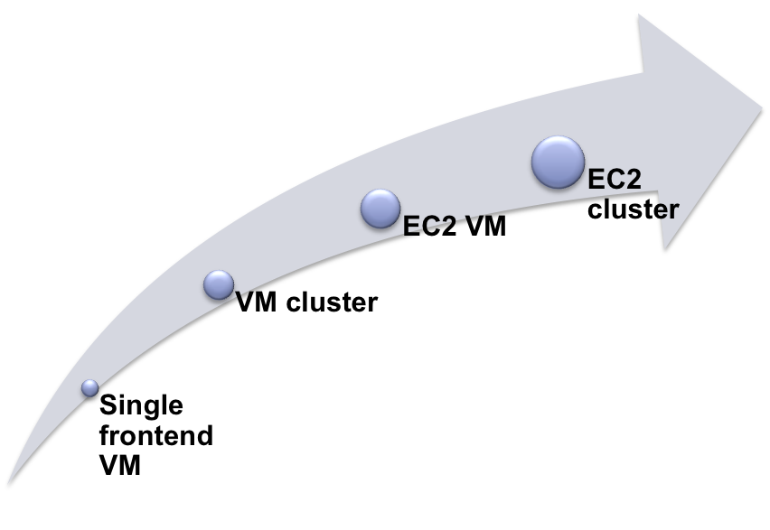
How we can use VM
Notes:
The aim is to have cooperation between IT infrastructure providers and computational scientists from different academic institutions.

Slide 7
Lessons learned
Focus on minimizing “time to uptime” through easy automatic VM setup
  Simplification, Unification and Automation of the VM creation (tight integration with Rocks environment)
  Easy automated reconfiguration
  Easy automated deployment into existing environment
Guarantee reproducibility
Interoperability
  Create VM anywhere – deploy anywhere. Works now with Rocks.
  Get missing features by creating “bridges” between different Virtualizations
Future work
  Extend to VM cluster deployment
  Extend to EC2 deployment
  Convert Xen VM image into KVM

Slide 8
Historical Lessons …
Inscription on an ancient Jade plate
Pang made this treasured vessel.
May it be used and treasured by
my descendents for 10 000 years.

