Slide 1
21st Century Science and Education for Global Economic Competition
NATIONAL SCIENCE FOUNDATION
William Y.B. Chang
Director, NSF Beijing Office
wychang@nsf.gov

Slide 2
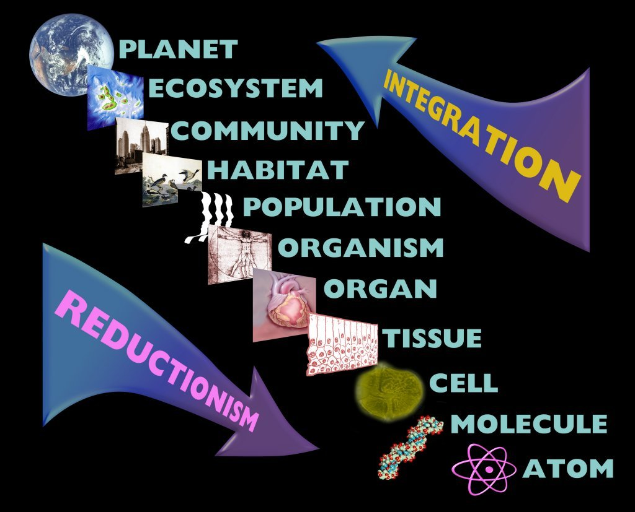
21st Century Science Research
Multidisciplinary
Multidimensional
Information-driven
Internationally engaged
Notes:
BIO funds the biology of the 21st century

Slide 3
21st Century Science
“Domestic and international collaborations are expanding in response to the complexities of new scientific fields, the growing scale and scope of scientific initiatives, new capabilities provided by advances in information and communications technologies, professional ties established during study or work abroad, and explicit government policies and incentives.”
Source: U.S. National Science Board,
Science and Engineering Indicators - 2004

Slide 4
Integrating research and education projects, programs, and networks to create constellations of scholars…
2
2
1
1
“… the 21st century is going to see a cohesion of the sciences and disappearance of their borders.”
- David Baltimore
5
4
3
5
3
4
4
2
1
6
3
1
3
5
5
2
… to stimulate innovation…
4

Slide 5
Solving the innovator’s dilemma
Competency
Innovations
Biological Sciences
Sustainability science
Computer Science
and Engineering
Complex systems
Mathematical
and Physical Sciences
Informatics
Social, Behavioral and
Economic Sciences
Genomics/proteomics
Geological Sciences
Capacity building
International S&E
Integrating formal and
practical knowledge
Education and
Human Resources
?

Slide 6
From understanding to application…
Development & Training
Service to Society
Assessment & Reporting
Broadening
Access
Basic
Research
&
Education
Networking &
Partnerships
Education
Research & Scholarship
Strategies for Change
Policy, Planning, & Administration
Solution Options
Physical Operations & Infrastructure
Community
Embeddedness
Knowledge Sharing & Product Development
…from disciplines to transformative research & education.

Slide 7
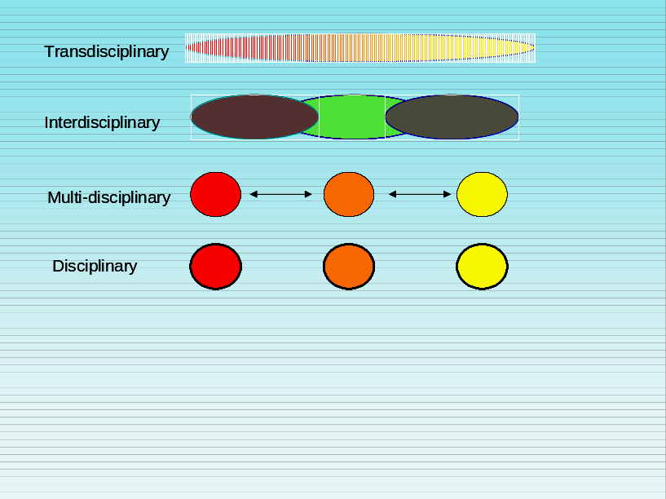
Transformative research and education:
Research that has the potential to revolutionize an existing discipline through a paradigm shift or create a new one. Transformative research is often high risk research with a high potential for significantly advancing a field of study.
A model system to foster these ideas and values…?
Notes:
The first sentence of this definition of transformative research was taken from the 12/16/2004 NSB/CPP charge memo to the Task Force on Transformative Research (http://www.nsf.gov/nsb/committees/cpptrcharge.htm).

Slide 8
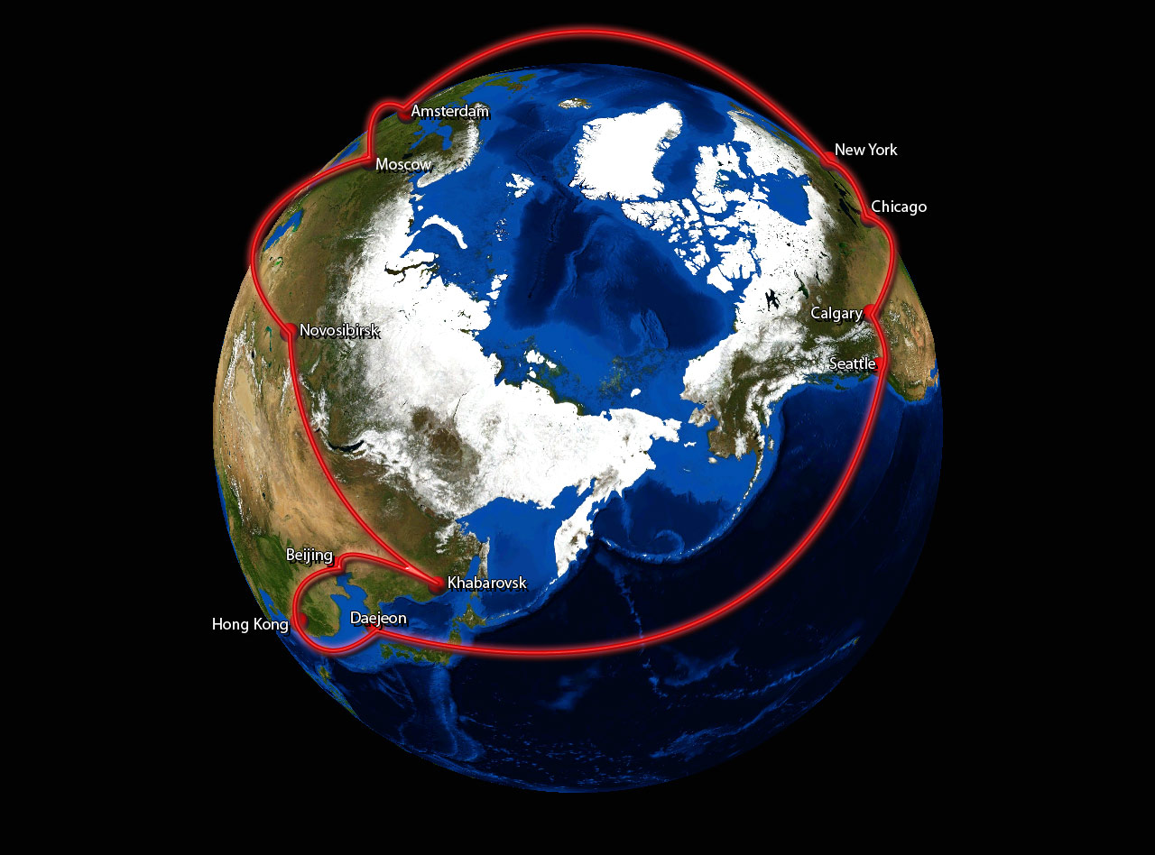
Cyberinfrastructure
Global-Ring Network for Advanced Science and Education (GLORIAD)

Slide 9

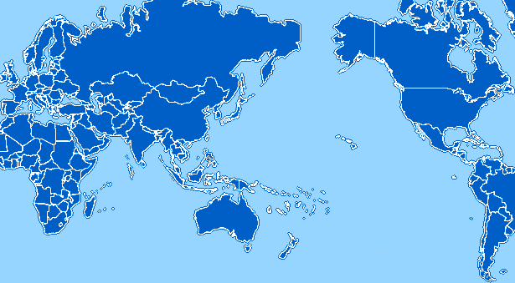

Cyber infrastructure
CNIC, China
GUCAS, China
Pacific Rim Applications Grid Middleware Assembly (PRAGMA)
Notes:
[Slide 5: PRAGMA]
PRAGMA, the Pacific Rim Applications Grid Middleware Assembly, is another excellent example of joint work to create middleware that enables scientists from China and the U.S. to collaborate globally. PRAGMA promotes effective data sharing through secure systems interfaces that are responsive to the scientific needs of the researchers. NSF would like to thank Professor YEN, BOW-PING for CAS’ contributions to making these, and many other programs, a reality.

Slide 10
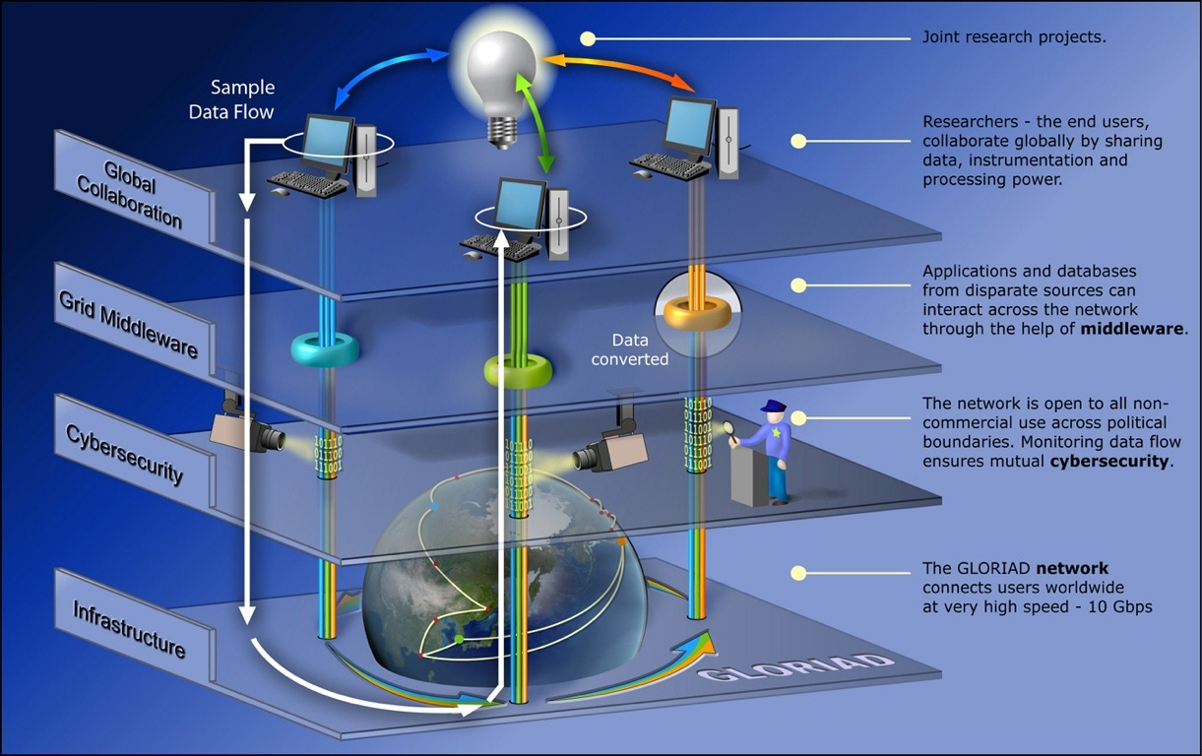
Integrated Cyberinfrastructure
The Global Ring Network for Advanced Applications Development, or GLORIAD, provides a network of high-speed computing capability to scientists and engineers around the Northern Hemisphere. Through the use of grid middleware, the GLORIAD network allows applications and data from disparate sources to be worked on collaboratively by researchers across international boundaries.
Credit: Zina Deretsky, National Science Foundation
GLORIAD is, at heart, a community building program

Slide 11
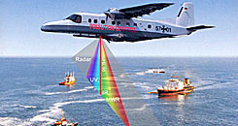

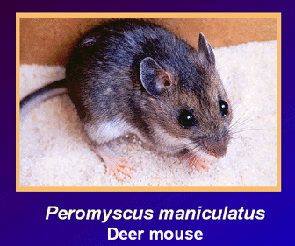

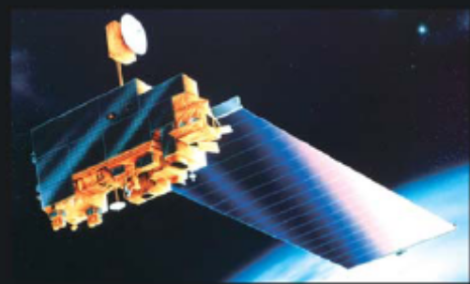
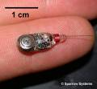
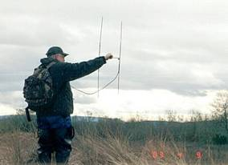
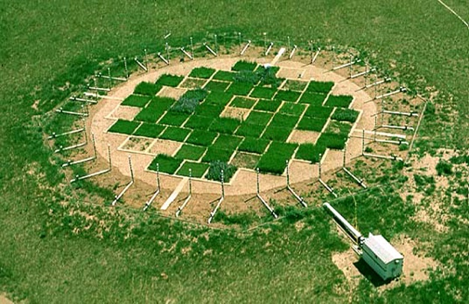
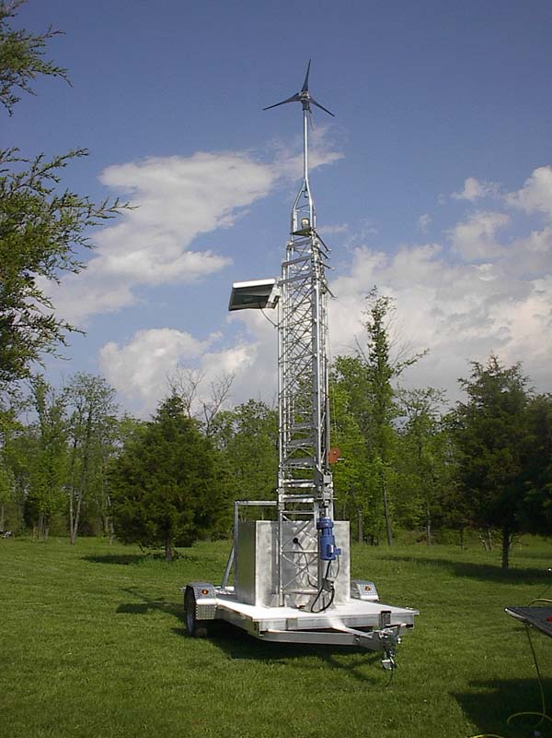
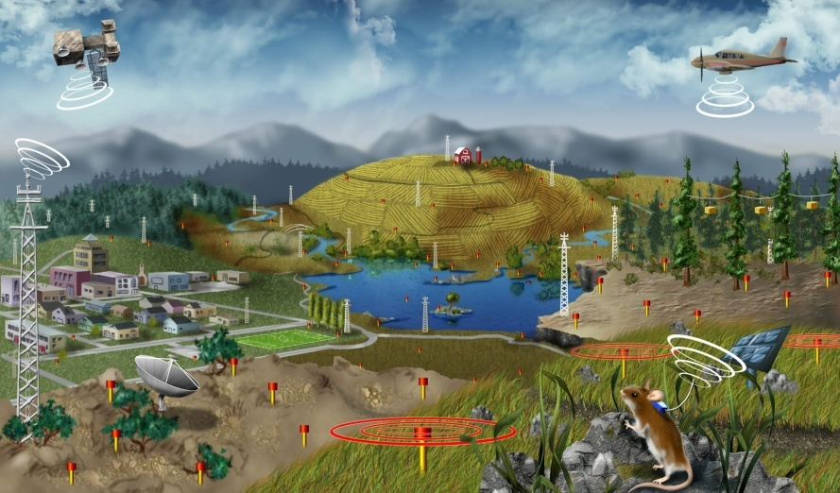
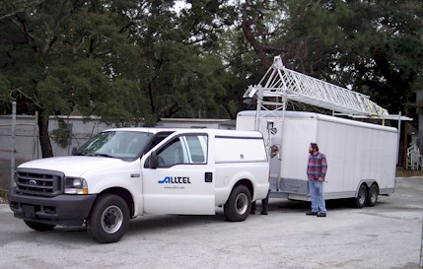
Continental Infrastructure Deployment
Remote Sensing
Sentinel
Experimental
Infrastructure
National Ecological Observatory Network (NEON)
Sensors & Instruments
Fixed
Mobile
Notes:
Depiction of the infrastructure that will be deployed at the core and gradient sites. In addition, a mobile capability is included to rapidly respond to episodic events such as hurricanes, wildfires, regional droughts, etc.
To scale from the local sites to the continental scale the design includes aircraft borne remote sensing and satellite based remote sensing.

Slide 12
Globalization
Two New Developments
Information Technology
The World is Flat

Slide 13
Global Economy
More Closely Integrated Global Economy
Competition for Global Resources and Talent

Slide 14
New Knowledge Economy
Increase
  R&D Investment
  Education
  Infrastructure

Slide 15
Maintaining Economic Competitiveness for Globalization
Develop Valuable Marketable Technologies -Invest in fundamental research at the beginning of the innovation food chain
Prepare Science, Engineering and Technology Workforce –
Train the generation of workers at the breaking frontier of science and engineering
Invest in Facilities & Instrumentation –
Build world-class facilities to attract top international partners
and to provide citizens of the world with new knowledge and technology.

Slide 16
Equation for prosperity
Talent +Education =
New discoveries =
Innovation + new products and services =
High-quality jobs + greater productivity =
Sustained economic growth.

Slide 17
PRAGMA Institute
  Expand and share regional
  R&D accomplishments
  Provide opportunities for training and sharing of cutting-edge technologies
  Develop world class facilities and infrastructure among PRAGMA Institutes

Slide 18
PRAGMA Educational Center at the NCHC Center in Taichung

Slide 19
Thank You

