Slide 1
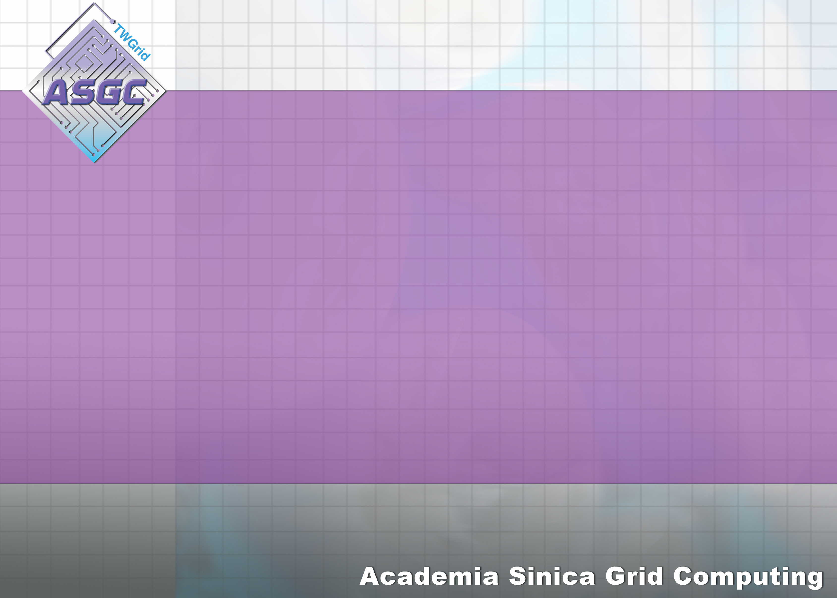
Avian Flu Data Challenge
Hsin-Yen Chen
ASGC
29 Aug. 2007
APAN24

Slide 2
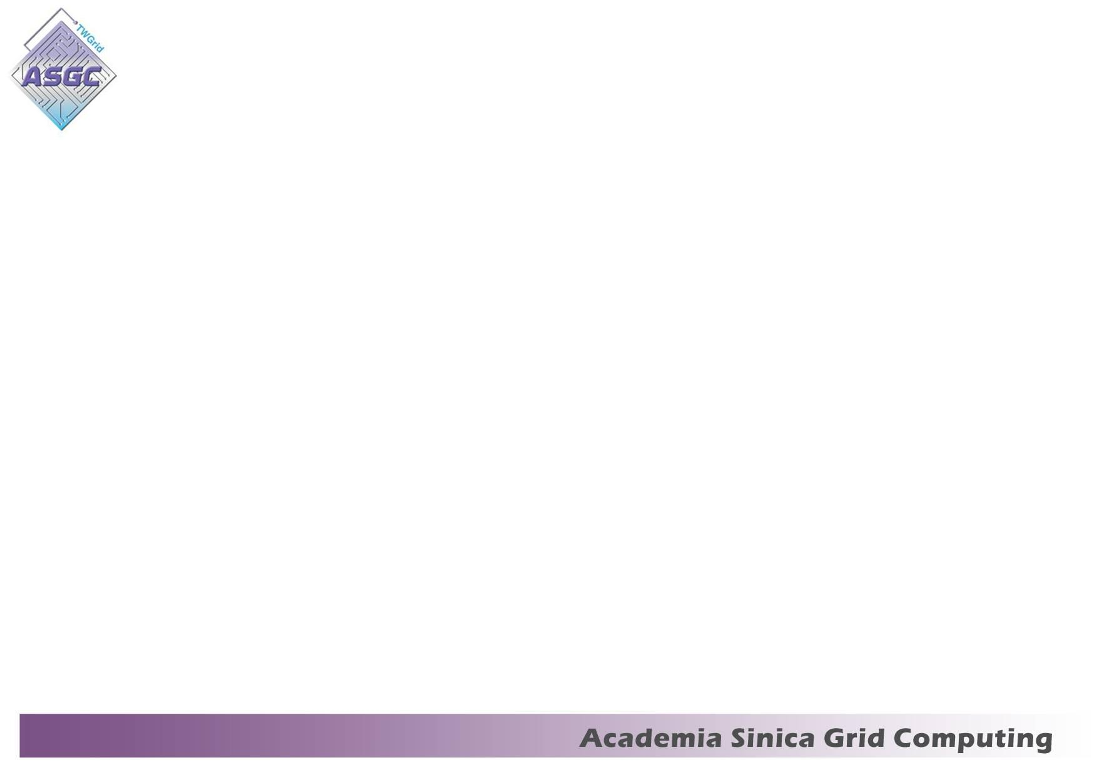
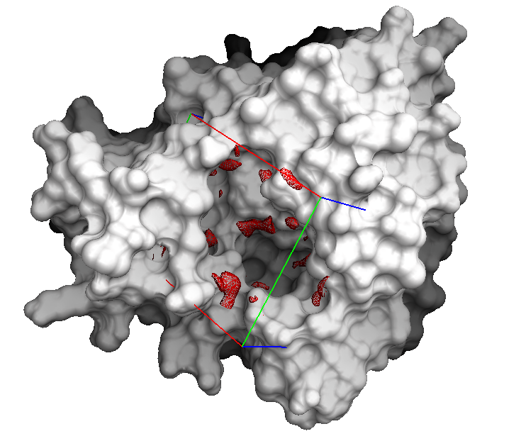
Drug Analysis: Modeling Complex
Targets
Compound
2D compound library
Lipinski’s RO5
“drug-like”
Data challenge on EGEE,
Auvergrid, TWGrid
~6 weeks on ~2000 computers
8 structures (including 1 original type)
structure generation
energy minimization
Molecular docking (Autodock)
~137 CPU years, 600 GB data
3D structure
Grid
Data Challenge
translation / step=2.0 Å
quaternion / step =20 degree
torsion / step= 20 degree
number of energy evaluation
=1.5 X 10⁶
max. number of generation
=2.7 X 10⁴
run number =50
ionization
tautermization
3D structure library
selection
308,585 (6 known drugs)
Notes:
To understand the benefits of Grid for drug analysis, in last April, we initiate a large scale in-silico screening on the Avian Flu virus by taking into account the possible N1 mutations and a set of 300,000 compounds. The goal is to
1. To analyze the efficiency of the known drugs to the possible mutations
2. To provide information for biochemists to have better response to the large-scale pandemic if the human-to-human transmission happens
By using the Grid, efficiency and flexibility are confirmed and achieved by quickly deployment of the Grid docking services to shorten the time to model over 24M of complexes.

Slide 3
Lessons learned from the 1st Grid DC
In general, grid is helpful; however … the application interface is not friendly for end-users.
  Lack of a friendly user interface to launch the in-silico docking process on the Grid
Requirements concerning the post data analysis
  An easy-to-use system to simplify the access of the docking results
  An automatic refinement pipeline emulating the real wet-lab screening process (initial screening → filtering → refinement screening)
Compound preparation issue
  Compounds should be carefully selected to ensure they are purchasable from vendors.
  Compounds should be better annotated with chemical properties.
Notes:
We demonstrated that huge compound collection can be effectively enriched by executing docking tasks on Grid. (-- A estimated 137 year molecular docking process was shorten to 6 weeks by using WISDOM and DIANE frameworks)
requirements ... should be taken into account, to provide
A workflow that mimic real HTS procedures with integration of chemical information and tools for automating post-analysis is implemented in the 2nd phase.

Slide 4
2nd Avian Flu Data Challenge
Objective
  Biology goals
    Re-analyzing the mutations based on the X-ray structures
    Comparing the open and close conformations of Neuraminidase
  Grid goal
    Realizing the 2-step docking emulating the wet-lab workflow
    Stress testing the new system pushing to a production grid application service

Slide 5
Challenge overview
8 NA targets
  Close and open conformations from PDB
  Mutations at E119V, H274Y, R292K
500,000 compounds + 12 positive controls
  500,000 compounds
  300,000 from in-house collection of AS-GRC
  200,000 from SPEC library
2-step pipeline
  1st step to quickly filter out 50% non-interesting compounds (~ 100 CPU years)
  2nd step to refine the rest 50% (~ 100 CPU years)
Docking program
  Autodock v3
Docking system
  DIANE, WISDOM with improved environment for data analysis (integrated with GAP)

Slide 6
Partners
Grid collaborators
  EGEE
    CERN, Switzerland
    IN2P3/CNRS, France
    ITB/CNR, Italy
  Asian-Pacific partners
    KISTI, Korea
    NGO, Singapore
Laboratories
  Genomic Research Center, Academia Sinica, Taiwan
  Chonnam National University, South Korea
  Drug Discovery and Design Center, Shanghai Institute of Materia Medica, Chinese Academy of Sciences, China

Slide 7
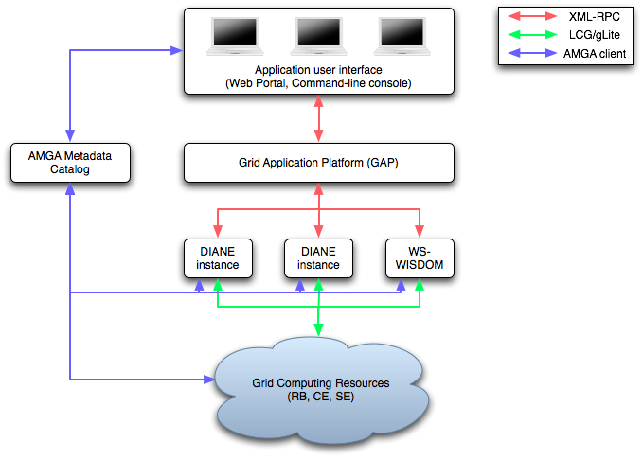
GAP in DC2
Why GAP ?
Light-weight client runs on user’s desktop
High-level interface for job configuration and data visualization
Easy to manage the distributed dockings performed by WISDOM and DIANE

Slide 8
Grid Application Platform (GAP)

Slide 9
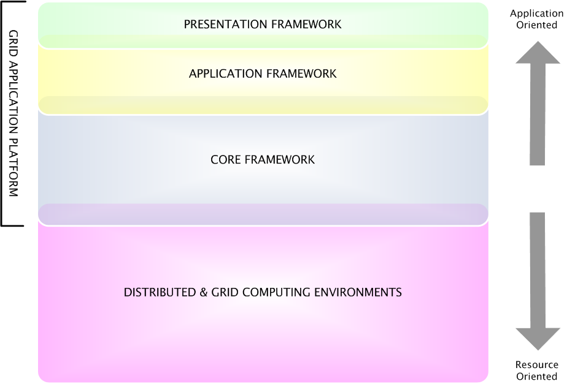
The layered GAP architecture
Reduce the effort of developing application services
Reduce the effort of adapting new technologies
Concentrate efforts on applications
Re-usable
interface components
High-level
application logic
Interfacing
computing resources
Notes:
We could roughly map the three works as three layers from bottom up on the layer called distributed and grid computing environments (services).
The layered architecture is not a new concept, but current implementation somehow overimplement each layer
We introduce a framework for each layer to clearly separate the works, defining interfaces between layers through the interconnection of the frameworks.
Abstract … Abstract … Abstract … Common APIs, extensible interfaces -> the advantage of Java and OO design pattern

Slide 10
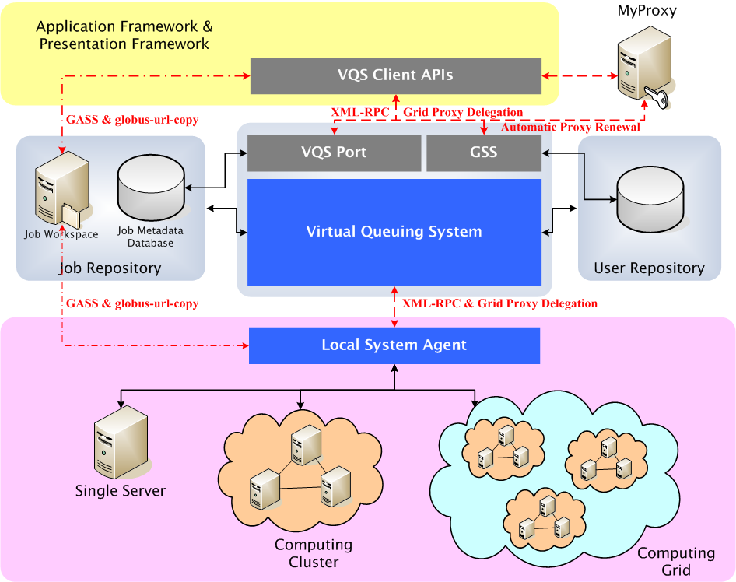
Grid Application Platform:
The architecture overview
Portable & light-weight Client
Common Interface to Heterogeneous Environment
Multi-user Environment
Service Oriented Architecture
Notes:
Three major components (VQSClient, VQS and LSA)
GASS simplifies the porting and running of applications that use file I/O to the Globus environment. Libraries and utilities are provided to eliminate the need to * manually login to sites and ftp files * install a distributed file system
GSS: Generic Security Service

Slide 11
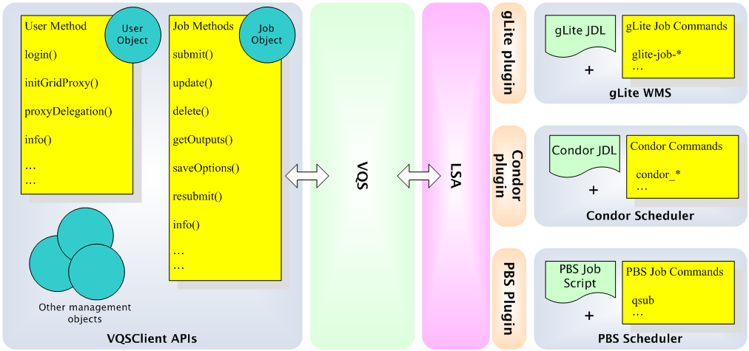
Common interface to different resources
common interface
different resources
Notes:
The most important contribution of the core framework is to convert resource diversity into a set of well-defined common APIs
In the future, we’d like to support both gLite and OSG/Condor, user could just using the API/libraries to organize his workflow and all the jobs will be taken care by the Grid
Currently, the AutoDocking services have been implement upon GAP, performance evaluation is undergoing to verify the effectiveness of GAP itself.

Slide 12
Demo
VQSClient command-line shell
  the VQSClient is based on a JAVA interpreter
Configure the properties of the current VQSClient shell
VQS [1]: config();

Slide 13
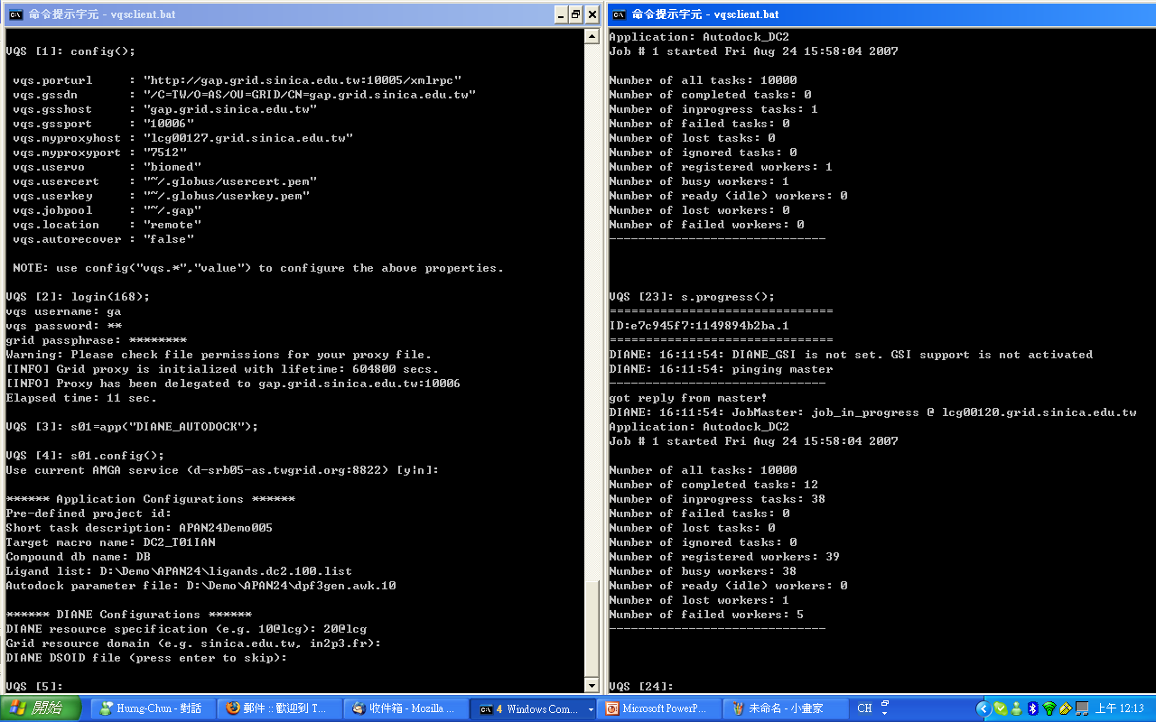

Slide 14
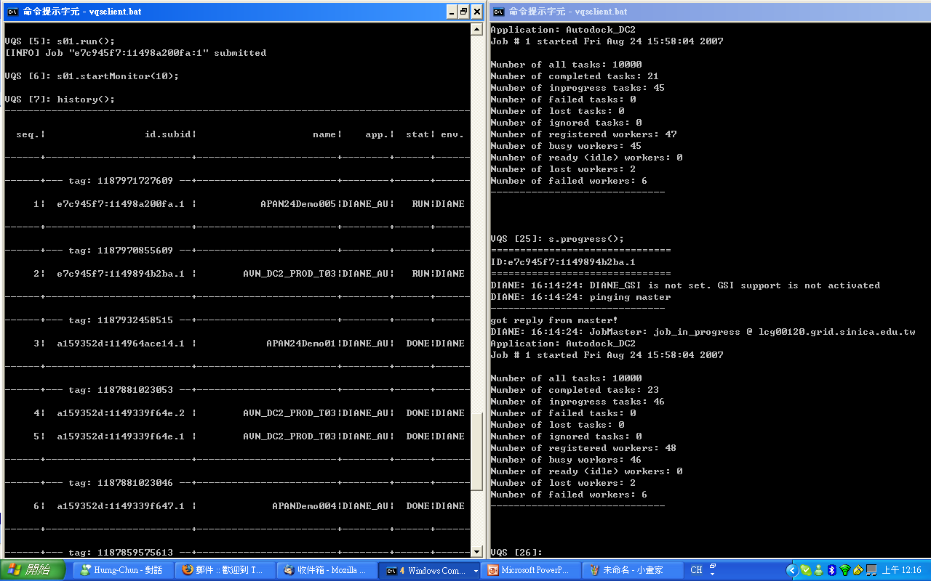

Slide 15
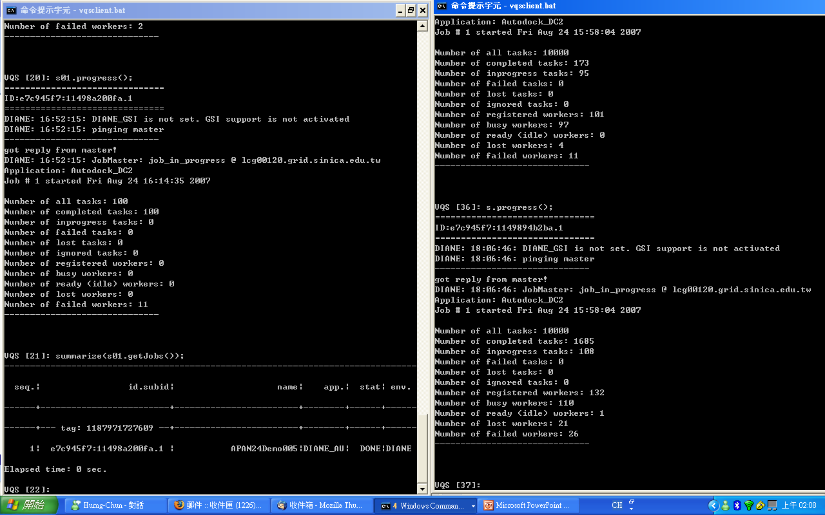

Slide 16
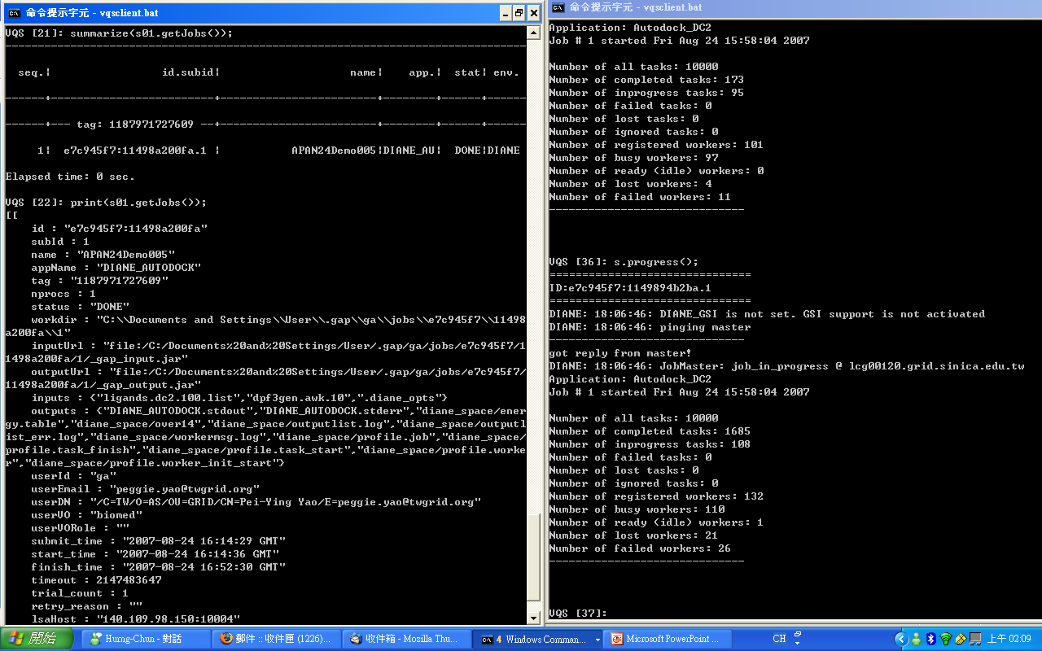

Slide 17
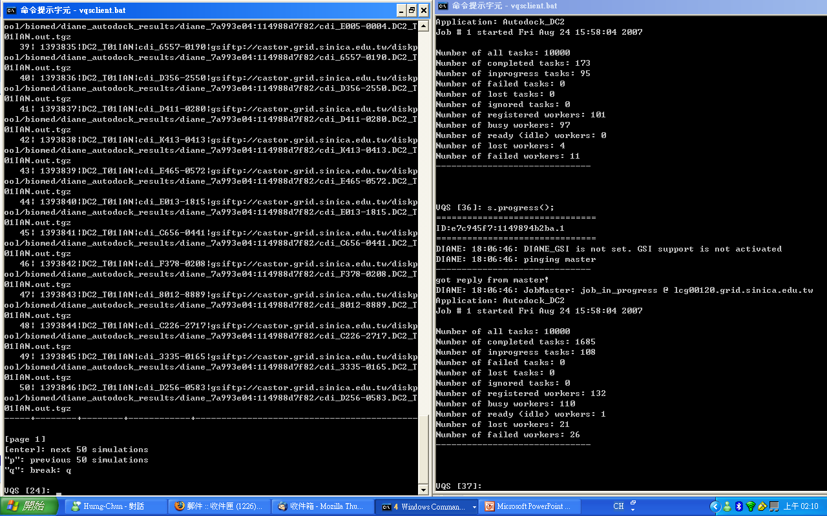

Slide 18
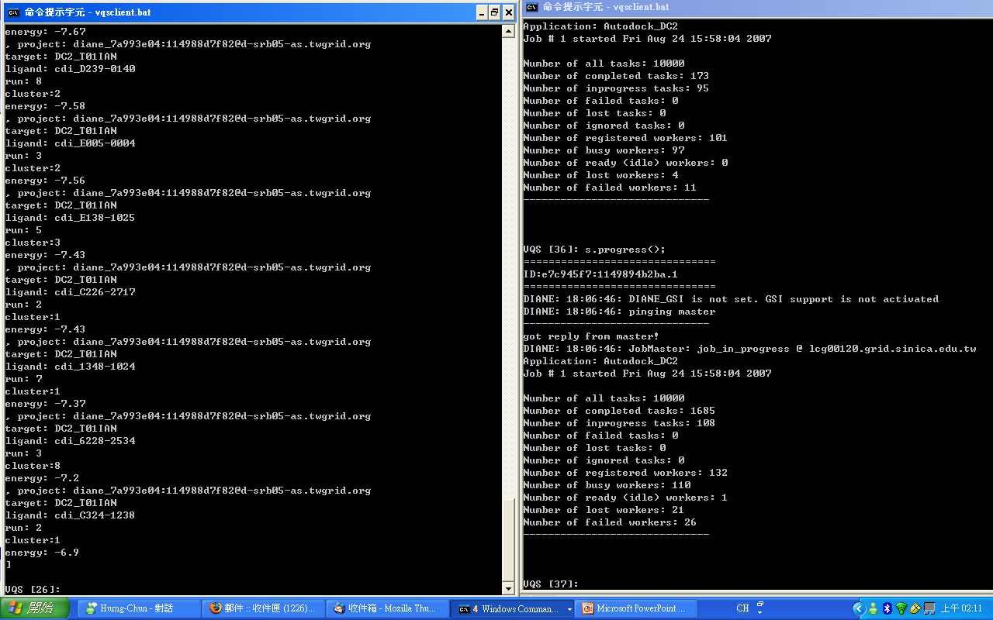

Slide 19
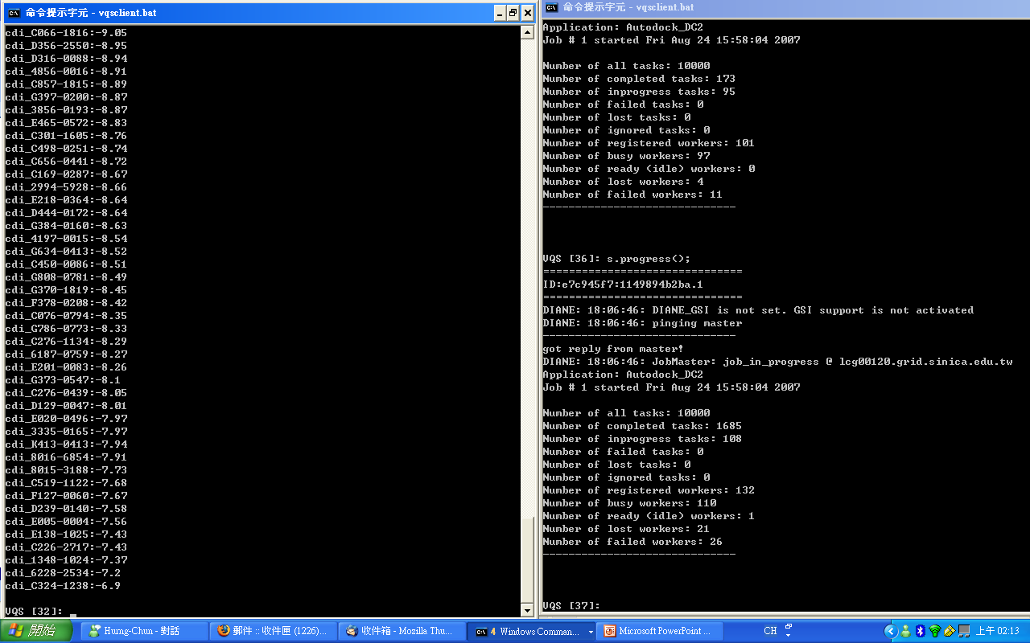

Slide 20
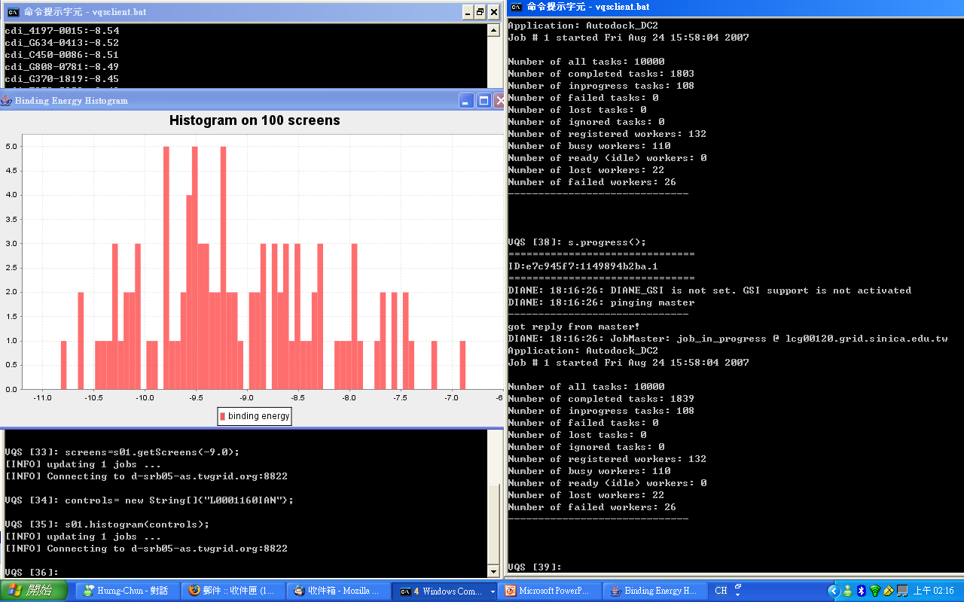

Slide 21
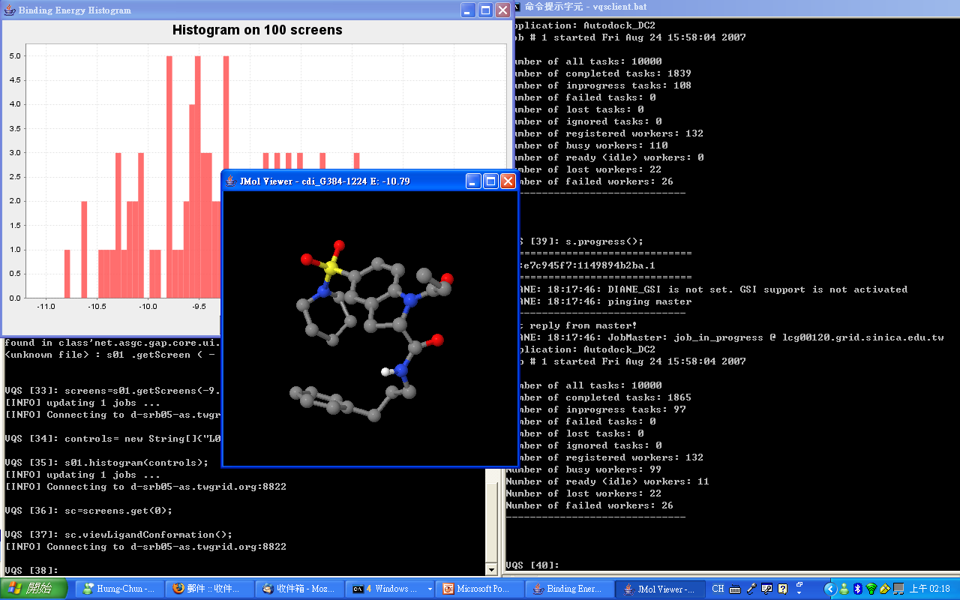

Slide 22
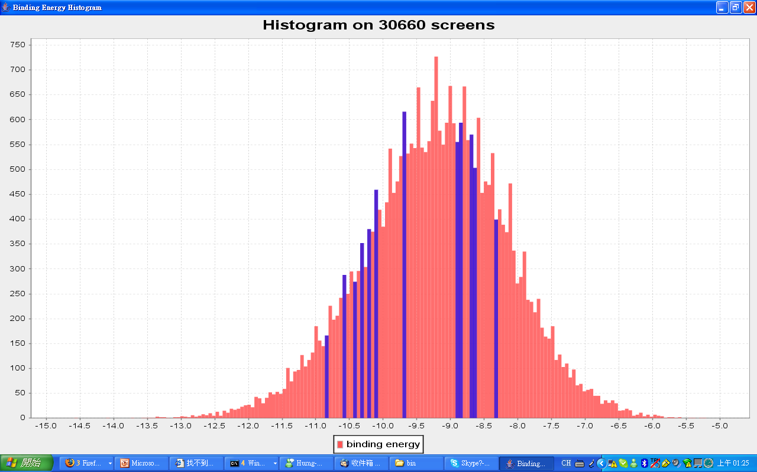

Slide 23
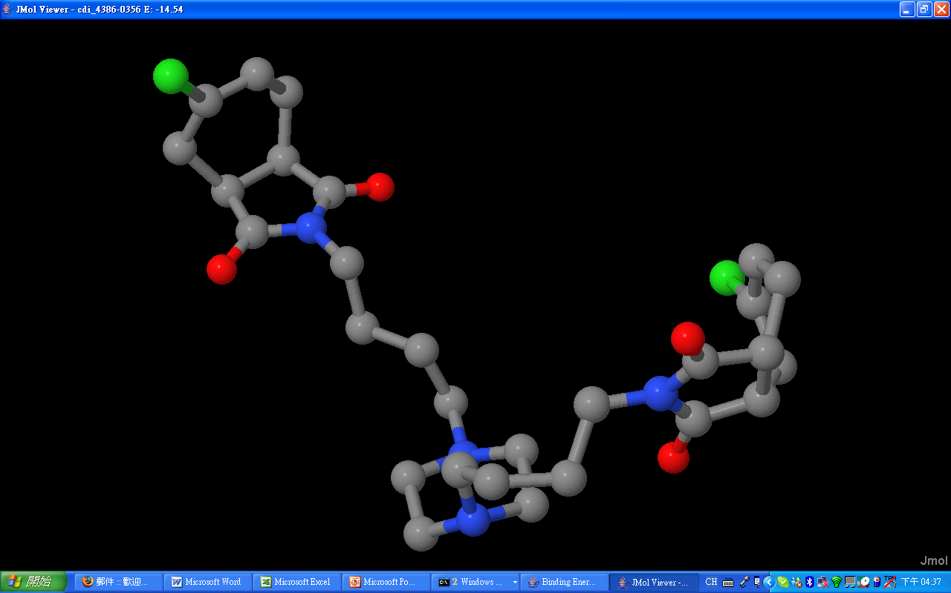

Slide 24
