Slide 1
Glyco-MGrid: A Collaborative Molecular Simulation Grid for e-Glycomics
Karpjoo Jeong (jeongk@konkuk.ac.kr)
Applied Grid Computing Center
Konkuk University

Slide 2
Collaborators
Konkuk University
  IT: Karpjoo Jeong, Dongkwan Kim, Jonghyun Lee, , Sang Boem Lim
  BT: Youngjin Choi, Seunho Jung
Kookmin University
  IT: Daeyoung Heo, Suntae Hwang
KISTI
  IT: Ok-hwan Byeon

Slide 3
e-Glycomics
Glycomics (or glycobiology): a discipline of biology that deals with the structure and function of glycans (or carbohydrates)
The term glycomics is derived from the chemical prefix for sweetness or a sugar, “glyco-”.
A glycan is one of the most important biomolecules in nature but limited knowledge is currently available
  Signaling molecule, an energy storehouse, or a structural ingredient within living organisms
Challenges. Structural diversity and dynamicity
  Molecular simulation: more effective to find structural behaviors than X-ray or NMR spectroscopy
e-Glycomics: advanced computer technology based research approach to glycomics which uses molecular modeling, molecular simulation and bioinformatics

Slide 4
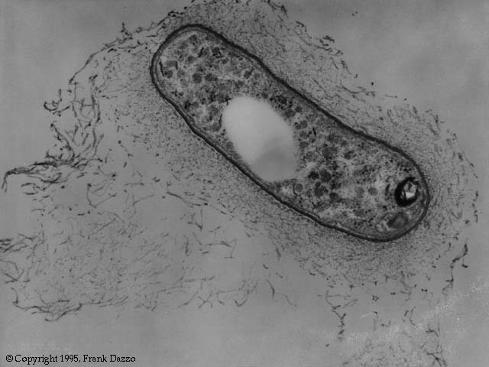
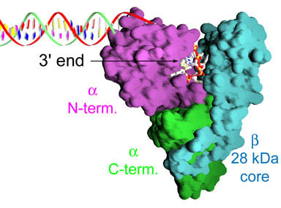
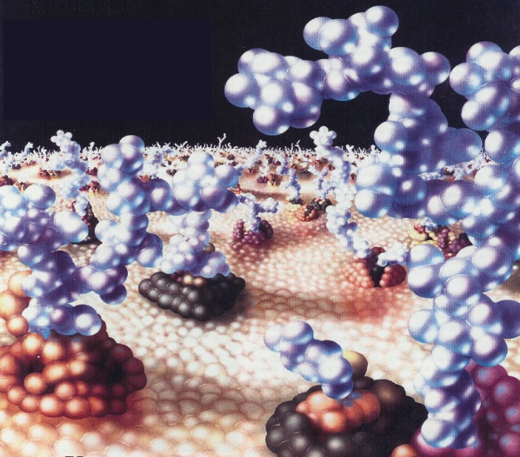


Slide 5
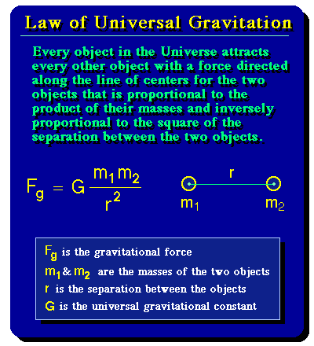
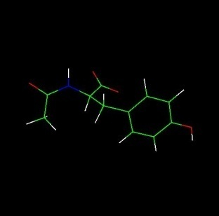
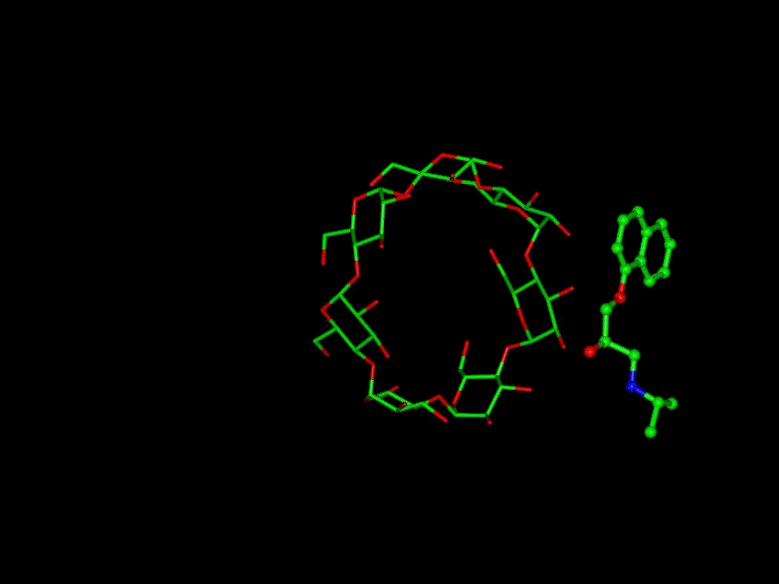
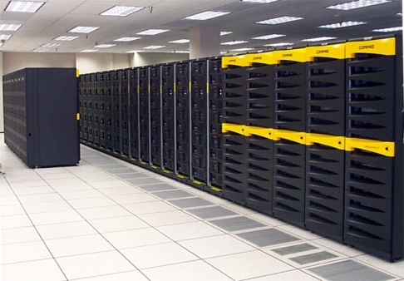
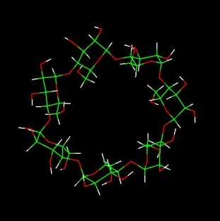
Molecular Simulation
Molecular
Simulation
Application Domains:
Physics
Chemistry
Engineering
Biology
Medical Engineering

Slide 6
Challenges
Computational Requirements
  Simulations for the bioconjugates of protein, DNA, lipid, and carbohydrates often needs much more than the computing capacity of large scale clusters or supercomputers at any single institute
Simulation Result Validation
  Simulation results on those molecules whose three-dimensional structures or appropriate simulation settings are not well-known are difficult to validate

Slide 7


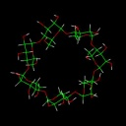

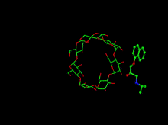


Collaborative Molecular Simulation
Detailed
Simulation
Results
Data Grids
Computational
Grids
Computational
Grids
Semantic Data Grids
Execute
Search
Re-execute
Papers
(Simplified Info)
PSE & Portal
Traditional Knowledge Sharing Communities
(Journals, Conferences)

Slide 8




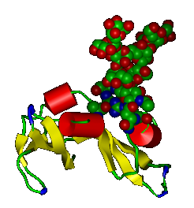

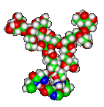
Result Sharing
Comparative Study
Cooperative
Simulation
Large Molecule
(e.g., Protein)
Parameter
Sets
Computational Grid
Computational Grid
Computational Grid
Goal
  Avoid similar simulations
  Allow community-oriented validation
  Integrate computing resources at application level
Data Grid
Data Grid
Data Grid
Analyze
Compare

Slide 9
MGrid
Integrated Molecular Simulation Grid Environment for Computing, Databases, and Analyses
Major Components
  MGrid-PSE (Problem Solving Environments)
  MGrid-CG (Computational Grids)
  MGrid-DG (Data Grids)
  MGrid-SDG (Semantic Data Grids)
  MGrid-DXG (Data Exchange Gateway)

Slide 10

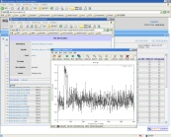
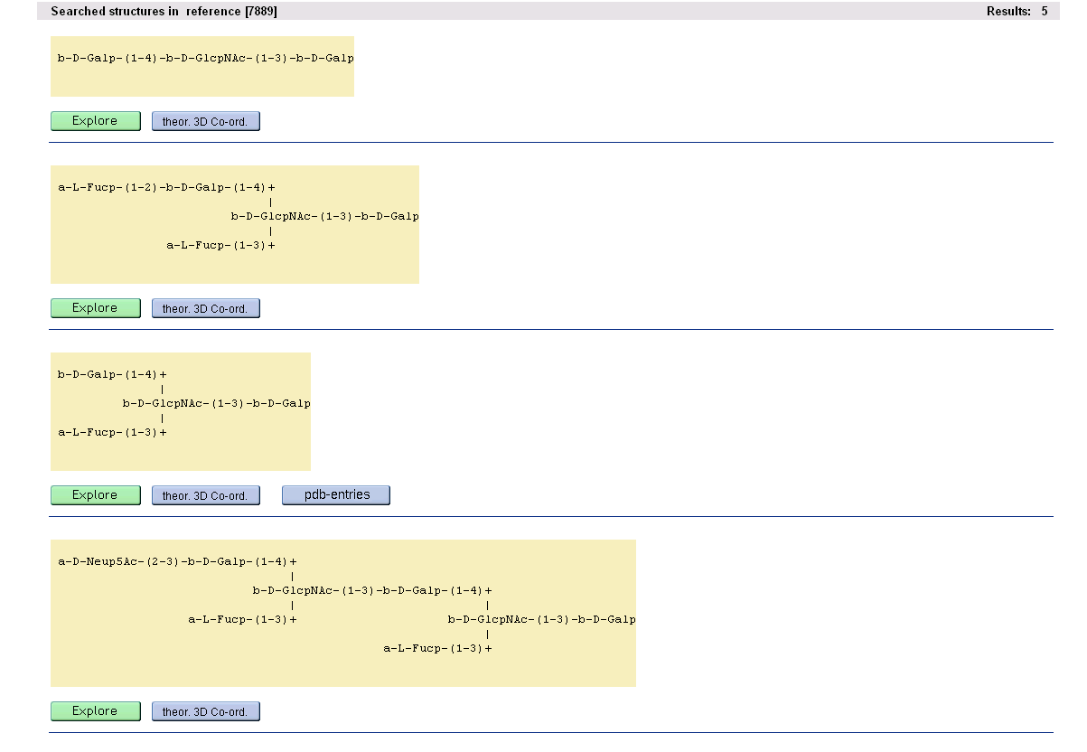
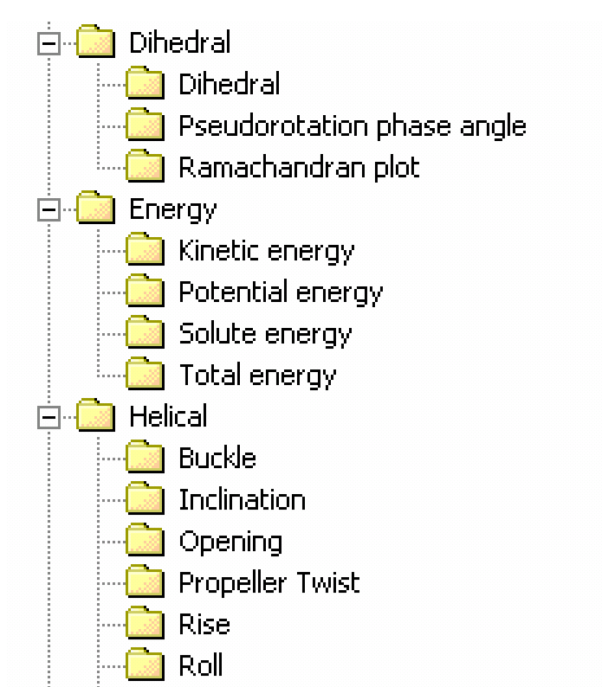


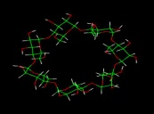
MGrid System Structure
MGrid-PSE
Simulation Job
Analysis Job
Search Job
Workspace Management
Private Data Space (Data Grid)
Run
Completed
Publish
Re-experiment
MGrid-CG
MGrid-SDG
Simulation Job Management
MetaData Management
Temporary Data Space
Shared Data Space
(Semantic Data Grid)

Slide 11
Glyco-MGrid
MGrid-based integrated environments (Extensions to MGrid) for e-Glycomics which support simulation, databases, and analysis in a collaborative way
Customization of or Extensions to the MGrid System
Major Goals
  Construct simulation result databases for glycans and glycoconjugates
  Provide simulation data sharing services for the global glycomics community
  Allow the user to perform further research based on previous simulation results which include post analyses and re-simulations with different parameter values.

Slide 12
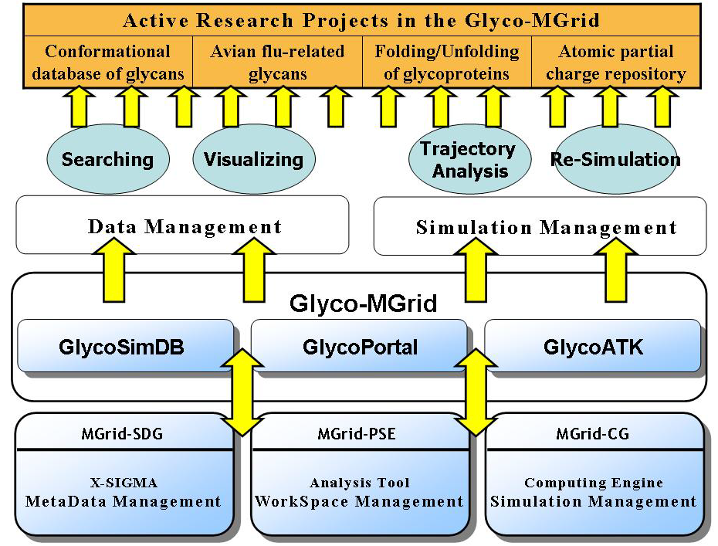
Glyco-MGrid System Structure

Slide 13
Major Components of Glyco-MGrid
MGrid
  Used to build Glyco-MGrid services.
GlycoSimDB
  It is a semantic data grid for glycan simulation data
GlycoATK
  Analysis toolkit for simulation trajectory files of glycan molecules.
GlycoPortal
  It is a grid portal to provide an integrated user environment for Glyco-MGrid.

Slide 14
Current Databases in GlycoSimDB
Conformational Database of Glycan Molecules
Conformational Database for Avian Flu-related Glycans
Folding/Unfolding Simulations of Glycoproteins
Atomic Partial Charge Databases
Details | Research Projects
 | Conformation DB | Avian-Flu | Folding/Unfolding | Partial Charge
Target | Glycans | Silalic Acids | Glycoproteins | Monosaccharides
Methods | MD | MC, MD | MD | QM
Analysis | Conformation Map | Conformation, Interaction Energy | Distance, Radius of Gyration | Atomic Charge
Expectation | Structural Prediction | Therapeutic Lead Design | BioMaterial Modification | Accurate Computing
Current Study | Disaccharides, Tetrasaccharides | Neu5Ac-Gal | Prion, Ribonuclease | Sialic Acids

Slide 15
Data Organization in GlycoSimDB
Simulation Data
  Input files (e.g. coordinate or parameter files)
  Output files (e.g. trajectory files and log files)
  Post processed data from trajectory files
Metadata (generic info + glycomics-specific info)
  Job information (e.g. job title, job description, and molecule name)
  Simulation parameters (e.g. time step, temperature, and pressure)
  Simulation data analysis results (e.g. potential energy, radius of gyration, inter-atomic distance).

Slide 16




Simulation Result Data
Computation Facility
GlycoSimDB
Simulation Program
Simulation Input
Job Title
Job Description
Molecular Name
Force Field
Program
Target System
Temperature
Pressure
Frame Number
Temp. Bath
Pressure Bath
Molecular
Coordinate
File
Simulation
Input
File
Molecular
Parameter
File
Molecular
Topology
File
Solvation
PBC
Crystal Type
Ensemble
Dielectrics
NonBond Option
Simulation Time
Time Step
Total Step
Update Number
Save Frequency
Restart Saving
Simulation Output
Trajectory File
Structure File
Coordinate File
Restart File
Velocity File
Output Log File
Float Number
Number List
Molecular Figure Data Plotting
2-D Scatter Plot
Probability Plot
Computing Resources

Slide 17
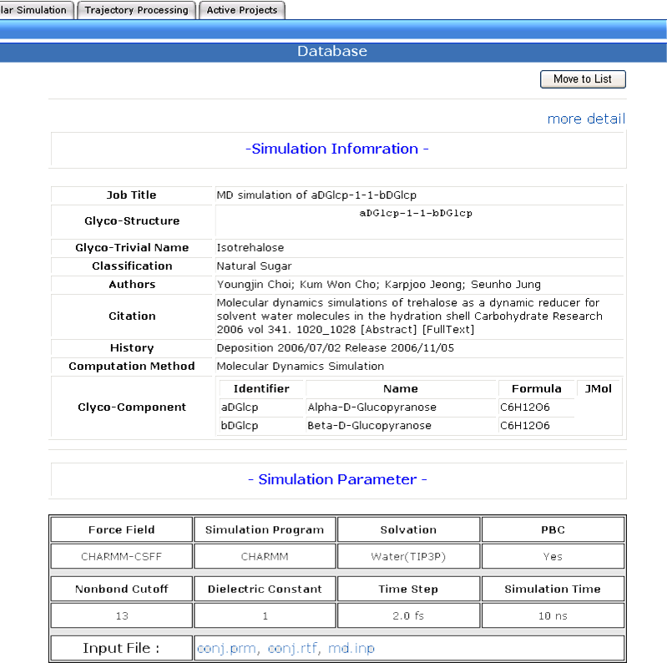
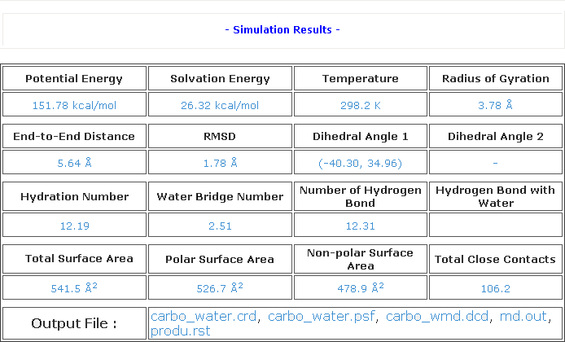
Portal User Interface for Simulation Data

Slide 18
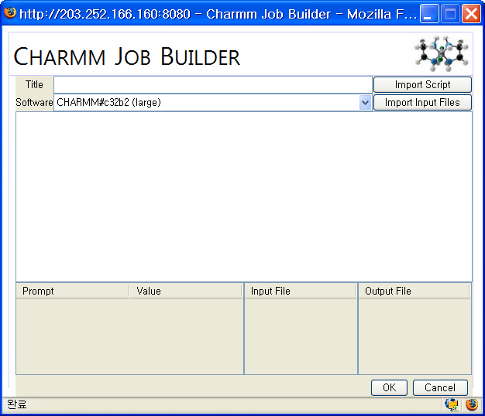
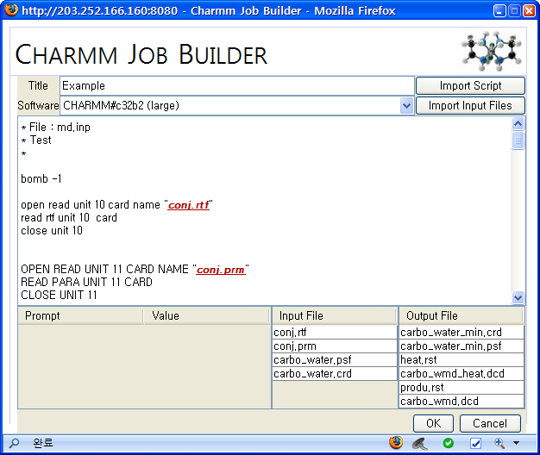
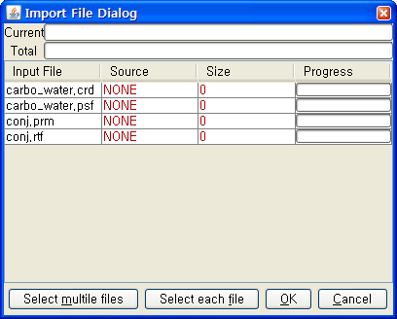
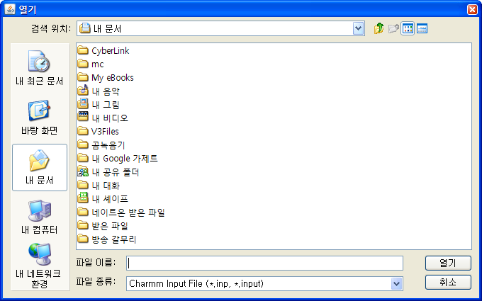
Metadata Collection
Automatic Collection
  Job Builder automatically extracts metadata (parameter values) from job file
Manual Insertion
  On publication, the scientist inserts metadata info manually
parsing
Upload job script file
Extract parameter values

Slide 19
Simulation Result Analyses
AnalysisToolKit Functions
Energy Analysis
Structure Analysis
Total Energy
Interaction
Energy
Radius of
Gyration
Surface
Area
Potential
Energy
Dihedral
Angle
Total
Kinetic
Energy
Solvation
Energy
Bond Energy
Interatomic
Distance
RMSD
Glycosidic
Angle Map
Total
Potential
Energy
MM/PBSA
Energy
Electrostatic
Energy
Center of
Mass Distance
Structure
Image
Maximum
Distance
Solvation Analysis
Number Analysis
RDF
Diffusion
Coefficient
Total Close
Contacts
Intra-
molecular
HB
Rotation
Time
Total
Hydrogen Bond
Hydration
Number
MSD
Hydration
Shell
Native
Contacts
Backbone HB
Inter-
molecular
HB
Water
Bridges
Translation
Time
Hydrogen
Bonds
Non-native
Contacts
Side-Chain HB
Solvent
HB

Slide 20
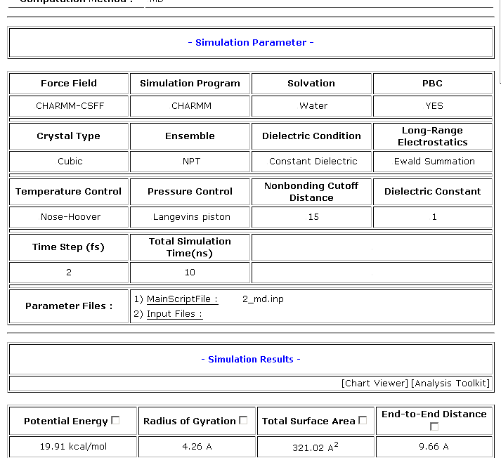
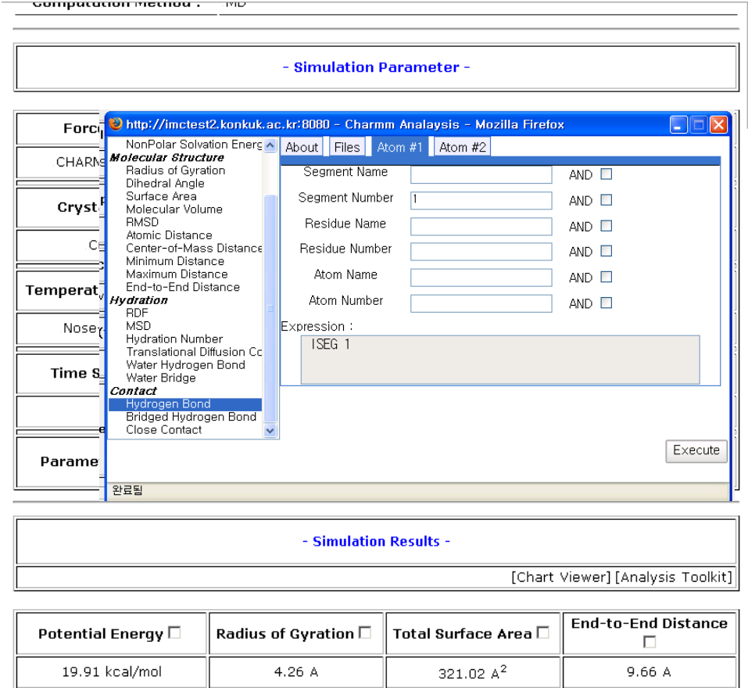
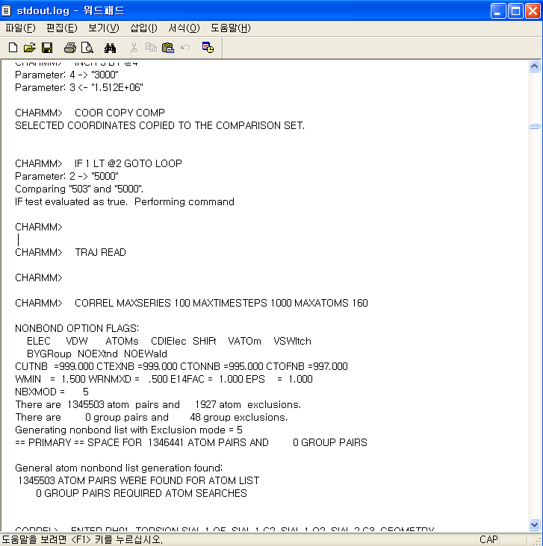
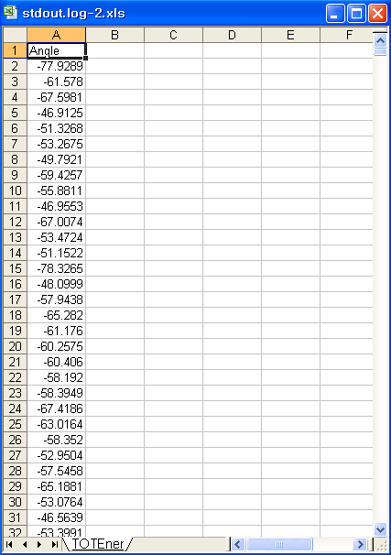
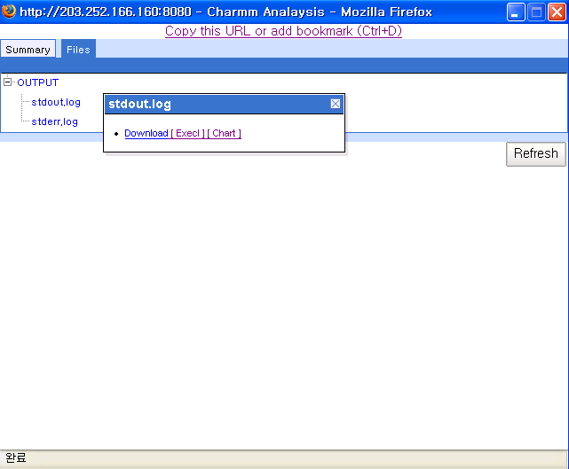
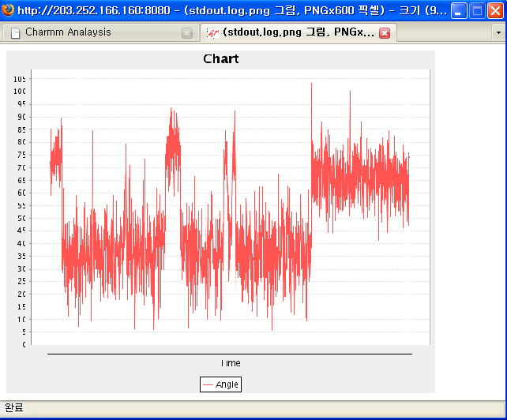
GlycoATK: Further Analysis

Slide 21


Publication & Re-simulation between MGrid to Glyco-MGrid
■ Publish: MGrid-PSE -> Glyco-MGrid
■ Re-Simulation: Glyco-MGrid -> MGrid-PSE
Publish
Metadata
+
Job Data
Job
Data
Web
Service
MGrid-PSE
Glyco-MGrid
Context Data
Management
Schema
Management
Workspace
Publish
/Re-Simulation
Query Process
Stored
Executor
/Monitor
Analyzer
/Transformer
Shared Data Space
(Result Repository)
Private Data Space
Web
Service
<
<
ContextData
>
<Job>
ExperimentalContext
>
Re-Simulation
Job
Data
<Name/>
<Experiment Information/>
<Authors/
>
……
<Analysis Info & Results />
<Annotation/>
<Versions/>
</
ExperimentalContext
>
<Tasks>
<
LogicalViewForExperimentalData
………
>
<
InputFiles
/>
<
MGridJob
>
<
OutputFiles
/>
………
</Tasks>
</
MGridJob
>
</
LogicalViewForExperimentalData
</Job>
</
ContextData
>
>
<
MGrid
Schema >
<
Glyco
-
MGrid
Schema >

Slide 22
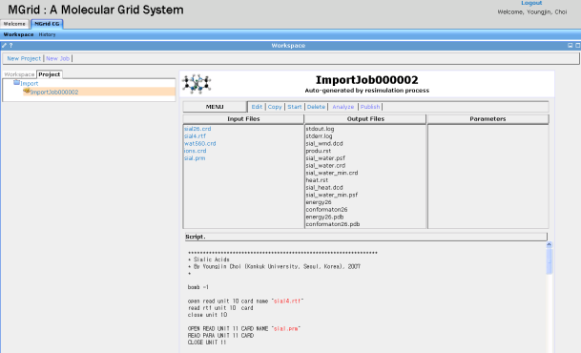
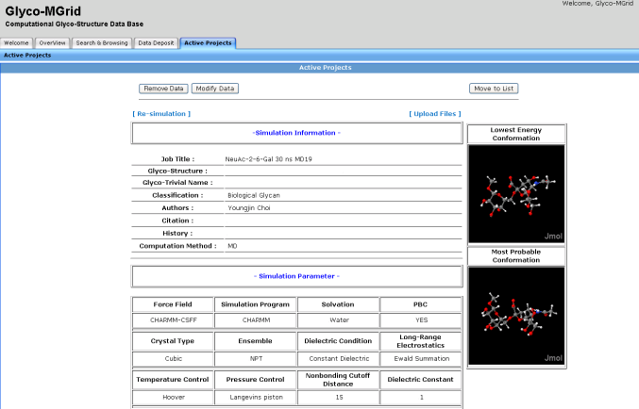
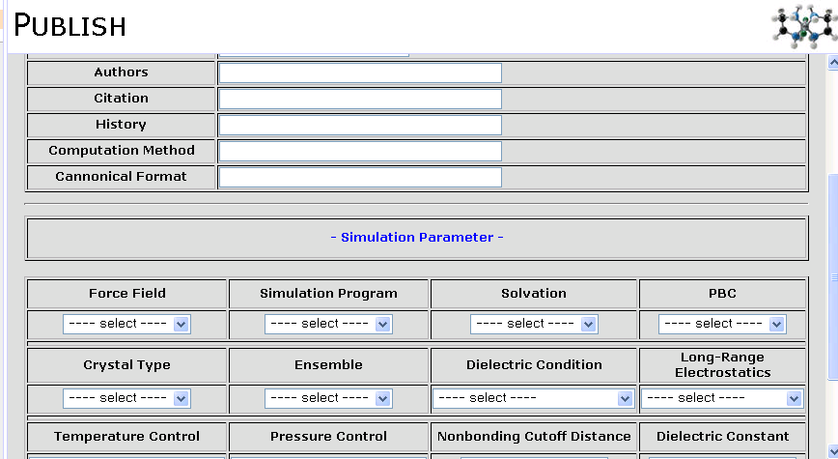
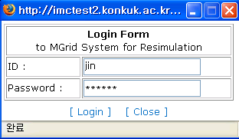
Publication/Re-simulation (cont.)
Publish: from MGrid
to Glyco-MGrid
Re-simulate: from Glyco-MGrid to MGrid
Manual Insertion of metadata

Slide 23






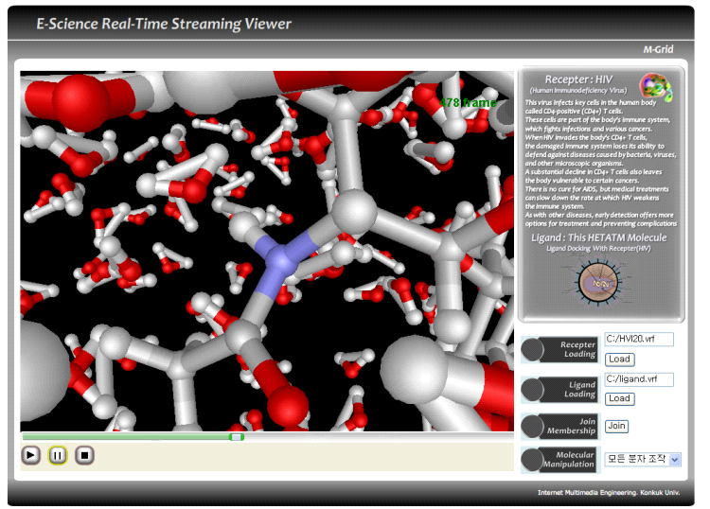







Streaming Viewer for Trajectory Files
3D Visualization for large simulation trajectory files
Streaming allow us to avoid downloading the entire trajectory files
Major Functions
Zoom-In/Out, Rotation
Rendering Techniques
  Wire frame, Van der waals, Ball and Stick, Point
Client
Frame
Connection
Operation Manager
IO Parser
Manager
-
VSSP Protocol
-
-
PLAY
,
PAUSE
,
STOP
,
SKIP
-
PSF
(
UDP
,
HTTP
,
-
TRANSLATE
,
ZOON
,
ROTATE
-
DCD
GRID FTP
)
Streaming Manager
Molecular
Renderer
-
Opengl
Buffer
(
Sliding Window
)
-
DCD

Slide 24
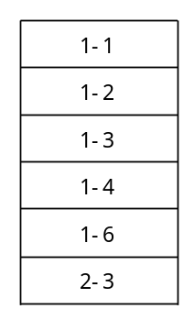
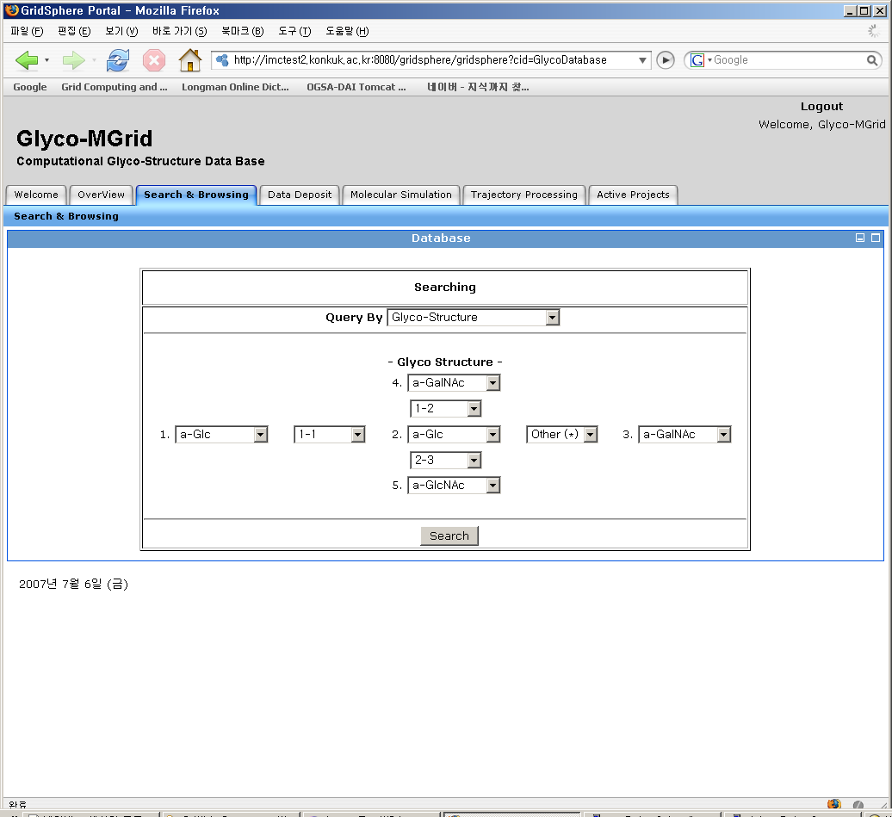
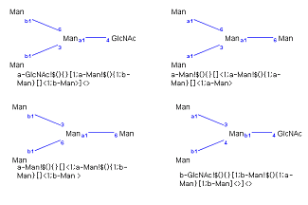
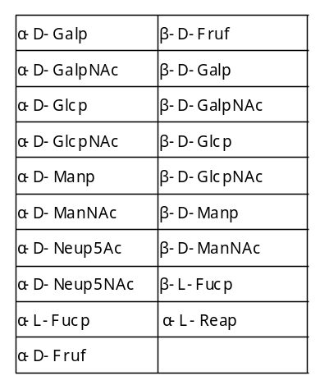
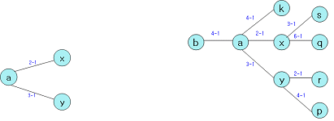
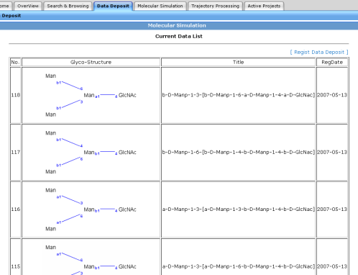
Structure-based Approximate Searching
No standard naming scheme for glycans or carbohydrates
Naming: structural description
Requirement for structure-based searching
Glyco-MGrid
Database
Link type
Structure-based
query
Structural
Matching
Glycan
basic unit
Search Result

Slide 25
Related Work
UNICORE (http://www.unicore.org)
  Computing environments for compute-intensive jobs (including molecular simulation) that provide a rich set of PSE functions
  But do not address the data sharing issue.
BioSimGrid (http://www.biosimgrid.org)
  Support the sharing of simulation data
  But do not intend to aim at integrated grid computing environments (e.g., support for re-simulation)
PRAMGA Avian Flu Grid (http://avianflugrid.pragma-grid.net/)
  Global collaborative effort.
  One of the major goals is to share research data including molecular simulation
  MGrid and Glyco-MGrid are used for this project

Slide 26
Conclusions and Future Work
Collaborative Molecular Simulation
  Effective Approach to challenges for molecular simulation
  Allow us to avoid repetition of similar simulation
  Promote community-based result validation
MGrid and Glyco-MGrid
  Integrated grid environments aimed at collaborative molecular simulation and customized for glycomics
  Contributions: Computing Infrastructures and Simulation Data
Future Work
  Global Data Sharing Infrastructure for PRAGMA Avian Flu Grid
  Access Control for Scientific Data Sharing
  Support heterogeneous computing platforms

