Slide 1


Collaboration- building successful Grids!
Ng Wai Keat (MIMOS)- 吴 伟 杰 &
Rajesh Chhabra (Altair)- 羅 杰 西

Slide 2

What are we talking?
Collaboration-Work together yeah yeah..
Why Portals-How many more portals we need?
What’s new?-Been there done that..

Slide 3
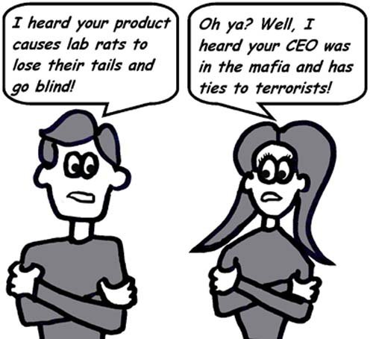
Academia & Industry Collaboration

Slide 4
Collaboration
Academia and Industry
  Vendors have done this before:
    Giving machines
    Giving free software
    Giving project grants
Development team formed
  2 Development managers (1 from MIMOS, 1 from Altair)
  2 programmers from MIMOS, 2 from Altair
  QA team from MIMOS (4-shared resources)
Technology transfer
  MIMOS team spent 1month plus in Altair development center working together
  Altair team performed joint development in MIMOS

Slide 5
Why Portals
Malaysia relatively new in the Grid domain
Similar requirements
  Mirror data
  Build infrastructure
  Form collaborations
  Build portals
    Local requirements
    Local applications focus
    Local Knowledge
  All the usual good stuff of a portal
    Easy to use interface
    Anywhere, anytime
    And all the rest we have said over the years ☺

Slide 6
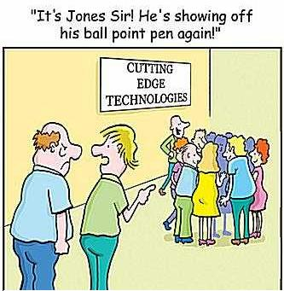
What’s new?

Slide 7
What’s new?
Smart card authentication
  Potentially whole Malaysia is on the Grid!
Industry strength QA process
CMMI Level 3 process of development
  Very well documented
    Use cases, design etc
Collaboration style
Business Intelligence based Accounting (upcoming)

Slide 8
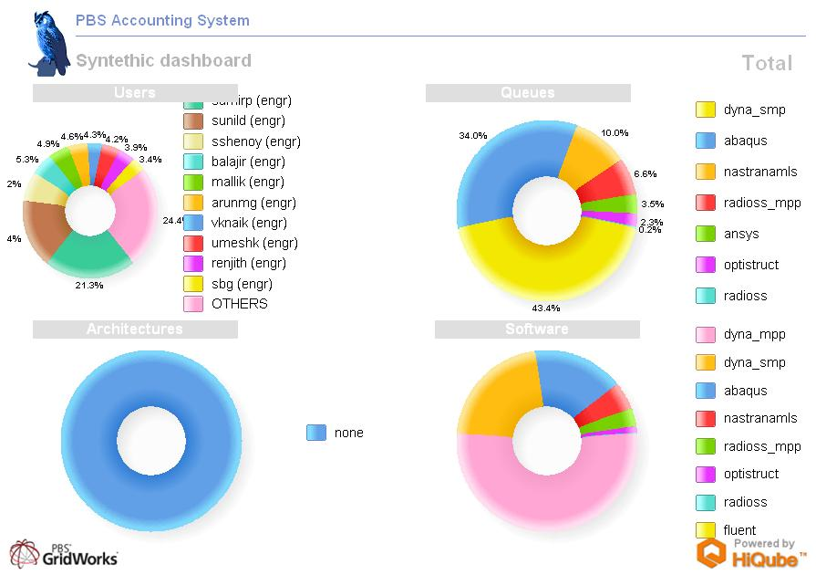

Slide 9
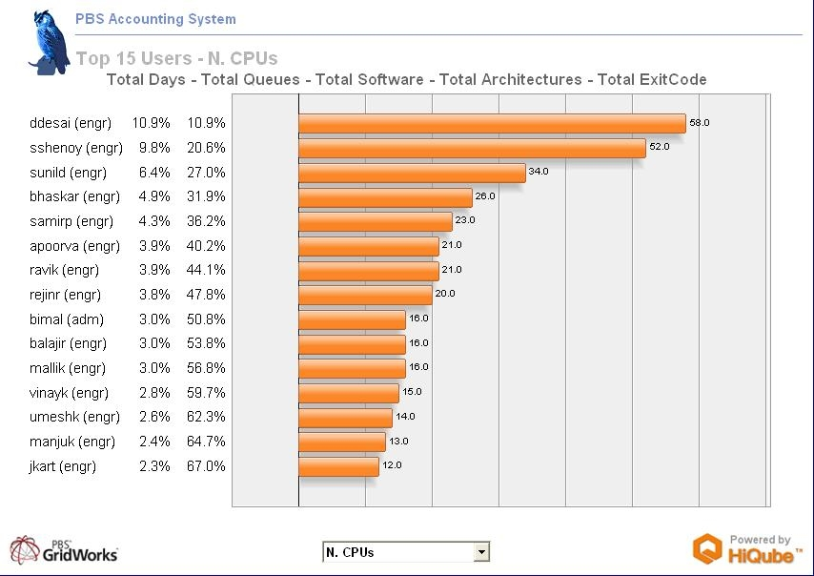

Slide 10
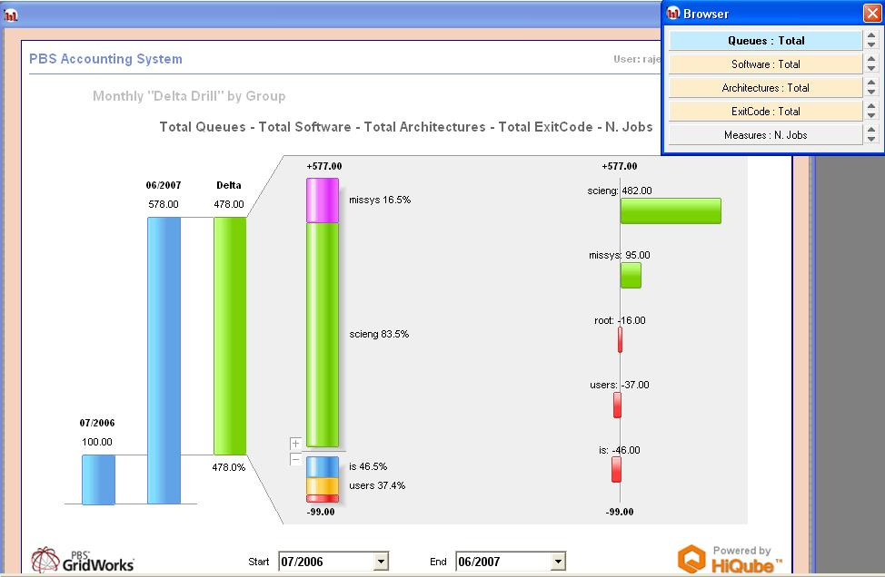

Slide 11
References
http://www.networkmarketingreview.com/www/wp-content/uploads/image/mymlmisbetterthanyourmlm_cartoon500.jpg
http://www.cartoonstock.com/newscartoons/cartoonists/pju/lowres/pjun13l.jpg

