Slide 1

NCHC-Grid Computing Portal (NCHC-GCE Portal)
Project Manager: Dr. Weicheng Huang
Developed Team: Chien-Lin Eric Huang
Chien-Heng Gary Wu
Yi-Lun Serena Pan
E-mail: serenapan.nchc.org.tw
National Center for High-performance Computing, Taiwan
DATE: 2008/03/11

Slide 2




Contents
Motivation of our work
The integrated grid architecture
NCHC’s Grid Computing Testbed
NCHC-GCE Portal & Portlets
  Aim at generic grid computing applications
    Workflow Portlet
    Job Submission Portlet

Slide 3
Motivation
Provide basic Grid Computing Environment
Without re-inventing the wheel
The lower barrier of using Grid Computing resources

Slide 4
The Integrated Grid Architecture
Applications
High Energy
Physics
Cosmology
Chemical
Engineering
Climate
…
Astrophysics
Application
Toolkits
Data
Grid
Resource
Broker
Portal
Remote
Visualization
…
Remote
Sensors
Grid
Services
Protocols, authentication, policy, instrumentation,
Resource management, discovery, and events
Grid
Fabric
Storage, networks, computers, display devices,
and their associated local services

Slide 5
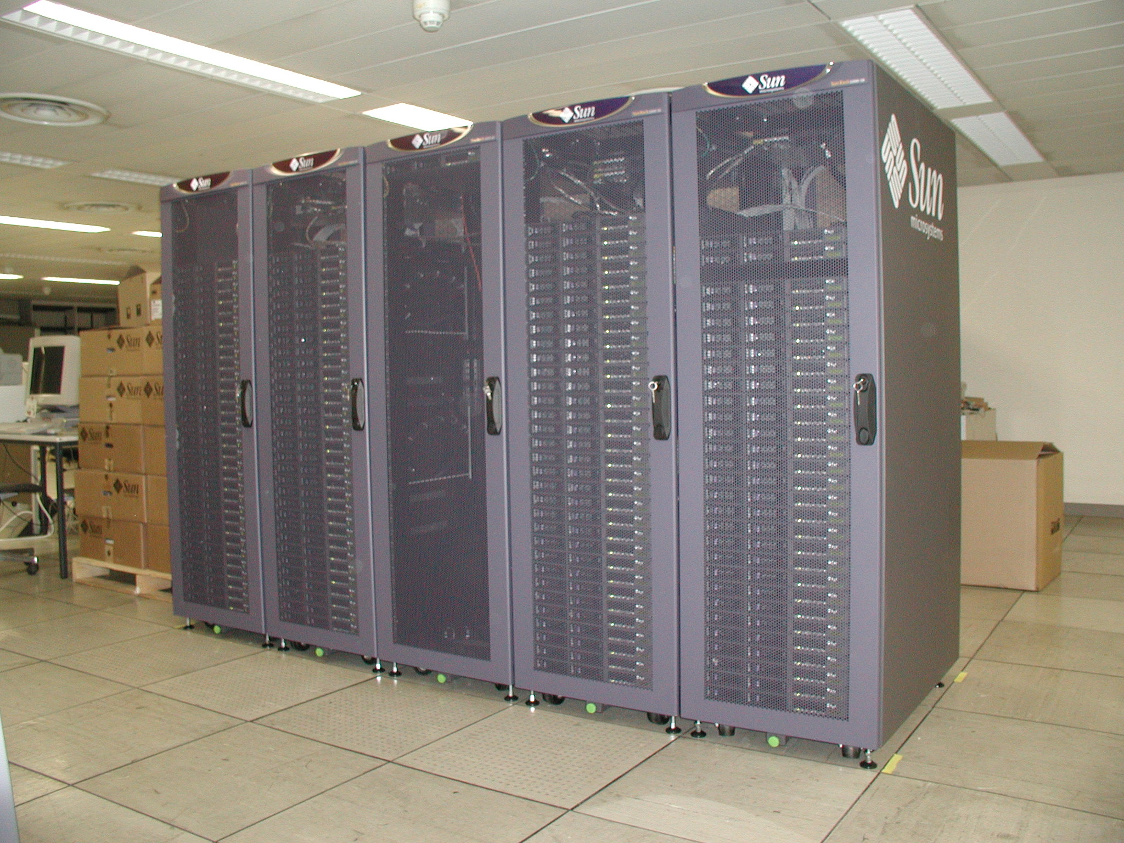
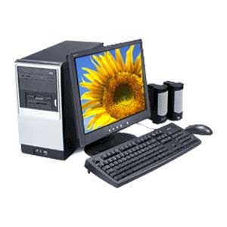
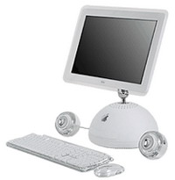
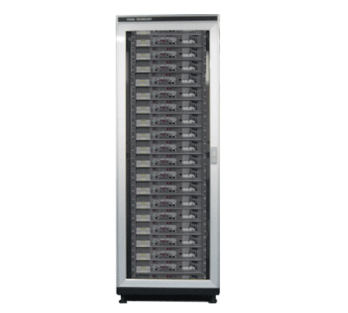
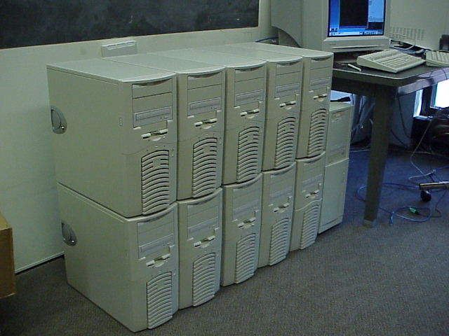
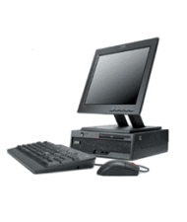
Grid Computing Environment
CA Authentication
Globus Toolkit
Backend testbed
DB Server
Portal Server
CA Server
Formosa Ext.2
cluster
MyProxy Server –
gcenode1
serena
gcenode2
Opteron cluster
Nacona cluster

Slide 6
Aim at the generic HPC computing applications
Generic HPC applications
Workflow portlet provides two components
Applications
GridFTP
Portal provides
user interface
and several portlets
portlet
Workflow
Portlet
portlet
portlet
Application
Toolkits
…
GRAM
Portal
Grid
Services
Protocols, authentication, policy, instrumentation,
Resource management, discovery, and events
Grid Middleware
(Globus Toolkit)
Command line tools
Grid
Fabric
Storage, networks, computers, display devices,
and their associated local services

Slide 7
Workflow Portlet
Purpose
  Workflow-oriented computational Grid applications
  Supports the creation and execution of workflow-based Grid applications in a Job Description Language (JDL)
Grid Services supported by the portlet
  GRAM job
  GridFTP

Slide 8
Grid Portal – Workflow Portlet
Demo
  http://gceportal.nchc.org.tw:8080
  Myproxy Portlet
  MPI Job – Povray Program

Slide 9
Grid Portal – Job Submission Portlet
Java programs for job submission
The components of Job Submission Portlet:
  Interactive Mode: displays the output in real time
  Hybrid Mode: writes into a file and also displays output in real time
  Batch Mode: writes into a file and then GridFTP to local machine

Slide 10
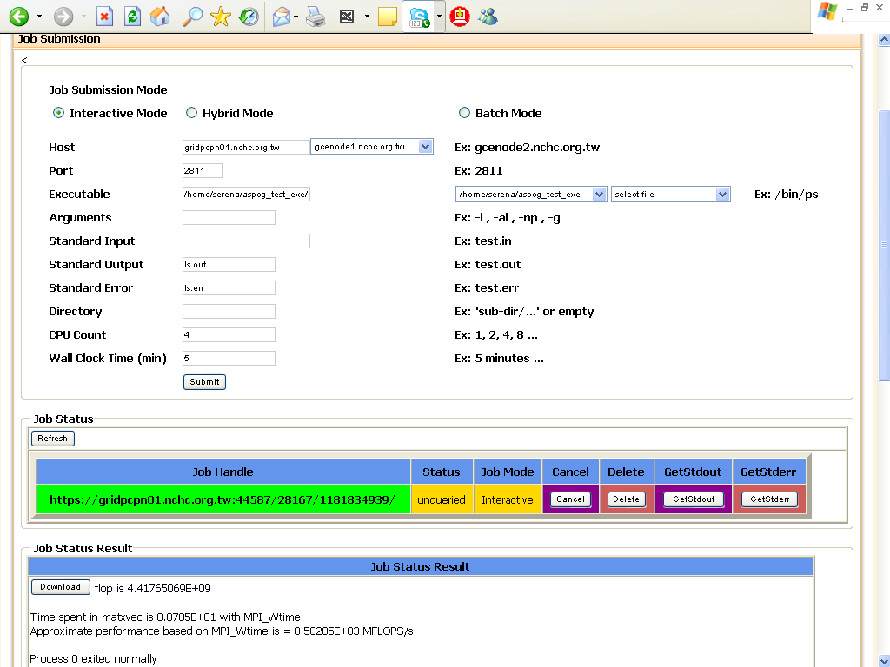
Grid Portal – Job Submission Portlet
Demo – Interactive mode
  http://gceportal.nchc.org.tw:8080
  Listening for Job Status Updates and Job Output
  The GASS Server
    Starting the GASS Server
    Receiving Output from GASS
    Storing into MySQL DataBase
  MPI Job
  Gaussian Job

Slide 11
Grid Portal – Job Submission Portlet

Slide 12
References
Grid
  http://www-fp.mcs.anl.gov/~foster/
Globus
  http://www.globus.org/
MyProxy
  http://grid.ncsa.uiuc.edu/myproxy/
NSF Middleware Initiative
  http://www.nfs-middleware.org/
Liferay
  http://www.liferay.com/
JSR-168
  http://www.jcp.org/aboutJava/communityprocess/review/jsr168/
NCHC
  http://www.nchc.org.tw/

Slide 13
Thank You!!

