Slide 1
Nimrod/K: Towards Massively Parallel Dynamic Grid Workflows
David Abramson, Colin Enticott, Monash
Ilkay Altinas, UCSD

Slide 2


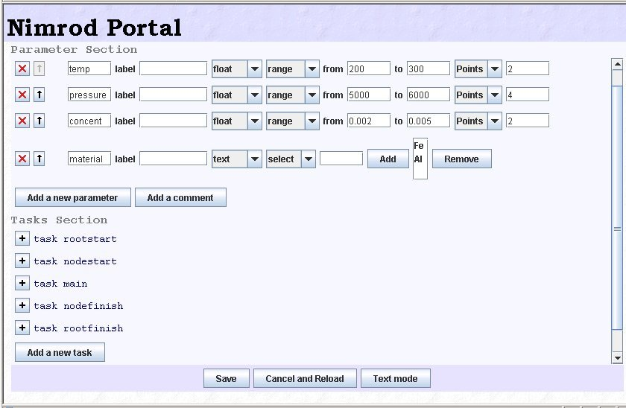


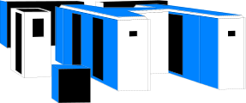
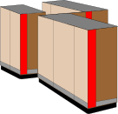

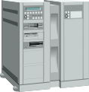
Plan File
Nimrod Portal
Nimrod/O
Nimrod/E
Nimrod/G
parameter pressure float range from 5000 to 6000 points 4
parameter concent float range from 0.002 to 0.005 points 2
parameter material text select anyof “Fe” “Al”
task main
copy compModel node:compModel
copy inputFile.skel node:inputFile.skel
node:substitute inputFile.skel inputFile
node:execute ./compModel < inputFile > results
copy node:results results.$jobname
endtask
Actuators
Grid Middleware

Slide 3
Some Good & Bad things about Nimrod
Declarative plan files
  Good for naïve users
  Multi start specification powerful
  Parameters and Seqameters
High level user interface
Portal
Agent/Glide-in’s
Powerful real-time scheduler
Range of search techniques
Actuators abstract underlying architecture
Agent trust model supporting VOs
Deployment spaces
Hierarchical proxies
Workflows not well handled
Lack of documentation
Installation difficult
  3rd party packages
Nimrod/O module structure not extensible enough
Error reporting and logging needs improving
Packing short running jobs

Slide 4
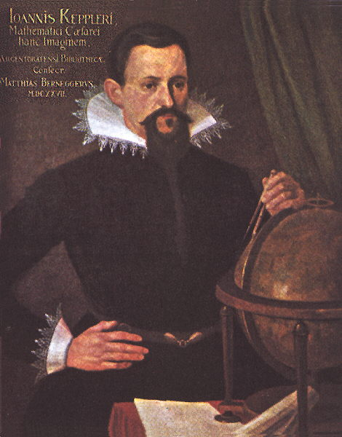
Web Services and Scientific Workflows in Kepler
Individual components (“actors”)
“Minute-Made” Application Integration:
  Plugging-in and harvesting web service components is easy and fast
Rich SWF modeling semantics (“directors” and more):
  Different and precise dataflow models of computation
  Clear and composable component interaction semantics
  Web service composition and application integration tool

Slide 5
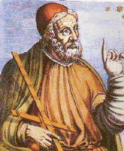

… based on Ptolemy II
A set of Java packages for heterogeneous, concurrent modeling, design and execution.
Strengths include:
  Precisely defined models of computation and component interaction
    e.g. Process Networks (PN) – data-flow oriented
  An intuitive GUI that lets rapid workflow composition
  A modular, reusable and extendable object-oriented environment
  An XML based workflow definition – MoML
    Workflows defined in Ptolemy II MoML XML schema
    Easily exchangable

Slide 6
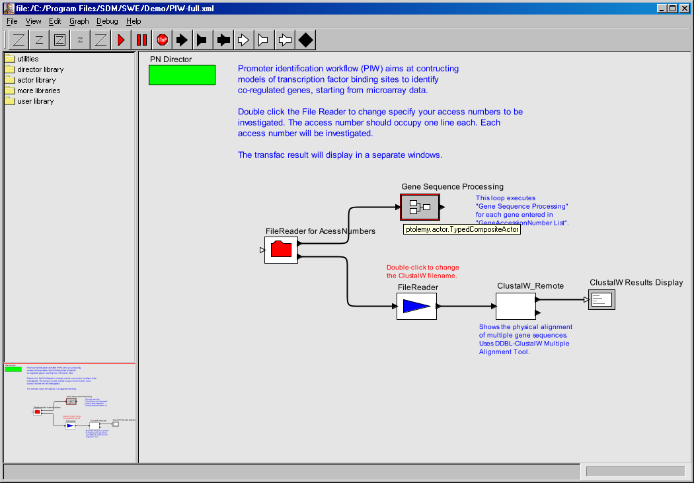
The KEPLER GUI (Vergil)
Drag and drop utilities, director
and actor libraries.

Slide 7
Some Good and Bad things about Kepler
Supports workflows
Powerful graphical UI
Can change execution semantics (Directors)
Intuitive interface
Huge library of actors
Massive parallelism
Dynamic parallelism
Grid infrastructure exposed
IO semantics specified (files vs pipes)

Slide 8
Nimrod/K
Extracting the best ideas from Nimrod and Kepler
Leveraging the Kepler code base
A chance to rebuild Nimrod ☺
Work is very preliminary_x0013_

Slide 9

A new director
Nimrod Director
Actor
Clone 1
Clone 1
Clone 2
Clone 2
Clone 3
Clone 3

Slide 10
Demo
Work in progress.
Proof of (some of the) concept(s)

