Slide 1

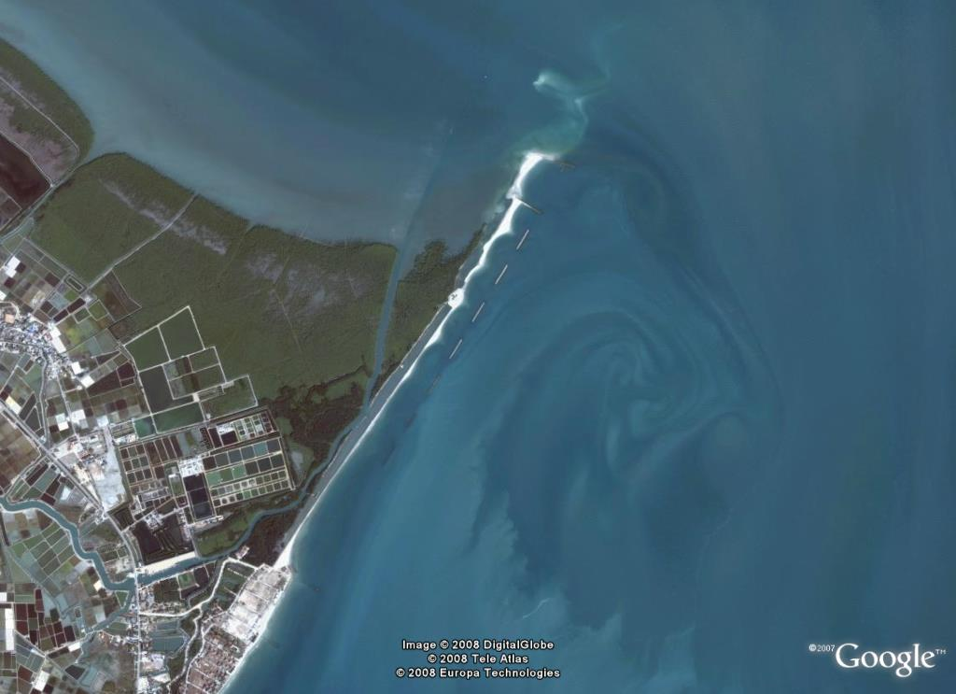
Simulation of Coastal Changes in Thailand
Sirod Sirisup
Large Scale Simulation Research Laboratory
NECTEC
National Electronics and Computer Technology Center
THAILAND

Slide 2
Outline
Introduction: Coastline of Thailand
Status of coastal changes in the Gulf of Thailand
Status of coastal changes study in Thailand
Position, approaches and primary goals

Slide 3
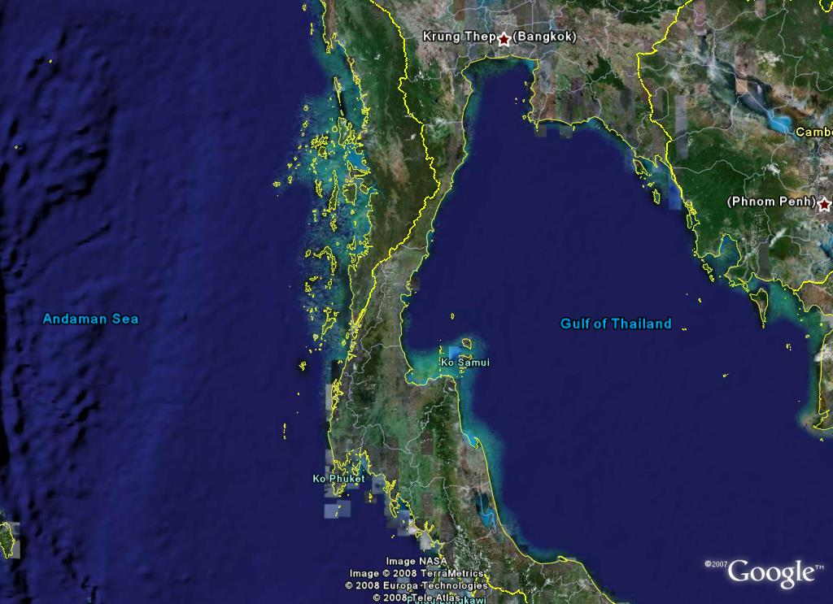
Coastline of Thailand
The length of the coastline of Thailand is approximately 2637 km.
The Gulf of Thailand coastline covers 17provinces. The total length is approximately 1700 km.
The Andaman sea coastline covers 6 provinces . The total length is approximately 937 km.

Slide 4
Statements of The Problem
Coastal erosion in the Gulf of Thailand coastline is about 376 km (14.26 % of total shoreline of Thailand).
22% for severe coastal erosion with rate of more than 5 meters/year along coastline of the gulf of Thailand.
The inner coast , the severe erosion has been found in Bang Khun Tien district, Bangkok, the erosion length is approximately 45 kilometers
The Eastern part of the Gulf of Thailand, the severe erosion has occurred in areas of Rayong and Chantaburi provinces , the coastal erosion length is approximately 18 kilometer
http://www.dmr.go.th

Slide 5
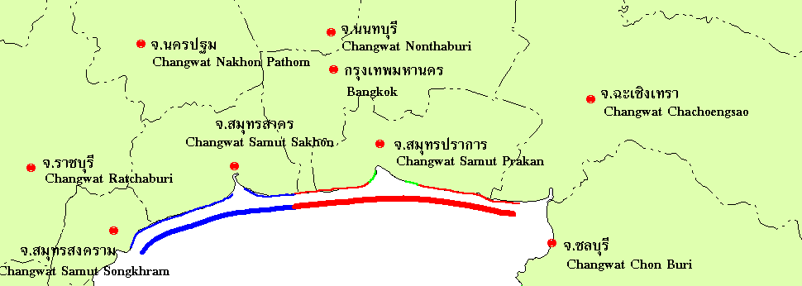
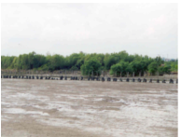
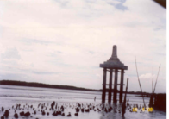
Inner part of the Gulf of Thailand
Coastal erosion in the Inner part of the Gulf of Thailand
severe erosion
moderately erosion
Inner shoreline
120 kilometers
Severe Erosion
45 kilometers
Economic Value
11,188 million bath
http://www.dmr.go.th

Slide 6
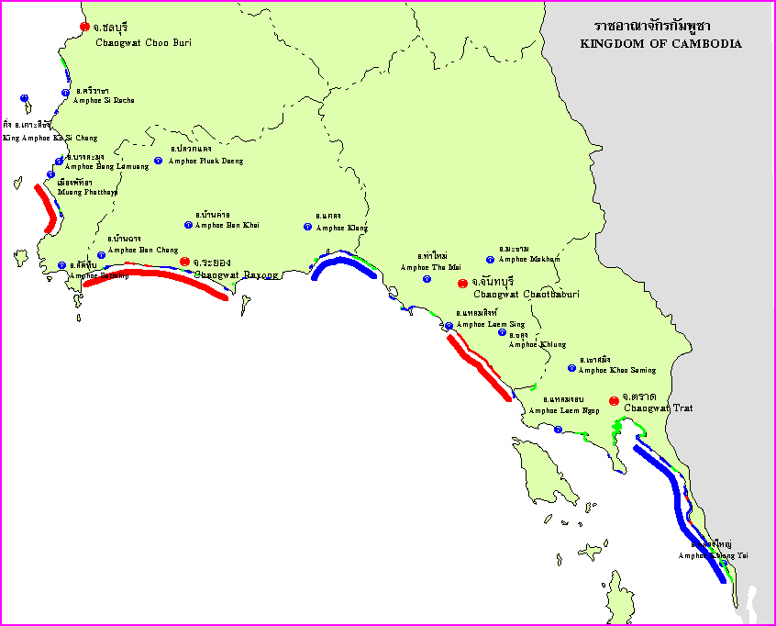
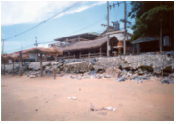
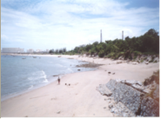
Eastern coast of the Gulf of Thailand
Coastal erosion in the Eastern coast of the Gulf of Thailand
Shoreline
485 kilometers
Severe Erosion Area 18 kilometers
Economic Value
11,520 million bath
Chonburi
Rayong
severe erosion
moderately erosion
http://www.dmr.go.th

Slide 7
Statements of The Problem
The Western part of the Gulf of Thailand, severe erosion has been found in the coast of Petchaburi and Prachup Kirikhan provinces, the erosion length is approximately 2 kilometers.
The upper southern part of the Gulf of Thailand, severe erosion has occurred in the coast of Songkra and Nakhon Srithammarat province, the erosion length is approximately 32 kilometers.
The lower southern part of the Gulf of Thailand, the severe erosion are found in the coast of Pattani province, the erosion length is approximately 64 kilometers.
http://www.dmr.go.th

Slide 8
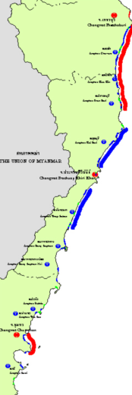
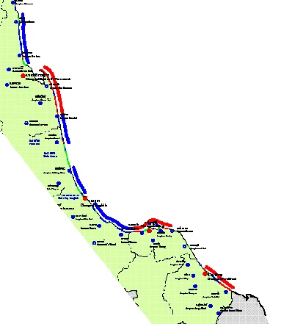
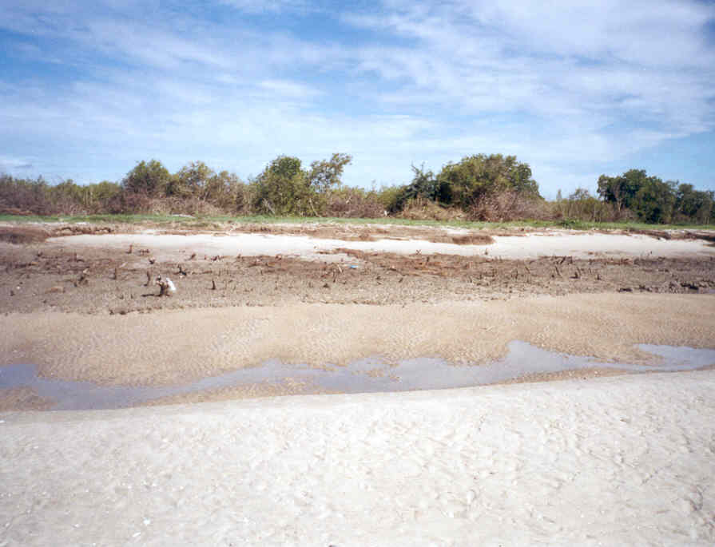
Southern of the Gulf of Thailand
Shoreline
475 kilometers
Severe Erosion
32 kilometers
Economic Value
15,990 million bath
Shoreline
170 kilometers
Severe Erosion
64 kilometers
Economic Value
5609 million bath
Petchaburi & Prachuabkirikhan
severe erosion
moderately erosion
http://www.dmr.go.th

Slide 9
Status of the study on coastal changes in Thailand
The areas undergoing erosion as, cause and degree of coastal erosion have been determined by Department of Mineral Resources since 1998.
Recent study in term of Forecasting/mapping are numerously founded in many Thai academics.
  Arial Photo interpretation and remote sensing.
  Survey by using Theodolite, Cone Penetration Tests.
  DGPS methods.
  Beach profiles.

Slide 10
Status of the study on coastal changes in Thailand
But …
Only Few studies on the mechanism or the processes of coastal changes, especially the physical based study.

Slide 11
Primary Goals
Make the through understanding of coastal changes processes based on both simulation and physical based approaches.
  Sediment Budgets
  Coastal processes
  Effects of relative sea level
Develop (local) simulation models in order to characterized the mechanism of shore evolution sediment transportation for the Gulf of Thailand.
Provide results as inputs for effects on economic and social impacts investigation.

Slide 12
Inputs ?

