Slide 1
A Service-Oriented Architecture for Ubiquitous Geographic Information Service Development
Sheng-Ming Wang^{[1]}
ryan@nttu.edu.tw
Fu-Mei Chen^{[2]}、Wayne San ^{[1]}
[1] ISMS Dept National Taitung University，,
[2] Graduate Institute of MIS, National Dong-Hwa University

Slide 2
Outline
Ubiquitous Computing and GIS Development
Service-Oriented Architecture
Ubiquitous Geographic Information Service
The SOA for UbGI Service Framework
Results and Discussions
Conclusions and Future Studies: Grid Enable
Q & A

Slide 3
Ubiquitous Computing and GIS Development

Slide 4
Ubiquitous Computing
The term ‘ubiquitous computing’ was coined by Mark Weiser in a 1991 Scientific American article. He points out that “We believe that people live through their practices and tacit knowledge so that the most powerful things are those that are effectively invisible in use.”
The highest ideal of “invisible” in ubiquitous computing is to make a computer so imbedded, so fitting, so natural, that we use it without even thinking about it.

Slide 5
Ubiquitous Computing (Cont.)
The development of Internet environment makes the ubiquitous computing reaches the level of maturity that allow the computers to be integrated in a manner that permits user to access the service at anywhere and anytime.

Slide 6
The Development of GIS
As early as the 1980's, the GIS community has been accused of elitism, archaism and being, in essence, “ivory tower geomancers”.
The development of navigation systems and then by web mapping and imagery services such as those available from Google™ Earth or Microsoft® Virtual Earth™ has cracked the shell of the “ivory tower”.
GI has begun a move into the mainstream and taken that “last mile” step into the “general public”.

Slide 7
Ubiquitous Geographic Information Service

Slide 8
Ubiquitous Geographic Information
The goal of ubiquitous GI is to make the “user experience” intuitive, and simple to use. Usually, users of GI seldom care how something is implemented, just how well it is implemented.
Within ISO TC 211 an internal discussion paper on Ubiquitous Geographical Information (UbiGI) has been published in 2005, which shows the awareness within these institutions for these emerging trends.

Slide 9
4 Major Characteristics of UbiGI Service to be Fulfilled
Distributed: That is data storage, processing and user interaction can occur at locations that are potentially widely scattered.
Disaggregated: That is the monolithic systems we have today are replaced by 'plug and play' components, possibly from different vendors, that are designed to interoperate through conformance with industry-wide standards.

Slide 10
4 Major Characteristics of UbiGI Service to be Fulfilled
Decoupled: That is the system must be able to access a number of components that may be required to complete a specific task, which may be distributed over many networks.
Interoperable: Which means the system is based on an "open" system such as that promulgated by the Open GIS Consortium (OGS).

Slide 11
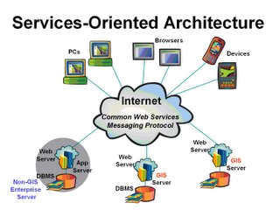
The Conceptual Diagram of SOA
Source: http://gismatters.blogspot.com/2005/11/ubiquitous-gis.html

Slide 12
The Application of SOA for UbiGI Service
A common UbiGI service structure, in general, brings together four important technology components: user appliances, networks, server-hosted data and applications, and a location fixing technologies.
In order to create Service-Oriented Architecture (SOA) for the UbiGI Services we need to create Web Service correspondences of each UbiGI Services with multi-participant, multi-user computing environment.

Slide 13
The Framework of SOA for UbiGI Service

Slide 14
Three Categories of UbiGI Services
Data Services: These types of services are tightly coupled with specific data sets and offer access to customized portions of that data.
Processing Services: These types of services provide operations for processing or transforming data in a manner determined by user-specific parameters.
Registry or Catalog Service: These types of services allow users and applications to classify, register, describe, search, maintain, and access information about Web Services.

Slide 15
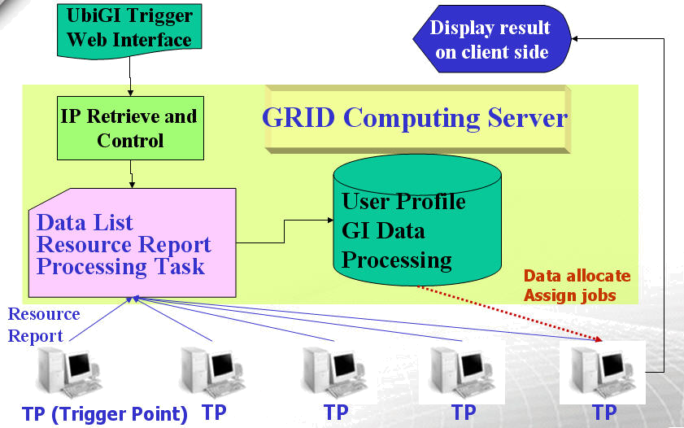
The Application of SOA for UbiGI Service (with GRID)
.

Slide 16
The Middleware and Web Service
The middleware is used to management the database as well as allocate data and assign processing job the TPs.
The top layer of this framework shows the web-based user interface and a X-Window environment to operate and display UbiGI Service results.

Slide 17
The Trigger Point
The trigger points (TP) shown in the bottom layer of this framework represent the nodes for grid computing. Each TP is installed with the open source GIS software for which has been set up for GI data processing service.
The TP are linked to the middle layer, which has a middleware to retrieve the IP from users and using a preset control mechanism to perform registry and catalog service of the UbiGI Service.

Slide 18
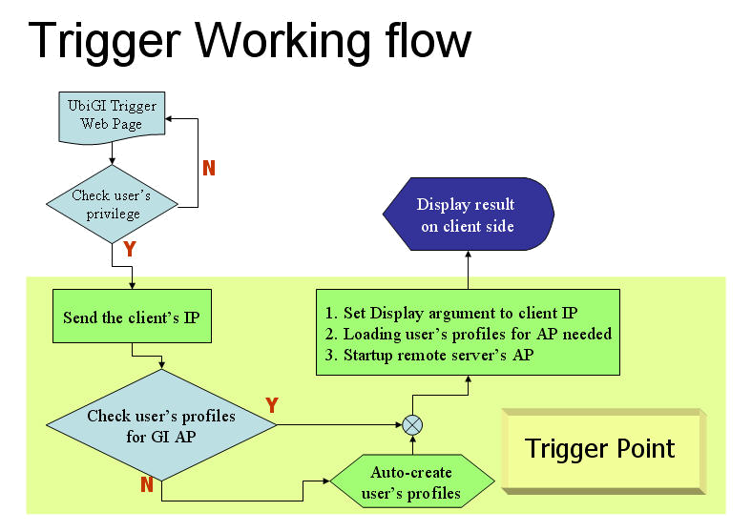
The Trigger Point Working Flow Design
Program functions developed in this work by using shell scripts embedded in php.

Slide 19
Results and Discussions

Slide 20
Implementation Server Environment
CPU: Intel Pentium IV 3.00GHz with HT
HDD: 150 GB SATA Hard Disk
RAM: 512 MB Memory
NIC: Realtek RTL-8169 Gigabit Ethernet
OS: Gentoo GNU/Linux with kernel 2.6.17 and Apache Web Server with PHP and MySQL database
Open Source GIS: GRASS 6.2

Slide 21
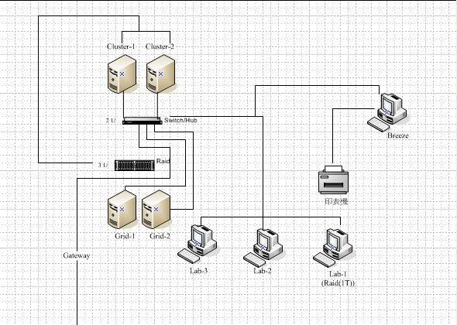
System Architecture Prototype
Globus
Toolkits
SRB
Windows
3 Terabyte Storage
Open Source GIS: GRASS
Linux

Slide 22
MS Windows X-Window Server Solution
Xming X Server for Windows: Xming is the leading free unlimited X Window server for Microsoft Windows (XP/2003/Vista).
Xming is fully featured, small and fast, simple to install and being standalone native Microsoft Windows, easily transported portable as a Pocket PC X server.

Slide 23
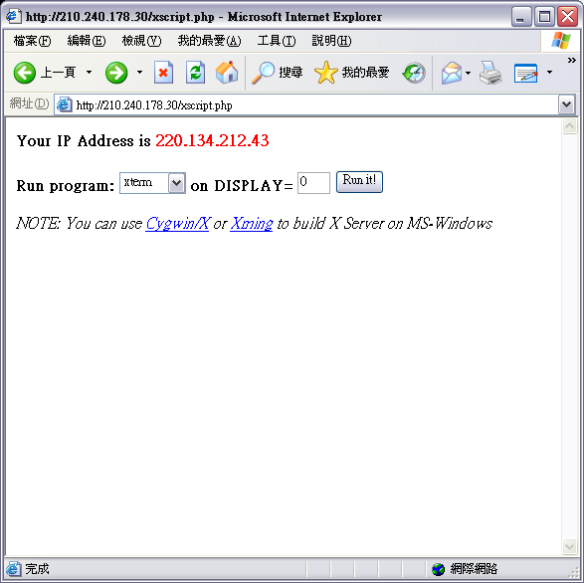
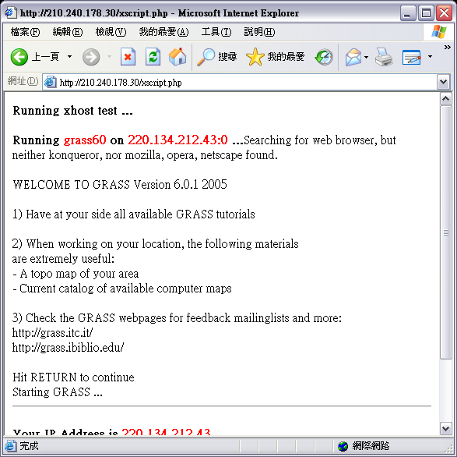
The User Interface of Accessing UbiGI Service
http\\:210.240.178.29/xscript.php

Slide 24
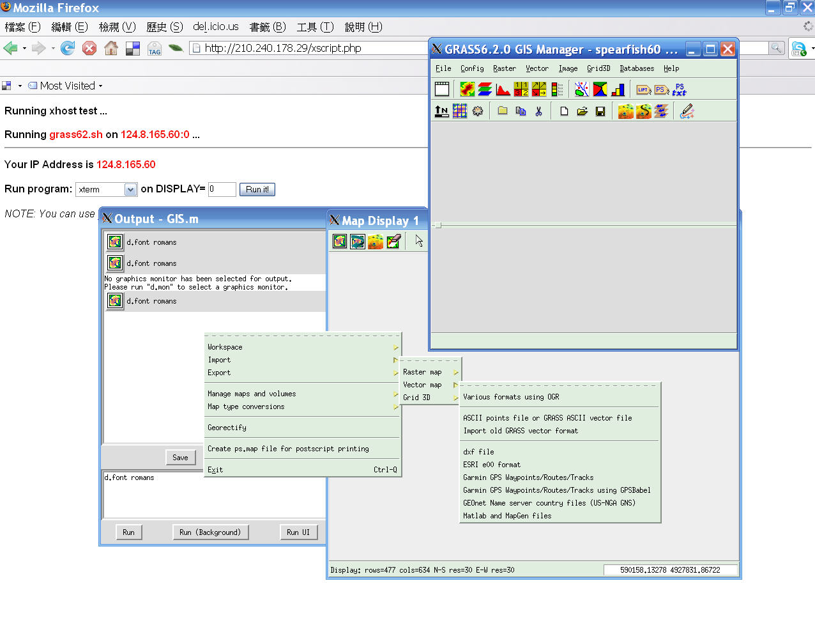
The Local Host Display Results in
MS-Window Environments

Slide 25
Conclusions

Slide 26
Conclusions
We have proposed a framework for UbiGI Service by the integration of Service-Oriented Architecture (SOA) and GRID Computing concept. A working flow for implementing the framework also has been proposed.
By using the hardware, open source software and trigger functions designed in this research, we have successfully build a ubiquitous open source GIS environment, which provides the full functions and database management applications of GIS in cyberspace.

Slide 27
Future Works: GRID Enable
Try on the implementation of GRID Computing middleware for registry, data catalog and resource management: Globus Toolkit and SRB.
Firewall and VPN Access.
To implement performance measurement and evaluation.
To achieve the development vision of UbiGI Service GRID.

Slide 28
Q & A
Contact: 王聖銘
國立台東大學資訊管理系
ryan@nttu.edu.tw

