Slide 1
Cross Calibration of
Multiple Satellite Sensors Using GEO Grid
Akihide Kamei, Ryosuke Nakamura, and Satoshi Tsuchida
Grid Technology Research Center
National Institute of Advanced Industrial Science and Technology (AIST), Japan
2008.3.11 PRAGMA14

Slide 2
Introduction
Radiometric calibration of satellite sensors is indispensable, because satellite sensors are degraded as time passes.
Cross calibration between different satellite sensors is one of various radiometric calibration methods.

Slide 3
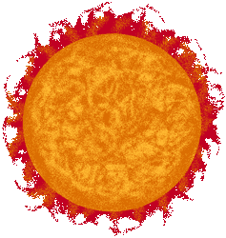
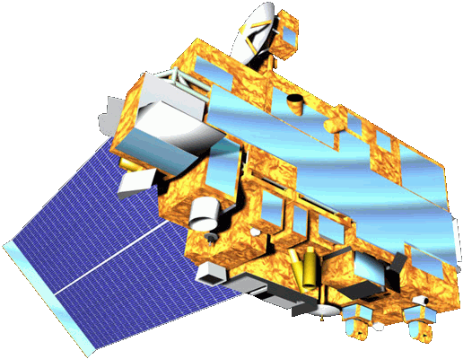
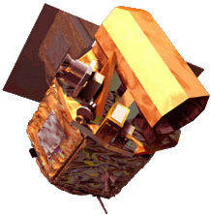
Cross Calibration
TERRA/MODIS
TERRA/ASTER
FORMOSAT-2/RSI

Slide 4
Cross Calibration for FORMOSAT2/RSI
ASTER has been radiometrically calibrated by several methods since TERRA was launched.
We just started cross calibration plan for FORMOSAT-2/RSI using TERRA/ASTER.
Data search is the first step for cross calibration, and satellite imagery of same location with few time lags are required.

Slide 5
Data Search
GEO Grid has an integrated data search system which can find satellite imagery of a particular location from federated databases (TERRA/ASTER, TERRA/MODIS, and FORMOSAT-2/RSI).
Firstly, we started searching imagery of FORMOSAT-2/RSI and TERRA/ASTER on the test sites using for radiometric calibration in the world.

Slide 6
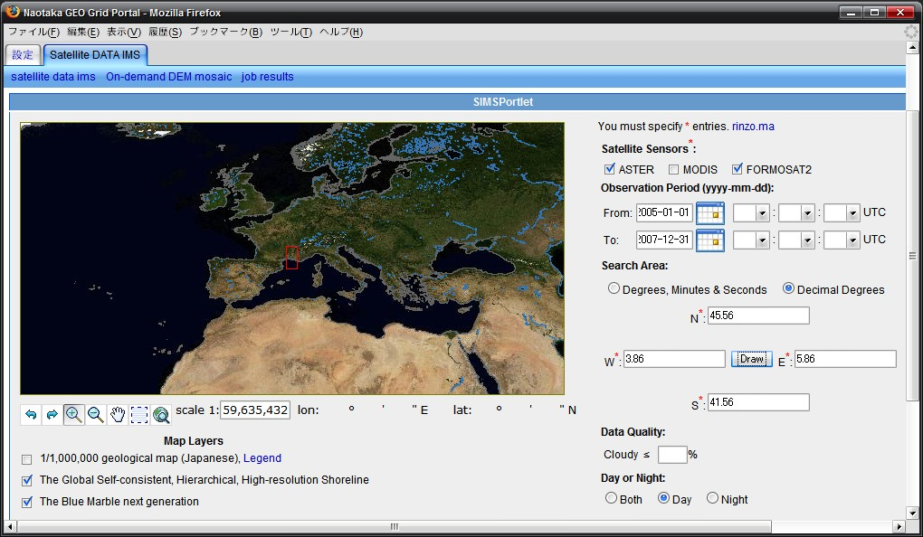

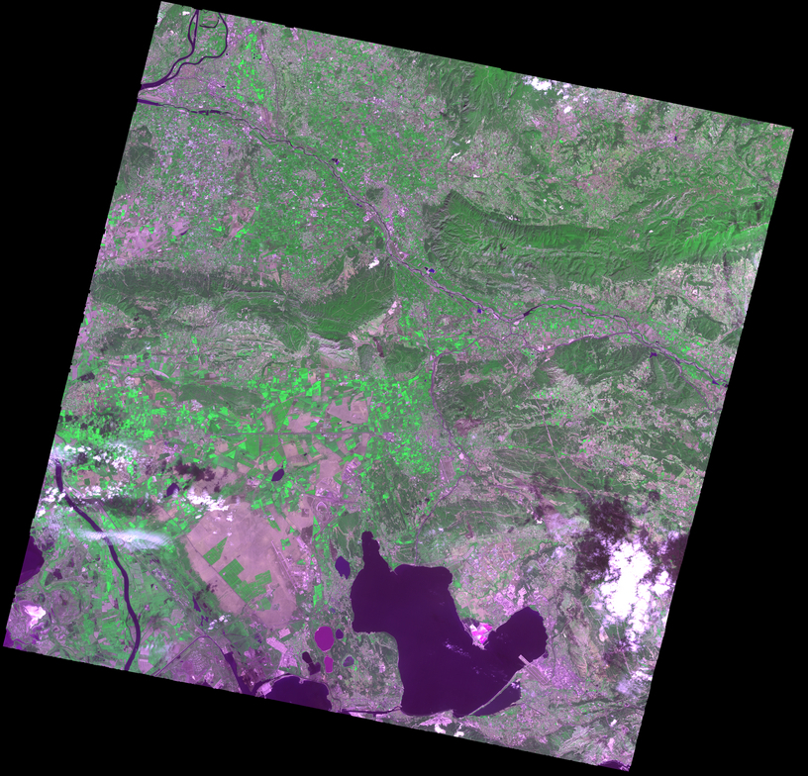

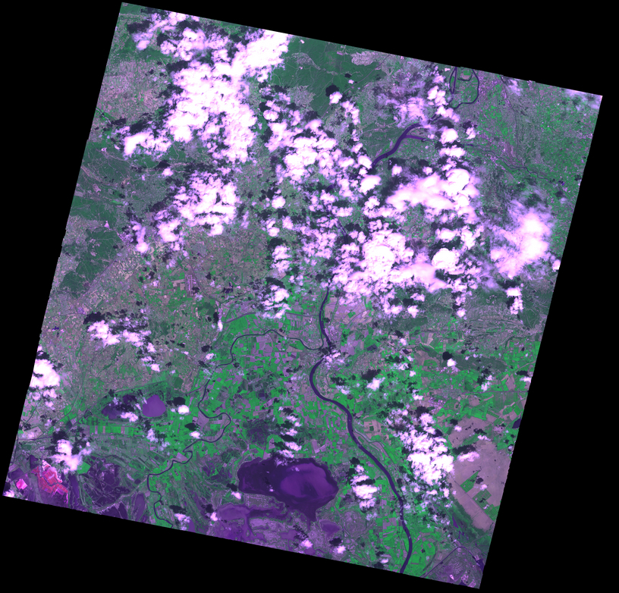
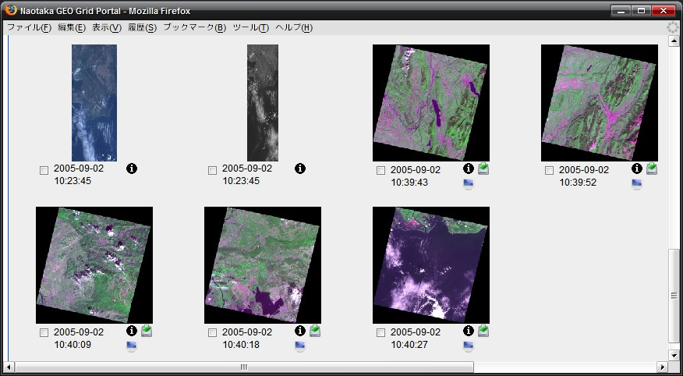
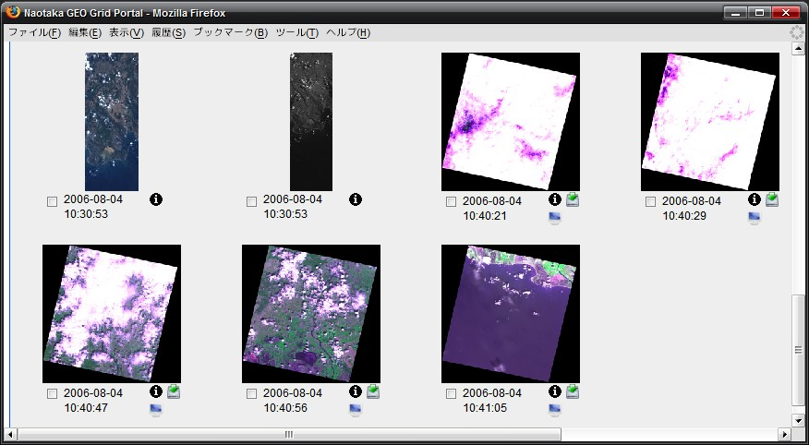
Data Search Results 1
2005/9/2
2006/8/4
La Crau, France
10:23:45
10:40:18
10:30:53
10:40:56
FORMO
SAT-2
FORMO
SAT-2
ASTER
ASTER

Slide 7
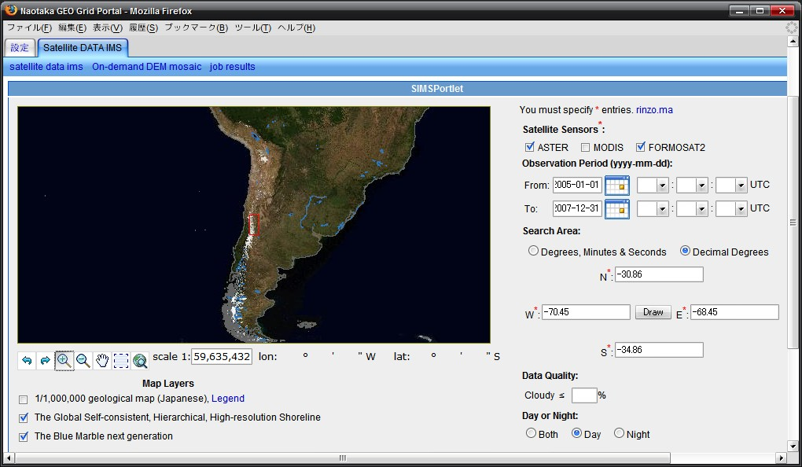

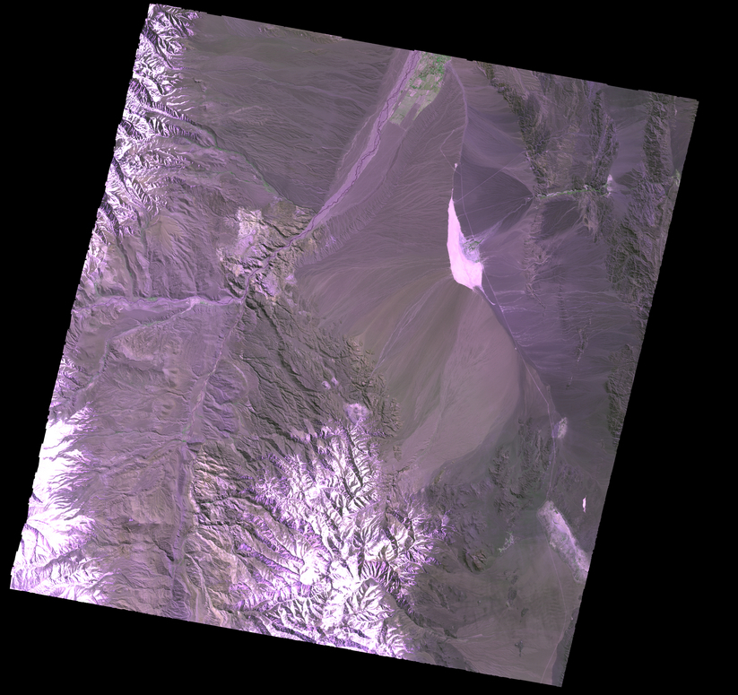

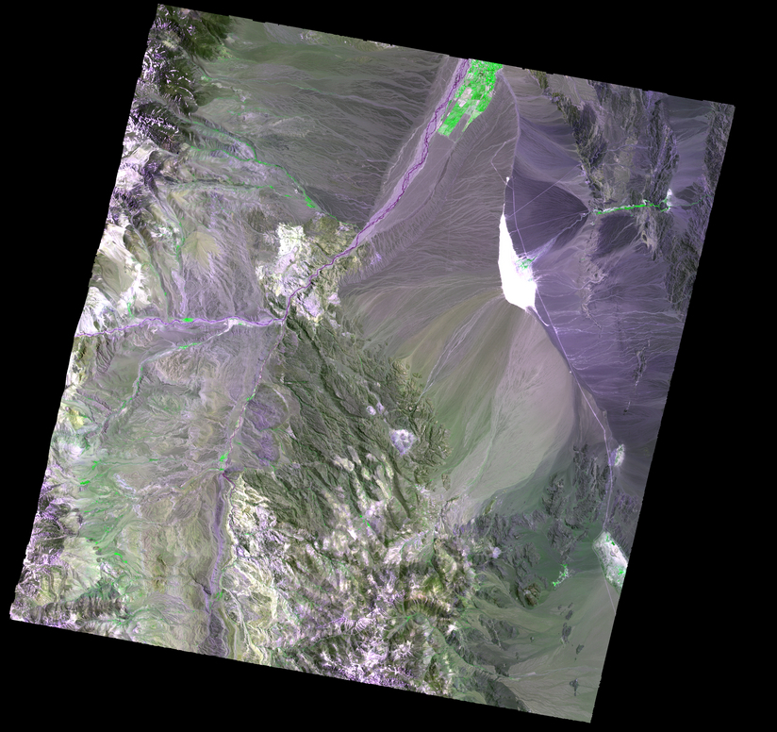
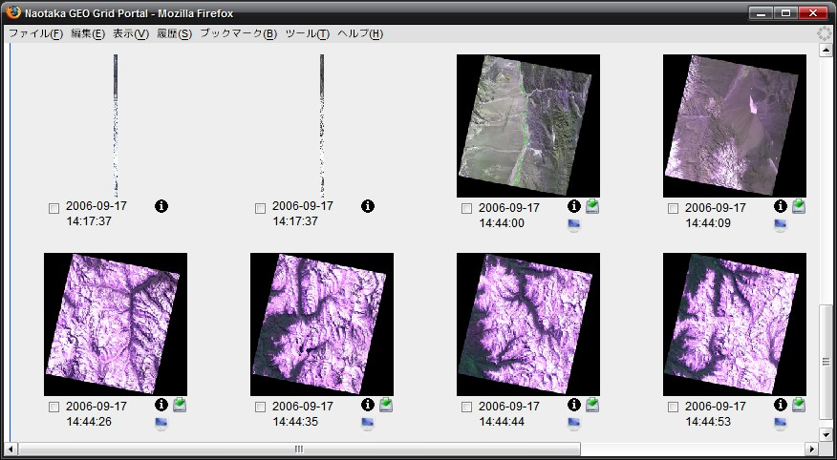
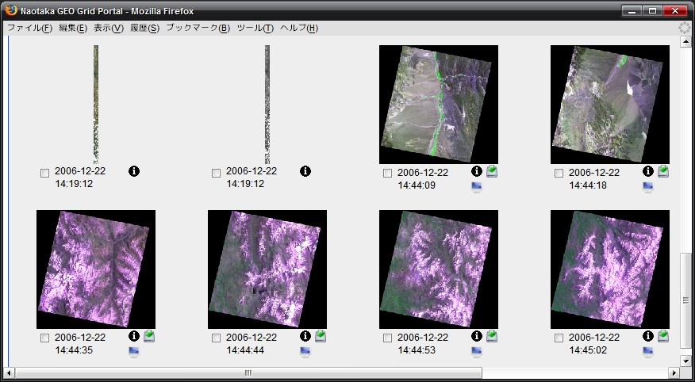
Data Search Results 2
2006/9/17
2006/12/22
Barreal Blanco, Argentina
14:17:37
14:44:09
14:19:12
14:44:18
FORMO
SAT-2
ASTER
FORMO
SAT-2
ASTER

Slide 8
Future Works
To find more satellite imagery is desired for cross calibration between FORMOSAT-2/RSI and TERRA/ASTER.
We are planning to making cross calibration system of multiple satellite sensors, which will be an application using GEO Grid.

