Slide 1
PSiGrid
The Philippine e-Science Grid
Improving research collaborations
bridging R&D outputs
through grid technologies.
Grace C. Dy Jongco
Advanced Science and Technology Institute
Department of Science and Technology
PHILIPPINES
14th PRAGMA Meeting
Taichung, Taiwan

Slide 2
Advanced Science and Technology Institute (ASTI)‏
ICT and microelectronics R&D agency under the Philippines' Department of Science and Technology
Based inside the University of the Philippines-Diliman campus, located in Quezon City in northern Metro Manila
Manages and operates the Philippine Research, Education and Government Information Network (PREGINET), the national research and education network of the Philippines (http://www.pregi.net)‏

Slide 3
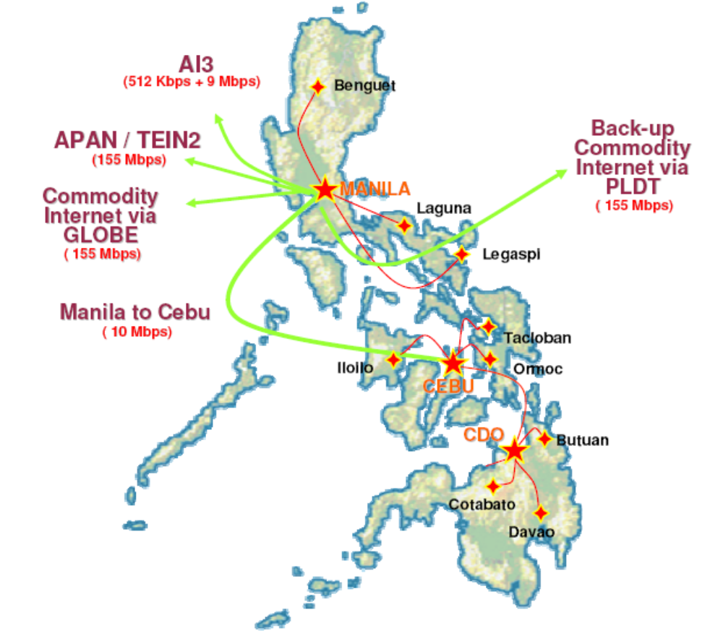
PREGINET Infrastructure
Has 80 local partners nationwide
4 exchange points: Quezon City, Makati City, Cebu City, and Cagayan de Oro.
16 access points: distributed throughout the country
Connected to APAN, TEIN2 and AI3

Slide 4
PREGINET Application Areas
E-learning (SOI-Asia, OPAPA/Agriculture Extension Technicians, Science and Math Teachers' Training)‏
IPv6 Deployment, Testbed and Training
VoIP Testbed
Access Grid
Philippine e-Library
Data/Content Mirroring
Network Measurements

Slide 5
Philippine e-Science Grid
Program: A National Grid Initiative
Notes:
With PREGINET already established, the focus now of ASTI's continued efforts in advanced networking is on the development of novel applications that can run over the grid.

Slide 6
Grid Computing in the Philippines
Part of DOST's 8-point agenda – identified as a priority R&D area in ICT
Key players
  Advanced Science and Technology – Department of Science and Technology (ASTI-DOST)‏
  Computer Science Research Center - University of the Philippines (UP-CSRC)‏
  School of Science and Engineering - Ateneo De Manila University (ADMU-SOSE)‏

Slide 7
Grid-related Activities
ASTI-DOST
  PICWIN Project (PAGASA Interactive Climate and Weather Information Network)‏
    Deployment of a Linux-based cluster using 14 64-bit Intel Xeon workstations
    Numerical weather forecasting (operations)‏
        Data: Deutscher Wetterdienst (DWD), weather service in Germany
        Model: HRM, MM5
  Grid testbed
    Three (3), three (3)-node clusters
    Demonstrate grid computing and familiarization with various grid middleware

Slide 8
Grid-related Activities
UP-CSRC
  Maintains a computing cluster used by researchers and graduate students who are engaged in information systems development, algebraic computations for modelling and simulations.
ADMU-SOSE
  AGILA Beowulf cluster - supports the computational subjects offered in the applied mathematics/computational science program of the Mathematics Department.

Slide 9
The PSiGrid Program
Duration: 3 years (January 2008 – December 2010)‏
Objective: To establish a grid infrastructure in the Philippines that will:
  Enable collaborative research activities among local educational and research institutions, and
  Provide distributed services to general users such as national institutions that will use the grid to deliver advanced services.
Initially, there are 2 projects under the program.
  Project 1: Grid Infra Project
  Project 2: Philippine Bioinformatics Solution (PBS) Project

Slide 10
Project 1: Grid Infra Project
Establish and maintain a high-performance computing facility in ASTI
Establish the core PSiGrid infrastructure
  Connect ASTI's computing cluster to the clusters in UP-CSRC, PAGASA and ADMU-SOSE using the existing PREGINET infrastructure
Offer basic computational and data grid services to national, educational and research institutions (bioinformatics, weather and climate modelling)‏
Promote grid technology locally by developing and conducting courses on grid and cluster computing
Participate in regional and international grid communities

Slide 11
ASTI HPC Facility
32 Computing nodes
  2 × Quad Core Intel® Xeon®, 2.0 GHz
24 Terabytes of storage space
16 Reconfigurable auxiliary computing nodes (Progeniq BioBoost)‏
  BLAST, ClustalW, HMMer, Smith-Waterman

Slide 12
Project 2: PBS Project
Enhance the availability of bioinformatics services locally
  Provide rapid access to major biological sequences and structure databases
    web-based search engine
    mirror of major biological sequences and structure databases
  Provide web-hosting services for bioinformatics application software
Provide assistance in capability building through the conduct of trainings (cluster management, bioinformatics software development and use of free and open source tools)‏

Slide 13
Project 3: FedGIS
Establish a web-based Federated Geospatial Information System for use in hazard mapping and assessment
  a precursor platform for the National Spatial Data Infrastructure (NSDI)‏
Enhance the capabilities of concerned agencies in disaster mitigation
  National Mapping & Resource Information Authority (NAMRIA)‏
  Office of Civil Defense (OCD)‏
  Philippine Institute of Volcanology and Seismology (PHIVOLCS)‏
  Philippine Atmospheric, Geophysical and Astronomical Services Administration (PAGASA)‏
  Mines and Geosciences Bureau (MGB)‏

Slide 14
Future Collaborators
International Rice Research Institute (IRRI) and Manila Observatory (MO)‏
  Climate forecasting for agricultural research
University of the Philippines, Los Baños – National Institute of Molecular Biology and Biotechnology (UPLB-BIOTECH)‏
  Analysis of results and data mining and management (PCR primer design, nucleotide sequence alignment, sequence analysis, phylogeny, protein structure prediction, epitope prediction, etc.)‏

Slide 15
Conclusion
With the PSiGrid initiative, ASTI hopes to promote locally the benefits of grid technology especially in the fields of Life Science, Earth Science and disaster mitigation.
Build the infrastructure, train people, identify collaborators
Notes:
The potential for the application of grid technology in various areas is limitless (i.e., agricultural biotechnology, medical bioinformatics, disaster mitigation, industry applications, digital animation economic modeling, etc.)‏
With the PSiGrid initiative, we hope to promote locally the benefits of grid technology especially in the fields of e-Science and disaster management.
Immediate benefits seen are improved research collaborations and enhanced R&D outputs.

Slide 16
Thank you!
Website: www.psigrid.gov.ph
E-mail: rnd@asti.dost.gov.ph
Research collaboration
Resource sharing
Enhanced computing

