Slide 1

High Performance and Grid Computing Group
Faculty of Computer Science and Engineering
Ho Chi Minh City University of Technology
Vietnam
Dr. Tran Vu Pham

Slide 2
Outline
About us
Research focus & collaborations
Research projects
Interest in PRAGMA
Commitments
Summary

Slide 3
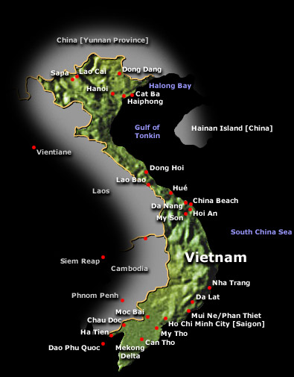

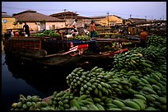
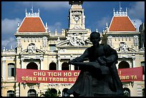
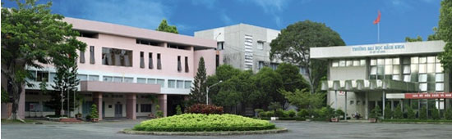
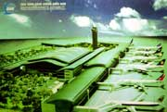
Overview
Geographical Location
Down Town 5 km
Airport 7 km

Slide 4
About Us
Founded in 1995 at Faculty of Computer Science and Engineering, University of Technology
Initial focus on parallel computing and operating systems
Current staff:
  20 persons (10 PhD, 4 Msc)

Slide 5
Research Focus
Grid and Peer-to-Peer computing
Tools for parallel machines
Performance analysis, debugging
Fault tolerance
Scientific computing
Operating systems
Collaborative systems

Slide 6
Research Collaborations
University of Linz, Austria
University of Heidelberg, Germany
University of Applied Sciences of Fribourg, Switzerland
Annual International Workshop on Advance Computing and Applications
  Jointly organized with Hanoi Institute of Mathematics and University of Heidelberg
PRAGMA

Slide 7
Research Projects
Past
  Supernode cluster (1998-2000)
  Supernode II (2004-2006)
  Checkpointing for parallel applications
  Management and visualization of the geophysical data of White-Tiger oilfield (1998-2001)
Current
  EDAGrid (2005-2008)
  VN-Grid (2007-2009)
  POP-C++ (2007-2009)

Slide 8
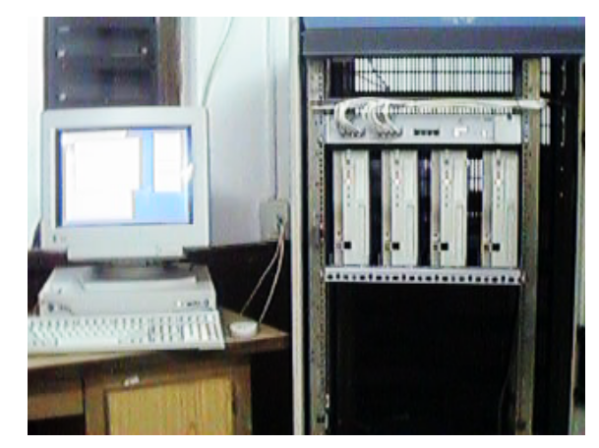
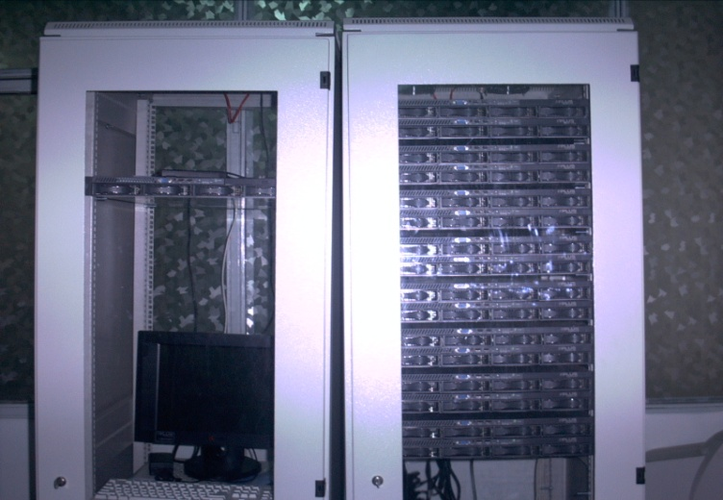
Supernode Projects
To build a HPC system with tools to support parallel programming
Supernode 1 (1998-2000)
Supernode II (2004-2006)
4 Nodes
Configurable network topology
MPI interface
64 Nodes (dual Xeon)
Fast network (32 links, 1Gb/s each)
330 GFlops effective performance
MPI interface

Slide 9
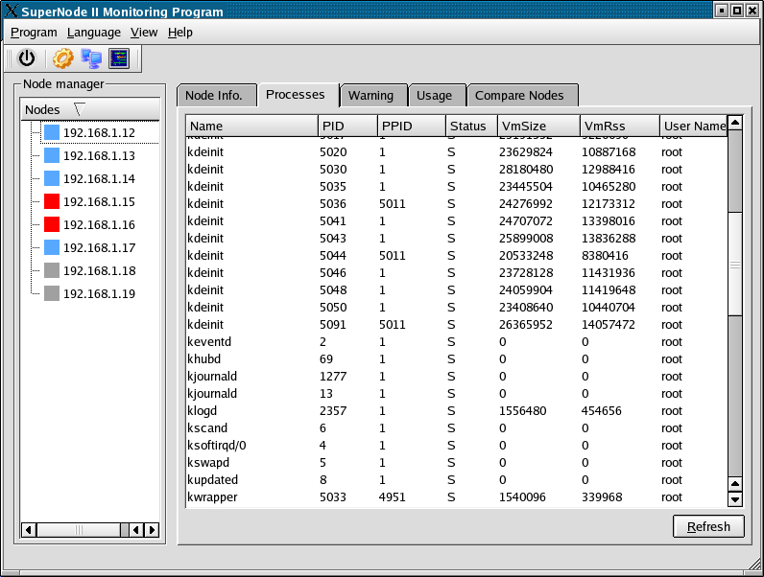
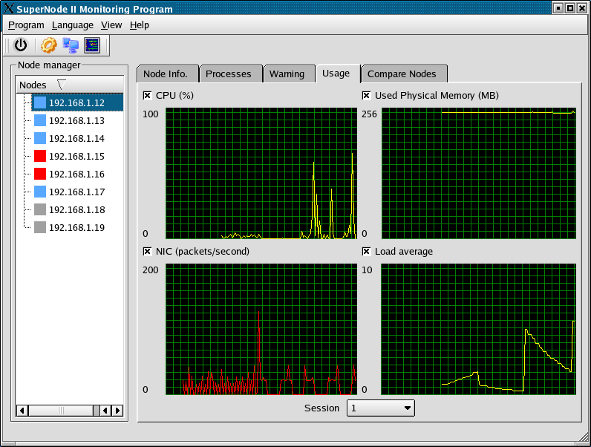
Supernode II: Tools
Notes:
Provide informations to administrator about hardware status, network status, system load, daemon status
Keep track of the running status of processes. User can monitor their job’s status.
Provide informations to Billing system

Slide 10
EDAGrid Project
To build and deploy a campus Grid infrastructure for HCMUT
Grid infrastructure
  Develop campus Grid middleware
  Deploy Grid infrastructure at HCMUT
Grid applications
  Data mining
  Circuit design and simulation
Project website
  http://www.edagrid.hcmut.edu.vn

Slide 11
EDAGrid@HCMUT
EDAGrid computing infrastructure has been operated at HCMUT
EDAGrid resources:
  Supernode II cluster
    64 dual Xeon nodes, 1Gb/s network
  Student lab cluster (CSE)
    40 workstations managed by SPNTOOL (our cluster management software)
  Staff workstations (CSE)

Slide 12


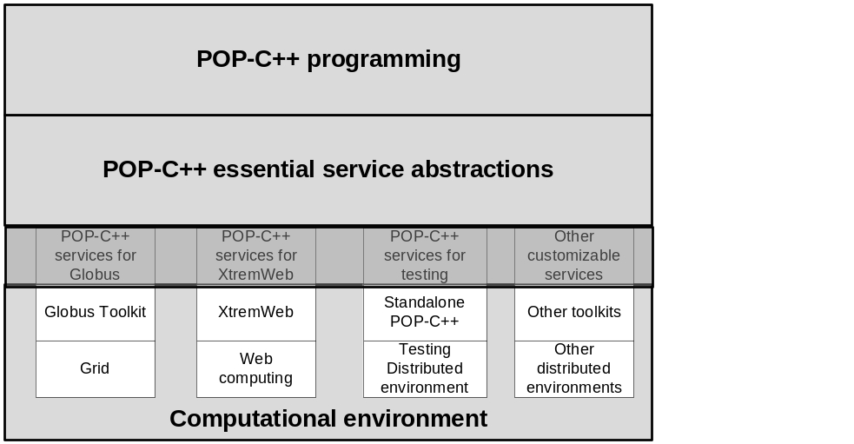
POP-C++: Parallel Object Environment
C++
POP-C++
class Foo {
Foo();
void MyMethod();
};
parclass Foo {
Foo() @{ od.power(100);};
async conc void MyMethod();
};
Grid Programming
Grid infrastructure
Foo::Foo() { ... }
void Foo::MyMethod(){...}
Architecture
Shared implementation
Transparent, requirement driven object allocation
Various method invocation semantics

Slide 13
VN-Grid Project (2007-2009)
Research and participate in the development of Vietnamese National Grid computing infrastructure (VN-Grid)
Promote the use of Grid technologies for computation-intensive applications
Create an initial testbed for resource sharing among university members within VNU-HCM

Slide 14
VN-Grid Infrastructure at HCMUT
Computational resources
  Supernode II
  Clusters
  1 Gb fibre optic network
Grid middleware
  Use Globus Toolkit 4.0
Demonstrating applications
  Simulations in used aerodynamics design
  Computation of permeability field for White-Tiger oil field (offshore Vietnam)
  Optimisation of super-conductor design
  Possibly: GEO science

Slide 15
Interests in PRAGMA
Consider PRAGMA as a key player in Grid technologies and applications in Asia-Pacific region
Promote Grid research collaborations with partners in Asia-Pacific region
  In Grid computing and high-performance computing
  Sharing resources, expertise and experience
  Research co-operation
Bridge the Grid research communities in Vietnam and the region

Slide 16
Commitments
Sharing resources, expertise and experience
  Currently, joining PRAGMA with 16 nodes from supernode cluster
Interested in joining resource and GEO-Science groups
  Developing and sharing Grid infrastructure and middleware
  Developing and providing infrastructure for GEO-Science applications
Ready to join regular PRAGMA activities
Willing to host future PRAGMA events

Slide 17
Summary
One of the most active Grid research groups in Vietnam
Look forwards to strengthening and widening international collaborations, particularly in Asia-Pacific region

Slide 18
Thank you
Contacts:
  Dr. Nguyen Thanh Son
    sonsys@hcmut.edu.vn
  Dr. Nguyen Tuan-Anh
    tuan-anh.nguyen@hcmut.edu.vn
  Dr. Tran-Vu Pham
    t.v.pham@cse.hcmut.edu.vn

Slide 19
International Workshop on Advanced Computing and Applications
Ho Chi Minh City 12-14 March 2008 http://www.cse.hcmut.edu.vn/ACOMP2008/
Welcome to HCMUT

