Slide 1

NU Community Research Institute (NUCRI)
(http://nucri.nu.edu)
NUCRI is an outreach to the Community for National University
HASTAC (higher education)/HASS grid
National School Board (NCC/FRC)
UC Humanities Research Institute
UCOP
Envision (San Diego) Creative Community (KPBS)/SDSU
NCSA/University of Urbana-Champaign
K12 (AmeriCorps)
ARTCA, PRAGMA ?
focused on digital technology need based Research for the community

Slide 2
NU Community Research Institute (NUCRI)
(http://nucri.nu.edu)
Tools and Technologies
i-Dataware – web based integrated database system for providing social services
ezSRB – web based interface for managing data through Storage Resource Broker (SRB) middleware; used in HASSgrid deployment
VCMSS – virtual collaboratory tool for working on collaborative projects
FastApps – web based software system for grant management
CyberEdWorld – immersive 3D space for virtual classroom
Open source software technologies (Portal Technology, Content management Software/Drupal, audio/video communication software/Access Grid, PHP, MySQL…)

Slide 3
CHOMS : A web based database system for obesity management for children
enter
PDX online – for professional development through Online or Hybrid
courses

Slide 4
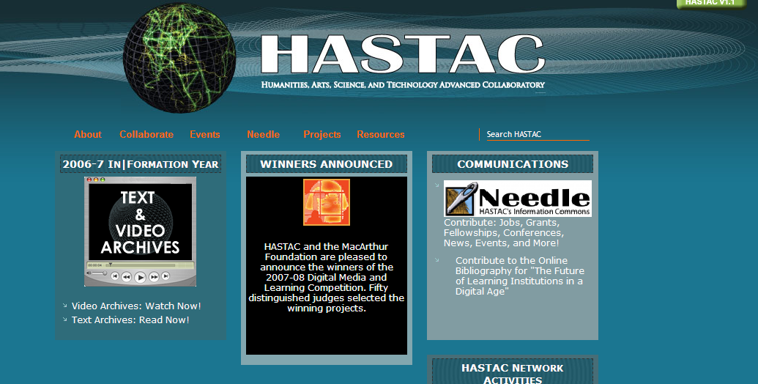
HASTAC Community
NSF funded InFormation Year 2006-7/InCommunity

Slide 5

i-DATAWARETM
SOFTWARE THAT POWERS THE FRC
SOFTWARE THAT POWERS THE
Family Resource Centers

Slide 6
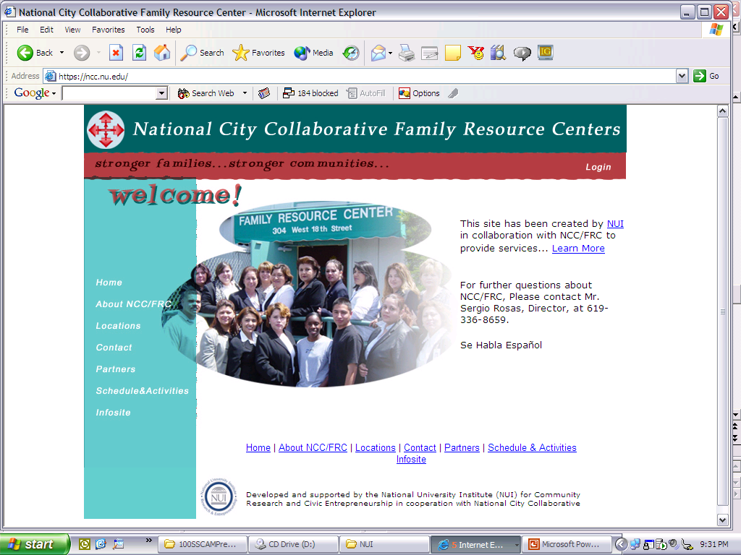
demo

Slide 7
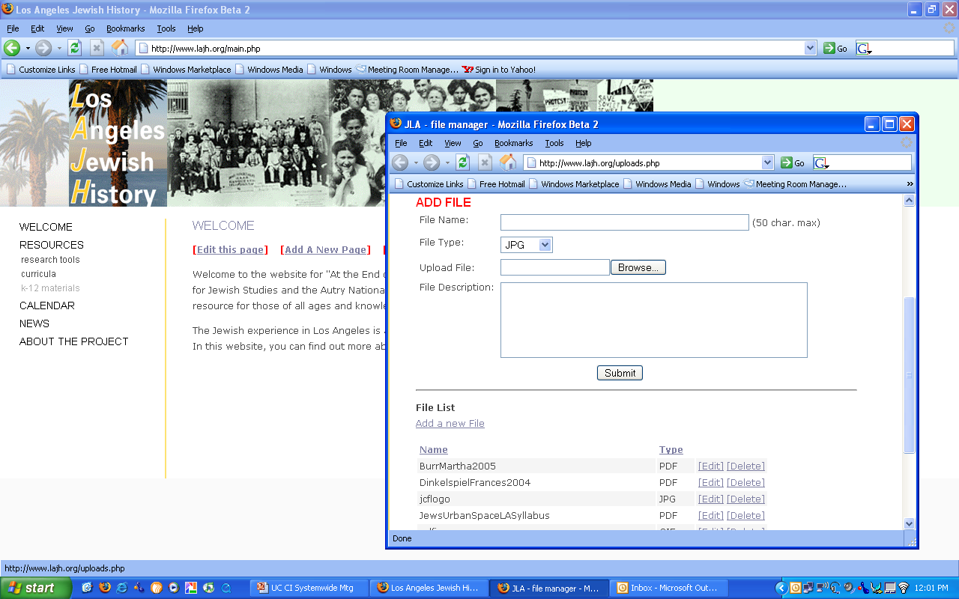
LA Jewish History Portal and Digital Library

Slide 8
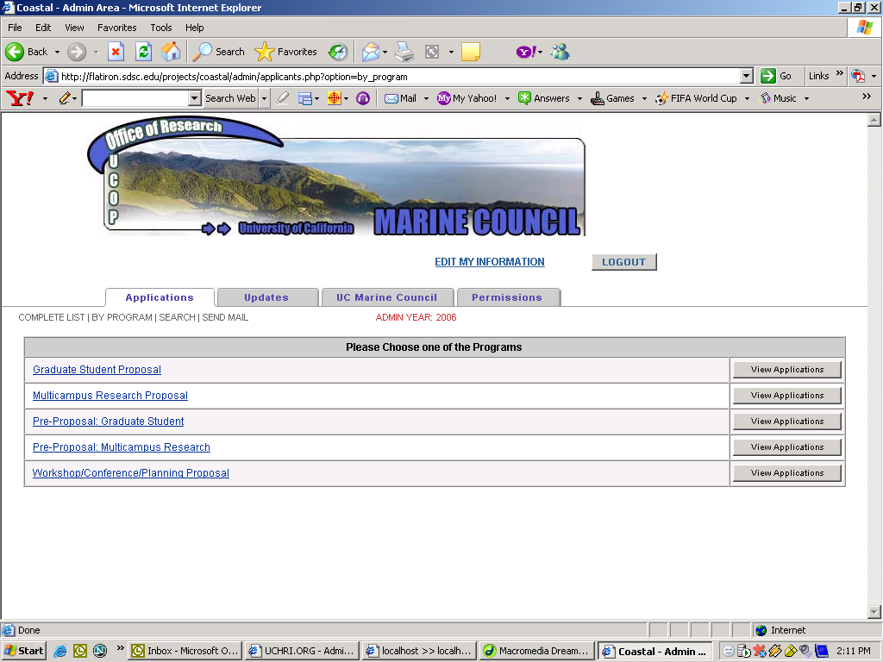
FastApps for Coastal (www.ucop.edu/research/coastal)

Slide 9
Virtual Collaborative Research Environment
Connecting heterogeneous digital devices /cell phones/ PDA/ sensors, etc. to data repositories, telecommunications and tele-research tools with the purpose of supporting collaborative research
Solution?
- grid technology
Data grid (SRB)
Grid computing (Globus, Condor)
Communication grid (Access grid)

Slide 10
Objectives
Research and Collaboration
Shared Global Resource
Creating Virtual Space for others to join in
Data manipulation, analyzing
Enhancing Human-to-Human interaction

Slide 11
Requirements:
Universal access
Data Management
Job submission
Security
Secured Login
Technology transfer
Gateway to other links, databases and applications

Slide 12
Data Grid
DATA Grid is Grid Computing systems that deals with controlled sharing and management of huge amounts of distributed data sets. The data grid creates virtual but collaborative environments that support distributed scientific and engineering research.
Current large scale projects are;
Biomedical Informatics and Research Network (BIRN)
Southern California Earthquake Center (SCEC)
Data Grid needs a middleware called Storage Resource Broker (SRB), which acts as the underlying data grid technology.

Slide 13
Features SRB
Data Virtualization
  Uniform Data Name Space & Virtual Collection-concept
Resource Transparency
  Local or Remote, Resource Type & Access Method
Location/Format Transparency
  Path Names, Schemas, Containers
User Transparency
  Uniform User Name Space
  Tickets & Groups
Method Transparency
Other Features
  Rich Access Control
  Cross-Domain Authentication
  Segmented & Replicated Data Mgmt
  Data Discovery
  …
UC-Berkley
UCHRI
UCLA
MCAT
Virtual Data Grid (SRB)
NUCRI SDSC

Slide 14
Solution SRB
SDSC Storage Resource Broker & Meta-data Catalog
Application
Resource,
Mthd, User
C, C++,
Linux I/O
Unix
Shell
Java, NT
Browsers
Prolog
Predicate
Web
Metadata
Extraction
User
Defined
SRB
Remote
Proxies
MCAT
Archives
HPSS, ADSM,
UniTree, DMF
File Systems
Unix, NT,
Mac OSX
Databases
DB2, Oracle,
Sybase
Dublin
Core
DataCutter
Application
Meta-data
Notes:
18

Slide 15
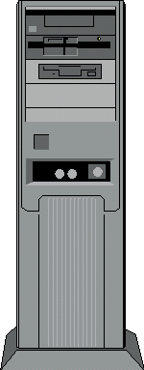

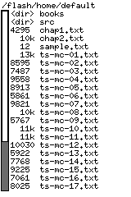

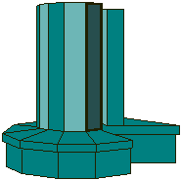
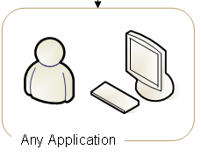

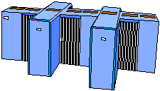


Visualization of SRB
SQL server/Oracle/MySQL
Any platform
Distributed Server
Supercomputers
Mainframes

Slide 16
SRB Clients
Scommands
Unix file system like interface
Version available for Unix, Dos and Mac
Inquisitor (inQ)
        Windows Explorer style interface
  Version available for Windows
Client access API
        C API
        JARGON – Java API to SRB
        MATRIX – SRB Workflow system
MySRB
Web Browser interface

Slide 17
MySRB
Web-bases Access to the SRB
Secure HTTP
Uses Cookies for Session Control
Self Registration of Users Supported
  Currently limited to SDSC users
Self Registration of Resources (soon)
Access to Both Data and Metadata

Slide 18
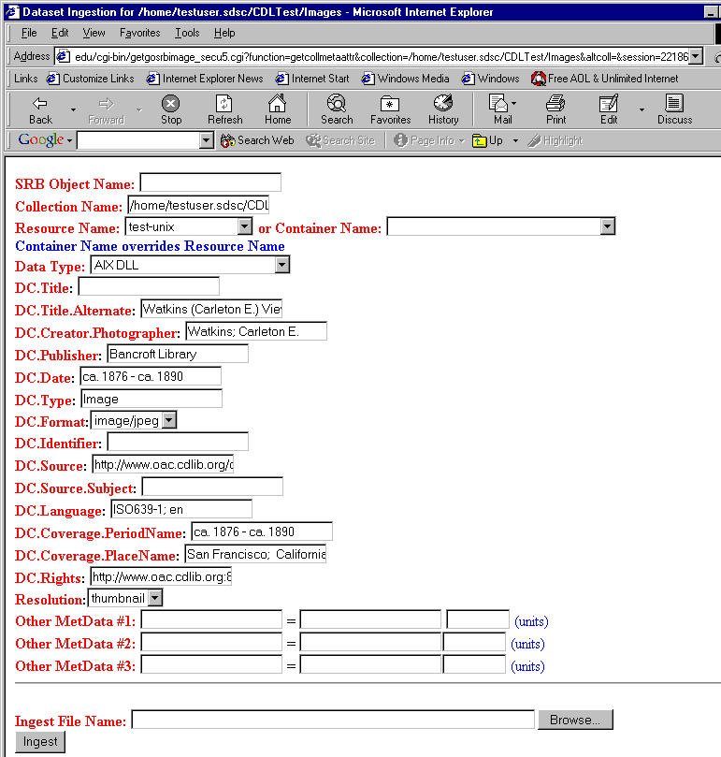
Types of Meta data
System-level Metadata
  Size, resource, owner, date, access control, …
User-defined Meta data
  for data & collections
  <name,value,unit> triples
  No limits in number of metadata
  Support for Collection-level schemas
    Comments, default values,
    drop-down lists
  Support for Standardized Schemas
    (eg. Dublin Core)
Annotations
  Supports textual annotations
  Annotator, date, context also registered

Slide 19
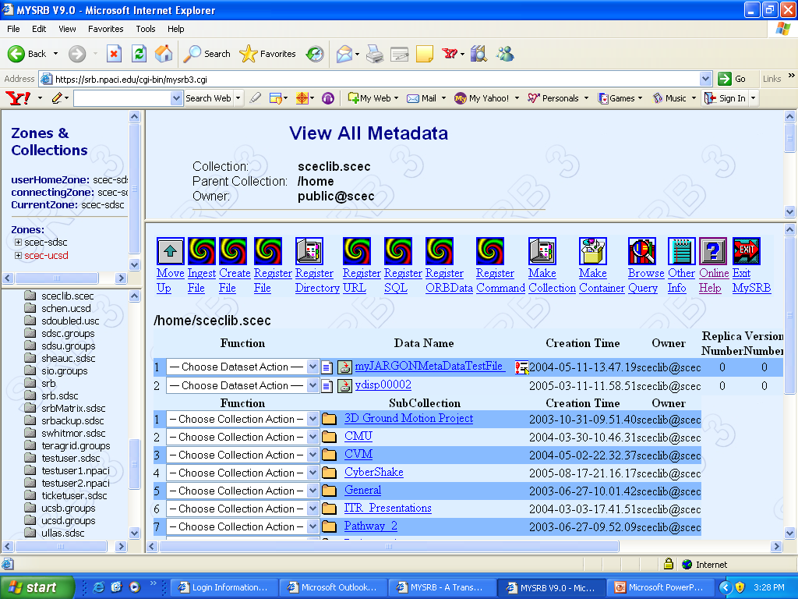
enter

Slide 20
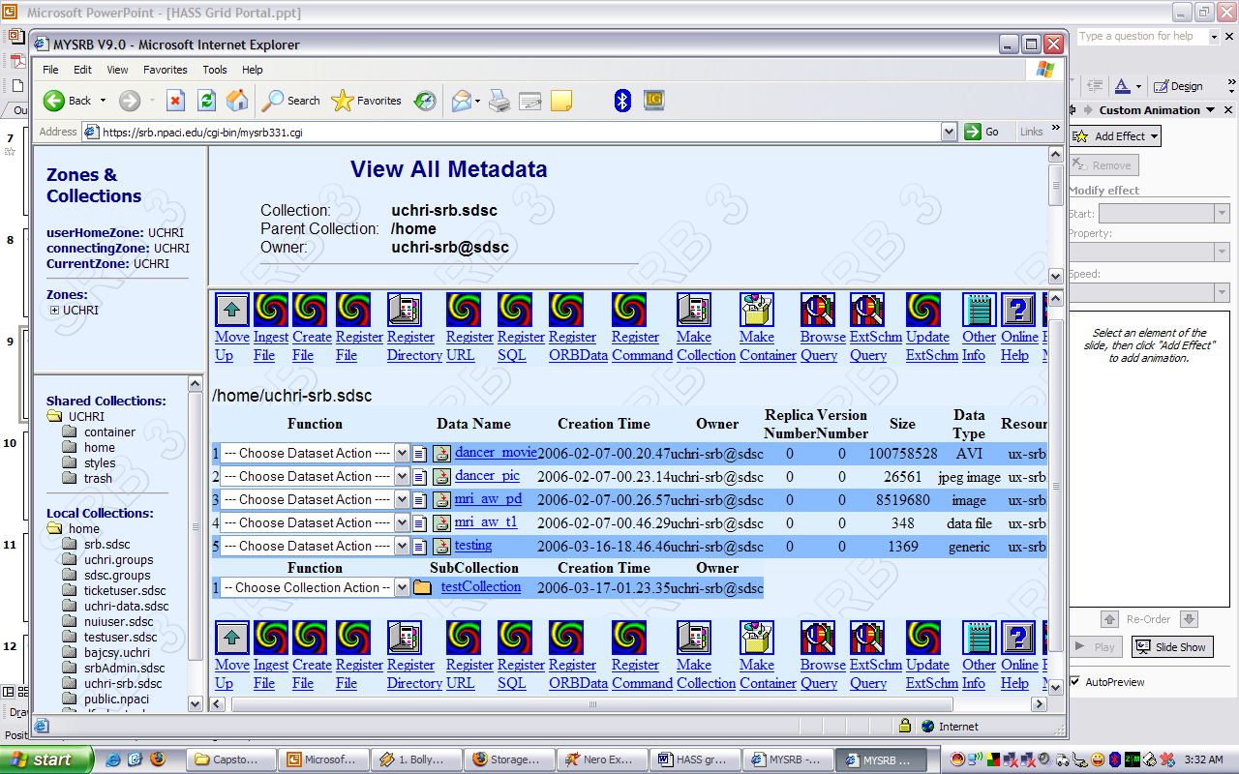
MySRB disadvantages..
Non User-friendly
Too Many complexity in accessing data
Too many features
High definition language used

Slide 21
About Scommands
Command line interface >> Scripting
Available for Unix and Dos platform
Most flexible and powerful for client SRB
Fastest and reliable
Great for scripts, batch jobs etc.
Example:
Sinit= establishes a session
Senv= displays connection information
Smkdir= makes a new directory
Sget= copy file from remote SRB Master to local
Sput= upload file from local to SRB Master server
Sexit= ends session

Slide 22
PHP Wrapper
PHP Scommand Wrapper
function sinit()
{
$retval=array();
putenv("mdasEnvFile=".$GLOBALS['MDASENV_PATH']."/.MdasEnv");
putenv("mdasAuthFile=".$GLOBALS['MDASENV_PATH']."/.MdasAuth");
$scmd_result=shell_exec($GLOBALS['SCMD_PATH'].'/Sinit -v');
if (stristr($scmd_result, "Connection to srbMaster failed."))
{
$retval['status']=false;
}
else
{
$retval['status']=true;
}
$retval['data']=$scmd_result;
return $retval;
}
function sls($param)
{
$retval=array();
$scmd_result=shell_exec($GLOBALS['SCMD_PATH']."/Sls -l $param");
if (stristr($scmd_result, "No such dataset or collection"))
{
$retval['status']=false;
}
else
{
$retval['status']=true;
}
$retval['data']=$scmd_result;
return $retval;
}

Slide 23
ezSRB – web based interface for managing data through Storage Resource Broker (SRB) middleware; used in HASSgrid deployment
enter

