Slide 1




Summary of Steering Committee Meeting
PRAGMA 14
13 March 2008
台中
NMNS
Living Grid:
combines multi-cultural folk arts with modern technology
All funding agencies

Slide 2
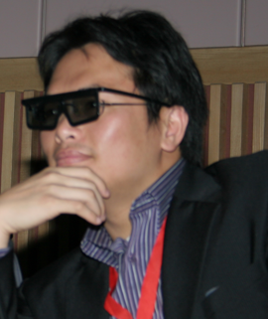
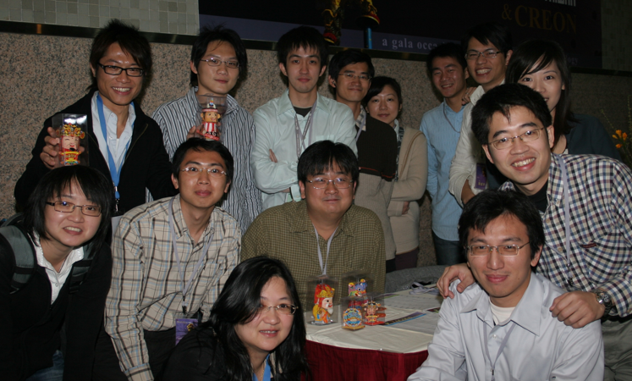
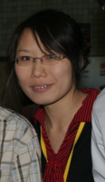
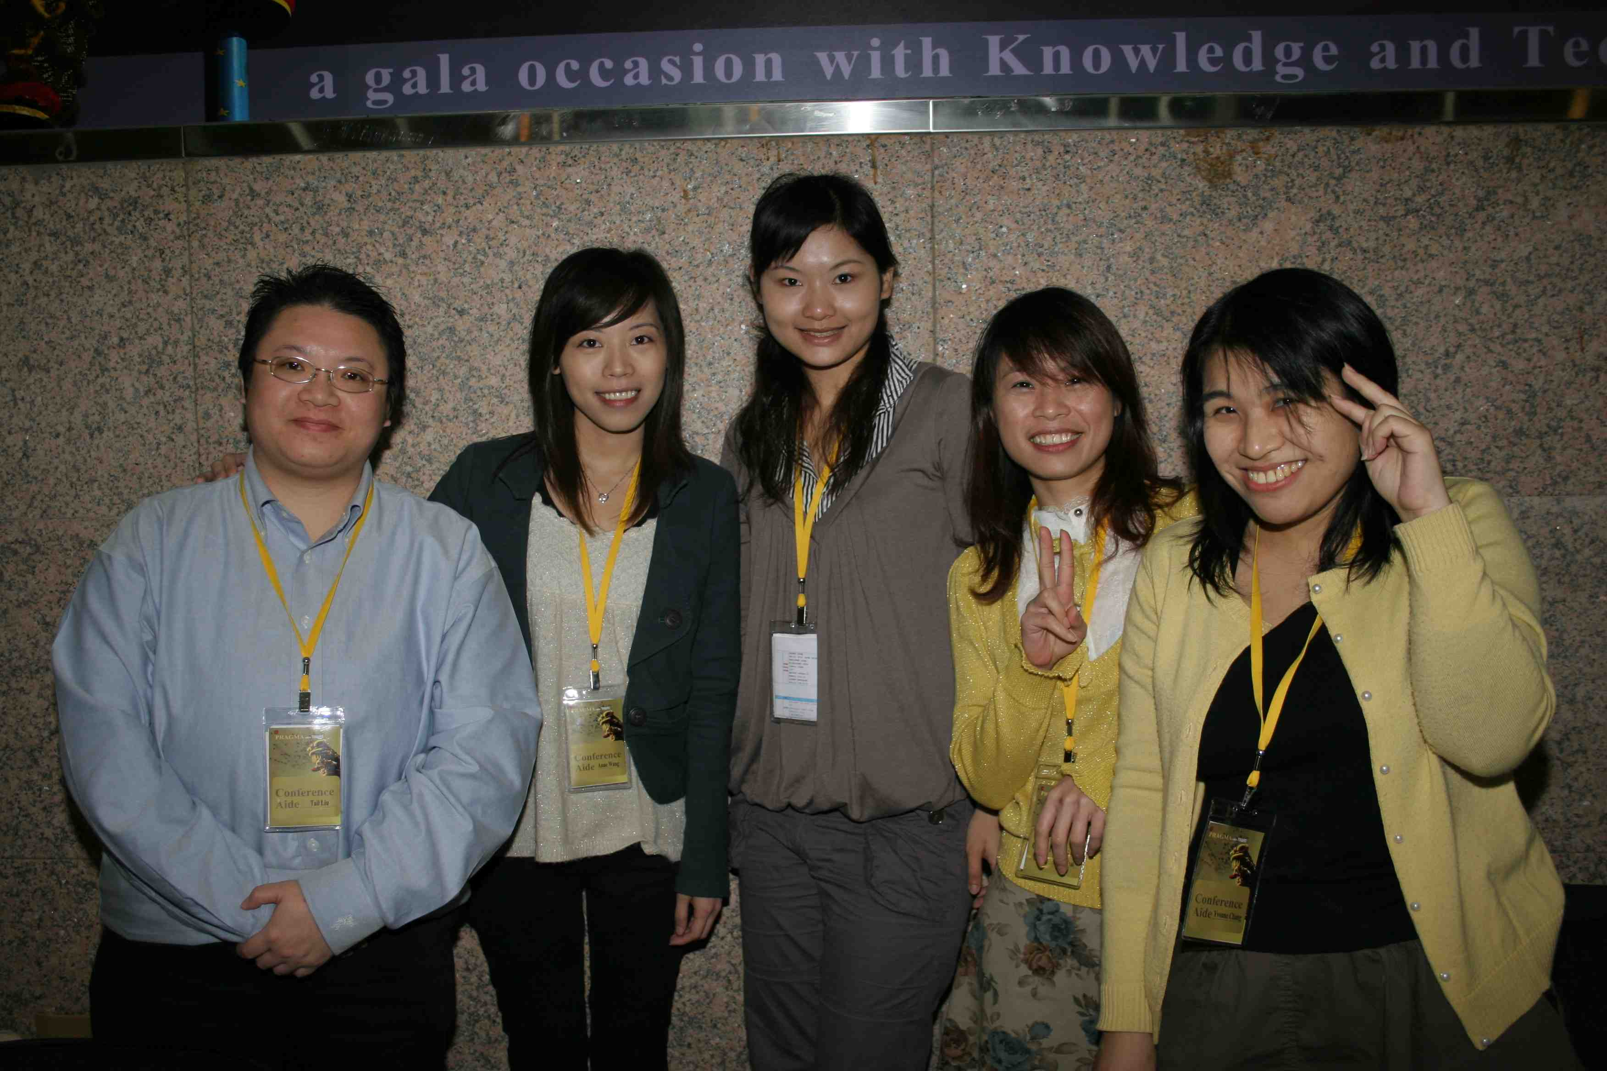
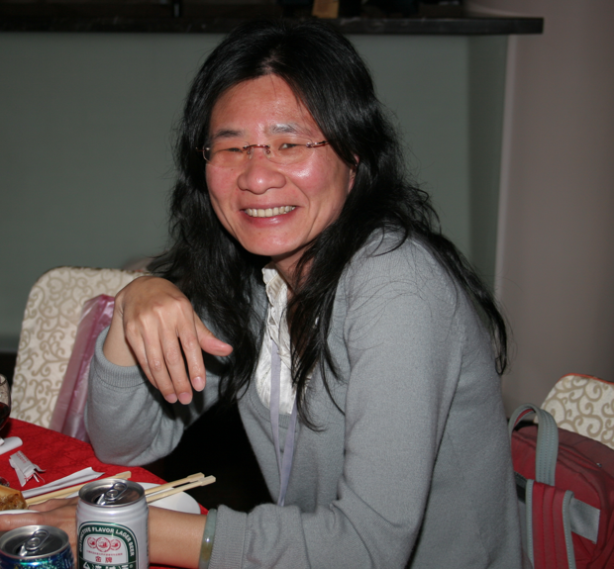
Technical Support
David
VIS GUYS
Annie
Hsiu Mei
Tail, Anne, Kim, Sally, Yvonne

Slide 3
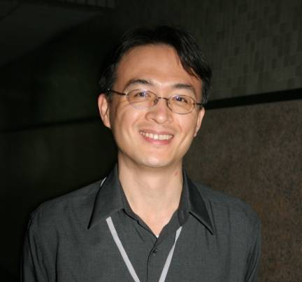
Recognition
About "Les Trophées du libre"/"International Free Software Contest":
"With 113 participants from 18 countries, 'Trophées du Libre' is unquestionably the largest competition ever organised to promote the spirit of Free Software to software users. The developers who will win this award will get the publicity they deserve."
- Richard M Stallman, chairman of the jury of the first Trophées du libre
What: DRBL (Diskless Remote Boot in Linux)
DRBL provides diskless or systemless environment. It uses distributed hardware resources and makes it possible for clients to fully access local hardware. It also includes Clonezilla, a partition and disk cloning utility similar to Ghost.
Who: NCHC (Steven Shiau leads the opensource / software development team)
Award: The First Prize in the category of "Public Sector Applications"

Slide 4



Steering Committee Agenda
New Member Applications
  Advanced Science and Technology Institute
  High Performance Computing Center, Hanoi University of Technology
  Ho Chi Minh University of Technology

Slide 5


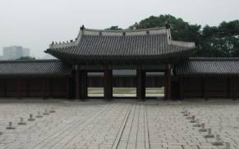


PRAGMA Workshops and Institutes of the Future
PRAGMA 15
  USM, Malaysia
  22 – 24 October 2008 (with other activities)
PRAGMA 16
  KISTI, Daejon, Korea
  23 – 25 March 2009
PRAGMA Institutes
  Joint Southeast Asia PRAGMA Institute; Nov/Dec 2008
  Possible with PRAGMA 15
  Discussions with CICESE Summer/Fall

Slide 6
PRAGMA Membership Responsibility
Active Involvement, such as
  Participation in workshop
  Engagement in working group
  Leading PRAGMA Institute
  ….
Integrity of Organization
Proposal: Non-involvement by Member after year
  Discussion with member at mutually agreed upon action

Slide 7
A Grand Outcome: Proposed Framework for PRAGMA Education Center
The Challenge: Consider a persistence location for interactions of students, postdocs, researchers in PRAGMA, like an Aspen Institute
The Opportunity: NCHC’s new Taichung location and the repeating Southeast Asia Institute
The Elements of the Proposed Framework:
  Propose a joint PRAGMA SEAIP Institute
  Create space for visitors and start program initial focus on SEA,
  Use 10G connectivity and OptIPortals for bringing in connections with other sites
Note: This concept can be duplicated elsewhere, such as NCSA
Notes:
The Aspen Institute is an international nonprofit organization founded in 1950 dedicated to "fostering enlightened leadership, the appreciation of timeless ideas and values, and open-minded dialogue on contemporary issues." The institute and its international partners seek to promote the pursuit of common ground and deeper understanding in a nonpartisan and nonideological setting through regular seminars, policy programs, conferences, and leadership development initiatives. The institute is headquartered in Washington, D.C. and has campuses in Aspen, Colorado (its original home) and near the shores of the Chesapeake Bay at the Wye River in Maryland. Its international network includes partner Aspen Institutes in Berlin, Rome, Lyon, Tokyo, New Delhi, and Bucharest, as well as leadership initiatives in the United States and in Africa, India, and Central America.
The Aspen Institute is largely funded by foundations such as the Carnegie Corporation, The Rockefeller Brothers Fund and the Ford Foundation, by seminar fees, and by individual donations. Its board of trustees includes a wide range of leaders from the realms of politics, government, business and academia who also contribute generously to its support; Walter Isaacson is currently President and CEO. Its vice-president is ex-US State Department official Eric Motley.

Slide 8
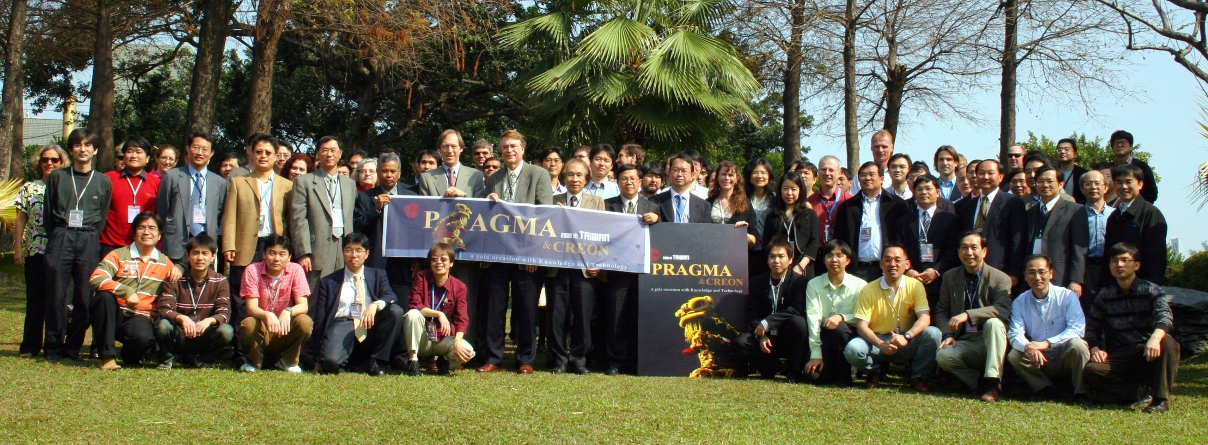
PRAGMA 14
10 – 12 March 2008
Taichung

