Slide 1
A method of data sharing in 2007 PRIME project and a study of its integration into NAREGI data grid environment
UPDATE
PRAGMA 14 Workshop
March 11, 2008
National Museum of Natural Science, Taichung
Eisaku Sakane <sakane@cmc.osaka-u.ac.jp>
Cybermedia center
Osaka University
Notes:
（自己紹介があれば）Thank you Mr. Chairperson.
Good afternoon, ladies and gentleman.
I will be talking about `a method of data sharing in 2007 PRIME project and a study of its integration into NAREGI data grid environment’.

Slide 2
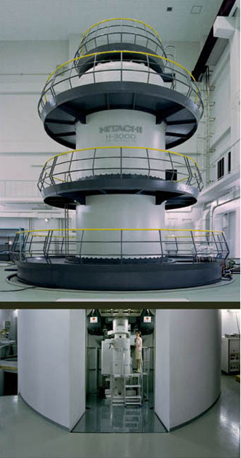
Research Objective of PRIME 2007
＋Big Ultimate Objective:
+ build/visualize/mathematically analyze
3D cardiomyocyte (Heart Cell) model
--> High Resolution
--> Finite Elements
--> Normal & Failing Hearts
--> Base on Realistic Anatomical Structures
Cardiac Mechanics Research Group
CMRG - UCSD
Cybermedia Center
CMC - Osaka University
Research Center for
Ultra-High Voltage Electron Microscopy
UHVEM - Osaka Univ.
National Center for Microscopy
and Imaging Research
NCMIR - UCSD
*Acknowledgement: Young Chun, UCSD
Notes:
I give a brief outline of a part of PRIME 2007 project. The ultimate goal of 2007 PRIME project is to build, comprehensively visualize, and mathematically analyze high-resolution 3D cardiomyocyte models with finite elements (normal and in failing hearts) based on realistic anatomical structures.
This project is collaboration with CMRG and NCMIR at UCSD, and CMC and UHVEM at Osaka University.
This slides is given by Young Chun of UCSD. She is a PRIME student last summer.
Unfortunately, I am not qualified to talk about this model.
This goal will be achieved by integrating resources and expertise of National Center of Microscopic Imaging Research (NCMIR) and Cardiac Mechanics Research Group (CMRG) at UCSD, and Cybermedia Center (CMC) and Research Center of Ultra-High Voltage Electron Microscopy (UVEM) at Osaka University. Effective and interactive data collection, data accumulation, and analyses will be facilitated by establishing a trans-Pacific cyber network that uses grid technologies.
*Target of 2007 PRIME project:
A preceding effort between the Biogrid project of CMC and NCMIR Telescience project created a grid-based connection (remote-data collection and data sharing) and enabled UCSD scientists to access the Osaka 3MeV UVEM and to visualize neural 3D micro-structures, providing a basis for this 2007 PRIME project.
*Specific Project Proposal:
1. Work with CMC and NCMIR to establish effective grid-based connection between Osaka and UCSD, while
integrating Osaka UVEM within this network.
2. Collect preliminary projection images with Osaka/NCMIR EM specialist of cardiac EM sections prepared
by NCMIR.
3. Work with Osaka/NCMIR EM specialist to obtain a series of projection images (a tilt series) of cardiac samples
in Osaka UVEM.
4. Work in CMC to reconstitute partial tomographies of cardiac EM utilizing the grid resources. May further
achieve partial segmentation of functional cellular structures. NCMIR will remotely assist.
5. Learn next-generation technologies of high-resolution visual data display in CMC, and work with NCMIR and
CMC through the grid environment in an attempt to adapt new media technologies to visualization of 3D EM
data and cardiomyocyte models.
6. While preliminarily reconstructing and segmenting cardiomyocyte 3D micro-structures, may interact with
CMRG to design protocols to fit adaptive meshes to segmented structures, and to finally achieve mathematical
modeling. CMC will be consulted.

Slide 3
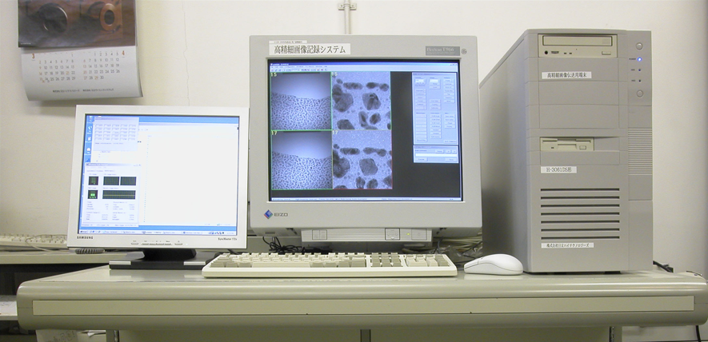
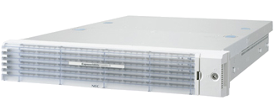
Overall UHVEM - CMC - NCMIR
Data flow
UHVEM
CCD camera
controller
data
Cybermedia Center
Research Center for Ultra-High Voltage Electron Microscopy
SCP/SFTP
Storage
IMOD (X11 client)
WebDAV
data
X11 server
Cell Centered Database
National Center for Microscopy and Imaging Research
data
data
Notes:
What you see here is an overall UHVEM-CMC-NCMIR data flow that was established last summer.
Currently, a user uploads image data to a storage server using SCP/SFTP client.
IMOD is a software for tomographic/3D reconstruction. A user operates it via X11 protocol.
A user at NCMIR accesses the data using WebDAV and stores automatically them in the Cell Centered Database by running a script.
This data sharing system is a simple solution for PRIME project.

Slide 4
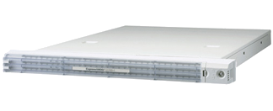
Integration into NAREGI data grid
UHVEM
CCD camera
controller
Virtual Organization
data
Cybermedia Center
VOMS
``Data provider’’
Research Center for Ultra-High Voltage Electron Microscopy
SCP/gfreg (gfarm)
Gfarm-VO
IMOD
SS/IS
data
WebDAV
NAREGI Portal
GridVMs
Tomographic/3D
reconstruction
Cell Centered Database
National Center for Microscopy and Imaging Research
data
data
Notes:
As the next step, we have considered its integration into NAREGI data grid environment. NAREGI grid middleware is developed by Center for Grid research and Development, National Institute of Informatics in Japan.
This is a design for integration into NAREGI data grid environment.
NAREGI portal, Super Scheduler, Information Service and GridVM server/clients are component of NAREGI GRID Middleware. And there are data grid components in this system. Gfarm-VO provides Gfarm filesystem for each VO.
The briefly scenario in this system is as follows;
Data provider uploads data from UHVEM and imports them into Gfarm filesystem.
A user is able to access the data through NAREGI grid portal as web service. At that time, the user does not need to import data.
And use more resources in the grid world for tomographic/3D reconstruction.
In grid world, the concept of virtual organization is important. In this case, the virtual organization is composed of UHVEM as data provider, CMC as VO manager and resource provider, and NCMIR as user.

Slide 5
Gfarm-VO
proxy cert. with VO attributes
Gfarm client
VO name
Auto selection
VO1
VO3
gfsd
gfsd
gfsd
VO name
Select suitable spool dir.
RP provides storages for VO1 and VO2.
VO2
Notes:
Gfarm-VO is contributed by NAREGI project and supports multiple virtual organizations. The multiple VO support means as follows:
Gfarm client checks VO name in proxy cert. with VO attributes and select a gfsd belonging to the VO automatically. Gfarm-VO provides Gfarm filesystem for each VO. Also, gfsd selects automatically spool directory for each VO.

Slide 6
Current Status
We are building an experimental system for NAREGI data grid at CMC:
  Based on NAREGI M/W β2
  Gfarm-VO
  VOMS
    A VO composed of UHVEM, NICMIR, CMC
  Design a function of importing data into Gfarm filesystem automatically

