Slide 1
Wrapping Scientific Applications
As Web Services
Using The Opal Toolkit
Nadya Williams nadya@sdsc.edu
Sriram Krishnan, Ph.D. sriram@sdsc.edu
Notes:
Supported by NBCR, an NIH resource
Acknowledgements - Brent Stearn, Karan Bhatia, Kim Baldridge, Wilfred Li, Peter Arzberger

Slide 2
Motivation
Enable access to scientific applications on Grid resources
  Seamlessly via a number of user interfaces
  Easily from the perspective of a scientific user
Enable the creation of scientific workflows
  Possibly with the use of commodity workflow toolkits
Overcome complexity of Grid access:
  User account creation
  Management of credentials
  Installation and deployment of scientific software
  Interaction with Grid schedulers
  Data management
Notes:
Not all users will use portals - some will use thick clients suitable for visualization and interactivity. Applications may need to run on complex resources, but access should be via desktop/web clients
Most times there is more than one step - use of workflow tools to compose scientific applications is key

Slide 3
Philosophy
Focus on application-level services
Provide access to virtualized resources
Enable access via multiple user interfaces

Slide 4
The Opal2 Toolkit: Key Contributions
Scientific Software as a Service (SaaS)
  Providing higher-level scientiﬁc services, focusing on improving scientiﬁc pipelines and workﬂows, rather than lower-level infrastructure services
  Building repeatable solutions for scientific software that can be leveraged by multiple clients
Scientific Service as Software (SaS)
  Packaging of scientific services as deployable units (Amazon Machine Images and Rocks Rolls)
  Customizable and usable by a broad community of scientific software developers and service providers
Notes:
Where we place Opal in the cloud computing model...

Slide 5
Application-level Services
Traditional model: services for middleware tools
  job launch
  data transfer
  …
Our model: “Services Oriented Science”
  Scientific applications as first class services (e.g. APBS, AutoDock, MEME)
  Delegation of middleware management to the services back-end
  End-users are presented with science-oriented, and not middleware-oriented interfaces
Notes:
* Scientists would much rather just launch an APBS or Blast job, rather than try to figure out how to interact with Globus or SGE

Slide 6
Access to Virtualized Resources
Enabling access to raw resources is quite complex
  Does not scale very well with the number of users, and number of systems
Instead, access should be provided to virtualized resources
  Provide Software as a Service
  Leverage Infrastructure & Storage as Services
Notes:
CPU: A single uniform virtualized CPU resource, with the meta-schedulers being responsible for scheduling jobs on distributed resources
Data: Files accessible via UUIDs, with the middleware providing features such as replication and fault tolerance
Application resources such as APBS and Blast, which may run on any of the back-end resources

Slide 7
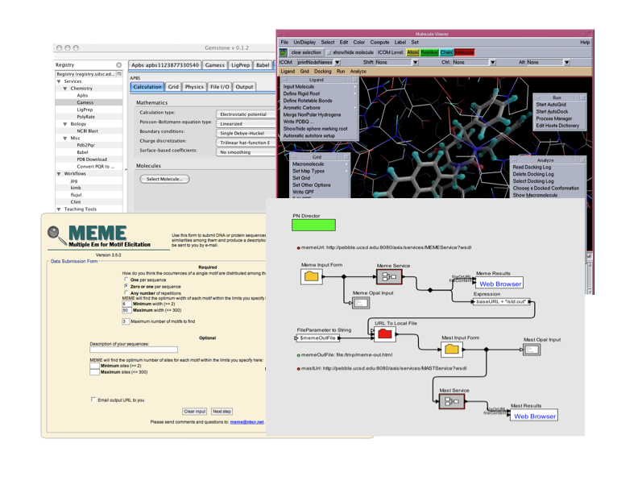
Multiple User Interfaces

Slide 8
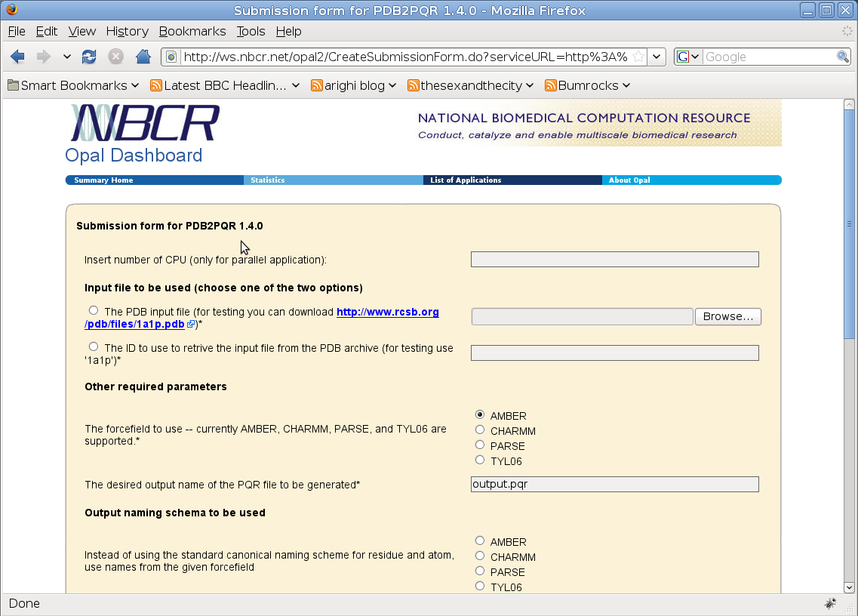
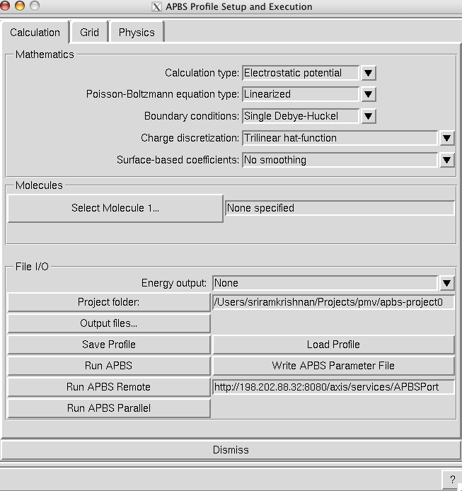
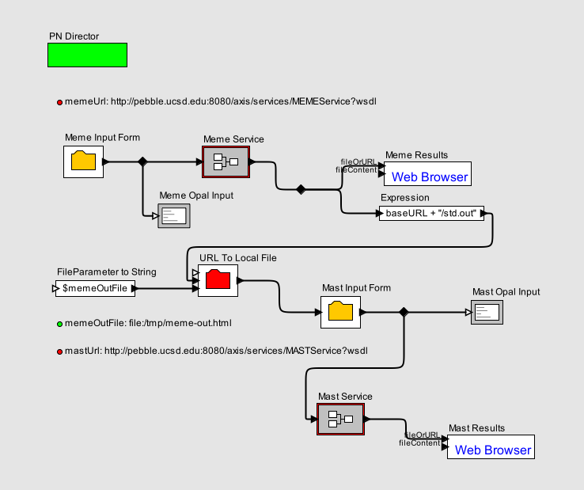
Big Picture
Opal GUI
PMV/Vision
Kepler
Application Services
Grid/Cloud Middleware
Globus
Globus
Globus
Condor pool
SGE Cluster
PBS Cluster
Notes:
Applications are first class services - users don’t have to specify paths to executables, working directories, etc
Examples of what the operations may look like
2. Security, state management, scheduling are all configured optionally
1. Jobs can even run on a Windows box - without a scheduler
3. Different services can exist in the same container - all accessible by separate URLs
4. Clients send command line arguments and input files to services (Base64 binary)

Slide 9
Possible Approaches
Write application services by hand
  Pros: More flexible implementations, stronger data typing via custom XML schemas
  Cons: Not generic, need to write one wrapper per application
Use a Web services wrapper toolkit, such as Opal
  Pros: Generic, rapid deployment of new services
  Cons: Less flexible implementation, weak data typing due to use of generic XML schemas
Notes:
Generic XML schemas to represent job inputs and outputs - these serve as wrappers for the file based I/O of legacy applications
In this talk, we present the second approach - using the Opal toolkit
Strong Datatyping - necessary for workflows, semantic mediation, etc

Slide 10
The Opal2 Toolkit: Overview
Enables rapid deployment of scientific applications as Web services (< 2 hours)
Steps
  Application writers create configuration file(s) for a scientific application
  Deploy the application as a Web service using Opal’s simple deployment mechanism (via Apache Ant)
  Users can now access this application as a Web service via a unique URL
Notes:
1. Configuration file - metadata (usage, etc), binary location, default arguments, parallel flag.
2. Service properties - globus and scheduler information, database information, mpi location, etc
3. Application writers don’t have to write a single line of code to expose an application as a Web service. Users pass the command line and list of files as arguments

Slide 11
Opal2: Key Features
Standard WSDL and SOAP API for management of scientific applications
  Operations to launch jobs, query status, retrieve outputs
  Ability to transfer input files using Base64 encoded binary format, MIME attachments, and 3rd party transfers
A “Dashboard” for accessing applications and usage statistics
  Automatic interface generation using the XML specification for command-line arguments
Ability to connect to multiple resource providers at the back-end
  Fork, Globus GRAM, DRMAA, Condor, CSF4
State management for jobs (and usage statistics) provided via Hibernate
Notes:
* Note that it is not an API such as DRMAA or GRAM – it provides service-level access

Slide 12
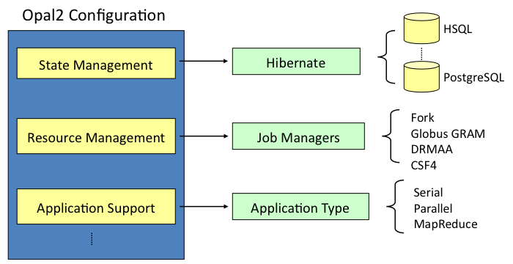
Opal2 Configuration: The Plug-in Model
Notes:
Easy to write job manager plug-ins – there is a developers guide for the same
Framework uses Apache Axis and Tomcat

Slide 13
Opal2: Configuration
tomcat.url=http://rocce.ucsd.edu:8080
num.procs=96
working.dir=opal-jobs
mpi.run=/opt/openmpi/bin/mpirun
mail.enable=true
mail.smtp.host=smtp.gmail.com
mail.smtp.auth=true
mail.smtp.debug=false
mail.smtp.from=noreply@rocce.ucsd.edu
mail.smtp.user=<account>
mail.smtp.password=<password>
opal.datalifetime=4 days
opal.hard_limit=3600
opal.jobmanager=edu.sdsc.nbcr.opal.manager.DRMAAJobManager
drmaa.pe=mpich
globus.gatekeeper=host:2119/jobmanager-sge
globus.service_cert=/path/to/your/globus/cert
globus.service_privkey=/path/to/your/globus/key
globus.gridftp_base=gsiftp://host:2811/working_dir
csf4.workingDir=opal_runs
mpi.script=/opt/condor/etc/examples/mp1script
opal.ip.processing=true
opal.ip.limit=35
opal.ip.blacklist=66.102.7.104
opal.ip.whitelist=66.102.7.105, 127.0.0.1
Notes:
* Note that it is not an API such as DRMAA or GRAM – it provides service-level access

Slide 14
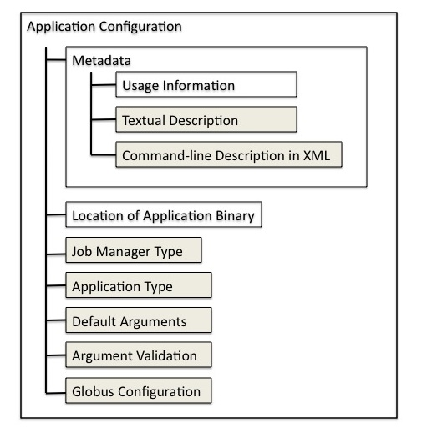
Opal2: Deploying Applications
No WSDL, no Java code to be written
One xml configuration file for an application

Slide 15
Sample Application Configuration
<appConfig xmlns="http://nbcr.sdsc.edu/opal/types"
xmlns:xsd="http://www.w3.org/2001/XMLSchema">
<metadata>
<usage><![CDATA[psize.py [opts] <filename>]]></usage>
<info xsd:type="xsd:string">
<![CDATA[
--help : Display this text
--CFAC=<value> : Factor by which to expand mol dims to
get coarse grid dims
[default = 1.7]
...
]]>
</info>
</metadata>
<binaryLocation>/homes/apbs_user/bin/psize.py</binaryLocation>
<defaultArgs>--GMEMCEIL=1000</defaultArgs>
<parallel>false</parallel>
</appConfig>

Slide 16
XML Specification for Command-line Arguments
Used for automatic interface generation, argument validation, auto-generation of WSDL (community contribution)
<!-- list of flags -->
<flags>
<flag>
<id>help</id>
<tag>--help</tag>
</flag>
</flags>
<!-- list of tagged parameters -->
<taggedParams>
<separator>=</separator>
<param>
<id>cfac</id>
<tag>--CFAC</tag>
<paramType>FLOAT</paramType>
</param>
……
</taggedParams>
<!-- list of untagged parameters, in order -->
<untaggedParams>
<param>
<id>pqr</id>
<paramType>FILE</paramType>
<ioType>INPUT</ioType>
<required>true</required>
<semanticType>PQR</semanticType>
</param>
</untaggedParams>
Usage: psize.py [opts] <filename>
Optional Arguments:
--help : Display this text
--CFAC=<value> : Factor by which to expand mol dimsto
get coarse grid dims
[default = 1.7]
--FADD=<value> : Amount to add to mol dims to get fine
grid dims
[default = 20]
--SPACE=<value> : Desired fine mesh resolution
[default = 0.5]
--GMEMFAC=<value> : Number of bytes per grid point required
for sequential MG calculation
[default = 160]
--GMEMCEIL=<value> : Max MB allowed for sequential MG
calculation. Adjust this to force the
script to perform faster calculations (which
require more parallelism).
[default = 400]
…..

Slide 17
Application Service Deployment & Undeployment
Deploy service onto a local Tomcat container:
ant -f build-opal.xml deploy -DserviceName=<serviceName>
-DappConfig=<appConfig.xml>
Undeploy service:
ant -f build-opal.xml undeploy -DserviceName=<serviceName>
Notes:
AppServiceImpl retrieves the appConfig property and executes the application appropriately
The deployment descriptor is generated automatically

Slide 18
Service Operations
Get application metadata: Returns metadata specified inside the application configuration
Launch job: Accepts list of arguments and input files (Base64 encoded), launches the job, and returns a jobID
Query job status: Returns status of running job using the jobID
Get job outputs: Returns the locations of job outputs using the jobID
Get output as Base64: Returns an output file in Base64 encoded form
Destroy job: Uses the jobID to destroy a running job
Notes:
All the above operations defined by the Opal WSDL. Operations stay the same for all applications - no additional operations required as all applications can be invoked via command line

Slide 19
Opal2 Toolkit: Client Side
Several clients APIs available: Java, Python, Perl
Generic command-line client:
# java edu.sdsc.nbcr.opal.GenericServiceClient
-l http://localhost:8080/axis/services/PDB2PQRServicePort
-r launchJob
-a "-ipdb sample.pdb -h -opdb output.pdb“
-f etc/sample.pdb
Too complex for beginners
Need a Graphical User Interface to simplify access

Slide 20
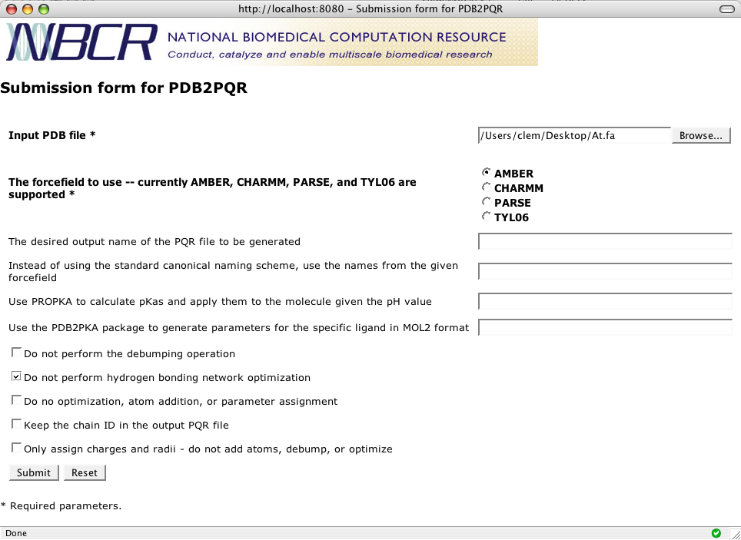
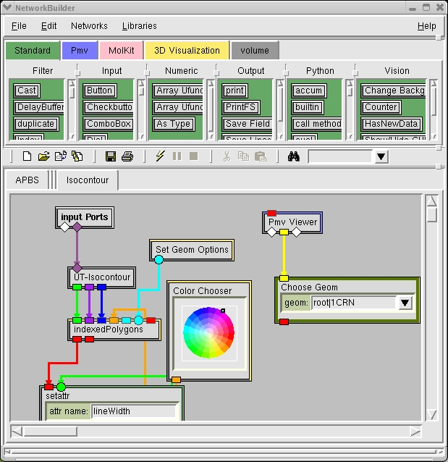

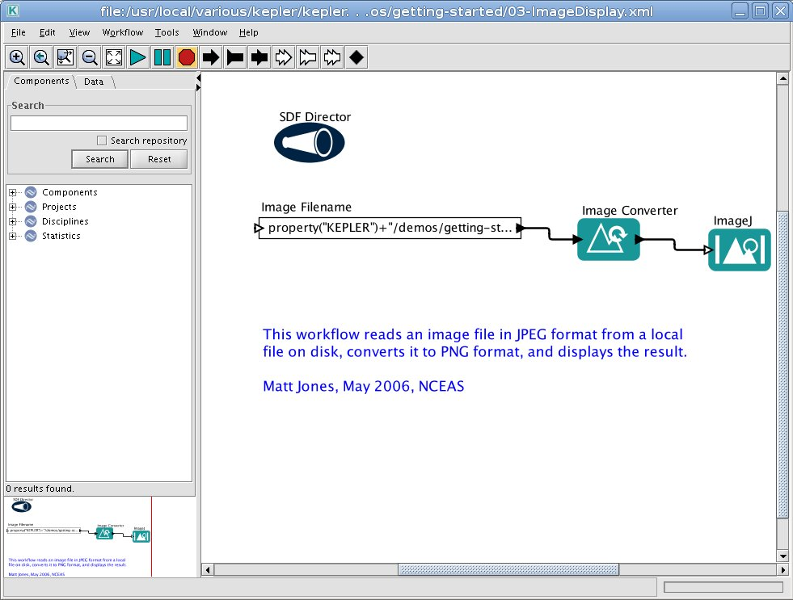
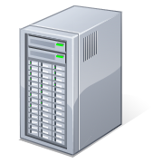
User Interfaces and Workflow Tools
User clients
Browser
Vision
getAppMetadata
Kepler
PDB2PQR
launchJob
getOutput
Opal server
getAppMetadata
MEME
launchJob
getOutput

Slide 21
Case Study: Opal2 Dashboard
Main characteristics:
  Working out of the box (No additional configuration)
  Multi-platform -> Web interface
  Implemented in Java
Key features:
  Service Registry/Listing
  Simple and advanced submission forms
  Usage statistics
  Documentation and tutorials

Slide 22
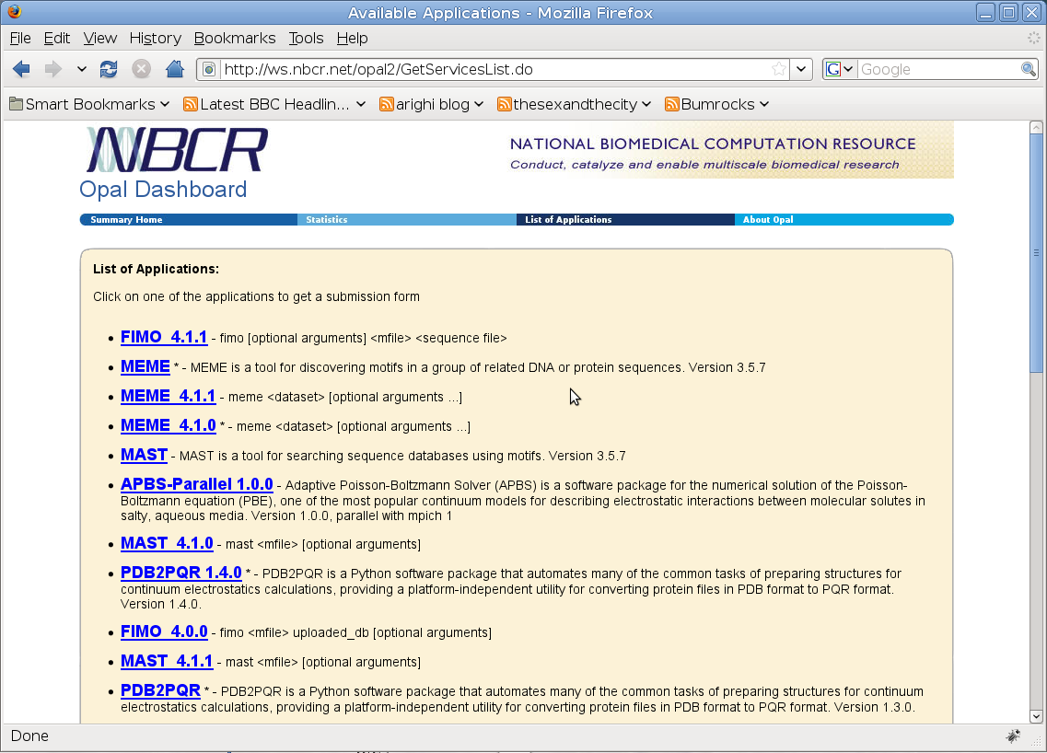
List of Services
http://ws.nbcr.net/

Slide 23
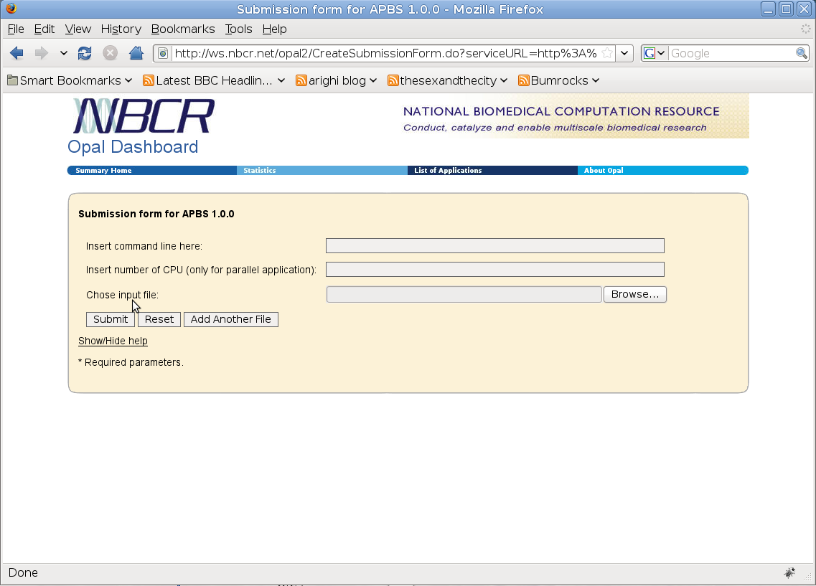
Simple Submission Form
Problem: user has to input command line - too error prone.
Solution: submission form must be customized for command line arguments
Notes:
Clumsy

Slide 24
Advanced Submission Form
An optional tag in the appConfig file to describe input parameters (types)
It is a command line syntax description language

Slide 25
Command Line Input Arguments Taxonomy
Flag:
not ordered, type Boolean,
a dash followed by characters
Parameters:
many types: integer, float, string,
file, enumeration, etc.
Tagged:
not ordered,
Prefixed by some tag
Untagged:
ordered, not prefixed

Slide 26
Advanced Submission Form
Grouping capability:
  To group several parameters together
  A group can be exclusive
Default values
An example of the command line syntax description language and of the form…

Slide 27
<flags>
<flag>
<id>nodebump</id>
<tag>--nodebump</tag>
<textDesc>Do not perform the debumping operation</textDesc>
</flag>
…
</flags>
<taggedParams>
<separator>=</separator>
<param>
<id>ffout</id>
<tag>--ffout</tag>
<paramType>STRING</paramType>
<textDesc>Instead of using the standard canonical naming scheme for
residue and atom names, use the names from the given forcefield
</textDesc>
</param>
…
</taggedParams>
Flags
Tagged Parameters

Slide 28
<untaggedParams>
<param>
<id>output-path</id>
<paramType>FILE</paramType>
<ioType>OUTPUT</ioType>
<textDesc>The desired output name of the PQR file to be generated
</textDesc>
</param>
…
</untaggedParams>
<groups>
<group>
<name>inputParam</name>
<elements>inFile inId</elements>
<required>true</required>
<exclusive>true</exclusive>
<textDesc>Input file to be used (choose one of the two options)
</textDesc>
</group>
…
</groups>
Untagged Parameters
Groups

Slide 29
PDB2PQR Advanced Submission Form
Exclusive group
String
Input file
Group 1
Exclusive enumeration
Group 2
Group 3

Slide 30


Usage Scenario
1
displayForm PDB2PQR
4
submissionForm
User
5
Opal GUI
On user submit:
invokes launchJob with right input parameters
3
appMetadata
2
getAppMetadata
getAppMetadata
PDB2PQR
launchJob
getOutput
Opal server
getAppMetadata
MEME
launchJob
getOutput
Notes:
web 2.0
use the Web as a platform for development
harness the collective intelligence of the community
focus on services, and not pre-packaged software, with cost-effective scalability
enable light-weight programming models
provide a rich user experience.

Slide 31
Summary
Opal enables rapid exposing legacy applications as Web services
  Provides features like Job management, Scheduling, Security, and Persistence
More information, downloads, documentation:
  http://opal.nbcr.net/

