Slide 1

Yanming Ma
Personal Webpage: http://nlshm-lab.jlu.edu.cn/YanmingMa/mym1.htm
State Key Lab of Superhard Materials,
Jilin University

Slide 2
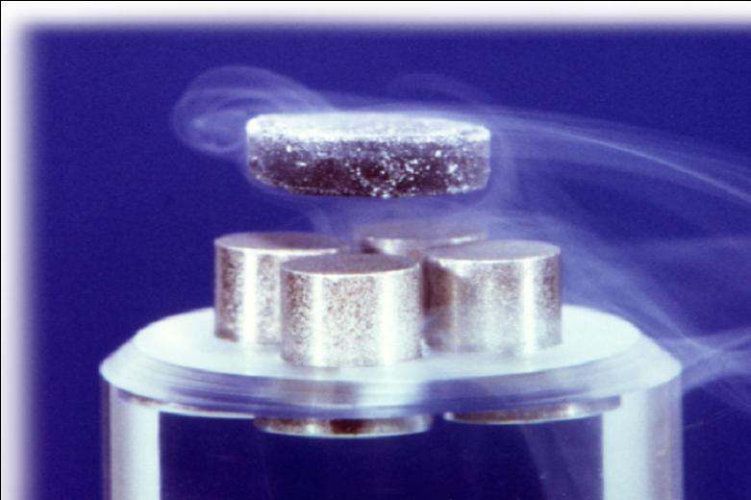

Condensed Matter Physics
Condensed phases: solids and liquids.
Condensed matter physics deals with the macroscopic/microscopic physical properties of condensed matters.
Macroscopic physical properties: Phonon spectrum; heat capacity; hardness; superconductivity; magnetism; Raman and Infrared spectra; thermoelectricity; bulk modulus; optical and near edge absorption spectra, etc.
Microscopic physical properties: Crystal structure; growth and phase transition mechanisms, etc.

Slide 3
Is numerical simulation necessary?
Experiments have limitations under certain circumstances (e.g., samples, techniques, signals, etc) so that many physical properties can not be measured accurately.
Microscopic process (e.g., growth and phase transition mechanism, etc) and the understanding of physics are not experimentally measurable.
Numerical computation must be relied on

Slide 4
Computational Physics
Performs idealized "experiments" on the computer by solving physical models numerically
Computation
predicts
tests
tests
predicts
predicts
Theory
Construction of idealized models through mathematical (analytical) analysis of physical principle to describe nature
tests
Experiments
Quantitative measurement of physical properties

Slide 5
Simulation methods
Classical – described by classical (Newtonian) mechanics.
Quantum – described by the Schrödinger equation (or its analogues).
Quantum electronic effects – exchange-correlation, antisymmetry of the wavefunction, Heisenberg uncertainty principle, electronic kinetic energy. ALWAYS IMPORTANT!
Quantum effects in atomic motion – 1)zero-point energy, 2)heat capacity and thermal expansion go to zero at T= 0 K. IMPORTANT ONLY AT LOW TEMPERATURES.
Atomistic methods – electrons are not considered. Instead, INTERATOMIC interactions, parameterised by some functions, are used.
Semiempirical methods – simplified quantum-mechanical treatments (some effects neglected, some approximated).
Hartree-Fock – exact exchange, neglect of correlation.
Density functional theory – in principle exact, in practice approximate for both exchange and correlation.
Quantum Monte Carlo – nearly exact method with a stochastic procedure for finding the many-body wavefunction.

Slide 6
Methods Temp. | Atomistic Cheap, qualitative | Semiemp. QM. Cheap, qualitative | HF. Often accurate, prob-lems for me-tals. Expensive | DFT. Accurate, convenient | QMC. Nearly exact, very expensive
Static Cheap, 0 K | + 1970s | + | + 1980s | + 1980s | + 1990s-2000s
Quasiharm Ideal at low T, poor at high T | + 1980s | + | - | + 1990s | -
MD, MC. Exact at high T, poor at low T. Fully anharm., classical. Expensive. | + 1980s | + | ? | + 1990s Ab Initio MD | -
Path-int.MD MD and MC for low T. Problems as T-> 0 K. Very expensive. | + | - | - | + | -

Slide 7
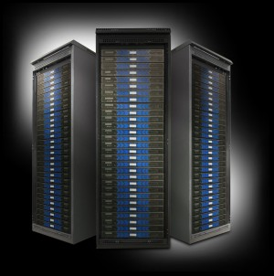
Computer "experiments"
With the development of computer science and computation physics, many properties of matters can be accurately predicted by theoretical simulations.
The computational physics can be called as “computer experiments".

Slide 8
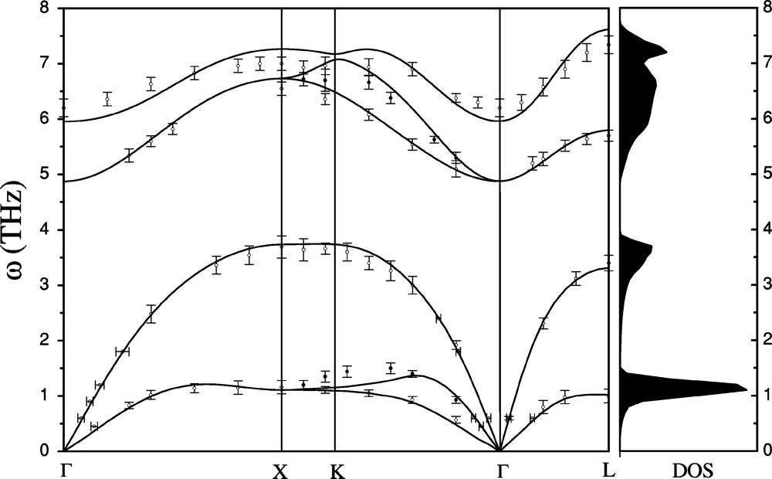
Simulation of Phonon dispersions
The calculated phonon frequencies (solid lines) and DOS of zinc-blende CuCl at the experimental lattice constants, along with the experimental phonon dispersion data (symbols).
Phonon dispersion is a very import criterion for the stabilization of materials.
The calculation of phonon dispersion normally takes several hours to several days.
We can see that the computer simulation can provide precise results.

Slide 9
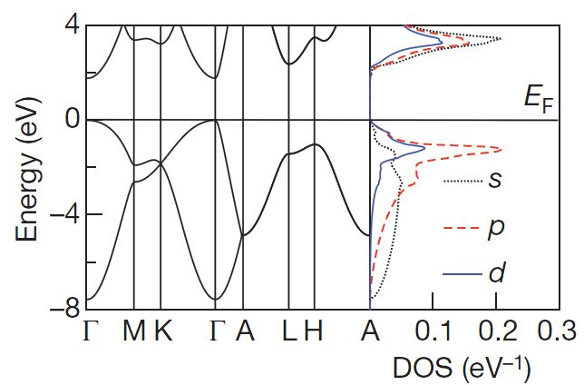
Simulation of electronic energy bands
The band structure of a material determines several characteristics, in particular its electronic and optical properties.
The band structure calculation is very fast and takes several to dozens of minutes on high-performance computers.

Slide 10
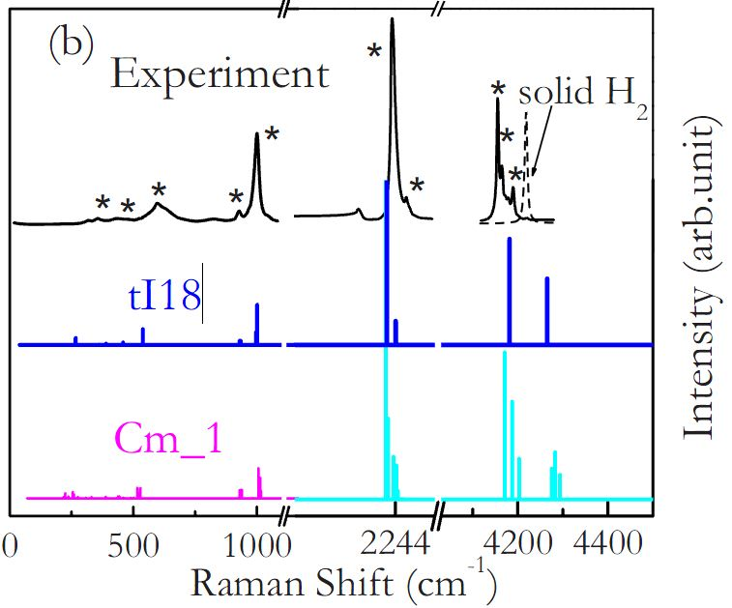
Simulation of Raman spectroscopy
The simulation of Raman spectroscopy often take several hours on 8 CPUs computer.
Raman spectroscopy is commonly used in chemistry, since vibrational information is specific to the chemical bonds and symmetry of molecules. Therefore, it provides a fingerprint by which the molecule can be identified.
In solid state physics, spontaneous Raman spectroscopy is used to, among other things, characterize materials, measure temperature, and find the crystallographic orientation of a sample.

Slide 11
Calculating the superconductivity
Superconductivity is an electrical resistance of exactly zero which occurs in certain materials below a characteristic temperature.
For decades, scientists have been going to great effort to design high-temperature superconducting materials.
The crucial issue in design of high temperature superconductor is to calculate the superconducting critical temperatures.
The calculation of superconducting temperatures is very expensive. It is an almost impossible task about 7 years ago.
It is possible now by high-performance computing,

Slide 12
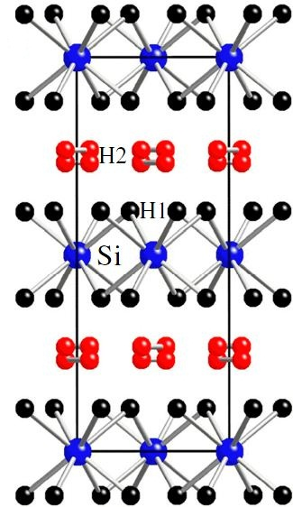
Superconductivity at ∼100 K in SiH₄(H2)₂
Owing to the power of high performance computing, we are able to design a novel high-temperature superconductor, SiH4(H2)2 .
We used more than 100 CPUs by about one month to calculate the superconducting temperature of SiH4(H2)2.
Application of computer simulation yields remarkably high superconducting temperatures of 107 K at 250GPa, among the highest values reported so far for phonon-mediated superconductors.
This work was published in PNAS (vol. 107, 15708, September 7, 2010).

Slide 13
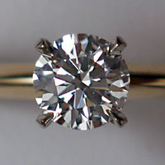
Design of superhard materials
Superhard materials are widely used in many applications, from cutting and polishing tools to wear-resistant coatings.
Ten years ago, the hardness of materials can only be measured by experiments.
Now, advances in theory and the high performance computing makes the simulation of the hardness possible.
Therefore, we are able to design novel new superhard materials.

Slide 14
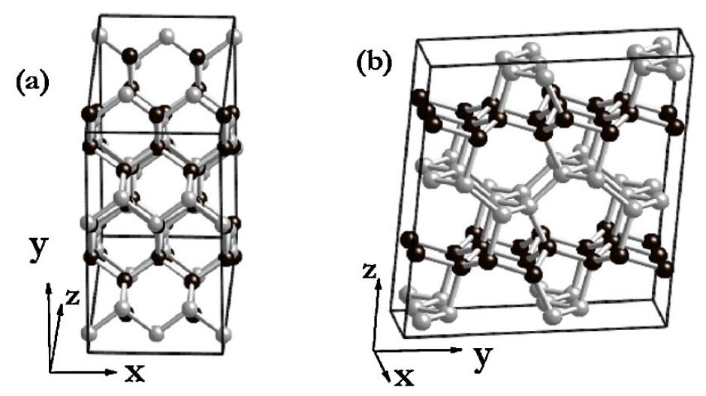

Carbon that cracks diamond
We have designed a new superhard materials (M-carbon), and simulated the hardness.
The predicted hardness for M-carbon is 83.1 GPa, which is much higher than that of c-BN (62.4 GPa) and comparable to that of diamond (94.4 GPa).
This work was published in Physical Review Letter (vol. 102, 175506, 2009), and was highlighted by Nature News.

Slide 15
Design of thermoelectric materials
Thermoelectric materials are materials which show the thermoelectric effect in a strong and/or convenient form.
Currently there are two primary arenas in which thermoelectric devices can lend themselves to increase energy efficiency and/or decrease pollutants: conversion of waste heat into usable energy, and refrigeration.
The efficiency of thermoelectric devices depends on the figure of merit, ZT.
The ZT value can be simulated using high-performance computer.

Slide 16
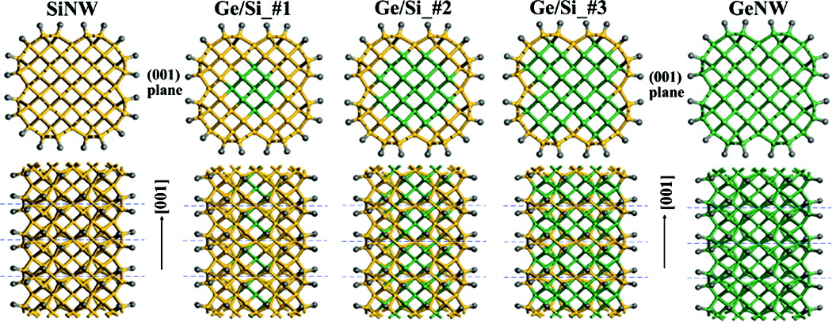
Design of novel thermoelectric Ge/Si core-shell nanowires
We have calculated the ZT value of Ge/Si core−shell nanowires, and the ZT value is 0.85 at 300K.
The computing time in simulating ZT value takes about several days on 8 CPUs parallel computer.

Slide 17

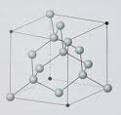




Crystal Structure is the basis for understanding materials and their properties
Electronic property
Optical property
Thermodynamic property
Crystal structure
Mechanical property
Magnetism
Notes:
首先，晶体结构是材料的最基本性质，是理论上计算材料性质的基础，通过晶体结构我们可以从微光上解释很过物理现象如物质发光，物质的磁性等待。

Slide 18
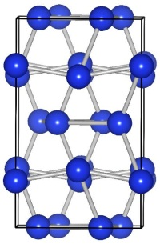
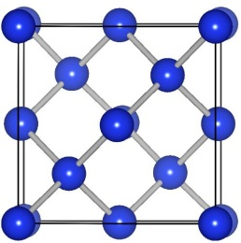
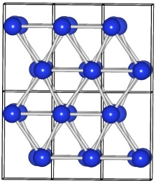
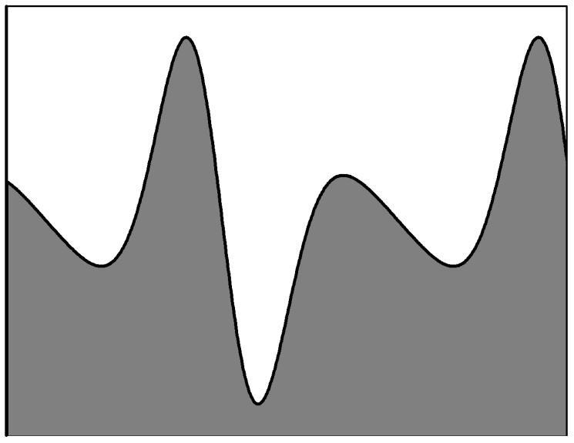

Crystal structure prediction through high performance computing becomes possible
The stable crystal structure is the structure with the lowest free energy.
So the task is to find the global lowest free energy.
Free energy
We recently developed a reliable CALPSO (crystal structure analysis by particle swarm optimization) code for structure prediction

Slide 19
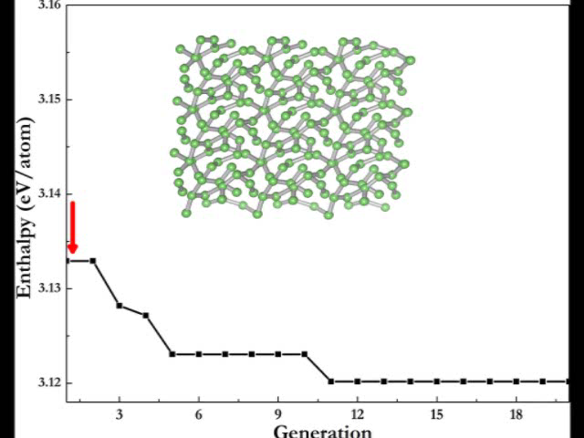
Structure Evolution of Li under pressure
Prediction of the crystal structure of Li at 80 GPa.
We found a new structure that was never to be discovered.
This calculation takes more than 1 month on parallel computer with 32 CPUs.

Slide 20
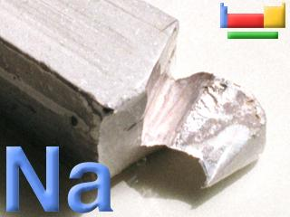
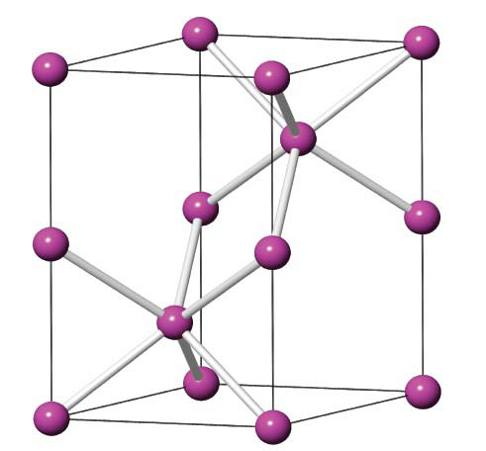
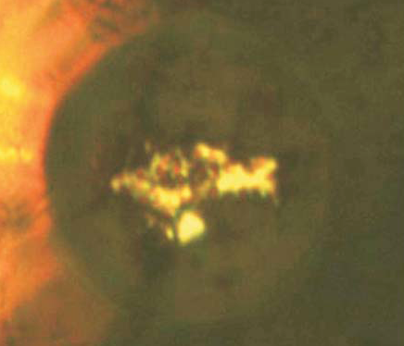
Transparent dense sodium
Sodium is a silvery-white, highly reactive good metal at ambient pressure.
We have spent several weeks to search new structures of Sodium under high pressures.
We found that a novel metal-insulator transition in sodium at megabar pressures against the traditional belief.
This work was published in Nature (Vol. 458, 182, 2009).

Slide 21
Conclusion
High-performance computing has become the irreplaceable tool in the scientific research on condensed matter physics.
Computer “experiment” can now in some ways be regarded as true “experiment”.
Further development of high performance computing technique could lead new era of condensed matter physics.

Slide 22
Thanks for your attention!!!

