Slide 1
PRAGMA18
NG-TEPHRA: Enabling Large-Scale Volcanic Hazard Simulations in the Pragma Grid Environment
¹Santiago Nunez, ²Gustavo Barrantes
²Eduardo Malavassi, ³Jose Brenes
1 Costa Rica Institute of Technology (ITCR)
2 National Autonomous Univesity (UNA)
3 University of Costa Rica (UCR)

Slide 2
The Context
Costa Rica is within an active geological region in terms of its seismology and volcanology
10 active volcanoes with different eruptive cycles
Most local disaster management plans are outdated and do not provide precise assessments of potential situations
It is also essential to have the risk assessment (area) and the hazard assessment (material and human loss)

Slide 3
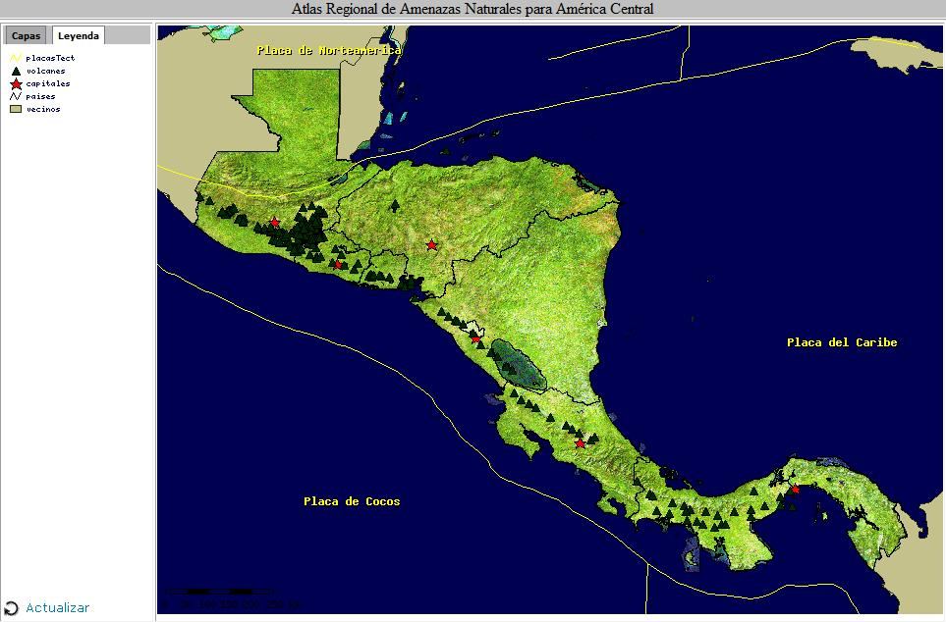
The Regional Perspective

Slide 4
Irazu 1963-1965
1963-1965 is a singular period of study for the current case
Irazu volcano: NE, in the wind path of the Great Metropolitan Area (GAM) for most of the year
The eruption wiped out two of the most important agriculture/livestock production sites
Health issues, buildings succumbed to heavy weight of ashes
What would happen today? (~3M people in the GAM)

Slide 5
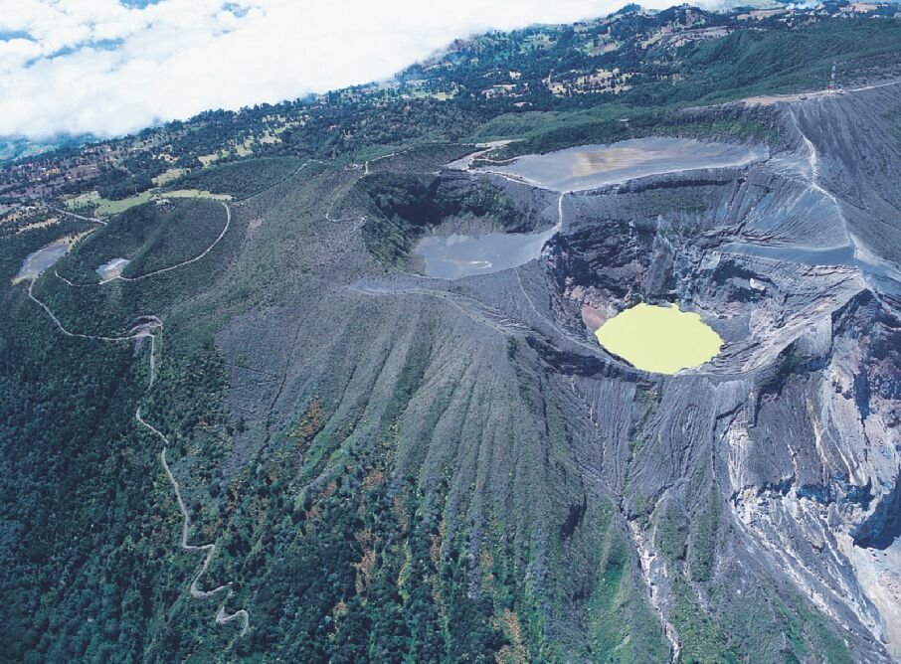
Irazu 1963-1965

Slide 6
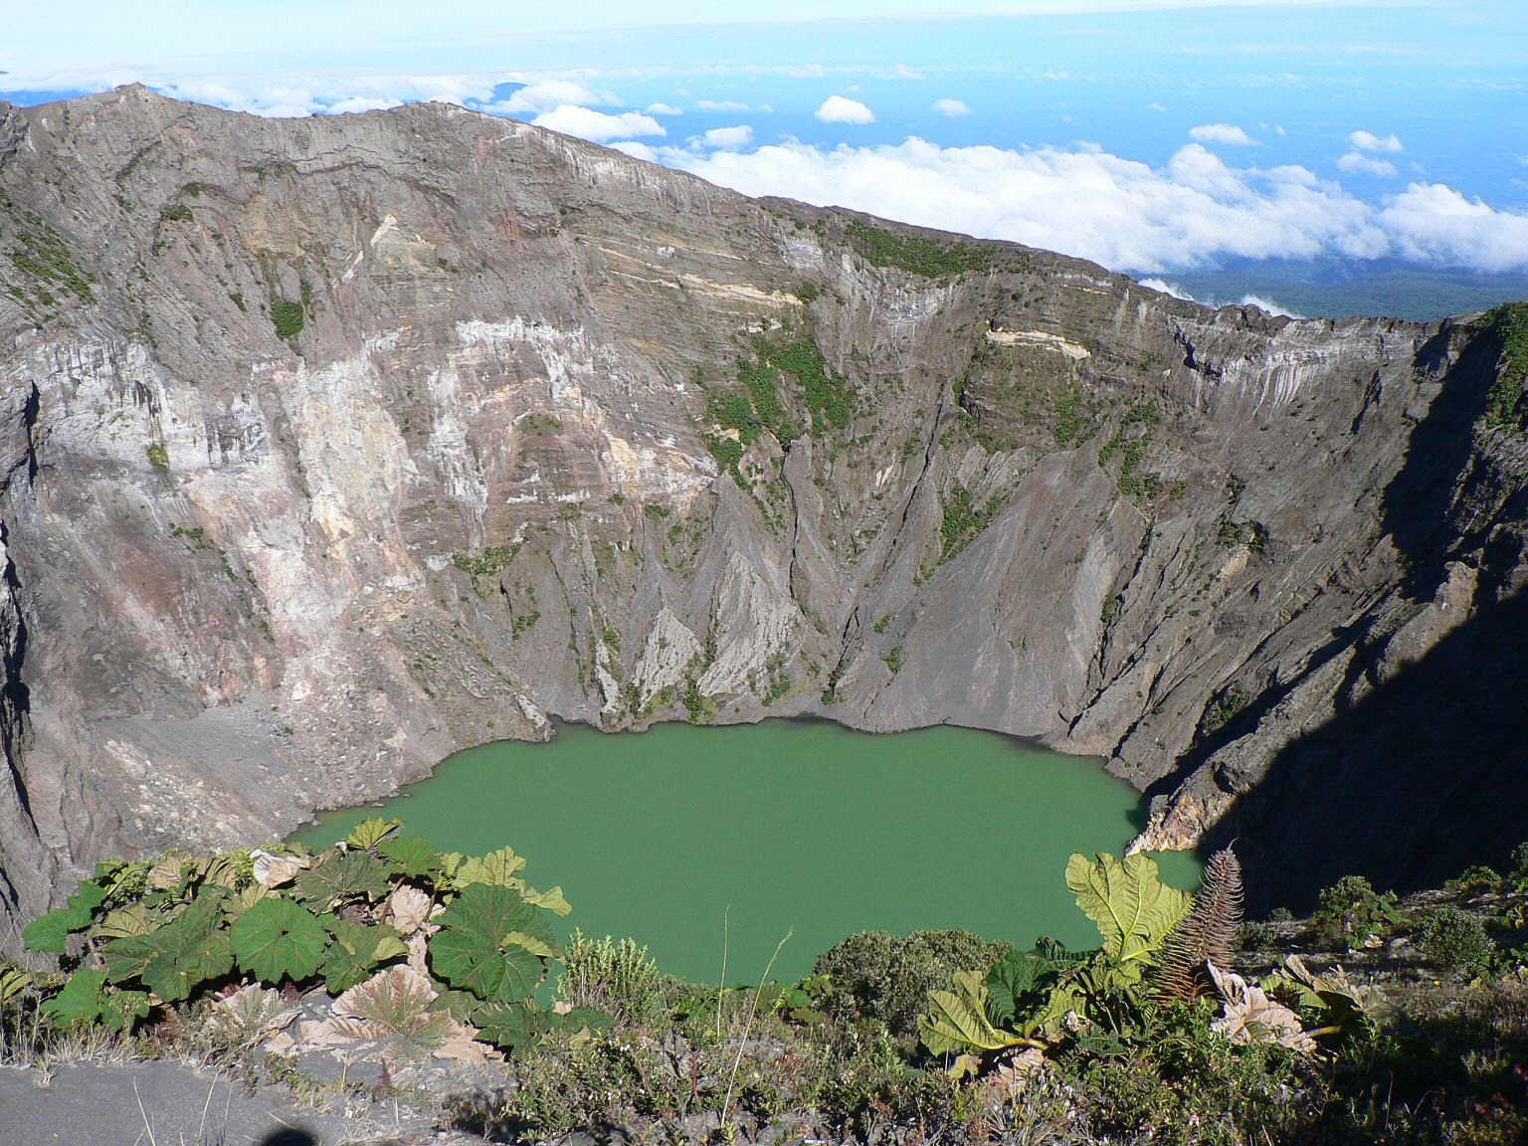
Irazu 1963-1965

Slide 7
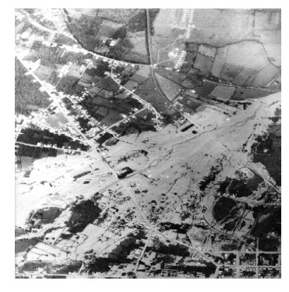
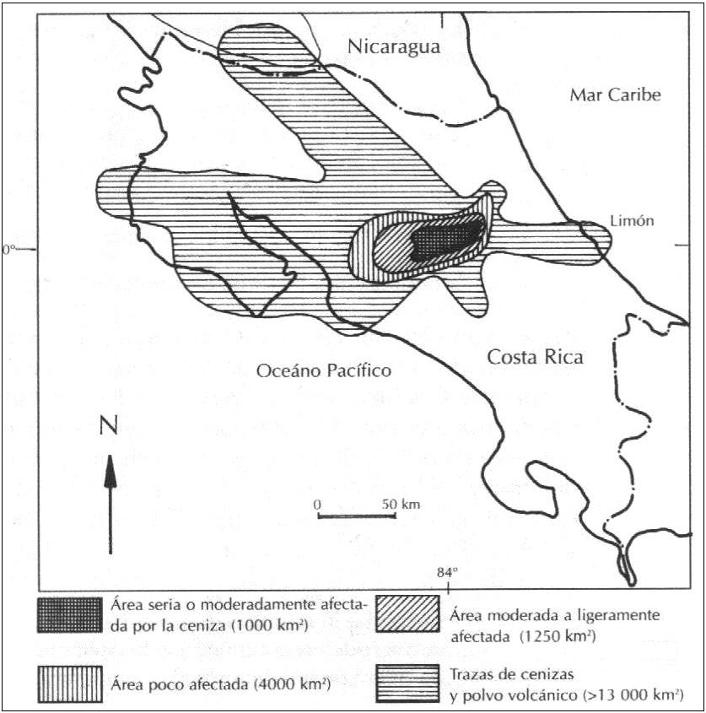
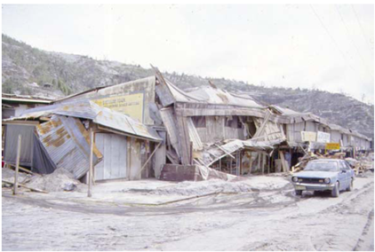
Irazu 1963-1965

Slide 8
TEPHRA 2005-2007
TEPHRA started as a project at ITCR and continued at other sites (UNA, UCR, CeNAT)
Jose Castro @ ITCR: use TEPHRA as an application to start a national supercomputing program
Main problem for modeling: lack of good data!
Existing data was lost 20 years after the main event
Any hazard assessment had to be based on remaining observations and simulation

Slide 9
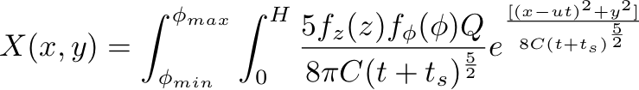
TEPHRA
TEPHRA is an application written by Charles Connor, USF in 2001 for simulating ash fall and deposition
Based on the Suzuki ash dispersion model
Modifications to the code have been made to improve precision and include probability per each possible simulation scenario

Slide 10
The Parameter Space
The model requires the following input parameters:
  Volcano spatial coodinates (CRTM05 → UTM)
  Particle size descriptors
  Column height and eruption total mass
  Geomorphology of the volcano and its DEM
  Climate and thermodynamics
Runs on MPI clusters
16-nodes → approx 15 mins

Slide 11
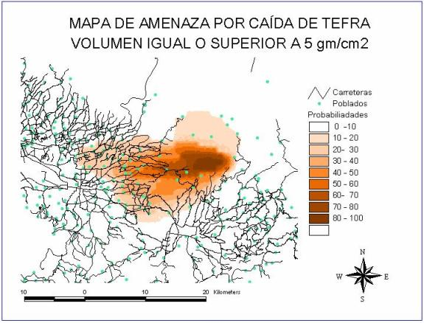
The Hazard Map
Probability of tephra fall with ash volumes >= 5 gm/cm²
Roads
Populated areas
Probability

Slide 12
(Very) Early 3D Visualization

Slide 13
NG-TEPHRA
Two years of intense research yielded a set of physically-meaningful limits for the simulation process (2008-2010)
Workflow implemented on local test clusters
Parametric sweep, ideal for NIMROD, since it is an embarrasingly parallel problem
The parameter space accounts for 220000 scenarios for a full probability map
Reviewed with Monash problem structure and updating code to be a Grid-friendly application

Slide 14
Next Steps
Setup the NIMROD resources and scripts
Run the complete set of experiments and obtain a complete hazard map for Irazu
Develop a multi-level reduction strategy that allows navigation between the map and individual cases (identification of the interesting amongst the crowd)
Implement a visualization that is easy to interpret by policy makers and experts
Create a web service for running individual simulations

Slide 15
The Larger Practical Perspective
NG-TEPHRA will be the first PRAGMA-hosted application for Costa Rica
This project can be replicated in a direct way for any other location as long as data are available
Inclusive for the whole Central America region, bringing more participants into PRAGMA
Could be complemented with a sensor network approach for obtaining real time data indicating a high probability of a volcanic eruption and triggering simulations on real-time

Slide 16
The Costa Rica Roadmap to PRAGMA, the Grid and Beyond
Our current experience
  More internal resources are needed
  Grid computing and supercomputing now understood as fundamental for research
  Data is not always available in a natural form
Challenges (a.k.a. advice welcome!)
  Highly visible applications (visualization array in progress, hardware in place)
  Development of a strong supercomputing center
  High speed networks (GLIF for CR)

Slide 17
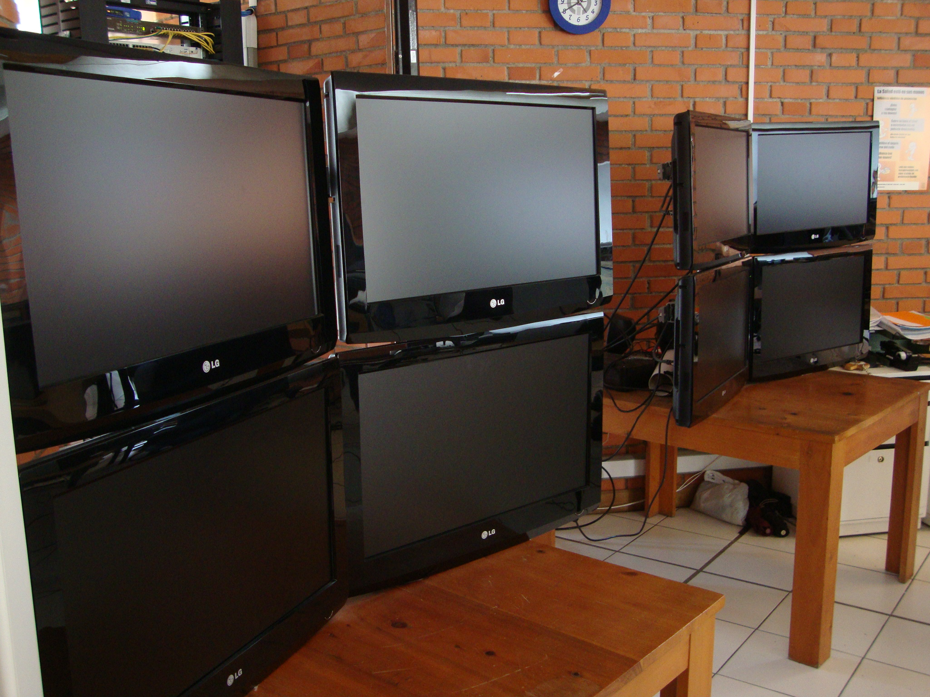
The Costa Rica Roadmap to PRAGMA, the Grid and Beyond

Slide 18

Thanks
Acknowledgements
  ITCR, UNA, UCR, CIC (Jose Castro)
  NCSA (Radha Nandkumar)
  University of Monash
  PRAGMA group
  NUCRI, NU
  RidgeRun, LLC
Contact information
  snunezcr@acm.org

