Slide 1
“How PRAGMA Can
Help Save the Planet”
Banquet Keynote Speech
Pacific Rim Applications and Grid Middleware Assembly (PRAGMA) 18
Birch Aquarium, Scripps Institution of Oceanography, UCSD
March 3, 2010
Dr. Larry Smarr
Director, California Institute for Telecommunications and Information Technology
Harry E. Gruber Professor,
Dept. of Computer Science and Engineering
Jacobs School of Engineering, UCSD
lsmarr@twitter.com

Slide 2
Abstract
I will review the evidence that global greenhouse gas emissions are causing an impulse to the nonlinear Earth climate system on a scale not seen for millions of years. It is essential that global reduction of such emissions be undertaken immediately. PRAGMA is in an important position to help, because the development and use of Green IT and telecom can provide a near term slowing of the emission rates. The Smart2020.org report shows that much of the opportunity lies in the Pacific Rim, where PRAGMA could be a leader toward a low carbon economy.

Slide 3
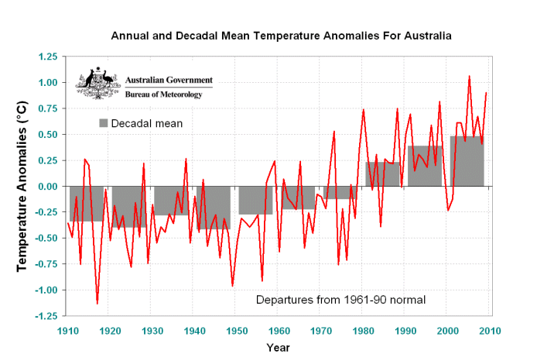
Annual and Decadal Mean Temperature Anomalies for Australia
Five Decades of Mean Temperature Rise

Slide 4
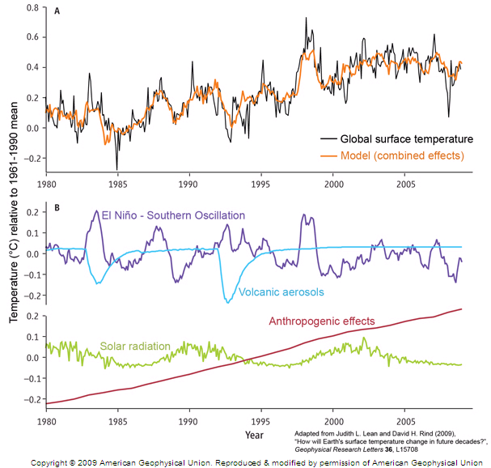
Climate Models Match Past Temperature Variations, Combining Both Natural and Anthropogenic Effects
"The warmest year on record, 1998, coincides with the 'super-El Nino' of 1997-98," points out Lean. "The ESNO is capable of producing significant spikes in the temperature record."
Solar minimum has the opposite effect: "A 0.1% decrease in the sun's irradiance has counteracted some of the warming action of greenhouse gases from 2002 - 2008," she notes.
"This is the reason for the well-known 'flat' temperature trend of recent years."
www.aip.org/history/climate/summary.htm

Slide 5
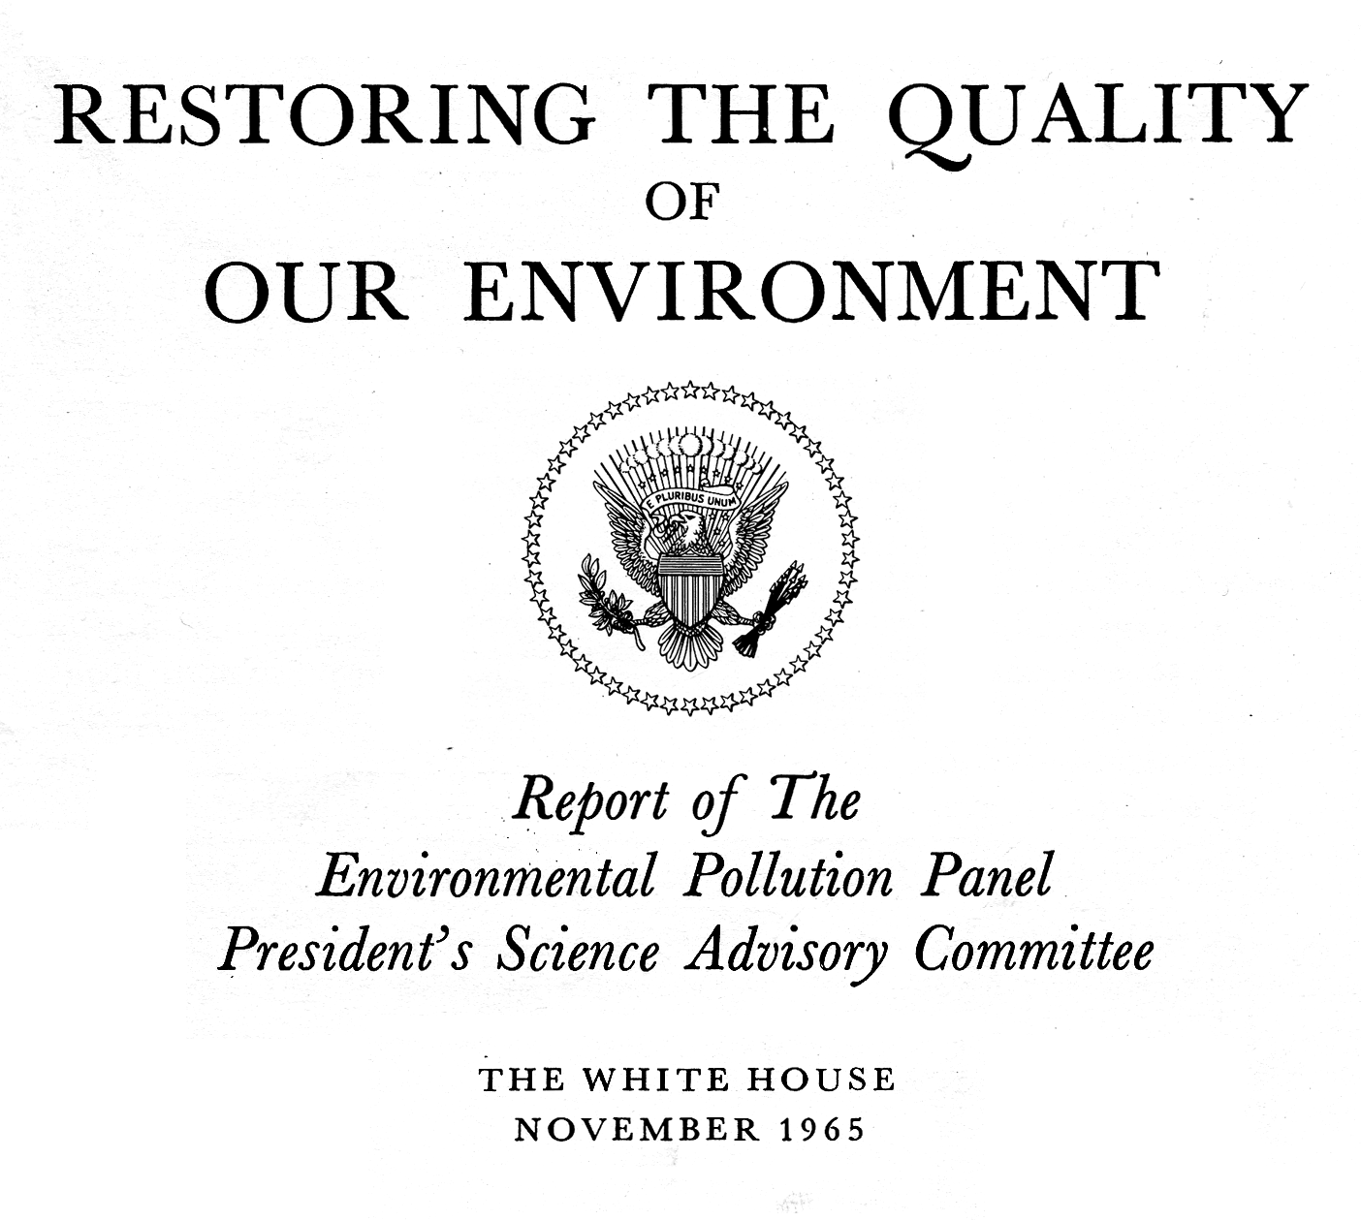
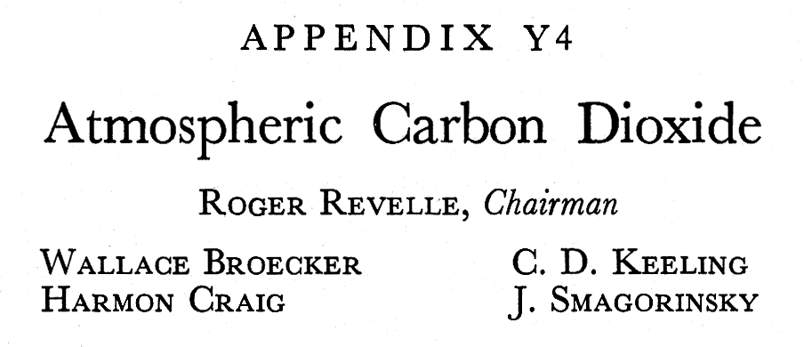
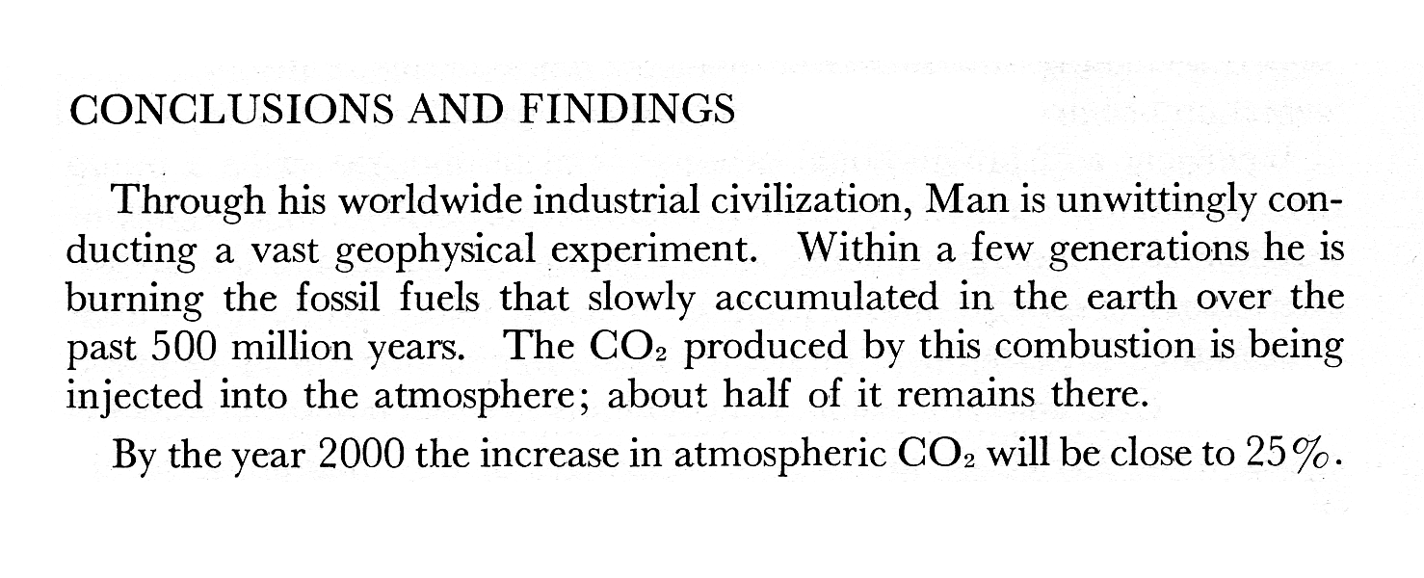
History, cont. (4, WH)
1965: White House document
⇧

Slide 6
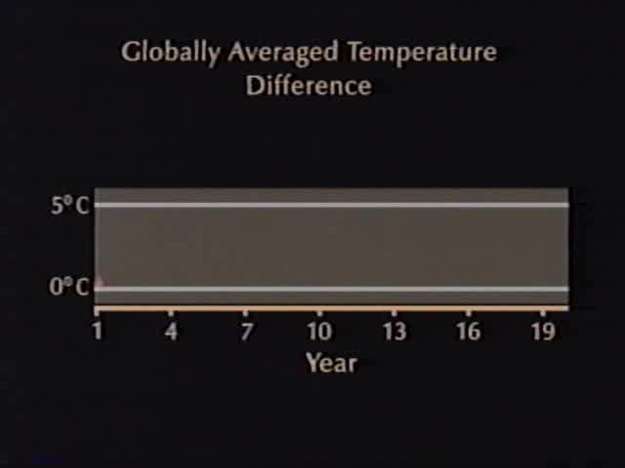
NCSA Visualization of a Doubling of CO₂
Warren Washington NCAR Simulation 1988

Slide 7
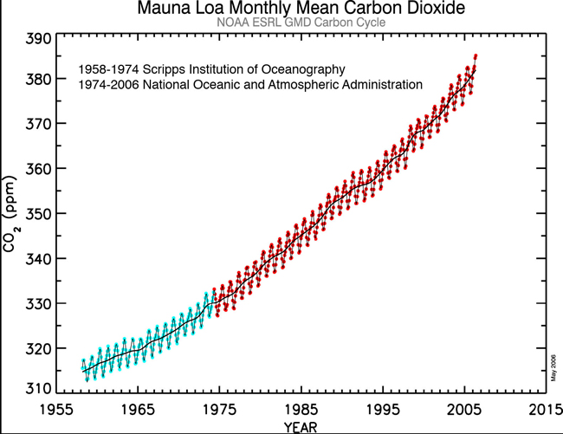
The Unrelenting Climb of CO₂
In Spite of Clear Understanding of the Problem
Inconvenient Truth
White House Report
Kyoto
Protocol
NCSA Video on Doubling CO₂

Slide 8
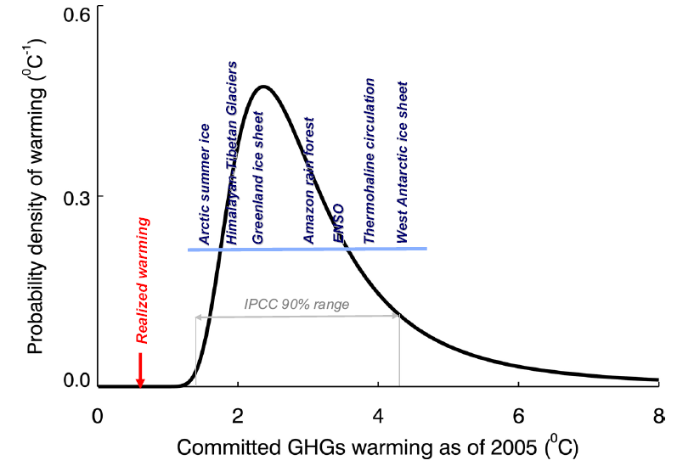
The Planet is Already Committed to a Dangerous Level of Warming
Temperature Threshold Range
that Initiates the Climate-Tipping
Earth Has Only Realized 1/3 of the
Committed Warming -
Future Emissions
of Greenhouse Gases
Move Peak to the Right
Additional Warming over 1750 Level
V. Ramanathan and Y. Feng, Scripps Institution of Oceanography, UCSD September 23, 2008
www.pnas.org/content/105/38/14245.full.pdf+html

Slide 9
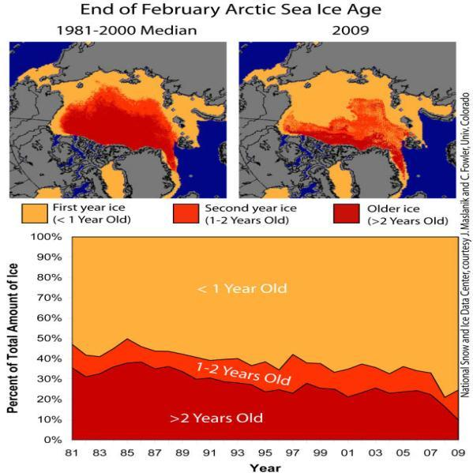
Global Climatic Disruption Early Signs:
Arctic Summer Ice is Rapidly Decreasing
"We are almost out of multiyear sea ice in the northern hemisphere--I've never seen anything like this in my 30 years of working in the high Arctic.”
--David Barber, Canada's Research Chair in Arctic System Science at the University of Manitoba
October 29, 2009
http://news.yahoo.com/s/nm/20091029/sc_nm/us_climate_canada_arctic_1
http://news.cnet.com/8301-11128_3-10213891-54.html

Slide 10
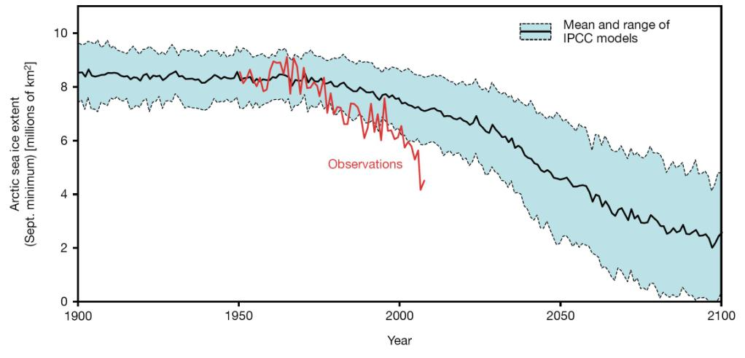
Arctic Summer Ice Melting
Accelerating Relative to IPCC 2007 Predictions
2020
Potentially Volume of Arctic Summer Ice Goes to Zero:
Talk by NPS’s Wieslaw Maslowski at AAAS San Diego Feb. 2010
http://aaas.confex.com/aaas/2010/webprogram/Paper1505.html

Slide 11
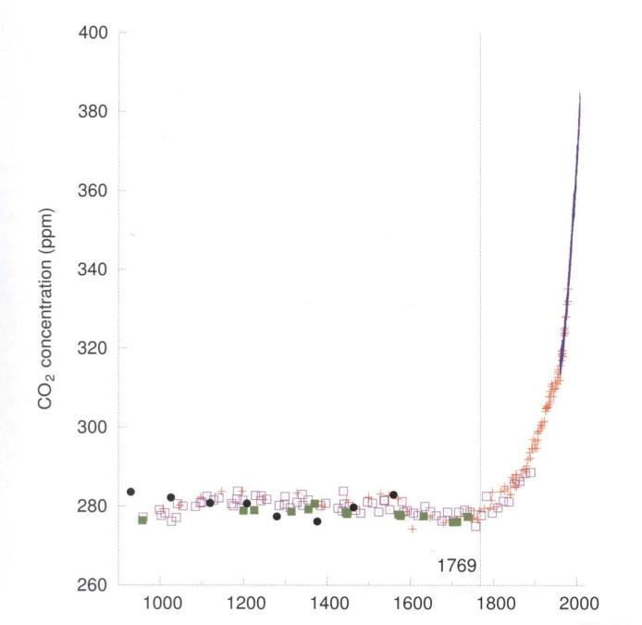
Rapid Increase in the Greenhouse Gas CO₂
Since Industrial Era Began
Source: Sustainable Energy
-Without the Hot Air
By David JC MacKay (2009), p.9
388 ppm in 2010
Medieval
Warm
Period
Little
Ice Age

Slide 12
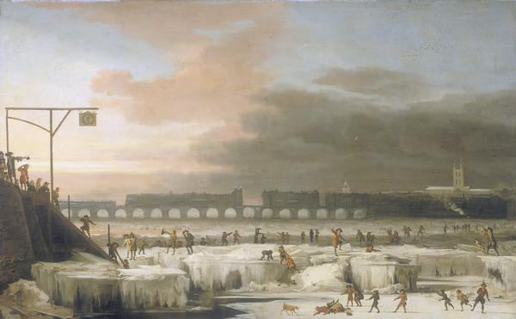
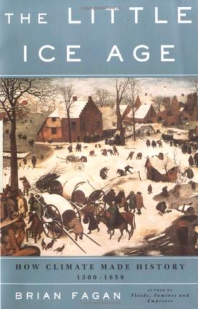
The Little Ice Age:
The Climate State Earth is Emerging From
The Frozen Thames, 1677
At Jamestown, the colonists had the bad fortune to arrive at the height
of the driest seven-year period in 770 years. No fewer than 4,800 of the 6,000 settlers who arrived between 1607 and 1625 perished.
-- The Little Ice Age, Brian Fagan
http://reference.findtarget.com/search/Little%20Ice%20Age/

Slide 13
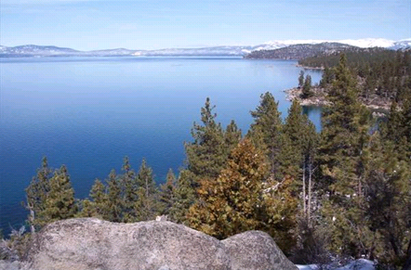
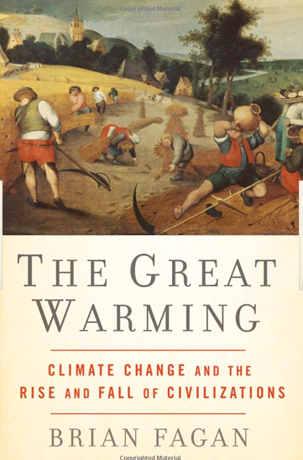
The Medieval Warm Period
Last Time Global Temperatures Were This High
Lake Tahoe—
Largest Alpine Lake in North America
A 300 Year California Megadrought:
“Precipitation was <60% of normal
between 950-1250 AD.
Several trees were radiocarbon dated to ~1250 AD and are positioned upslope a
~60 meter deep submerged paleoshoreline.
--Daniel Brothers Ph.D. Thesis UCSD SIO Dec 2009
But CO₂ in 1250AD was <290ppm;
Today ~390ppm

Slide 14
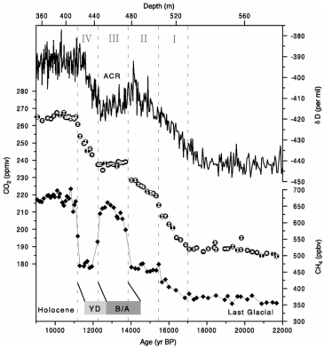
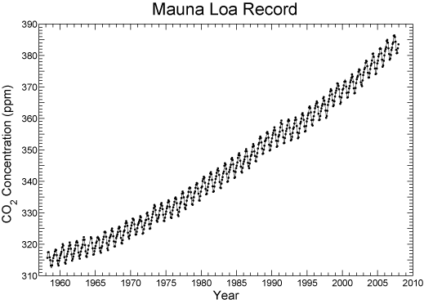
The Earth is Warming Over 100 Times Faster Today
Than During the Last Ice Age Warming!
Monnin, et al., Science v. 291 pp. 112-114, Jan. 5, 2001.
http://scrippsco2.ucsd.edu/program_history/keeling_curve_lessons.html
CO₂ Rose From
185 to 265ppm (80ppm)
in 6000 years or
1.33 ppm per Century
CO₂ Has Risen From
335 to 385ppm (50ppm)
in 30 years or
1.6 ppm per Year

Slide 15


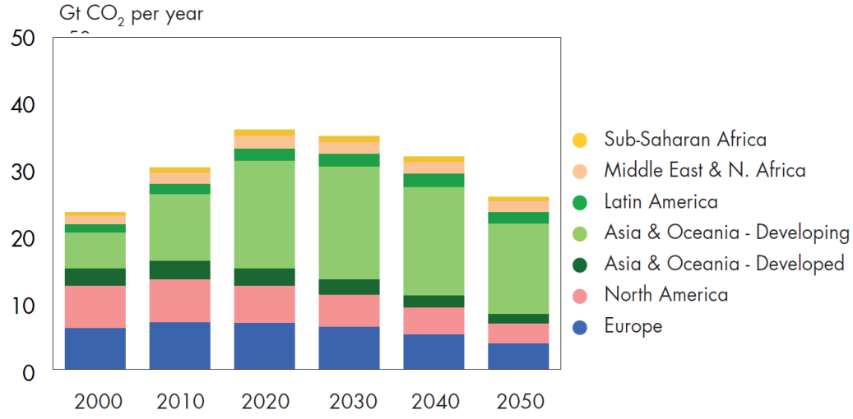
Future Estimates of CO₂ Emissions From Energy:
An Aggressive CO₂ Emission Reduction Scenario
www-static.shell.com/static/public/downloads/brochures/corporate_pkg/scenarios/shell_energy_scenarios_2050.pdf
“China and India resisted signing up for a global goal of halving greenhouse gas emissions by 2050.”
—Reuters July 8, 2009
China
India
Estimated CO₂ Level in 2100 is 550ppm
Current CO₂ Level is 388 ppm

Slide 16
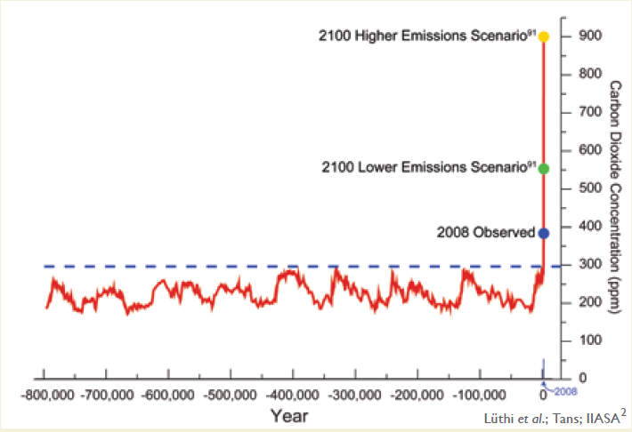
Atmospheric CO₂ Levels for 800,000 Years
And Projections for the 21st Century
Source: U.S. Global Change Research Program Report (2009)
(MIT Study)
(Shell Study)
www.globalchange.gov/publications/reports/scientific-assessments/us-impacts/download-the-report

Slide 17
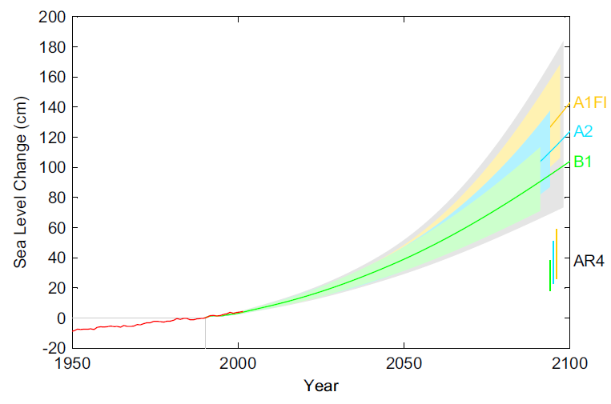
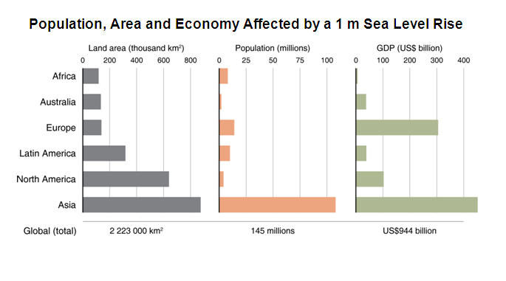

Sea Level Rise Will Impact 150 Million People by 2100
—The Vast Majority in Asia
CO₂ Emissions are an Impulse to Earth Climate System—Equilibrium Response will Take Centuries
1 Meter Sea Level Rise
IPCC 2007
Estimates
http://maps.grida.no/go/graphic/population-area-and-economy-affected-by-a-1-m-sea-level-rise-global-and-regional-estimates-based-on-
“Global sea level linked to global temperature,”
Martin Vermeer and Stefan Rahmstorf,
PNAS, v. 106, 21527–21532 (2009)

Slide 18
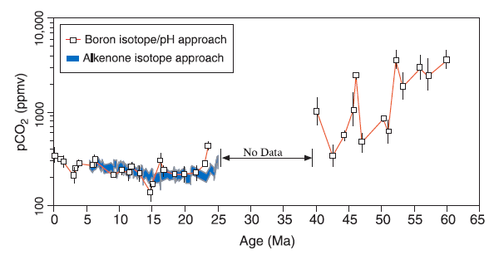
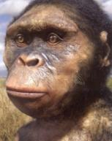
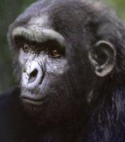
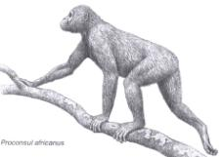
Earth’s Climate Hasn’t Seen the Current Level of CO₂
During the Entire Evolution of Homonids!
With No Policy Change, MIT Estimates ~900ppm by 2100
900 ppm
Australopithecus afarensis
Sahelanthropus tchadensis
550 ppm
Current CO₂ Level
Estimates of Cenozoic atmospheric pCO₂ based on two independent proxies as measured in subtropical deep-sea sediment cores from the Pacific
CO₂: James Zachos, et al. Science v. 292 p. 686 27 Apr. 2001
Homonid Images: The Last Human, G.J. Sawyer and V. Deak

Slide 19
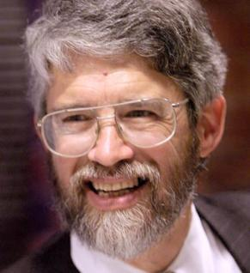
Earth’s Climate is Rapidly Entering a Novel Realm
Not Experienced for Over 20 Million Years
“Global Warming” implies gradual, uniform, mainly about temperature, and quite possibly benign.
What’s happening is rapid, non-uniform, affecting everything about climate, and is almost entirely harmful.
A more accurate term is ‘global climatic disruption’
This ongoing disruption is:
  Real without doubt
  Mainly caused by humans
  Already producing significant harm
  Growing more rapidly than expected”
- John Holdren, Director Office of Science and Technology Policy
  June 25, 2008
See Video Lecture: http://greenmonk.net/john-holdren-on-global-climatic-disruption/

Slide 20
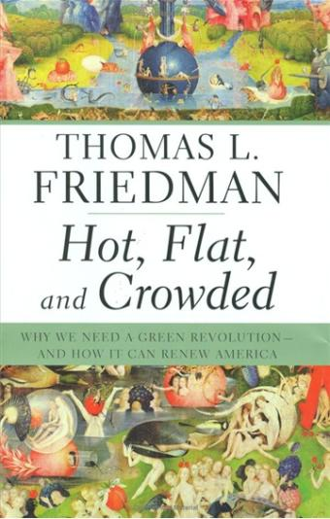
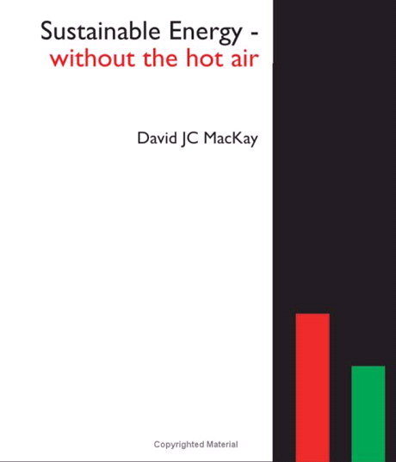
What is Creating the Problem and What Can the World Do to Change?
“It Will Be the Biggest Single Peacetime Project Humankind Will Have Ever Undertaken”

Slide 21
How Can PRAGMA Research Help Slow Down the Increasing Greenhouse Gas Emissions?

Slide 22
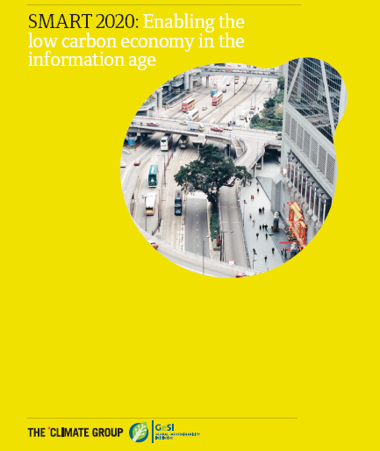
ICT is a Critical Element in Achieving Countries Greenhouse Gas Emission Reduction Targets
GeSI member companies:
Bell Canada,
British Telecomm.,
Plc,
Cisco Systems,
Deutsche Telekom AG,
Ericsson,
France Telecom,
Hewlett-Packard,
Intel,
Microsoft,
Nokia,
Nokia Siemens Networks,
Sun Microsystems,
T-Mobile,
Telefónica S.A.,
Telenor,
Verizon,
Vodafone Plc.
Additional support:
Dell, LG.
www.smart2020.org

Slide 23
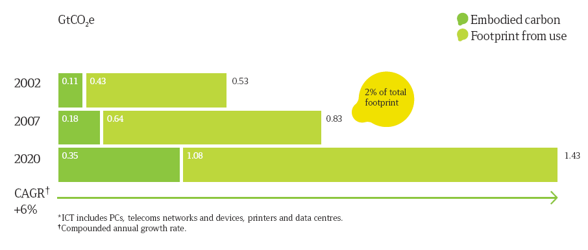
The Global ICT Carbon Footprint is Significant and Growing at 6% Annually!
Most of Growth is in
Developing Countries
the assumptions behind the growth in emissions expected in 2020:
takes into account likely efficient technology developments
that affect the power consumption of products and services
and their expected penetration in the market in 2020
www.smart2020.org

Slide 24
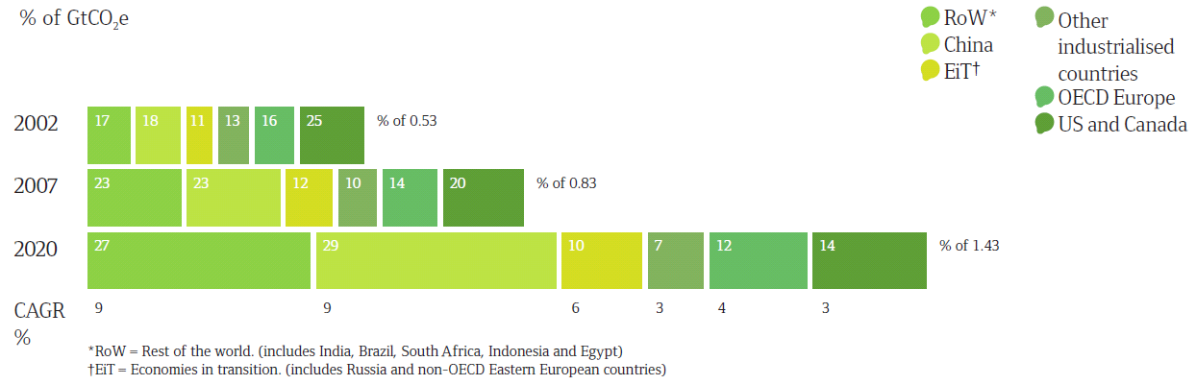
Reduction of ICT Emissions is a Global Challenge –
U.S. and Canada are Small Sources
U.S. plus Canada Percentage Falls From
25% to 14% of Global ICT Emissions by 2020
www.smart2020.org

Slide 25
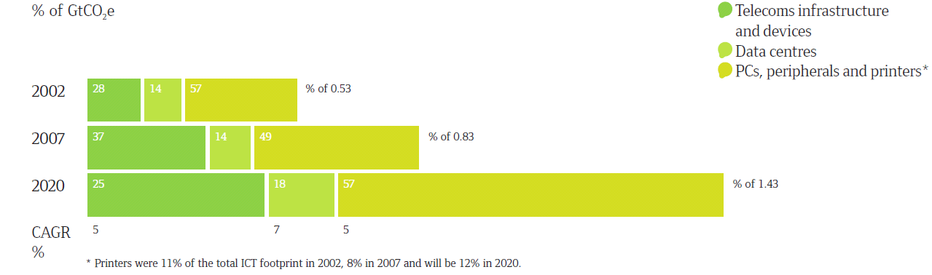
The Global ICT Carbon Footprint by Subsector
The Number of PCs (Desktops and Laptops) Globally is Expected to Increase
from 592 Million in 2002
to More Than Four Billion in 2020
Data Centers Are Rapidly Improving
PCs Are Biggest Problem
www.smart2020.org

Slide 26
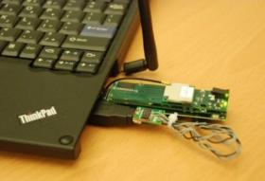
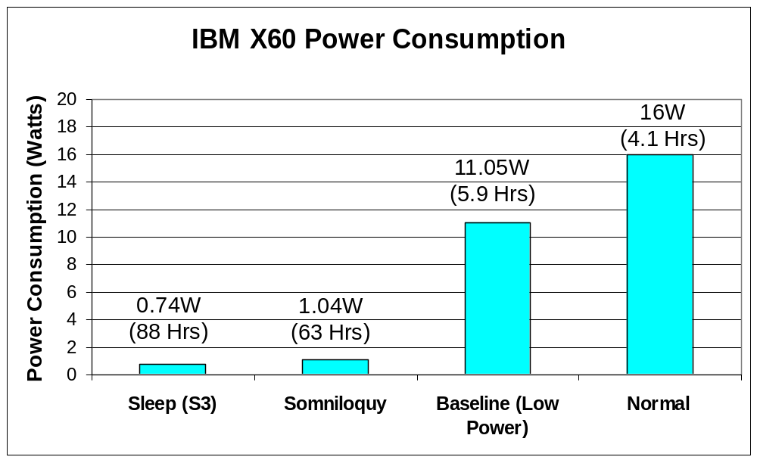
Increasing Laptop Energy Efficiency:
Putting Machines To Sleep Transparently
Laptop
Rajesh Gupta, UCSD CSE; Calit2
Network interface
Peripheral
Low power domain
Secondary processor
Network interface
Management
software
Main processor,
RAM, etc
Somniloquy
Enables Servers
to Enter and Exit Sleep While Maintaining
Their Network and Application Level Presence

Slide 27
Application of ICT Can Lead to a 5-Fold Greater
Decrease in GHGs Than its Own Carbon Footprint
While the sector plans to significantly step up
the energy efficiency of its products and services,
ICT’s largest influence will be by enabling
energy efficiencies in other sectors, an opportunity
that could deliver carbon savings five times larger than
the total emissions from the entire ICT sector in 2020.
--Smart 2020 Report
Major Opportunities for the United States*
  Smart Electrical Grids
  Smart Transportation Systems
  Smart Buildings
  Virtual Meetings
* Smart 2020 United States Report Addendum
www.smart2020.org

Slide 28
Next Stage: Developing Greener Smart Campuses
Calit2 (UCSD & UCI) Prototypes
Coupling the Internet and the Electrical Grid
  Choosing non-GHG Emitting Electricity Sources
  Measuring Demand at Sub-Building Levels
  Reducing Local Energy Usage via User Access Thru Web
Transportation System
  Campus Wireless GPS Low Carbon Fleet
  Green Software Automobile Innovations
  Driver Level Cell Phone Traffic Awareness
Travel Substitution
  Commercial Teleconferencing
  Next Generation Global Telepresence
Student Video -- UCSD Living Laboratory for Real-World Solutions
www.gogreentube.com/watch.php?v=NDc4OTQ1 on UCSD
UCI Named ‘Best Overall' in Flex Your Power Awards
www.today.uci.edu/news/release_detail.asp?key=1859

Slide 29
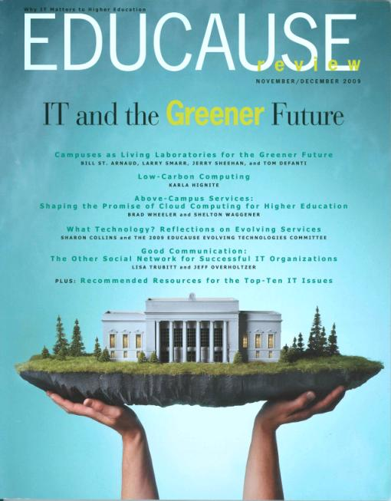
Make All PRAGMA Campuses
Living Laboratories for the Greener Future
www.educause.edu/EDUCAUSE+Review/EDUCAUSEReviewMagazineVolume44/CampusesasLivingLaboratoriesfo/185217

Slide 30
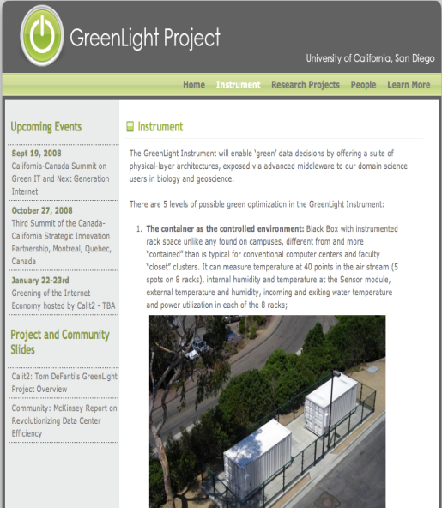

Research Needed on How to Deploy a Green CI:
PRAGMA as an International Green CI Testbed?
MRI
Computer Architecture
  Rajesh Gupta/CSE
Software Architecture
  Amin Vahdat, Ingolf Kruger/CSE
CineGrid Exchange
  Tom DeFanti/Calit2
Visualization
  Falko Kuster/Structural Engineering
Power and Thermal Management
  Tajana Rosing/CSE
Analyzing Power Consumption Data
  Jim Hollan/Cog Sci
Direct DC Datacenters
  Tom Defanti, Greg Hidley
http://greenlight.calit2.net

Slide 31
Toward “Zero Carbon” ICT
Green Cloud Computing and Storage
Purchasing Green Power Locally is Expensive with Significant Transmission Line Losses
  Demand for Green Power Within Cities is Growing Dramatically
  ICT Facilities Don’t Need To Be Located In Cities
But Most Renewable Energy Sites are Very Remote and Impractical to Connect to Electrical Grid
  Can be Easily Reached by an Optical Network
  Provide Independence from Electrical Utility
  Savings in Transmission Line Losses (Up To 15% Alone)
  Plus Carbon Offsets Can Pay for Moving ICT Facilities to Renewable Energy Site
Calit2 is Discussing Partnering with Canada
  Move a GreenLight Facility to Hydro Site in British Columbia
  Link by 10Gbps Optical Fiber to Calit2—Offer to Remote Users
Source: Bill St. Arnaud, CANARIE, Canada

Slide 32
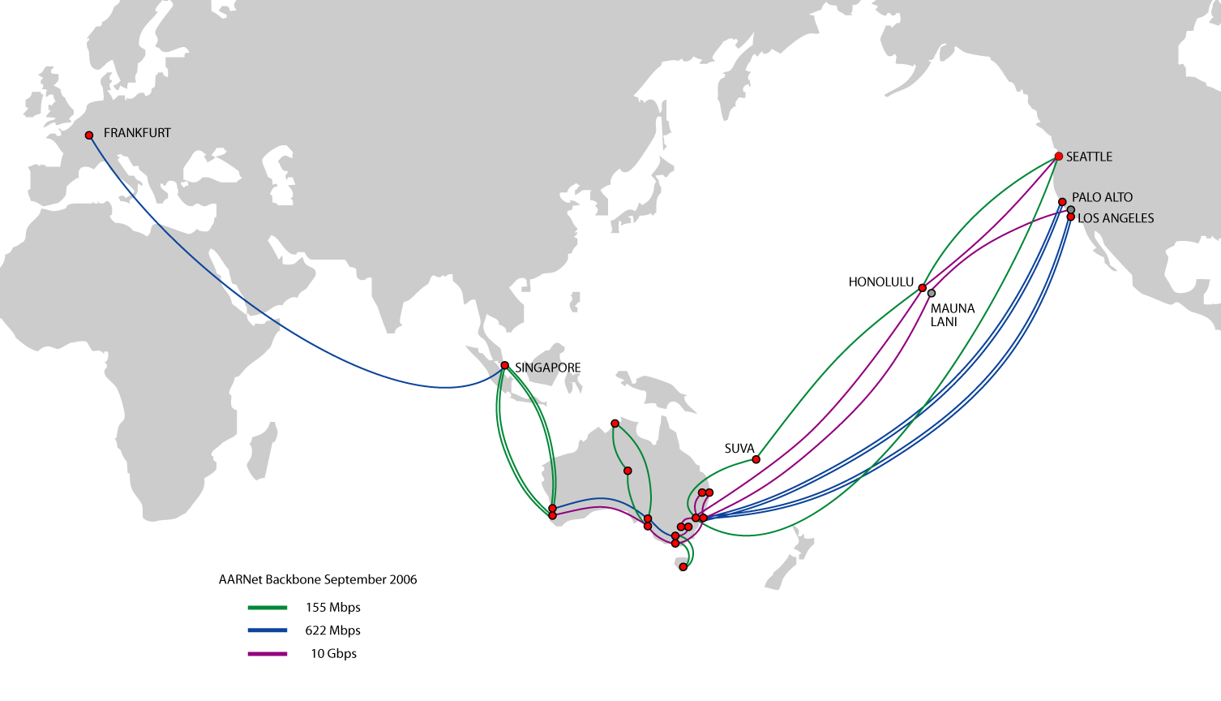


Coupling AARNet - CENIC/PW - CANARIE Optical Nets:
An Australian-U.S.-Canada Green Cloud Testbed
Extend Throughout PRAGMA?
Toward Zero Carbon ICT

Slide 33
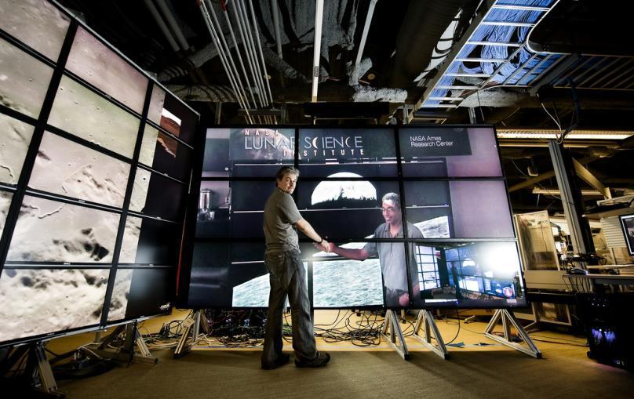

High Definition Video Connected OptIPortals:
Virtual Working Spaces for Data Intensive Research
NASA Interest
in Supporting
Virtual Institutes
LifeSize HD
NASA Ames
Lunar Science Institute
Mountain View, CA
Extend Throughout PRAGMA?
Source: Falko Kuester, Kai Doerr Calit2;
Michael Sims, NASA

Slide 34
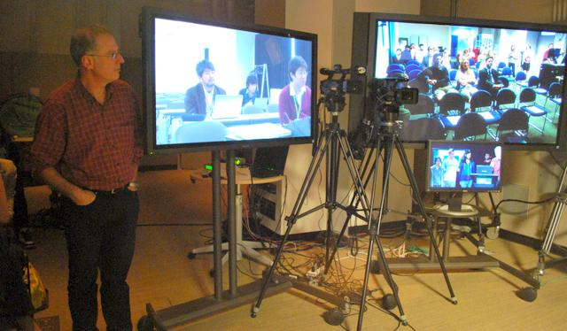
PRAGMA Reducing Carbon Emissions
Using Optical Networks and HD
February 24, 2010
Japan
Australia
MURPA Students
in Calit2 HD Studio
David Abramson,
Monash Univ.
Melbourne, Australia

Slide 35
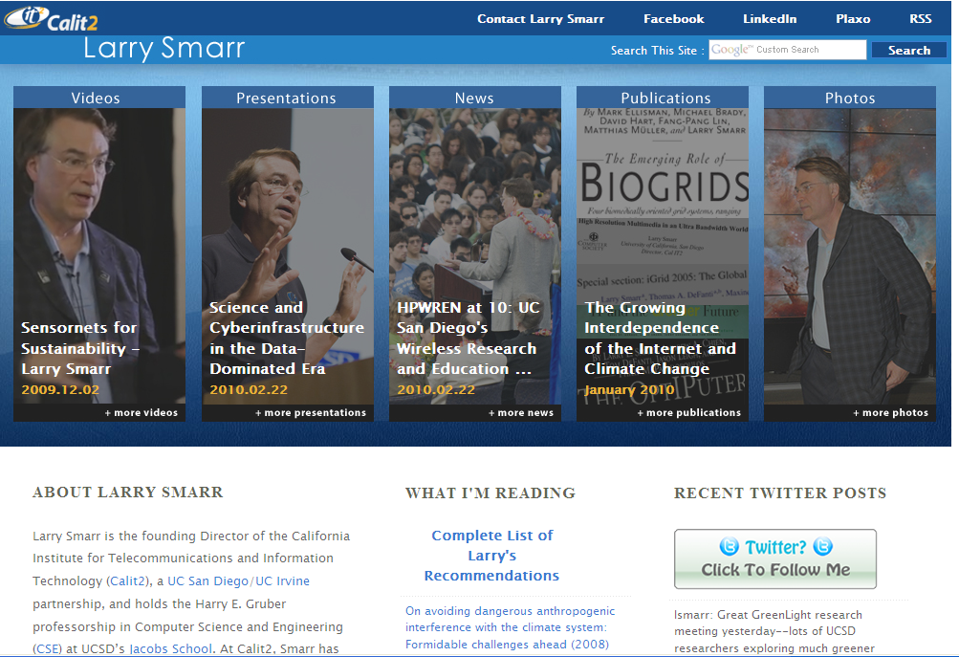
You Can Download This Presentation at lsmarr.calit2.net

