Slide 1
Introduction to Clusters and Rocks Overview
Rocks for Noobs
© 2008 UC Regents

Slide 2
High Performance Computing Cluster
Frontend Node
Public Ethernet
Power Distribution
(Net addressable units as option)
Private
Ethernet Network
Application
Network (Optional)
Node
Node
Node
Node
Node
Node
Node
Node
Node
Node
© 2008 UC Regents
Notes:
© 2008 UC Regents
Application Network Could be:
Myrinet
IB
Gigabit
katz prius

Slide 3
The Dark Side of Clusters
Clusters are phenomenal price/performance computational engines …
  Can be hard to manage without experience
  High-performance I/O is still unsolved
  Finding out where something has failed increases at least linearly as cluster size increases
Not cost-effective if every cluster “burns” a person just for care and feeding
Programming environment could be vastly improved
Technology is changing very rapidly. Scaling up is becoming commonplace (128-256 nodes)
© 2008 UC Regents
Notes:
© 2008 UC Regents
katz prius

Slide 4
The Top 2 Most Critical Problems
The largest problem in clusters is software skew
  When software configuration on some nodes is different than on others
  Small differences (minor version numbers on libraries) can cripple a parallel program
The second most important problem is adequate job control of the parallel process
  Signal propagation
  Cleanup
© 2008 UC Regents
Notes:
© 2008 UC Regents
katz prius

Slide 5
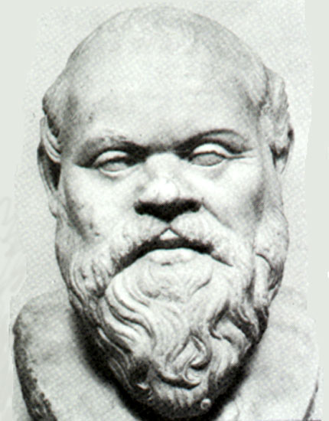
Philosophy
Caring and feeding for a system is not fun
System Administrators cost more than clusters
  1 TFLOP cluster is less than $100,000 (US)
  Close to actual cost of a fulltime administrator
The system administrator is the weakest link in the cluster
  Bad ones like to tinker (make small changes)
  Good ones still make mistakes
© 2008 UC Regents
Notes:
© 2008 UC Regents
katz prius

Slide 6
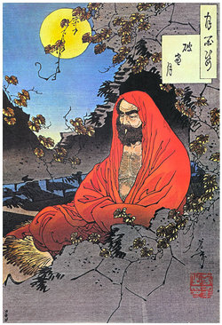
Philosophy continued
All nodes are 100% automatically configured
  Zero “hand” configuration
  This includes site-specific configuration
Run on heterogeneous standard high volume components (PCs)
  Use components that offer the best price/performance
  Software installation and configuration must support different hardware
  Homogeneous clusters do not exist
  Disk imaging requires homogeneous cluster
© 2008 UC Regents
Notes:
© 2008 UC Regents
katz prius

Slide 7
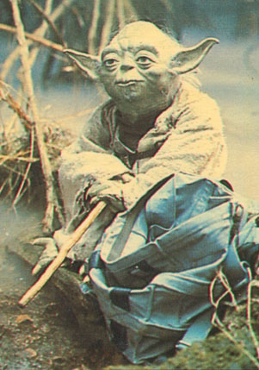
Philosophy continued
Optimize for installation
  Get the system up quickly
  In a consistent state
  Build supercomputers in hours not months
Manage through re-installation
  Can re-install 128 nodes in under 20 minutes
  No support for on-the-fly system patching
Do not spend time trying to issue system consistency
  Just re-install
  Can be batch driven
Uptime in HPC is a myth
  Supercomputing sites have monthly downtime
  HPC is not HA (High Availability)
© 2008 UC Regents
Notes:
© 2008 UC Regents
katz prius

Slide 8
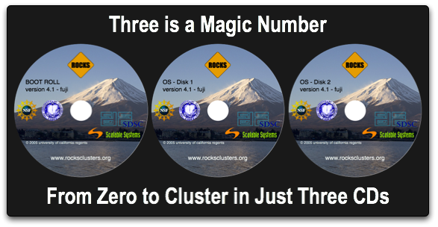
Rocks Basic Approach
Install a frontend
  Insert Rocks Base CD
  Insert Roll CDs (optional components)
  Answer 7 screens of configuration data
  Drink coffee (takes about 30 minutes to install)
Install compute nodes:
  Login to frontend
  Execute insert-ethers
  Boot compute node with Rocks Base CD (or PXE)
  Insert-ethers discovers nodes
  Goto step 3
Add user accounts
Start computing
Optional Rolls
  Condor
  Grid (based on NMI R4)
  Intel (compilers)
  Java
  SCE (developed in Thailand)
  Sun Grid Engine
  PBS (developed in Norway)
  Area51 (security monitoring tools)
  Many Others …
© 2008 UC Regents
Notes:
© 2008 UC Regents
katz prius

Slide 9
Minimum Requirements
Frontend
  2 Ethernet Ports
  CDROM
  18 GB Disk Drive
  512 MB RAM
Compute Nodes
  1 Ethernet Port
  18 GB Disk Drive
  512 MB RAM
Complete OS Installation on all Nodes
No support for Diskless (yet)
Not a Single System Image
All Hardware must be supported by RHEL
© 2008 UC Regents
Notes:
© 2008 UC Regents
katz prius

Slide 10
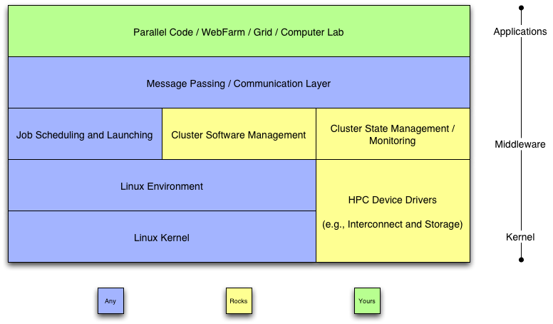
Cluster Software Stack
© 2008 UC Regents
Notes:
© 2008 UC Regents
katz prius

Slide 11
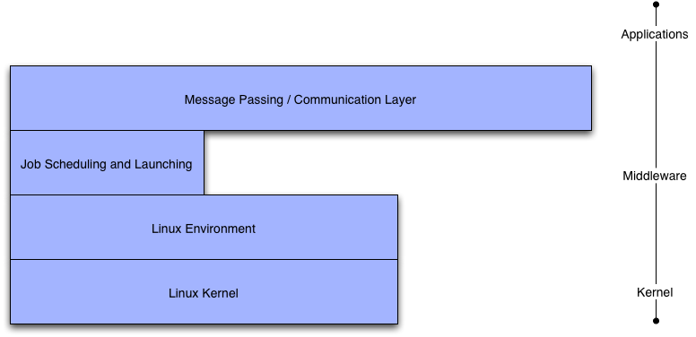
Common to Any Cluster
© 2008 UC Regents
Notes:
© 2008 UC Regents
katz prius

Slide 12
Red Hat
Enterprise Linux
  Recompiled from public SRPMS, including errata updates (source code)
  No license fee required, redistribution is also fine
  Recompiled for all CPU types (x86, Opteron)
Standard Red Hat Linux kernel
  No Rocks added kernel patches
No support for other linux distributions
  Red Hat is the market leader for Linux
    In the US
    And becoming so in Europe
  Trivial to support any Anaconda-based system
  Others would be harder, and require vendor support (SuSe ~ 12 months work)
Excellent support for automated installation
  Scriptable installation (Kickstart)
  Very good hardware detection
© 2008 UC Regents
Notes:
© 2008 UC Regents
katz prius

Slide 13


Batch Systems
Portable Batch System and Maui
  Long time standard for HPC queuing systems
  Maui provides backfilling for high throughput
  PBS/Maui system can be fragile and unstable
  Multiple code bases:
    PBS
    OpenPBS
    PBSPro
    Scalable PBS
Sun Grid Engine
  Rapidly becoming the new standard
  Integrated into Rocks by Scalable Systems
  Now the default scheduler for Rocks
  Robust and dynamic
© 2008 UC Regents
Notes:
© 2008 UC Regents
katz prius

Slide 14
Network File System
User account are served over NFS
  Works for small clusters (<= 128 nodes)
  Will not work for large clusters (>1024 nodes)
  Network Attached Storage (NAS) is better than Linux
    Rocks uses the Frontend machine to server NFS
    We have deployed NAS on several clusters
Applications are not served over NFS
  /usr/local/ does not exist
  All software is installed locally from RPM
© 2008 UC Regents
Notes:
© 2008 UC Regents
katz prius

Slide 15
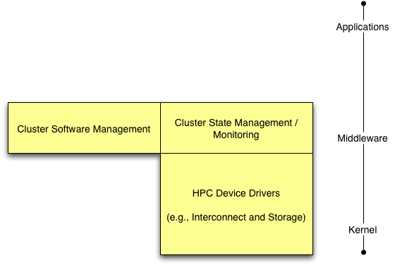
Rocks Cluster Software
© 2008 UC Regents
Notes:
© 2008 UC Regents
katz prius

Slide 16
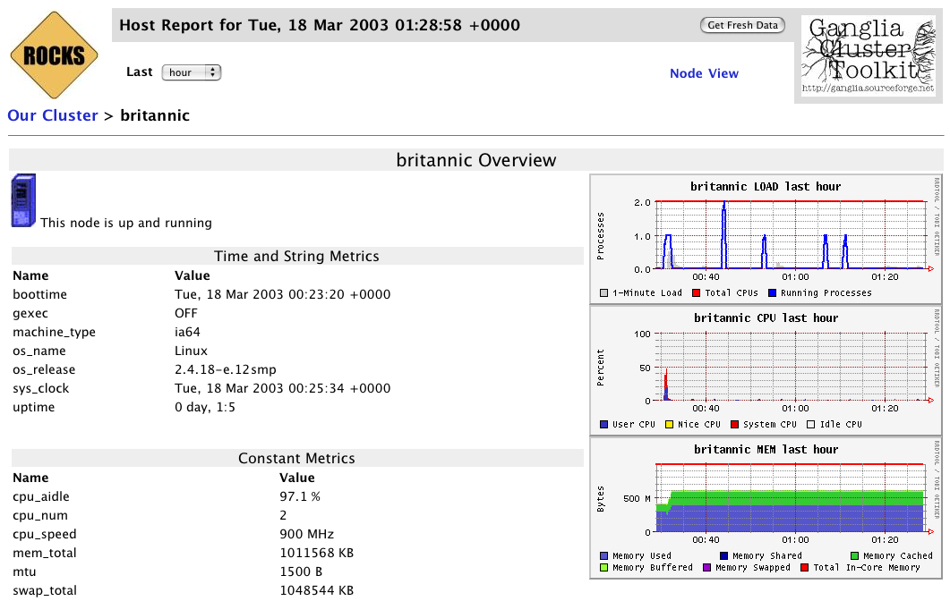
Ganglia Screenshot
© 2008 UC Regents
Notes:
© 2008 UC Regents
katz prius

Slide 17
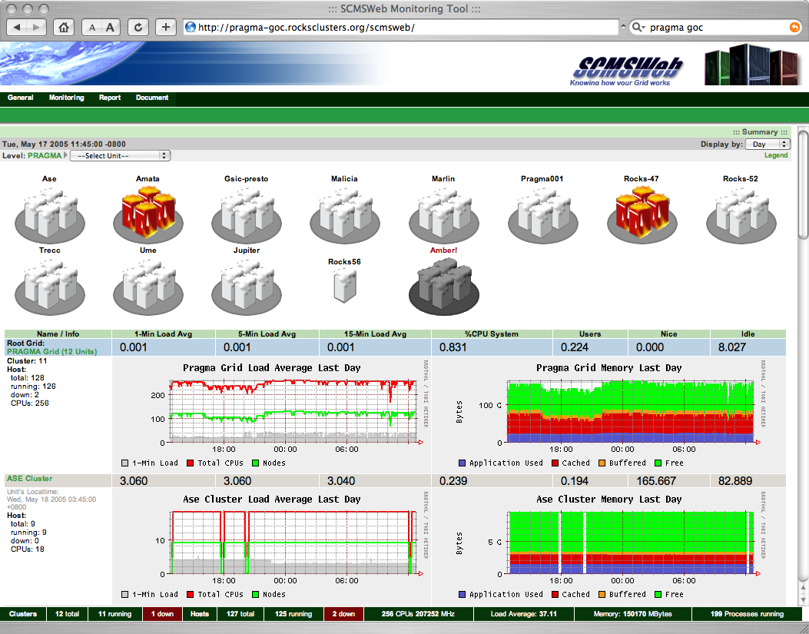
SCMSWeb Screenshot
© 2008 UC Regents
Notes:
© 2008 UC Regents
katz prius

Slide 18


Cluster State Management
Static Information
  Node addresses
  Node types
  Site-specific configuration
Dynamic Information
  CPU utilization
  Disk utilization
  Which nodes are online
© 2008 UC Regents
Notes:
© 2008 UC Regents
katz prius

Slide 19
Software Installation
Collection of all possible
software packages
(AKA Distribution)
Descriptive information to
configure a node
Kickstart
file
RPMs
Appliances
Compute Node
IO Server
Web Server
© 2008 UC Regents
Notes:
© 2008 UC Regents
katz prius

Slide 20
Software Repository
Collection of all possible
software packages
(AKA Distribution)
Descriptive information to
configure a node
Kickstart
file
RPMs
Appliances
Compute Node
IO Server
Web Server
© 2008 UC Regents
Notes:
© 2008 UC Regents
katz prius

Slide 21
Installation Instructions
Collection of all possible
software packages
(AKA Distribution)
Descriptive information to
configure a node
Kickstart
file
RPMs
Appliances
Compute Node
IO Server
Web Server
© 2008 UC Regents
Notes:
© 2008 UC Regents
katz prius

Slide 22
Cluster Software Management
Software Packages
RPMs
  Standard Red Hat (desktop) packaged software
  Or your own addons
Rocks-dist
  Manages the RPM repository
  This is the distribution
Software Configuration
Tuning RPMs
  For clusters
  For your site
  Other customization
XML Kickstart
  Programmatic System Building
  Scalable
© 2008 UC Regents
Notes:
© 2008 UC Regents
katz prius

Slide 23
Kickstart File Sections
Main
  Disk partitioning
  Root password
  RPM repository URL
  …
Packages
  List of RPMs (w/o version numbers)
  The repository determines the RPM versions
  The kickstart file determines the set of RPMs
Pre
  Shell scripts run before RPMs are installed
  Rarely used (Rocks uses it to enhance kickstart)
Post
  Shell scripts to cleanup RPM installation
  Fixes bugs in packages
  Adds local information
© 2008 UC Regents
Notes:
© 2008 UC Regents
katz prius

Slide 24
What is a Kickstart File?
Setup & Packages (20%)
cdrom
zerombr yes
bootloader --location mbr --useLilo
skipx
auth --useshadow --enablemd5
clearpart --all
part /boot --size 128
part swap --size 128
part / --size 4096
part /export --size 1 --grow
lang en_US
langsupport --default en_US
keyboard us
mouse genericps/2
timezone --utc GMT
rootpw --iscrypted nrDq4Vb42jjQ.
text
install
reboot
%packages
@Base
@Emacs
@GNOME
Post Configuration (80%)
%post
cat > /etc/nsswitch.conf << 'EOF'
passwd: files
shadow: files
group: files
hosts: files dns
bootparams: files
ethers: files
EOF
cat > /etc/ntp.conf << 'EOF'
server ntp.ucsd.edu
server 127.127.1.1
fudge 127.127.1.1 stratum 10
authenticate no
driftfile /etc/ntp/drift
EOF
/bin/mkdir -p /etc/ntp
cat > /etc/ntp/step-tickers << 'EOF'
ntp.ucsd.edu
EOF
/usr/sbin/ntpdate ntp.ucsd.edu
/sbin/hwclock --systohc
© 2008 UC Regents
Notes:
© 2008 UC Regents
katz prius

Slide 25
Issues
High level description of software installation
  List of packages (RPMs)
  System configuration (network, disk, accounts, …)
  Post installation scripts
De facto standard for Linux
Single ASCII file
  Simple, clean, and portable
  Installer can handle simple hardware differences
Monolithic
  No macro language
  Differences require forking (and code replication)
  Cut-and-Paste is not a code re-use model
© 2008 UC Regents
Notes:
© 2008 UC Regents
katz prius

Slide 26
XML KICKSTART
© 2008 UC Regents
Notes:
© 2008 UC Regents
katz prius

Slide 27
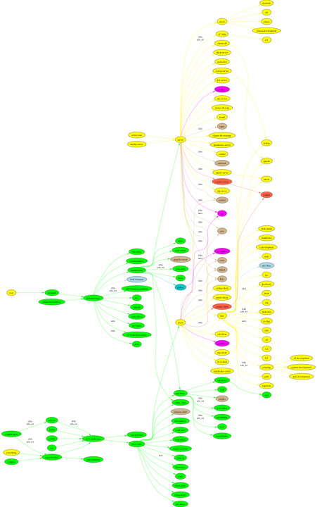
It looks something like this
© 2008 UC Regents
Notes:
© 2008 UC Regents
katz prius

Slide 28
Implementation
Nodes
  Single purpose modules
  Kickstart file snippets (XML tags map to kickstart commands)
  Approximately 200 node files in Rocks
Graph
  Defines interconnections for nodes
  Think OOP or dependencies (class, #include)
  A single default graph file in Rocks
Macros
  SQL Database holds site and node specific state
  Node files may contain &var; entities (start from db)
© 2008 UC Regents
Notes:
© 2008 UC Regents
katz prius

Slide 29
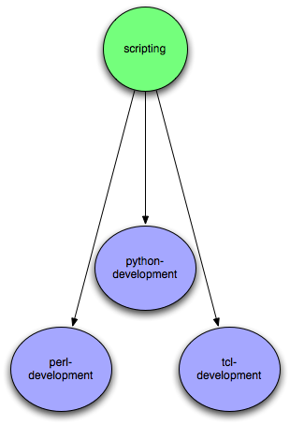
Composition
Aggregate Functionality
Scripting
  IsA perl-development
  IsA python-development
  IsA tcl-development
© 2008 UC Regents
Notes:
© 2008 UC Regents
katz prius

Slide 30
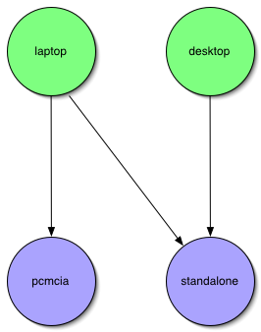
Appliances
Laptop / Desktop
  Appliances
  Final classes
  Node types
Desktop IsA
  standalone
Laptop IsA
  standalone
  Pcmcia
Specify only the differences
© 2008 UC Regents
Notes:
© 2008 UC Regents
katz prius

Slide 31
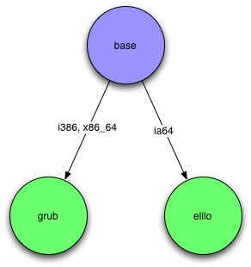
Architecture Differences
Conditional inheritance
Annotate edges with target architectures
if i386
  Base IsA grub
if ia64
  Base IsA elilo
One Graph, Many CPU Architectures
  Heterogeneity becomes easy
  Not true for SSI or Imaging
© 2008 UC Regents
Notes:
© 2008 UC Regents
katz prius

Slide 32
Putting in all together
© 2008 UC Regents
Notes:
© 2008 UC Regents
katz prius

Slide 33
Sample Node File
<?xml version="1.0" standalone="no"?>
<!DOCTYPE kickstart SYSTEM "@KICKSTART_DTD@" [<!ENTITY ssh "openssh">]>
<kickstart>
<description>
Enable SSH
</description>
<package>&ssh;</package>
<package>&ssh;-clients</package>
<package>&ssh;-server</package>
<package>&ssh;-askpass</package>
<post>
cat &gt; /etc/ssh/ssh_config &lt;&lt; 'EOF’ <!-- default client setup -->
Host *
ForwardX11 yes
ForwardAgent yes
EOF
chmod o+rx /root
mkdir /root/.ssh
chmod o+rx /root/.ssh
</post>
</kickstart>>
© 2008 UC Regents
Notes:
© 2008 UC Regents
katz prius

Slide 34
Sample Graph File
<?xml version="1.0" standalone="no"?>
<graph>
<description>
Default Graph for NPACI Rocks.
</description>
<edge from="base" to="scripting"/>
<edge from="base" to="ssh"/>
<edge from="base" to="ssl"/>
<edge from="base" to=”grub" arch="i386"/>
<edge from="base" to="elilo" arch="ia64"/>
…
<edge from="node" to="base"/>
<edge from="node" to="accounting"/>
<edge from="slave-node" to="node"/>
<edge from="slave-node" to="nis-client"/>
<edge from="slave-node" to="autofs-client"/>
<edge from="slave-node" to="dhcp-client"/>
<edge from="slave-node" to="snmp-server"/>
<edge from="slave-node" to="node-certs"/>
<edge from="compute" to="slave-node"/>
<edge from="compute" to="usher-server"/>
<edge from="master-node" to="node"/>
<edge from="master-node" to="x11"/>
<edge from="master-node" to="usher-client"/>
</graph>
© 2008 UC Regents
Notes:
© 2008 UC Regents
katz prius

Slide 35
CLUSTER SQL DATABASE
© 2008 UC Regents
Notes:
© 2008 UC Regents
katz prius

Slide 36
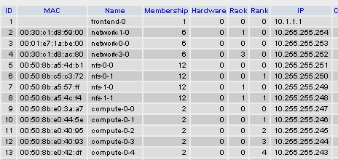
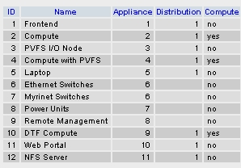
Nodes and Groups
Nodes Table
Memberships Table
© 2008 UC Regents
Notes:
© 2008 UC Regents
katz prius

Slide 37
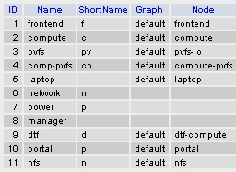
Groups and Appliances
Memberships Table
Appliances Table
© 2008 UC Regents
Notes:
© 2008 UC Regents
katz prius

Slide 38
Nodes XML Tools: &var;
Get Variables from Database
  &Kickstart_PrivateGateway;
  &hostname;
  Can grab any value from the attribute database tables
10.1.1.1
compute-0-0
© 2008 UC Regents
Notes:
© 2008 UC Regents
We will talk mostly about the Kickstart Graph. If you need help packaging your software,
see the Maximum RPM docbook, or examples in our CVS code repository.
katz prius

Slide 39
Nodes XML Tools: <eval>
Do processing on the frontend:
  <eval shell=“bash”>
To insert a fortune in the kickstart file:
<eval shell=“bash”>
/usr/games/fortune
</eval>
"Been through Hell? Whaddya bring back for me?"
-- A. Brilliant
© 2008 UC Regents
Notes:
© 2008 UC Regents
We will talk mostly about the Kickstart Graph. If you need help packaging your software,
see the Maximum RPM docbook, or examples in our CVS code repository.
katz prius

Slide 40
Nodes XML Tools <file>
Create a file on the system:
  <file name=“/etc/hi-mom” mode=“append”>
    How are you today?
  </file>
Used extensively throughout Rocks post sections
  Keeps track of alterations automatically via RCS.
<file name=“/etc/hi” perms=“444”>
How are you today?
I am fine.
</file>
…RCS checkin commands...
cat > /etc/hi << ‘EOF’
How are you today?
I am fine.
EOF
chmod 444 /etc/hi-mom
…RCS cleanup commands…
© 2008 UC Regents
Notes:
© 2008 UC Regents
We will talk mostly about the Kickstart Graph. If you need help packaging your software,
see the Maximum RPM docbook, or examples in our CVS code repository.
katz prius

Slide 41
Fancy <file>: nested tags
<file name=“/etc/hi”>
Here is your fortune for today:
<eval>
date +”%d-%b-%Y”
echo “”
/usr/games/fortune
</eval>
</file>
…RCS checkin commands...
cat > /etc/hi << ‘EOF’
Here is your fortune for today:
13-May-2005
"Been through Hell? Whaddya
bring back for me?"
-- A. Brilliant
EOF
…RCS cleanup commands…
© 2008 UC Regents
Notes:
© 2008 UC Regents
We will talk mostly about the Kickstart Graph. If you need help packaging your software,
see the Maximum RPM docbook, or examples in our CVS code repository.
katz prius

Slide 42
Nodes Main
Used to specify basic configuration:
  timezone
  mouse, keyboard types
  install language
Used more rarely than other tags
Rocks main tags are usually a straight translation:
<main>
<timezone>America/Mission_Beach
</timezone>
</main>
…
timezone America/Mission_Beach
…
rootpw --iscrypted sndk48shdlwis
mouse genericps/2
url --url http://10.1.1.1/install/rocks-dist/..
© 2008 UC Regents
Notes:
© 2008 UC Regents
katz prius

Slide 43
Nodes Packages
<package>java</package>
  Specifies an RPM package. Version is automatically determined: take the newest rpm on the system with the name ‘java’.
<package arch=“x86_64”>java</package>
  Only install this package on x86_64 architectures
<package arch=“i386,x86_64”>java</package>
<package>newcastle</package>
<package>stone-pale</package>
<package>guinness</package>
%packages
newcastle
stone-pale
guinness
© 2008 UC Regents
Notes:
© 2008 UC Regents
katz prius

Slide 44
Nodes Post
ntp-client.xml
<post>
/bin/mkdir -p /etc/ntp
/usr/sbin/ntpdate <var name="Kickstart_PrivateNTPHost"/>
/sbin/hwclock --systohc
</post>
%post
/bin/mkdir -p /etc/ntp
/usr/sbin/ntpdate 10.1.1.1
/sbin/hwclock --systohc
© 2008 UC Regents
Notes:
© 2008 UC Regents
katz prius

Slide 45
PUTTING IT TOGETHER
© 2008 UC Regents
Notes:
© 2008 UC Regents
katz prius

Slide 46
Space-Time and HTTP
Node Appliances
Frontends/Servers
DHCP
IP + Kickstart URL
Kickstart RQST
Generate File
kpp
SQL DB
Request Package
Serve Packages
kgen
Install Package
HTTP:
Kickstart URL (Generator) can be anywhere
Package Server can be (a different) anywhere
Post Config
Reboot
© 2008 UC Regents
Notes:
© 2008 UC Regents
katz prius

Slide 47
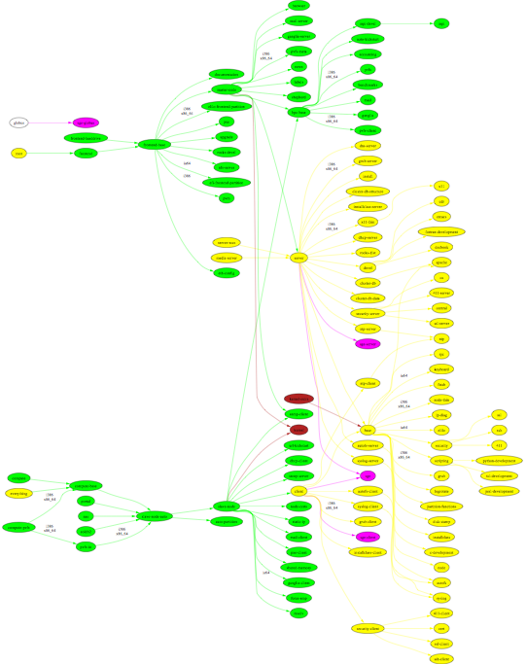
Gathering Node Files
Frontend
Root
Traverse a graph to build up a kickstart file
Makes kickstart file building flexible
Easy to share functionality between disparate node types
Compute
Root
© 2008 UC Regents
Notes:
© 2008 UC Regents
katz prius

Slide 48
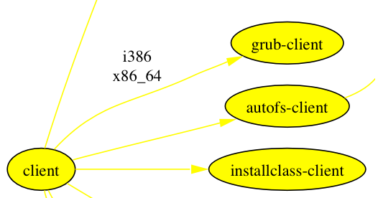
Another Look at XML
<graph>
<edge from=“client”>
<to arch=“i386,x86_64”>grub-client</to>
<to>autofs-client</to>
<to>installclass-client</to>
</edge>
</graph>
© 2008 UC Regents
Notes:
© 2008 UC Regents
katz prius

Slide 49
Partial Ordering
<graph>
<order head=“autofs-client” tail=“client”/>
<edge from=“client”>
<to arch=“i386,x86_64”>grub-client</to>
<to>autofs-client</to>
<to>installclass-client</to>
</edge>
</graph>
Forces autofs-client <post> section to run before client’s <post> section
In order graph traversal enforces a partial ordering
Applying standard graph theory to system installation
© 2008 UC Regents
Notes:
© 2008 UC Regents
katz prius

Slide 50
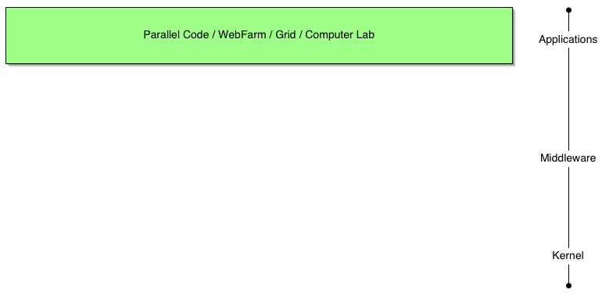
Application Layer
Rocks Rolls
  Optional component
  Created by SDSC
  Created by others
Example
  Bio (BLAST)
  Chem (GAMESS)
  Visualization Clusters
© 2008 UC Regents
Notes:
© 2008 UC Regents
katz prius

Slide 51
BUILDING ON TOP OF ROCKS
Rolls
© 2008 UC Regents
Notes:
© 2008 UC Regents
katz prius

Slide 52

Need Better Flexibility in Stack
Issues
  Static Stack
    Cannot redefine
    Cannot extend
  Monolithic Stack
    Cannot “opt out”
    All or nothing solution
    E.g. PBS not SGE
What we need
  Dynamic Stack
  Component Based Stack
  User / Developer Extensible
© 2008 UC Regents
Notes:
© 2008 UC Regents
katz prius

Slide 53
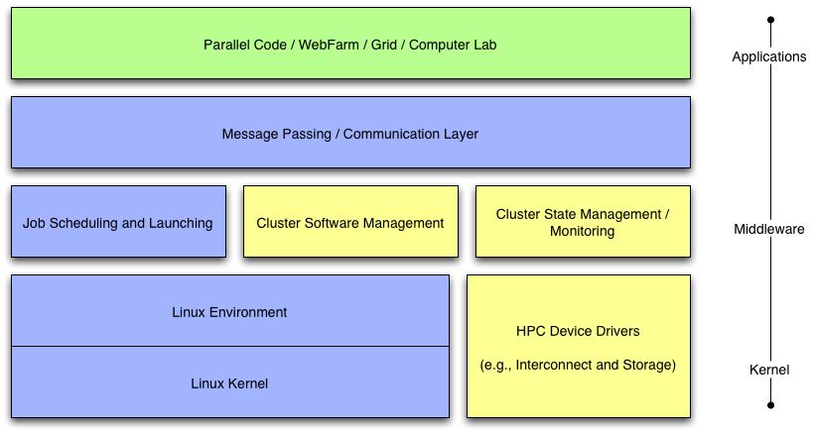
Rolls Break Apart Rocks
Rolls: Modifying a Standard System Installer to Support User-Customizable Cluster Frontend Appliances. Greg Bruno, Mason J. Katz, Federico D. Sacerdoti, and Phil M. Papadopoulos. IEEE International Conference on Cluster Computing, San Diego, California, Sep. 2004.
© 2008 UC Regents
Notes:
© 2008 UC Regents
katz prius

Slide 54
Rocks is What You Make it
Motivation
  “I’m concerned Rocks is becoming everything for everyone” - rocks mailing list
  “Building a cluster should be like ordering a car. I want the sports package, but not the leather seats, …” - z4 owning rocks developer
  We need to let go of Rocks but hold onto the core
    Recruit more external open-source developers
    Only trust ourselves with fundamental architecture and implementation
  We wanted to move the SGE but need to still support PBS
Rolls
  Optional configuration and software
  Just another CD for installed (think application pack)
  SGE and PBS are different Rolls
    User chooses scheduler
    PBS Roll supported by Norway
    SGE Roll supported by Singapore (and us)
  Rolls give us more flexibility and less work
Rocks is done
  The core is basically stable and needs continued support
  Rolls allow us to develop new ideas
  Application Domain specific
IEEE Cluster 2004 - “Rolls: Modifying a Standard System Installer to Support User-Customizable Cluster Frontend Appliances”
© 2008 UC Regents
Notes:
© 2008 UC Regents
katz prius

Slide 55
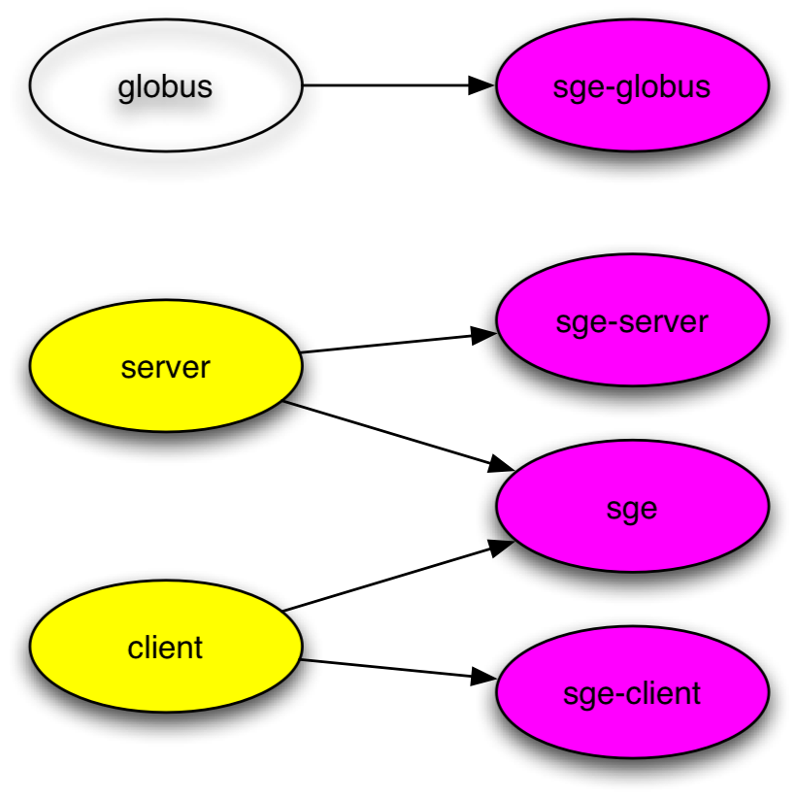
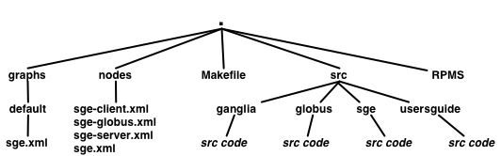
Rolls are sub-graphs
A graph makes it easy to ‘splice’ in new nodes
Each Roll contains its own nodes and splices them into the system graph file
© 2008 UC Regents
Notes:
© 2008 UC Regents
katz prius

Slide 56
STARTING FROM THE EMPTY SET
{ }
© 2008 UC Regents
Notes:
© 2008 UC Regents
katz prius

Slide 57
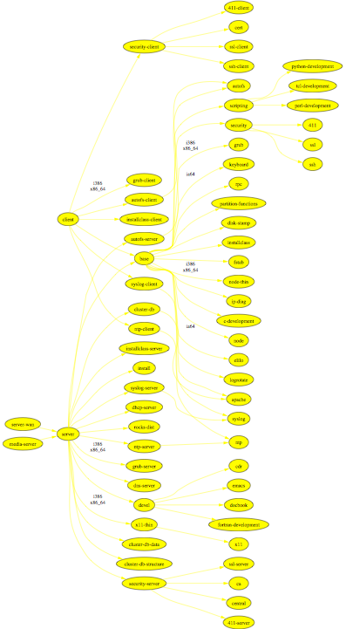
{ base }
© 2008 UC Regents
Notes:
© 2008 UC Regents
katz prius

Slide 58
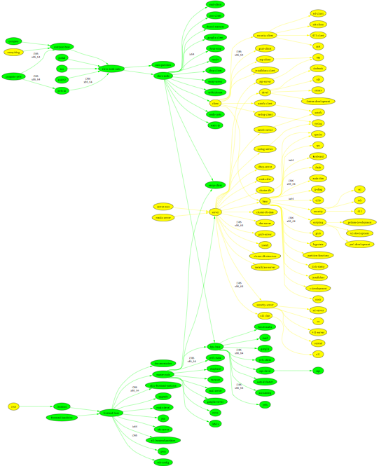
{ base, hpc }
© 2008 UC Regents
Notes:
© 2008 UC Regents
katz prius

Slide 59
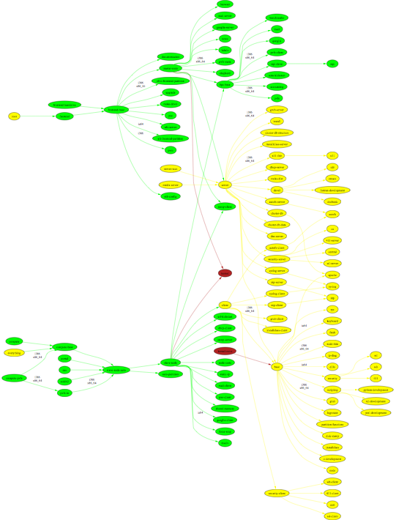
{ base, hpc, kernel }
© 2008 UC Regents
Notes:
© 2008 UC Regents
katz prius

Slide 60
{ base, hpc, kernel, sge }
© 2008 UC Regents
Notes:
© 2008 UC Regents
katz prius

Slide 61
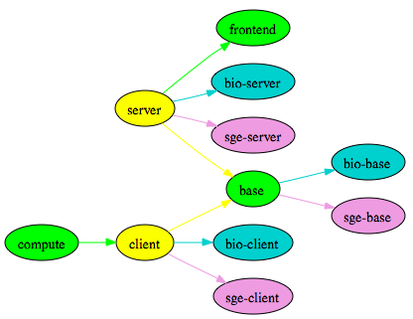
Simplified Example
{base, hpc, sge, bio}
© 2008 UC Regents
Notes:
© 2008 UC Regents
katz prius

Slide 62
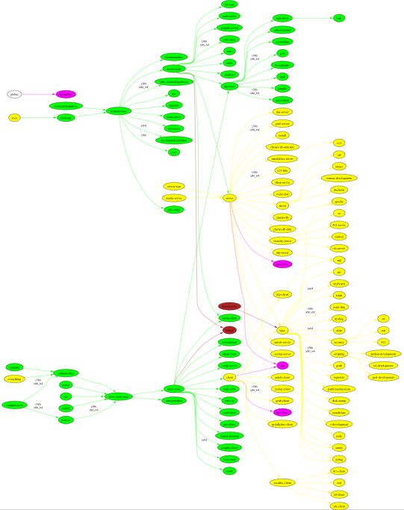
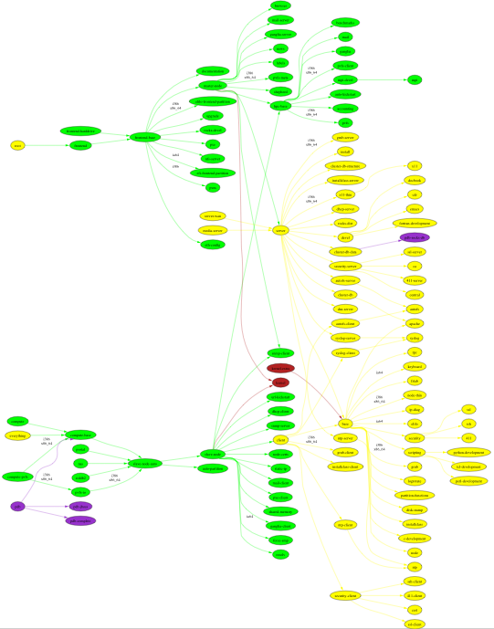
Two different Clusters
MPI Cluster::{base, hpc, kernel, sge}
Protein Databank::{base, hpc, kernel, pdb}
© 2008 UC Regents
Notes:
© 2008 UC Regents
katz prius

Slide 63
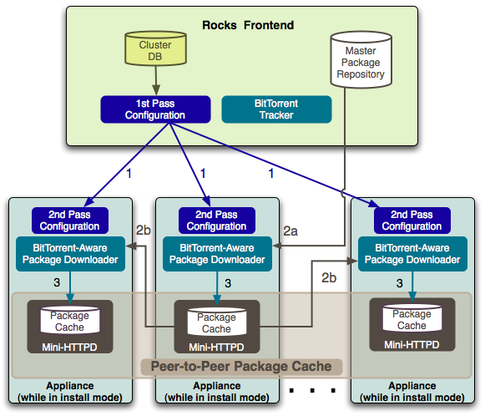
Avalanche Installer
Install nodes from a peer-to-peer package cache
Takes advantage of switched networks to unload the frontend
Kickstart generation is split between frontend and nodes
Backoff mechanisms keep the frontend load under control
Zero administration
© 2008 UC Regents
Notes:
© 2008 UC Regents
katz prius

Slide 64
Pre-Avalanche
Space-Time and HTTP
Node Appliances
Frontends/Servers
DHCP
IP + Kickstart URL
Kickstart RQST
Generate File
kpp
SQL DB
Request Package
Serve Packages
kgen
Install Package
HTTP:
Kickstart URL (Generator) can be anywhere
Package Server can be (a different) anywhere
Post Config
Reboot
© 2008 UC Regents
Notes:
© 2008 UC Regents
katz prius

Slide 65
Avalanche
Space-Time and HTTP
Node Appliances
Frontends/Servers
DHCP
IP + Kickstart URL
Generate
Graph Traversal
Kickstart RQST
kpp
SQL DB
kgen
Request Package
Tracker Response
Request Bits
Serve Package
Install Package
Installing node receives XML of graph traversal
Installing node converts XML into a kickstart file
Any node can server packages over BT
Post Config
Reboot
© 2008 UC Regents
Notes:
© 2008 UC Regents
katz prius

