Slide 1

Brief Introduction to Xen Virtualization
© 2009 UC Regents

Slide 2
What is Xen
Xen is “virtual machine monitor” (VMM) used to control VMs
Xen VMM is called the “hypervisor”
Xen VMs are called “guests”
© 2009 UC Regents

Slide 3
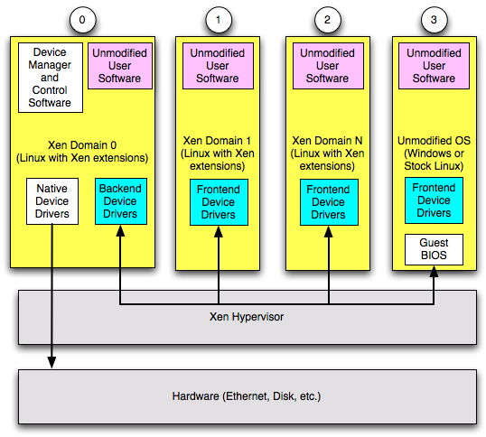
What is Xen
Guest device i/o is passed to and handled by hypervisor
© 2009 UC Regents

Slide 4
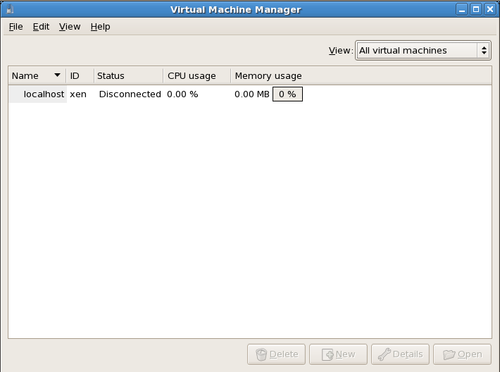
Virtualized Console
console (kvm) is also virtualized
Virt-manager
  Run in Dom0
  Run as root
  Can start/stop
  KVM access
© 2009 UC Regents

Slide 5
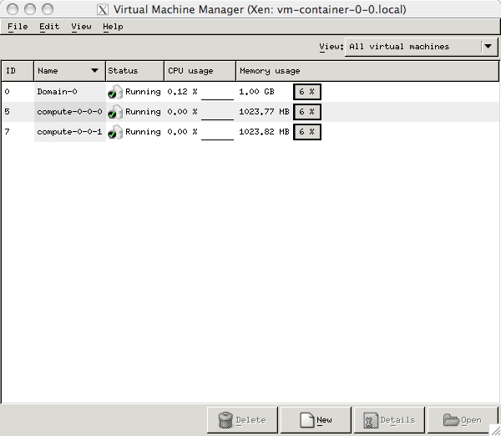
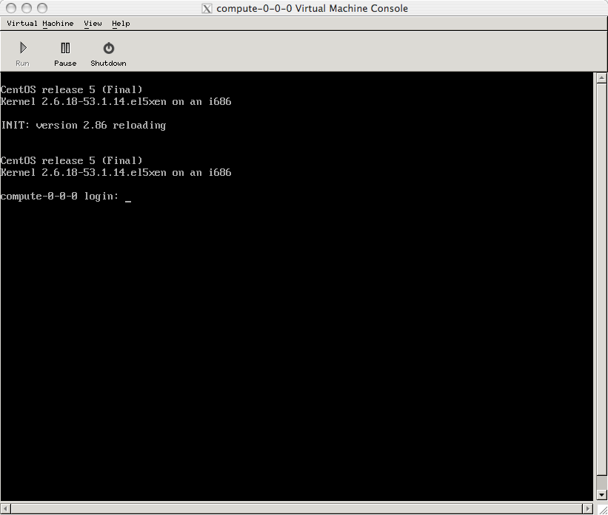
Click for Console
© 2009 UC Regents

Slide 6
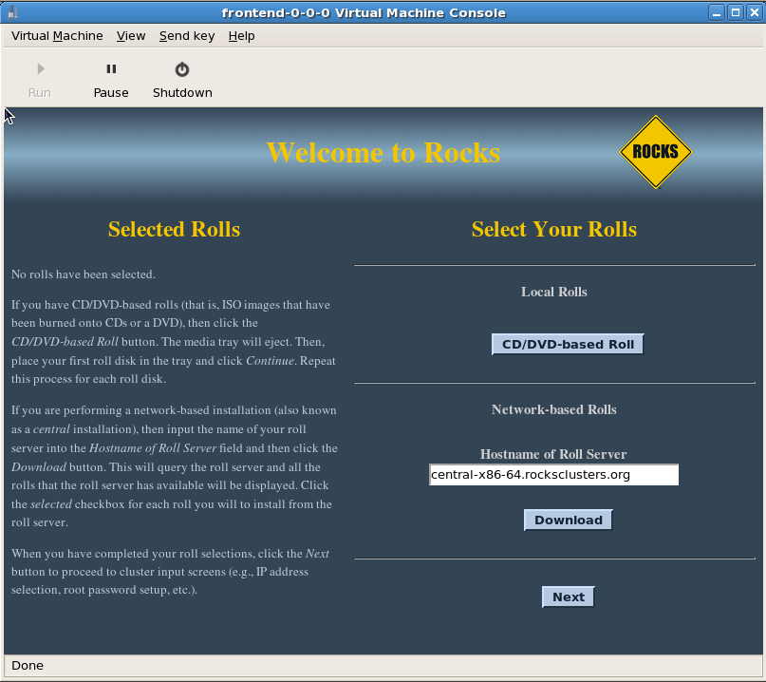
Graphical Console Works Also
© 2009 UC Regents

Slide 7
Recap
Virtual Machines look like Physical Machines
Device I/O goes through Hypervisor
Root user on Dom0 is in charge
Easy to get confused
  What does lspci do?
  Where is a VM “physically” located?
© 2009 UC Regents

Slide 8
What is it good for?
Slicing servers into many small services
  We do this for web, cvs, trac, etc
User controlled software stacks
  Build at home and deploy elsewhere
  Turn time-sharing into single-user
Virtual Clusters
HPC?
© 2009 UC Regents

Slide 9
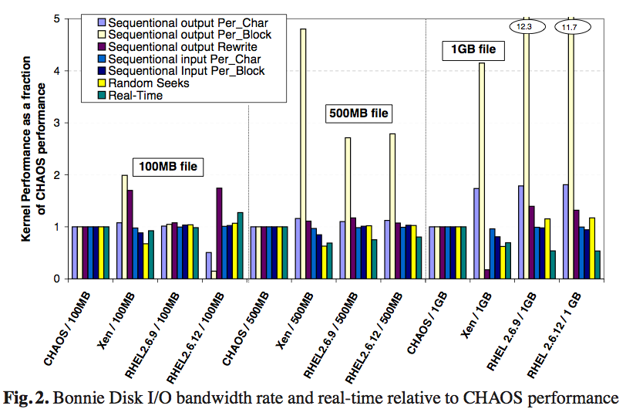
Xen Disk Performance
Source: Paravirtualization for HPC Systems (2006) Lamia Youseff, Rich Wolski, Brent Gorda, Ra Krintz
© 2009 UC Regents

Slide 10
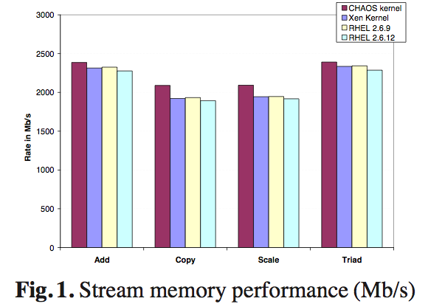
Xen Memory Performance
Source: Paravirtualization for HPC Systems (2006) Lamia Youseff, Rich Wolski, Brent Gorda, Ra Krintz
© 2009 UC Regents

Slide 11
We Need A Bypass
All I/O goes through
  DomU kernel
  Xen HyperVisor
  Dom0 kernel
Non-Xen HPC IO uses OS-bypass
  Kernel DMA directly to/from application
  Only way to get low latency
Xen Needs a similar idea
  Give DomU kernel direct HW access
  Let Dom0 kernel DMA directly to DomU application
Solved for some interconnects
  Mellanox has this today for IB
  Myrinet can bind directly to DomU
© 2009 UC Regents

Slide 12
Xen in Rocks 5.3
Virtual Clusters
© 2009 UC Regents

Slide 13
Step 0
You must install a Rocks 5.3 frontend with the Xen Roll
© 2009 UC Regents

Slide 14
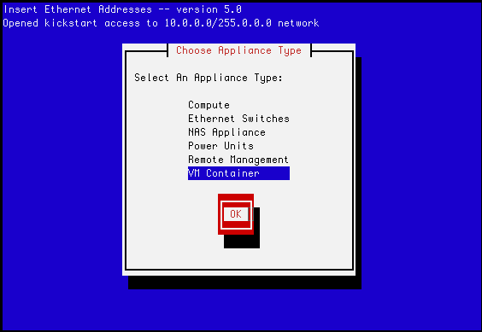
Step 0.5
Optionally install at least one cluster node as a “VM Container”
© 2009 UC Regents

Slide 15
Supported Configurations
Physical frontend with virtual compute nodes
Virtual frontend with virtual compute nodes
  Note: A virtual frontend with physical compute nodes is doable, but it requires an understanding of VLANs
© 2009 UC Regents

Slide 16
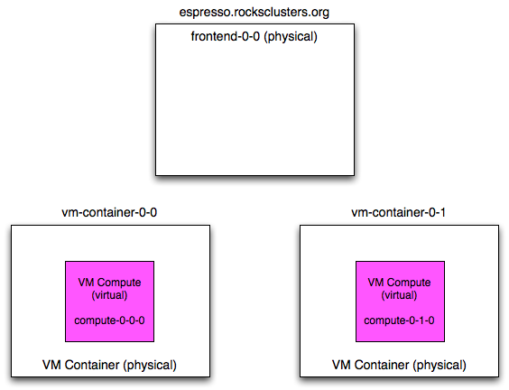
Physical Frontend and Virtual Computes
All node names with a white background are physical machines
All node names with purple backgrounds are virtual
This was the only configuration that Rocks v5.0 supported
© 2009 UC Regents

Slide 17
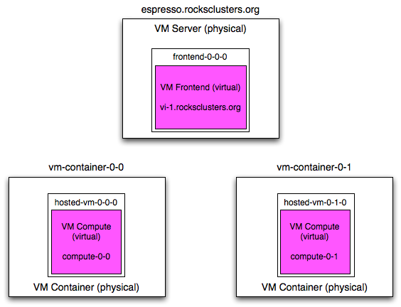
Virtual Frontend and Virtual Computes
© 2009 UC Regents

Slide 18
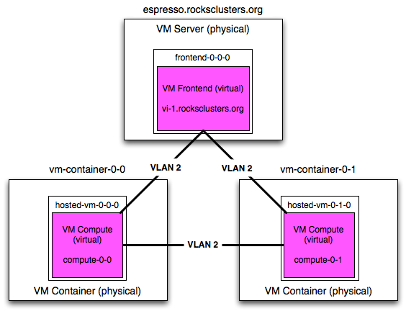
Virtual Frontend and Virtual Computes
Network traffic for VM frontend and VM computes are isolated with a VLAN
Processes running on the physical machines don’t see the traffic from the virtual cluster
© 2009 UC Regents

Slide 19
Key VM Functions
“add cluster”
  Add a new VM cluster
“start host vm”
  Boot a VM
“set host boot”
  Set a VM to install or boot its OS
© 2009 UC Regents

Slide 20
Adding a Cluster
“rocks add cluster” command
What this does:
  Creates a frontend VM on the physical frontend (frontend-0-0-0)
  Creates virtual compute nodes on VM containers (in round robin order)
  Creates a unique VLAN for this cluster and plumbs the VMs to it
    Adds a new unique VLAN to the physical machines on-the-fly
# rocks add cluster {FQDN of frontend} \
{IP of frontend} {number of computes}
© 2009 UC Regents

Slide 21
More on What the Command Does
Adds an entry to the vm_nodes table
  Keep track of which physical host houses the VM
Adds an entry to the vm_disks tables
  Allocates disk space for the VM
    Uses the Xen “file” virtual block device
    Puts the file on the largest partition of the physical host
Allocates unique MAC addresses for each VM
  MAC prefix is based on the frontend’s public IP
© 2009 UC Regents

Slide 22
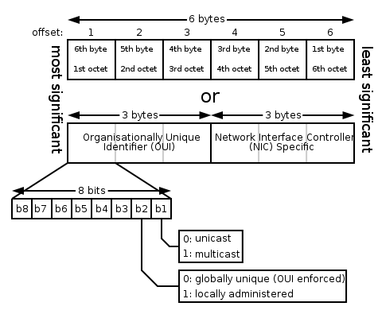
MAC Address Prefix
MAC prefix is based on the frontend’s public IP
  Take the public IP, toss the first octet, then reverse it
    Most unique part of IP address is the MAC’s first octet
Also set the “locally administered” bit and clear the “multicast” bit
© 2009 UC Regents

Slide 23
Adding a Cluster
Example
Output:
# rocks add cluster vi-1.rocksclusters.org \
137.110.119.118 2
created frontend VM named: frontend-0-0-0
created compute VM named: hosted-vm-0-0-0
created compute VM named: hosted-vm-0-1-0
© 2009 UC Regents

Slide 24
Adding a Cluster
# rocks list cluster
FRONTEND CLIENT NODES TYPE
bayou.rocksclusters.org: ---------------- physical
: vm-container-0-0 physical
: vm-container-0-1 physical
vi-1.rocksclusters.org: ---------------- VM
: hosted-vm-0-0-0 VM
: hosted-vm-0-1-0 VM
© 2009 UC Regents

Slide 25
‘rocks add cluster’ Extra Flags
[container-hosts=string]
  A list of VM container hosts that will be used to hold the VM compute nodes.
[cpus-per-compute=string]
  The number of CPUs to allocate to each VM compute node. The default is 1.
[disk-per-compute=string]
  The size of the disk (in gigabytes) to allocate to each VM compute node. The default is 36.
[disk-per-frontend=string]
  The size of the disk (in gigabytes) to allocate to the VM frontend node. The default is 36.
[mem-per-compute=string]
  The amount of memory (in megabytes) to allocate to each VM compute node. The default is 1024.
[vlan=string]
  The VLAN ID to assign to this cluster. All network communication between the nodes of the virtual cluster will be encapsulated within this VLAN. The default is the next free VLAN ID.
© 2009 UC Regents

Slide 26
Install the Frontend VM
“rocks start host vm” command
This starts a standard Rocks installation on the VM
# rocks start host vm frontend-0-0-0
© 2009 UC Regents

Slide 27
Install the Frontend VM
To input data at user screens, need to bring up the console for the VM frontend
# virt-manager
© 2009 UC Regents

Slide 28
Install the Frontend VM
Input the data
  Hint: use the FQDN of the physical frontend for the “Hostname of the Roll Server”
The frontend will install, then reboot
X will start and you’ll see the graphical login screen
  Just like a physical frontend!
© 2009 UC Regents

Slide 29
Virtualized Console
console (kvm) is also virtualized
Virt-manager
  Run in Dom0
  Run as root
  Can start/stop
  KVM access
© 2009 UC Regents

Slide 30
Graphical Console Works Also
© 2009 UC Regents

Slide 31
Install VM Compute Nodes
Login to the VM frontend
  Run ‘insert-ethers’
On the physical frontend, execute:
The software configuration comes from the VM frontend
The “power control” comes from the physical frontend
# rocks start host vm hosted-vm-0-0-0
© 2009 UC Regents

Slide 32
Virtual Frontend and Virtual Computes
© 2009 UC Regents

Slide 33
Get Status
Use ‘rocks list cluster status=y’
On the physical frontend:
# rocks list cluster status=y
FRONTEND CLIENT NODES TYPE STATUS
bayou.rocksclusters.org: ---------------- physical -------
: vm-container-0-0 physical -------
: vm-container-0-1 physical -------
vi-1.rocksclusters.org: ---------------- VM active
: hosted-vm-0-0-0 VM active
: hosted-vm-0-1-0 VM nostate
© 2009 UC Regents

Slide 34
Other Rocks Xen Commands
© 2009 UC Regents

Slide 35
list
List info about all configured VMs
# rocks list host vm status=y
VM-HOST SLICE MEM CPUS MAC HOST STATUS
frontend-0-0-0: 0 1024 1 72:77:6e:80:00:00 bayou active
frontend-0-0-0: ----- ----- ---- 72:77:6e:80:00:01 ---------------- -------
hosted-vm-0-0-0: 0 1024 1 72:77:6e:80:00:02 vm-container-0-0 active
hosted-vm-0-1-0: 0 1024 1 72:77:6e:80:00:03 vm-container-0-1 nostate
© 2009 UC Regents

Slide 36
set
Change VM parameters
Example, allocate 4 GB of memory to a VM:
# rocks set host vm {host} [disk=string] [disksize=string] \
[mem=string] [physnode=string] [slice=string] \
[virt-type=string]
# rocks set host vm hosted-vm-0-0-0 mem=4096
© 2009 UC Regents

Slide 37

pause/resume
Execute the “pause” and “resume” Xen commands on a VM
“pause” holds the VM in memory, but the hypervisor doesn’t schedule the VM
  Like hitting a breakpoint
# rocks pause host vm hosted-vm-0-0-0
# rocks resume host vm hosted-vm-0-0-0
© 2009 UC Regents

Slide 38

save/restore
Execute the “save” and “restore” Xen commands on a VM
What’s the difference between “pause” and “save”?
  “pause” keeps the VM in memory
  “save” writes VM state to a file and releases memory and CPU
# rocks save host vm hosted-vm-0-0-0
# rocks restore host vm hosted-vm-0-0-0
© 2009 UC Regents

Slide 39

stop
Destroy a VM
This is equivalent to pulling the power cord on a physical machine
# rocks stop host vm hosted-vm-0-0-0
© 2009 UC Regents

Slide 40
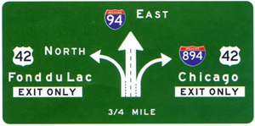
move
Move a VM from one physical node to another
This operation will take some time
  It “saves” the current VM
  Copies the VMs disk file to the new VM container
    If your diskfile is 36 GB, it will move 36 GB across the network
  Then “restores” the VM
# rocks move host vm hosted-vm-0-0-0 vm-container-1-0
© 2009 UC Regents

Slide 41
Other “Internal” Commands
“dump”
  Used on the restore roll to capture VM configuration
“report”
  Called by “rocks start host vm” to create Xen VM configuration files
“remove”
  Called by “rocks remove host” to remove the VM specific info for a host
© 2009 UC Regents

