Slide 1
SOS-based
Environment Informatorium
Speaker: Ekasit Kijsipongse
Large Scale Simulation Research Laboratory
National Electronics and Computer Technology Center
Thailand

Slide 2
Outline
Introduction
Environment Informatorium
Our Collaborators
Demostration
Future Work
Notes:
http://igrid1.lsr.nectec.or.th/SOSPortal/index.html

Slide 3
Data Providers
publish their data via non-standard/standard services:
  Web Map Service (WMS)‏
  Web Feature Service (WFS)‏
  Sensor Observation Service (SOS)‏
self-develop the system to:
- verify users
- show agreement
- keep query log
- evaluate information usage

Slide 4


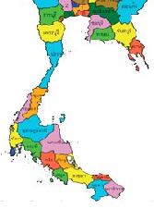

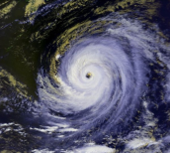



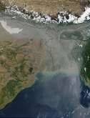
Data Consumers
access various data published via standard services:
aerosol
weather
Land Surface
Temperature
Simulation
wind
storm
current
wave
manually find services' endpoints
subscribe to each service
manually evaluate the potential services
view information using other tools
tidal
Satellite images

Slide 5








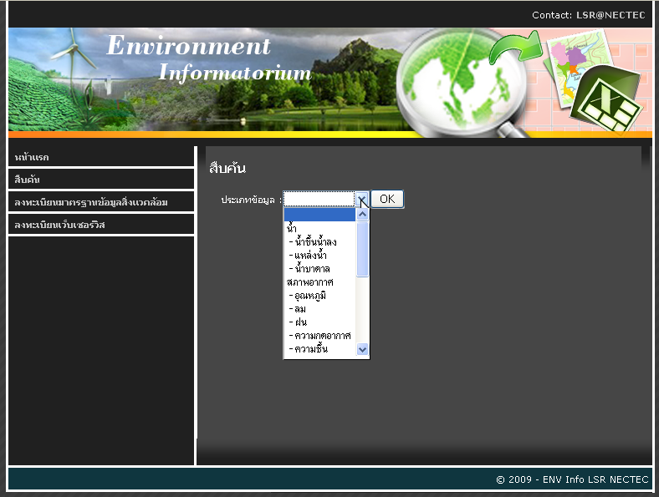







Environment Informatorium
Information Grid
search the desired data from
various services ranked w.r.t. user query &
based on an agreement acceptance
provide mechanism to access data from
a large number of services in an efficient manner
view data via table, graph & map
register service to publish information via portal
view query log
evaluate information usage

Slide 6

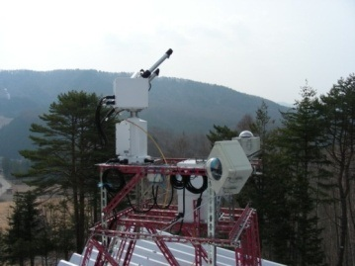
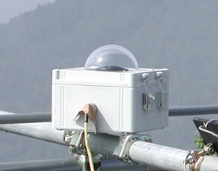
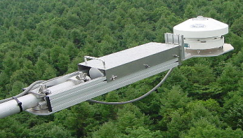

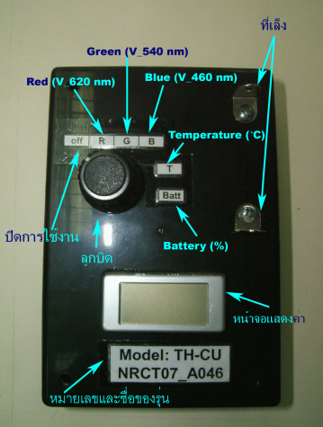
Our Collaborators
Data : aerosol, angstrom
• Sunphoto meter (SP) 400 500 600 nm
• Automatic-capturing Digital Fisheye Camera (ADFC)‏
• Hemi-Spherical Spectral Radiometer (HSSR)
Data : aerosol, pm10
• Sunphoto meter (SP) 460 540 620 nm

Slide 7
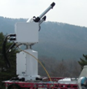




aerosol,angstorm
@GeoGrid
SOS
SOS
aerosol@START
Information Grid
SOS
PM10@START

Slide 8
Future Work
Fulfill Env. Informatorium to be able to
  access information from services in different standards
  view information via graph & map
Collaborate with other organizations to
  publish information through Env. Informatorium
  access information from Env. Information
Notes:
- providers
- tele sci, japan
- marine department, Thailand

Slide 9
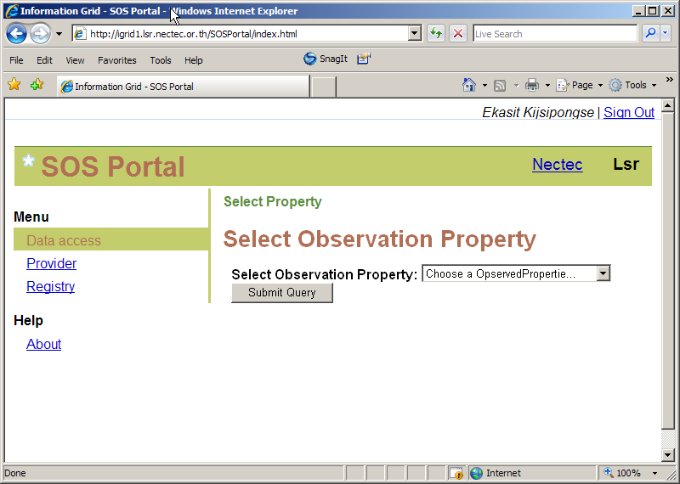

Slide 10
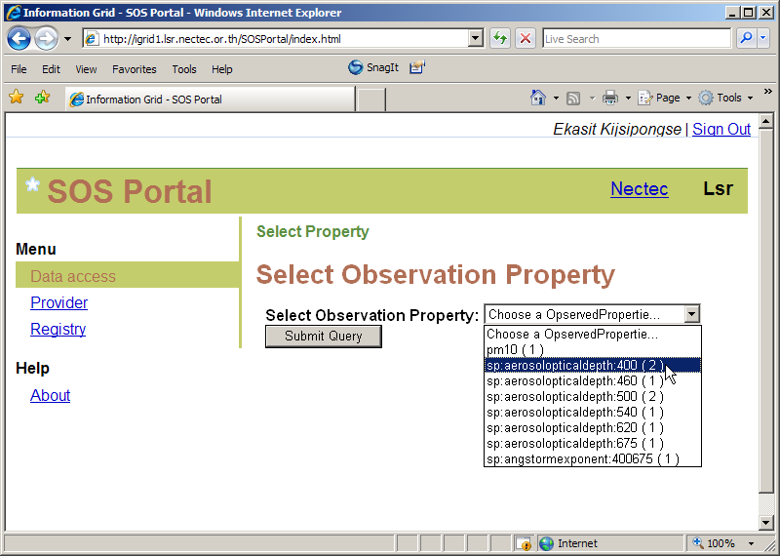

Slide 11
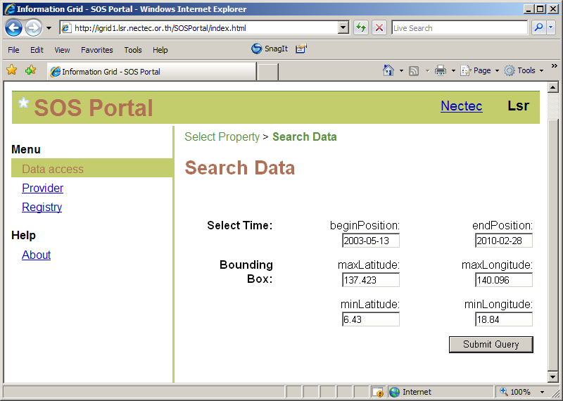

Slide 12
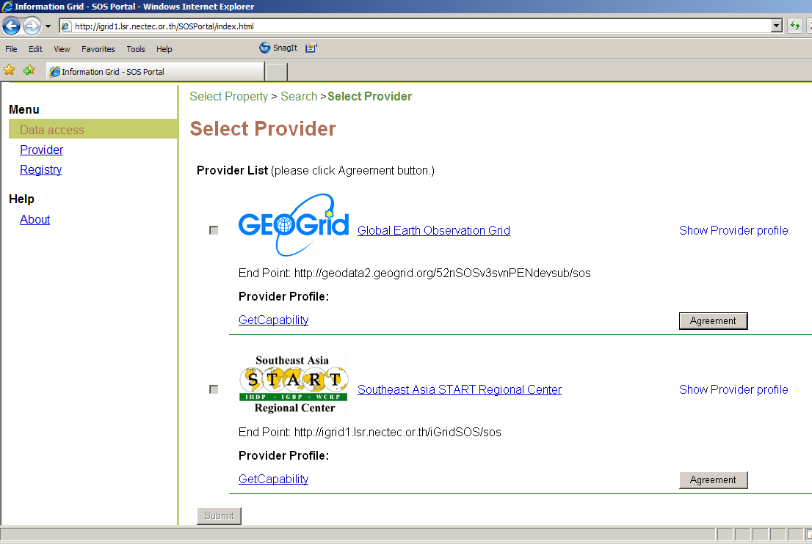
Notes:
GetCapability returns service description containing supported operations, version, available data.

Slide 13
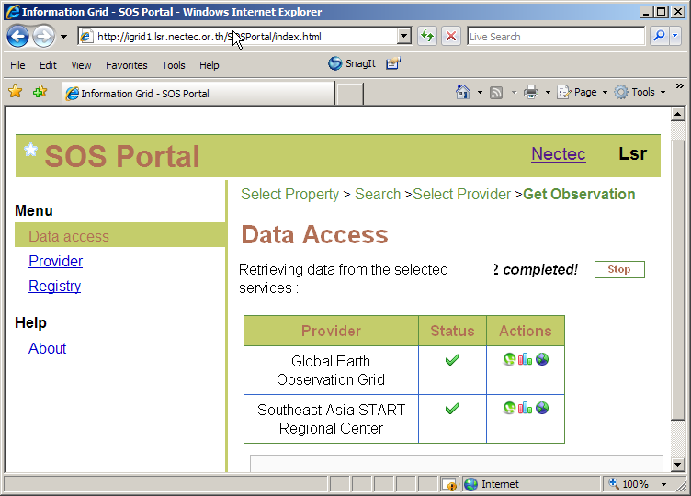

Slide 14
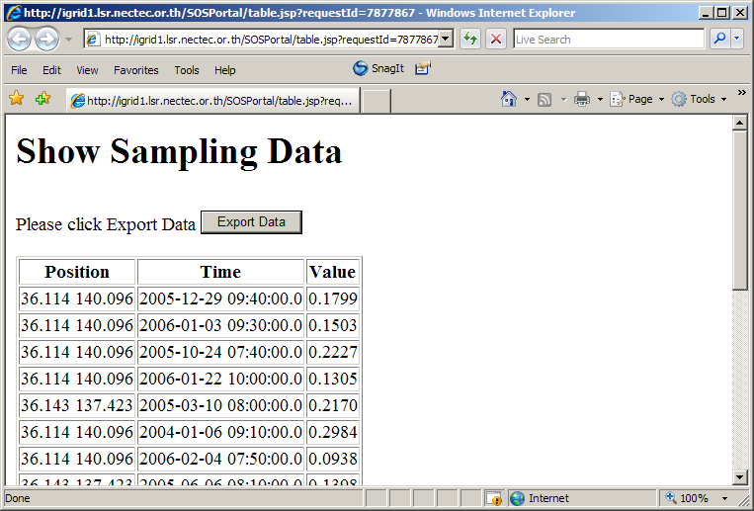

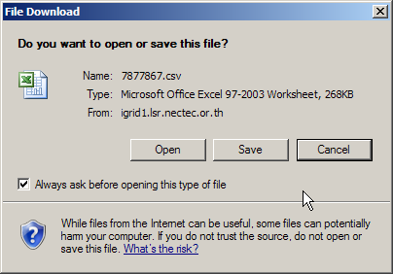

Slide 15
