Slide 1
Researcher: Ji CHEN
Department of Civil Engineering
The University of Hong Kong, Pokfulam

Slide 2
Large-scale
Water Resources Management

Slide 3
Large-Scale Water Resources Management
Project Description
  to investigate the status of water resources over the main four river basins, the Yangtze River, the Yellow River, the Haihe and the Huaihe, in China
  to understand the on-going South to North Water Diversion Project (SNWDP) in China
  to identify the different usages of the diverted water
  to study the effects of the diverted water on the evapotranspiration over the northern China
Project Duration
  September 2004 to August 2007

Slide 4
Large-Scale Water Resources Management
Project Achievements
  The three water diversion routes in the SNWDP will influence on the evaporation differently. In the east route, the increased evaporation is about 0.13%, the middle route is about 0.53% and the west route is about 1.04%.
Using High Performance Computing Cluster
  The HPC in HKUCC provides the basic platform for fulfilling the computation requirements of the project

Slide 5
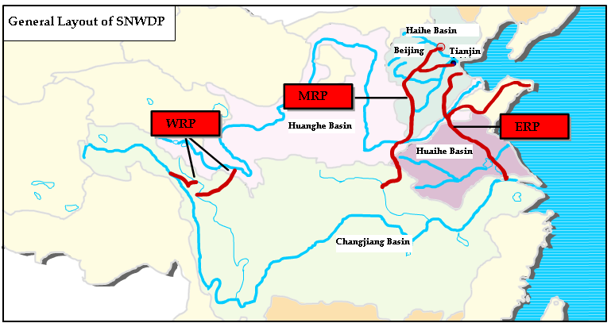
SNWDP
Source: [http://www.nsbd.gov.cn]

Slide 6
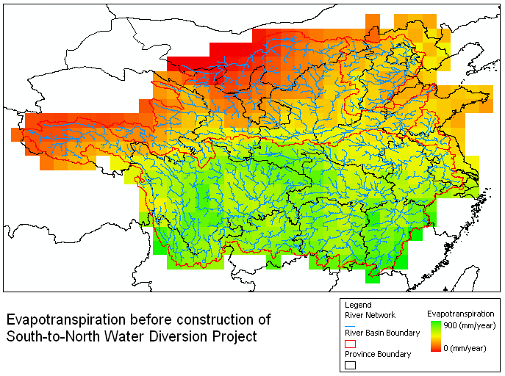

Slide 7
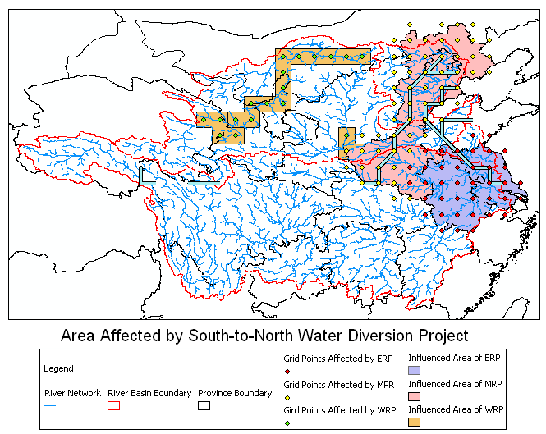

Slide 8
