Slide 1
Resource WG Summary
@ PRAGMA 18
Mason Katz, Yoshio Tanaka

Slide 2

Homework from P17

Slide 3
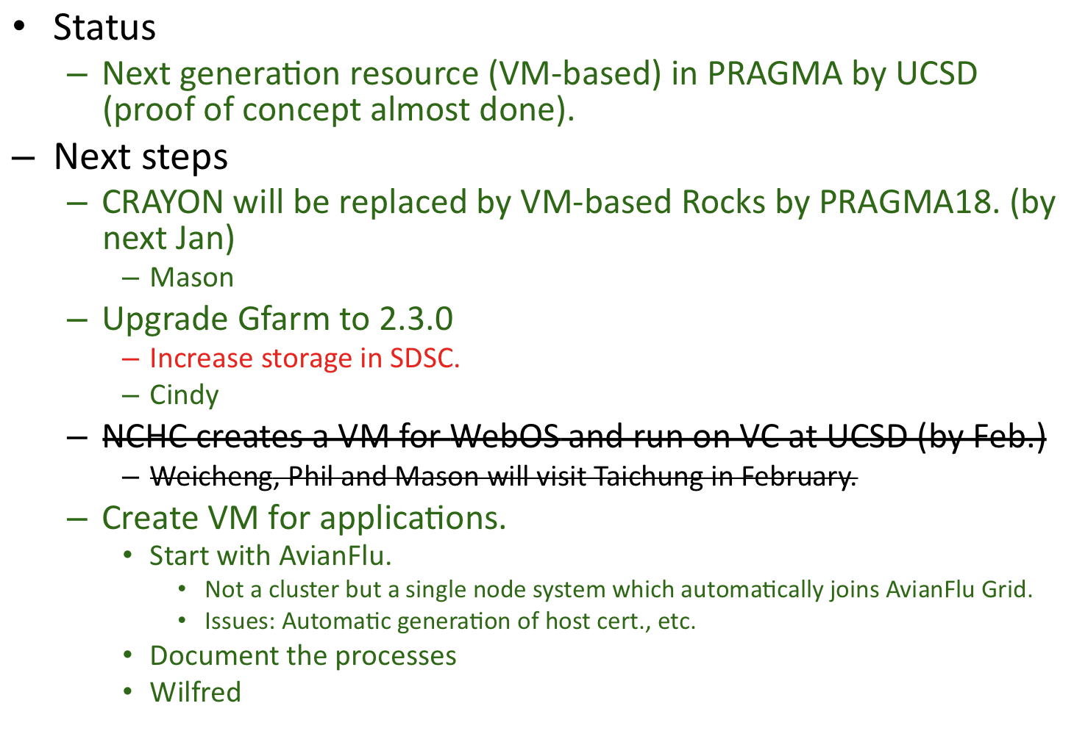
Next generation resources on PRAGMA

Slide 4
GEO+Resource breakout
Requirements for Tsukuba-GAMA
  MyProxy CA, MyProxy Repository, Web server
  Gridsphere
  Can be installed on a single server
  Installation on CentOS 5 must be easy.
AIST will complete development and distribute (by SC09)
San Diego will host Tsukuba-GAMA
Cindy will be the CA (Tsukuba-GAMA) operator
Run this on VM
Procedure
  Yoshio and Ryosuke will summarize procedure for issuing certificates.
    Draft CP/CPS (By Dec.)
Timeline
  Everything by PRAGMA 18

Slide 5
P18 Agenda
Day 1
  VM-based Infrastructure
  Gfarm
Day 2
  Tsukuba-GAMA
  Migration from traditional Grid to VM-based infrastructure

Slide 6
VC: Status and next steps
Applications implemented by VC
  Tsukuba GAMA
  Gfarm
  Nimrod + Condor + EC2
Next steps for Grarm
  Gfarm roll release (clsuter fs only for now)
    Users guide
    By Mason (by end of March)
  Enhance Gfarm roll for Grid
    Shared secret key copied from gfarm, _gfarmfs user
    FS nodes require public internet access
    Single Meta Data server
    By mason (by end of March)
  Gfarm on UCSD Server
    Solaris server (ordered today)
      gfsd can here
      Or export iSCSI, NFS
      Ability to replicate/snapshot data
    Gfmd on linux frontend (16GB mem)
    End of March
  Get Gfarm (as grid) running on two VC @ UCSD
    By Mason in 2 months
    Grow to AIST next

Slide 7
VC: Status and next steps
Next steps for Nimrod
  Finish EC2 Condor connection on UCSD Nimrod VC
  Done yesterday
Nimrod / Condor connection
  Done yesterday
Release Nimrod Roll
  Still being developed
  Blair, Phil, Mason by PRAGMA 19

Slide 8
Migration from traditional Grid to VM-based Infrastructure
How to be a VM-enabled site?
  Cluster running Xen.
    Rocks 5.3
    PIAX+OpenVPN+Xen (Osaka)
  Add VM-enabled sites
    Osaka
    Zurich as soon as migrate to 5.3
    Cindy will send emails to PRAGMA ML
    Phil/Mason will write necessary information
  VM replicate and move test between (1) UCSD-UCSD, (2) AIST-UCSD
    Both are using Rocks 5.3
    Avian Flu and Nimrod are sample applications
    In next few weeks
  Discuss with Date-sensei if Osaka system is appropriate for PRAGMA-wide VC
    Test on PRAGMA by PRAGMA19

Slide 9
Tsukuba-GAMA
Vlad will ask Sam how to make automatic registration via VOMRS. Cc to Cindy.
Implement VOMRS interface in Tsukuba-GAMA (Yamamoto)
  Schedule depends on the VOMRS interface
Observe what happens in GEO WG.
CRL
  Sync between front-end and compute node
  Cindy

Slide 10
PRAGMA Implementation Day
Good experiment
  Hadoop/Gfarm demo
  Gfarm Roll – to be released
  Nimrod/Condor/EC2 demo
  Nimrod Roll – to be released
Would like to repeat
  Focus on local work
  This time was Rocks since we are at UCSD
  Next time CSF4, Gfarm, AFG?

