Slide 1
Introduction of PRAGMA routine-basis experiments
Yoshio Tanaka (yoshio.tanaka@aist.go.jp)
PRAGMA
Grid Technology Research Center, AIST, Japan

Slide 2
Grid Communities in Asia Pacific – at a glance –
ApGrid: Asia Pacific Partnership for Grid Computing
  Open Community as a focal point
    more than 40 member institutions from 15 economics
  Kick-off meeting: July 2000, 1st workshop: Sep. 2001
PRAGMA: Pacific Rim Applications and Grid Middleware Assembly
  NSF funded project led by UCSD/SDSC
    19 member institutions
  Establish sustained collaborations and advance the use of the grid technologies
  1st workshop: Mar. 2002, 10th workshop: next month!
APAN (Asia Pacific Advanced Network) Grid Committee
  Bridging APAN application communities and Grid communities outside of APAN
  Grid WG was launched in 2002, re-organized as a committee in 2005
APGrid PMA: Asia Pacific Grid Policy Management Authority
  General Policy Management Authority in the Asia Pacific Region
    16 member CAs
  A founding member of the IGTF (International Grid Trust Federation)
  Officially started in June 2004
APEC/TEL APGrid
  Building social framework
  Semi-annual workshops
APAN (Asia Pacific Advanced Network) Middleware WG
  Share experiences on middleware.
  Recent topics include ID management and National Middleware Efforts.
  Approved in January 2006.

Slide 3
PRAGMA routine-basis experiments
Most slides are by courtesy of
Mason Katz and Cindy Zheng (SDSC/PRAGMA)

Slide 4
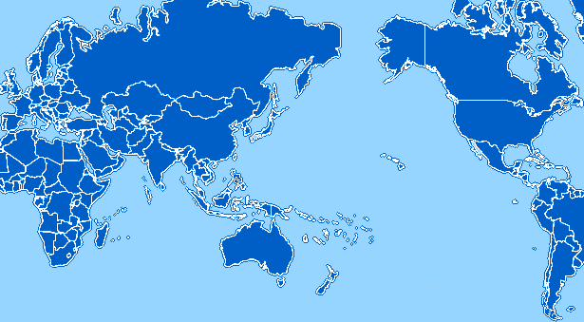
PRAGMA Grid Testbed
UZurich, Switzerland
NCSA, USA
KISTI, Korea
CNIC, China
UMC, USA
AIST, Japan
GUCAS, China
TITECH, Japan
SDSC, USA
UoHyd, India
NCHC, Taiwan
CICESE, Mexico
KU, Thailand
ASCC, Taiwan
UNAM, Mexico
USM, Malaysia
BII, Singapore
MU, Australia
UChile, Chile
http://pragma-goc.rocksclusters.org

Slide 5
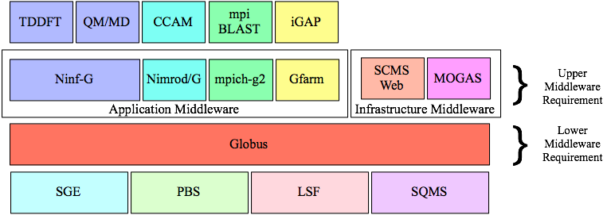
Application vs. Infrastructure Middleware

Slide 6
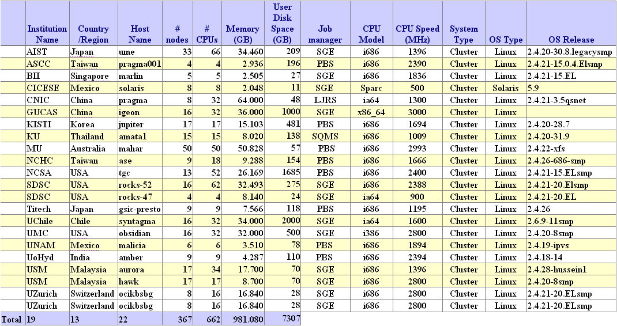
PRAGMA Grid resources http://pragma-goc.rocksclusters.org/pragma-doc/resources.html

Slide 7
Features of PRGMA Grid
Grass-root approach
  No single source of funding for testbed development
  Each site contributes its resources (computers, networks, human resources, etc.)
Operated/maintained by administrators of each site.
  Most site admins are not dedicated for the operation.
Small-scale clusters (several 10s CPUs) are geographically distributed in the Asia Pacific Region.
Networking is there (APAN/TransPAC), but performance (throughput and latency) is not enough.
Aggregated #cpus is more than 600 and still increasing.
Really an international Grid across national boundary.
Give middleware developers, application developers and users many valuable insights through experiments on this real Grid infrastructure.

Slide 8
Why Routine-basis Experiments?
Resources group Missions and goals
  Improve interoperability of Grid middleware
  Improve usability and productivity of global grid
PRAGMA from March, 2002 to May, 2004
  Computation resources
  10 countries/regions, 26 institutions, 27 clusters, 889 CPUs
  Technologies (Ninf-G, Nimrod, SCE, Gfarm, etc.)
  Collaboration projects (Gamess, EOL, etc.)
  Grid is still hard to use, especially global grid
How to make a global grid easy to use?
  More organized testbed operation
  Full-scale and integrated testing/research
  Long daily application runs
  Find problems, develop/research/test solutions

Slide 9
Routine-basis Experiments
Initiated in May 2004 PRAGMA6 workshop
Testbed
  Voluntary contribution (8 -> 17)
  Computational resources first
  Production grid is the goal
Applications
  TDDFT, mpiBlast-g2, Savannah, QM/MD
  iGAP over Gfarm
  Ocean science, Geoscience (proposed)
Learn requirements/issues
Research/implement solutions
Improve application/middleware/infrastructure integrations
Collaboration, coordination, consensus

Slide 10
Rough steps of the experiment
Players:
  A conductor
  An application driver
  Site administrators
Select an application and an application driver
The application driver prepares a web page that describes software requirements (prerequisite software, architecture, public/private IP addresses, disk usage, etc.) of the application. Then, the application driver informs the conductor that the web page is ready.
The conductor ask site administrators to (1) create an account for the driver (including adding an entry to grid-mapfile, and CA certificate/policy file), and (2) install necessary software listed on the web site.
Each site admin let the conductor and the application driver know when she/he has done account creation and software installation.
The application driver login and test the new site. If she/he finds any problems, she/he will directly contact to the site admin.
The application driver will start main (long-run) experiment when she/he decides the environment has been ready.

Slide 11
Progress at a Glance
May
June
July
Aug
Sep
Oct
Nov
Dec - Mar
2 sites
5 sites
8 sites
10 sites
12 sites
14 sites
2nd user start executions
1st App. start
1st App. end
2nd App. start
3rd App. start
Setup Resource Monitor (SCMSWeb)
PRAGMA6
Setup Grid
Operation Center
PRAGMA7
SC’04
On-going works
1. Site admins install required software
2. Site admins create users accounts (CA, DN, SSH, firewall)
3. Users test access
4. Users deploy application codes
5. Users perform simple tests at local sites
6. Users perform simple tests between 2 sites
Join in the main executions (long runs) after all’s done

Slide 12

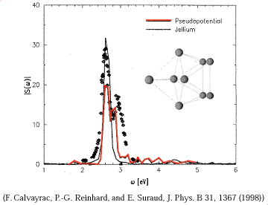

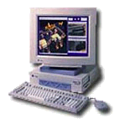

1st application
Time-Dependent Density Functional Theory (TDDFT)
Computational quantum chemistry application
Driver: Yusuke Tanimura (AIST, Japan)
Require GT2, Fortran 7 or 8, Ninf-G2
6/1/04 ~ 8/31/04
gatekeeper
Cluster 1
Sequential program
Exec func() on backends
Client
Server
tddft_func()
Client program of TDDFT
main(){
:
grpc_function_handle_default(
&server, “tddft_func”);
:
grpc_call(&server, input, result);
:
4.87MB
3.25MB
Cluster 2
GridRPC
Cluster 3
Cluster 4
user
http://pragma-goc.rocksclusters.org/tddft/default.html

Slide 13
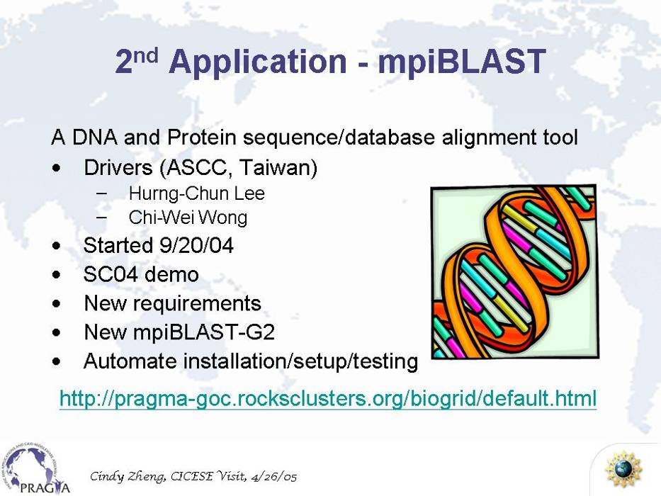
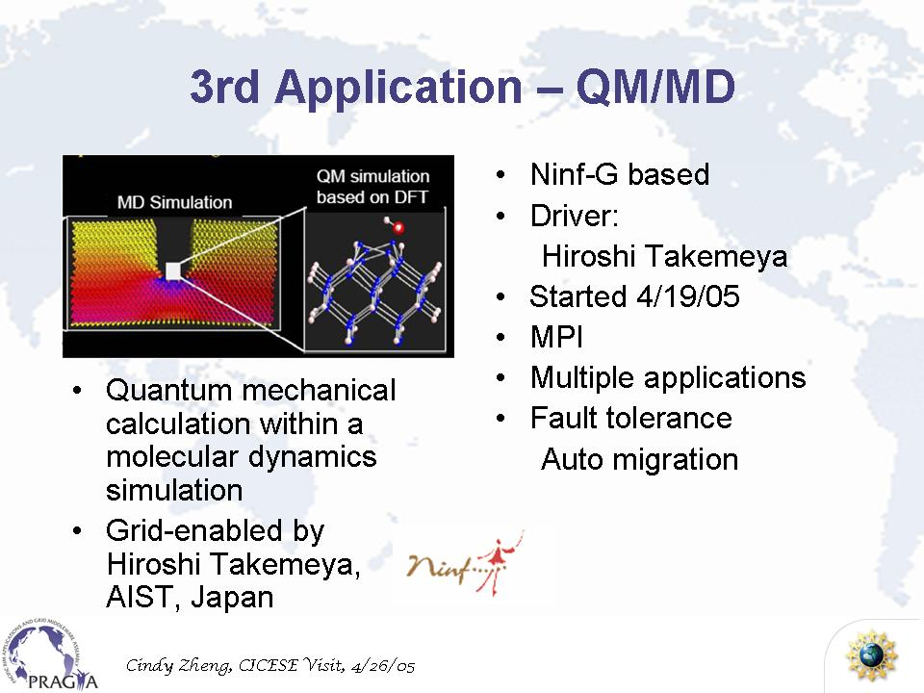
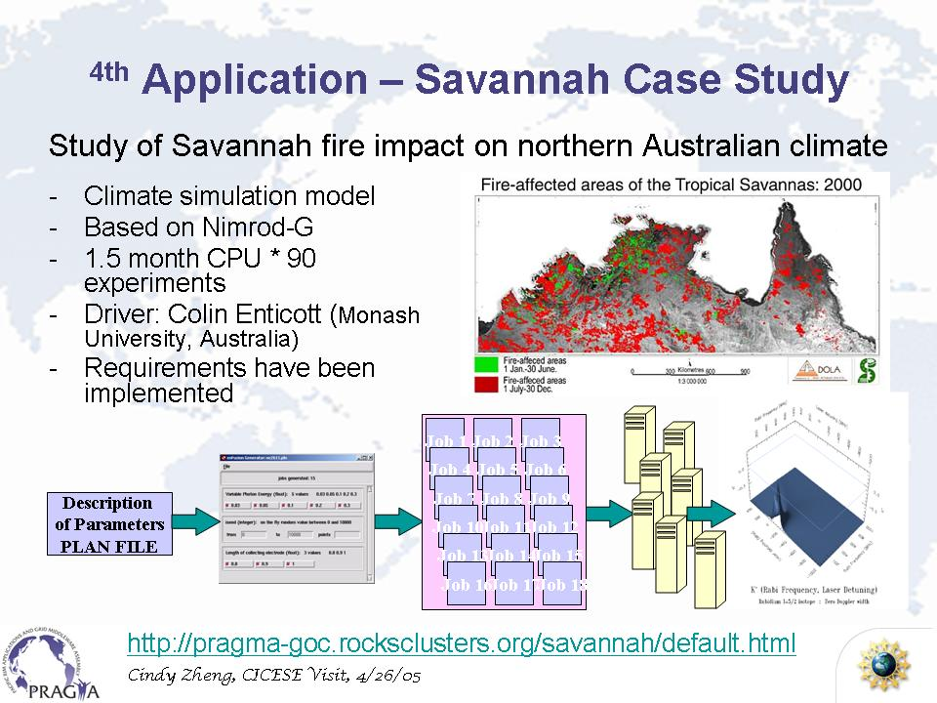
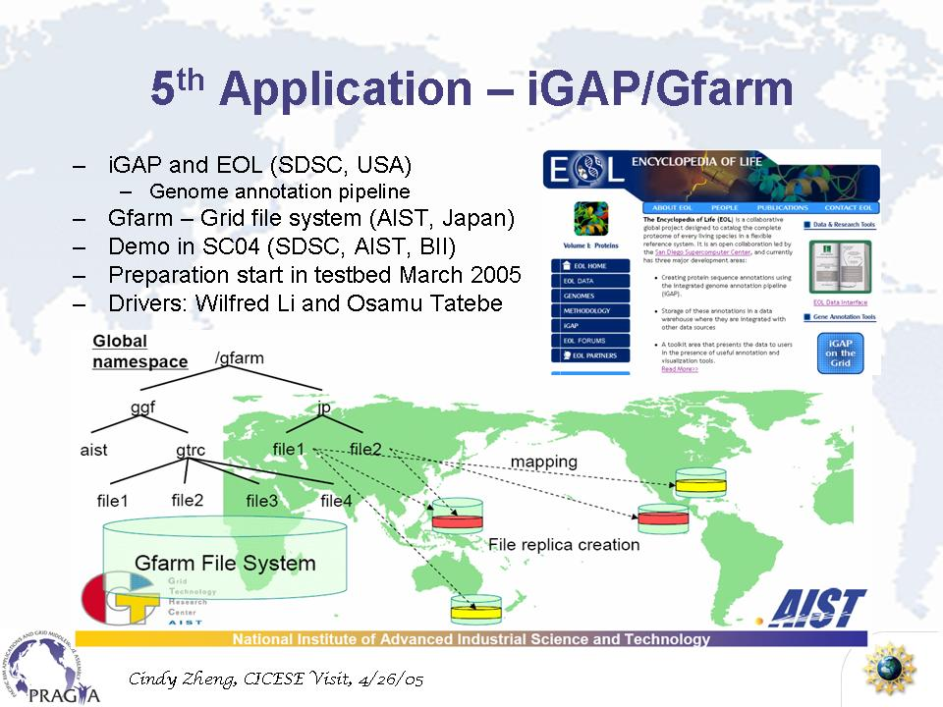
Routine Use Applications

Slide 14
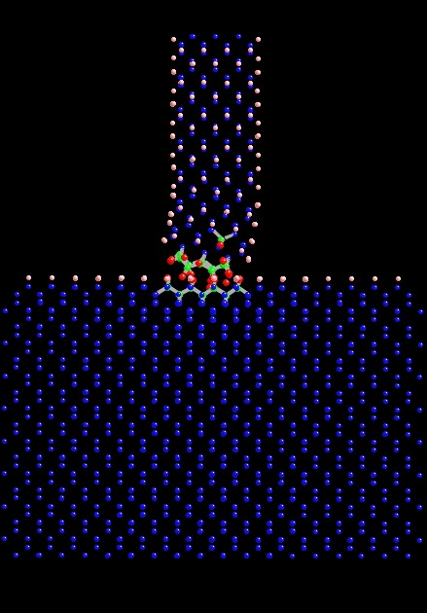
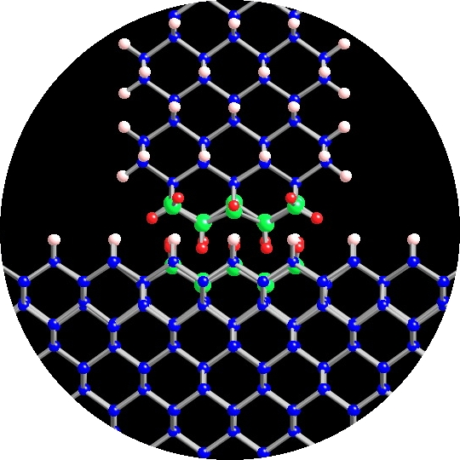
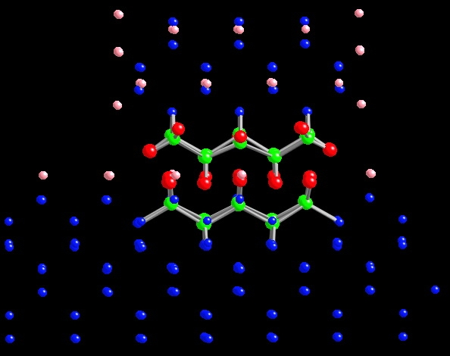
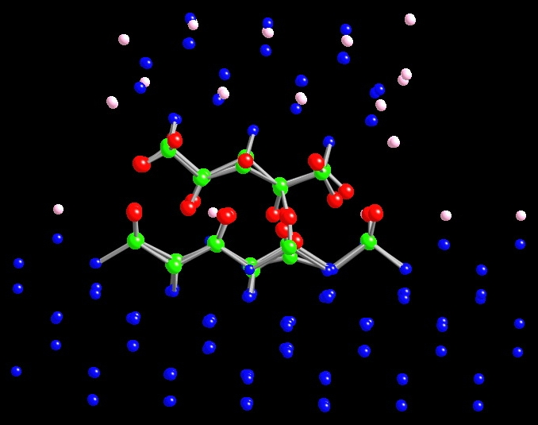
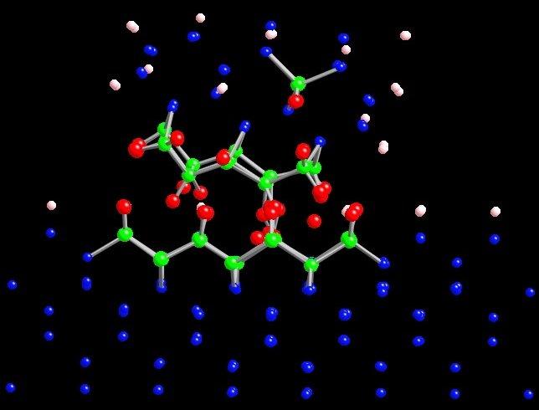
QM/MD simulation of
Atomic-scale Stick-Slip Phenomenon
Nanoscale-Tip
under strain
H-saturated
Si(100)
40Å
motion
Initial Status
After 520 fs (image)
15fs
300fs
525fs
(1) Number of atoms in a
QM region is small
(2) Number of atoms in a QM
region has been increased
(3) One QM region has been
splitted into two QM regions

Slide 15
180
180
160
160
140
140
Number of CPUs
120
120
Number of atoms
100
100
80
80
60
60
40
40
20
20
0
0
50
100
150
200
250
300
350
Elapsed Time Steps
: Total number of QM atoms
: Number of CPUs used for main QM simulation
: Number of CPUs used for sub QM simulations

Slide 16
Lessons Learned http://pragma-goc.rocksclusters.org/
Grid Operator’s point of view
  Preparing a web page is good to understand necessary operation.
    But should be described in more detail as much as possible
  Grid-enabled MPI is ill-suited to Grid
    difficult to support co-allocation
    private IP address nodes are not usable
    (performance, fault tolerance, etc…)
Middleware developer’s point of view
  Observed may kinds of faults (some of them were difficult to detect)
    Improved capabilities for fault detection
      e.g. heartbeat, timeout, etc.
Application user (driver)’s point of view
  Heterogeneity in various layers
    Hardware/software configuration of clusters
      Front node, compute nodes, compile nodes
      public IP, private IP
      File system
      Configuration of batch system
      …
    Need to check the configuration when the driver accessed to the site for the first time
  Not easy to trace jobs (check the status of jobs / queues)
  Clusters were sometimes not clean (zombie processes were there).

Slide 17
Summary: Collaboration is the key
Non-technical, most important
Different funding sources
How to get enough resources
How to get people to act, together
  how to motivate them to participate in
Mutual interests, collective goals
Cultivate collaborative spirit
Key to PRAGMA’s success
Experiences on the routine-basis experiments helped experiments on multi-grid interoperation between PRAGMA and TeraGrid.
  Details will be presented by Phil P. this afternoon ☺

