Slide 1
GIN Testbed Status
5/11/2006
Peter Arzberger, Cindy Zheng
http://goc.pragma-grid.net/gin

Slide 2
Grids and People
EGEE
  Erwin Laure, Olivier van der Aa, Mona Aggarwal, Oscar Koeroo, etc.
PRAGMA
  Peter Arzberger, Phil Papadoupolos, Mason Katz, Cindy Zheng, Yoshio Tanaka, Yusuke Tanimura, Somsak Sriprayoonsakul, Putchong Uthayopas etc.
TeraGrid
  Charlie Catlett, Dane Skow, JP Navarro, Laura Pearlman etc.

Slide 3
First Application and Middleware Test
TDDFT/Ninf-G
  Lead: Yoshio Tanaka, Yusuke Tanimura (AIST)
  Deployed and run
    PRAGMA - AIST, NCSA, SDSC
    TeraGrid – ANL
  Working on deployment to EGEE – LCG
    Middleware interoperability problem
      Assumptions by middleware about local architecture are the main cause – bad idea
        head node, home directory, etc.
    New version of Ninf-G should resolve current problem
      Release today
      Resume deployment and testing after GGF17

Slide 4
Lessons Learned, Issues and Work (1)
Progress
  Committed individuals
Authentication
  People involved so far
    gin-auth, gin-ops, Globus people
  User obtain initial access
    Process documented by Cindy Zheng, http://pragma-goc.rocksclusters.org/gin/gin-egee.htm
    Not easy, not simple
    Need documentation to guide users
    Need to simply the process. How? Can this be tied to any other GIN working groups effort?
  DN incompatibility
    Summarized by Oscar Koeroo, http://goc.pragma-grid.net/gin/Cert-probs-GIN.pdf
    Commented by Charles Bacon (Globus), http://goc.pragma-grid.net/gin/DN_Charles-Bacon.htm
    Need both standard and flexibility
    Voms server is modified to handle both styles of DN strings

Slide 5
Lessons Learned, Issues and Work (2)
Software stack and Community Software Area (CSA)
  People involved so far
    JP Navarro, Yoshio Tanaka, Yusuke Tanimura, Mason Katz, etc.
  Software stack is different among grids. Problems with conflicting requirements.
    CSA as a solution for users to deploy their sub-stack and share installed software
  JP Navarro will summarize the discussions
  Near term - work on CSA within each grid
  Need focused discussion on solution for GIN
  Any other GIN working groups are working on related issues?

Slide 6
Lessons Learned, Issues and Work (3)
Cross-grid monitoring
  Need to view/monitor jobs/resources in GIN environment
  People involved so far:
    Somsak Sriprayoonsakul, JP Navarro, Laura Pearlman, Oxana Smirnova, Ben Evans, etc.
  Summary by Somsak Sriprayoonsakul, http://goc.pragma-grid.net/gin/gin-monitor.htm
    Get some monitoring software together, develop a common schema
  Wiki - http://wiki.pragma-grid.net/index.php?title=GIN_%28Grid_Inter-operation_Now%29_Monitoring
  Multiple ideas and works should be fine
  Needs more communication with gin-info. (Other groups?) How to do that.

Slide 7
Questions
How do we communicate our lessons learned to GIN community and beyond?
How do we get enough human resources for work?
Do we expand the activity? If so:
  Do we grow the number of grids in participating in the testbed?
  Do we start a second application?
    Possible candidate: Savanah Study (Climate simulation; greater data needs)
      Middleware – Nimrod/G
      David Abramson, Colin Enticott, Monash University, Australia
      Requirements: user account, GT2,3,4, 75GB user disk space
  Do we focus next on a simplest application that runs easily on most machines (e.g. Hello World)
    To systematically document process
    To involve more grids

Slide 8
Proposed Next Steps
More communications between groups
  Group leads on all groups mailing lists?
  Combined list to post info/status from all groups?
Complete TDDFT / Ninf-G interoperation between PRAGMA, TeraGrid, EGEE
Community Software Area
  Work on within each grid
  Need to discuss/work on what to do for GIN.
Cross-grid monitoring
  Support grass-root effort
  Encourage exchange ideas/info with other groups
New application/middleware testcase
  Hello World?
  Something already on EGEE, TeraGrid ..?
  Nimrod/Savanah?
More grids?
Recommendation of an immediate GIN activity…
  Need committed people

Slide 9
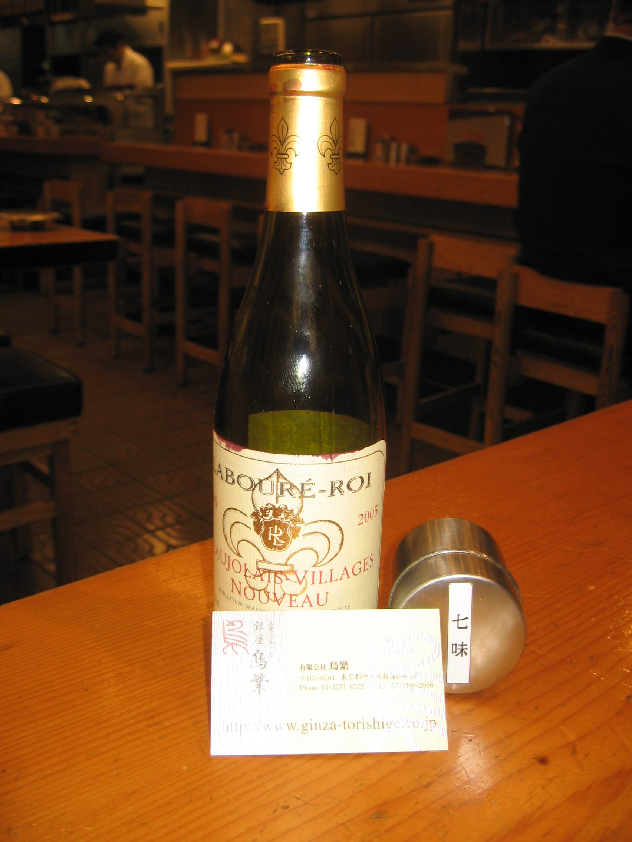
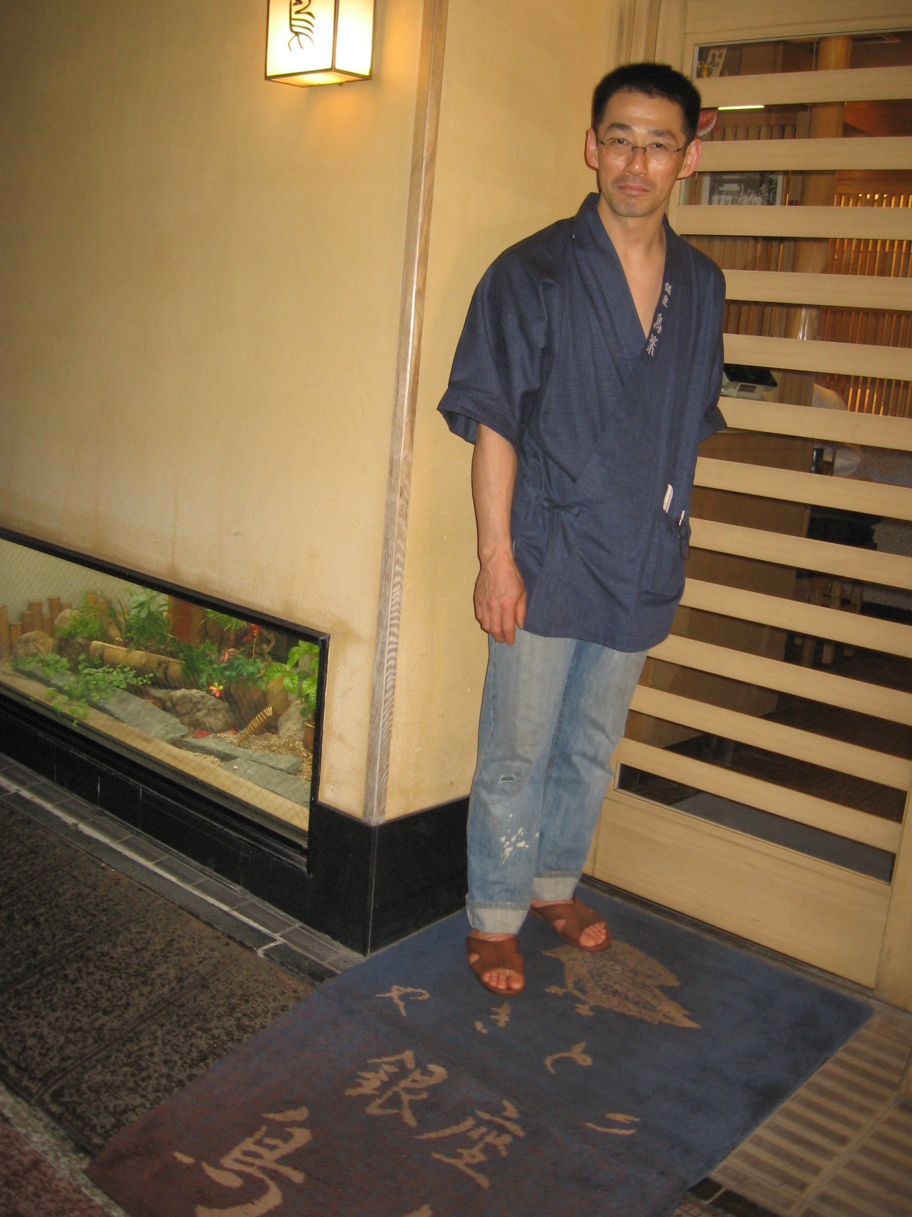
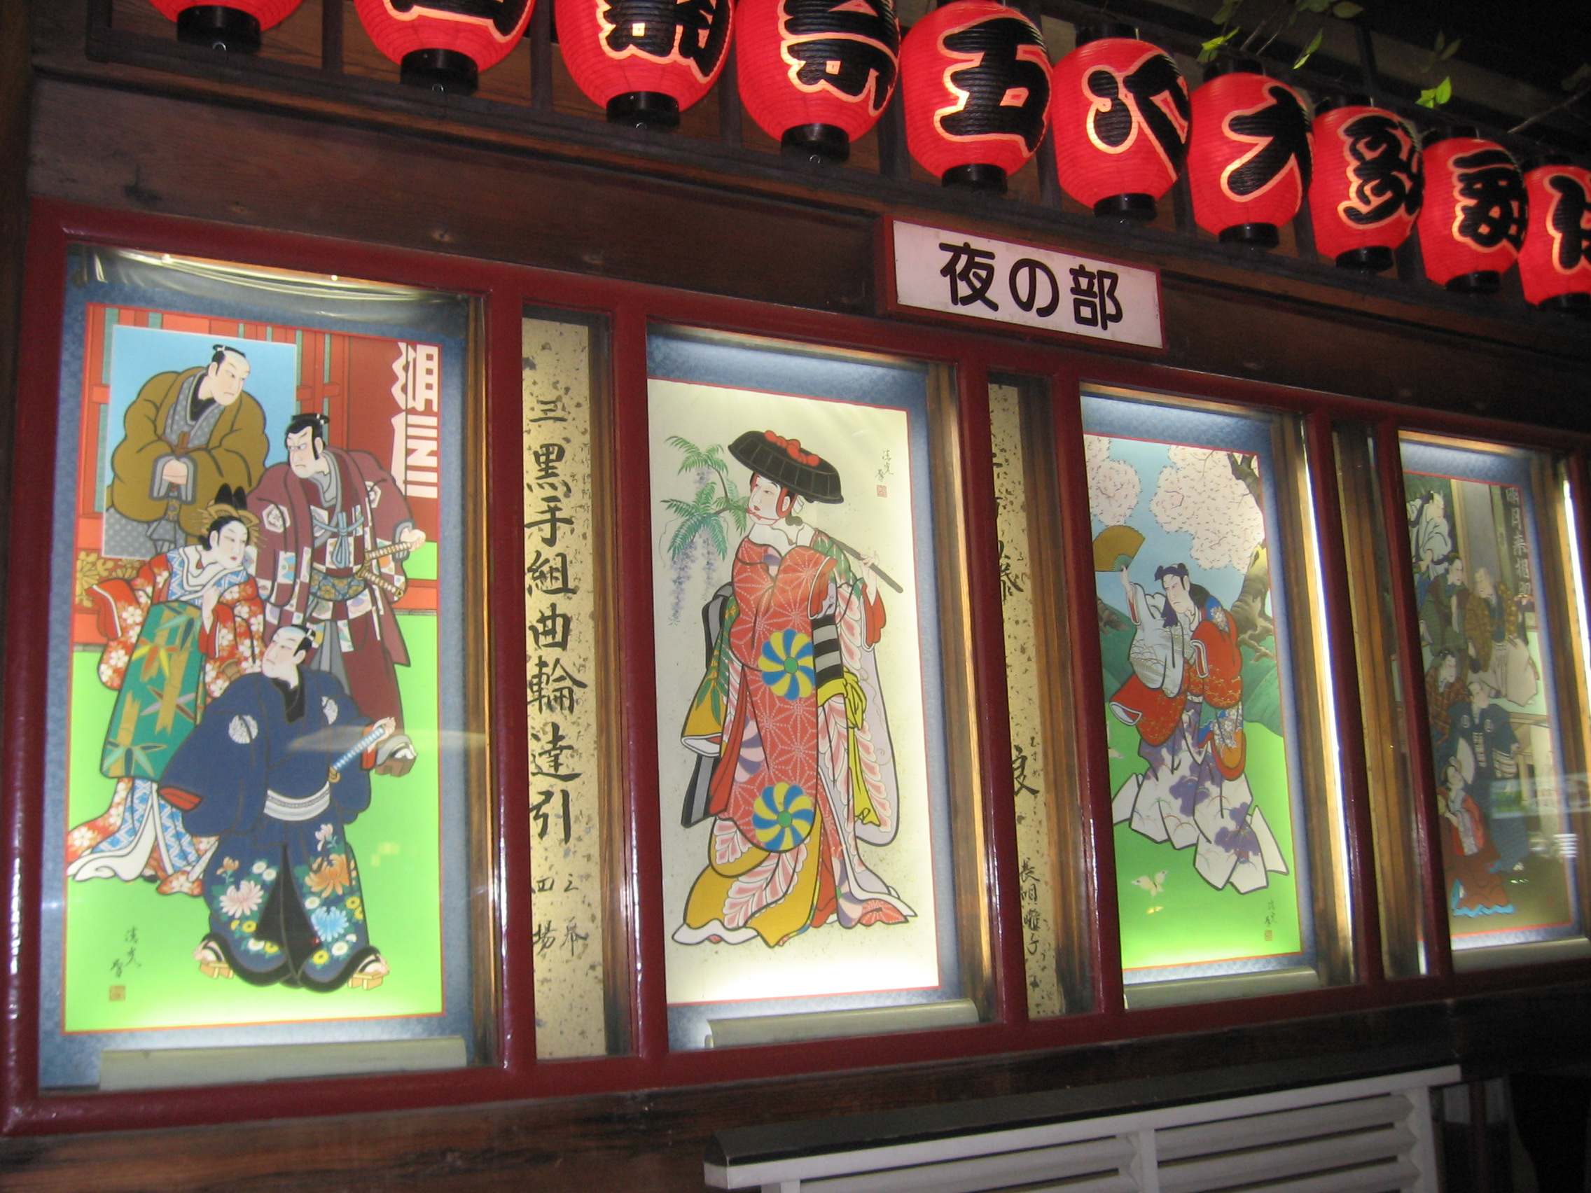
Enjoy Kabuki at Kabuki-ZA
Feast at Ginza
Drink GIN

