Slide 1


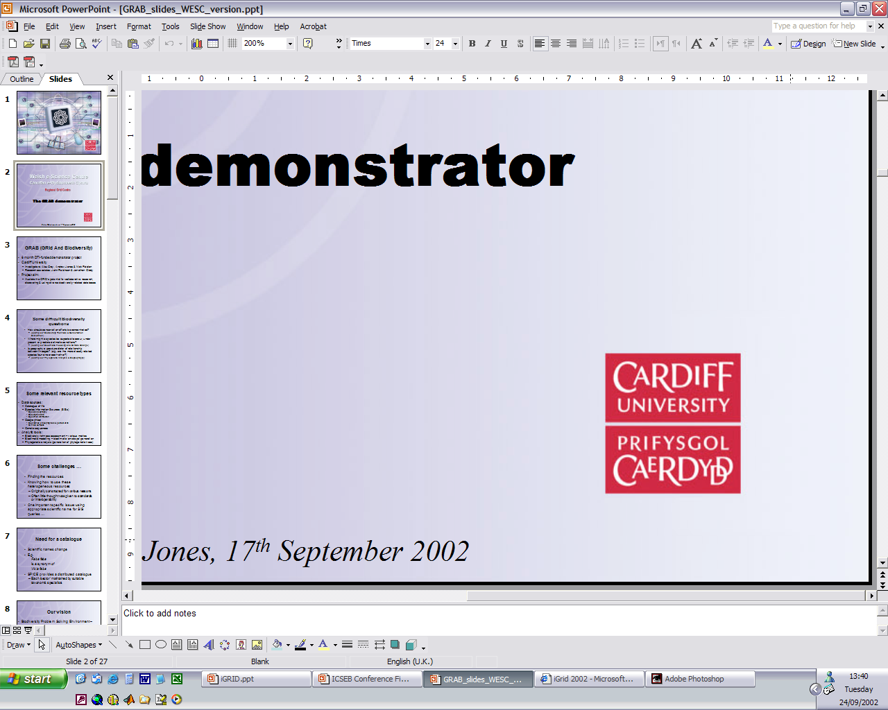


BiodiversityWorld: a GRID-based problem solving environment for global biodiversity
Frank Bisby, Alastair Culham, Alex Gray, Nick Fiddian, Andrew Jones, Malcolm Scoble, Paul Valdes, Richard White,
Peter Brewer, Oliver Bromley, Neil Caithness, Nick Pittas, Tim Sutton, Xuebiao Xu
www.bdworld.org

Slide 2
THE CHALLENGE
Some difficult Biodiversity questions
How should conservation efforts be concentrated?
  (example of Biodiversity Richness & Conservation Evaluation)
Where might a species be expected to occur, under present or predicted climatic conditions?
  (example of Bioclimatic modelling and Climate Change)
Is geography a good predictor of relationship between lineages? (e.g. are the more closely related species found near each other?)
  (example of Phylogenetic Analysis & Biogeography)

Slide 3
BDWorld origins
LITCHI improving quality of catalogue of life
SPICE establishing a catalogue of life
GRAB proof of concept demonstrator

Slide 4
CURRENT STATUS of ORIGINS
LITCHI NEEDS RE-ENGINEERING
SPICE NEEDS EXTENSION OF DATA
GRAB DEMONSTRATOR WORKS
CONTINUING IN NEW PROJECTS
  ENBI, EUROCAT, BDWorld

Slide 5
Our vision
Biodiversity Problem Solving Environment –
  Heterogeneous diverse resources
  Flexible workflows
  Main challenges centre around metadata, interoperability, ontologies, etc;
  High-performance computing secondary (though relevant)
  ‘collaboratorium’: collaborative environment in which each resource community can collaborate with the others
  ‘excessively distributed resources’: biodiversity data systems are scattered in all countries and in multiple agencies within each country

Slide 6
Need for a Catalogue of Life
Scientific names change
Synonyms – common plus previous
E.g.
  Faba faba
  is a synonym of
  Vicia faba
Species 2000 provides a distributed catalogue
  Each ‘sector’ maintained by suitable taxonomic specialists

Slide 7
Basic uses of catalogue
Checking taxonomy
Access or store data about species
  Observations etc
  Links accepted name & sysnonyms
  Exhaustive retrieval use all names
  Intelligent linkage

Slide 8
GRAB (GRid And Biodiversity)
6 month DTI-funded demonstrator project
Cardiff University
  Investigators: Alex Gray, Andrew Jones & Nick Fiddian
  Research associates: John Robinson & Jonathan Giddy
Project aim:
  illustrate the GRID’s potential for collaborative research,
  discovering & using diverse biodiversity-related databases

Slide 9
Test scenario
Find species in the catalogue
Retrieve species information:
  Synonyms & Common Names
  Geography
  Images
Retrieve climate information
Search for species within specified climate envelope
Do the above iteratively if desired

Slide 10
GRAB resource types
Catalogue
of life
SIS
SIS
Climate
...
GRAB resource clients
GRAB interface
Catalogue of life
  Scientific & common names
Species Information System (SIS)
  Images; geography
Climate
  Max/min temperature; annual precipitation

Slide 11
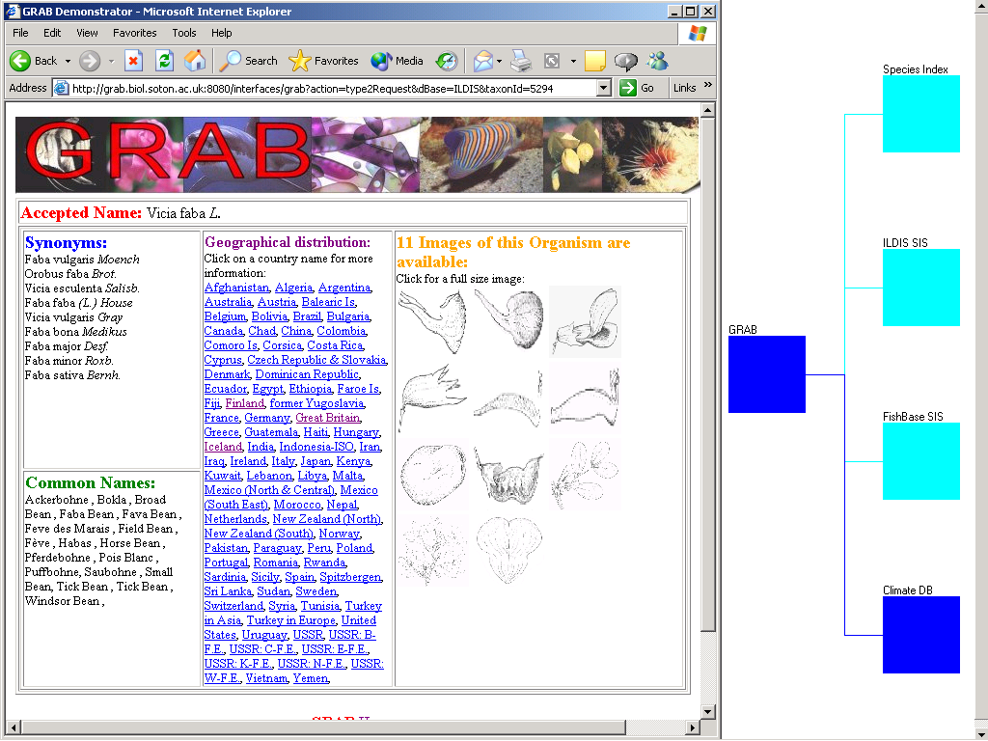
Typical GRAB display
Applet
monitoring
communication
between GRAB
server and
GRAB
databases
Web browser
‘front-end’ to
the GRAB
server

Slide 12
Using Globus …
We have used Globus to give us:
  Invokable services (GRAM) and retrieval of results (GASS)
  Security (single log-on – GASS)
  (Elementary!) resource discovery; exploitation of metadata (MDS)
Potentially:
  Seamless interface to computationally intensive modelling; load balancing, etc.

Slide 13
Sample metadata (for SIS)
Search for a particular kind of database:
(&(objectClass=GrabTaxonDatabase)(Grab-Taxon-name=ILDIS))
MDS data
{dn=Grab-Taxon-name=ILDIS, Mds-Vo-name=local, o=Grid
objectClass=GrabTaxonDatabase
Grab-Taxon-name=ILDIS
Mds-keepto=200206301146.24Z
Mds-validto=200206301146.24Z
Mds-validfrom=200205291146.24Z
Grab-Taxon-contact=grab.biol.soton.ac.uk
Grab-Taxon-higherTaxon=Leguminosae
Grab-Taxon-executable=
/home/globus/mybin/ILDISImageInterfaceServer}
Could easily alter to search for database by higherTaxon instead of name

Slide 14
THE CHALLENGE
Some difficult Biodiversity questions
How should conservation efforts be concentrated?
  (example of Biodiversity Richness & Conservation Evaluation)
Where might a species be expected to occur, under present or predicted climatic conditions?
  (example of Bioclimatic modelling and Climate Change)
Is geography a good predictor of relationship between lineages? (e.g. are the more closely related species found near each other?)
  (example of Phylogenetic Analysis & Biogeography)

Slide 15
Next steps:
BiodiversityWorld (BDWorld) on the GRID:
  Universities of Reading, Cardiff and Southampton; Natural History Museum (BBSRC-funded)
  Development of appropriate middleware, linking to:
    existing partial catalogue of life (SPICE)
    thematic data sources, and
    analytic tools
  3 exemplar application areas:
    biodiversity richness analysis
    bioclimatic modelling and climate change
    phylogenetic and biogeography analysis
In parallel, EU-funded Species 2000 Europa
will be augmenting and improving the Catalogue of Life

Slide 16
Some relevant resource types
Data sources:
  Species 2000 ‘Catalogue of Life’
  Species Information Sources (SISs)
    Species geography
    Descriptive data
    Specimen distribution
  Geographical
    Boundaries of geographical & political units
    Climate surfaces
  Genetic sequences
Analytic tools:
  Biodiversity richness assessment – various metrics
  Bioclimatic modelling – bioclimatic ‘envelope’ generation
  Phylogenetic analysis (generation of phylogenetic trees)

Slide 17
Some challenges …
Finding the resources
Knowing how to use these heterogeneous resources
  Originally constructed for various reasons
  Often little thought was given to standards or interoperability
One important specific issue: using appropriate scientific name for SIS queries …

Slide 18
Taxonomic index (SPICE
Catalogue of Life)
Analytic tool
Analytic tool
GSD
GSD
Proxy
GSD
Proxy
GSD
Proxy
Ontology:
Metadata
Intelligent links
Resource & Analytic tool descriptions
Maintenancetools
BioD-GRID
Problem Solving Environment:
Broker agents
Facilitator agents
Presentation agents
Proxy
Proxy
Proxy
User
Thematic Data source
Problem Solving Environment User Interface
Abiotic Data source
Local tools

Slide 19
START
Enquiry name(s)
Distributed Array of GSD’s
STAGE 1
Species 2000 Catalogue of Life
Returns list of accepted taxa,
synonyms and common names
Enquiry: select ‘data’
for ‘taxon set’
Distributed array of thematic data sources
STAGE 2
Return dataset composed of
homologous responses from
multiple thematic data sources
STAGE 3
Analytical Toolbox
Reference to Abiotic datasets
Presentation and
storage of results

Slide 20
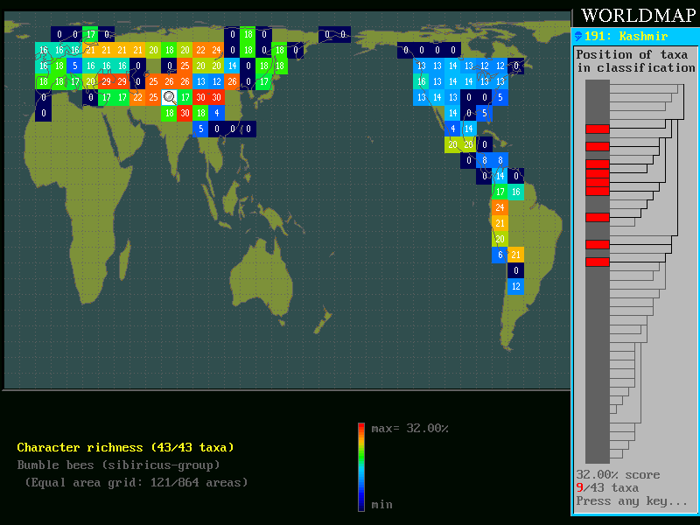

Slide 21
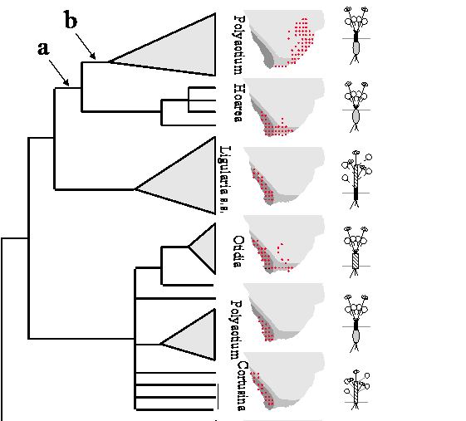

Slide 22
Case Study - Leucaena leucocephala
Leucaena leucocephala (Lam.) De Wit
Native of Central America
Widely introduced around the tropics
Widely utilised around the globe for:
  - Wood
  - Forage
  - Soil enrichment and erosion control
Regarded as an invasive weed in some areas

Slide 23
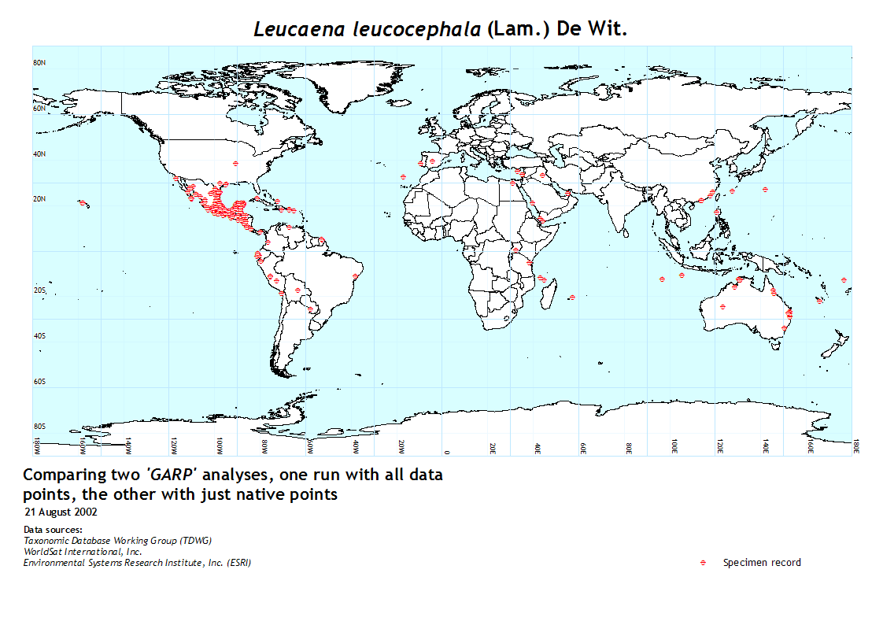
Point data from various herbaria

Slide 24
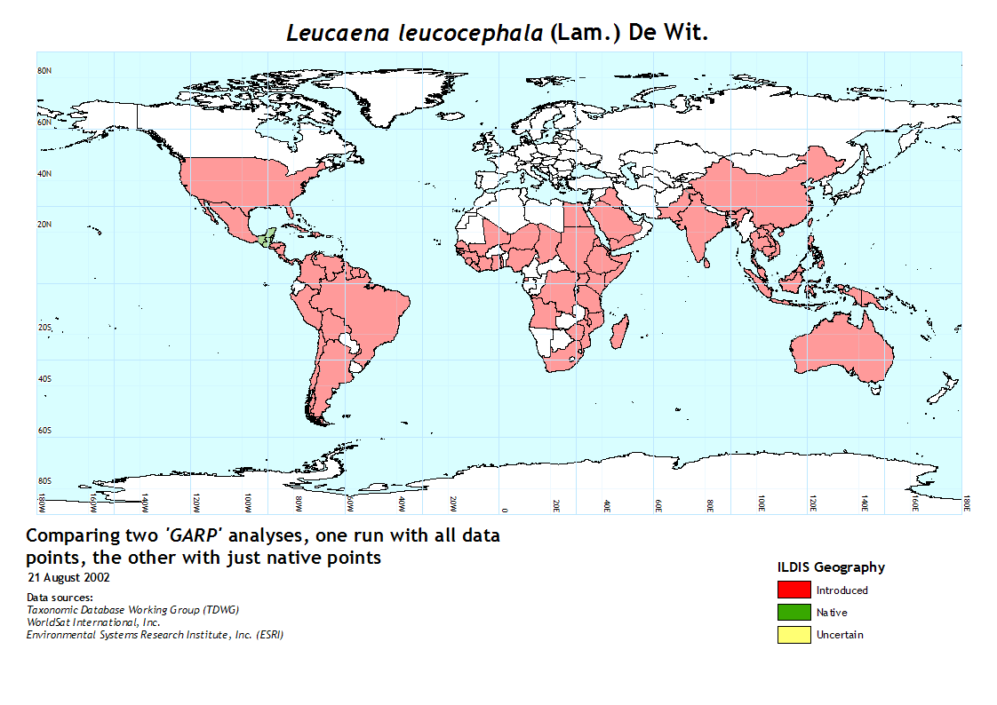
Distribution data from ILDIS database

Slide 25
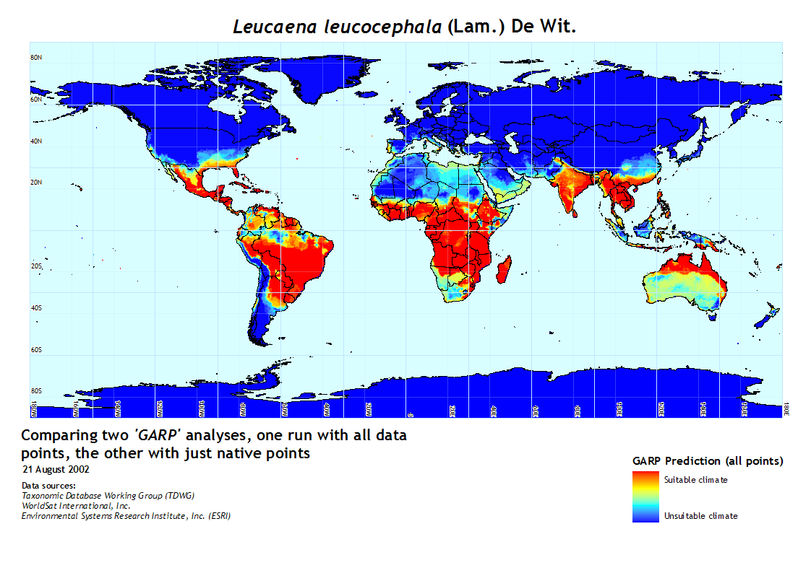
GARP prediction of climatic suitability

Slide 26
Leucaena leucocephala – future predictions
Hadley Circulation Model - HadCM3 – IS92a Scenario
“Population rises to 11.3 billion by 2100 and economic growth averages 2.3% per annum between 1990 and 2100 with a mix of conventional and renewable energy sources being used.”
Global view
Notes:
Discuss ability to extrapolate to GCM scenarios
Lots of models and scenarios to choose from
Used one of the most popular for this presentation: HadCM3
Global views show fluctuating temperatures but some clear trends
Reduction in Central Africa
Reduction in South America
Central American view shows:
Northward trend
More work to do using other model (ECHAM) for comparison. Will help give a better idea of uncertainty with model data

Slide 28
Big Questions for EVBL and decision making support
Consequences from rapid change to the Common Agricultural Policy
Consequences from climate change
Consequences from population movement
What protected areas would be needed to bring species loss to a halt over 10yrs

Slide 29
CURRENT STATUS
EARLY DAYS
ITERATIVE DEVELOPMENT – STAGE 1
DEFINING BASIC METADATA
INITIAL WORKFLOW
RESOURCE DISCOVERY & LINKAGE
RICHER METADATA – DESCRIPTIVE, PROVENANCE
ONTOLOGY

Slide 30
Initial test workflow
Submit scientific
name; retrieve
accepted name
& synonyms
for species
SPICE
Climate
Climate
surfaces
Retrieve
distribution maps
for species of
interest
Localities
Climate
Space Model
Model of climatic conditions
where species is currently
found
Climate
World or
regional
maps
Base Maps
Possibly different
climate surfaces
(e.g. predicted
climate)
Prediction
Prediction of suitable
regions for species
of interest

Slide 31
Metadata
“key area”
(h) Human – intended for user
(m) Machine – intended for software
Functions of metadata – descriptions of:
  data
  process/tool
  interface protocols
  workflow
  representations

Slide 32
Types of metadata (i)
Descriptive – a description of elements
  h – file of climate data
  m – relational database
Navigational – how to find elements
  h – where data is held
  m – URL
Representational – how elements are held
  h – units of representation (e.g. metric)
  m – style of representation (e.g. real number)
Identification – unique descriptor
  h – data set name
  m – file name

Slide 33
Types of metadata (ii)
Quality & reputation
  h – description of quality procedures
  m – integrity checks
Presentation – display details
  h – styles of display (e.g. visual, tabular)
  m – details needed for display
Provenance
  h – description of elements and how they were created
  m – details of software processes used

Slide 34
Role/use of metadata
Descriptive
Create electronic book for user
Create workflows
  necessary transformations
  provenances
  interoperability
Locate appropriate elements
Restart/do processing

Slide 35
Use of ontology
Location of:
  terms
  data resources
  available processes
  transformation tools
  available workflows
  styles of representation

Slide 36
