Slide 1
Facilitating access to biological information with a global catalogue of life
Andrew C. Jones & W. Alex Gray
Cardiff University, UK
Hannu Saarenmaa
Global Biodiversity Information Facility (GBIF)

Slide 2
The Species 2000 vision
To enumerate all known species of plants, animals, fungi and microbes on Earth as the baseline dataset for studies of global biodiversity
To provide a simple access point enabling users to link from Species 2000 to other data systems for all groups of organisms, using direct species-links
To enable users worldwide to verify the scientific name, status and classification of any known species through species checklist data drawn from an array of participating databases
(More recently) to provide a “synonymy server” for use as a service by other applications needing to obtain
suitable scientific names, e.g. for querying
biological data sets

Slide 3
SPICE for Species 2000: Meeting the Computing challenges
The SPICE for Species 2000 project aimed to:
  build a federated ‘registry’ of scientific names organised by taxon (species, etc.)
  accommodate GSD (Global Species Database) heterogeneity
  accommodate GSD autonomy & instability
  ensure scalability
Funding:
  SPICE was funded by the UK BBSRC/EPSRC Bioinformatics panel
  EuroCat – new EU-funded project to augment
  SPICE catalogue of life & develop/maintain
  SPICE software

Slide 4






SPICE Project Staff
Cardiff – Prof. Alex Gray, Dr. Andrew Jones, Prof. Nick. Fiddian, Dr. Xuebiao Xu,
(Mr. Nick Pittas).
Object and Knowledge-based Systems Group, Department of Computer Science, Cardiff
University, PO Box 916, Cardiff CF24 3XF
Email: {W.A.Gray|Andrew.C.Jones|N.Fiddian|X.Xu|N.Pittas}@cs.cf.ac.uk
Telephone +44 (0)29 2087 4812
Reading – Prof. Frank Bisby, Prof. Sir Ghillean Prance and Dr. Sue Brandt.
Centre for Plant Diversity & Systematics, The University of Reading, Reading RG6 6AS
Email: {F.A.Bisby|S.M.Brandt}@reading.ac.uk
Telephone +44 (0) 118 378 6437
Southampton – Dr. Richard White and Mr. John Robinson.
Biodiversity & Ecology Research Division, School of Biological Sciences,
University of Southampton, Southampton SO16 7PX
Email: {R.J.White|J.S.Robinson}@soton.ac.uk
Telephone +44 (0)23 8059 2021
Royal Botanic Gardens, Kew - Prof. Peter Crane, Dr. Don Kirkup,
Ms. Sally Hinchcliffe, Mr. Graham Christian and others
Natural History Museum, London - Prof. Paul Henderson, Mr. Charles Hussey
and others
BIOSIS UK - Mr. Michael Dadd, Ms. Judith Howcroft and others

Slide 5
Interactive use of SPICE …

Slide 6
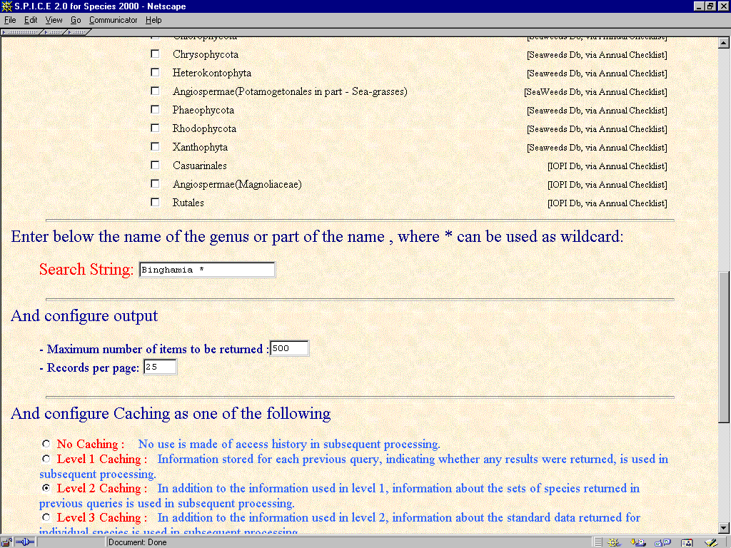

Slide 7
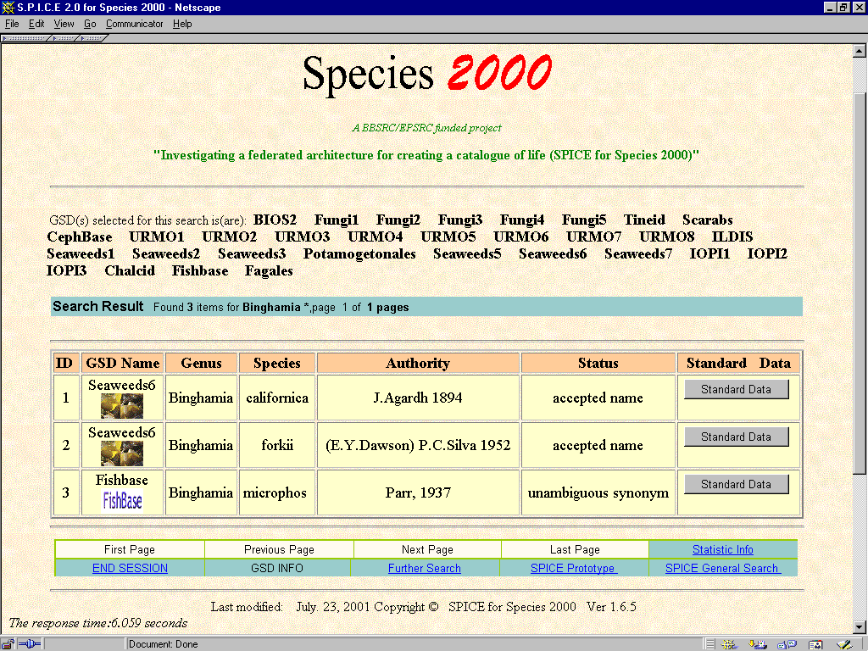

Slide 8
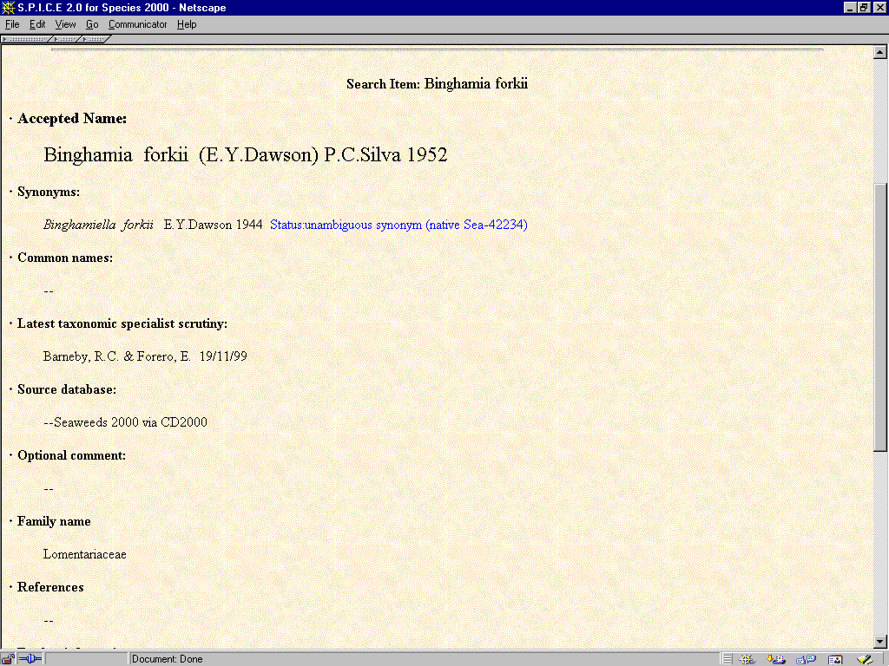

Slide 9
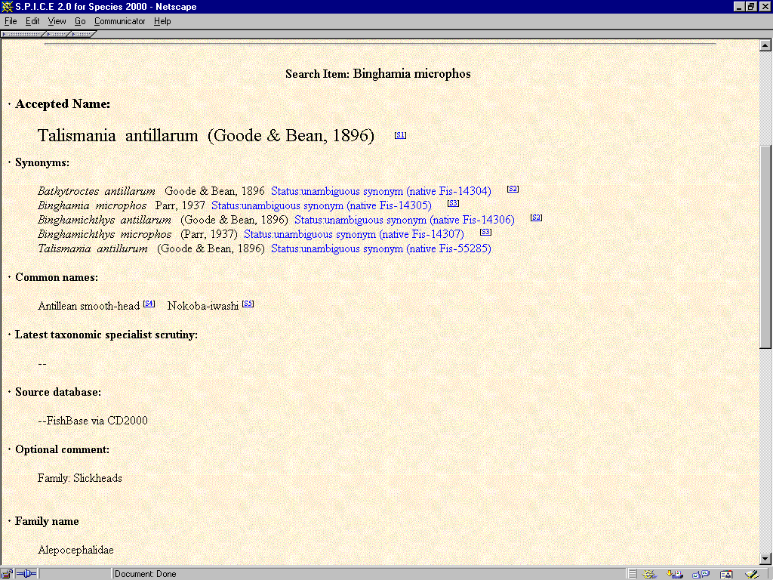

Slide 10
Basic uses for the catalogue
User wishes to check taxonomy of some organisms interactively; or
User wishes to access or store data (observations, gene sequences; …) associated with a given species:
  Catalogue gives information about accepted name/synonyms
  Can use all names for retrieval, for example
  May well want to use the accepted name provided by SPICE for storing new data.

Slide 11
Users and potential users
Individual scientists
GBIF (SPICE for Species 2000 is a candidate for the Electronic Catalogue of Names)
ENBI
GRAB
BDWORLD (see next presentation)
…

Slide 12
GBIF
(Global Biodiversity Information Facility)
GBIF is an international scientific co-operative project based on a multilateral agreement (MoU) between countries, economies and international organisations, dedicated to:
establishing an interoperable, distributed network of databases containing scientific biodiversity information, in order to:
make the world’s scientific biodiversity data freely and universally available to all,
  with initial focus on species- and specimen-level data,
  with links to molecular, genetic and ecosystems
  levels

Slide 13
The GBIF Registry
GBIF’s registry of datasets, data sources, and providers will be the global marketplace of biodiversity data. It will be based on web services concepts.
Content area responsibilities of GBIF
GenBank, et al.
Sequence Data
(RNA, protein, etc.)
Specimen & Observation Data
Registry of Shared Biodiversity Data
GeospatialData
Climate
Data
Electronic Catalog of Names
SpeciesBank, Search Engines & Portals
Ecosystems Data
Existing responsibilities of other groups
Ecological Data
Notes:
10

Slide 14
GBIF’s data index, which is used by applications, is created dynamically by querying the distributed datasources
The GBIF Data index
Communications
Portal:
Syndication
Collaboration
User directories
Species Bank
Specialised Portal B
Web Application A
Search Engine A
Logging
services:
Data use
Requests
Services registry:
Providers
Datasources
Services of above
Data Index:
Names and concepts
Federated key data
Indexes of content
Data
source
Institution
Data
source
Institution

Slide 15
ENBI
(European Network of Biodiversity Information)
EU-funded network
Aims to contribute to GBIF
In particular, aims to provide integration of standards & protocols for taxonomic, specimen, collection and survey data
Will include use of the Species 2000 catalogue

Slide 16
GRAB (GRid And Biodiversity)
6 month DTI-funded demonstrator project
Cardiff University
  Investigators: Alex Gray, Andrew Jones & Nick Fiddian
  Research associates: John Robinson & Jonathan Giddy
Project aim:
  illustrate the GRID’s potential for collaborative research,
  discovering & using diverse biodiversity-related databases

Slide 17
GRAB resource types
Catalogue
of life
SIS
SIS
Climate
...
GRAB resource clients
GRAB interface
Catalogue of life
  Scientific & common names
Species Information System (SIS)
  Images; geography
Climate
  Max/min temperature; annual precipitation

Slide 18
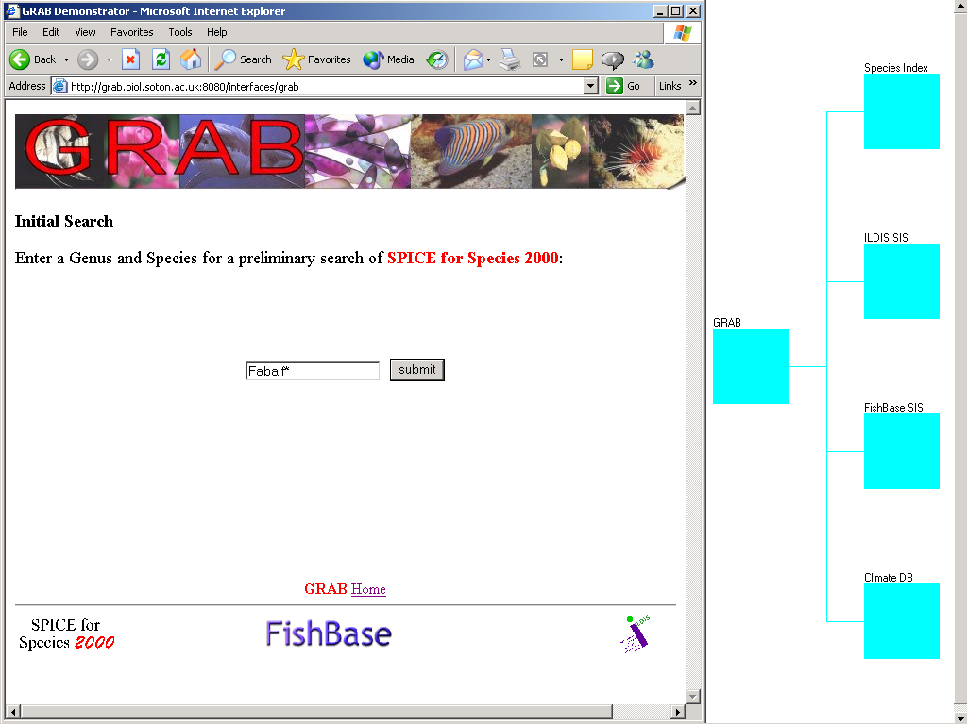
Search for species information by scientific name —
type in search string (in this case ‘Faba f*’) …

Slide 19
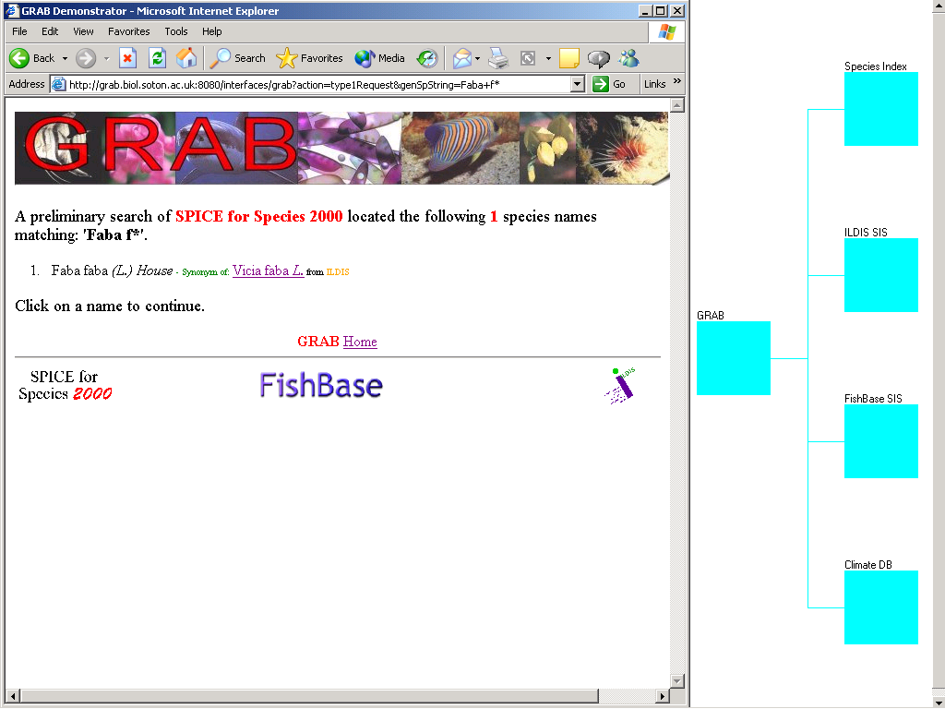
In this case there is only one matching name, ‘Faba faba’
Search on accepted name by selecting the ‘Vicia faba’ link

Slide 20
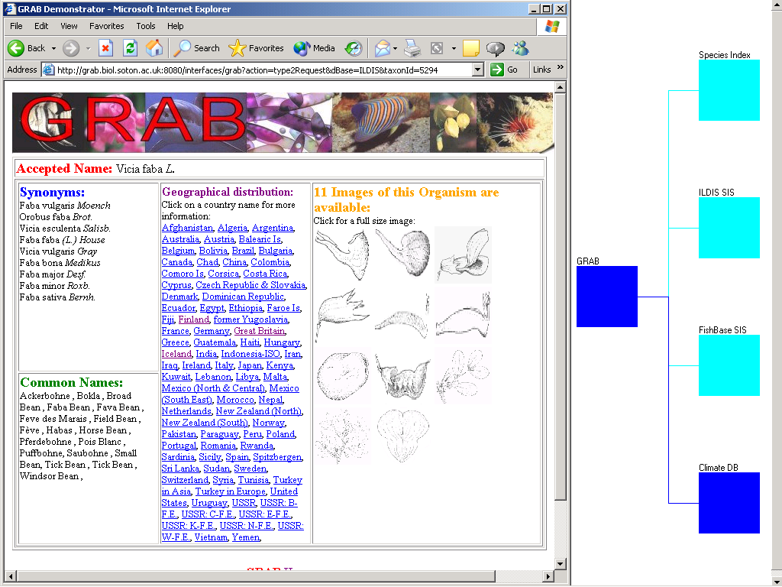
Results displayed — in this case, retrieved from ILDIS SIS
Select ‘Iceland’ to retrieve climate information for that region …

Slide 21
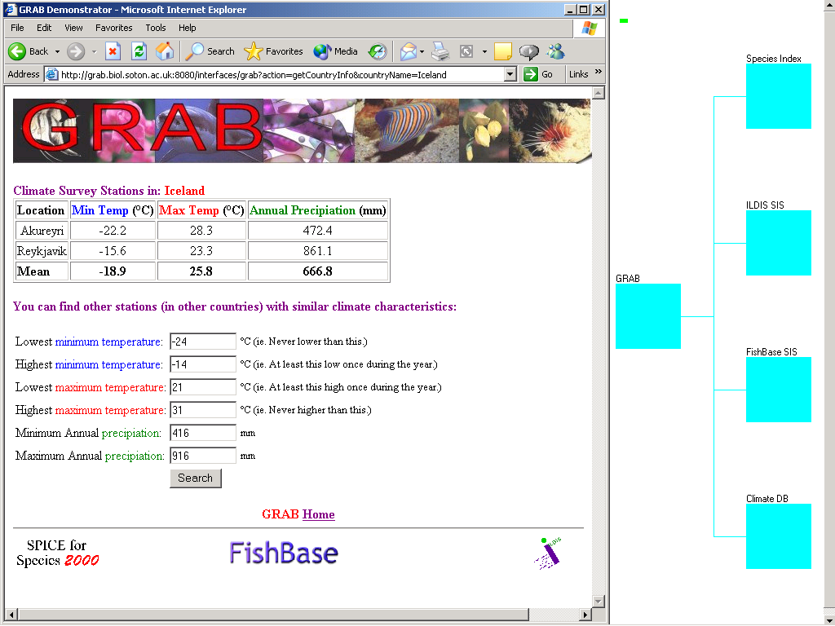
There is data for two climate survey stations
‘Climate envelope’ is automatically created (lowest min temp, etc.) …

Slide 22
Using Globus in GRAB …
We have used Globus to give us:
  Invokable services (GRAM) and deposit/retrieval of results (GASS)
  Security (single log-on – GASS)
  (Elementary!) resource discovery; exploitation of metadata (MDS)
Potentially:
  Seamless interface to computationally intensive modelling; load balancing,
  etc.

Slide 23
The taxonomic problem - example
Treatment A
recognises one genus,
Cytisus
Treatment B
recognises two genera,
Cytisus and Sarothamnus
Cytisus multiflorus
Cytisus multiflorus
Genus
Cytisus praecox
Cytisus praecox
Cytisus
Genus
Cytisus
Cytisus scoparius
Sarothamnus scoparius
Genus
Cytisus striatus
Sarothamnus striatus
Sarothamnus
In the case of the species Cytisus scoparius
Treatment A will list it as
Cytisus scoparius
(synonym Sarothamnus scoparius)
Treatment B will list it as
Sarothamnus scoparius
(synonym Cytisus scoparius)

Slide 24
SPICE for Species 2000 provides a workable solution …
A usable taxonomy
SPICE provides synonyms to names it recognises as accepted names; these can be used to access data associated with various names that have been used for a species
Also, if SPICE is given a synonym, it will return the species (accepted name & all synonyms) this is associated with
The latter needs to be used with care (the accepted name may refer to a “bigger” species than
the synonym)

Slide 25
Richer taxonomic concepts
Could enhance with richer taxonomic concepts for yet greater precision, e.g.
  LITCHI (a previous project in which we developed a constraint-based representation of consistent taxonomic checklists – could extend to store explicit relationships between taxa)
  Prometheus (identifies taxa with sets of specimens)
  Potential Taxon Model (finer granularity than represented in a standard taxonomic checklist)
  …

Slide 26
SPICE internal architecture
User
(Web Browser)
……
User
(Web browser)
CORBA
User Server module
(HTTP)
CAS knowledge repository
(taxonomic hierarchy,
annual checklist, genus
and other caches, ...)
Common Access System (CAS)
‘Query’ co-ordinator
Wrapper
(e.g. JDBC)
……
Wrapper
(e.g.CGI/XML
+ ODBC)
(in some cases, generic) CORBA ‘wrapper’ element of GSD Wrapper
GSD
GSD
Notes:
Explain basic components:
GSDs
CAS
Divided/Unified wrappers using XML; CORBA

Slide 27
Design rationale
Distributed
  taxonomist has control over data included, expressed in his or her preferred form
  SPICE has control over assembly & presentation of results
Common Data Model & wrapping (required data is well defined, but GSDs highly heterogeneous)
Mediator-based approach: data is collected by the CAS or CASs
To build on standards reasonably stable at start of project (1999)

Slide 28
Migration of SPICE to the GRID
The steps are as follows:
  Existing SPICE Web front-end
  CGI/XML interface, which was developed for programmatic access from GRAB
  Revised CGI/XML for early BiodiversityWorld prototype (almost complete)
  Web services for BiodiversityWorld (and EuroCat, GBIF, etc.)
    Defining and registering the services
    Add Web services interface option for individual GSDs too
  GRID services for BiodiversityWorld (and other Bioinformatics users)
    Possibly GRID-enable the GSD/CAS communication too

Slide 29
GRID AND GBIF
GBIF is building a web services architecture
Grid services can be seen as a kind of web service
Grid services can be incorporated in GBIF architecture when OGSA implementations are ready for GBIF use
Possible services in GBIF’s network
  Semantic Grid might fit the taxonomic name service
  Grid data replication is relevant for GBIF data archiving and mining services
  Production of global distribution map under multiple global change scenarios could require computational capacities from the Grid.
  Advanced collaborative environment (ACE is a Grid Research Group) is needed for accelerating species discovery and distributed authoring of the Species Bank

Slide 30
Metadata in SPICE
An important issue in making SPICE available on the GRID, and GRID-enabling its components, is metadata …

Slide 31
Use of “Metadata” in SPICE & SP2000
Representational (common data model)
Locational (how to communicate with each GSD)
Presentational (for CAS front end)
Descriptive (certain kinds of provenance information)

Slide 32
Common Data Model
Some of the logical relationships among the data elements cannot be represented in, for example, the IDL, DTD (also, XML Schema currently being prototyped)
but they can be documented (more or less formally) in the CDM,
then used as a reference by people implementing algorithms processing data, which for example may comply with the DTD

Slide 33
CDM Request Types 0-6
  Type 0: Get CDM version compliance for a GSD
  Type 3: Get information about a GSD
  Type 1: Search for a name in a GSD
  Type 2: Fetch “standard data” about a chosen species
  Type 4: Move up the taxonomic hierarchy
  Type 5: Move down the taxonomic hierarchy

Slide 34
The “standard data”
Comprises the information about a species which Species 2000 wishes to provide:
  AVCNameWithRefs
  SynonymWithRefs
  CommonNameWithRefs
  Family
  Comment
  Scrutiny
  DataLink
  Geography

Slide 35
XML DTD extract
<!ELEMENT TYPE1RESULT (SPECIESNAME*)>
<!ELEMENT SPECIESNAME ((AVCNAME | SYNONYMWITHAVC),TAXONID?)>
<!ELEMENT AVCNAME (FULLNAME, AVCSTAT, IDL?)>
<!ELEMENT FULLNAME (GENUS, SPECIES, AUTHORITY)>
<!ELEMENT GENUS (#PCDATA)>
<!ELEMENT SPECIES (#PCDATA)>
<!ELEMENT AUTHORITY (#PCDATA)>
<!ELEMENT AVCSTAT (#PCDATA)>
<!ELEMENT IDL (#PCDATA)>
<!ELEMENT TAXONID (#PCDATA)>
<!-- TAXONID is newly introduced here in comply with CDM1.11 -->
<!ELEMENT SYNONYMWITHAVC (SYNONYM, ID?, AVCNAME)>
<!ELEMENT SYNONYM (FULLNAME, INFRASPECIFICPORTION?, SYNONYMSTATUS)>
<!ELEMENT INFRASPECIFICPORTION (#PCDATA)>
<!ELEMENT SYNONYMSTATUS (#PCDATA)>
<!ELEMENT ID (#PCDATA)>

Slide 36
Type 1 response (XML) extract
<type1result>
<SPECIESNAME>
<SYNONYMWITHAVC>
<SYNONYM>
<FULLNAME>
<GENUS>Abrus</GENUS>
<SPECIES>abrus</SPECIES>
<AUTHORITY>(L.) Wright</AUTHORITY>
</FULLNAME>
<INFRASPECIFICPORTION> </INFRASPECIFICPORTION>
<SYNONYMSTATUS>synonym</SYNONYMSTATUS>
</SYNONYM>
<AVCNAME>
<FULLNAME>
<GENUS>Abrus</GENUS>
<SPECIES>precatorius</SPECIES>
<AUTHORITY>L.</AUTHORITY>
</FULLNAME>
<AVCSTAT>accepted</AVCSTAT>
<IDL>1571</IDL>
</AVCNAME>
</SYNONYMWITHAVC>
</SPECIESNAME>
<SPECIESNAME> …

Slide 37
Locational & Presentational metadata
XML configuration files used, e.g.
  <SPICECONTEXT>
  <DividedGSDService id="02" Abbr="Fagales" GSDname="RBG Kew Fagales database"
  URL="http:// <omitted for confidentiality>"
  CurrentAvailability="Yes"
  AltURL=""
  AltCurrentAvailability="No"
  FamiliesContained="Fagaceae, Betulaceae,Ticodendraceae"
  Description=“Divided CGI/XML wrapper to Fagales GSD from KEW" />
  <DividedGSDService id="03" Abbr="Chalcidoidea" GSDname="Chalcidiodea database " …

Slide 38
Descriptive metadata
“Species 2000 metadatabase” not used in computation
Information, for human consumption, about:
  GSDs or potential GSDs (e.g. shortName, fullName, inAnnualChecklist, formOfDb (MySql, printed(!), etc.), …)
  Contact people (e.g. organisation, name, telephone …)
And basic on-line editor

Slide 39
Links repository
At present, the “standard data” pages can include the URL of some Web page providing further information
We plan to extend this within SPICE for Species 2000 to store “taxonomically intelligent links”, representing relationships between taxonomic treatments underlying on-line biological resources. An agent designed to use these links will support navigation between these resources, advising when differing taxonomic concepts are encountered, etc.

Slide 40
Summary
A scientific names facility can provide essential services for interoperation among resources based on differing taxonomies – on the GRID or elsewhere
SPICE for Species 2000 provides a suitable set of facilities for such a service
We intend to make the SPICE system available as a GRID service, freely accessible from other GRID applications
  Currently a prototype supporting programmatic use exists, but only using a proprietary CGI/XML protocol
We intend to build an additional “intelligent linking” service that will provide more precision in navigation between individual biological GRID resources
Major Biodiversity facilities, e.g. GBIF, can use SPICE
for Species 2000 – on the GRID or elsewhere – to
help users access other biological resources.

