Slide 1

iGAP: Integrative Grid-enabled Genome Annotation Pipeline
Wilfred Li, Ph.D.
Integrative Biosciences Program
San Diego Supercomputer Center
University of California, San Diego
http://eol.sdsc.edu

Slide 2
Encyclopedia Of Life Project
High quality functional and 3-D structure assignment using iGAP
  Grid-enabled bioinformatics applications
  Optimization
  Dedicated and grid resources
Integrative biological data warehouse
  Web services consumer
  Distributed database and data mining
Advanced query environment
  Open Notebook
  Web services provider

Slide 3
iGAP Workflow
Reassemble proteome, Data replication
PAT-NR
1000+ Genomes
Proteome
Specific
Benchmarking
iGAP:
Prestaging
Execution
Monitoring
Only unique sequences are processed
iGAP WMS
DBMS

Slide 4
Protein sequences
structure info
sequence info
Prediction of :
signal peptides (SignalP, PSORT)
transmembrane (TMHMM, PSORT)
coiled coils (COILS)
low complexity regions (SEG)
SCOP, PDB
NR, PFAM
Step 1
Building FOLDLIB:
PDB chains
SCOP domains
PDP domains
CE matches PDB vs. SCOP
90% sequence non-identical
minimum size 25 aa
coverage (90%, gaps <30, ends<30)
Structural assignment of domains by WU-BLAST
Step 2
Structural assignment of domains by PSI-BLAST profiles on FOLDLIB
Step 3
Structural assignment of domains by 123D on FOLDLIB
Step 4
Functional assignment by PFAM, NR assignments
Step 5
FOLDLIB
Domain location prediction by sequence
Step 6
Store assigned regions in the DB

Slide 5
Workflow Management System for iGAP
Work Stations
Blue
Horizon
Grid Resources
WMS
Others
SRB
Japst
Anywhere
SDSC
BII

Slide 6



EOL and APST
The AppLeS Parameter Sweep Template (APST) provides EOL with transparent access to Grid resources and smart scheduling via Grid middleware.
EOL Software/Data
Grid Resources
A
P
S
T
Globus GRAM/GASS
Application
Description
SSH/SCP
SRB/SFTP
PBS/Loadleveler/Condor
Globus MDS/NWS/Ganglia
Grid Metadata

Slide 7
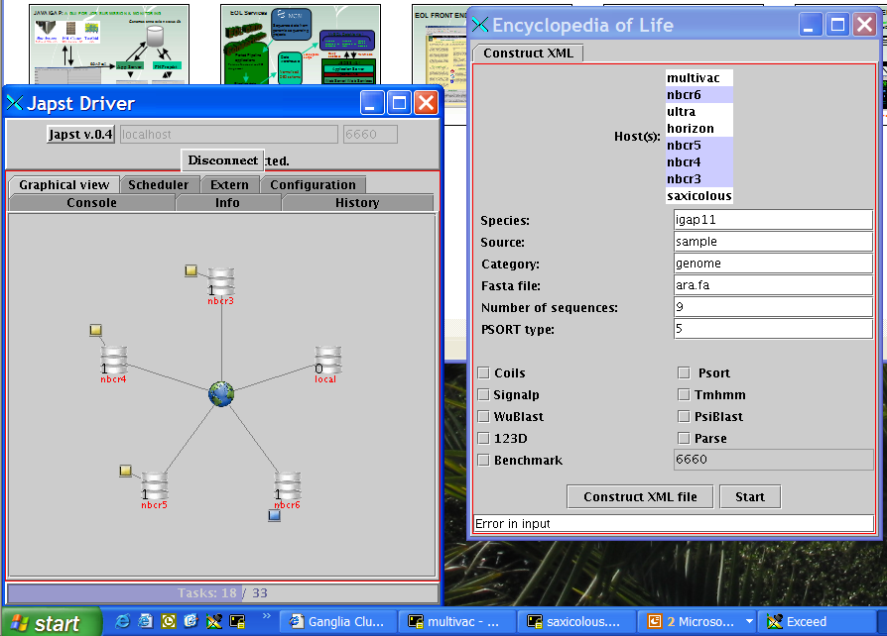

Slide 8
Acknowledgement
SDSC
  Fran Berman
    Director
  Philip E. Bourne
    IBS Director
  Mark Miller
    Project Coordinator
  Ilya N. Shindyalov
    CE
  Greg Quinn
    Web service
  Coleman Mosley
  Vicente Reyes
  Robert Byrnes
  Kim Baldrige
    iCC Director
  Jerry Greenberg
    CE portal
  Philip Papadoplous
    Rocks
  Mason Katz
  Greg Bruno
SDSC
  Chaitan Baru
  David Archbell
  Jerry Rowley
UCSD
  Peter Arzberger
    PRAGMA
  Henri Casanova
  Jim Hayes
Ceres Inc.
  Nickolai Alexandrov
    123D
  Richard Flavell
BII, Singapore
  Larry Ang
  Kishore Sakharkar
  Arun Krishnan
  Atif Shahab
  Other BII members
Everyone else
Additional partner institutions

