Slide 1
IMMUNOGRID
Nikolai Petrovsky and Vladimir Brusic
Medical Informatics Centre, University of Canberra
March 2003

Slide 2
Summary
Introduction
Databases
Vaccine development
Conclusion

Slide 3
The immune system is composed of many interdependent cell types, organs, and tissues
that jointly protect the body from infections (bacterial, parasitic, fungal, or viral) and from the growth of tumor cells.
The immune system is the second most complex body system in humans.

Slide 4
An enormous diversity in human immune system
>10¹³ MHC class I haplotypes (IMGT-HLA)
10⁷-10¹⁵ different T-cell receptors (Arstila et al., 1999)
10¹² B-cell clonotypes in an individual (Jerne, 1993)
10¹¹ linear epitopes composed of nine amino acids
>>10¹¹ conformational epitopes
>10⁹ combinatorial antibodies (Jerne, 1993)

Slide 5
Immunology is a combinatorial science
The amount of immune data is growing exponentially
GRID technology offers a unique opportunity to divide and conquer immune complexity.

Slide 6
IMMUNOINFORMATICS
COMPUTER
SCIENCE
IMMUNOLOGY
COMPUTER
SCIENCE
IMMUNOLOGY
Learning
Algorithms,
Pattern
Recognition,
Adaptive
Memories,
Intelligent
Agents
COMPUTATIONAL
IMMUNOLOGY
Design of
Experiments,
Data
Interpretation
DATABASES
COMPUTATIONAL
MODELS
DATABASES
COMPUTATIONAL
MODELS
COMPUTATIONAL
EXPERIMENTS
COMPUTATIONAL
EXPERIMENTS

Slide 7
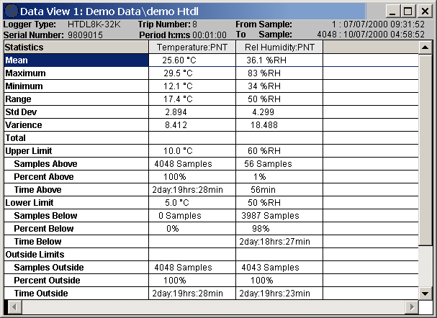
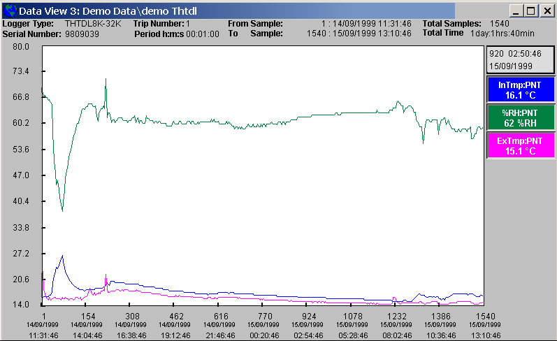
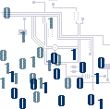

basic
immunology
clinical
immunology
maths/stats
IMMUNOGRID
molecular
biology
artificial
intelligence
cell biology
databases
physics/chemistry
algorithms
systems
science

Slide 8
Summary
Introduction
Databases
Predictions of vaccine targets
Functional genomics/Immunomics
Conclusion

Slide 9
IMMUNOGRID
Database technology for storage,
manipulation, and modelling of
immunological data
Computational models to facilitate
immunological research
- predictive models
- mathematical models

Slide 10
Databases
General databases
Specialist immunological databases
Data warehouses

Slide 11
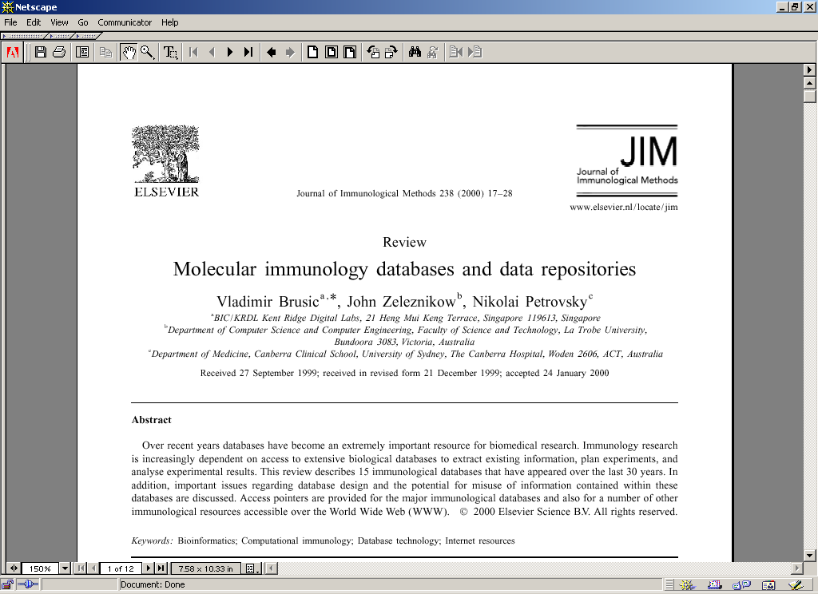

Slide 12
General databases
GenBank Prosite
EMBL
DDBJ
PIR PDB
SWISS-PROT
GenPept
DBCAT Catalogue of databases
www.infobiogen.fr/services/dbcat

Slide 13
General databases
Advantages
significant infrastructure
interfaces for data extraction and analysis
curation and quality assurance of data
centrally accessible
standardised formats facilitating automation
independently maintained and funded

Slide 14
General databases
Disadvantages
quality control of content
error propagation
typically poor annotation of features
obsolete, incomplete, or redundant entries
lack of synchronisation
application of standards (nomenclature etc.)

Slide 15
Specialist databases
KABAT HIV molecular
IMGT immunology
FIMM
MHCPEP SLAD
SYFPEITHI
MHCDB
15 databases described in the JIM review

Slide 16
Specialist databases
Advantages
more detailed information
created and maintained by the domain experts
high level of quality assurance of data
better compliance to standards
have specialist tools

Slide 17
Specialist databases
Disadvantages
irregular updates
low level of automation
less reliable for access and currency
funding uncertainty

Slide 18
Data warehouse goals
Efficient querying, reporting and complex analyses of data
Flexibility in adding tools for data analyses
Scalability etc.
Schönbach et al. Briefings in Bioinformatics, 2000

Slide 19
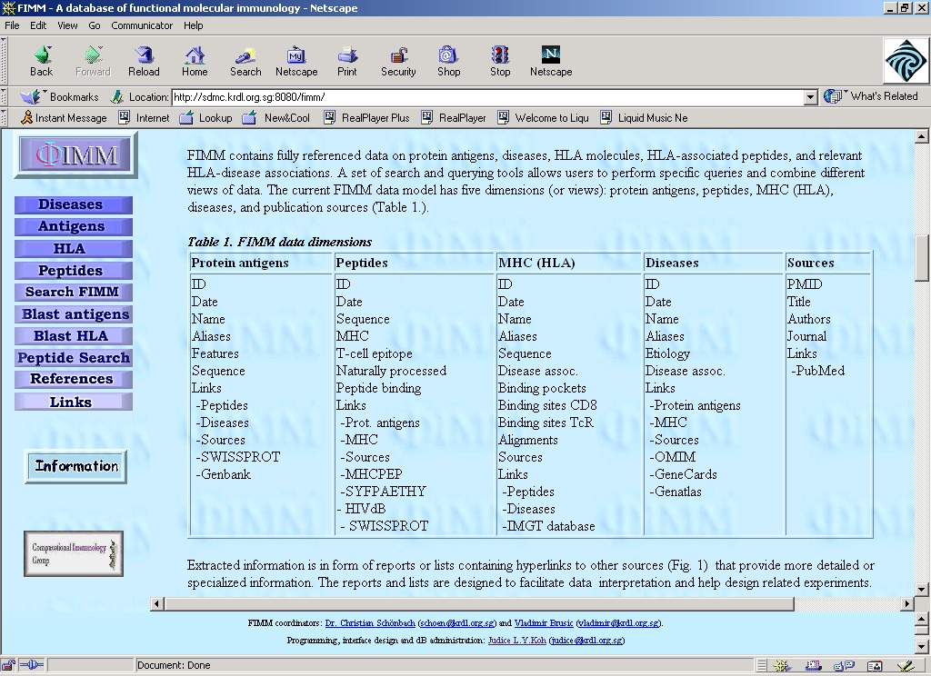
FIMM

Slide 20
Summary
Introduction
Databases
Vaccine development
Conclusion

Slide 21
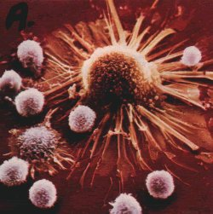
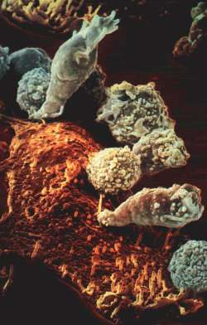
A cancer cell under attack by T cells
of the immune system
Cancer cell killed

Slide 22
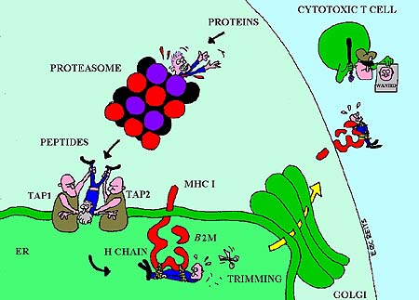
V. Brusic, 2002

Slide 23
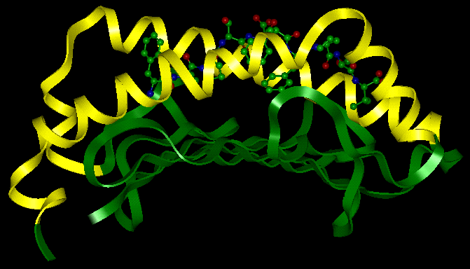
Modelling MHC-binding peptides

Slide 24
Model requirements
High accuracy
High specificity (cheap confirmation)
High sensitivity (broad coverage)
Generalisation
Predict well previously unseen peptides
Predict well across allelic variants
Improvement over time
Robustness (resistance to errors and biases)

Slide 25
MHC-binding peptides
Binding motifs
Quantitative matrices
Artificial neural networks
Hidden Markov models
Molecular modelling

Slide 26
ARTIFICIAL NEURAL NETWORK
O
U
T
P
U
T
H
I
D
D
E
N
A
C
D
E
F
G
H
I
K
L
M
N
P
Q
R
S
T
V
W
Y
A
C
D
E
F
G
H
I
K
L
M
N
P
Q
R
S
T
V
W
Y
Y
I
N
P
U
T

Slide 27
Example 1
1994 - Prediction of MHC class I binding peptides
Molecule: HLA-A*0201
Subset: 9-mers
Data: 186 binders, 1071 non-binders

Slide 28
Example
Experimental testing of protein thyrosine phosphatase (IA-2) in
at-risk IDDM relatives
Binding assays
T-cell proliferation assays
Honeyman et al., Nat. Biotechnol. 1998
Brusic et al., Bioinformatics 1998

Slide 29
.
HLA-DR4 T-cell epitopes from an IDDM antigen IA-2
1000
T-cell resp. < 1 SD
T-cell resp. 1-2 SD
T-cell resp. > 2 SD
1/IC50)*100
100
10
Binding Index (
1
-2
0
2
4
6
8
10
Binding Prediction

Slide 30
Example 2

Slide 31
Cyclical refinement
Initial
experiments
refine
Optimise/
clean
Computer
models
Further
experiments
define

Slide 32
Example 3
Malaria - 500 000 000 cases per annum
Search for vaccine targets in HLA-A11 population
in Vosera - Papua New Guinea
Six antigens from P. falciparum
LSA-1 ~1909 AA
SALSA ~ 83 AA
CSP ~ 432 AA
GLURP ~1262 AA
STARP ~ 604 AA
TRAP ~ 559 AA
3127 peptides

Slide 33
Example 3
TRAP-559AA
MNHLGNVKYLVIVFLIFFDLFLVNGRDVQNNIVDEIKYSE
EVCNDQVDLYLLMDCSGSIRRHNWVNHAVPLAMKLIQQLN
LNDNAIHLYVNVFSNNAKEIIRLHSDASKNKEKALIIIRS
LLSTNLPYGRTNLTDALLQVRKHLNDRINRENANQLVVIL
TDGIPDSIQDSLKESRKLSDRGVKIAVFGIGQGINVAFNR
FLVGCHPSDGKCNLYADSAWENVKNVIGPFMKAVCVEVEK
TASCGVWDEWSPCSVTCGKGTRSRKREILHEGCTSEIQEQ
CEEERCPPKWEPLDVPDEPEDDQPRPRGDNSSVQKPEENI
IDNNPQEPSPNPEEGKDENPNGFDLDENPENPPNPDIPEQ
KPNIPEDSEKEVPSDVPKNPEDDREENFDIPKKPENKHDN
QNNLPNDKSDRNIPYSPLPPKVLDNERKQSDPQSQDNNGN
RHVPNSEDRETRPHGRNNENRSYNRKYNDTPKHPEREEHE
KPDNNKKKGESDNKYKIAGGIAGGLALLACAGLAYKFVVP
GAATPYAGEPAPFDETLGEEDKDLDEPEQFRLPEENEWN

Slide 34
Example 3
1) Overlapping study
Twenty overlapping 9-mer peptides from
the known immunogenic region of LSA-1
90 94 105
88 NVKNVSQTNFKSLLRNLGVSENIFLKEN 115
2) Initial ANN model: 98 binders and 145 non-binders
34 peptides selected and tested for HLA-A*1101 binding
3) Refined ANN model: 123 (98+13+12) binders and
203 (145+41+17) non-binders
twenty-nine (29) peptides were selected and tested

Slide 35
Correctly predicted binders
3/20 10/36 22/29
%
76
29
15
Brusic et al. Journal of Molecular Graphics and Modelling, 2001

Slide 36
Other work
Identification of relationship between TAP transporter and MHC binding using KDD techniques
Brusic et al. (1999). In Silico Biology 1, 109-121.
Daniel et al. (1998). Journal of Immunology 161, 617-624.
Prediction of cancer-related T-cell epitopes
Zarour et al. (2002). Canc. Res. 62, 213-218.
Kierstad et al. (2001). Br. J. Canc. 85, 1735-1745.
Zarour et al. (2000). Canc. Res. 60, 4946-4952.
Zarour et al. (2000). PNAS USA 97, 400-405.
Prediction of peptides that bind multiple MHC molecules
Brusic et al. (2002). Immunology and Cell Biology 80, 280-285.
Large-scale (genome-wide) screening of MHC binders
Schönbach et al. (2002). Immunology and Cell Biology 80, 300-306.
Prediction of renal transplant outcomes
Petrovsky et al (2002). Graft 4, 6-13.

Slide 37
A substantial effort is required to model a single MHC molecule
There are more than 1000 different human MHC molecules and growing
The number of pathogen genomes for vaccine design is increasing rapidly
Thus vaccine target identification is a parallel problem ameniable to IMMUNOGRID

Slide 38
Summary
Introduction
Databases
Predictions of vaccine targets
Conclusion

Slide 39
Conclusions
Bioinformatics is revolutionising immunology
The scope of immunoinformatics is huge – it comprises
databases, molecular-level and organism level models,
genomics and proteomics of the immune system, as well as
genome-to-genome studies
The size and complexity of the field necessitates a distributed approach to database management, analysis and data mining
GRID provides the perfect answer to the needs of Immunoinformatics

Slide 40
basic
immunology
clinical
immunology
maths/stats
IMMUNOGRID
molecular
biology
artificial
intelligence
cell biology
databases
physics/chemistry
algorithms
systems
science

