Slide 1



(EUROGRID and GRIP project)
Piotr Bała
ICM Warsaw University – Warsaw (PL)
N. Copernicus University – Toruń (PL)
Funding by European Commission Grant No. IST-1999-20247 (EUROGRID)
and IST-2001-32257 (GRIP)

Slide 2
EUROGRID Vision
Build a European Grid infrastructure
that gives users
a seamless, secure access to
High Performance Computing resources
and that advances computational science
in Europe

Slide 3
GRIP Project
Extend EUROGRID to cooperativity with globus middleware.
Provide UNICORE users with access to resources avaliable trough globus.
Use biomolecular applications to demonstrate interoperability

Slide 4
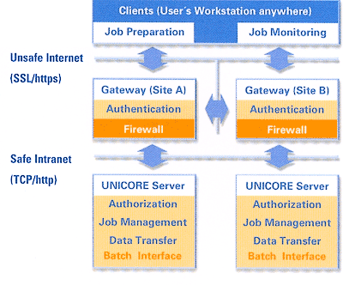
EUROGRID Infrastructure and Components
Based on UNICORE system
Develop additional GRID components
  efficient data transfer
  ASP infrastructure
  resource broker
  application coupling
  interactive access
Integration of new components by Pallas and Fecit

Slide 5
UNICORE architecture
UNICORE Client
UNICORE Gateway B
Insecure Internet
UNICORE Gateway A
UNICORE Server
(NJS)
UNICORE Server
(Globus NJS)
TSI
Globus TSI
NQE (Cray SV1)
GT 2.0 (Linux cluster)

Slide 6
UNICORE Security
Based on the PKA
Industrial standard X509
Secure communication
  Gateway, NJS cetificates
  Gateway, NJS check user certificate
  Multiuple CA accepted
User certificates
  User certificate stored in client
  Public key stored in UUDB database at each site
  PKA mapped to user account (XLOGIN)
    more than one certificate can map to xlogin
    multiple CA allowed
  Multiple certificates allowed

Slide 7




EUROGRID resources
European HPC GRID testbed
Agreement on security standards, certification, access policies etc.
CRAY SV1 (16PE)
NEC SX4B/2A
SGI O2000
Linux Cluster (4 PE)
SGI O2000 (64 PE)
SGI Onyx 2000 (64PE)
IBM SP4
FZJ
Linux Intel Cluster (36 PE)
IBM (1PE)
CRAY T3E - 600 (512 PE)
CRAY T3E - 1200 (512 PE)
CRAY T3E - 1200 (816 PE)
FUJITSU VPP300 (8 PE)
SGI O2000 (128 PE)
SGI O3000 (256 PE)
IBM SP3 (8 PE)
NEC SX5 cluster (40 PE)
IBM Power4 (256 PE, 1.3 TFLOPS)
COMPAQ Linux Cluster (24 PE)

Slide 8
UNICORE Applications
Job files for user applications
  script tasks
  command tasks
  file transfer tasks (client-vsite, vsite-vsite)
Plug-in for job and input preparation
User can run the same script at all VSITEs
  Introduction of IDB entries for site dependent installation
    GROMOS96=/pkg/gromos96; export GROMOS96
    GAUSS_EXEDIR=/pkg/gaussian/g98; export GAUSS_EXEDIR
    AMBERHOME=/pkg/amber6; export AMBERHOME
    CHARMM=/pkg/charmm/c27b2/exec/t3e/charmm; export CHARMM

Slide 9
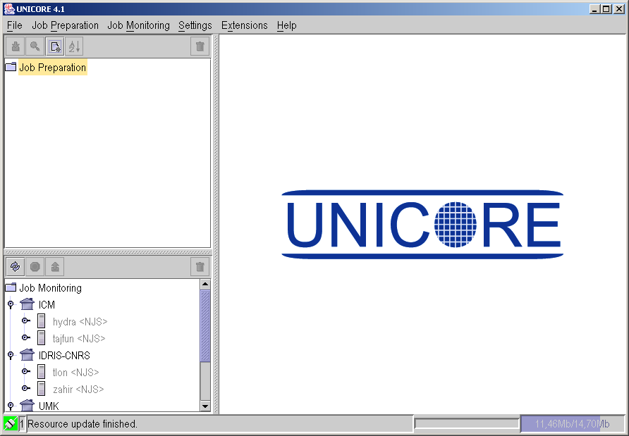
UNICORE Client
Single application
Job preparation
Job monitoring

Slide 10
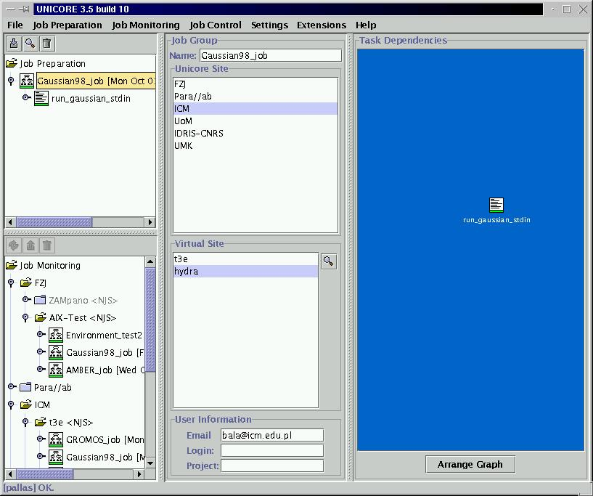
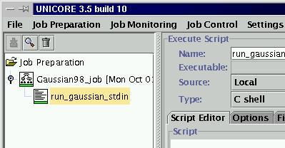
UNICORE Client

Slide 11
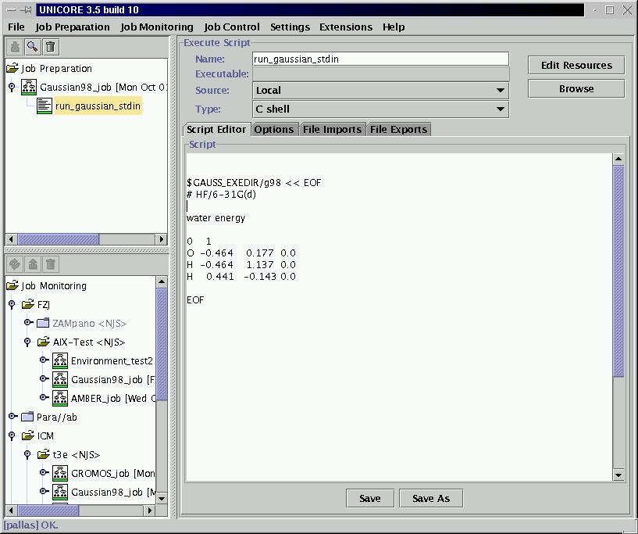
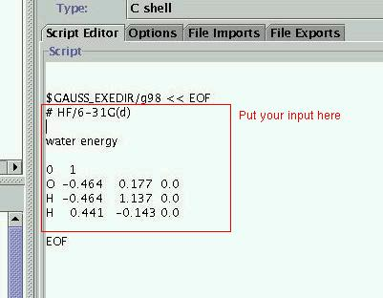
UNICORE Client – Gaussian98 job preparation

Slide 12
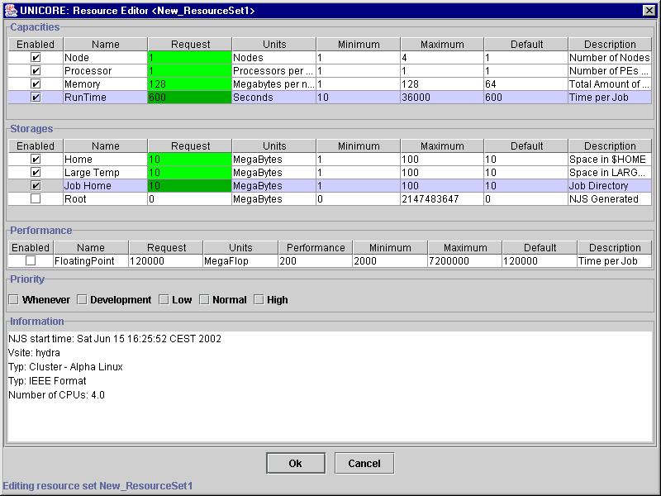
UNICORE Client – edit resources for job

Slide 13
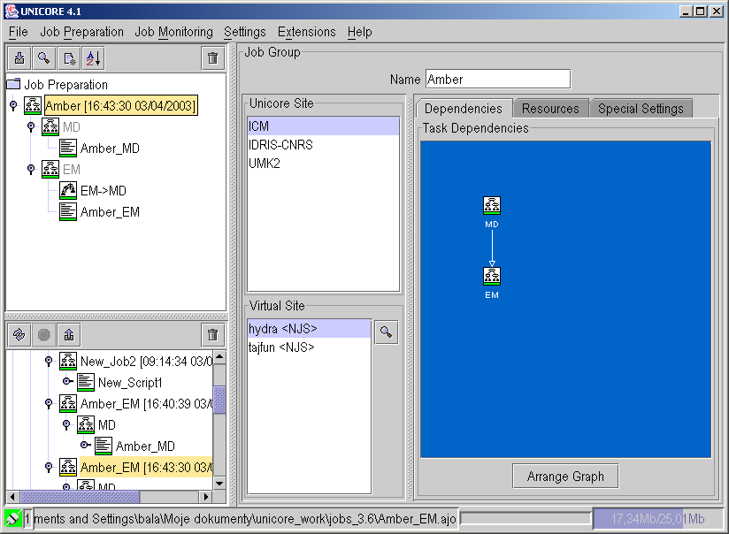
UNICORE Client – workflow editor

Slide 14
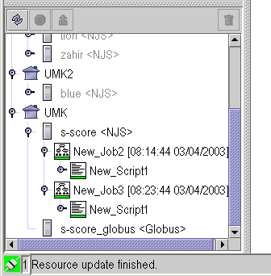
UNICORE – Globus interoperability
New VSITE type: <Globus>
UNICORE adopts OGSA standards

Slide 15
BioGRID
UNICORE Client unix and Windows
  Easy installation (www.unicore.org)
Example jobs:
  Gaussian98
  Amber
  Gromos
Plugins
  Gaussian98
  AMBER
  CPMD (Unicore Plus project)
  PDB Search
  List Jobs

Slide 16
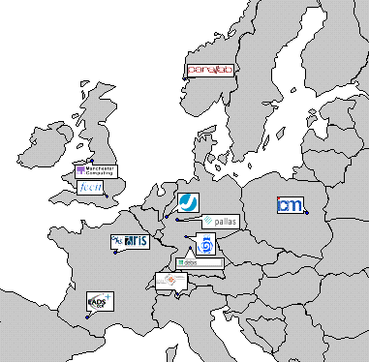

Gaussian98 in EUROGRID

Slide 17
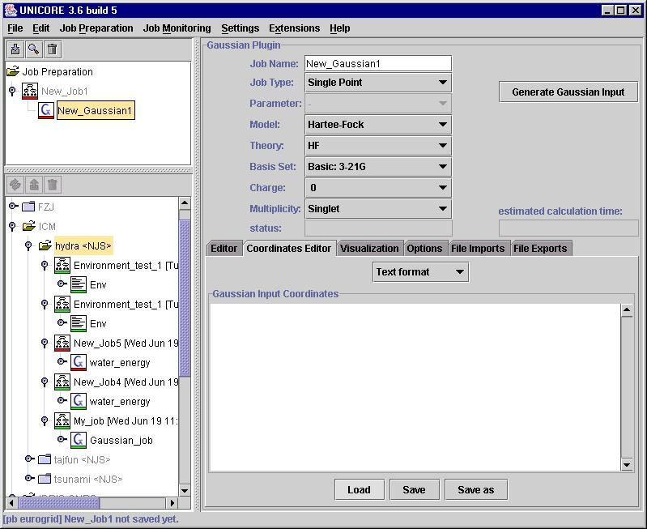
Gaussian98 plugin
Input preparation
reads existing input, recognizes keywords
Molecule coordinate editor
formats:
XYZ
Z-matrix
text

Slide 18
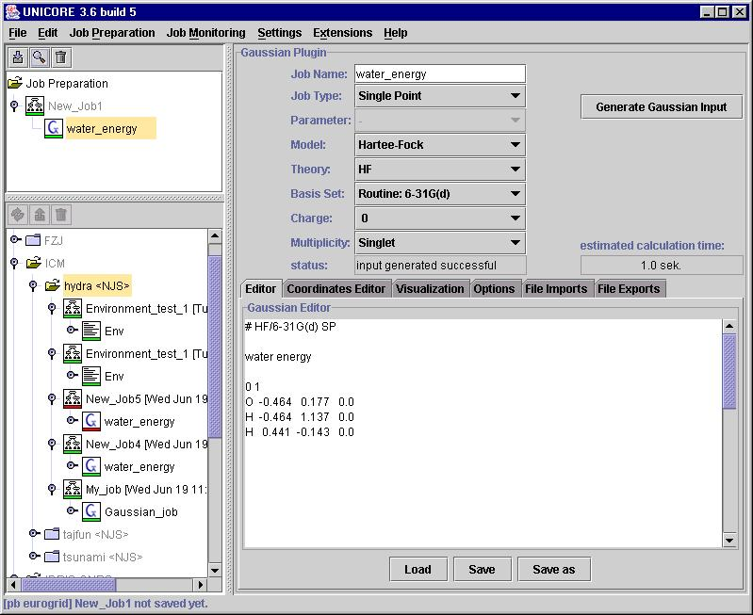
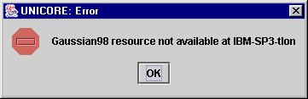
Gaussian98 plugin
CPU time estimate
based on known algorithm scaling O(N⁴)
Checks program avaliability

Slide 19
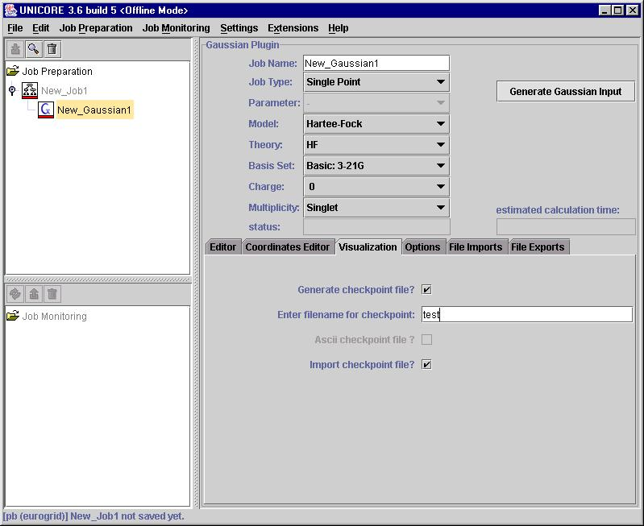
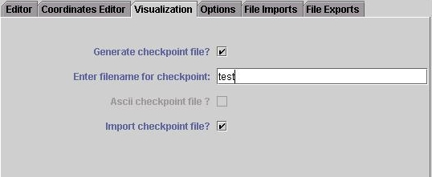
Gaussian98 plugin
Prepares and transfers files for visualization

Slide 20
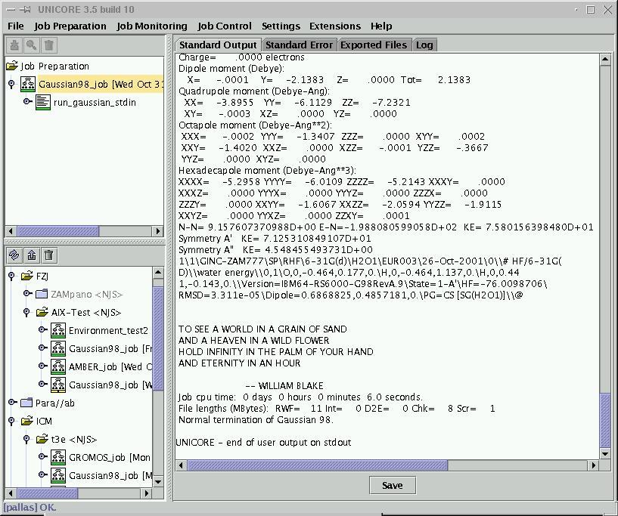
Gaussian98 plugin
Output

Slide 21
Amber 6.0 plugin
Input preparation
  extended input preparation wizard
  covers all most popular options for NVT, NVE, NPT simulations
  NMR simulations are not covered yet
Extended user help
  short help available for each button
  Keyword list and keyword locator
    user is navigated to the proper panel
  JavaHelp entries
Plugin checks Amber availability
  SOFTWARE_RESOURCES entries

Slide 22
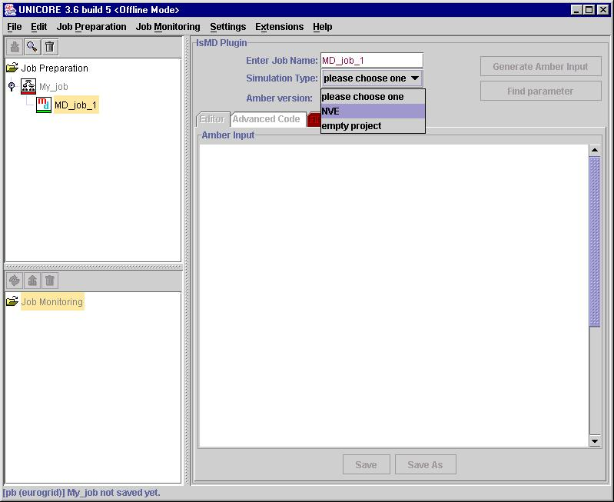
Amber 6.0 plugin
Input preparation

Slide 23
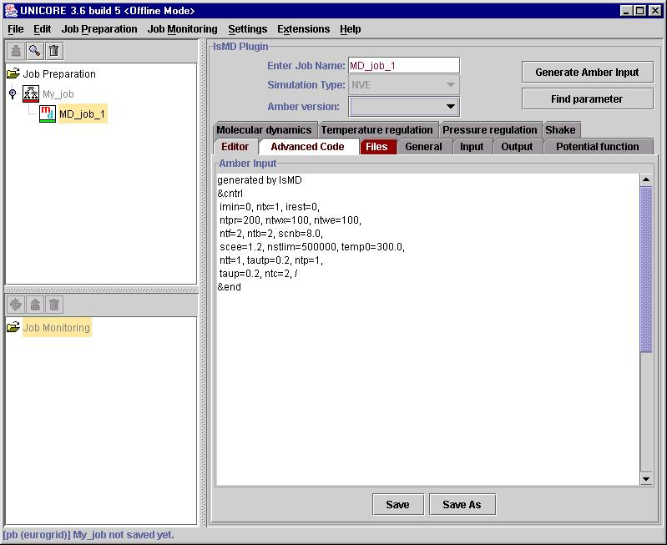
Amber 6.0 plugin
Input can be edited by user
Errors are marked in red

Slide 24
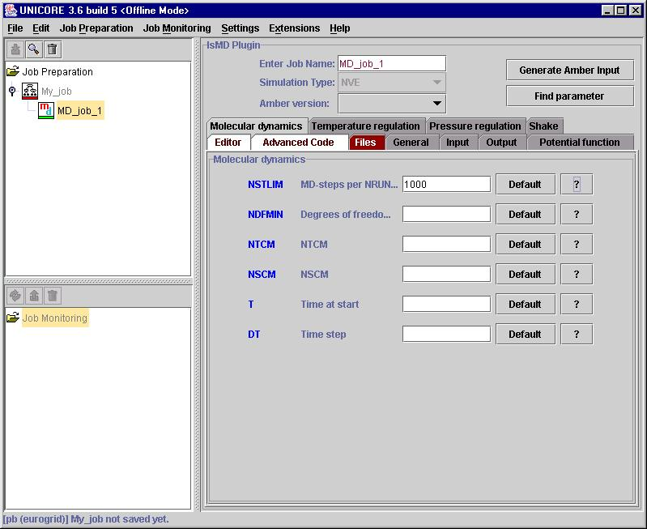
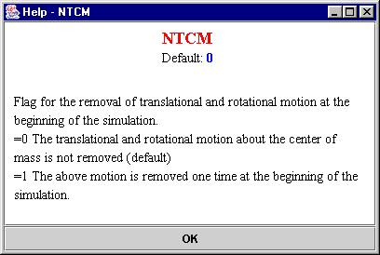
Amber 6.0 plugin
Panel for each group of options
Default options
Help window

Slide 25
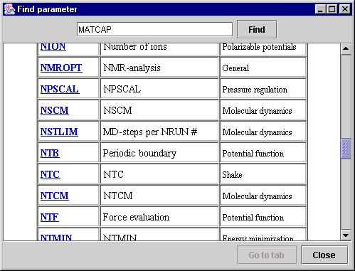
Amber 6.0 plugin
Find parameter button

Slide 26
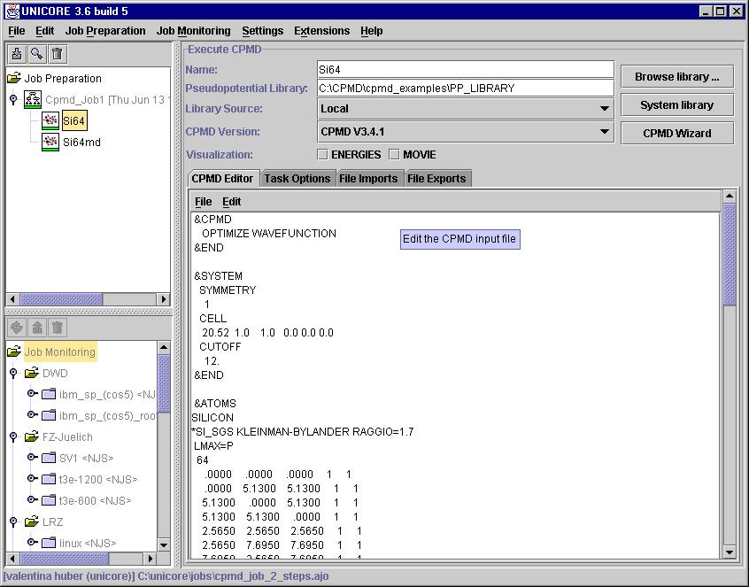
CPMD plugin
CPMD input

Slide 27
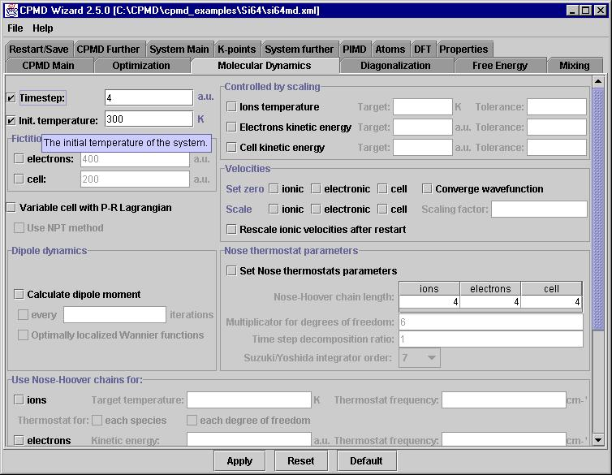
CPMD plugin
CPMD wizard

Slide 28
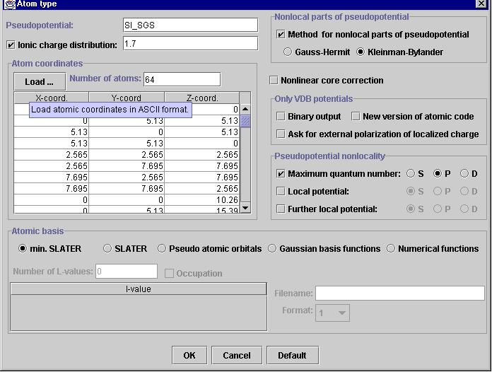
CPMD plugin
CPMD wizard
Atomic type editor

Slide 29
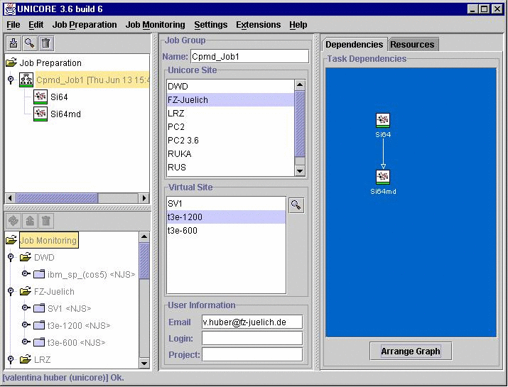
CPMD plugin
Job submision

Slide 30
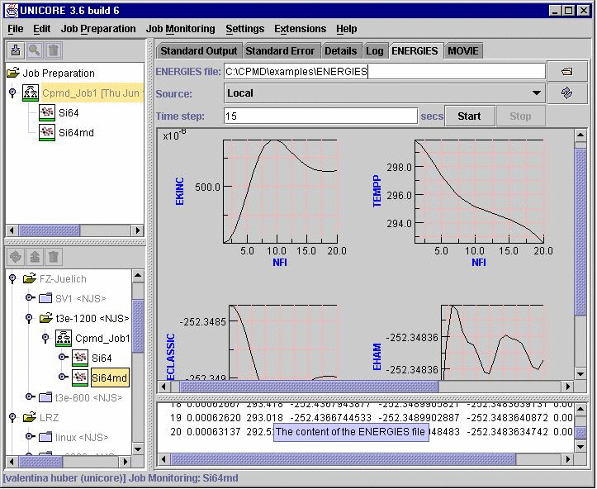
CPMD plugin
Output window
text
tables
graphs

Slide 31
PDB search plugin
Prepares database query:
  Protein Data Bank (PDB) database
  Sequence database
Databases available through web interface
  Plugin uses HTTP protocol to generate query
  QoS – the nearest mirror is used
Output visualization
  PDB structure can be visualized in the plugin using external software
    JMV (Java Molecular Viewer)
      Requires Java3D
    Jmol
    RasMol/WinMol

Slide 32
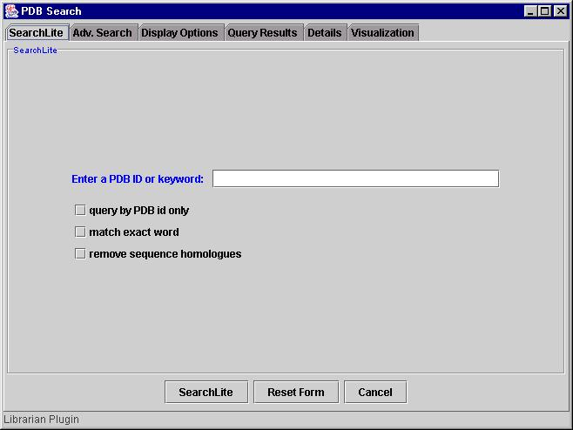
PDB search plugin
Lite search

Slide 33
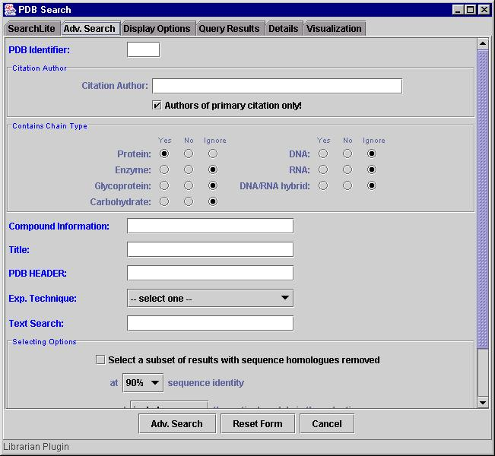
PDB search plugin
Advanced search

Slide 34
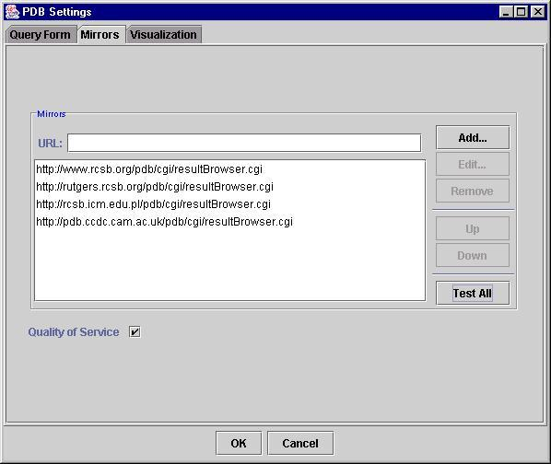
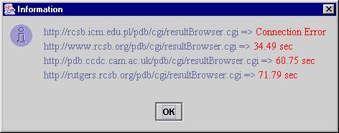
PDB search plugin
User can use different mirrors
The best one is selected
(fastest answer)

Slide 35
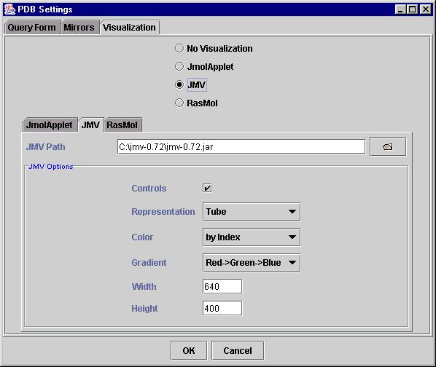
PDB search plugin
Visualization with external packages

Slide 36
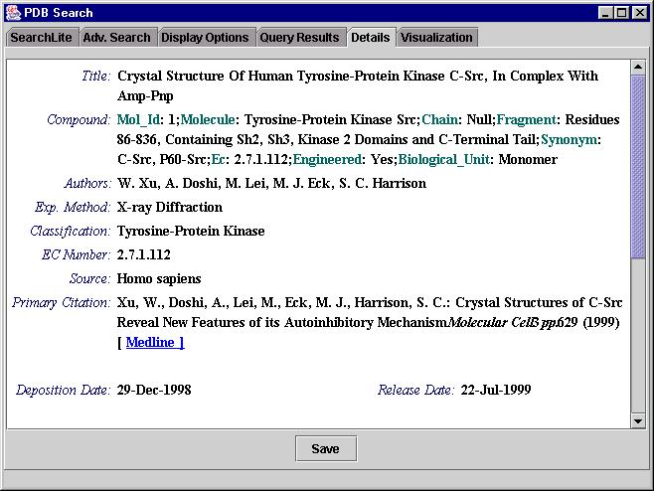
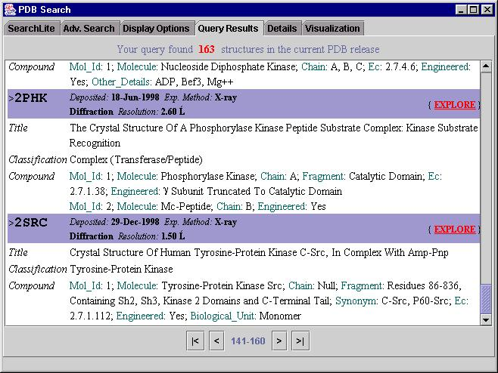
PDB search plugin
Search results

Slide 37
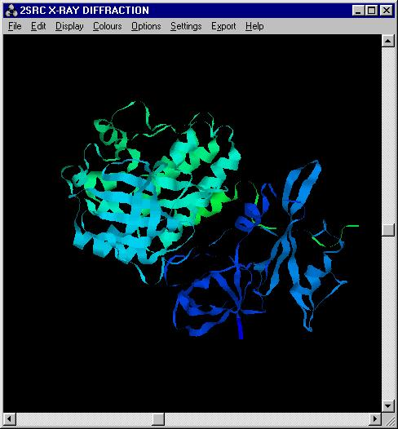
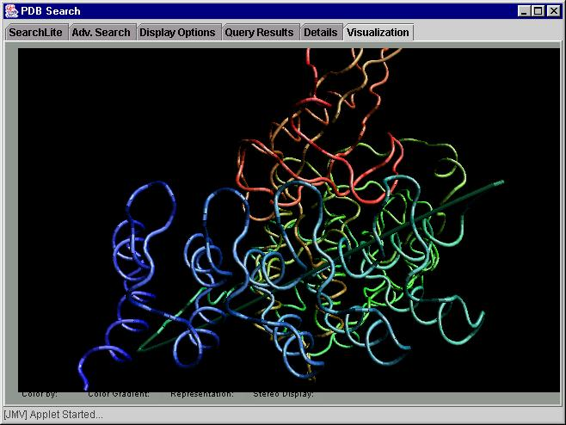
PDB search plugin
Rasmol
JMV
Jmol
User-defined

Slide 38
List All Jobs Plugin
List all users jobs
  Scans USITEs and VSITEs
  Lists Job information
  Will be used to obtain information on running jobs
    Alternative mechanism based on the additional buttons which can be defined in the Job window can be used.

Slide 39
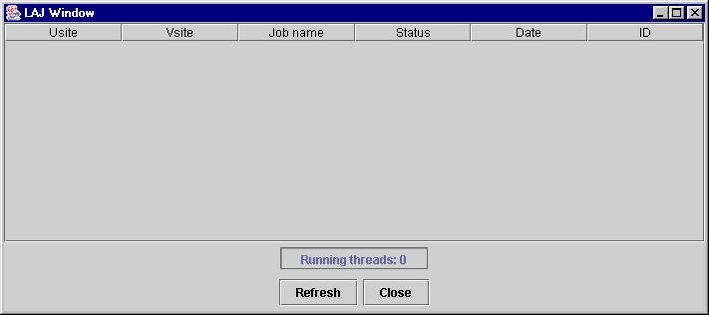
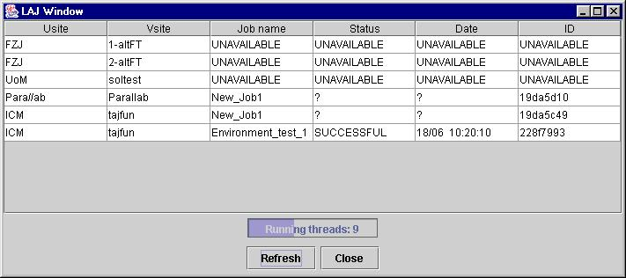
List All Jobs Plugin

Slide 40
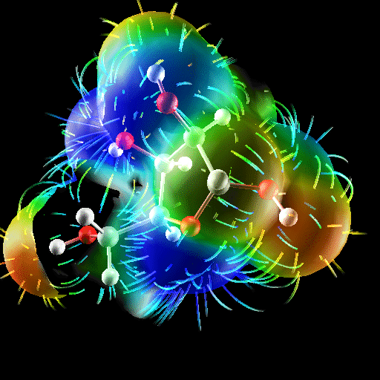
BioGRID
Operate a GRID for biomolecular simulations
Develop interfaces to existing biological and
chemical codes
Web site: biogrid.icm.edu.pl

Slide 41
P. Bała
ICM Warsaw University – Warsaw (PL)
N. Copernicus University – Toruń (PL)
biogrid.icm.edu.pl
www.eurogrid.org
www.grid-interoperability.org
Funding by European Commission Grant No. IST-1999-20247 (EUROGRID)
and IST-2001-32257 (GRIP)

Slide 42
Gaussian98 job
Demonstration: Calculate quantum chemical properties of water molecule with Gaussian98
Start UNICORE client
Create new job
  Use Gaussian plugin
Load existing Gaussian input
Modify input paremeters
  Single point energy calculations for water molecule
Choose server for computations
Submit job
Check results: save output and visualize

Slide 43
Amber 6.0 job
Demonstration: Minimalize energy of the structure and start molecular dynamics simulations
Start UNICORE client
Load Amber EM+MD job
  Transfer initial data (coordinates, topology, input)
  EM run: Minimize energy of the 4086 water molecules
  Transfer final coordinates to another VSITE
  MD run: molecular dynamics simulations
  Transfer trajectory and final results to the user workstation
Choose servers for computations
Submit job
Check results

