Slide 1
REALISTE – Realistic modelling in Environmental and LIfe Sciences Through Escience
Presented by John Brooke^{1,2}
¹SVE Group, Manchester Computing, University of Manchester
²ESNW, North West UK Regional eScience Centre
http://www.esnw.ac.uk
j.m.brooke@man.ac.uk

Slide 2
What is REALISTE about?
REALISTE is a proposal for a European Network of Excellence in sciences of complexity, notably life and environmental sciences.
These sciences are faced with the need to integrate massive amounts of complex data with large scale simulation in a collaborative environment.
What distinguishes them from current DataGrid work is the complexity and heterogeneity of data and computation.
Also the life sciences community does not have the long experience of very large and distributed collaboration that is the heritage of high energy physics or astronomy.
Notes:
The essential challenges of Life Science are heterogeneity of data and computation.
Particle Physicists have for many years planned experiments via international
Collaboration since the the apparatus is so expensive and centralised. Biology
Entered this era with the Human Genome project for which the Web was essential
The task is now to integrate computation and collaborative working tools.

Slide 3
REALISTE background
UK myGrid eScience project provided ideas on data integration and management in a distributed environment.
UK RealityGrid project provided ideas on integration of simulation, experiment and visualization.
EU Project EUROGRID provided ideas for managing complex workflows in scientific problem solving.
EU Project GRIP provided ideas on interoperability issues of Grid software, most specifically Globus and UNICORE.
Access Grid provided ideas on promoting persistent distributed collaborations.
We know there are many other relevant projects, but we now provide slides from each of these projects to show the REALISTE problem domain and proposals for integration.
Notes:
Realiste was conceived using ideas from current projects and how they might be
Extended. myGrid deals with interoperability of complex data sources and with
Creating and managing metadata, annotation and workflows involving database
Searches. RealityGrid integrates high performance computing and visualization
Giving the ability of teams to interact with and steer massive computations.
EuroGrid is the EU Grid project directly concerned with complex problem solving
On a heterogeneous Grid and GRIP investigates interoperability of software.

Slide 4
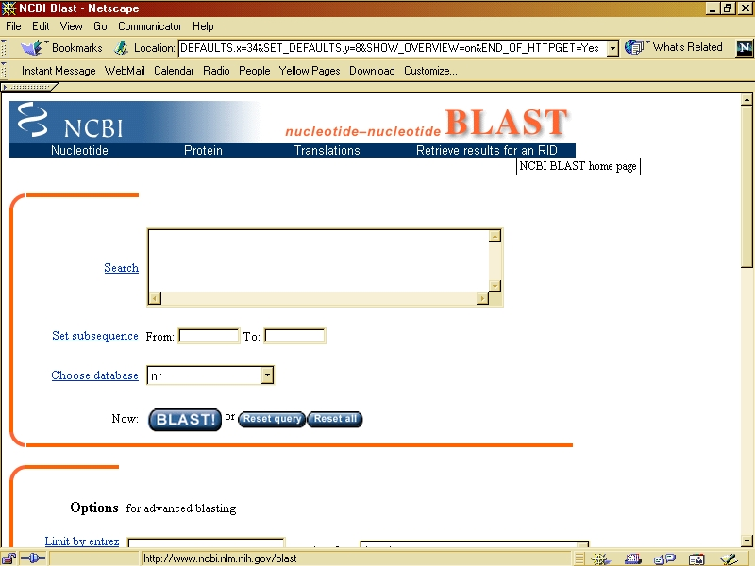
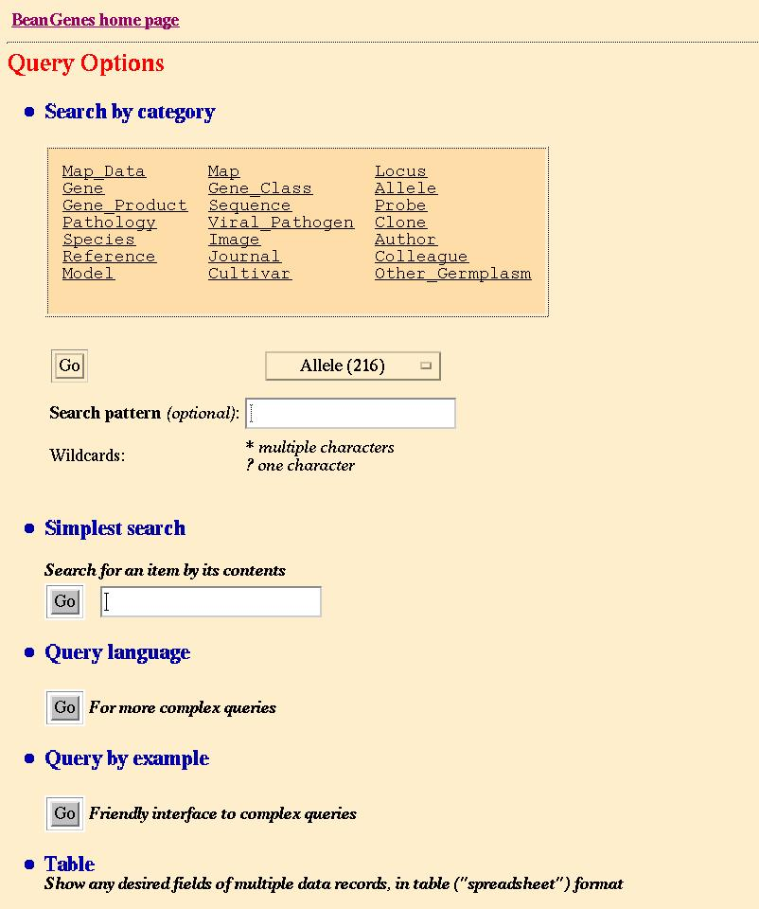
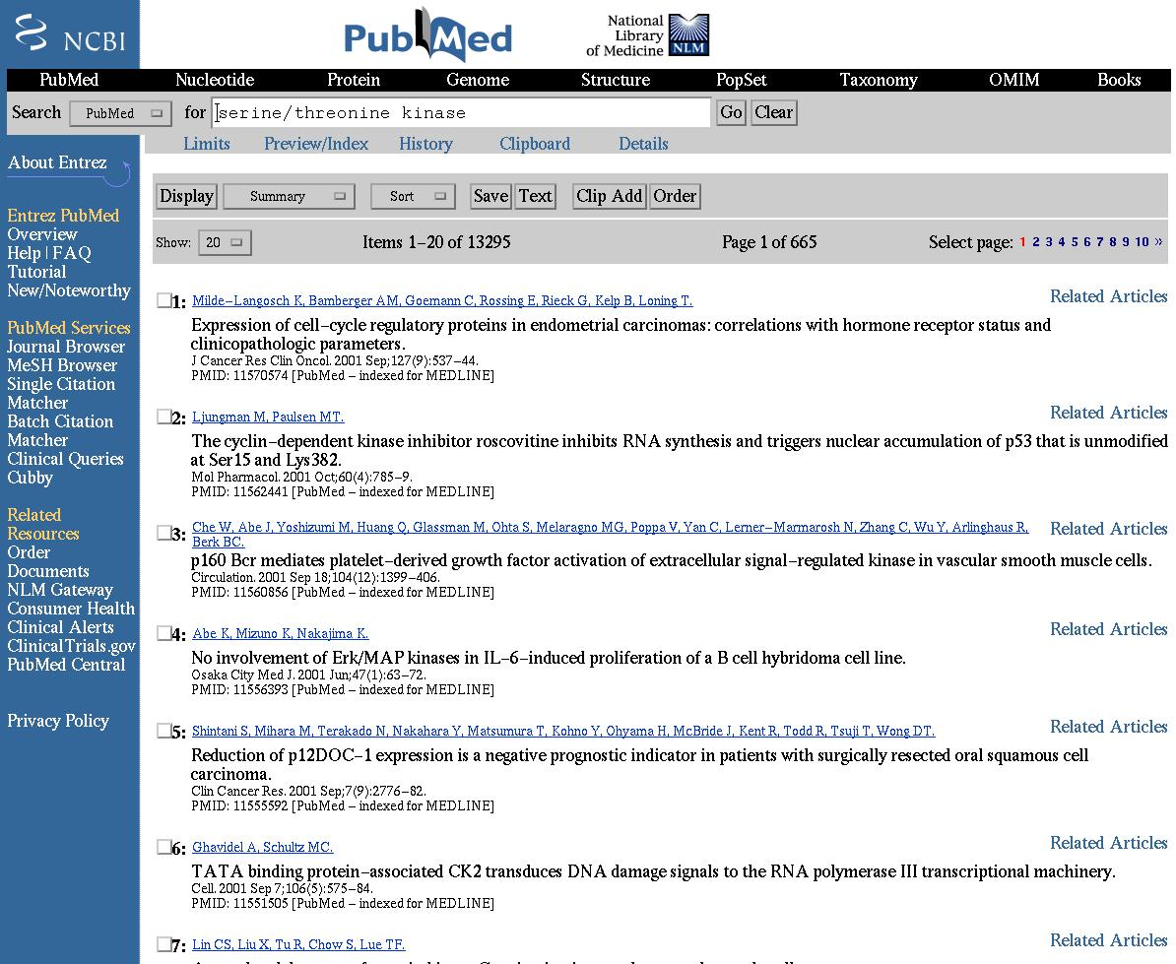
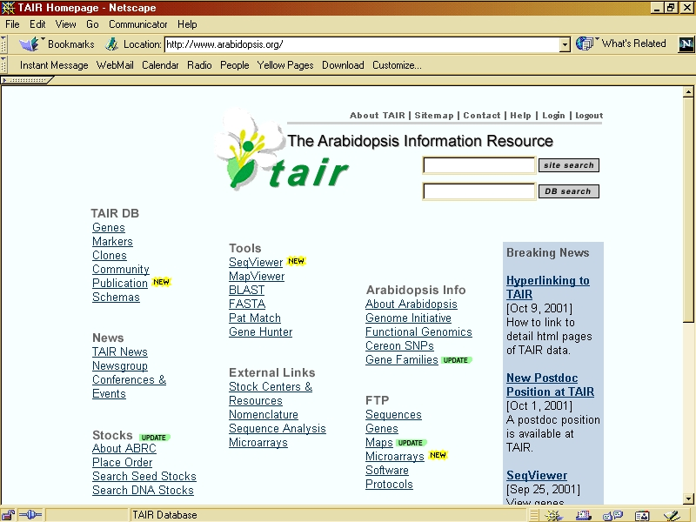
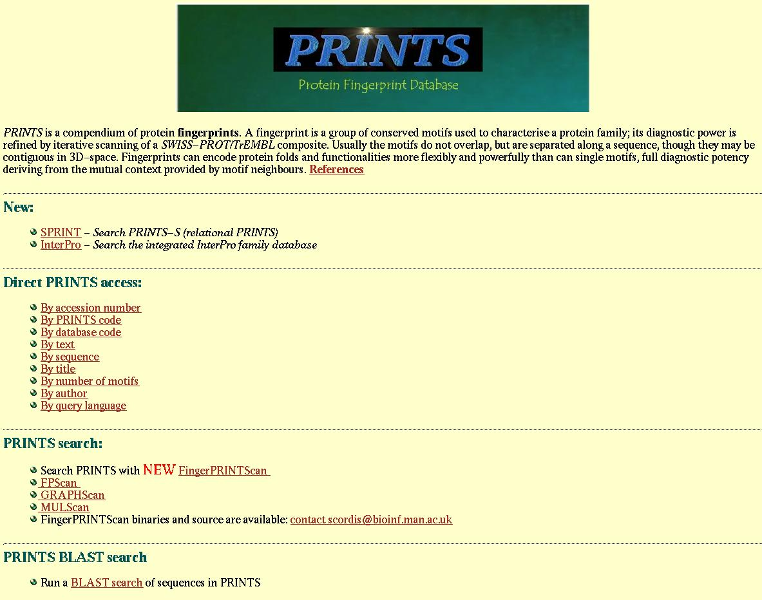
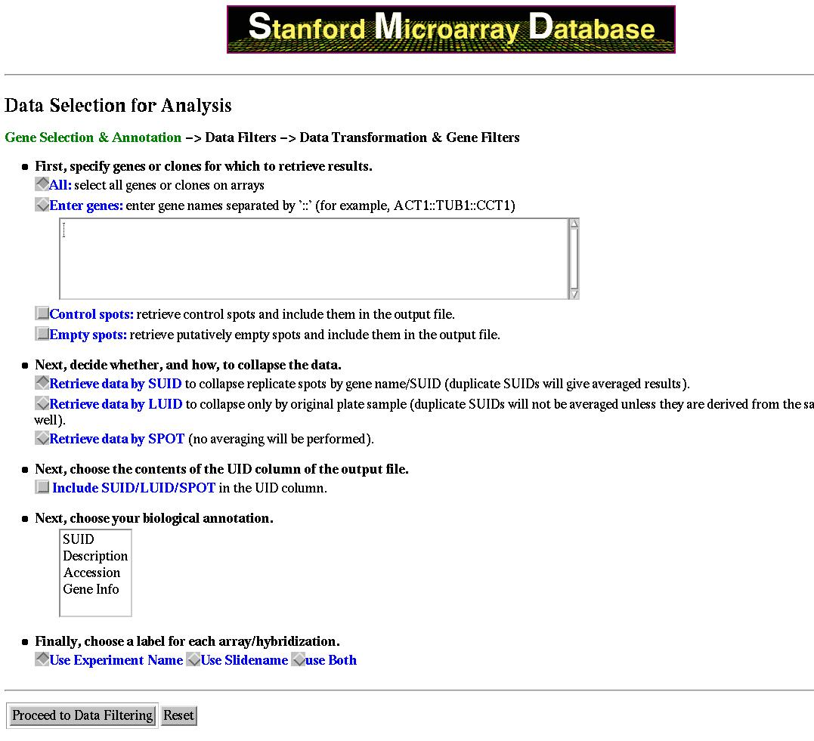
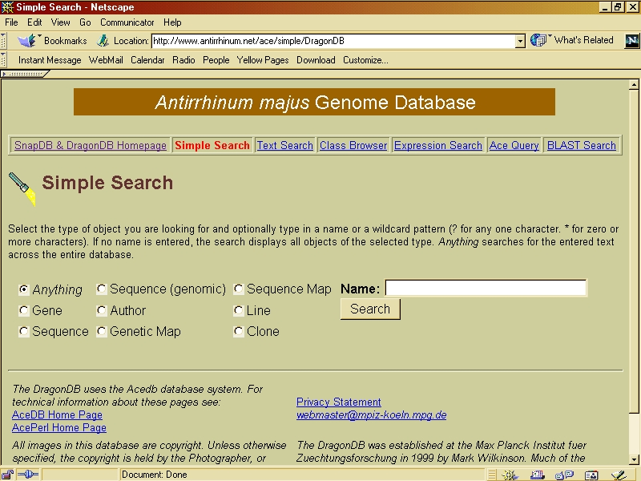
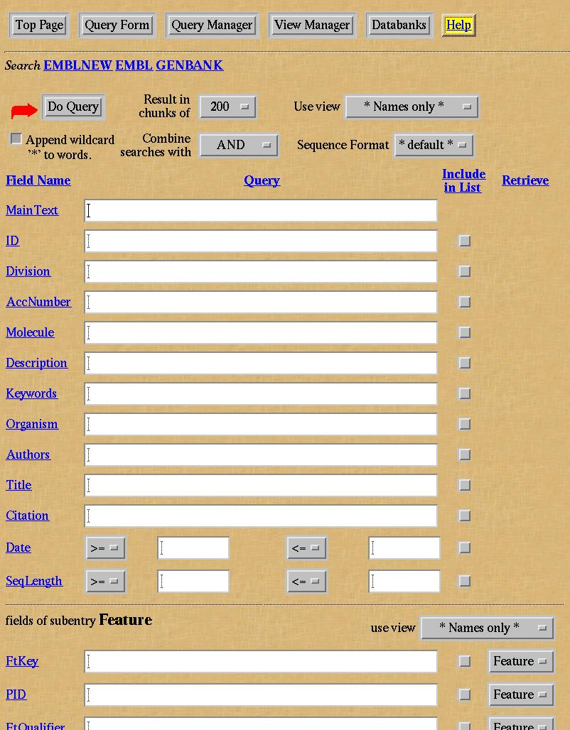
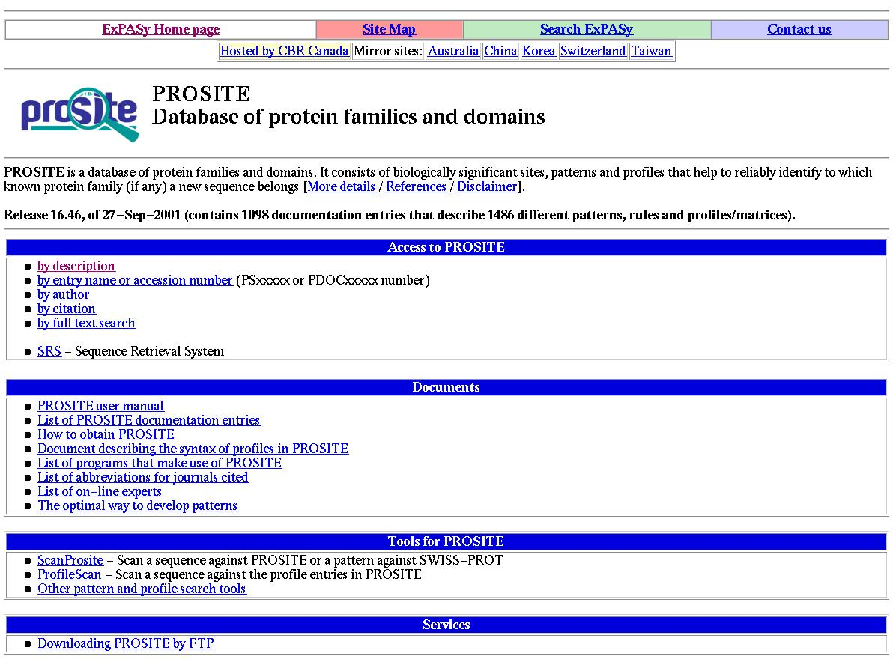
Obstacles Everywhere to Information Weaving (addressed by the UK myGrid project)
Large amounts of different kinds of data & many applications.
Highly heterogeneous.
  Different types, algorithms, forms, implementations, communities, service providers
High autonomy.
Highly complex and inter-related, & volatile.
Notes:
In the field of genomics and post-genomics different groups have reproduced broadly comparable functionality in different implementations, e.g.
Different algorithms
BLAST, FASTA, pSW
Different implementations
WU-BLAST,
NCBI-BLAST
Different service providers
NCBI, EBI, DDBJ

Slide 5
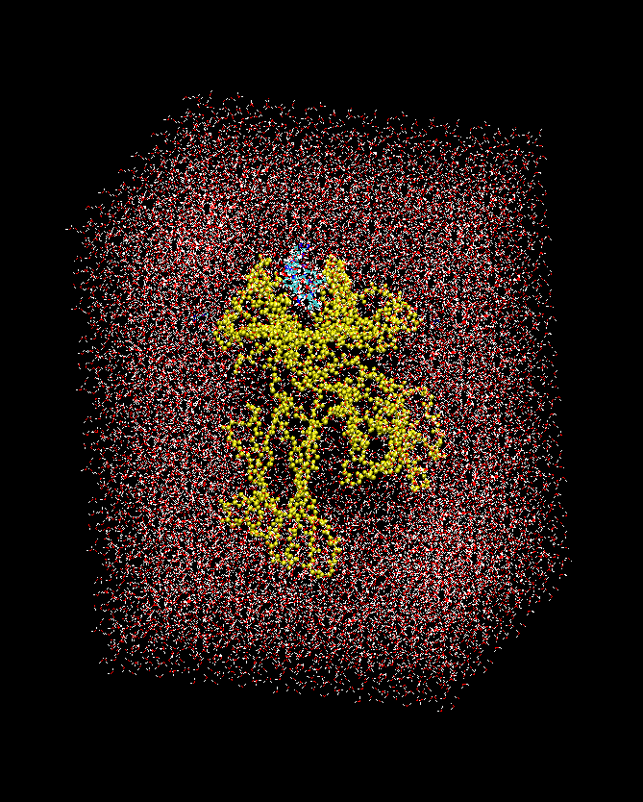
Need to integrate computation and visualization (addressed by UK RealityGrid Project)
Need to understand binding affinities of various peptide antigens
Binding mechanism depends on dynamical behaviour of peptide in MHC groove
Full model has 58,825 atoms including water in periodic box
Need many nanoseconds of simulation to compute binding energies (thermodynamic integration)
Funding from BBSRC, EPSRC, Jenner Institute, CSAR
Notes:
We can obtain certain information about protein structure from experiment (X-Ray
Diffraction etc but to get accurate information need to do a molecular dynamics
Calculation to equilibrium state. Also structure is dependent on ambient medium
(e.g. water) and forces are long range, HPC is essential to compute, visualization
Is crucial to understand.

Slide 6
Compose complex workflows
(EU Projects EUROGRID and GRIP)
Monitor apparatus
Import &
Compute
HP
Import
Compute
Transfer
IBM
Import
SGI
Compile
Compute
Synchronize
Link
Onyx
Compute
Transform
Render
Export
Visualize
Notes:
Here is an example of a complex workflow. The HP computer monitors a
Running experiment and the IBM imports information from a database of
Previous experiments. This input is used to launch computations on SGI
And IBM HPC architectures which need to loosely synchronize (say every
Thousand time steps). They both feed data to a visual supercomputer (Onyx)
Which creates a visualization of the data and renders sending the rendered
Scene to graphics pipes whose ouput can be exported to users workstations.

Slide 7
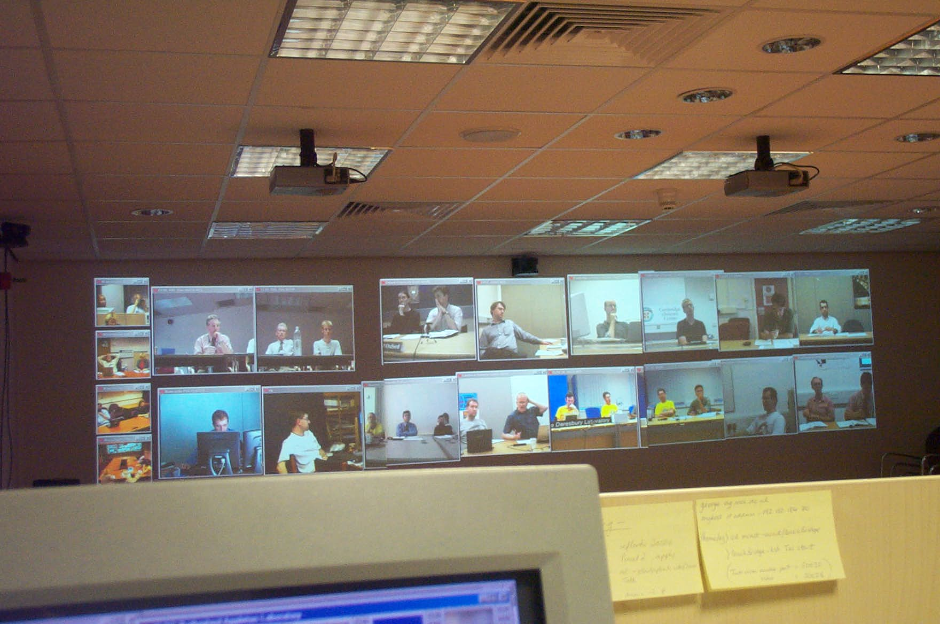
Access Grid meetings for problem solving, e.g. UK Engineering Task Force
Notes:
A feeling of live prescence is important for collaboration. The UK Grid
Engineering task force meets regularly via Access Grid, over a dozen sites
Can be involved. REALISTE wishes to extend this to European collaborations
And integrate the steering and collaborative working tools.

Slide 8
Grid challenges in complex problem-solving for life sciences
Focus on heterogeneous networks providing data extraction, simulation, visualization and links with live experiments.
Use of grid technologies to provide a unified image and a transparent access to such environments
Need to componentise current scientific codes and use metadata to describe interaction with Grid environment.
Steering and collaboration via visualization, brings to the fore issues of synchronicity and dataflow between running applications.
Interoperability of data, software components and Grid middleware. Community involvement essential.
Notes:
The keywords are steering, collaboration and interoperability. Each is a
Formidable Grid challenge. The Network also needs the community to agree
Standards for data curation and annotation.

Slide 9
Visual steering pipeline on Grid
Code Optimisation
Parallel modules
(e.g. vtk)
1 Gbps
Geometrical Transformation
Knowledge feedback
(Steering)
0.001 Gbps
1 Gbps
Graphics pipes
Viewing and steering
Rendering
(e.g. AVS/MPE)
VizServer
Notes:
A Schematic visualization pipeline. The yellow rectangle represents the
Computation component which could be run over several loosely coupled
Machines, the red reactangle is the geometrical computations for visualization
Such as isosurface extraction this could be done on commodity architecture,
The green rectangel represents a specialist visual supercomputer for
Rendering and the output of the graphics pipes is exported to multiple users.
The steering is very light touch, just XML documents and the
Computation polls for these at user-specificed intervals. Thus the computation can
Continue even if the visualization part of the configuration is cut off.

Slide 10
Integrated experiments
Simulation and informatics data often decoupled from experimental design and data gathering
Experimental data compared with simulation and theory only ex post facto
Scientific discovery can be enhanced by closely coupling computation and experiment
E.g. X-ray microtomography, bio-electric field monitoring.
This brings in a very important issue: integration into a Grid of entities which are not computers. It is an important issue in the GGF document
“Core Functions for Production Grids”
(Bill Johnston and John Brooke, GGF Working Document from GPA-RG)
Notes:
We wish to integrate experimental apparatus and use supercomputing to process
The data maybe in real time. There is an interesting question about a minimal
Environment for a grid component and Reality Grid in particular is Grid
Enabling a robotic experimental apparatus and having to design the
Steering and scheduling interface for the Grid.

Slide 11
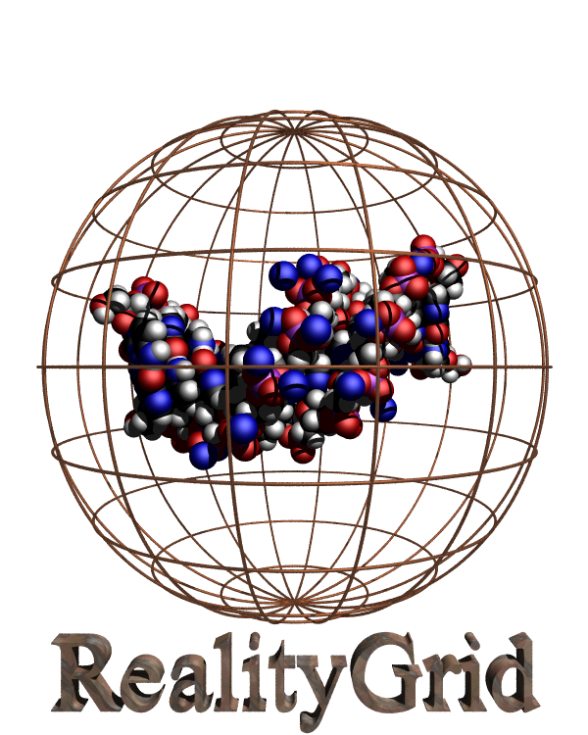
A workflow example – RealityGrid steering application
Bezier
SGI Onyx @ Manchester
Vtk + VizServer
SGI OpenGL VizServer
Firewall
UNICORE
Gateway and NJS
Manchester
Laptop
SHU Conference Centre
Simulation
Data
UNICORE
Gateway and NJS
QMUL
VizServer client
Steering GUI
The Mind Electric GLUE web service hosting environment with OGSA extensions
Single sign-on using UK e-Science digital certificates
Dirac
SGI Onyx @ QMUL
LB3D with RealityGrid
Steering API
Steering (XML)
Notes:
An early exemplar is the Reality Grid Steering application. This allows
Computation (Dirac) to be coupled to visualization (Bezier) with the output
Being exported. The workflow is initiated by contacting a Web service with
OGSA like extensions (OGSA standard does not yet exist). Note that the
Light-touch steering uses XML and that UNICORE handles all file transmission
Job-control and negotiation of firewalls in a manner that is seamless to the user
Who signs on via a digital certificate issued by the UK Grid CA. SGI Vizserver
Is integrated into the OGSA service.

Slide 12

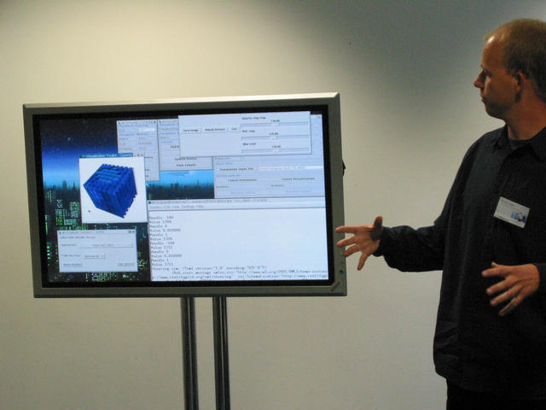
RealityGrid: “Fast Track” Demonstration
Notes:
The steering GUI is independent of the visualization. Parameters can be
Changed via the GUI according to what they see in the visualization
Window. This is Jens Harting of RealityGrid showing the application at the
UK eScience All-hands meeting at Sheffield in September 2002. The
Demonstration was repeated at SC2002, this time working via trans-atlantic
Links.

Slide 13
Generic features of the steering application
No need to commit to overall framework, e.g. Cactus, SciRun
Fault-tolerant, components can be migrated, networks can go down and come up, application is resilient.
User initiates by contacting OGSA service, in this application very coarse granularity at OGSA level, but can be refined.
Single sign on via digital certificates (UK eScience CA) and single job committal implements entire workflow.
Client application on the laptop is very lightweight, intend to port to PDA and beyond that mobile phones.
Visualization not coupled to steering, therefore visualization component can crash but computation continues.
UNICORE gives us “just enough” vertical integration.
Notes:
The integration is loose therefore fault-tolerant. The RealityGrid API can be
Easily incorporated into user code and the client application which launches
Can be very lightweight. UNICORE gives “just enough” integration and is
More general than a dedicated portal would be. It is also a very resilient workflow
Manager and the server and client components are separate and easy to install.
Thus can just install clients on users machine.

Slide 14
UNICORE-Globus interoperability
Need UNICORE for workflow management, vertical integration and adaptivity of its client plugins (e.g. for biomolecular modelling)
Need Globus for its ability to locate resources dynamically and ability to spawn jobs dynamically plus wider availability.
So it would be good to use UNICORE to access Globus resources, but also:
Globus-UNICORE interoperability is a proof-of-concept for the much wider interoperability necessary for REALISTE.
Notes:
Globus is market leader and has dynamic features that UNICORE does not. We
Also use UNICORE-Globus interoperability as a proof-of-concept for the
REALISTE approach of getting different systems to interoperate rather than
Demanding a uniform software environment.

Slide 15
Interoperability architecture
Client
grid-proxy-init
plugin
Incarnation of a UNICORE Abstract Job Object (AJO) via a Target System Interface (TSI) for a Globus Grid
Gateway
(Logical) Globus Usite
Generic
Globus IDB
Vsite A
NJS
Vsite B
NJS
Globus TSI
IDB
Host A
IDB
Host B
Globus TSI
IDB
Maker
Globus JM
Host A
GRIS
Globus
GIIS
GRIS
Globus JM
Host B
Notes:
The UNICORE client composes an AJO that is expressed in Java and has
Abstractions for user filespace, file transfer, job launching, software resource.
These are incarnated via the Incarnation Data Base IDB. This information
Form the IDB is used to automatically generate the scripts that will actually
Run on a given machine (Vsite). This in normally done via a UNICORE TSI,
Here we have a TSI which translates the AJO into scripts that can run on a
Grid controlled by Globus (Globus TSI).

Slide 16
REALISTE – Summary
Realistic modelling in Environmental and LIfe Sciences Through Escience, proposal to 2nd round of EU FP6
Can build on data and computation layers of the Grid, FP5 projects, plus UK eScience Programme.
Bring together communities concerned with biological data-handling, simulation and experiment to agree standards and tools to create a problem-solving environment.
Want to link with the live feeling of presence brought by AccessGrid, integrating visualization and interactive steering.
Early exemplars, RealityGrid steering application, interoperability of UNICORE and Globus, show potential of underlying REALISTE approach.

Slide 17
Thanks
To Peter Coveney, Stephen Pickles and the RealityGrid team.
To Carole Goble and the myGrid team.
To our European partners in GRIP and EuroGrid and ANL partners Gregor von Laszewski and Sam Meder of Argonne.
To the AccessGrid project and all involved in AG.
To Dave Snelling, co-chair of the OGSI-WG at GGF and to Bill Johnston co-chair of GPA-RG.
We acknowledge funding under the EU 5th framework projects EuroGrid and GRIP and the UK eScience Pilot Projects RealityGrid and myGrid.
Finally thanks to the Life Sciences Workshop organisers for inviting us.

